Slide 1
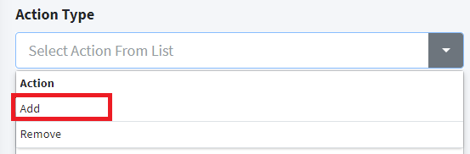

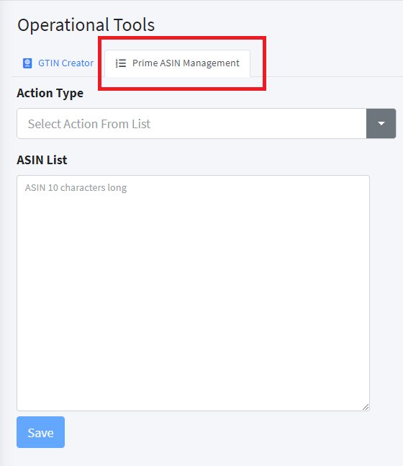

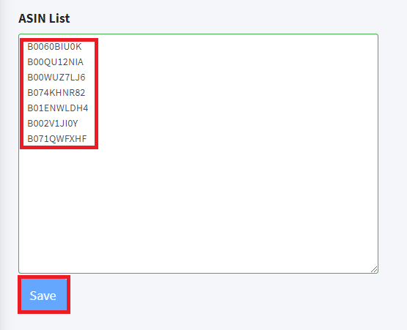
Cerebro Training Cheat Sheet: Enable ASINS in Cerebro (that get saved to the Brain)
Log into Cerebro (Production)
(always use red “Sign in using Google button)
https://cerebro.pharmapacks.net/
Click on “Operations” in the left menu
Click on “Operational Tools” in the left menu
Be sure to choose the “Prime ASIN Management” Tab
Click the arrow pointing down and choose “Add”
Copy and paste up to 1,000 ASINS in the box, that are either comma-delimited, or on separate lines, then click the “Save” button:

