Slide 1

Project Title - Car Market Trends Analysis with Car Dekho Data
[STU6a07fdf0488dd1778908656 ]

Slide 2

PROBLEM STATEMENT
Car Market Trends Analysis with Car Dekho Data
The used car market in India is highly fragmented and lacks transparency in pricing. Buyers and sellers struggle to determine fair market value due to inconsistent pricing, varying depreciation rates, and lack of data-driven insights. This project analyzes the Car Dekho dataset (301 records, 2003-2018) to identify key market trends, depreciation patterns, and factors affecting used car prices.

Slide 3
Project Description
This project performs comprehensive Exploratory Data Analysis (EDA) on 301 used car records from the Car Dekho dataset spanning years 2003 to 2018. Key analyses include: • Price distribution across different car models and brands • Impact of fuel type, transmission, and seller type on pricing • Depreciation trends and correlation with vehicle age & mileage • Year-wise market price trends and value retention patterns • Identification of high-value retention models The analysis provides actionable insights for buyers, sellers, and dealers.

Slide 4

WHO ARE THE END USERS?
• Car Buyers — To understand fair pricing and identify best value-for-money deals
• Car Sellers — To set competitive selling prices based on market trends
• Dealerships — To optimize inventory and pricing strategies
• Financial Institutions — For accurate loan valuation of used vehicles
• Insurance Companies — To determine appropriate premium calculations
• Market Analysts — To study automotive industry depreciation patterns

Slide 5

Technology Used
• Python — Primary programming language • Pandas — Data manipulation and analysis • NumPy — Numerical computations • Matplotlib — Data visualization and charting • Seaborn — Statistical data visualization • Jupyter Notebook — Interactive development environment

Slide 6
RESULTS
Dataset Overview: • Total Records: 301 used cars • Year Range: 2003 – 2018 • Average Selling Price: ₹4.66 Lakhs • Average Present Price: ₹7.63 Lakhs • Average Depreciation: 36.6% • Average Kms Driven: 36,947 km Fuel Split: 79.4% Petrol | 19.9% Diesel | 0.7% CNG Transmission: 86.7% Manual | 13.3% Automatic Seller Type: 64.8% Dealer | 35.2% Individual
Demo Link

Slide 7
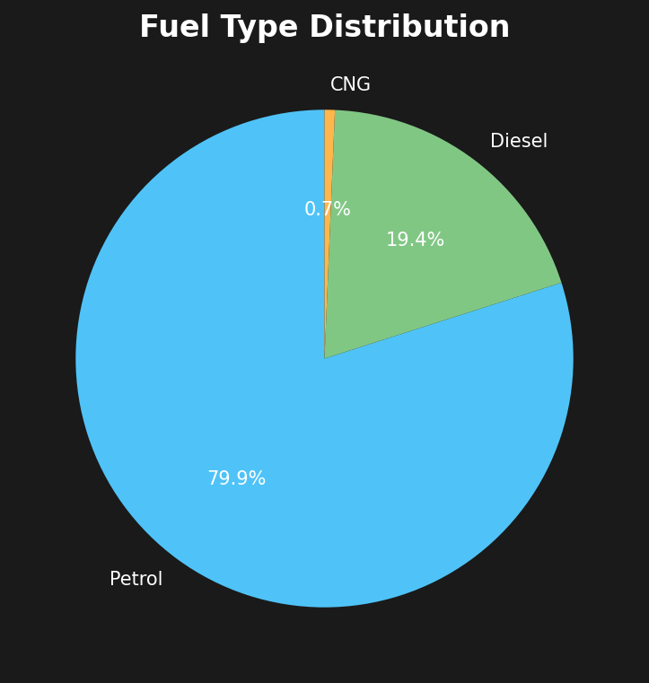
RESULTS — Fuel Type Distribution
Key Findings: • Petrol dominates with 79.4% of listings • Diesel cars hold 19.9% market share • CNG vehicles are rare (0.7%) • Diesel shows lowest depreciation (32%) • Petrol depreciates at 37.6% on average

Slide 8
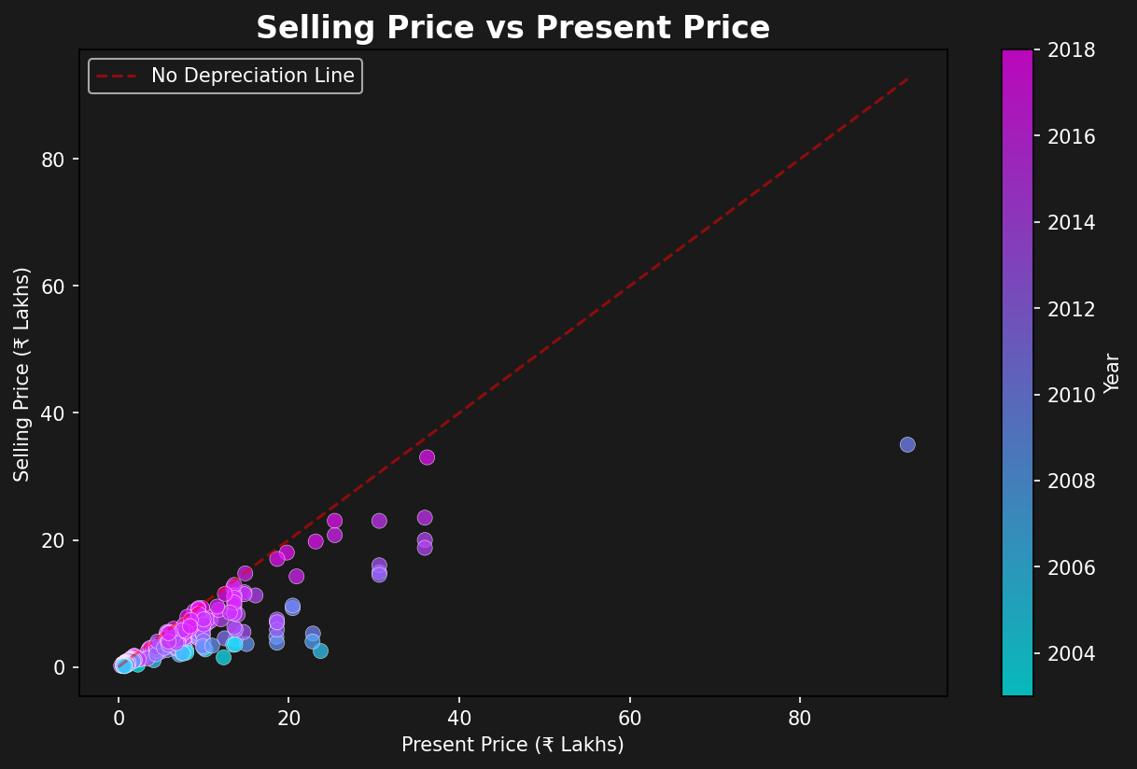
RESULTS — Selling vs Present Price
Key Findings: • Strong correlation (0.88) between prices • Newer cars near no-depreciation line • Older cars show significant value drop • Average depreciation: 36.6% • Color shows newer = higher prices

Slide 9
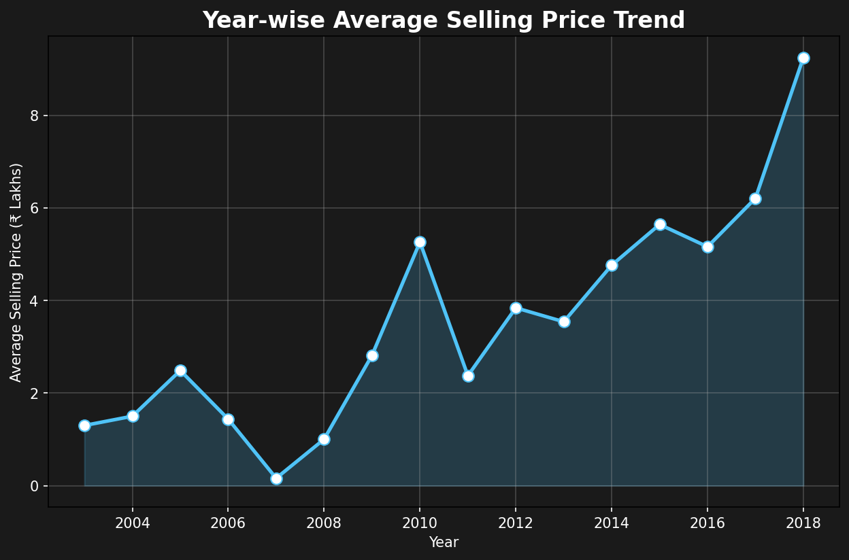
RESULTS — Year-wise Price Trend
Key Findings: • 2018 models: highest avg price (~₹9.2L) • Significant dip in 2007 (~₹0.2L) • Steady upward trend from 2012 • Price directly correlates with year • 2010 spike = premium model listings

Slide 10
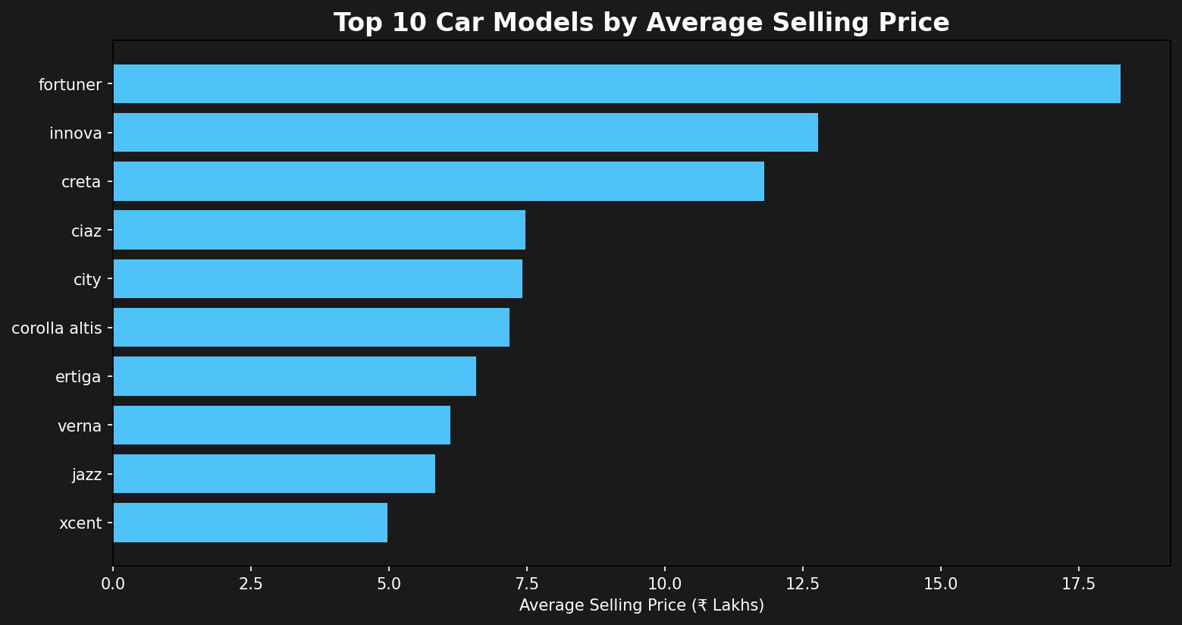
RESULTS — Top Models by Selling Price
Key Findings: • Toyota Fortuner: ₹18.7L avg (highest) • Toyota Innova: ₹12.8L avg • Hyundai Creta: ₹11.5L avg • Sedans (City, Ciaz) mid-range • Budget cars under ₹6L avg

Slide 11
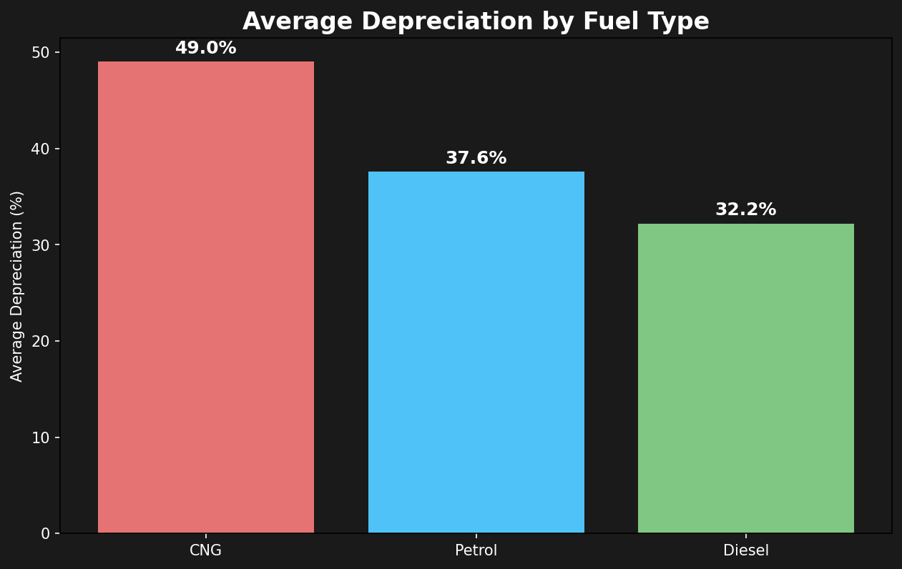
RESULTS — Depreciation by Fuel Type
Key Findings: • CNG cars depreciate most (49.0%) • Petrol cars: 37.6% avg depreciation • Diesel retains value best (32.0%) • Lower depreciation = Better investment • Diesel engines have longer lifespan

Slide 12
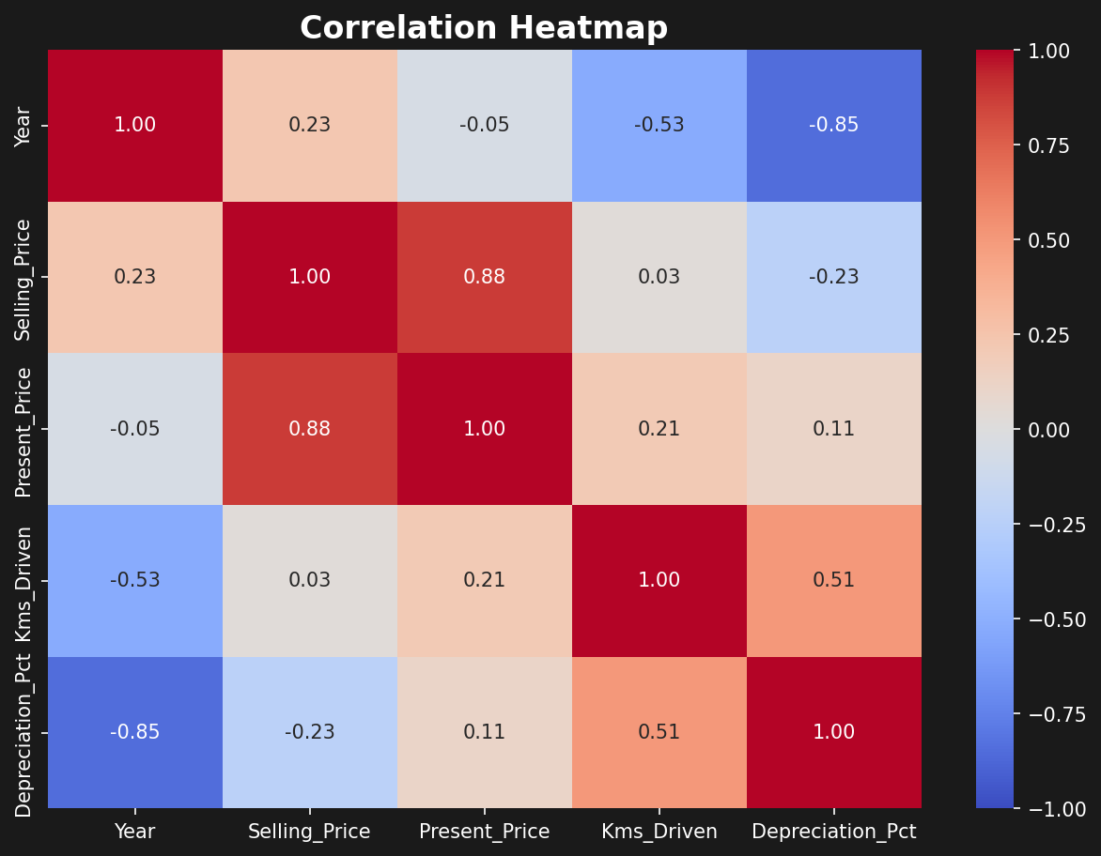
RESULTS — Correlation Heatmap
Key Findings: • Year vs Depreciation: -0.85 • Present vs Selling Price: +0.88 • Kms Driven weakly correlates • Age is biggest price determinant • Depreciation % rises with mileage

Slide 13
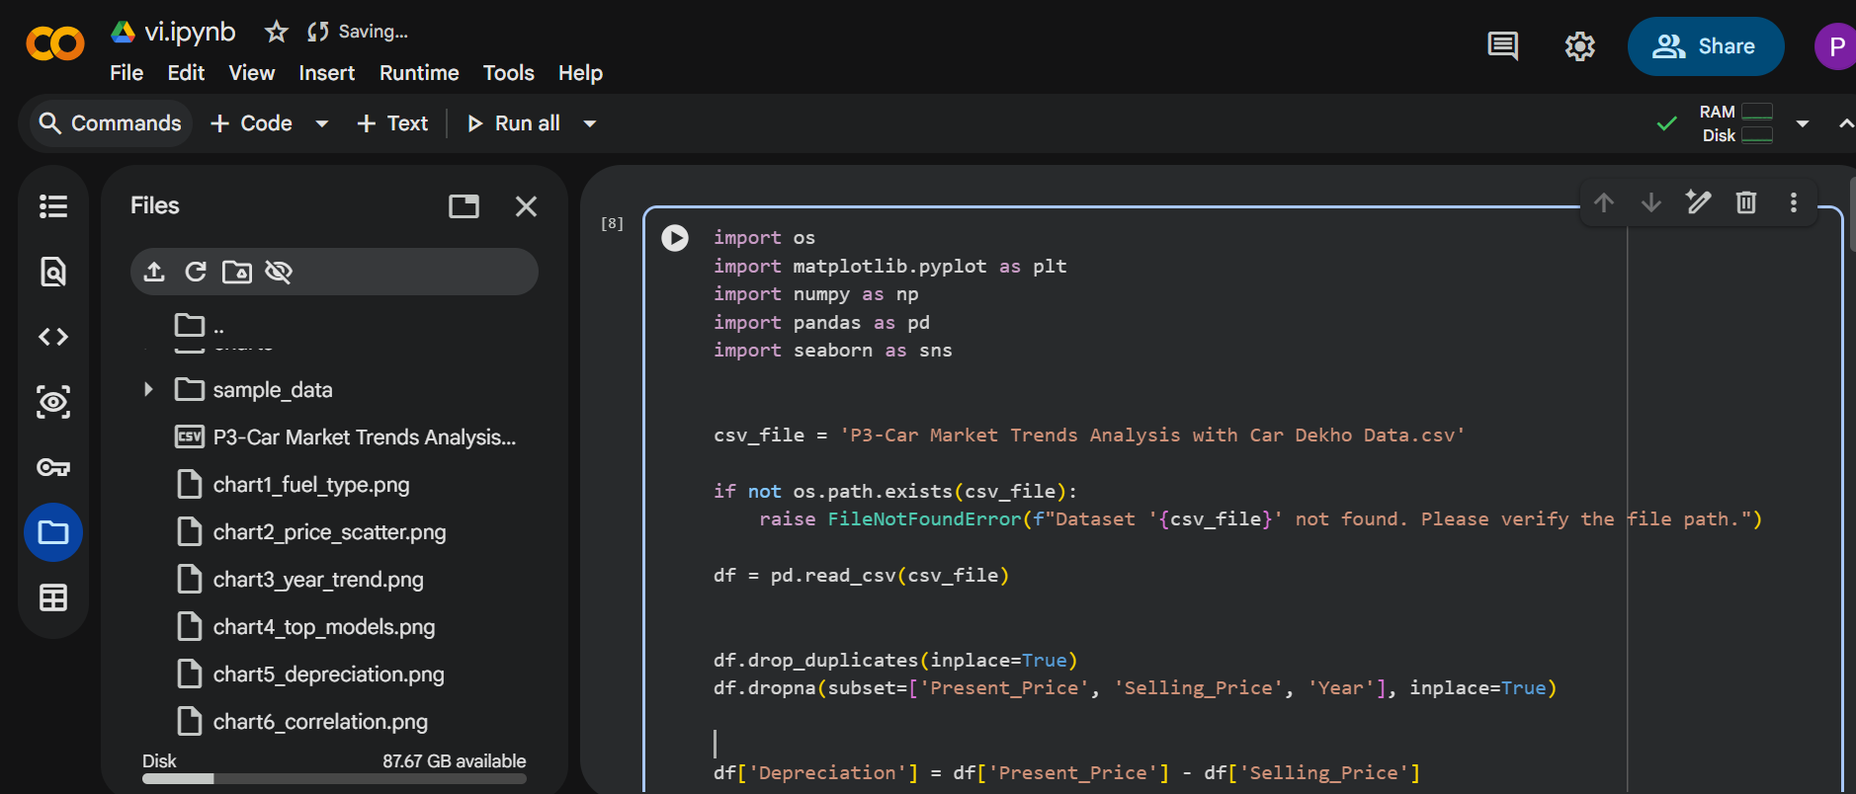
Demo Link
GitHub Repository: [Your Repo Link]
Dataset: 301 used car records from Car Dekho (2003-2018)

Slide 14
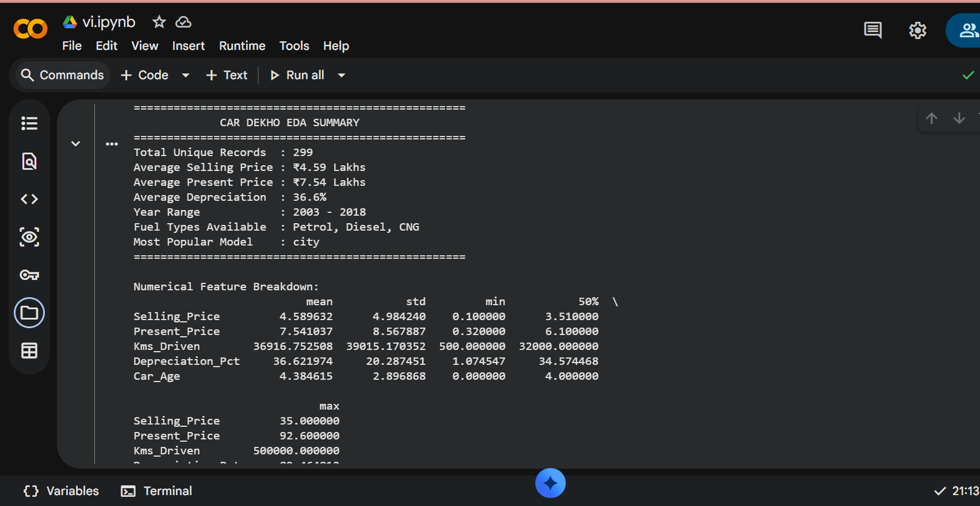

Slide 15
Github : https://github.com/mrsonu-boop/Car-Market-Trends-Analysis-with-Car-Dekho-Data/tree/main

Slide 16
Thank you
.
.

