Slide 1

Project Title - SEASONAL AGRICULTURE PERFORMANCE ANALYSIS
[ Name - Prathmesh Rajendra Thorwat
College Name- MET BKC Institute of Engineering]
AICTE STU ID : (STU6a07fdf0488dd1778908656)

Slide 2

PROBLEM STATEMENT
Seasonal Complexity: Agricultural activities and productivity vary significantly across different seasons due to environmental conditions, resource availability, and market dynamics.
Data Gap: Raw agricultural datasets do not directly reveal the underlying patterns or reasons behind these seasonal variations.
Core Challenge: Need for structured data analytics to investigate seasonal differences, uncover trends, and evaluate performance variations across farming environments.

Slide 3
Project Description
The Seasonal Agricultural Performance & Yield Optimization Analysis system is a comprehensive, data-driven framework developed to evaluate agricultural metrics across multi-seasonal farming cycles. Designed to address productivity inefficiencies, variable crop yields, and economic fluctuations, this project conducts end-to-end data auditing, soil chemistry profiling, and financial evaluation across 28 key operational parameters.
By analyzing environmental factors such as soil pH, soil moisture, and NPK nutrient balances alongside climatic variables like precipitation and temperature, the platform models crop performance across Kharif, Rabi, and Zaid seasons. The analytics engine processes operational metrics—including farm acreage, cost per hectare, market revenue, and net profit margins—to isolate drivers of agricultural yield. Through statistical workflows, regression modeling, and multi-panel visualizations, the system converts raw agricultural data into actionable insights for optimized resource allocation, crop selection, and risk management.

Slide 4

WHO ARE THE END USERS?
Agricultural Planners & Policy Makers: To design evidence-based seasonal strategies and resource allocation frameworks.
Farmers & Cooperatives: To optimize crop selection, input timing, and market risk management across seasons.
Data Analysts & Researchers: To explore seasonal agricultural performance trends and build predictive models.

Slide 5

Technology Used
Python 3.10+: Main language used for data processing, statistics, and script logic.
Jupyter Notebook / Google Colab: Interactive environment for data analysis and visual output.
Pandas & NumPy: Essential libraries for data cleaning, manipulation, and numerical operations.
SciPy (scipy.stats): Applied for distribution skewness checks and statistical testing.
Matplotlib & Seaborn: Visualization libraries used for custom multi-panel charts, violin plots, and heatmaps.
Git & GitHub: Used for version control, repo hosting, and project documentation.

Slide 6
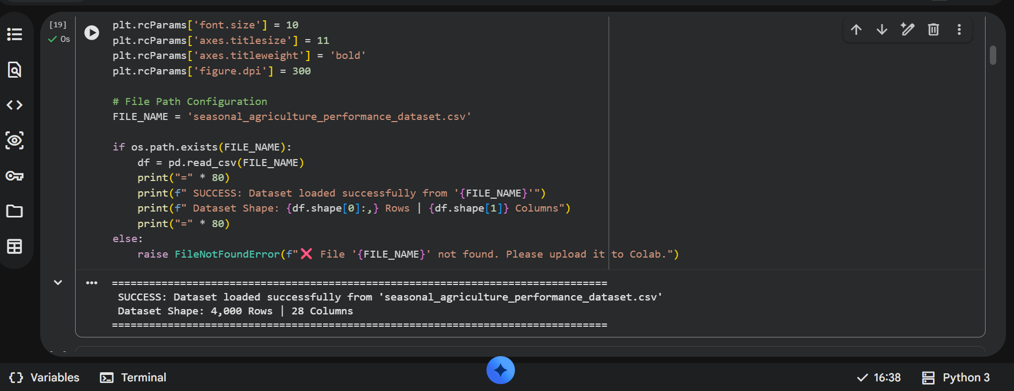
RESULTS
[Dataset loading and dataset shape]

Slide 7
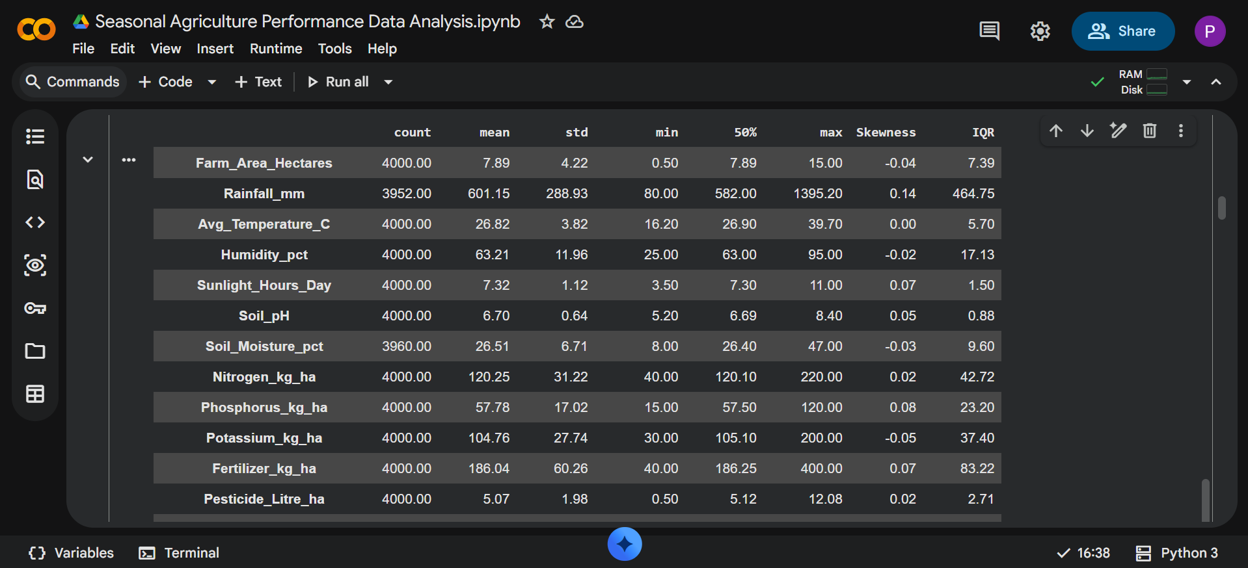
RESULTS
[EXTENDED NUMERICAL STATISTICAL SUMMARY (SKEWNESS & IQR)]

Slide 8
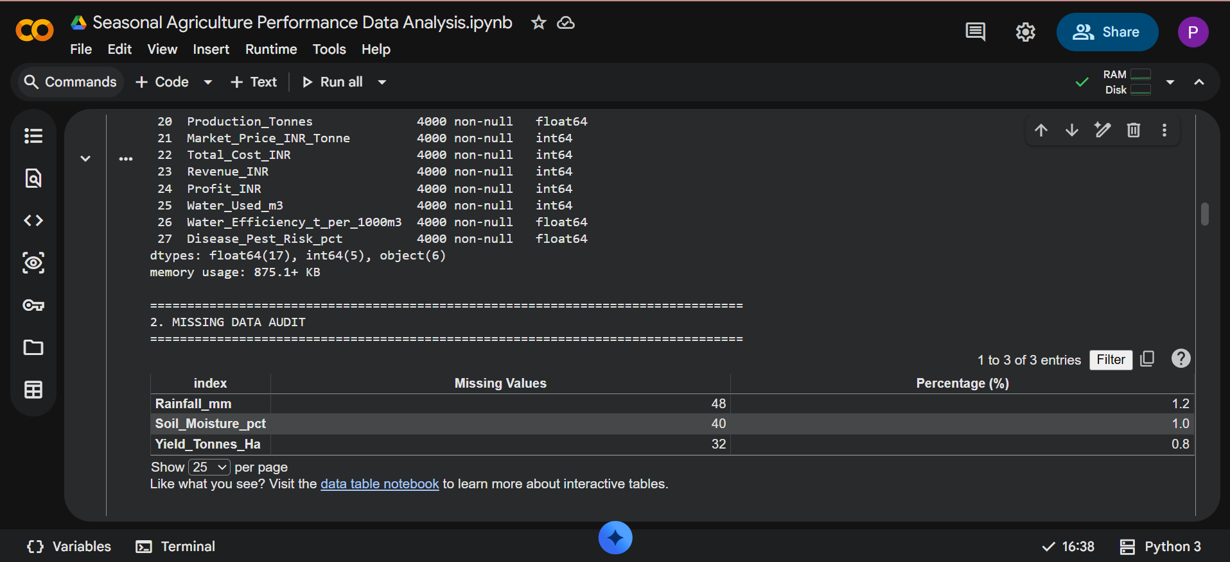
RESULTS
[Missing data for adualt ]

Slide 9
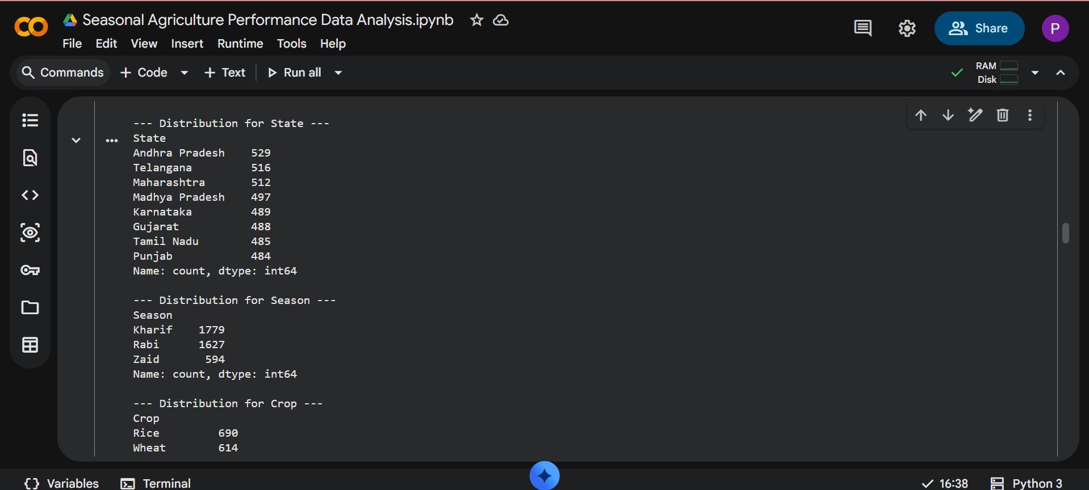
RESULTS
[Distribution for state , season and crops ]

Slide 10
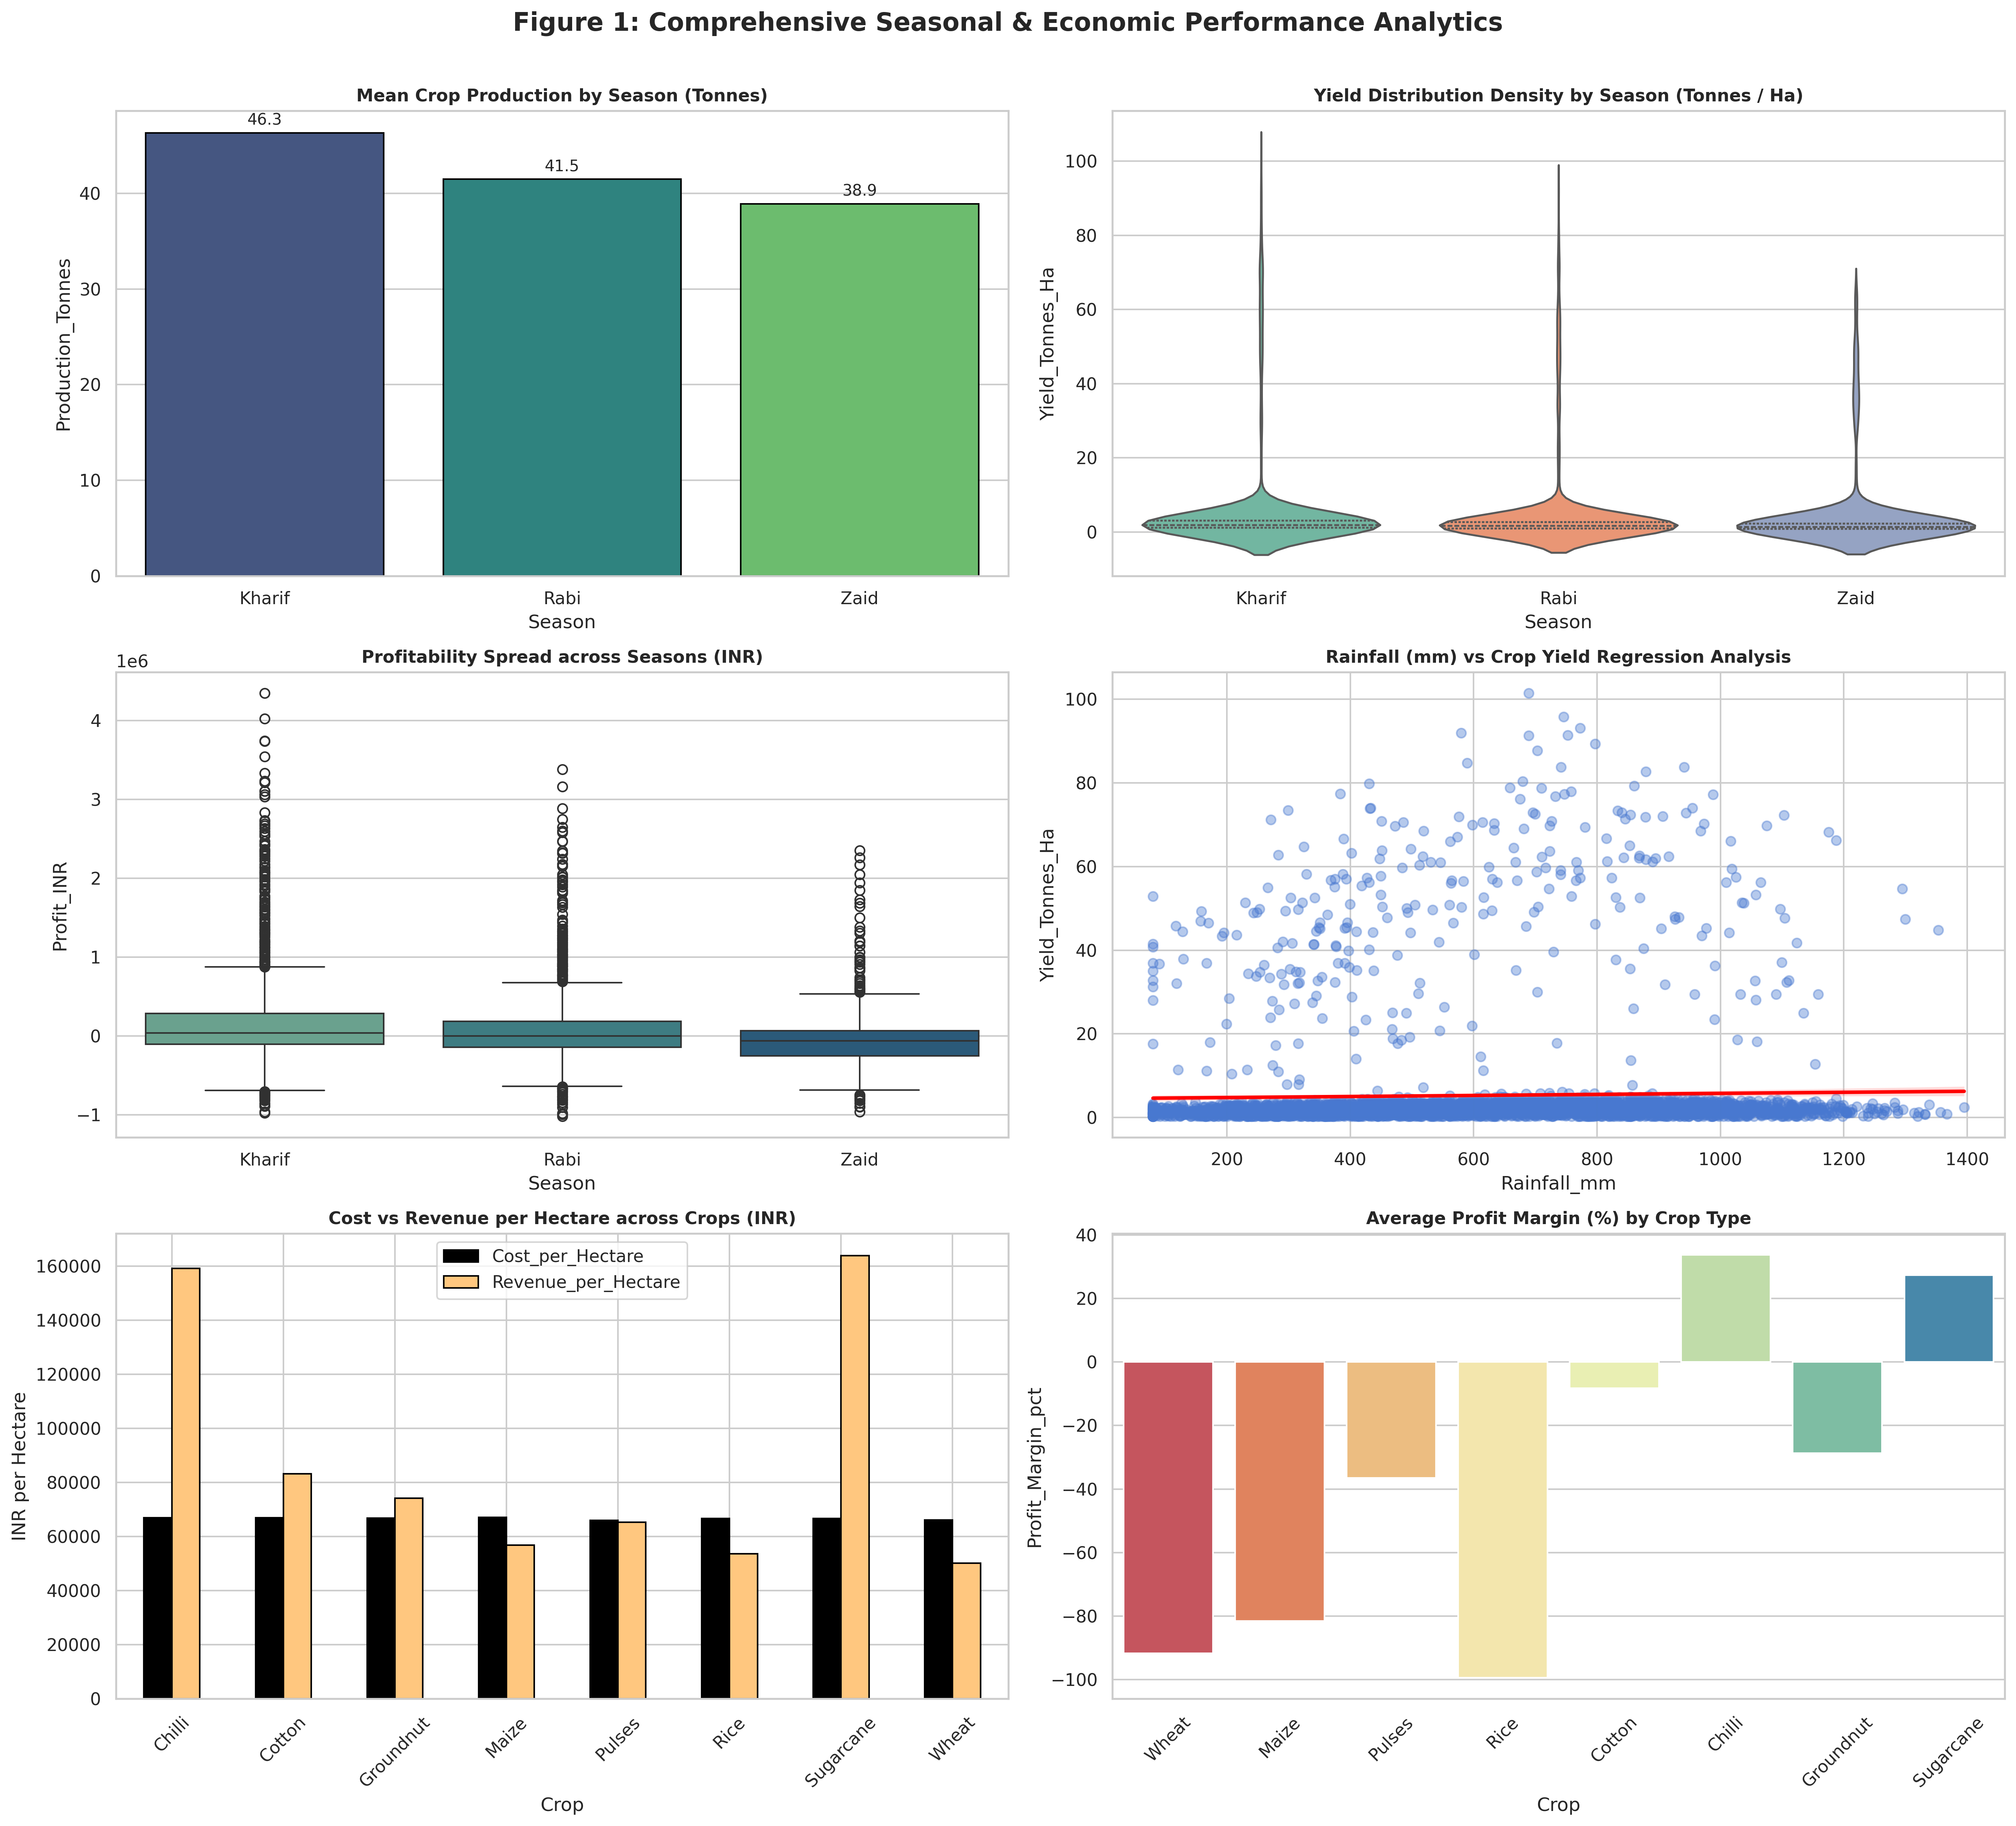
RESULTS
[Add screen shots of your code ]

Slide 11
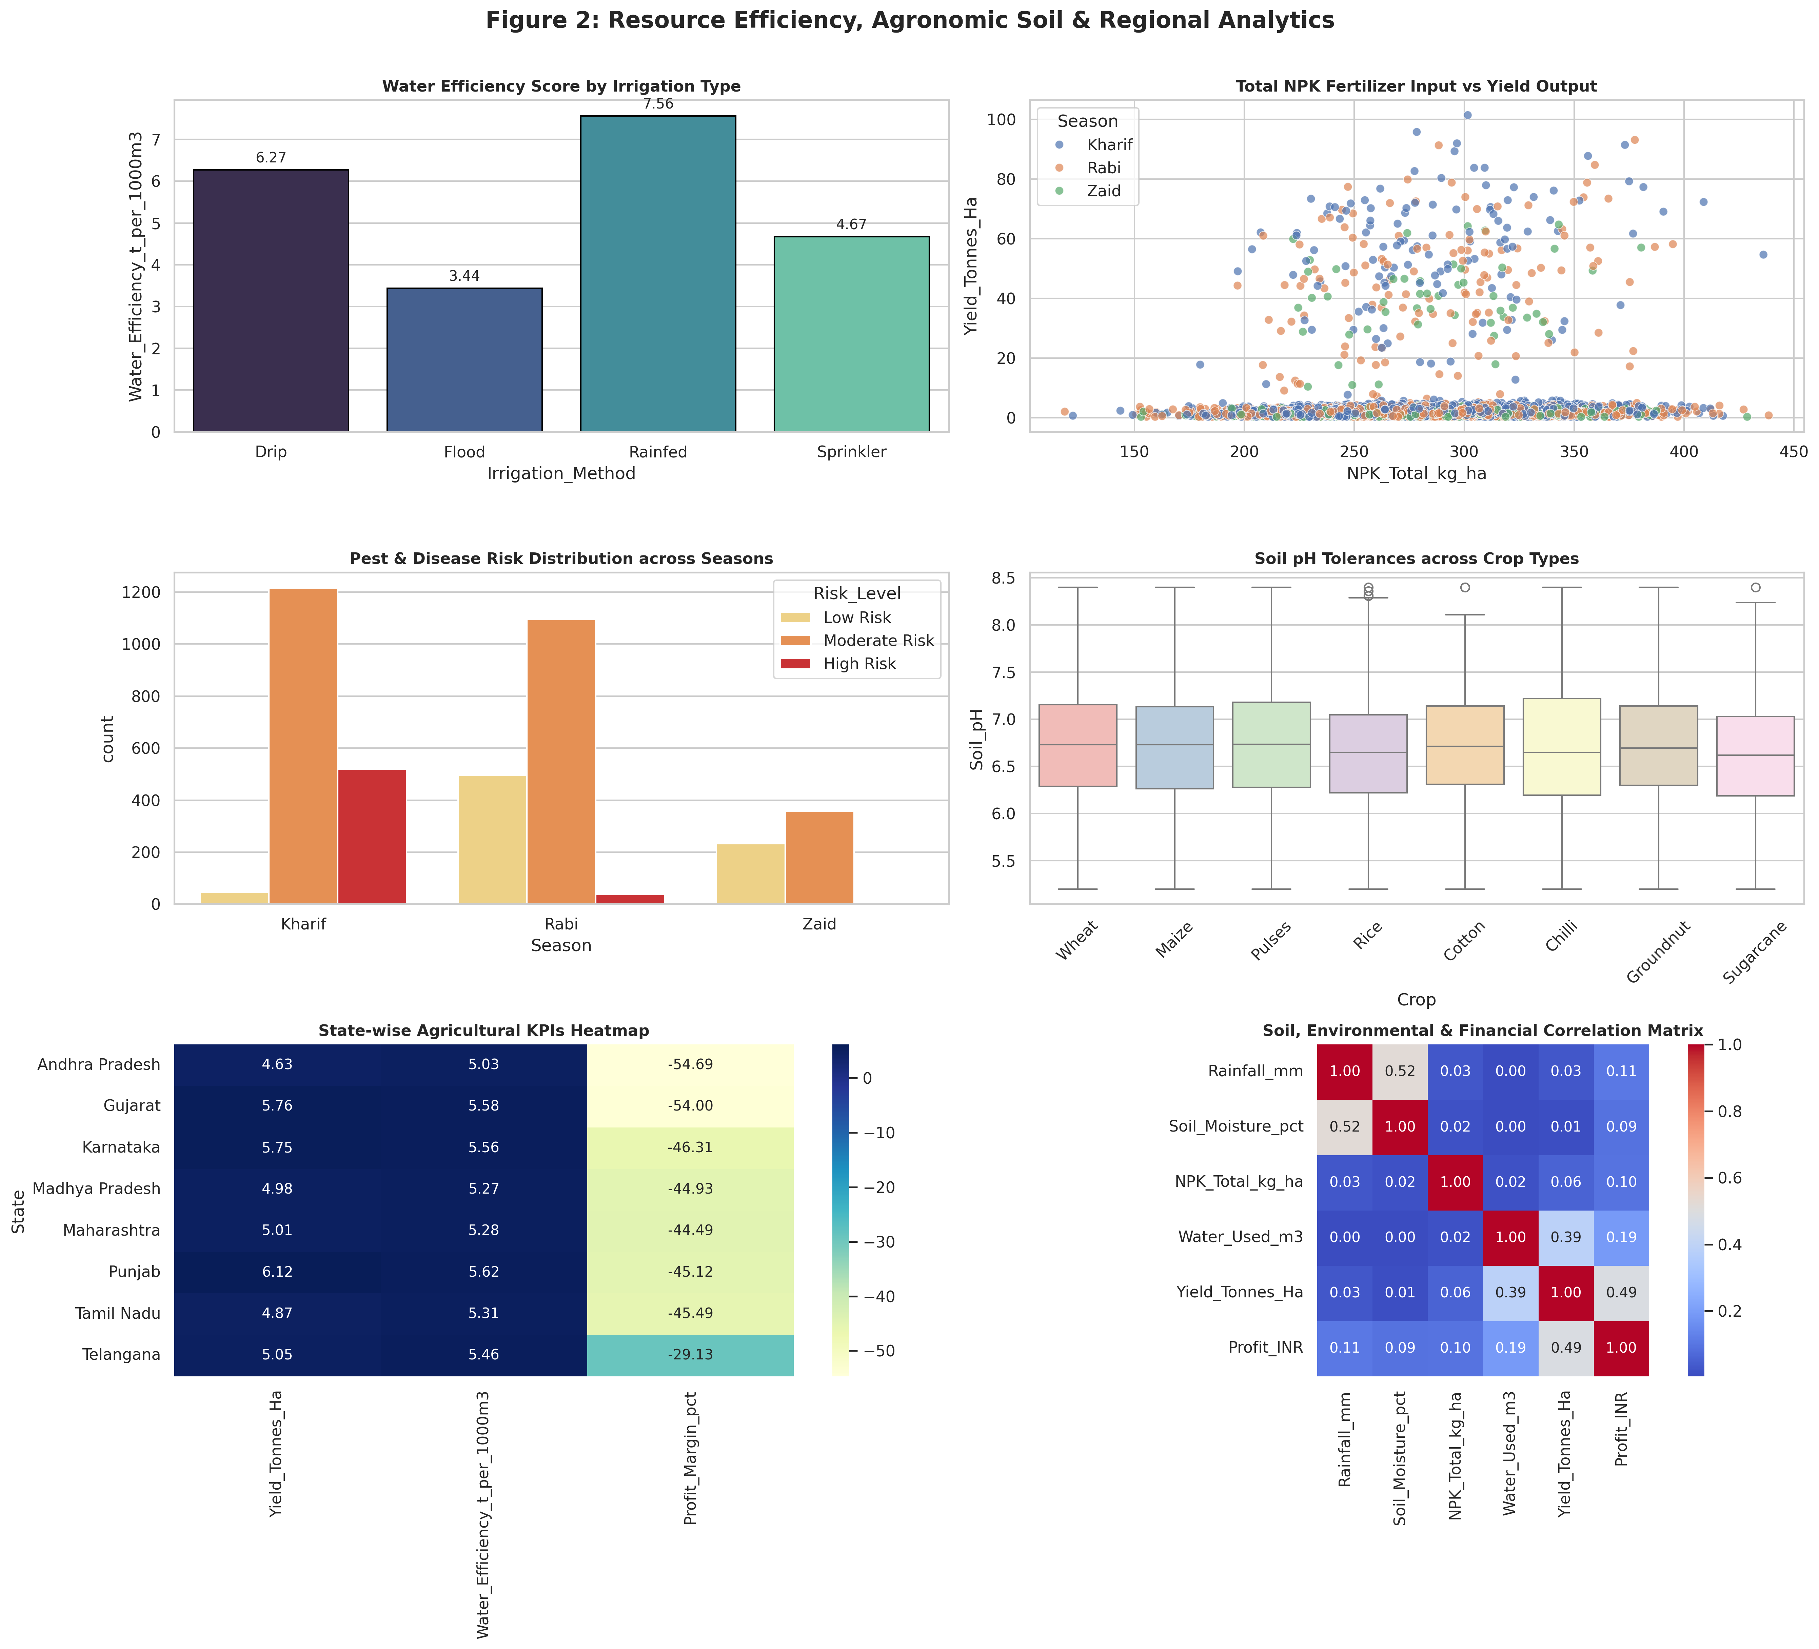

Slide 12
Future scope
Predictive Modeling: Integrating Machine Learning algorithms (e.g., Random Forest, XGBoost) to forecast future seasonal yields.
Real-time Integration: Building a interactive Streamlit dashboard for real-time monitoring of regional agricultural metrics.
Geospatial Mapping: Incorporating GIS data to map seasonal performance geographically across regions.

Slide 13
GitHub Link
https://github.com/mrsonu-boop/seasonal_agriculture_performance_analysis.git

Slide 14

VOIS Course completion certificate - Course name- Data Visualization

Slide 15
Thank you
.
.

