Slide 1
SDEC Capacity & ED Streaming: Data Analysis
13 July 2026

Slide 2
SDEC Capacity exists, but it’s limited in some services
SDEC CAPACITY & ED STREAMING
ED Majors (Type 1) into SDEC pathways: Six months of hourly data, Jan-Jul 2026
The ask: We've been engaging staff across the ED on available non-admitted pathways, referral workflows, clinical and patient criteria, designed to increase numbers streamed from ED majors.
The result: Whilst there have been some increases from the 12-month baseline, recent trajectory is flat.
What we heard: “there's often nowhere to stream to, the services are full.”
What we did: tested against six months of hourly occupancy data (SAU, EAU3, EAU4) and attendance data (Clinic 5, DVT Clinic).
Conclusion: there is some capacity but it’s not consistent, and operational issues stops effective streaming. SAU and EAU3 have theoretical daytime capacity; EAU4 is typically full; Clinic 5 requires additional data validation.
Source: verbal feedback via ED/Flow Programme engagement; hourly occupancy and attendance data, Jan–Jul 2026.

Slide 3
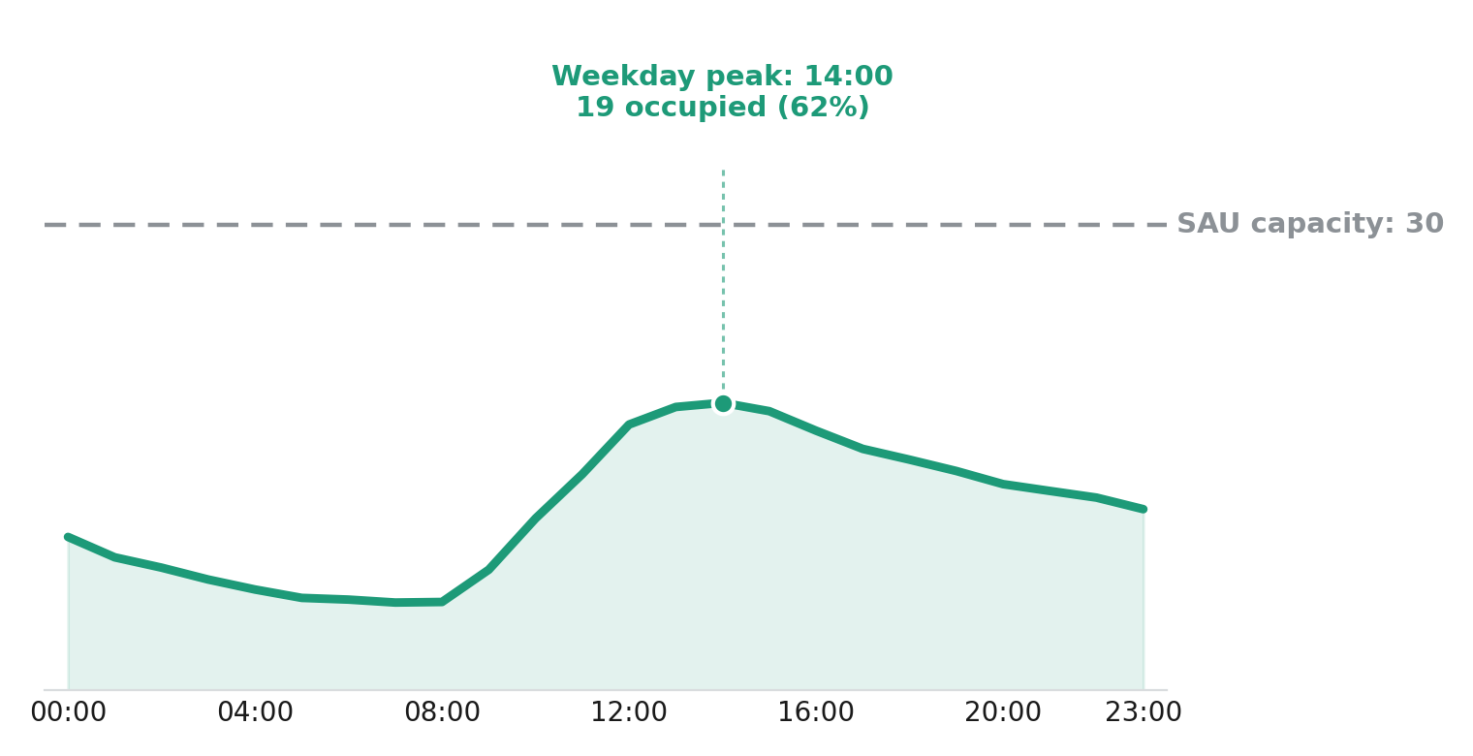
Data shows SAU presents an opportunity for increased surgical take
SDEC CAPACITY & ED STREAMING
Average % of stated capacity occupied, Jan-Jul 2026 (192 days) · SAU: 30 chairs
Surgical and Medical Assessment Units
2 of 3
Services units show sustained daytime headroom
SAU - Surgical Assessment Unit
35%
average occupied, all hours, all days
EAU4 is the exception: 93–96% occupied continuously, confirming feedback.
Clinic 5: ongoing work to confirm appointment slot utilisation.
Weekday peak is just 62% (19 of 30 chairs) at 14:00 - and occupancy stays under 50% for ~3 in 4 hours.
Provision is 30 chairs: Anecdotal evidence that is there are a limited number of surgical presentations suitable for sitting in a chair.
Source: CHEQS SAU / EAU3 / EAU4 hourly occupancy data, Jan–Jul 2026. EAU3: 36-chair capacity confirmed; operational and workforce factors mean not all chairs are staffed/available every day - not visible in this data.

Slide 4
EAU3 has real daytime capacity with EAU4 operating at capacity
SDEC CAPACITY & ED STREAMING
Hourly occupancy, Jan–Jul 2026 · EAU3: 26 core / 30 extended | EAU4 = 25 trolleys + 3 side rooms (28)
EAU3
42–69%
of 26-chair core capacity (30 extended)
EAU4
93–96%
occupied continuously - weekdays and weekends
Extended capacity (30) - reached 30+ chairs in 11 of 4,608 hours (0.2%); rarely needed.
More constrained from 18:00 — peak of 21 (81% core / 70% extended).
Operational/workforce factors: not all chairs staffed daily - not visible in this data.
The data confirms the feedback - at or near capacity almost every hour of every day.
What this means: More acutely unwell patients are more likely to be directly admitted through EAU5 or direct to specialty wards.
Source: CHEQS EAU3 & EAU4 Hourly Occupancy. - 192 days, Jan–Jul 2026. EAU3.

Slide 5
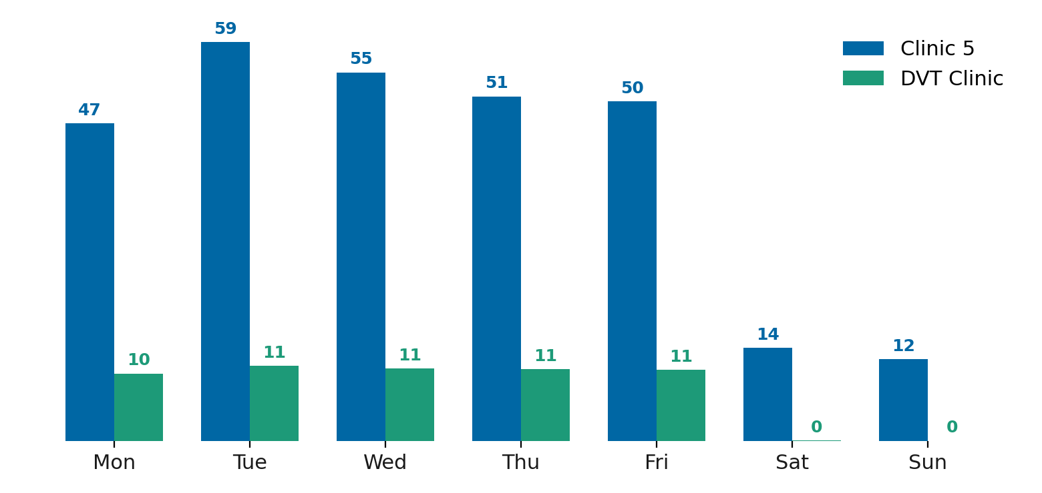
Clinic 5 & DVT: a different model, and a data gap
SDEC CAPACITY & ED STREAMING
Appointment-based SDEC, not bed-based · daily attendances by day of week
Clinic 5 runs ~50–60 attendances/day Mon–Fri, dropping to ~13/day at weekends - consistent with a service close to its weekday limit.
Only 0.5% of Clinic 5 attendances arrived via ED (40 of 7,896 over six months) – explained by limits on direct streaming from ED (Type 1 attendance) where clinic is now structured for hot clinics rather than open SDEC appointment slots.
DVT Clinic is ~99.5% non-ED (GP/Outpatient referral pathway) in line with service configuration
Source: Trust attendance data by departure date, Jan–Jul 2026; ED-prior referral-source breakdown.

Slide 6
Next steps
SDEC CAPACITY & ED STREAMING
Resolving actual or perceived blockers
Meeting between ED / EAU teams to resolve capacity issues
SAU – excess capacity to be discussed or escalated.
Service Ops Managers – sense check data against known operational and workforce driven gaps.
Flow Programme – include as a risk/blocker in programme reporting
Messaging to ED medics?
Possible to re-introduce streaming to Clinic 5?

