Slide 1
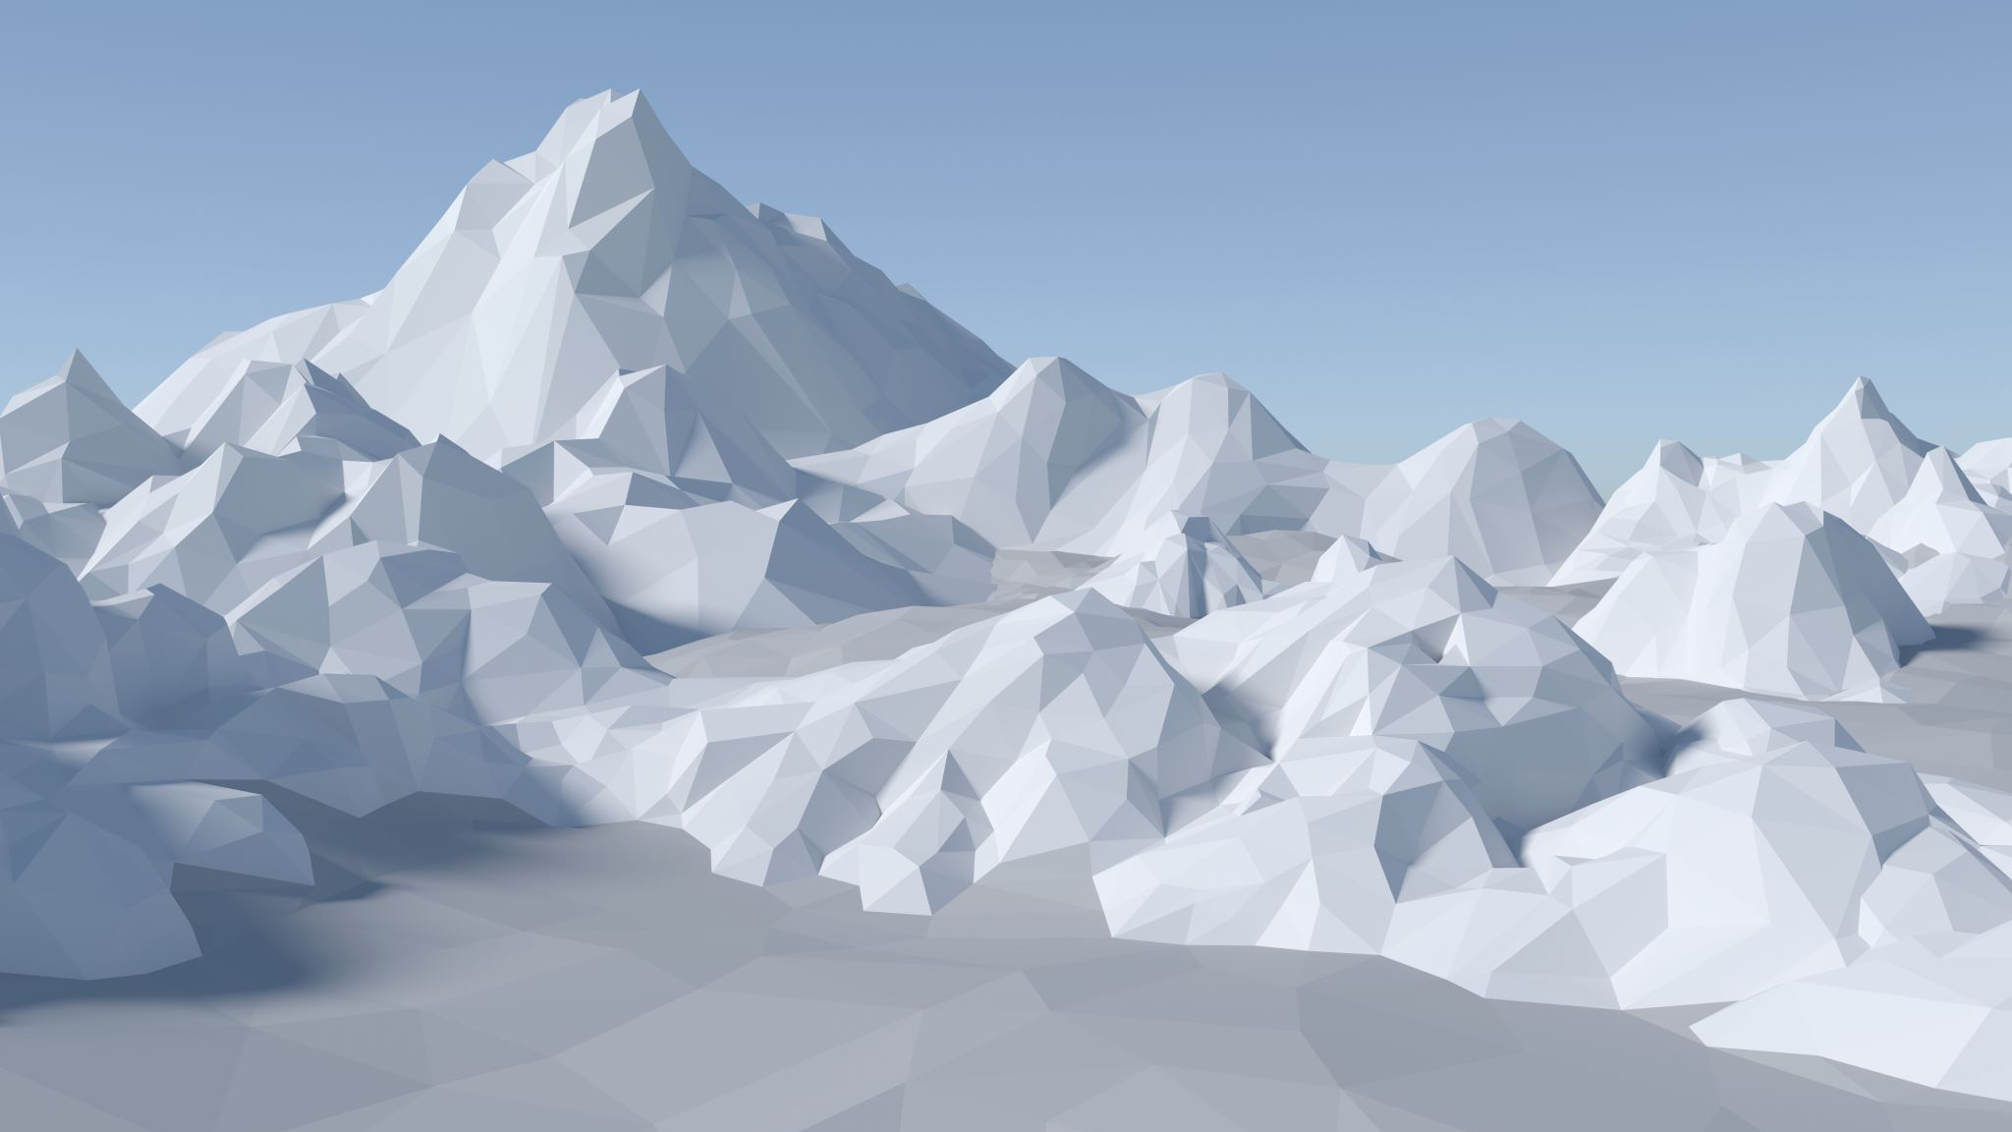
Glacier Project
Text hinzufügen
Dylan Baumgartner, Julian Chalabi, Felix Hofmann, Fernando Moreno

Slide 2
Index
Motivation
Dataset
Analysis
Results
Conclusions

Slide 3
Motivation
Visible changes in the glaciers
Glacier changes impacts
New avalanche danger
Alteration of landscape
Global Warming related
Politics

Slide 5
Dataset
Glacier Data: https://www.glamos.ch/downloads#tab-zeitreihen
Greenhouse gas emisions data: https://www.bafu.admin.ch/bafu/en/home/topics/climate/state/data/greenhouse-gas-inventory.html
Temperature data: https://data.geo.admin.ch/ch.meteoschweiz.klima/nbcn-tageswerte/liste-download-nbcn-d.csv

Slide 6
Dataset
Average the length change per glacier per year
Average the temperature per year

Slide 7
Analysis
Build and fit a linear model
Try to predict 2017 and 2018

Slide 8
Analysis
What model did we use?
Lm(length_changes ~ Time_trend + Yearly_avg_temp + Gg_Emissions)
Why not use Cumulative Length Change?
--> Introduces dependencies among residuals
Gg Emissions of Switzerland

Slide 9
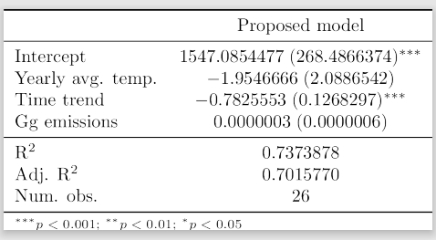
Analysis - Table

Slide 10
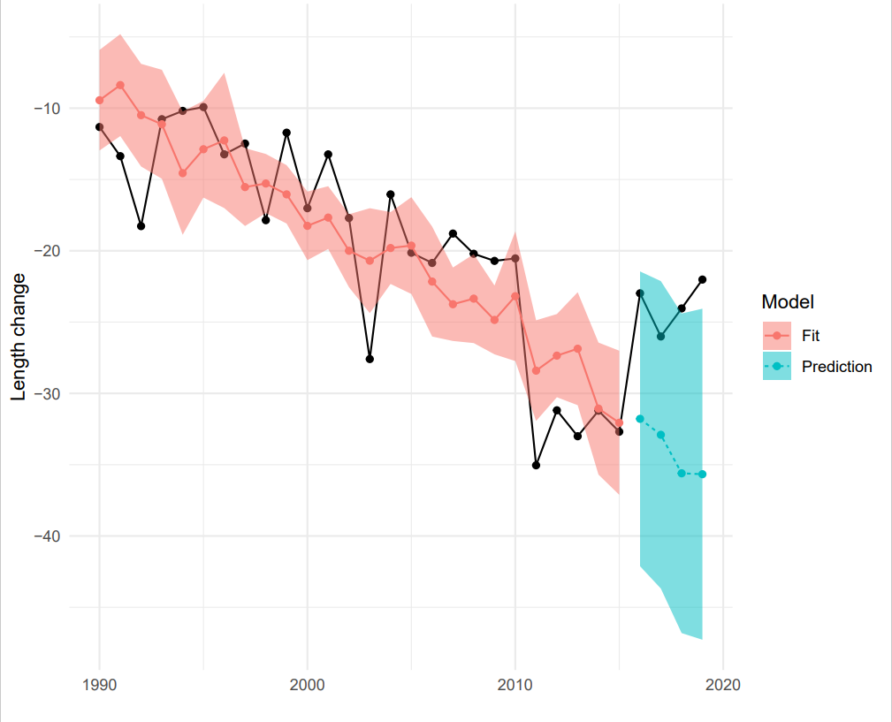
Results

Slide 11
Results
Fit seems to be fine – but prediction off
R squared value is good, but GHG emissions of Switzerland add no predictive/explanatory value to model
Model maybe too simple for complex phenomena involved
But still ...

Slide 12
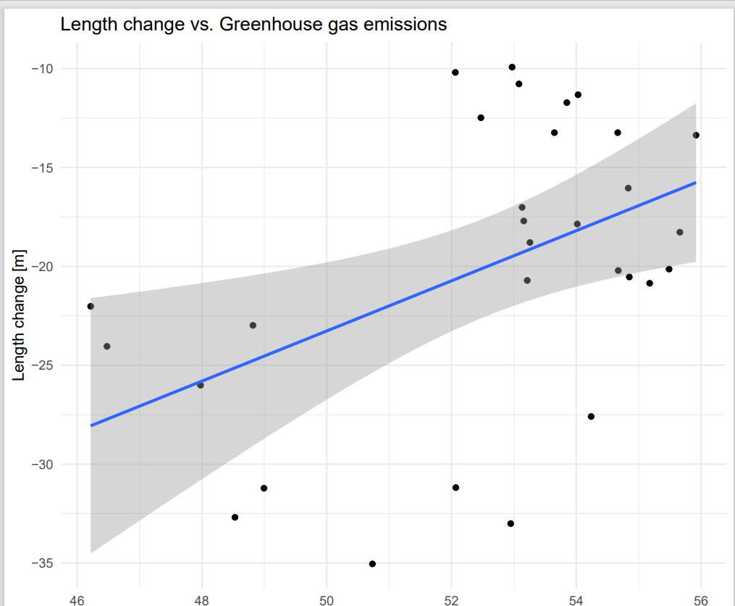
Results

Slide 13
Conclusions
A linear model predicts the evolution of glacier changes
Adding CO2 to the model is redundant with the temperature

