Slide 1
Flight delay prediction at 05:00
Gradient boosting against strong baselines · NYC 2013 flights
Team T107 · Section D · Project 21 · Phase 1
Rishik · Praneeth · Srikar · Sami · Mani Kanta
Notes:
Rishik: introduce the team and the question. We predict at 05:00 on the day of travel whether a New York departure will arrive 15+ minutes late.

Slide 2
All learned models beat the baselines; none clearly beats the others
Verdict
Test PR AUC, November–December (used once) · bars = 95% day-block CI
0.258
Majority class
0.369
Planner's rule (flight's 28-day rate)
0.403
Logistic regression
0.390
Gradient boosting (tuned XGBoost)
0.403
Hybrid (boosting from LR)
random = base rate 0.258
0.20
0.25
0.30
0.35
0.40
0.45
0.50
At 05:00 the useful signal is recent delay history, which a linear model uses as well as boosting does — and transfers better across seasons.
Notes:
Rishik: the answer first. Hybrid 0.403, logistic regression 0.403, boosting 0.390; planner's rule 0.369; random 0.258. The CIs overlap heavily, so we claim no winner among learned models.

Slide 3
Five notebooks, one per person, following the course life cycle
Overview
01
02
03
04
05
Rishik
Praneeth
Srikar
Sami
Mani Kanta
Problem, data, metric, split
EDA and preprocessing
Features, selection, leakage test
Baselines, GD from scratch, model selection
Boosting: tuning, training, test
Phases 1, 2, 5
Phases 3, 4
Phase 6
Phases 7, 8A
Phases 8B, 8C, 9
Each notebook writes its module to src/fdp/ and its numbers to reports/*.json.
The report and these slides are generated from those JSON files, so no number is typed by hand.
Every decision below is numbered (1–35); the full log with evidence is at the end of the deck.
Notes:
Rishik: explain the order of work. Each notebook builds on the modules pushed before it.

Slide 4
A yes/no question asked at 05:00, with only what is known then
01 · Rishik
336,776
1
Binary classification: delayed = arrives ≥15 min late
adopted
→ 327,346 labelled flights, 0.245 delayed.
scheduled flights
327,346
2
Predict at 05:00 on day D; post-departure columns banned; history ends on D-1
worked
→ Leakage tests pass (2 passed in 7.08s); no post-departure column is a feature.
labelled flights
0.245
3
Cancelled/diverted flights unlabelled but kept on the schedule
adopted
→ 8,255 cancelled + 1,175 diverted excluded from training and scoring, counted in congestion features.
share delayed (≥15 min)
Notes:
Rishik: classification because the decision is yes/no and BTS uses 15 minutes. 05:00 because ~3% of the previous day's flights land after midnight. Cancelled flights have no label; we do not invent one.

Slide 5
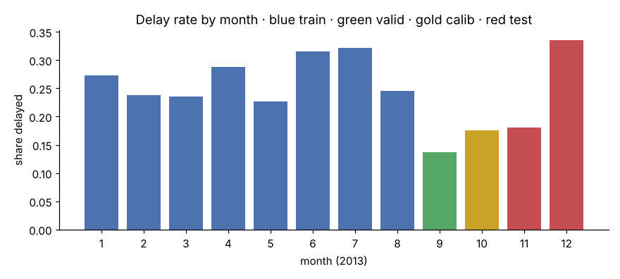
Metric before model, and a split that follows time
01 · Rishik
4
Metric fixed before modelling: PR AUC (+ ROC AUC, Brier, ECE, lift)
worked
→ “Always on time” scores 0.863 accuracy in September with zero recall; random scores PR AUC ≈ base rate.
5
Chronological split: warm-up Jan 1–14, train to Aug, valid Sep, calib Oct, test Nov–Dec (once)
worked
→ Shares 65.2/8.6/9.1/17.1%. Monthly delay rate ranges 0.137 (Sep) to 0.336 (Dec): a base-rate shift that later drives the calibration and threshold results.
0.863
accuracy of “always on time” in September — and zero delays caught. So: PR AUC, not accuracy.
6
Confidence intervals by day-block bootstrap
worked
→ Test CIs are about ±0.05 wide (LR [0.351, 0.459]), which is what makes the LR/boosting gap non-significant.
Notes:
Rishik: the split. Train 2013-01-15–2013-08-31, valid September, calibration October, test November–December once. Monthly delay rate moves from 0.137 to 0.336: this base-rate shift comes back in every later result.

Slide 6
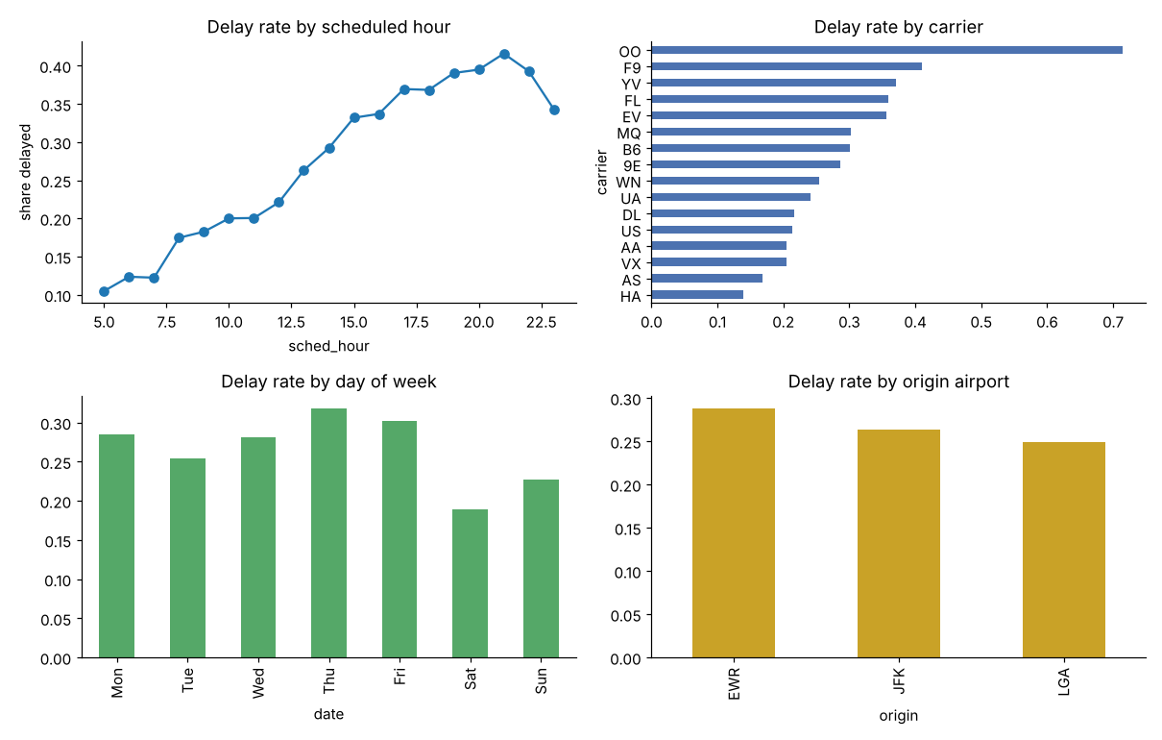
EDA on training rows only: missing data is systematic, outliers are real
02 · Praneeth
8
Impute aircraft fields (median + missing indicator); do not delete rows
adopted
→ Indicator columns keep the “unknown aircraft” signal; no rows lost.
9
Keep delay outliers
adopted
→ No rows removed.
10
Check duplicates
no action needed
Delay rate climbs from 0.105 at 05:00 to 0.395 at 20:00: delays propagate through the day.
→ 0 full and 0 key duplicates: nothing to remove.
Notes:
Praneeth: aircraft year missing 17.47% — MQ 95.1%, AA 69.5%. Systematic, so impute + indicator. Keep outliers. No duplicates.

Slide 7
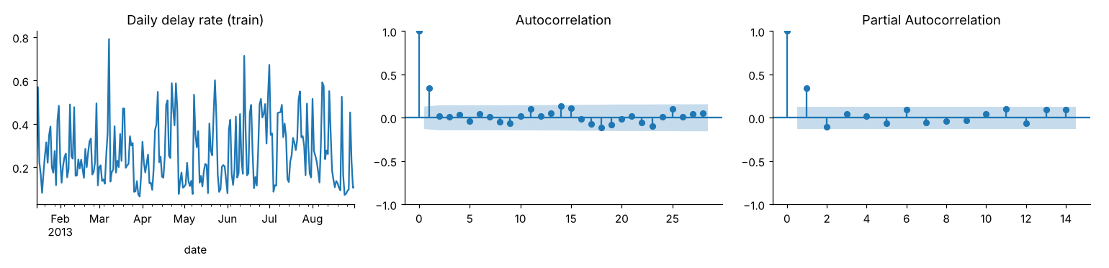
Yesterday matters, last week does not — so we chose the history windows from the ACF
02 · Praneeth
11
History windows chosen from ACF/PACF of the daily delay rate
worked
12
No SMOTE / re-sampling
worked
13
Standard (z-score) scaler for the linear model
tie
→ LR's raw test probabilities were already well calibrated (ECE 0.029).
→ September PR AUC 0.1974 vs 0.1978: a tie, standard kept.
→ In notebook 03 the history group raised September PR AUC from 0.209 to 0.261.
Notes:
Praneeth: ACF lag 1 0.343, PACF cuts off after lag 1, lag 7 0.008. So a 1-day window and day-of-week features. Decision 14: one-hot for linear models, ordinal codes for trees, native categoricals in XGBoost.

Slide 8
Five feature groups, all known at 05:00 — and a test that proves it
03 · Srikar
15
Five feature groups, 41 numeric + 3 categorical
worked
→ LR with all five groups is best on both months (Sep 0.261, Oct 0.306). History adds +0.052 in Sep but only +0.002 in Oct.
16
Shrink history rates towards the overall rate (α = 10)
adopted
→ Small groups pulled to the mean; log-volume features say how much evidence a rate rests on.
17
No month or day-of-year feature
adopted
→ Seasonality enters only through history features (see drift, notebook 05).
rate = (k + α·prior) / (n + α), α = 10 · windows end on day D−1 (.rolling().sum().shift(1))
Notes:
Srikar: 41 numeric features in five groups. History is the big September jump, but in October calendar and congestion matter more. Leakage tests: Leakage tests pass (2 passed in 7.08s); no post-departure column is a feature.

Slide 9
No selection method beat “all features” on both months, so we kept all
03 · Srikar
18
Keep all features unless a method beats them on both September and October
all features kept
→ None passed. SFS: Sep 0.279 > 0.261 but Oct 0.281 < 0.306: it over-fitted the month it was selected on.
19
Report VIF but keep collinear features
worked
→ Pruning 7 features lowered both months (0.256 / 0.302).
Notes:
Srikar: SFS looked best on September (0.279) — the month it chose on — and lost on October (0.281 vs 0.306). That is selection over-fitting.

Slide 10
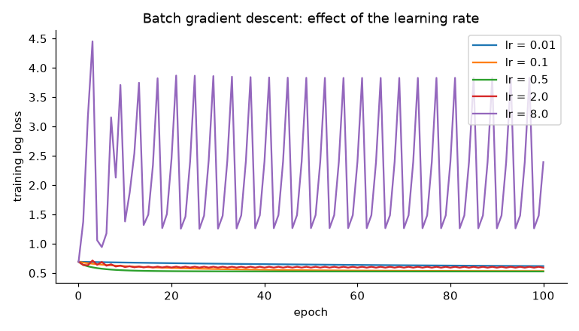
The floor: a planner's rule, and logistic regression written from scratch
04 · Sami
20
Baselines before any learned model
floor set
→ Sep / Oct PR AUC: majority 0.137 / 0.176; flight's 28-day rate 0.190 / 0.269; scheduled hour 0.188 / 0.229.
21
Logistic regression from scratch (batch, mini-batch, SGD), checked against scikit-learn
verified
→ Batch GD train log loss 0.5279 vs scikit-learn 0.5278; mini-batch 0.5282 in 5 epochs.
22
Learning-rate sweep for batch GD
as expected
→ lr 0.01 → 0.6195 after 100 epochs (slow); 0.5 → 0.5282 (best); 8 → 2.3942 (diverged).
Notes:
Sami: baselines first. Gradient = Xᵀ(σ(Xw) − y)/n + λw. Batch GD matches scikit-learn to the fourth decimal. Learning rate 8 diverges. Decision 23: C = 0.001 chosen on September only.

Slide 11
Model families on rolling months: logistic regression led, untuned boosting was third
04 · Sami
24
Decision-tree depth sweep
as expected
→ Unlimited depth: train 1.000, Sep 0.140; best Sep at depth 2 (0.180).
25
Compare families on rolling Jul/Aug/Sep with fixed configurations
LR leads
→ Mean PR AUC: LR 0.408 > random forest 0.386 > untuned XGBoost 0.366 > tree 0.328. LR is the model to beat; boosting goes on to tuning.
Model | Mean | Fit s
Logistic regression | 0.408 | 3.6
Decision tree | 0.328 | 1.9
Random forest | 0.386 | 8.0
Gradient boosting (untuned) | 0.366 | 2.3
Notes:
Sami: a deep tree memorises (train 1.0). On three rolling months LR is best; untuned XGBoost loses to it — so boosting has to earn its place through honest tuning in notebook 05.

Slide 12
We found an early-stopping trap that inflates boosting's score
05 · Mani Kanta
26
Gradient boosting from scratch, checked against scikit-learn
verified
→ September log loss 0.4165 and PR AUC 0.208, identical to scikit-learn.
27
Honest early stopping: stop on month m-1, refit, score m
trap found
→ Same configuration: optimistic mean 0.402 vs honest 0.382 (+0.020 inflation avoided).
+0.020 of the optimistic mean came from the stopping rule seeing the answers.
Notes:
Mani Kanta: boosting fits trees to r = y − p. Our from-scratch version equals scikit-learn. Then the trap: early-stopping on the month you report is optimistic. All tuning uses the honest protocol.

Slide 13
Tuned boosting stayed below logistic regression; the hybrid caught up
05 · Mani Kanta
Rolling PR AUC | Jul | Aug | Sep | Mean
Logistic regression | 0.556 | 0.406 | 0.266 | 0.409
Gradient boosting (tuned) | 0.548 | 0.391 | 0.219 | 0.386
Hybrid: boosting from LR | 0.559 | 0.391 | 0.268 | 0.406
28
Random search, 8 of 288 XGBoost configurations, honest rolling score
boosting behind LR
→ Best: lr 0.03, depth 3, min child weight 50, subsample 0.7, colsample 0.5, λ 1.0 → 0.386. All 8 lie in 0.376–0.386, below LR (0.409).
Trees chosen by early stopping, per fold
29
Hybrid: XGBoost starts from LR's logit (base_margin) and learns corrections
matches LR
Boosting
40
110
13
median → 40
→ Rolling mean 0.406 (LR 0.409, boosting 0.386); trees per fold [16, 1219, 15].
Hybrid
16
1219
15
median → 16
30
Final tree count = median of the fold counts
worked
September alone would stop at 1 tree.
→ Boosting folds [40, 110, 13] → 40 trees; hybrid → 16; September alone would pick 1.
Notes:
Mani Kanta: random search over 8 configurations; best lr 0.03, depth 3. Shallow trees win. The tree count swings between folds — the structure that transfers is not stable. The hybrid starts from LR's logit and adds corrections.

Slide 14
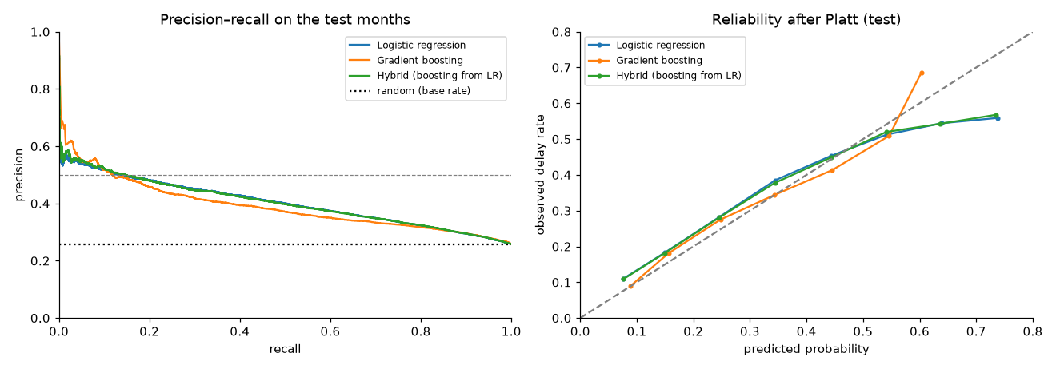
The final exam: test months scored once
05 · Mani Kanta
Model | PR AUC | 95% CI | ROC AUC | Lift | ECE raw → Platt
Majority class | 0.258 | — | 0.500 | 1.00 | 0.010
Rule: flight's 28-day rate | 0.369 | — | 0.638 | 1.43 | 0.036
Logistic regression | 0.403 | [0.351, 0.459] | 0.670 | 1.56 | 0.029 → 0.035
Gradient boosting | 0.390 | [0.336, 0.451] | 0.654 | 1.51 | 0.034 → 0.023
Hybrid (boosting from LR) | 0.403 | [0.352, 0.458] | 0.670 | 1.56 | 0.028 → 0.032
32
Test set (Nov–Dec) scored once, all models together
no winner
→ PR AUC: hybrid 0.403, LR 0.403, boosting 0.390, rule 0.369, majority 0.258. Intervals overlap: no winner among learned models.
Notes:
Mani Kanta: compare PR AUC and the intervals together. They overlap heavily: no winner. Platt helped boosting's calibration but slightly hurt LR and the hybrid, which were already calibrated.

Slide 15
For planners: a flag list where about half the flags are real delays
05 · Mani Kanta
Model | Rule | Precision | Recall | Flagged / 1000 | Really delayed | Random list
Logistic regression | (a) October threshold | 0.538 | 0.055 | 26.4 | 14.2 | 6.8
Logistic regression | (b) calibrated p >= 0.5 | 0.525 | 0.086 | 42.6 | 22.3 | 11.0
Gradient boosting | (a) October threshold | 0.547 | 0.053 | 25.2 | 13.8 | 6.5
Gradient boosting | (b) calibrated p >= 0.5 | 0.517 | 0.097 | 48.6 | 25.2 | 12.6
Hybrid | (a) October threshold | 0.547 | 0.056 | 26.2 | 14.4 | 6.8
Hybrid | (b) calibrated p >= 0.5 | 0.529 | 0.085 | 41.6 | 22.0 | 10.8
33
Flag policy: calibrated p ≥ 0.5 instead of the October score threshold
rule (b) chosen
31
Refit on Jan 15–Sep 30; Platt-calibrate on October
mixed
→ Boosting ECE 0.034 → 0.023 (better); LR 0.029 → 0.035 and hybrid 0.028 → 0.032 (worse: already calibrated, then October's lower base rate pulled them).
→ October threshold: precision 0.538–0.547, recall 0.053–0.056, 25–26 flagged per 1000. Calibrated rule: precision 0.517–0.529, recall 0.085–0.097, 42–49 flagged, about 2× a random list.
Notes:
Mani Kanta: the delay rate rose from 0.176 in October to 0.258 in the test months, so a score cut-off fixed in October lands in a different place. Out of every 1,000 flights the model hands over a few dozen, about half really late — roughly twice what a random list of the same size would catch.

Slide 16
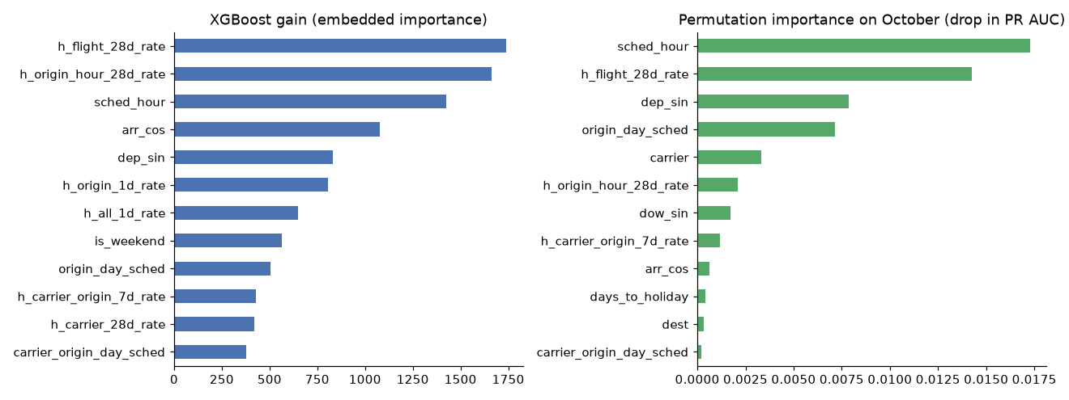
Why boosting gains little: tree thresholds learned in summer drift in autumn
05 · Mani Kanta
34
Importance and ablation on October, never on test
drift found
→ Permutation: sched_hour 0.01726, h_flight_28d_rate 0.01424. Ablation: peak 0.303 with schedule+calendar+aircraft; + congestion 0.291; + history 0.264.
35
Error analysis by month and airport (lift)
boosting weaker in Nov
→ Boosting is weakest in November (lift 1.38 vs LR 1.58) and at JFK (1.44 vs 1.54); December is hard for all (about 1.35).
Notes:
Mani Kanta: on October, adding congestion and then history lowers boosting while LR keeps gaining. Trees split on absolute rate levels from a high-delay summer. Note: the two lines use different training windows (LR Jan–Aug, boosting Jan–Sep).

Slide 17
35 decisions: what worked, what we found, what we would revisit
All
Worked / verified · 26
Findings · 5
Ties / neutral · 4
1 Binary classification: delayed = …
16 Shrink history rates towards the …
28 Random search, 8 of 288 XGBoost …
10 Check duplicates
2 Predict at 05:00 on day D; …
17 No month or day-of-year feature
31 Refit on Jan 15–Sep 30; …
13 Standard (z-score) scaler for the …
3 Cancelled/diverted flights unlabelled …
18 Keep all features unless a method …
32 Test set (Nov–Dec) scored once, all …
25 Compare families on rolling …
4 Metric fixed before modelling: PR AUC …
19 Report VIF but keep collinear features
34 Importance and ablation on October, …
29 Hybrid: XGBoost starts from LR's …
5 Chronological split: warm-up Jan …
20 Baselines before any learned model
35 Error analysis by month and airport …
6 Confidence intervals by day-block …
21 Logistic regression from scratch …
7 EDA and every preprocessing statistic …
22 Learning-rate sweep for batch GD
8 Impute aircraft fields (median + …
23 Choose L2 strength C on September only
9 Keep delay outliers
24 Decision-tree depth sweep
11 History windows chosen from ACF/PACF …
26 Gradient boosting from scratch, …
12 No SMOTE / re-sampling
27 Honest early stopping: stop on month …
14 One-hot for linear models, ordinal …
30 Final tree count = median of the fold …
15 Five feature groups, 41 numeric + 3 …
33 Flag policy: calibrated p ≥ 0.5 …
Notes:
All: one line per decision, grouped by outcome. The full log with evidence follows.

Slide 18
Decision log (1–9 of 35)
Appendix
# | NB | Decision | What happened | Verdict
1 | 01 | Binary classification: delayed = arrives ≥15 min late | 327,346 labelled flights, 0.245 delayed. | adopted
2 | 01 | Predict at 05:00 on day D; post-departure columns banned; history ends on D-1 | Leakage tests pass (2 passed in 7.08s); no post-departure column is a feature. | worked
3 | 01 | Cancelled/diverted flights unlabelled but kept on the schedule | 8,255 cancelled + 1,175 diverted excluded from training and scoring, counted in congestion features. | adopted
4 | 01 | Metric fixed before modelling: PR AUC (+ ROC AUC, Brier, ECE, lift) | “Always on time” scores 0.863 accuracy in September with zero recall; random scores PR AUC ≈ base rate. | worked
5 | 01 | Chronological split: warm-up Jan 1–14, train to Aug, valid Sep, calib Oct, test Nov–Dec (once) | Shares 65.2/8.6/9.1/17.1%. Monthly delay rate ranges 0.137 (Sep) to 0.336 (Dec): a base-rate shift that later drives the calibration and threshold results. | worked
6 | 01 | Confidence intervals by day-block bootstrap | Test CIs are about ±0.05 wide (LR [0.351, 0.459]), which is what makes the LR/boosting gap non-significant. | worked
7 | 02 | EDA and every preprocessing statistic on training rows only | Pipelines fitted on train; imputer median of plane age (11.0) is the training median. | adopted
8 | 02 | Impute aircraft fields (median + missing indicator); do not delete rows | Indicator columns keep the “unknown aircraft” signal; no rows lost. | adopted
9 | 02 | Keep delay outliers | No rows removed. | adopted
Notes:
Read-ahead slide: every decision with the evidence from the saved results. The report's appendix also gives the reason for each.

Slide 19
Decision log (10–18 of 35)
Appendix
# | NB | Decision | What happened | Verdict
10 | 02 | Check duplicates | 0 full and 0 key duplicates: nothing to remove. | no action needed
11 | 02 | History windows chosen from ACF/PACF of the daily delay rate | In notebook 03 the history group raised September PR AUC from 0.209 to 0.261. | worked
12 | 02 | No SMOTE / re-sampling | LR's raw test probabilities were already well calibrated (ECE 0.029). | worked
13 | 02 | Standard (z-score) scaler for the linear model | September PR AUC 0.1974 vs 0.1978: a tie, standard kept. | tie
14 | 02 | One-hot for linear models, ordinal codes for trees, native categoricals in XGBoost | LR validation matrix: 120 columns. | adopted
15 | 03 | Five feature groups, 41 numeric + 3 categorical | LR with all five groups is best on both months (Sep 0.261, Oct 0.306). History adds +0.052 in Sep but only +0.002 in Oct. | worked
16 | 03 | Shrink history rates towards the overall rate (α = 10) | Small groups pulled to the mean; log-volume features say how much evidence a rate rests on. | adopted
17 | 03 | No month or day-of-year feature | Seasonality enters only through history features (see drift, notebook 05). | adopted
18 | 03 | Keep all features unless a method beats them on both September and October | None passed. SFS: Sep 0.279 > 0.261 but Oct 0.281 < 0.306: it over-fitted the month it was selected on. | all features kept
Notes:
Read-ahead slide: every decision with the evidence from the saved results. The report's appendix also gives the reason for each.

Slide 20
Decision log (19–27 of 35)
Appendix
# | NB | Decision | What happened | Verdict
19 | 03 | Report VIF but keep collinear features | Pruning 7 features lowered both months (0.256 / 0.302). | worked
20 | 04 | Baselines before any learned model | Sep / Oct PR AUC: majority 0.137 / 0.176; flight's 28-day rate 0.190 / 0.269; scheduled hour 0.188 / 0.229. | floor set
21 | 04 | Logistic regression from scratch (batch, mini-batch, SGD), checked against scikit-learn | Batch GD train log loss 0.5279 vs scikit-learn 0.5278; mini-batch 0.5282 in 5 epochs. | verified
22 | 04 | Learning-rate sweep for batch GD | lr 0.01 → 0.6195 after 100 epochs (slow); 0.5 → 0.5282 (best); 8 → 2.3942 (diverged). | as expected
23 | 04 | Choose L2 strength C on September only | C = 0.001 (Sep 0.2655); scores barely move with C, so LR is bias-limited, not variance-limited. | adopted
24 | 04 | Decision-tree depth sweep | Unlimited depth: train 1.000, Sep 0.140; best Sep at depth 2 (0.180). | as expected
25 | 04 | Compare families on rolling Jul/Aug/Sep with fixed configurations | Mean PR AUC: LR 0.408 > random forest 0.386 > untuned XGBoost 0.366 > tree 0.328. LR is the model to beat; boosting goes on to tuning. | LR leads
26 | 05 | Gradient boosting from scratch, checked against scikit-learn | September log loss 0.4165 and PR AUC 0.208, identical to scikit-learn. | verified
27 | 05 | Honest early stopping: stop on month m-1, refit, score m | Same configuration: optimistic mean 0.402 vs honest 0.382 (+0.020 inflation avoided). | trap found
Notes:
Read-ahead slide: every decision with the evidence from the saved results. The report's appendix also gives the reason for each.

Slide 21
Decision log (28–35 of 35)
Appendix
# | NB | Decision | What happened | Verdict
28 | 05 | Random search, 8 of 288 XGBoost configurations, honest rolling score | Best: lr 0.03, depth 3, min child weight 50, subsample 0.7, colsample 0.5, λ 1.0 → 0.386. All 8 lie in 0.376–0.386, below LR (0.409). | boosting behind LR
29 | 05 | Hybrid: XGBoost starts from LR's logit (base_margin) and learns corrections | Rolling mean 0.406 (LR 0.409, boosting 0.386); trees per fold [16, 1219, 15]. | matches LR
30 | 05 | Final tree count = median of the fold counts | Boosting folds [40, 110, 13] → 40 trees; hybrid → 16; September alone would pick 1. | worked
31 | 05 | Refit on Jan 15–Sep 30; Platt-calibrate on October | Boosting ECE 0.034 → 0.023 (better); LR 0.029 → 0.035 and hybrid 0.028 → 0.032 (worse: already calibrated, then October's lower base rate pulled them). | mixed
32 | 05 | Test set (Nov–Dec) scored once, all models together | PR AUC: hybrid 0.403, LR 0.403, boosting 0.390, rule 0.369, majority 0.258. Intervals overlap: no winner among learned models. | no winner
33 | 05 | Flag policy: calibrated p ≥ 0.5 instead of the October score threshold | October threshold: precision 0.538–0.547, recall 0.053–0.056, 25–26 flagged per 1000. Calibrated rule: precision 0.517–0.529, recall 0.085–0.097, 42–49 flagged, about 2× a random list. | rule (b) chosen
34 | 05 | Importance and ablation on October, never on test | Permutation: sched_hour 0.01726, h_flight_28d_rate 0.01424. Ablation: peak 0.303 with schedule+calendar+aircraft; + congestion 0.291; + history 0.264. | drift found
35 | 05 | Error analysis by month and airport (lift) | Boosting is weakest in November (lift 1.38 vs LR 1.58) and at JFK (1.44 vs 1.54); December is hard for all (about 1.35). | boosting weaker in Nov
Notes:
Read-ahead slide: every decision with the evidence from the saved results. The report's appendix also gives the reason for each.

Slide 22
What we would flag before anyone else does
All
!
Small selection optimism
!
Small search
C = 0.001 was picked on September and reused in the rolling comparison whose September fold is the same month (0.266 vs 0.262 with C = 1). Boosting's configuration was also picked on the folds it is reported on. The test set is unaffected.
8 configurations were tried; their spread was only 0.010, so a larger search is unlikely to close a 0.023 gap, but this is untested.
!
Unstable hybrid fold
!
One month, one year
The hybrid's August fold stopped at 1219 trees against 16 and 15; the median rule absorbs it.
Ablation uses October only and a fixed tree count; one year of data cannot separate season from trend.
Notes:
Rishik: honest limitations. None of them touches the one-time test result.

Slide 23
At 05:00, boosting does not beat a well-tuned linear model
All learned models beat the planner's rule (0.369) and random (0.258); their test intervals overlap.
Honest tuning mattered: the early-stopping shortcut would have overstated boosting.
Phase 2: drift-robust (relative) history features, weather forecasts known at 05:00, more years of data, temporal deep learning.
Notes:
Rishik: conclusion and Phase 2 plan.

Slide 24
Contributions
All
01
Rishik Chowdary Karuturi
2401010381
01 · Problem, data, metrics, split; report and slides
02
Nakkina Lakshmi Praneeth
2401010288
02 · EDA, preprocessing
03
Balanagu Sesha Srikar
2401010124
03 · Features, selection, leakage test
04
Shaik Junaid Sami
2401010435
04 · Baselines, gradient descent, model selection
05
Siraparapu Shiva Sankar Mani Kanta
2401010457
05 · Gradient boosting, tuning, evaluation
Notes:
All: each person's work is in their own commits.

