Slide 1
Attendance Management System
MINI PROJECT
In the partial Fulfillment of the Requirement
For the award of the
BACHELOR OF INFORMATION TECHNOLOGY
Submitted By
Sushil Shrestha (340307)
Sailendra Bhattarai (340301)
Ashish Thami (340290)

Slide 2
Introduction
"Student Attendance Management" System is program developed for maintaining the attendance of the student on the daily basis in the collage.
Professor who are handling the subjects will be responsible to mark the attendance of the students.
An accurate report based on the student attendance in generated.

Slide 3

Problem Statement
The current system is manual entry for the students.
Here the attendance is carried out with hand written register.
Needs lot of paperwork which is time consuming

Slide 4
Objective
To provide paperless environment.
To minimize the time of attendance taking.
To reduce paperwork and maintenance cost of registers.
To provide more accurate and precise data.
To reduce human error at the time of record generation

Slide 5
PROPOSED SYSYTEM
We developed a system generated program which is easy to operate and use.
In our program the entry is as same as on hand written registers but the output can be taken as per need. Which is more accurate and fast as compare to human calculations.

Slide 6

Scope of the project
Free approach to enter attendance
Free trouble to use.
Better use interface.
High reliable.

Slide 7
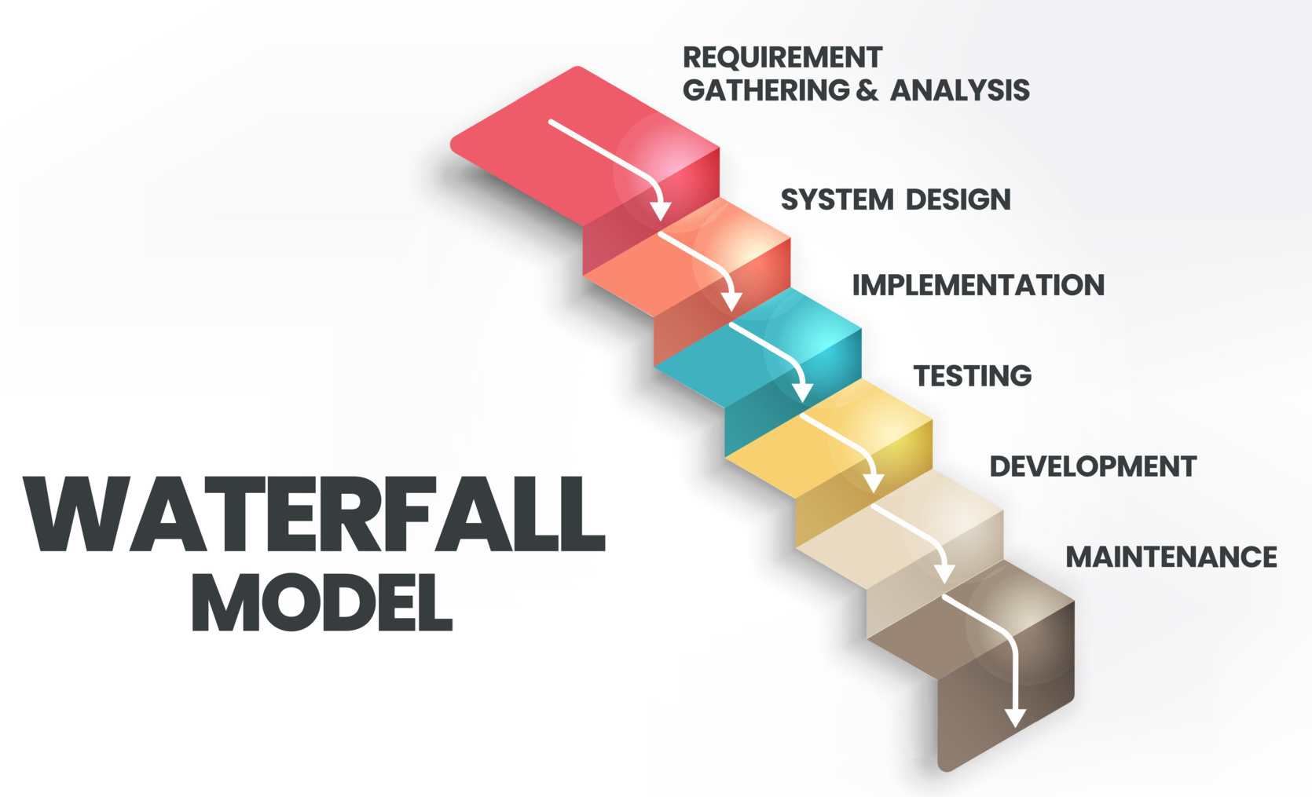
Software Development life cycle
Step-by-Step Process
Organized Method
Easy to Understand
Focus on Documentation

Slide 8
Feasibility Study
Technical Feasibility
Evaluate compatibility with existing hardware and software.
Operational Feasibility
Determine if the system meets user needs and improves efficiency.
Economic Feasibility
Analyze cost-benefit aspects
Legal Feasibility
Ensure compliance with data protection and privacy laws.
Schedule Feasibility
Estimate time required for development, testing, and deployment.

Slide 9
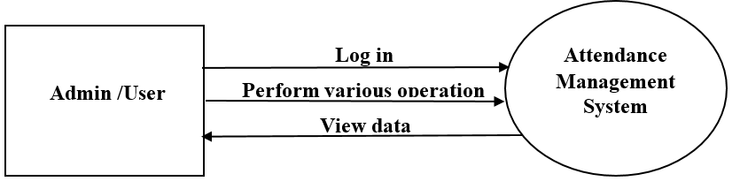
Context Diagram

Slide 10
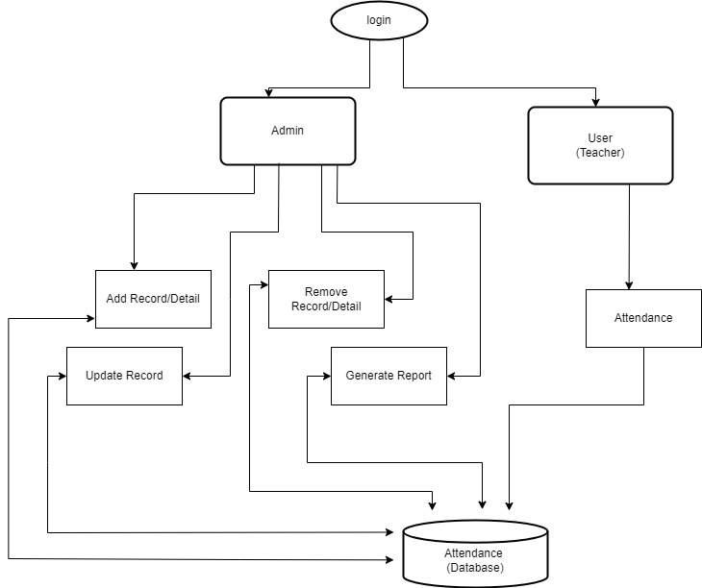
Data Flow Diagram

Slide 11
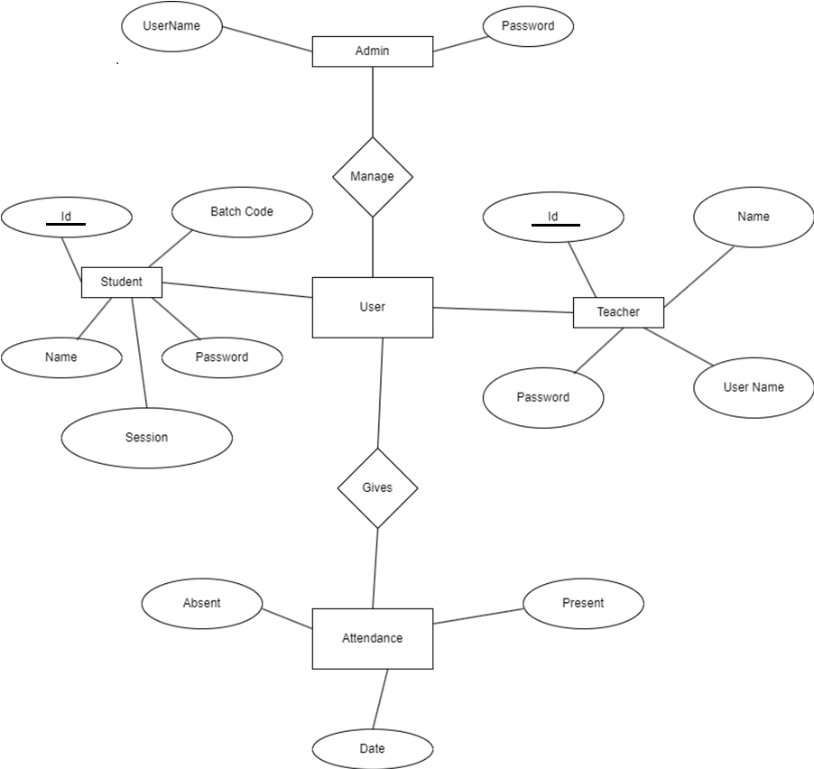
ER Diagram

Slide 12
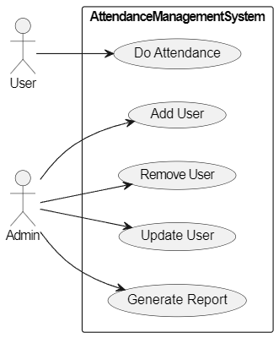
Use Case Diagram

Slide 13
Gantt Chart
S.No | Task | Weeks
 |  | 1 | 2 | 3 | 4 | 5 | 6 | 7 | 8 | 9 | 10 | 11 | 12 | 13 | 14 | 15
1 | Project Study
2 | Planning and research
3 | Requirement analysis
4 | System Design
5 | Frontend development
6 | Backend development
7 | Database implementation
8 | Integration and testing
9 | Documentation

Slide 14
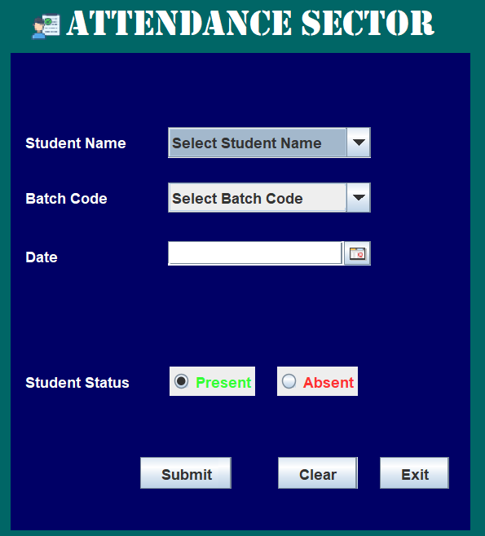
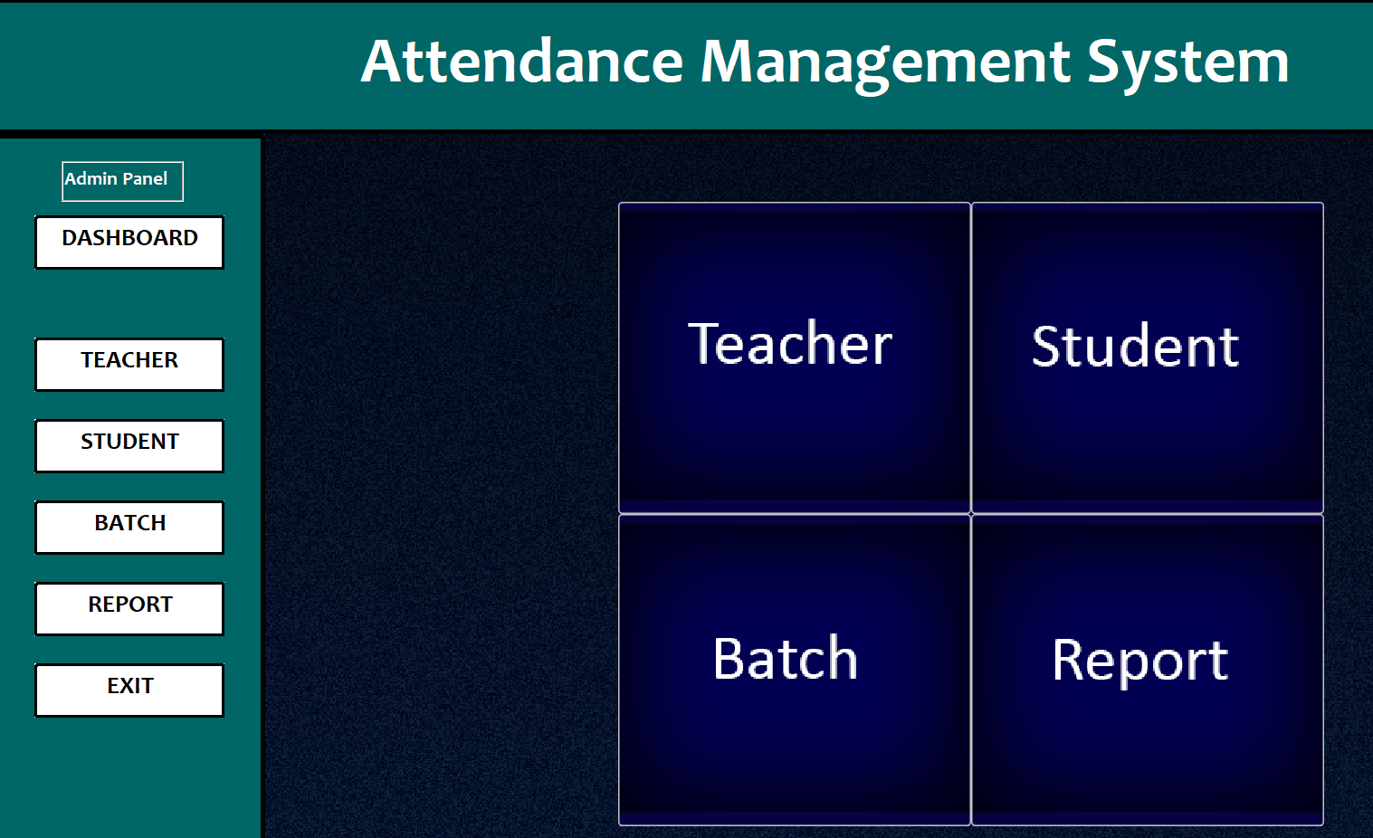
Final Outcome
User(Teacher) Panel
ADMIN Panel

Slide 15
Conclusion
This project will help the lectures to reduce their workload by reducing the time and calculations required to update the attendance manually.

Slide 16
Reference
[1] Ayush Purawr , “Attendance Management System Project in Java with Source Code,”CopyAssignment.com, Nov. 29, 2022. https://copyassignment.com/attendance-management-system-project-in-java/ [Accessed: 2nd march]
[2] Dr. Muhammad Zubair Asghar, “A Web Based Attendance Management System,” Dec.2015.https://www.researchgate.net/publication/303023739_Webbased_Attendance_Management_System [Accessed: 4th march] Dr. Muhammad Zubair Asghar
[3] Tushar Gubani , “An Android Based Attendance Management System,” Feb.2020 https://codecanyon.net/item/employee-attendance-management-system-source code/25551278[Accessed: 10th march]

Slide 17

Thank you So Much

Slide 18
DO YOU HAVE A ANY QUESTIONS
?

