Slide 1
Learning Management System
Team Members:
Sushil Shrestha
Ashish Thami
Sailendra Bhattarai

Slide 2

Introduction
A Learning Management System (LMS) is a software application or web-based platform designed to facilitate the administration, delivery, tracking, and management of educational content and training programs. LMS platforms have become essential tools in modern education and corporate training, enabling organizations to create, distribute, and manage learning experiences efficiently.

Slide 3
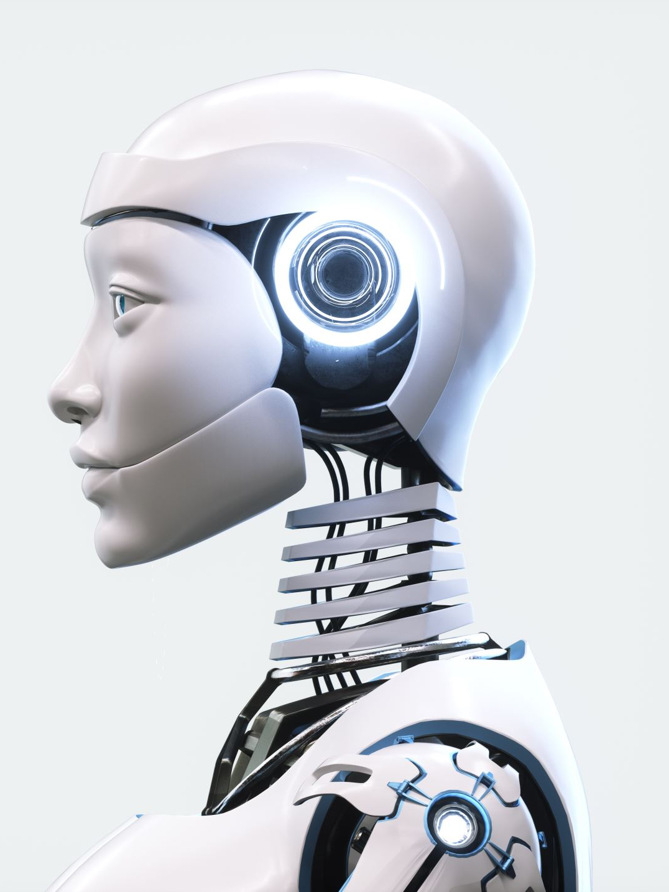
Problem Statement
High Costs: Many platforms charge expensive fees for courses or subscriptions, making them inaccessible to students with limited budgets.
Complex Interfaces: Some platforms are difficult to use, especially for non-technical users like older teachers or beginners.
Limited Customization: Teachers often cannot fully customize their courses to suit their teaching style or the needs of their students.

Slide 4
Objectives
General Objective
To design and develop a Learning Management System (LMS) similar to Udemy using Python Django. The system will provide a platform for teachers to create and manage courses and for students to learn effectively.
Specific Objectives
To build a secure and user-friendly interface for both teachers and students.
To enable teachers to easily upload course materials, such as videos, PDFs, and quizzes.
To allow students to browse courses, enroll in them, and track their progress.
To include interactive features like discussion forums, assignments, and quizzes to keep students engaged.
To ensure the platform is affordable and accessible to a wide range of users.

Slide 5

Scope and Limitations
Scope:
A course library where students can search for and enroll in courses.
Tools for uploading and organizing course materials (videos, documents, quizzes, etc.).
Discussion forums for students and teachers to interact.

Slide 6
Limitations
The platform will not support live classes or video conferencing in the first version.
Advanced analytics, such as detailed reports on student performance, will not be included initially.
Mobile apps will not be developed in this phase
only a responsive website will be available.
The system will target individual learners and small-scale educators, not large institutions or schools.

Slide 7
Feasibility Analysis
A feasibility study is a systematic analysis to determine the practicality and potential success of a proposed project.
Technical Feasibility: Technical feasibility is concerned with the availability of hardware and software required for the development of the system.
Operational Feasibility: Operational feasibility is all about problems that may arise during operations. There are two aspects related with the issue. What is the probability that the solution developed may not be put to use or may not work?

Slide 8
Cont..
Time Feasibility: Time feasibility refers to the assessment of whether a proposed project can be completed within a reasonable timeframe
Cost Feasibility: The cost feasibility analysis for the AI-Powered Knowledge Base (Deep Seek AI Integration) involves evaluating expenses related to development, maintenance, and operational aspects.

Slide 9
Cont…
Legal Feasibility: Legal feasibility entails ensuring compliance with relevant laws and regulations governing data privacy. Specifically, for the AI-Powered Knowledge Base (Deep Seek AI Integration), it involves adherence to data protection laws ensuring proper handling and security of user data

Slide 10
SDLC model
The Software Development Life Cycle (SDLC) is a structured process used to design, develop, and test high-quality software. It ensures that the system meets user requirements, is delivered on time, and operates efficiently. There are several SDLC models available, such as the Waterfall Model , Agile Model , Spiral Model. Each model has its own advantages and is chosen based on the project's complexity, timeline, and requirements.

Slide 11
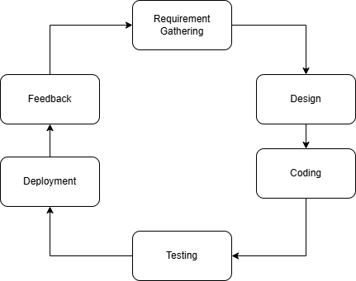
Selected Model (Agile Model)

Slide 12
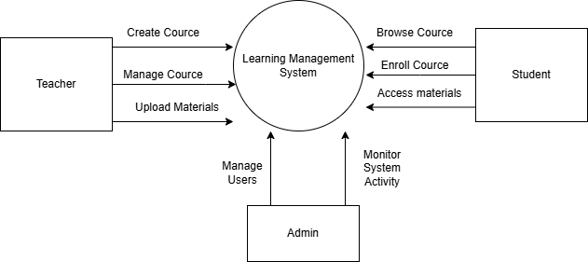
Context diagram
A context diagram is a high-level visual representation that illustrates the scope and boundaries of a system or process within its environment.

Slide 13
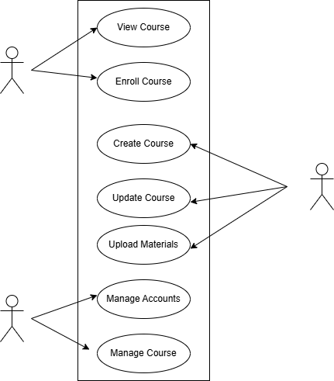
Use Case Diagram
A Use Case Diagram is a type of behavioral diagram in Unified Modelling Language (UML) that illustrates the interactions between actors (users or external systems) and a system to accomplish specific goals or tasks
.

Slide 14
Gantt Chart
We have outlined the timeline for the implementation of project below using a Gantt chart. This chart illustrates the major tasks, their dependencies and the estimated duration for each task.

Slide 15

Final System Expectation
The primary goal of this project is to develop a robust and user-friendly Learning Management System (LMS) inspired by platforms like Udemy, using Python Django. The expected outcome of the system is to provide a seamless experience for both instructors and students while addressing the limitations of existing platforms.

Slide 16
Conclusion
The development of this Learning Management System (LMS) using Python Django has been a rewarding and insightful journey. The project aimed to address the limitations of existing online learning platforms by creating a user-friendly, affordable, and feature-rich system for both instructors and students.

Slide 17

Thank You

