Slide 1
Welcome Back! Let's Get Started. Lecture: 2
Sushil Shrestha

Slide 2
Lecture: 2 ‘Introduction of String’, “Indexing and Slicing” ””” .String_method()”””
Sushil Shrestha

Slide 3
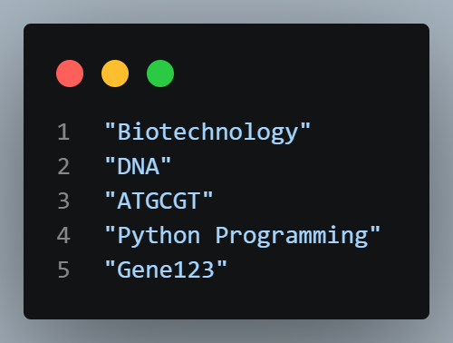
Strings
A string is a sequence of characters enclosed in quotation marks.
A string can contain:
Letters
Numbers
Symbols
Spaces

Slide 4
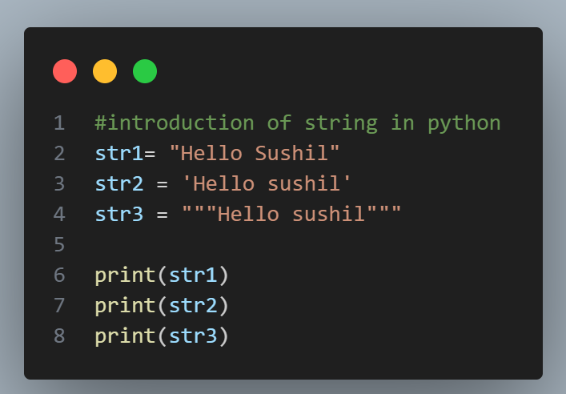
Strings

Slide 5
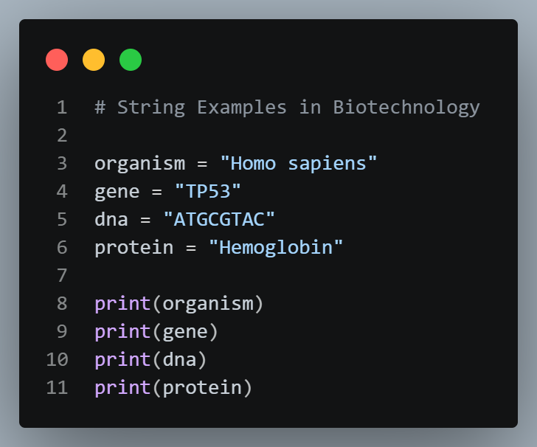
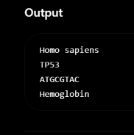
Strings Example

Slide 6
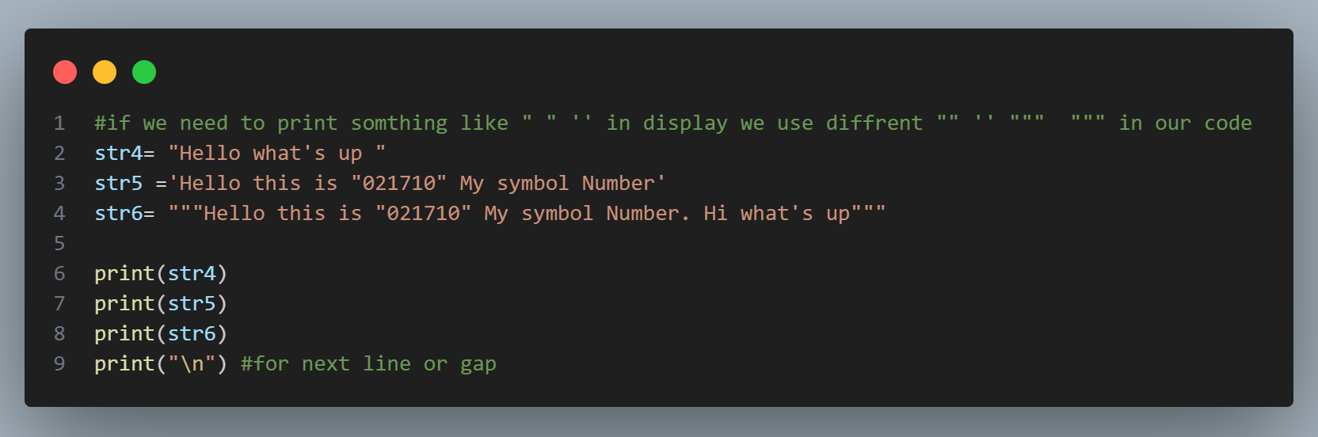
Strings

Slide 7
Strings
String is data type that stores a sequence of characters.
Basic Operations
concatenation
“hello” + “world”
“helloworld”
length of str
len(str)

Slide 8
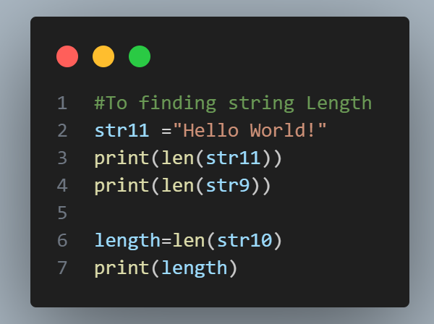
Strings

Slide 9
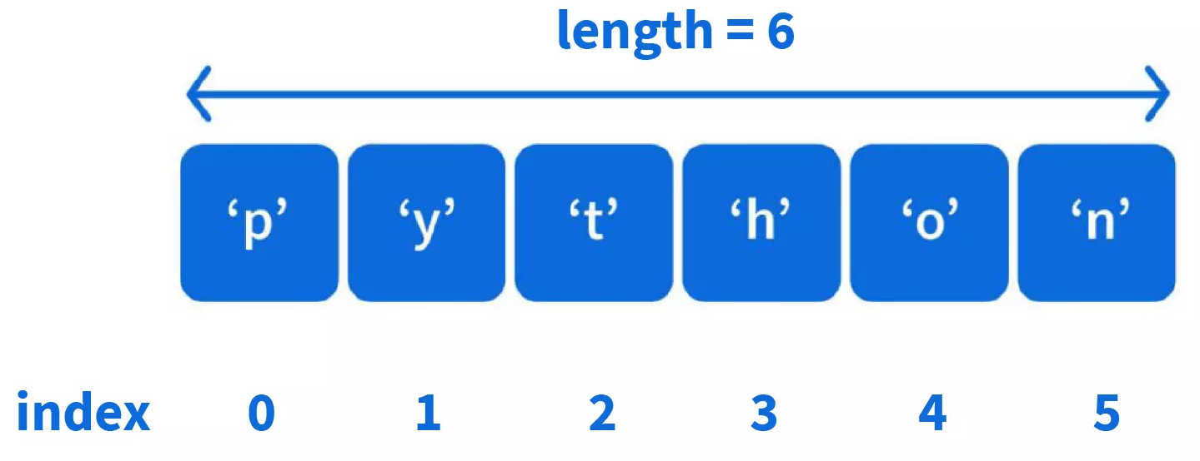
Indexing
S u s h ii l _S h r e s t h a
0 1 2 3 4 5 6 7 8 9 10 11 12 13 14
str = “Sushil_Shrestha” str[0] is ‘S’, str[1] is ‘U’ ... str[0] = ‘B’ #not allowed

Slide 10
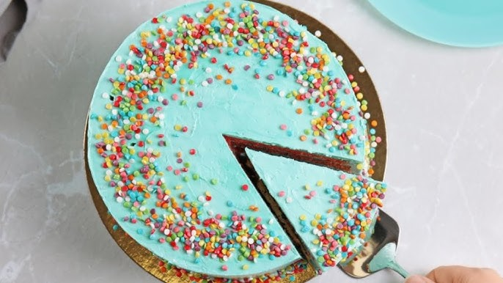
Slicing
Accessing parts of a string
str[ starting_idx : ending_idx ] #ending idx is not included
str = “Sushilshrestha” str[ 1 : 4 ] is “ush”
str[ : 4 ] is same as str[ 0 : 4]
str[ 1 : ] is same as str[ 1 : len(str) ]

Slide 11
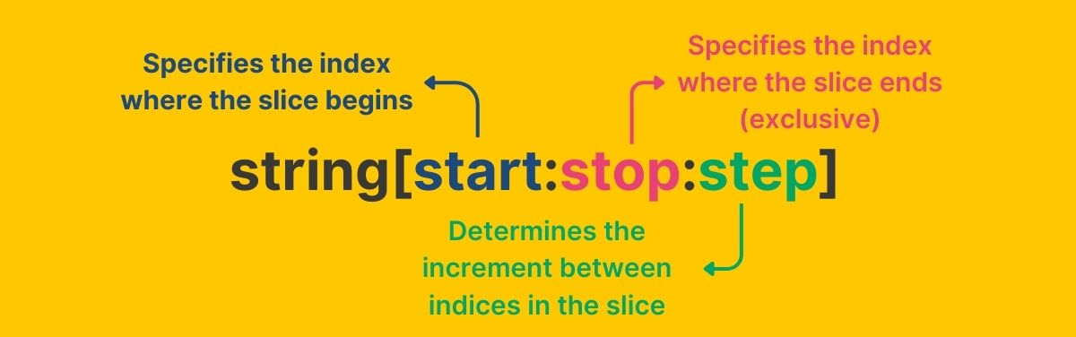
Slicing

Slide 12
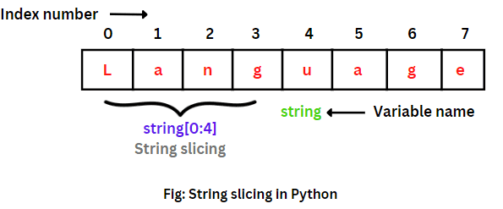
Slicing

Slide 13
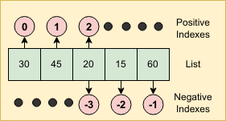
Slicing
Negative Index
A p p l e
-5 -4 -3 -2 -1
str = “Apple”
str[ -3 : -1 ] is “pl”

Slide 14
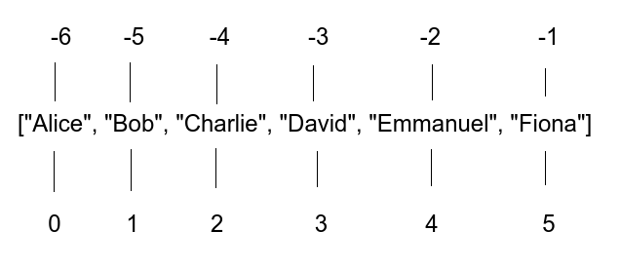
Slicing

Slide 15
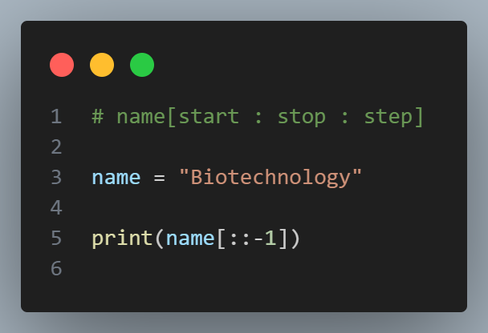

Slicing

Slide 16
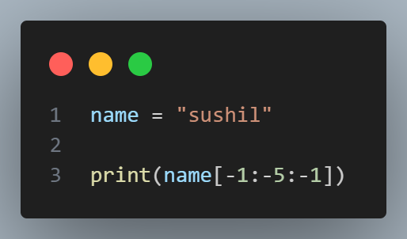

Slicing

Slide 17
String Functions
str = “I am a coder.”
str.endsWith(“er.“) #returns true if string ends with substr
str.capitalize( ) #capitalizes 1st char
str.replace( old, new ) #replaces all occurrences of old with new str.find( word ) #returns 1st index of 1st occurrence str.count(“am“) #counts the occurrence of substr in string

Slide 18
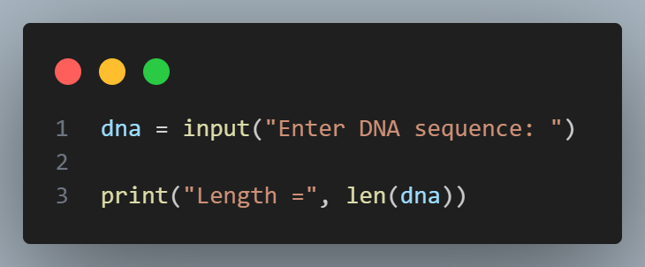
Let‘s Practice
WAP to input a DNA sequence and print its length.

Slide 19
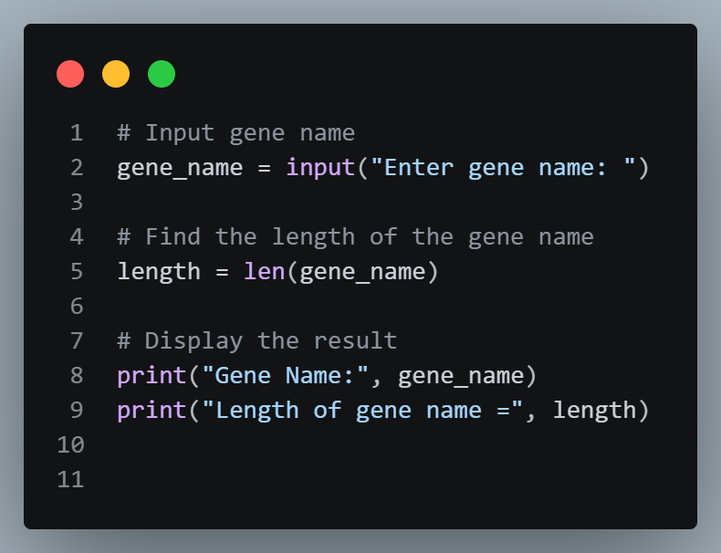
Let‘s Practice
WAP to Input a Gene Name and Find Its Length
# Example Output Enter gene name: BRCA1 Length of gene name = 5
Concept: String, len()

Slide 20
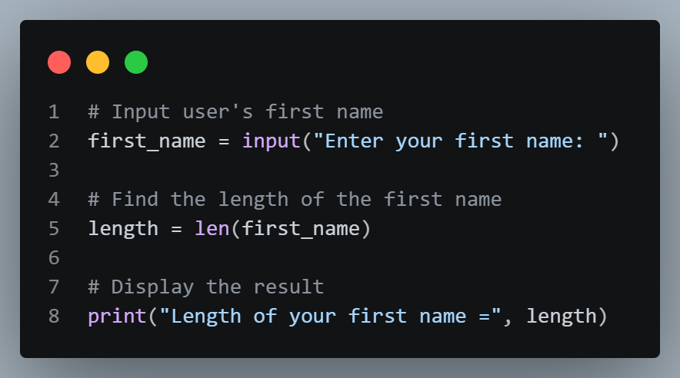
Let‘s Practice
WAP to input user’s first name & print its length.

Slide 21
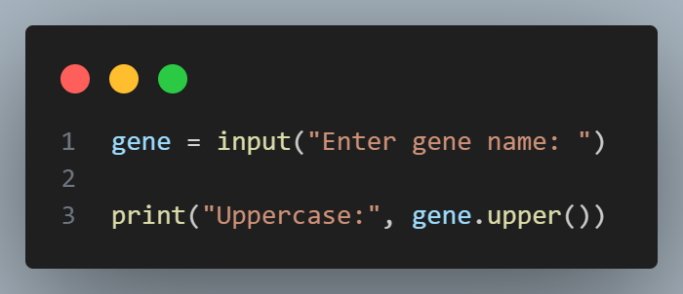
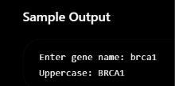
Let‘s Practice
upper()
WAP to input a gene name and convert it to uppercase.

Slide 22
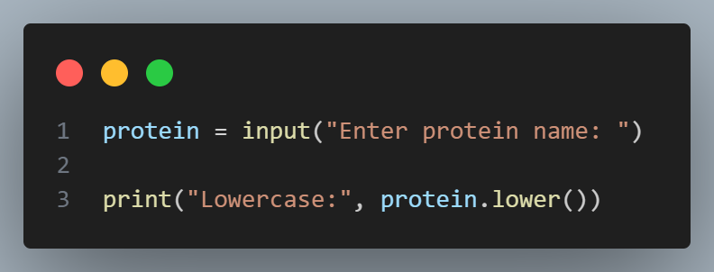
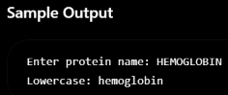
Let‘s Practice
lower()
WAP to input a protein name and convert it to lowercase.

Slide 23
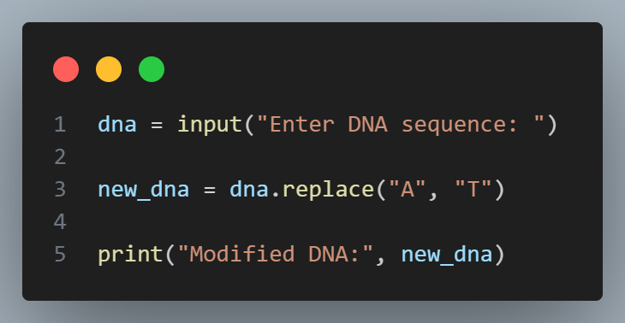
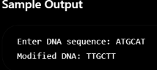
Let‘s Practice
replace()
WAP to input a DNA sequence and replace all occurrences of 'A' with 'T'.

Slide 24
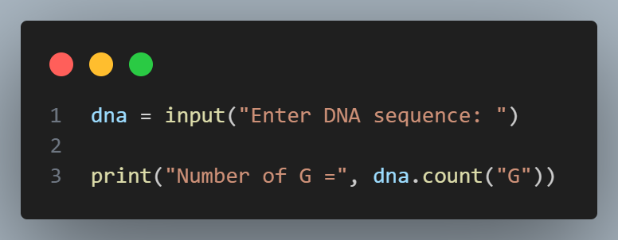
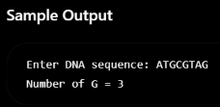
Let‘s Practice
count()
WAP to input a DNA sequence and count the number of 'G' nucleotides.

Slide 25
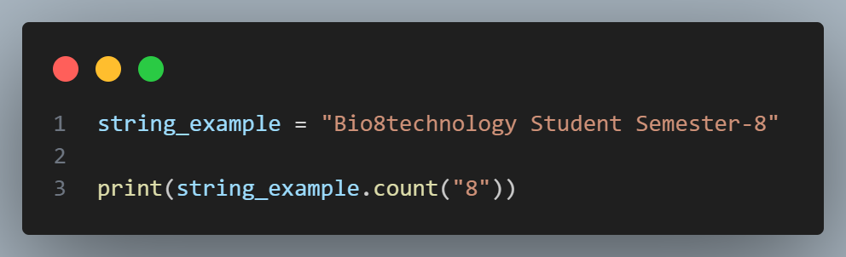
Let‘s Practice
WAP to find the occurrence of ‘8’ in a String.

Slide 26
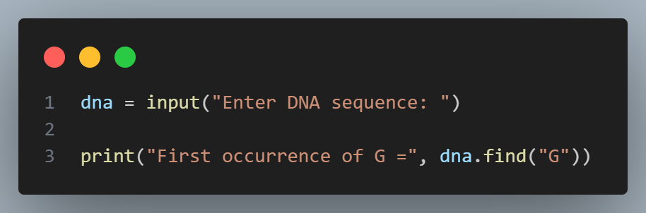
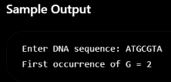
Let‘s Practice
find()
WAP to input a DNA sequence and find the first occurrence of 'G'.

Slide 27
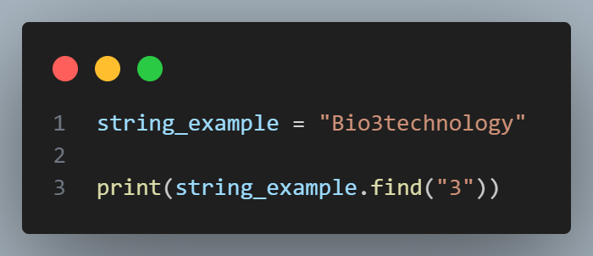
Let‘s Practice
find the first position (index) of '3'

Slide 28
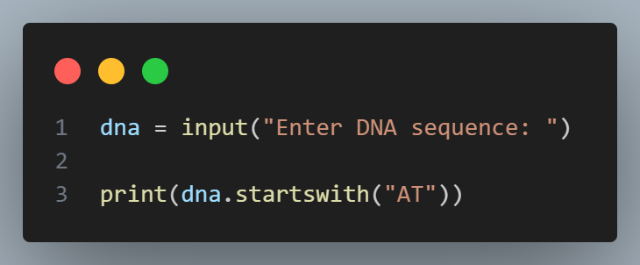
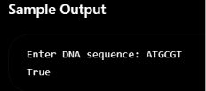
Let‘s Practice
startswith()
WAP to input a DNA sequence and check whether it starts with 'AT'.

Slide 29

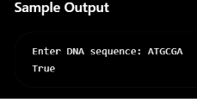
Let‘s Practice
endswith()
WAP to input a DNA sequence and check whether it ends with 'GA'.

Slide 30
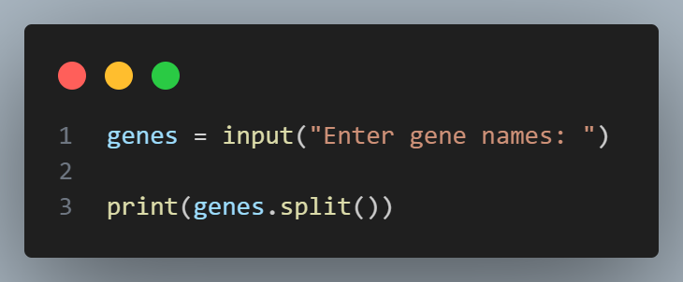
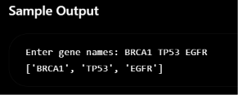
Let‘s Practice
split()
WAP to input three gene names separated by spaces and split them into a list.

Slide 31
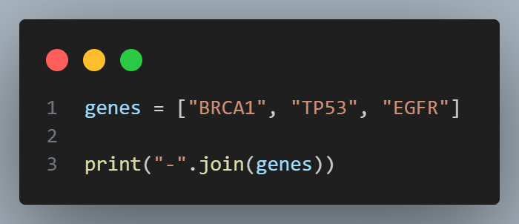
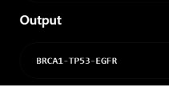
Let‘s Practice
join()
WAP to join the following gene names using a hyphen (-).

Slide 32
Conditional Statements
if-elif-else (SYNTAX)
if(condition) :
Statement1 elif(condition):
Statement2 else:
StatementN

Slide 33
Let‘s Practice
WAP to check User Can eligible for vote or Not

Slide 34
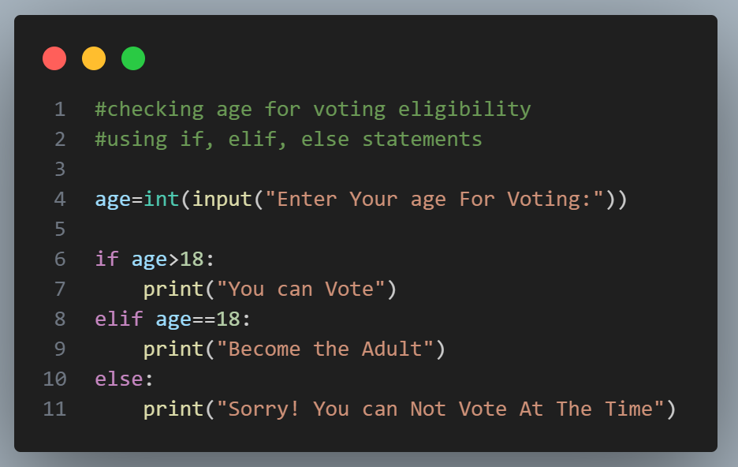

Slide 35
Let‘s Practice
WAP to check if a number entered by the user is odd or even.

Slide 36
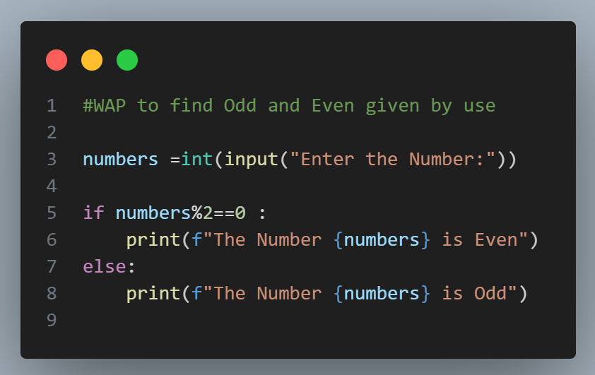

Slide 37
Let‘s Practice
WAP to find the greatest of 3 numbers entered by the user.

Slide 38
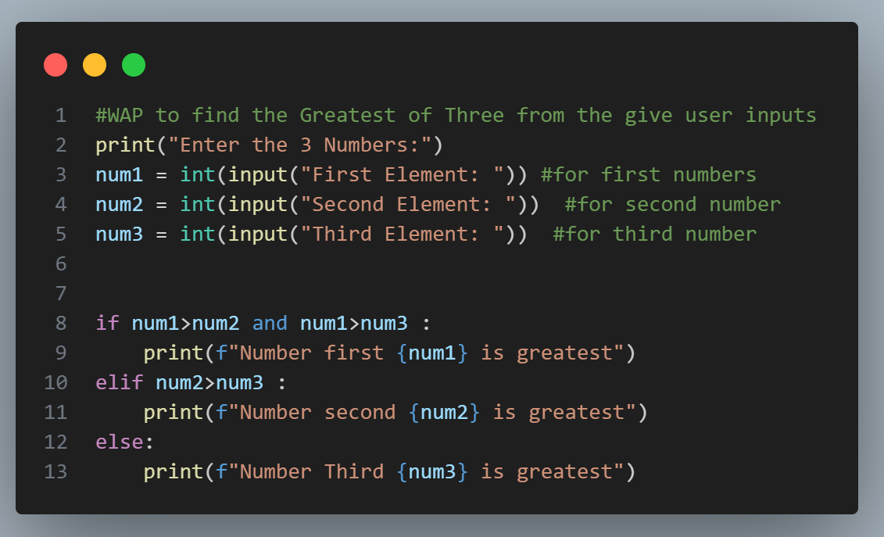

Slide 39
Let‘s Practice
WAP to check if a number is a multiple of 7 or not.

Slide 40
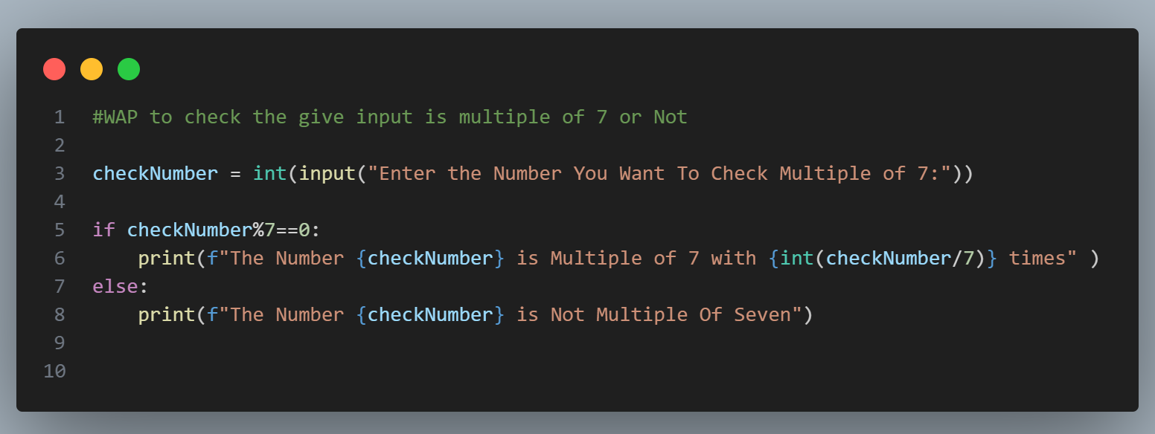

Slide 41
Let‘s Practice
WAP to check Today is Holiday or Not.

Slide 42
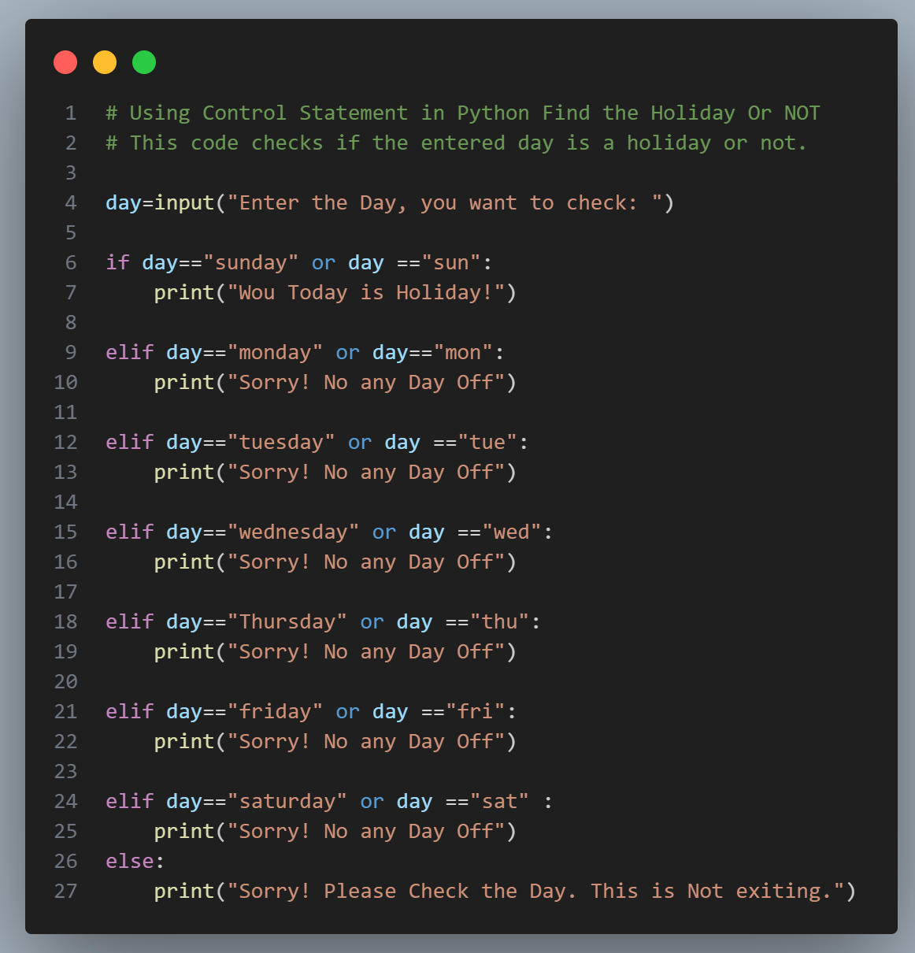

Slide 43
Let‘s Practice
WAP to check the Result of the Student and also show the obtain Grade.
e.g.
marks >= 90, grade = “A”
90 > marks >= 80, grade = “B”
80 > marks >= 70, grade = “C” 70 > marks, grade = “D”

Slide 44
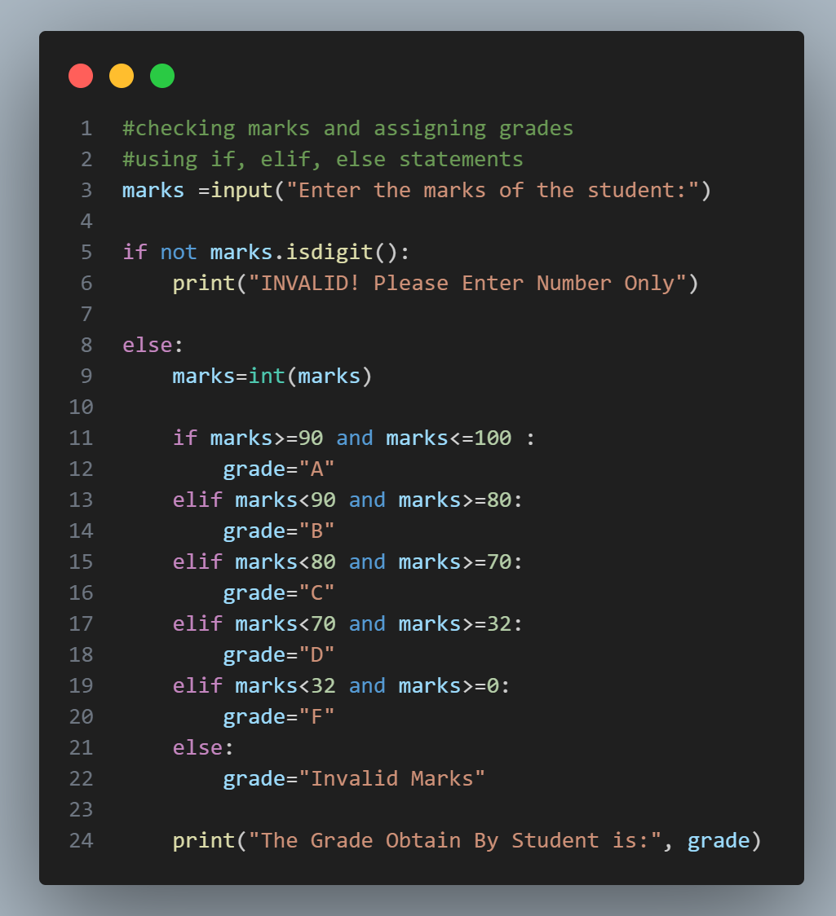

Slide 45
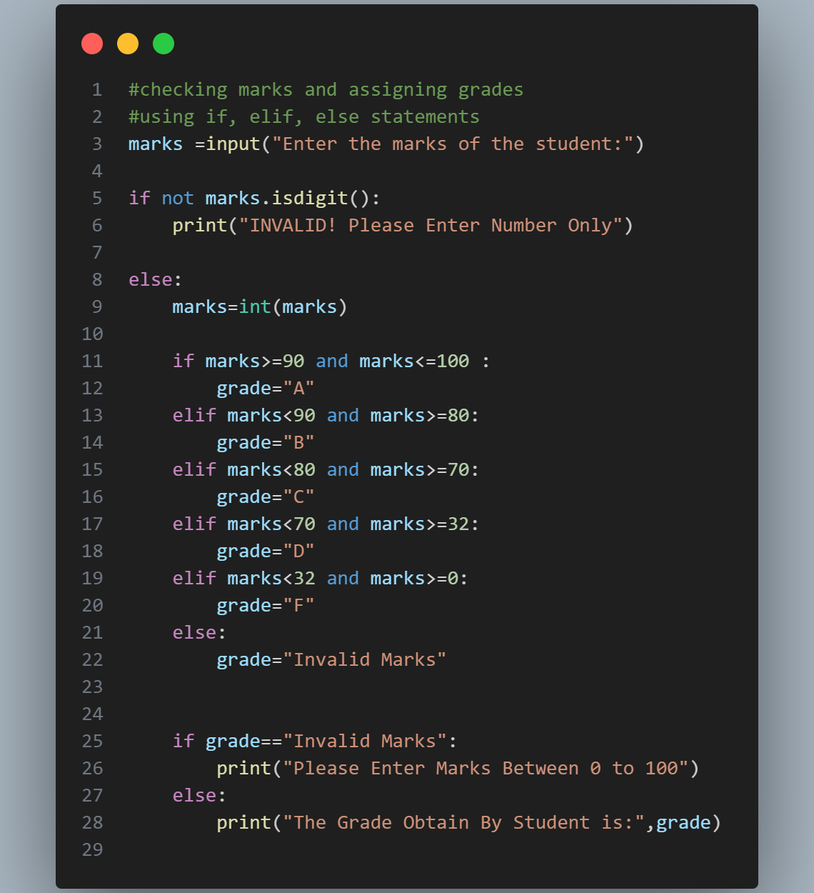

Slide 46
Thank You So Much

