Slide 1
Lecture: 6 Loop In Python While Loop, For Loop
Sushil Shrestha

Slide 2
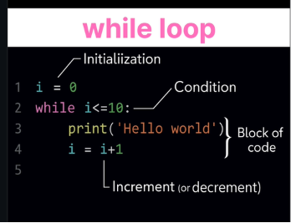
Loops in Python
Loops are used to repeat instructions.
while Loops

Slide 3
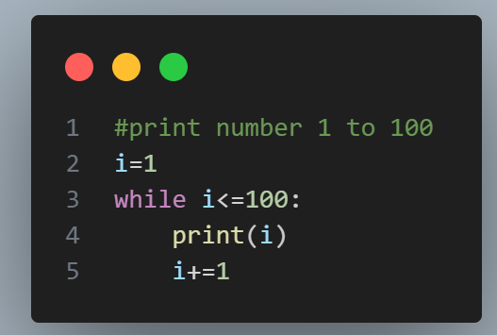
Loops in Python
while Loops
while condition : #some work

Slide 4
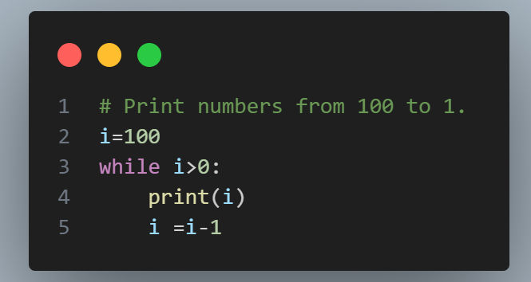
Let‘s Practice
Print numbers from 100 to 1.

Slide 5
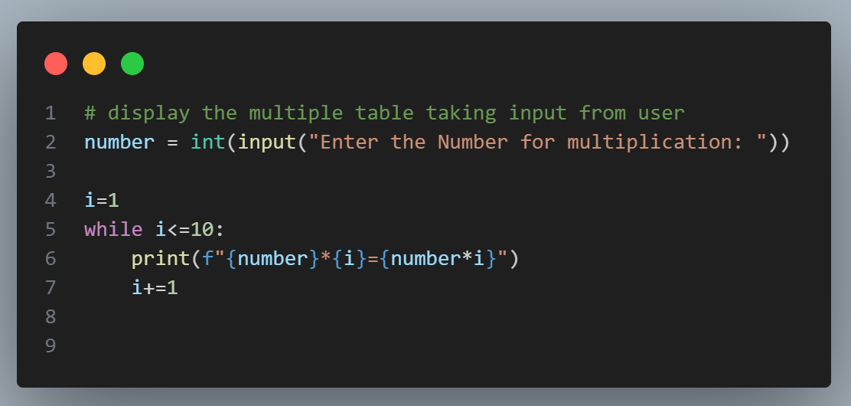
Let‘s Practice
Print the multiplication table of a number n.

Slide 6
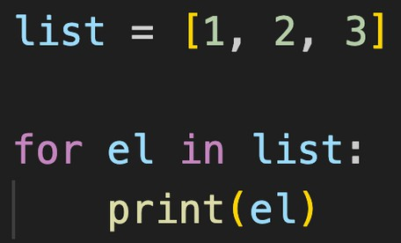
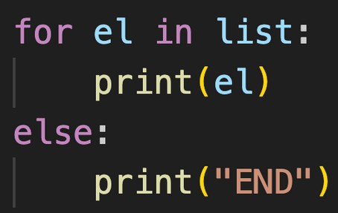
Loops in Python
Loops are used for sequential traversal. For traversing list, string, tuples etc.
for Loops for el in list:
#some work
for Loop with else
for el in list: #some work
else:
#work when loop ends
else used as it doesn’t execute when break is used

Slide 7
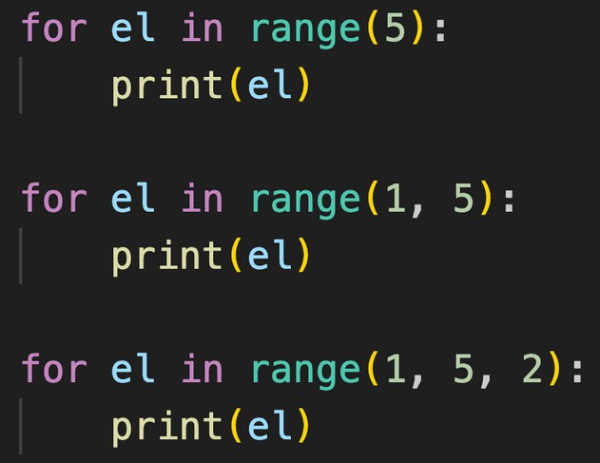
range( )
Range functions returns a sequence of numbers, starting from 0 by default, and increments by 1 (by default), and stops before a specified number.
range( start?, stop, step?)

Slide 8
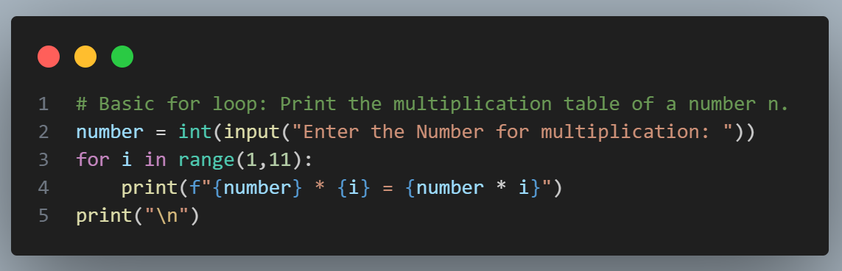
Let‘s Practice
using for & range( )
Print the multiplication table of a number n.

Slide 9
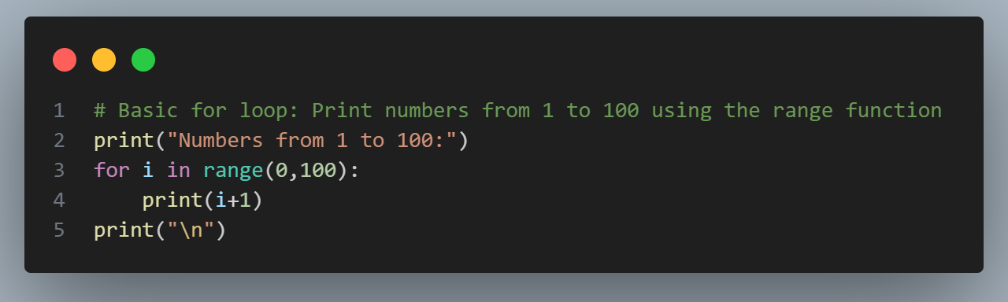
Let‘s Practice
using for & range( )
Print numbers from 1 to 100.

Slide 10
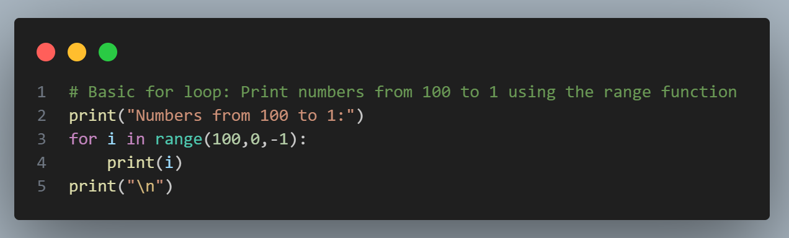
Let‘s Practice
using for & range( )
Print numbers from 100 to 1.

Slide 11
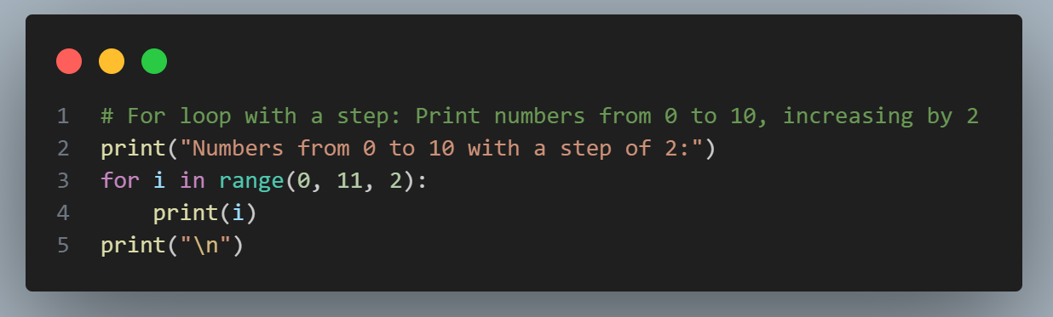
Let‘s Practice
WAP to Print numbers from 0 to 10, increasing by 2

Slide 12
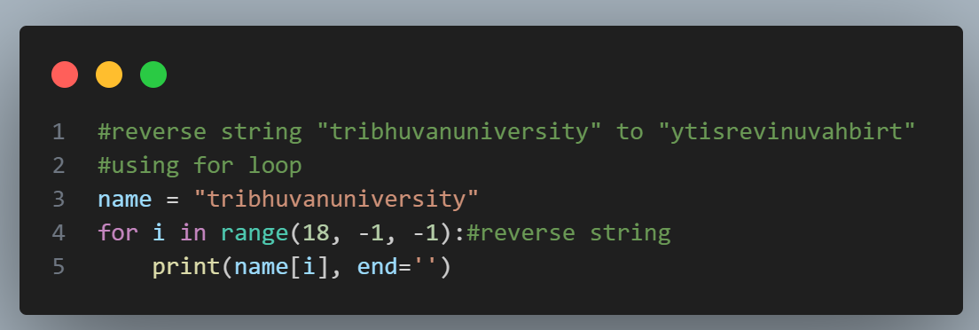
Let‘s Practice
WAP reverse string "tribhuvanuniversity" to "ytisrevinuvahbirt“ using for loop

Slide 13
Thank You So Much

