Slide 1


Introduction of Jupyter
Sushil Shrestha

Slide 2


Slide 3
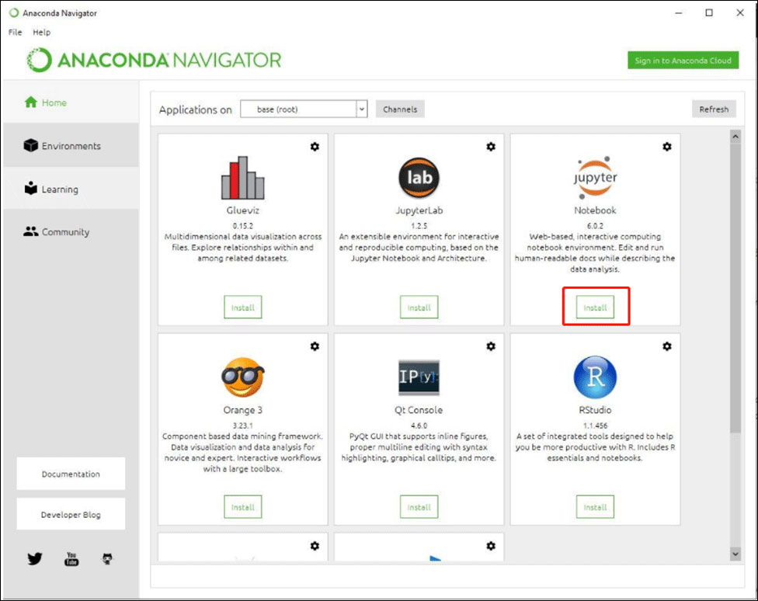

Slide 4
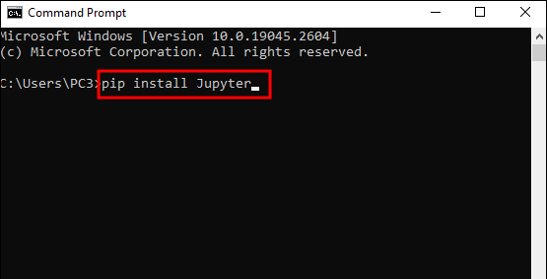
Installing Jupyter on Your Device

Slide 5
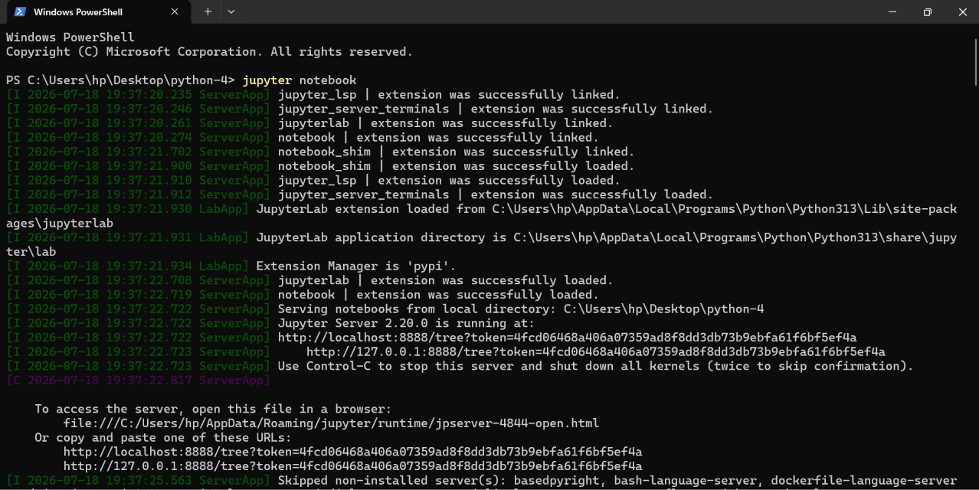
Run Jupyter Notebook

Slide 6
Thank You So Much

