Slide 1
Lecture: 5 Data Structures or Data Types In Python [list],(tuple),{dict: dictionary},{set}
Sushil Shrestha

Slide 2
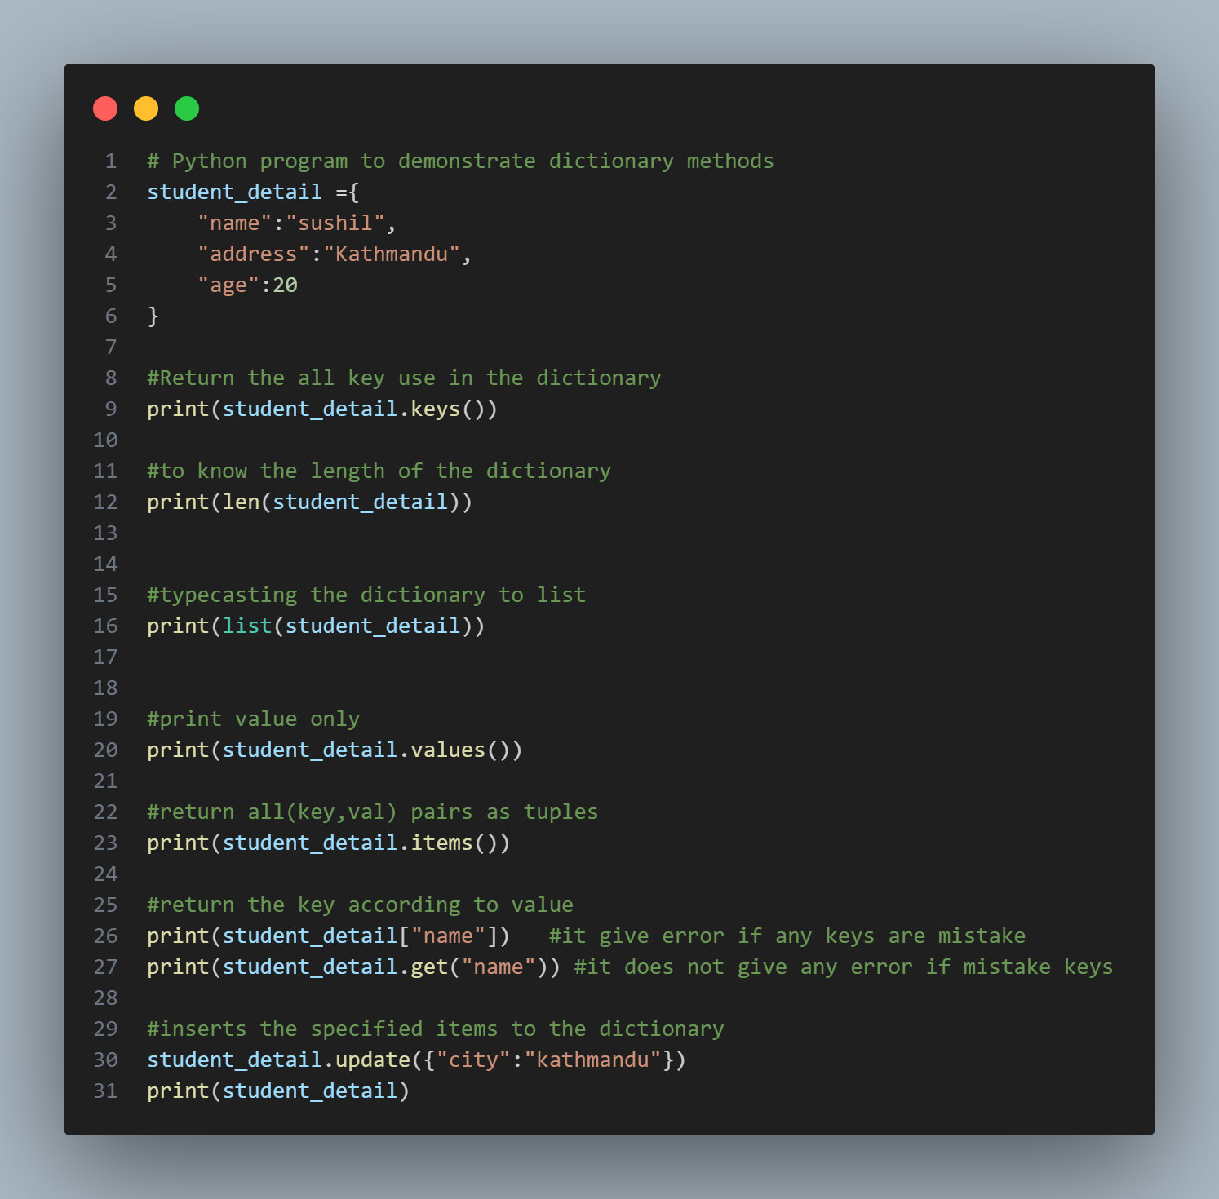
Dictionary in Python
Dictionaries are used to store data values in key:value pairs
They are ordered, mutable(changeable) & don’t allow duplicate keys
“key” : value

Slide 3
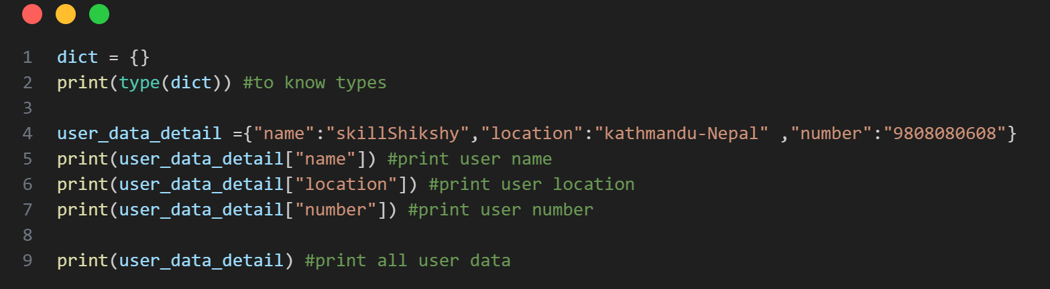

Slide 4
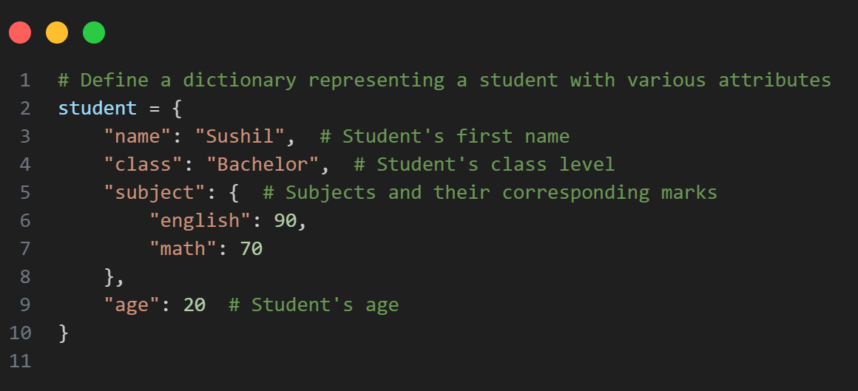
Dictionary in Python
Nested Dictionaries

Slide 5
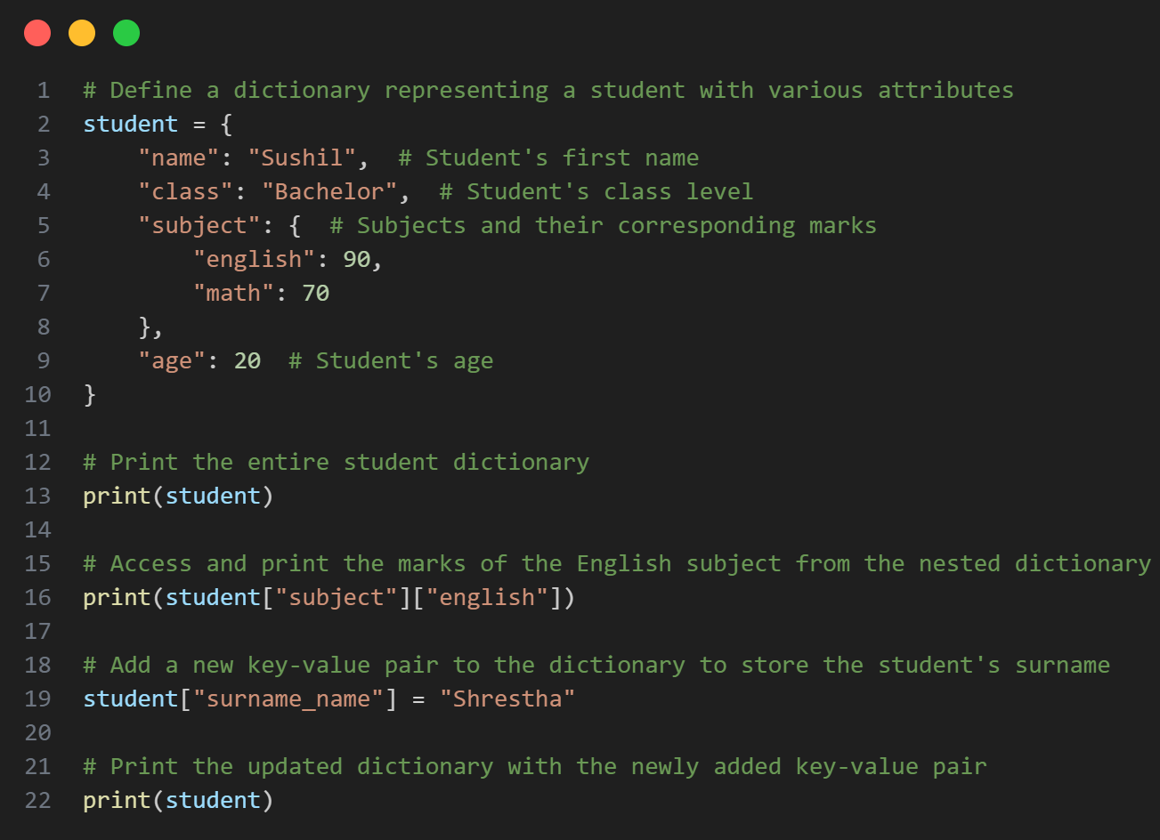

Slide 6
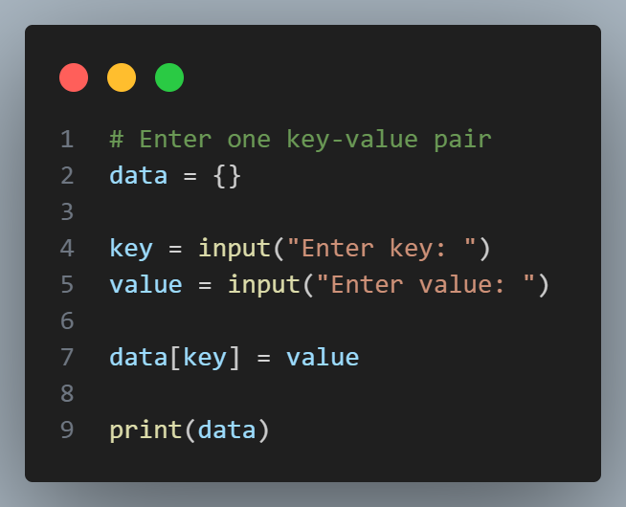

Slide 7
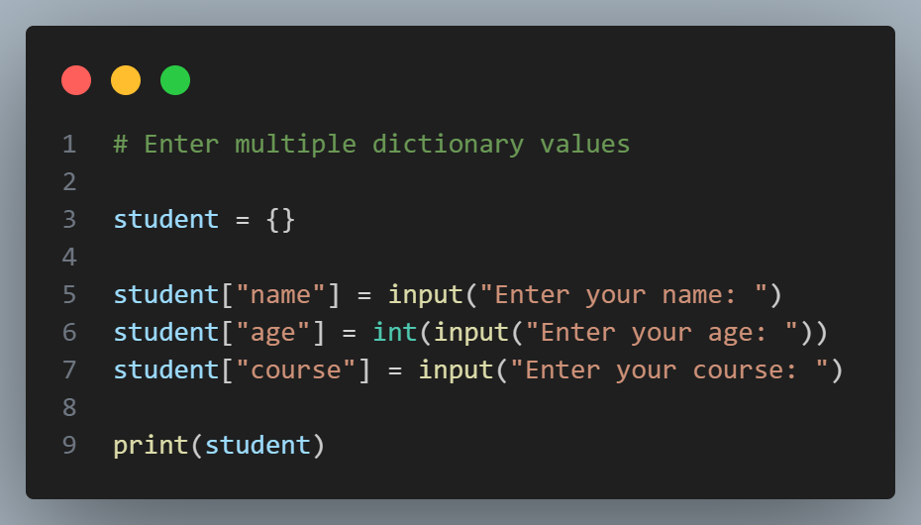

Slide 8
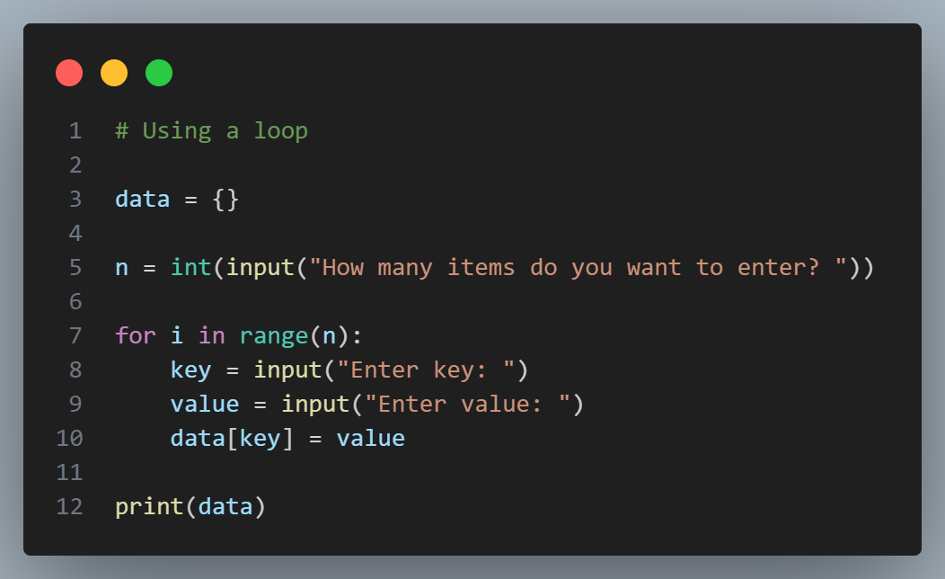

Slide 9
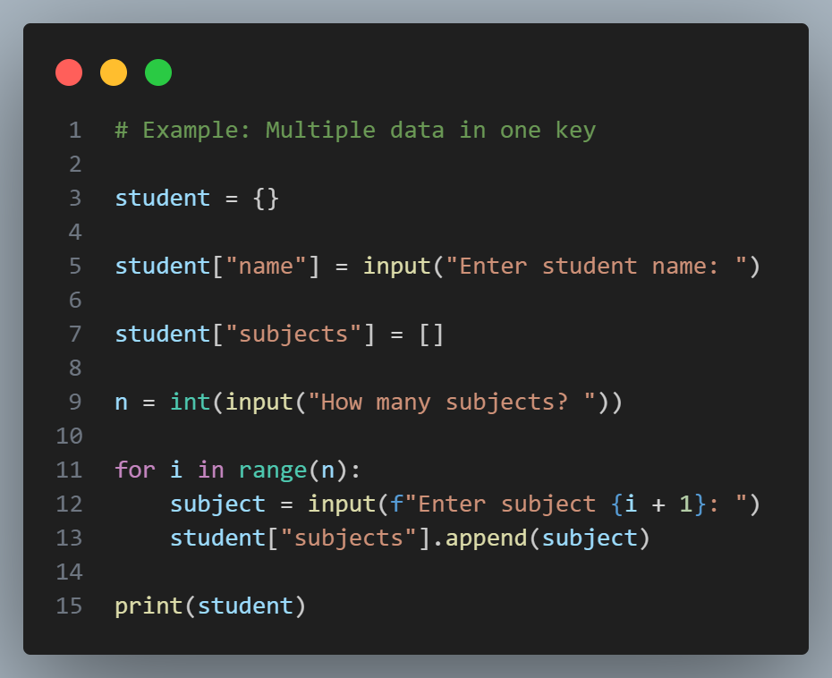

Slide 10
Dictionary Methods
myDict.keys( ) #returns all keys
myDict.values( ) #returns all values
myDict.items( ) #returns all (key, val) pairs as tuples myDict.get( “key““ ) #returns the key according to value
myDict.update( newDict ) #inserts the specified items to the dictionary

Slide 11
Dictionary Methods

Slide 12
Set in Python
Set is the collection of the unordered items.
Each element in the set must be unique & immutable.
nums = { 1, 2, 3, 4 }
set2 = { 1, 2, 2, 2 }
#repeated elements stored only once, so it resolved to {1, 2}
null_set = set( )
#empty set syntax

Slide 13
Set Methods
set.add( el ) #adds an element
set.remove( el ) #removes the elem an set.clear( ) #empties the set
set.pop( ) #removes a random value

Slide 14
Set Methods
set.union( set2 ) #combines both set values & returns new
set.intersection( set2 ) #combines common values & returns new

Slide 15
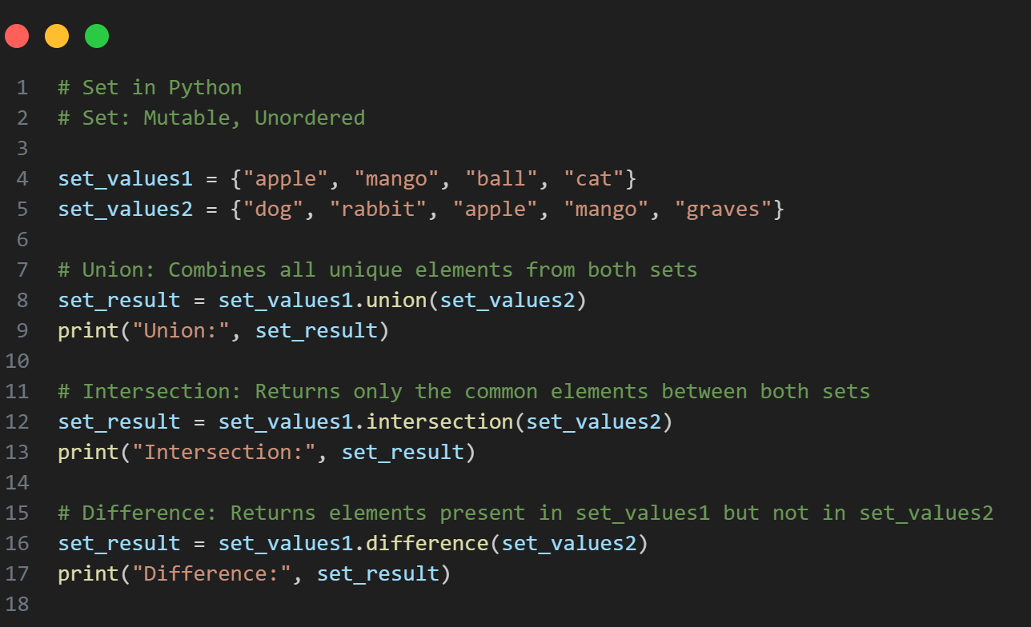
Set Methods

Slide 16
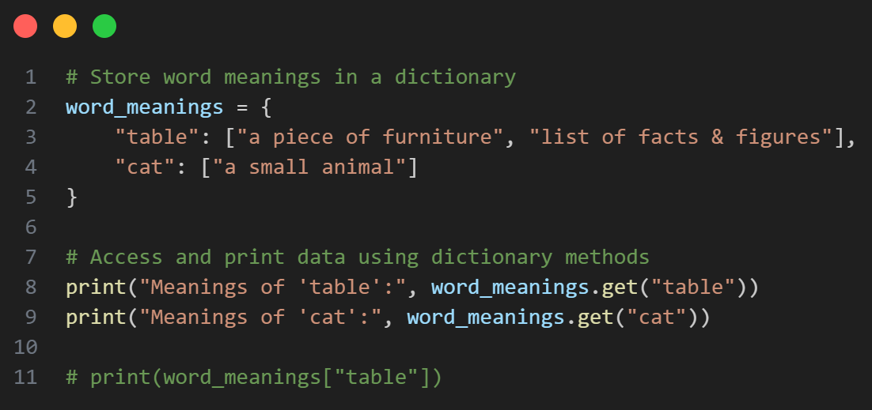
Let‘s Practice
Store following word meanings in a python dictionary :
table : “a piece of furniture”, “list of facts & figures” cat : “a small animal”

Slide 17
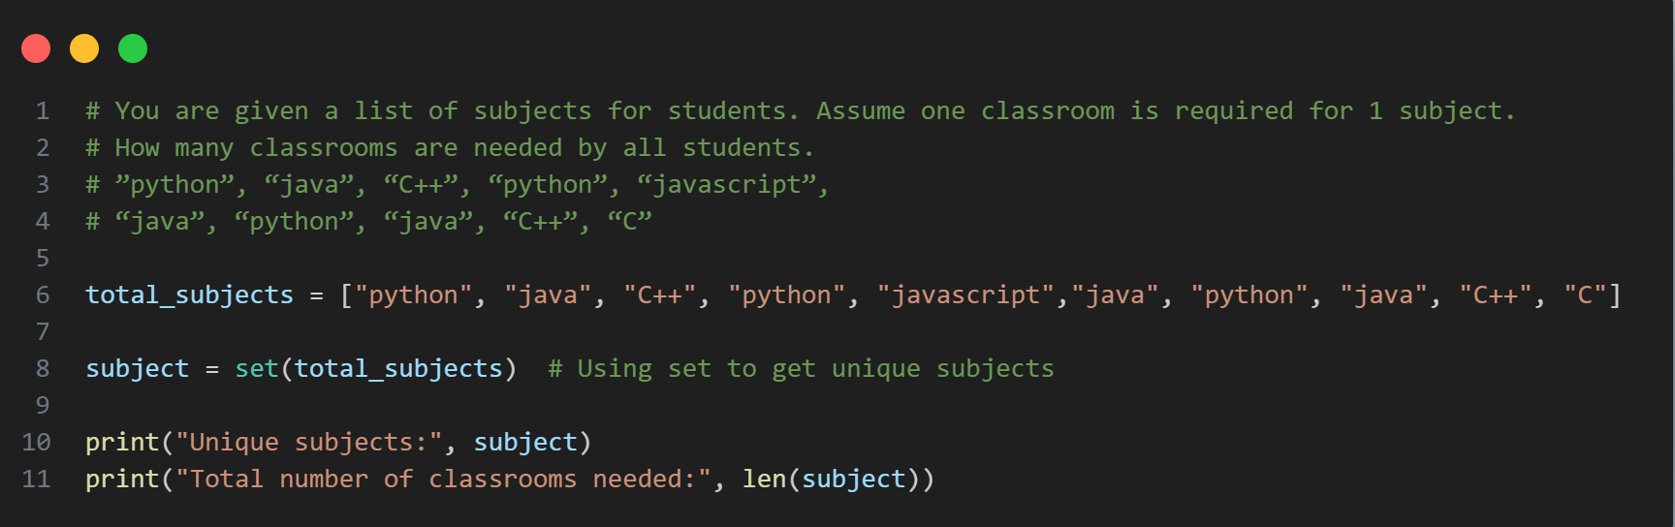
Let‘s Practice
You are given a list of subjects for students. Assume one classroom is required for 1 subject. How many classrooms are needed by all students.
”python”, “java”, “C++”, “python”, “javascript”,
“java”, “python”, “java”, “C++”, “C”

Slide 18
Let‘s Practice
WAP to enter marks of 3 subjects from the user and store them in a dictionary. Start with an empty dictionary & add one by one. Use subject name as key & marks as value.

Slide 19
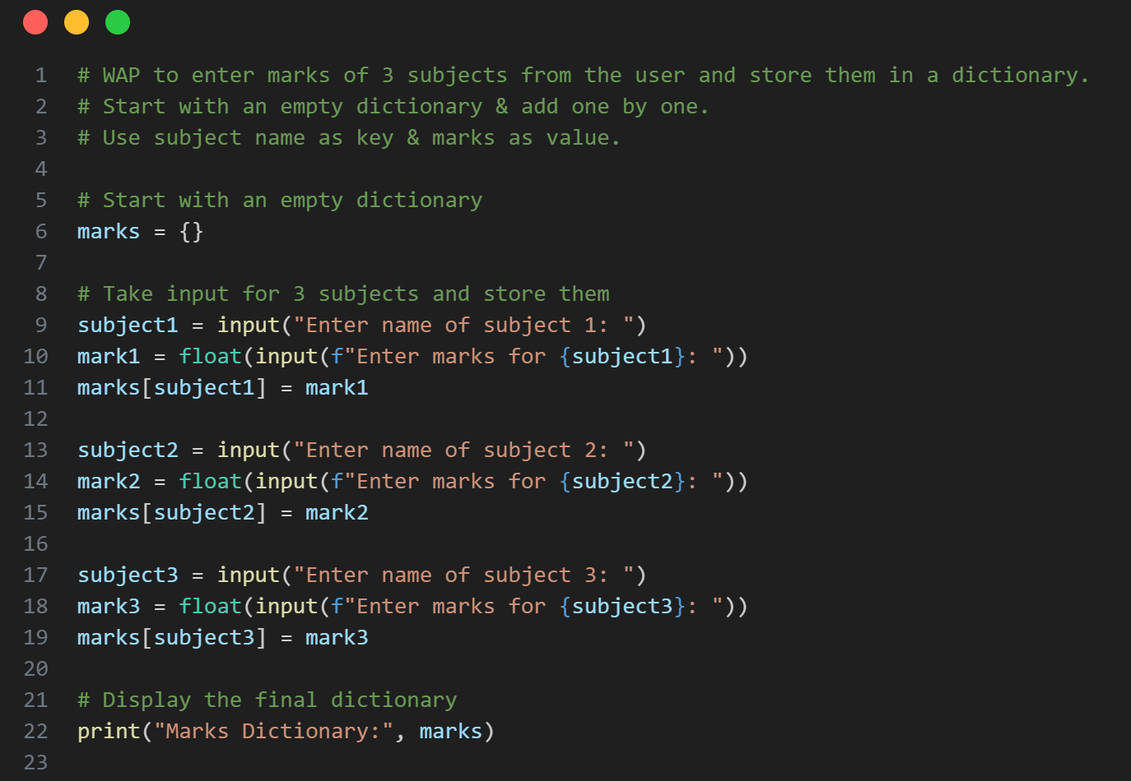

Slide 20
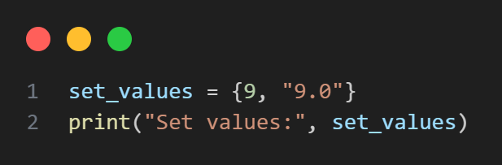
Let‘s Practice
Figure out a way to store 9 & 9.0 as separate values in the set. (You can take help of built-in data types)

Slide 21
Thank You So Much

