Slide 1
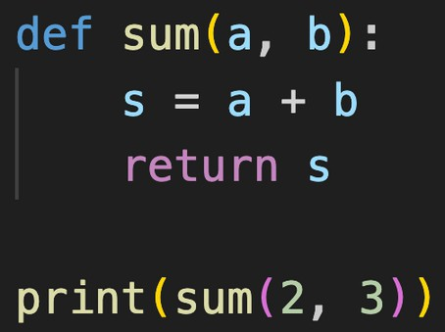
Functions in Python
Block of statements that perform a specific task.
def func_name( param1, param2..) : #some work
return val
Function Definition
func_name( arg1, arg2 ..) #function call

Slide 2
Functions in Python
Built-in Functions
print( ) len( )
User defined Functions
type( )
range( )

Slide 3
Default Parameters
Assigning a default value to parameter, which is used when no argument is passed.

Slide 4
Let‘s Practice
WAF to print the length of a list. ( list is the parameter)
WAF to print the elements of a list in a single line. ( list is the parameter)
WAF to find the factorial of n. (n is the parameter)
WAF to convert USD to INR.

Slide 5
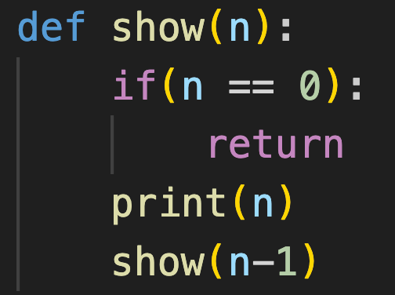
Recursion
When a function calls itself repeatedly.
#prints n to 1 backwards
Base case

Slide 6
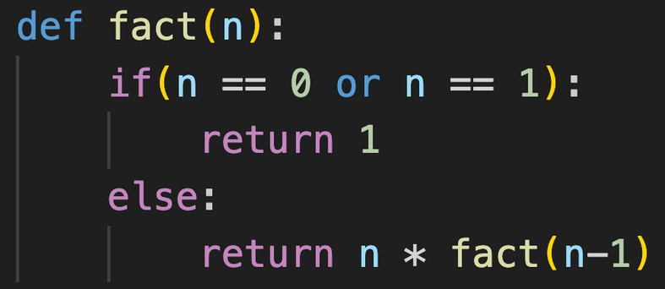
Recursion
#returns n!

Slide 7
Let‘s Practice
Write a recursive function to calculate the sum of first n natural numbers.
Write a recursive function to print all elements in a list. Hint : use list & index as parameters.

