Slide 1
Loops in Python
Loops are used to repeat instructions.
while Loops
while condition : #some work
print hello 5 times
print numbers from 1 to 5
show infinite, iterator

Slide 2
Let‘s Practice
Print numbers from 1 to 100.
Print numbers from 100 to 1.
Print the multiplication table of a number n.
Print the elements of the following list using a loop:
[1, 4, 9, 16, 25, 36, 49, 64, 81,100]
Search for a number x in this tuple using loop:
[1, 4, 9, 16, 25, 36, 49, 64, 81,100]

Slide 3
Break & Continue
Break : used to terminate the loop when encountered.
Continue : terminates execution in the current iteration & continues execution of the loop with the next iteration.
take search example
& stop the search when found
print all numbers but not multiple of 3

Slide 4
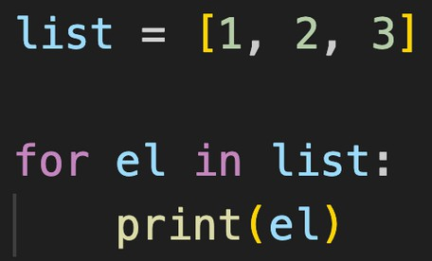
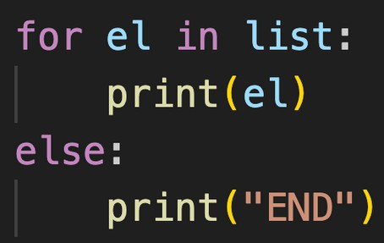
Loops in Python
Loops are used used for sequential traversal. For traversing list, string, tuples etc.
for Loops for el in list:
#some work
for Loop with else
for el in list: #some work
else:
#work when loop ends
else used as it doesn’t execute when break is used

Slide 5
Let‘s Practice
using for
Print the elements of the following list using a loop:
[1, 4, 9, 16, 25, 36, 49, 64, 81,100]
Search for a number x in this tuple using loop:
[1, 4, 9, 16, 25, 36, 49, 64, 81,100]

Slide 6
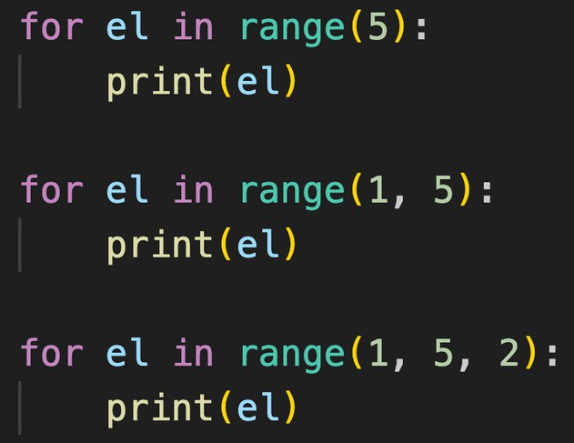
range( )
Range functions returns a sequence of numbers, starting from 0 by default, and increments by 1 (by default), and stops before a specified number.
range( start?, stop, step?)

Slide 7
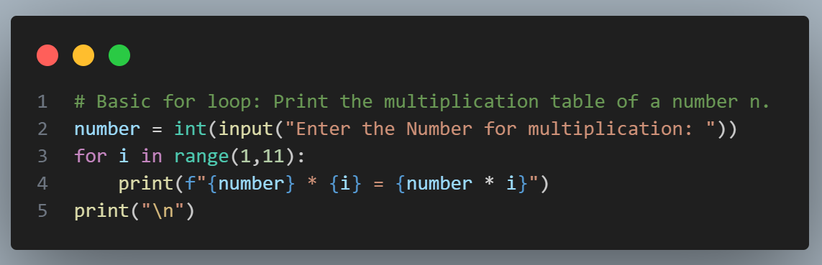
Let‘s Practice
using for & range( )
Print the multiplication table of a number n.

Slide 8
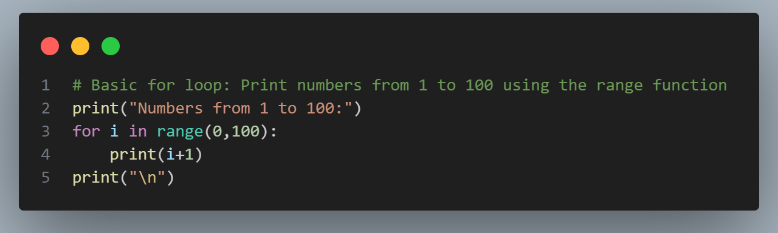
Let‘s Practice
using for & range( )
Print numbers from 1 to 100.

Slide 9
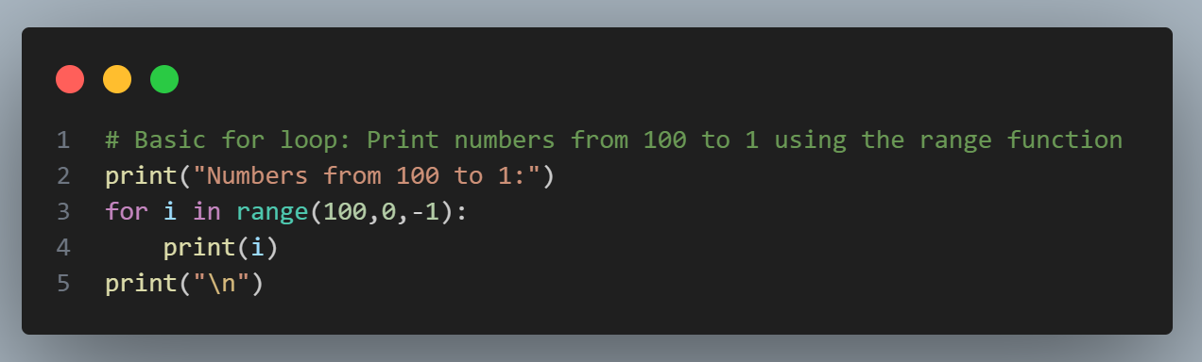
Let‘s Practice
using for & range( )
Print numbers from 100 to 1.

Slide 10
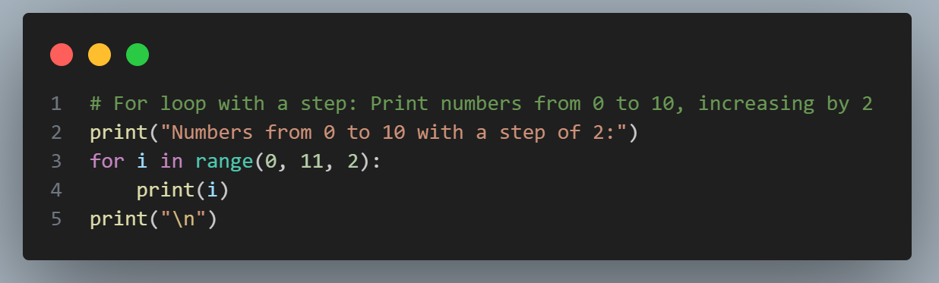
Let‘s Practice
WAP to Print numbers from 0 to 10, increasing by 2

Slide 11
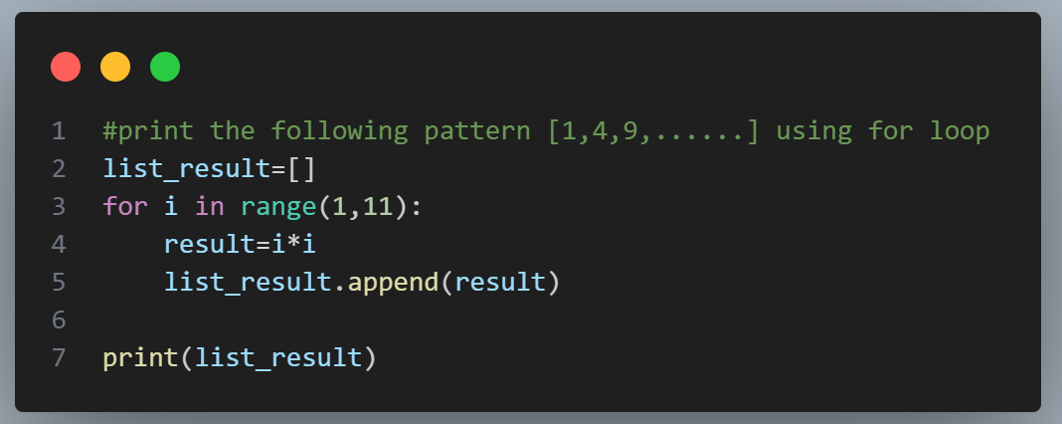
Let‘s Practice
WAP to print the following pattern [1,4,9,......] using for loop

Slide 12
Let‘s Practice
WAP reverse string "tribhuvanuniversity" to "ytisrevinuvahbirt“ using for loop

Slide 13
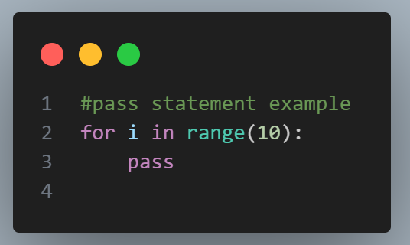
pass Statement
pass is a null statement that does nothing. It is used as a placeholder for future code.
for el in range(10):
pass
generally used in execption handling

Slide 14
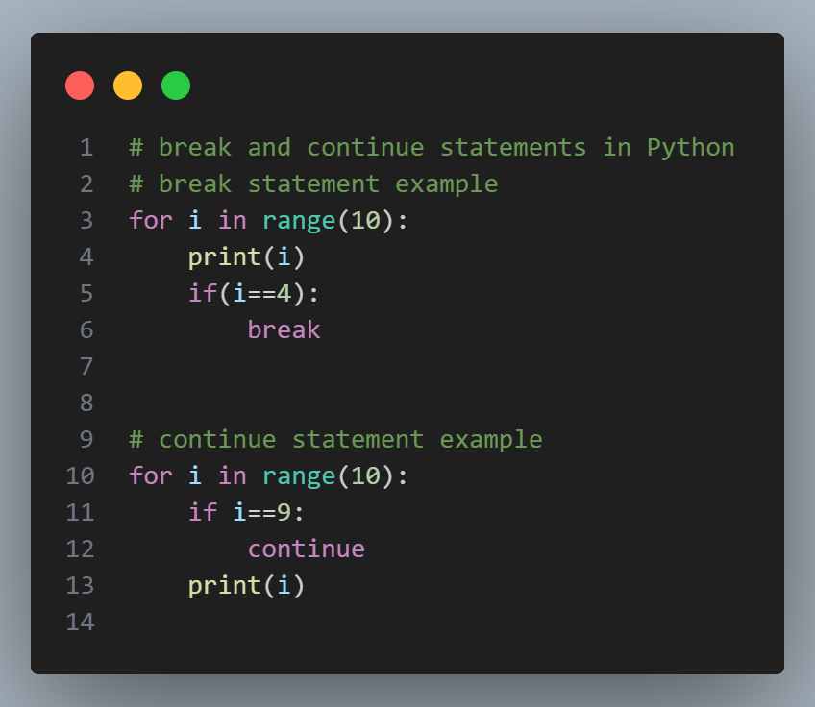
Break and continue Statement
generally used in execption handling

Slide 15
Let‘s Practice
WAP to find the sum of first n numbers. (using while)
WAP to find the factorial of first n numbers. (using for)

