Slide 1

Python
Sushil Shrestha

Slide 2

Programming
Translator
(Compiler / Interpreter)
Machine
Code

Slide 3

What is Python?
Python is simple & easy
Free & Open Source High Level Language
Developed by Guido van Rossum
Portable

Slide 4
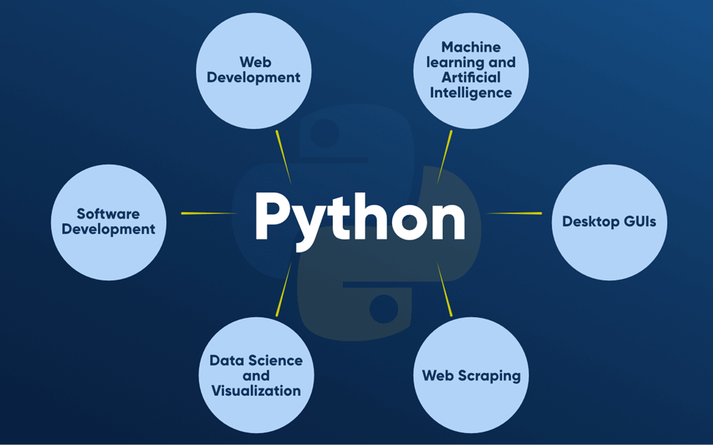
SCOPE OF PYTHON

Slide 5
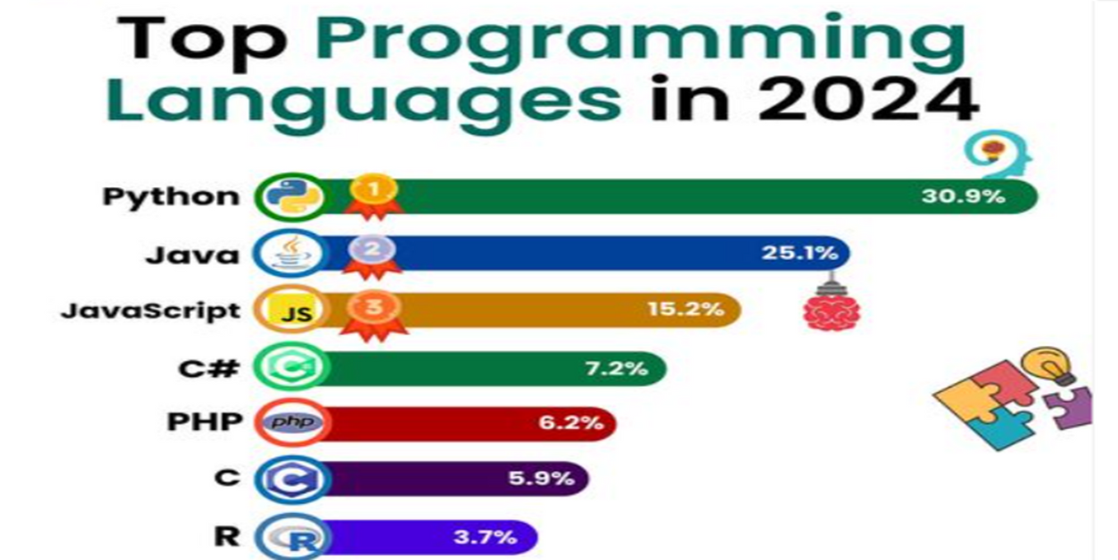
TOP PROGRAMMING LANGUAGE IN 2024

Slide 6

WHO USE PYTHON TODAY

Slide 7
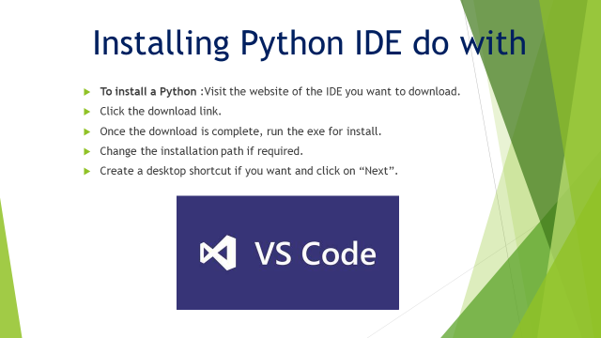

Slide 8

Check Version/Install Status
Python –v or python --version

Slide 9
Our First Program
print("Hello World")

Slide 10
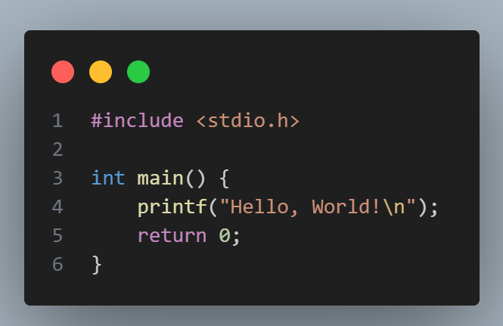
“Hello World” In Python
“Hello World” In C
print("Hello World")

Slide 11
Python Character Set
Letters – A to Z, a to z Digits – 0 to 9
Special Symbols - + - * / etc.
Whitespaces – Blank Space, tab, carriage return, newline, formfeed
Other characters – Python can process all ASCII and Unicode characters as part of data or literals

Slide 12
Data Types
Integers
String Float Boolean None

Slide 13
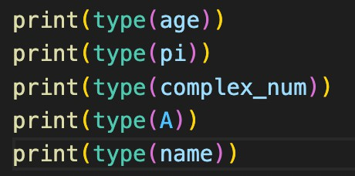
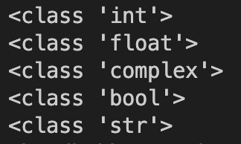
Data Types

Slide 14
Variables
A variable is a name given to a memory location in a program.
name = "Sushil" age = 20
price = 25.99

Slide 15
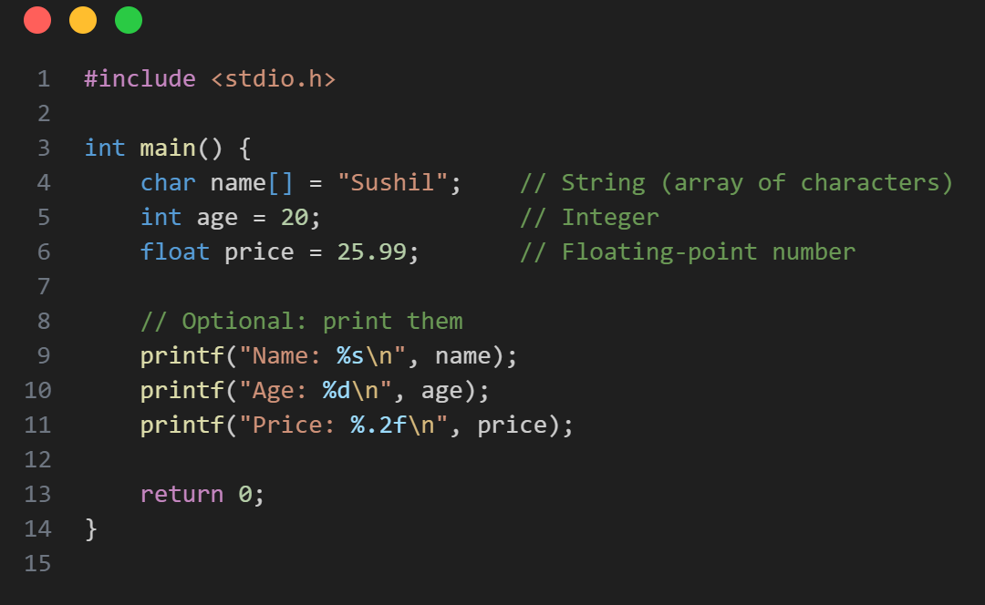
Variables Declare in C
Variables Declare in Python
name = "Sushil" age = 20
price = 25.99

Slide 16
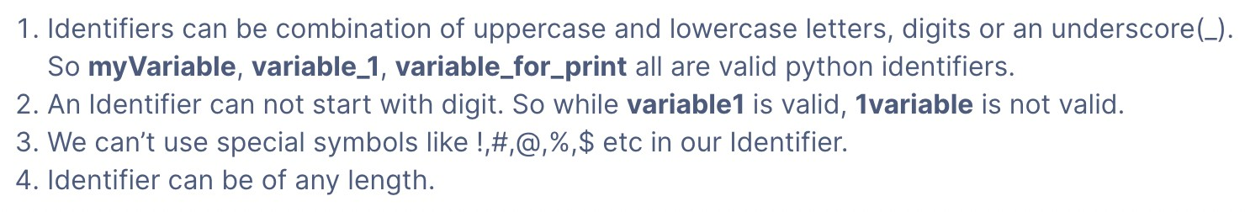
Rules for Identifiers

Slide 17
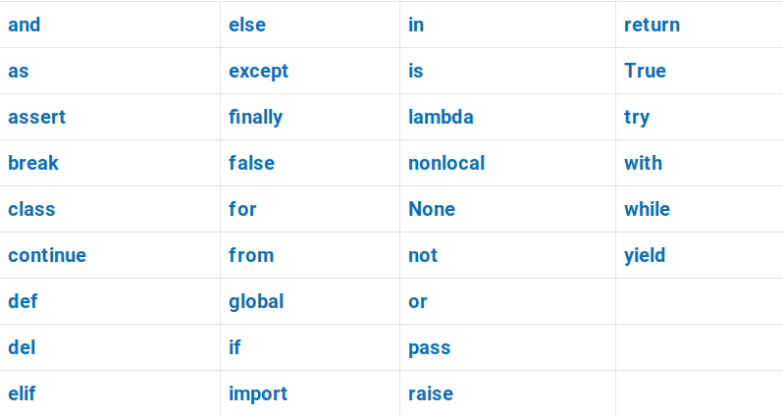
Keywords
Keywords are reserved words in python.
*False should be uppercase

Slide 18
Print Sum

Slide 19
Input in Python
input( ) statement is used to accept values (using keyboard) from user
input( ) #result for input( ) is always a str
Example: name= input(“Enter Your Name”)
print(name)

Slide 20
Comments in Python
# Single Line Comment
"""
Multi Line Comment """

Slide 21
Types of Operators
An operator is a symbol that performs a certain operation between operands.
Arithmetic Operators ( + , - , * , / , % , ** )
Relational / Comparison Operators ( == , != , > , < , >= , <= ) Assignment Operators ( = , +=, -= , *= , /= , %= , **= ) Logical Operators ( not , and , or )

Slide 22
Type Conversion
a, b = 1, 2.0
sum = a + b
#error
a, b = 1, "2"
sum = a + b

Slide 23
Type Casting
a, b = 1, "2"
c = int(b)
sum = a + c

Slide 24
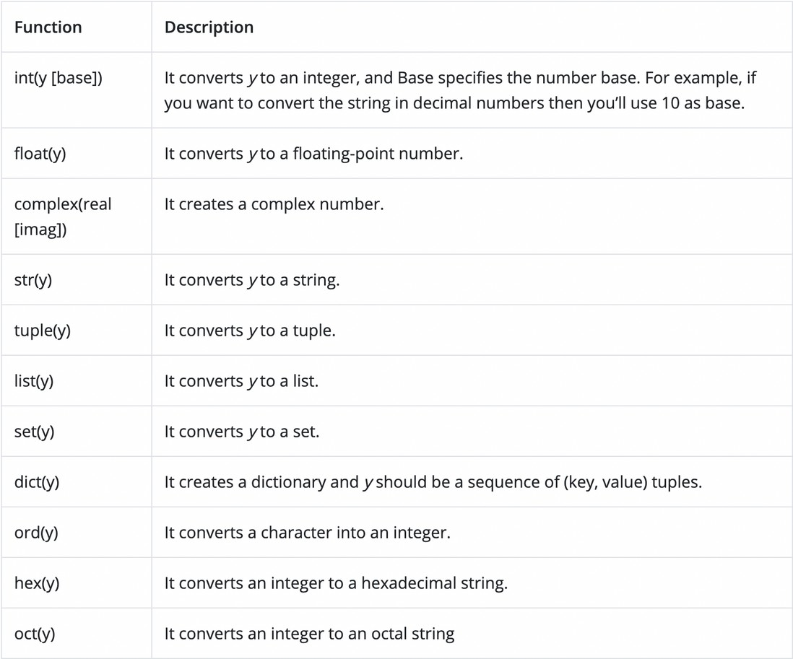
Type Casting

Slide 25
Input in Python
input( ) statement is used to accept values (using keyboard) from user
input( ) #result for input( ) is always a str
int ( input( ) ) #int
float ( input( ) ) #float

Slide 26
Let‘s Practice
Write a Program to input 2 numbers & print their sum.

Slide 27
Let‘s Practice
WAP to input side of a square & print its area.

Slide 28
Let‘s Practice
WAP to input 2 floating point numbers & print their average.

Slide 29
Let‘s Practice
WAP to input 2 int numbers, a and b.
Print True if a is greater than or equal to b. If not print False.

