Slide 1
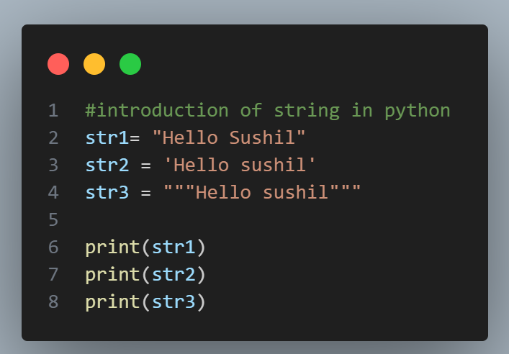
Strings

Slide 2
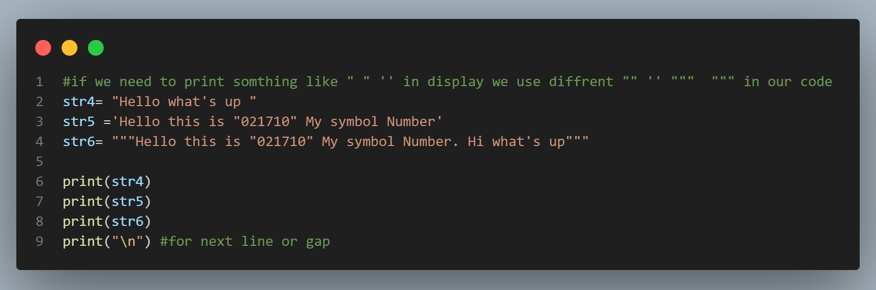
Strings

Slide 3
Strings
String is data type that stores a sequence of characters.
Basic Operations
concatenation
“hello” + “world”
“helloworld”
length of str
len(str)

Slide 4
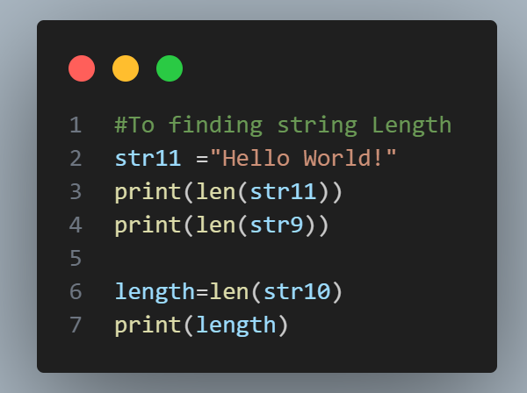
Strings

Slide 5
Indexing
S u s h ii l _S h r e s t h a
0 1 2 3 4 5 6 7 8 9 10 11 12 13 14
str = “Sushil_Shrestha” str[0] is ‘A’, str[1] is ‘U’ ... str[0] = ‘B’ #not allowed

Slide 6
Slicing
Accessing parts of a string
str[ starting_idx : ending_idx ] #ending idx is not included
str = “Sushilshrestha” str[ 1 : 4 ] is “ush”
str[ : 4 ] is same as str[ 0 : 4]
str[ 1 : ] is same as str[ 1 : len(str) ]

Slide 7
Slicing
Negative Index
A p p l e
-5 -4 -3 -2 -1
str = “Apple”
str[ -3 : -1 ] is “pl”

Slide 8
String Functions
str = “I am a coder.”
str.endsWith(“er.“) #returns true if string ends with substr
str.capitalize( ) #capitalizes 1st char
str.replace( old, new ) #replaces all occurrences of old with new str.find( word ) #returns 1st index of 1st occurrence str.count(“am“) #counts the occurrence of substr in string

Slide 9
Let‘s Practice
WAP to input user’s first name & print its length.
WAP to find the occurrence of ‘3’ in a String.

Slide 10
Conditional Statements
if-elif-else (SYNTAX)
if(condition) :
Statement1 elif(condition):
Statement2 else:
StatementN

Slide 11
Let‘s Practice
WAP to check User Can eligible for vote or Not

Slide 12
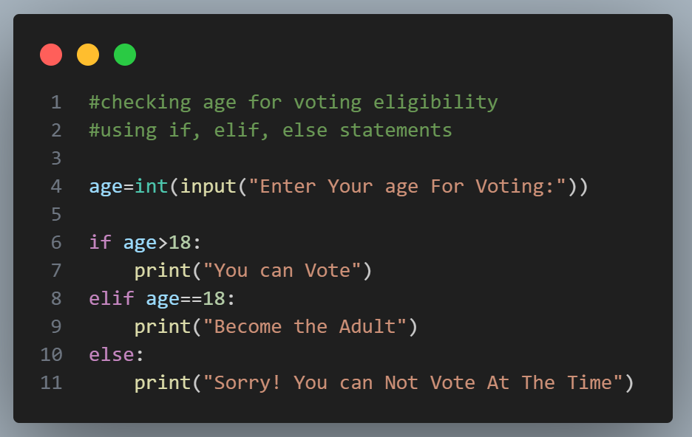

Slide 13
Let‘s Practice
WAP to check if a number entered by the user is odd or even.

Slide 14
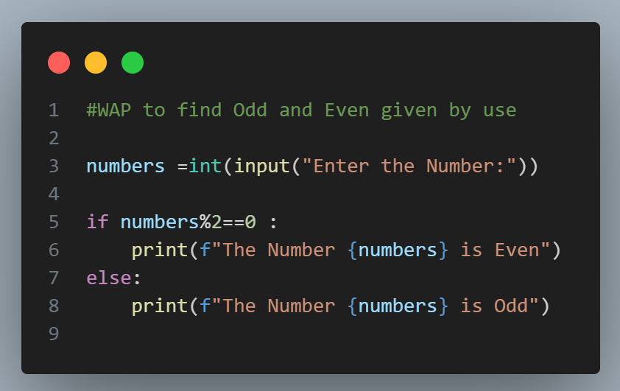

Slide 15
Let‘s Practice
WAP to find the greatest of 3 numbers entered by the user.

Slide 16
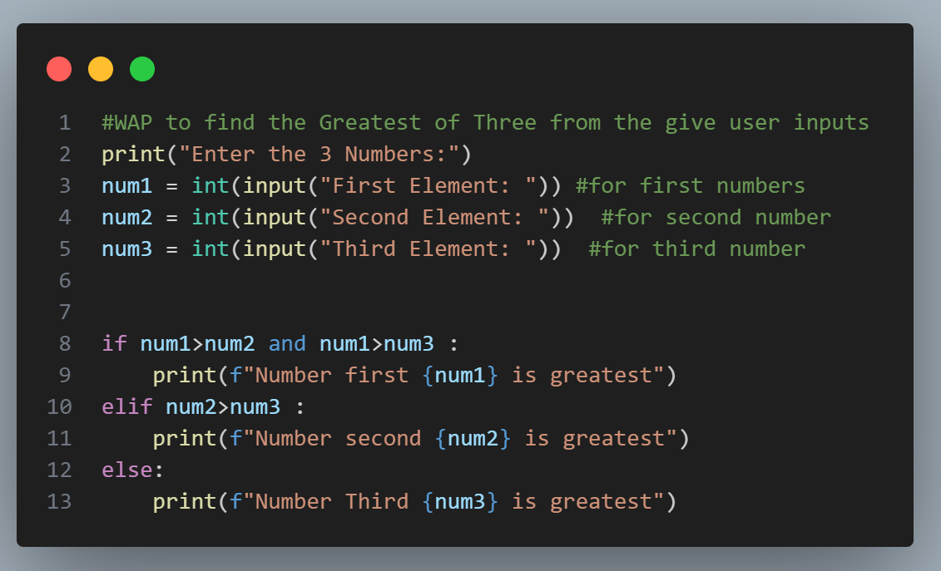

Slide 17
Let‘s Practice
WAP to check if a number is a multiple of 7 or not.

Slide 18
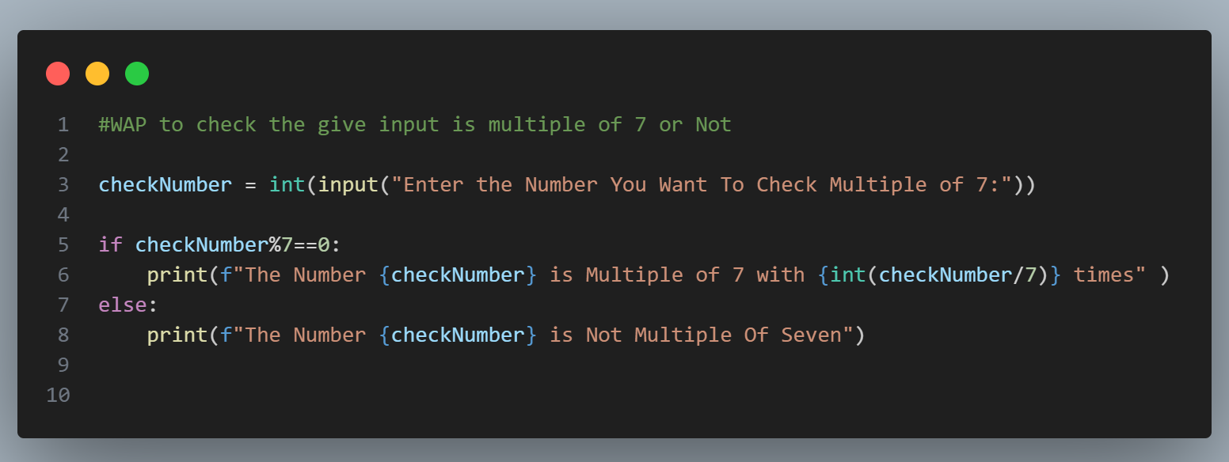

Slide 19
Let‘s Practice
WAP to check Today is Holiday or Not.

Slide 20
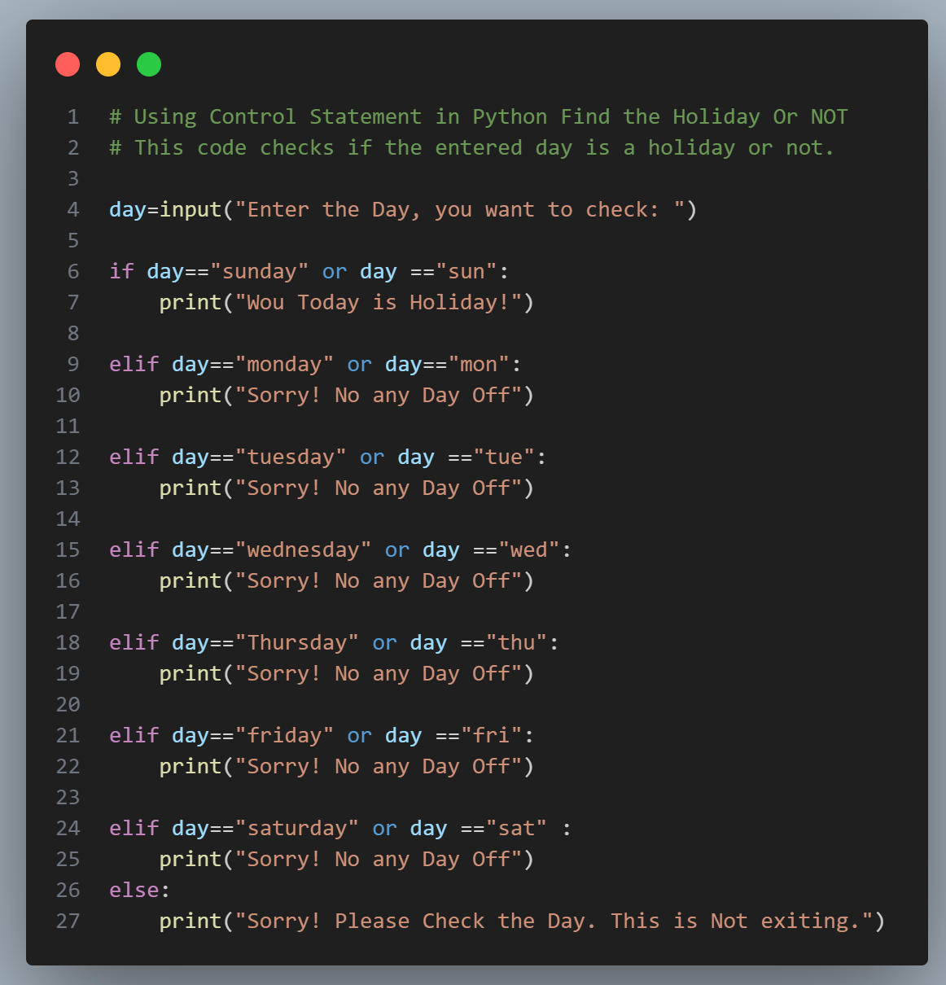

Slide 21
Let‘s Practice
WAP to check the Result of the Student and also show the obtain Grade.
e.g.
marks >= 90, grade = “A”
90 > marks >= 80, grade = “B”
80 > marks >= 70, grade = “C” 70 > marks, grade = “D”

Slide 22
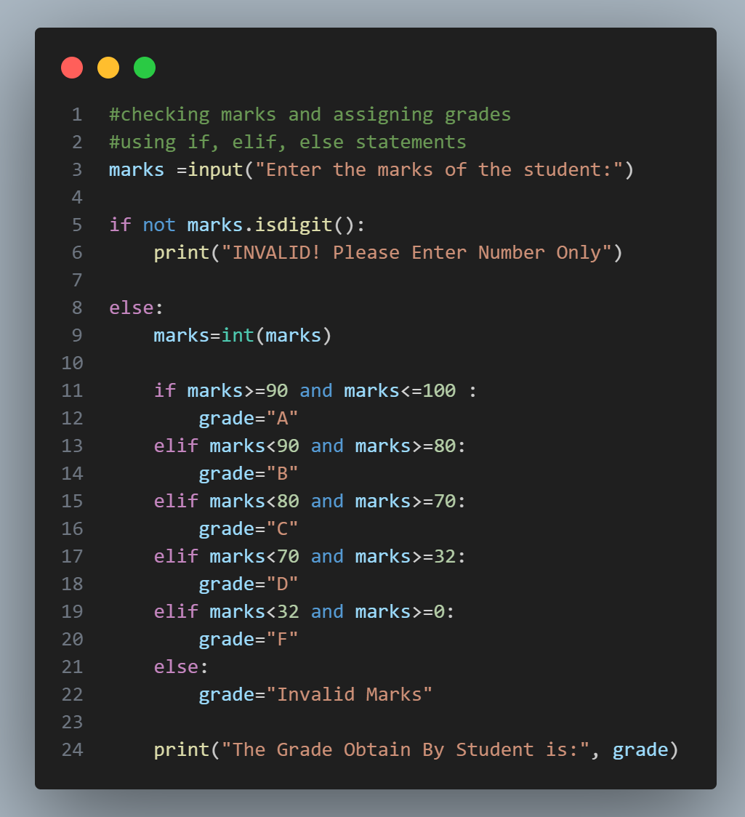

Slide 23
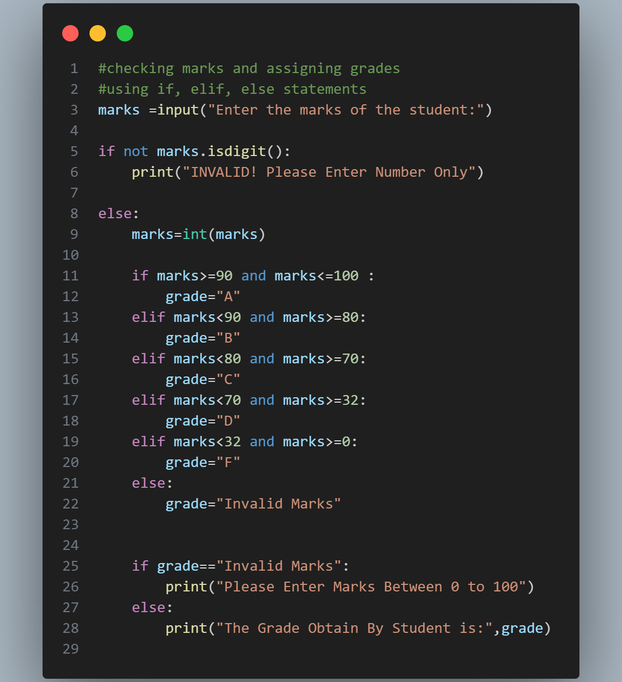

Slide 24
Thank You So Much

