Slide 1
Lecture -3 Control Statement

Slide 2
Conditional Statements
if-elif-else (SYNTAX)
if(condition) :
Statement1 elif(condition):
Statement2 else:
StatementN

Slide 3
Let‘s Practice
WAP to check User Can eligible for vote or Not

Slide 4
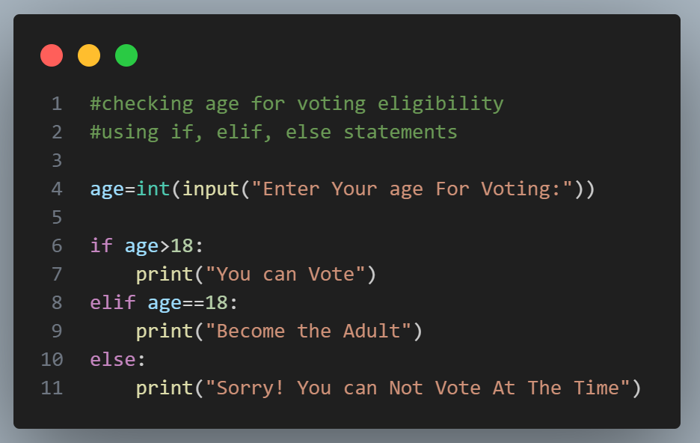

Slide 5
Let‘s Practice
WAP to check if a number entered by the user is odd or even.

Slide 6
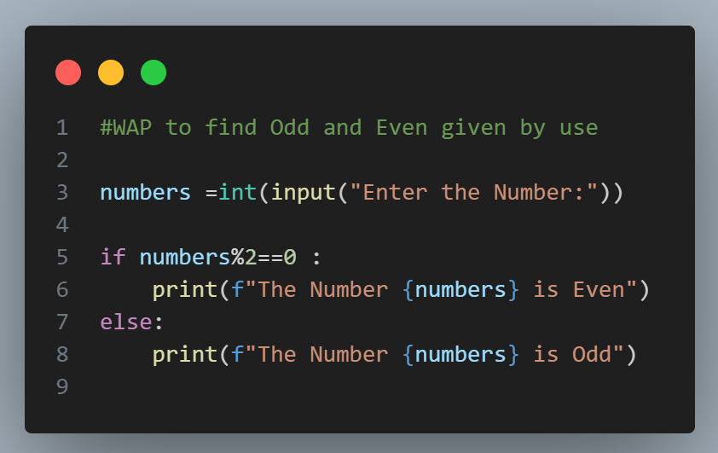

Slide 7
Let‘s Practice
WAP to find the greatest of 3 numbers entered by the user.

Slide 8
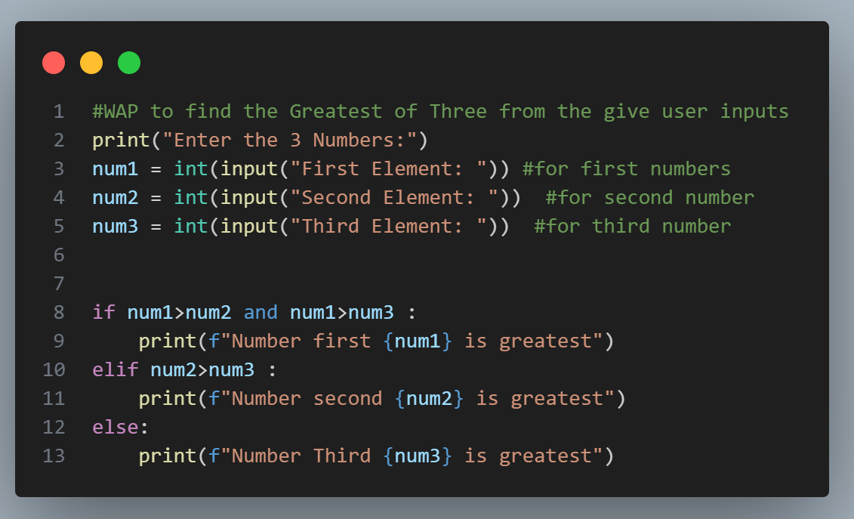

Slide 9
Let‘s Practice
WAP to check if a number is a multiple of 7 or not.

Slide 10
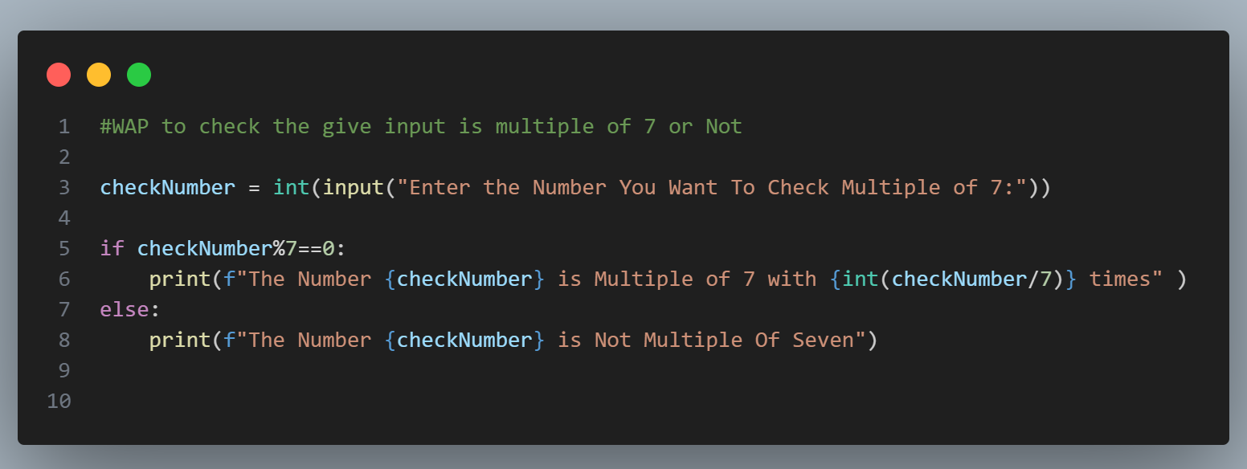

Slide 11
Let‘s Practice
WAP to check Today is Holiday or Not.

Slide 12
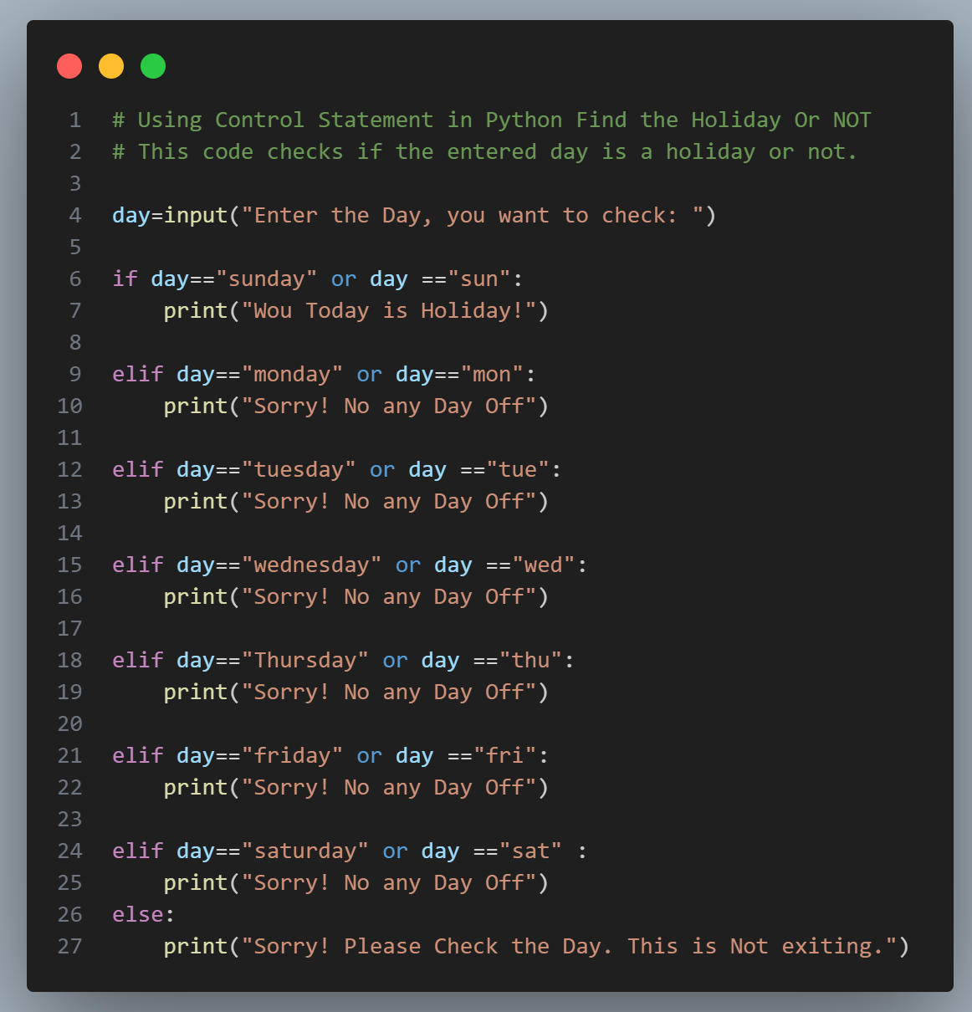

Slide 13
Let‘s Practice
WAP to check the Result of the Student and also show the obtain Grade.
e.g.
marks >= 90, grade = “A”
90 > marks >= 80, grade = “B”
80 > marks >= 70, grade = “C” 70 > marks, grade = “D”

Slide 14
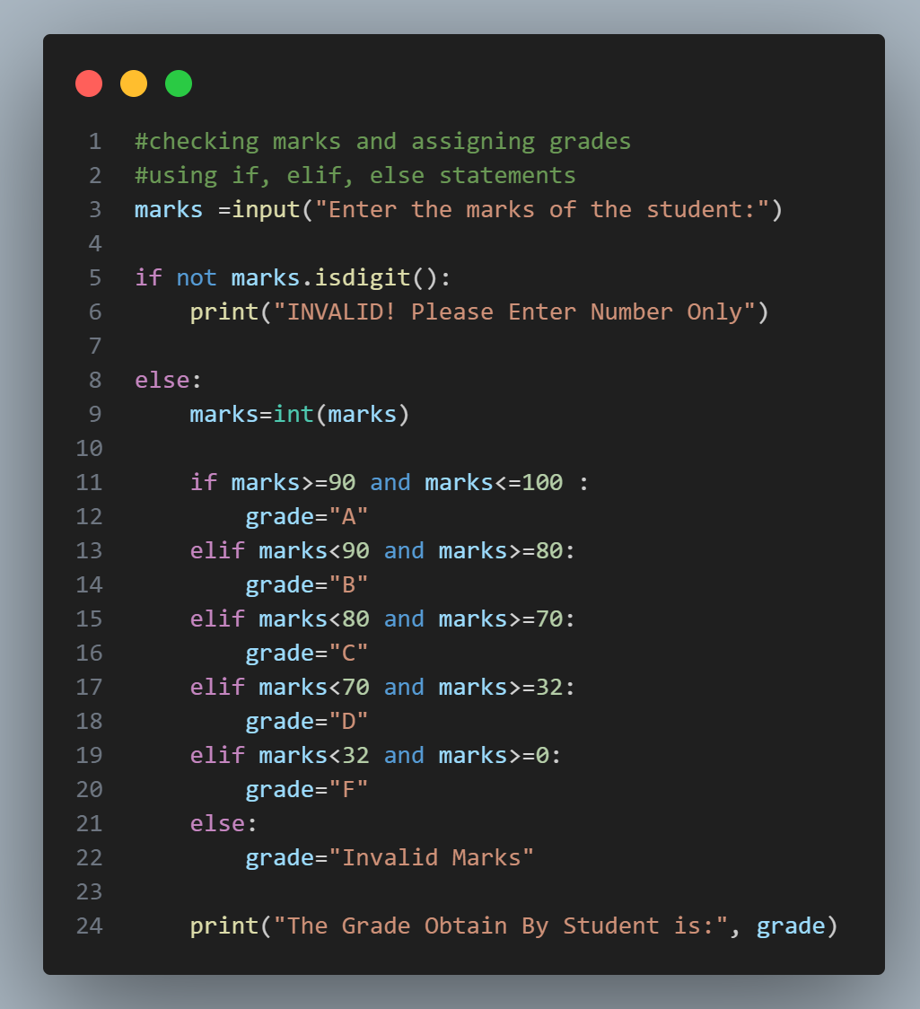

Slide 15
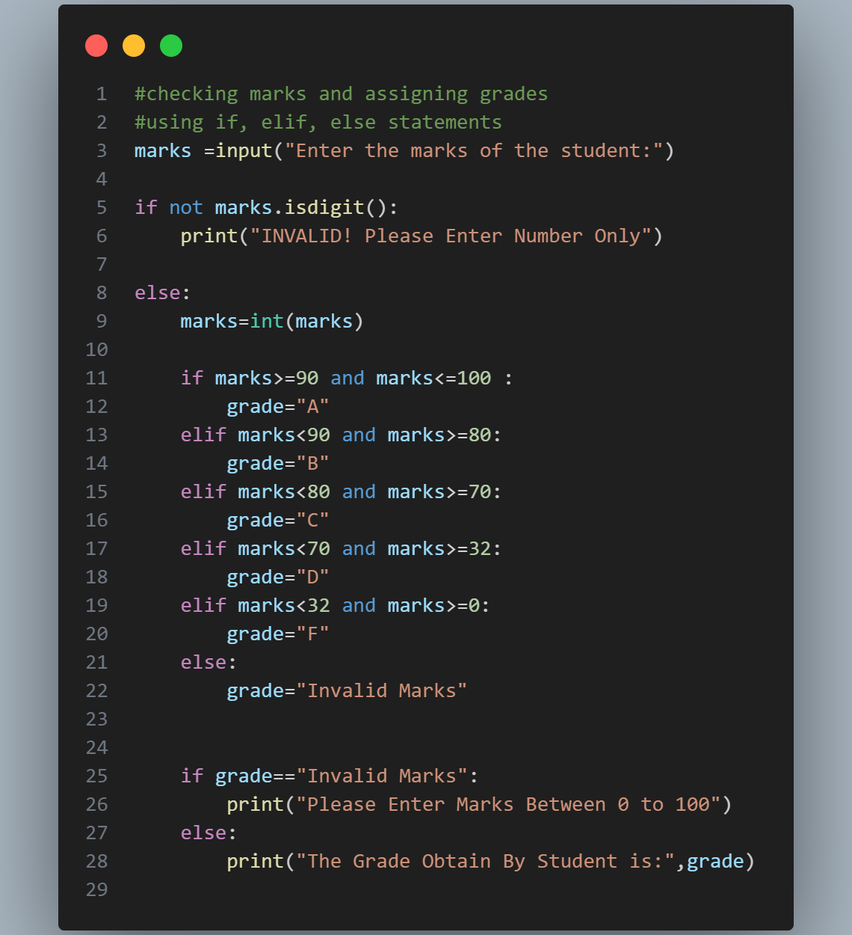

Slide 16
Thank You So Much

