Slide 1
Lecture: 4 Data Structures or Data Types In Python [list],(tuple),{dict: dictionary},{set}

Slide 2
Data Structures or Data Types In Python
[List]
(tuple)
{dict : dictionary}
{set}

Slide 3
List in Python
A built-in data type that stores set of values
It can store elements of different types (integer, float, string, etc.)
marks = [87, 64, 33, 95, 76]
#marks[0], marks[1]..
student = [”Karan”, 85, “Delhi”] #student[0], student[1]..
student[0] = “Arjun” #allowed in python len(student) #returns length

Slide 4
List Slicing
Similar to String Slicing
list_name[ starting_idx : ending_idx ] #ending idx is not included
marks = [87, 64, 33, 95, 76]
marks[ 1 : 4 ] is [64, 33, 95]
marks[ : 4 ] is same as marks[ 0 : 4]
marks[ 1 : ] is same as marks[ 1 : len(marks) ] marks[ -3 : -1 ] is [33, 95]

Slide 5
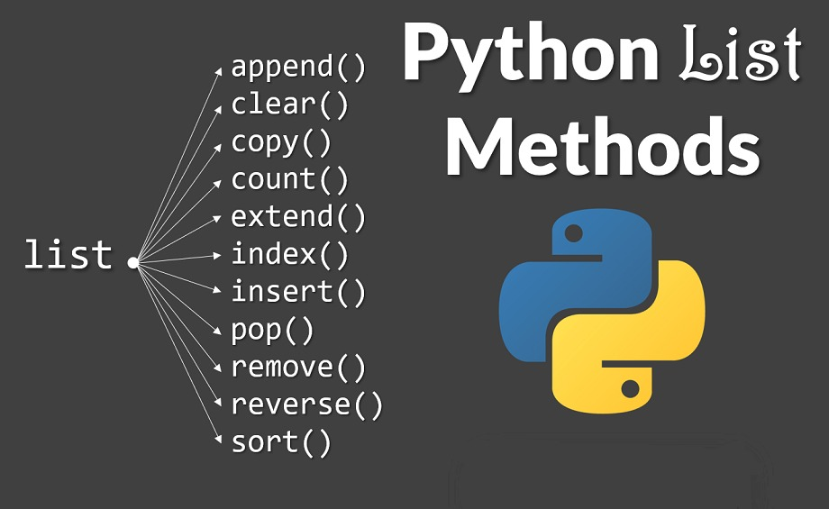

Slide 6
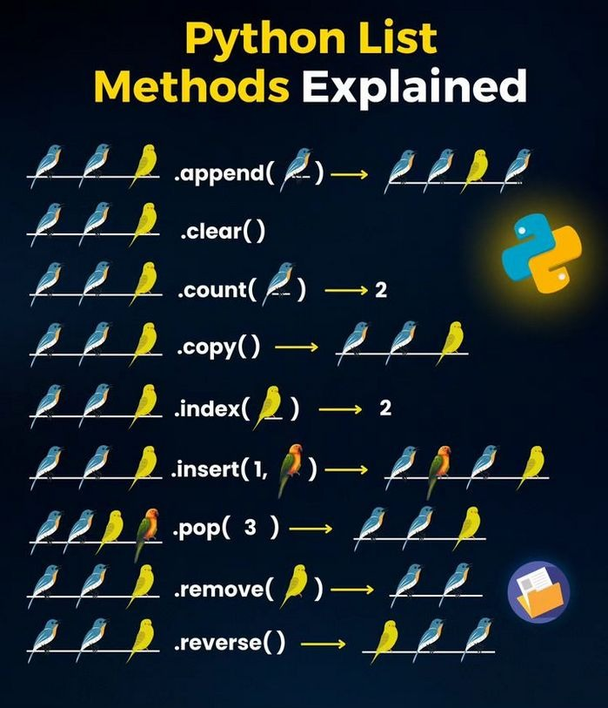

Slide 7
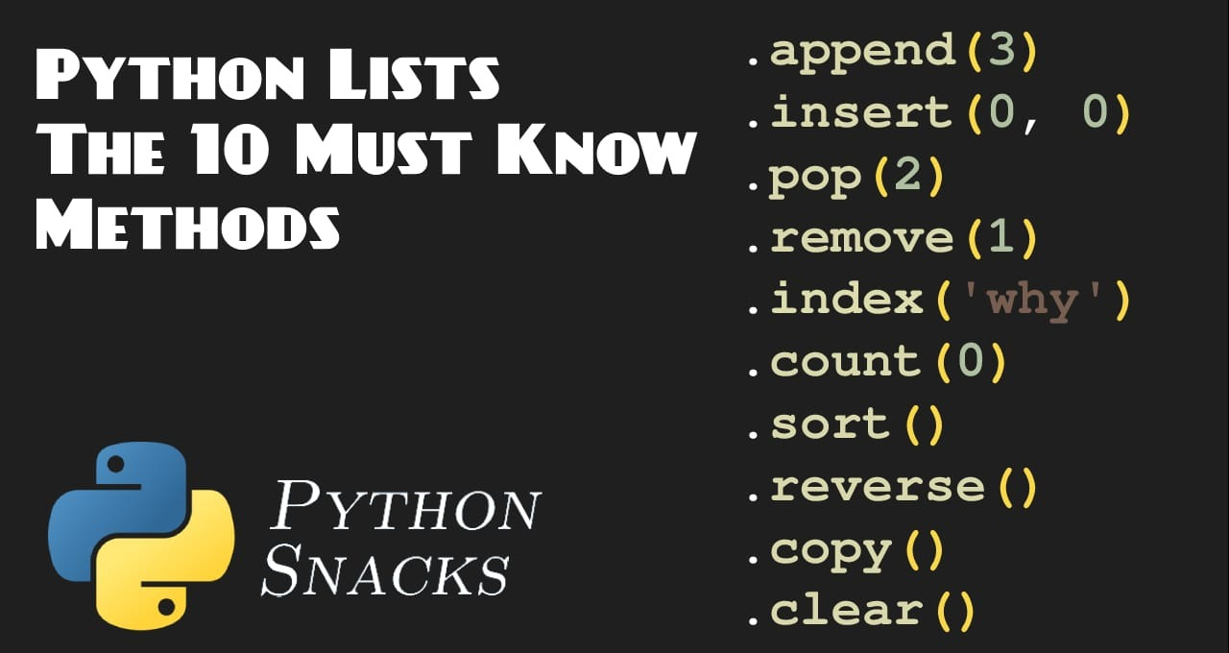

Slide 8
List Methods
list = [2, 1, 3]
list.append(4) #adds one element at the end
[2, 1, 3, 4]
list.sort( ) #sorts in ascending order [1, 2, 3]
list.sort( reverse=True ) #sorts in descending order list.reverse( ) #reverses list [3, 1, 2]
list.insert( idx, el ) #insert element at index
[3, 2, 1]

Slide 9
List Methods
list = [2, 1, 3, 1]
list.remove(1) #removes first occurrence of element
[2, 3, 1]
list.pop( idx ) #removes element at idx

Slide 10
Tuples in Python
A built-in data type that lets us create immutable sequences of values.
tup = (87, 64, 33, 95, 76) #tup[0], tup[1]..
tup[0] = 43 #NOT allowed in python
tup1 = ( )
tup2 = ( 1, )
tup3 = ( 1, 2, 3 )

Slide 11
Tuple Methods
tup = (2, 1, 3, 1)
tup.index( el ) #returns index of first occurrence tup.index(1) is 1
tup.count( el ) #counts total occurrences tup.count(1) is 2

Slide 12
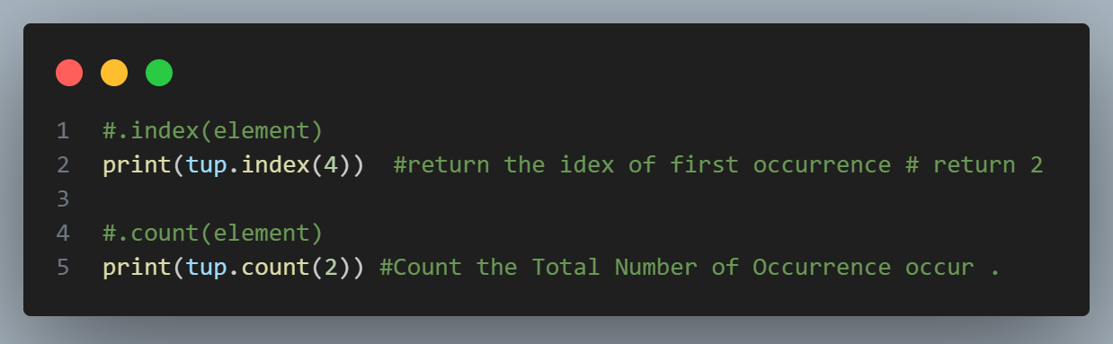

Slide 13
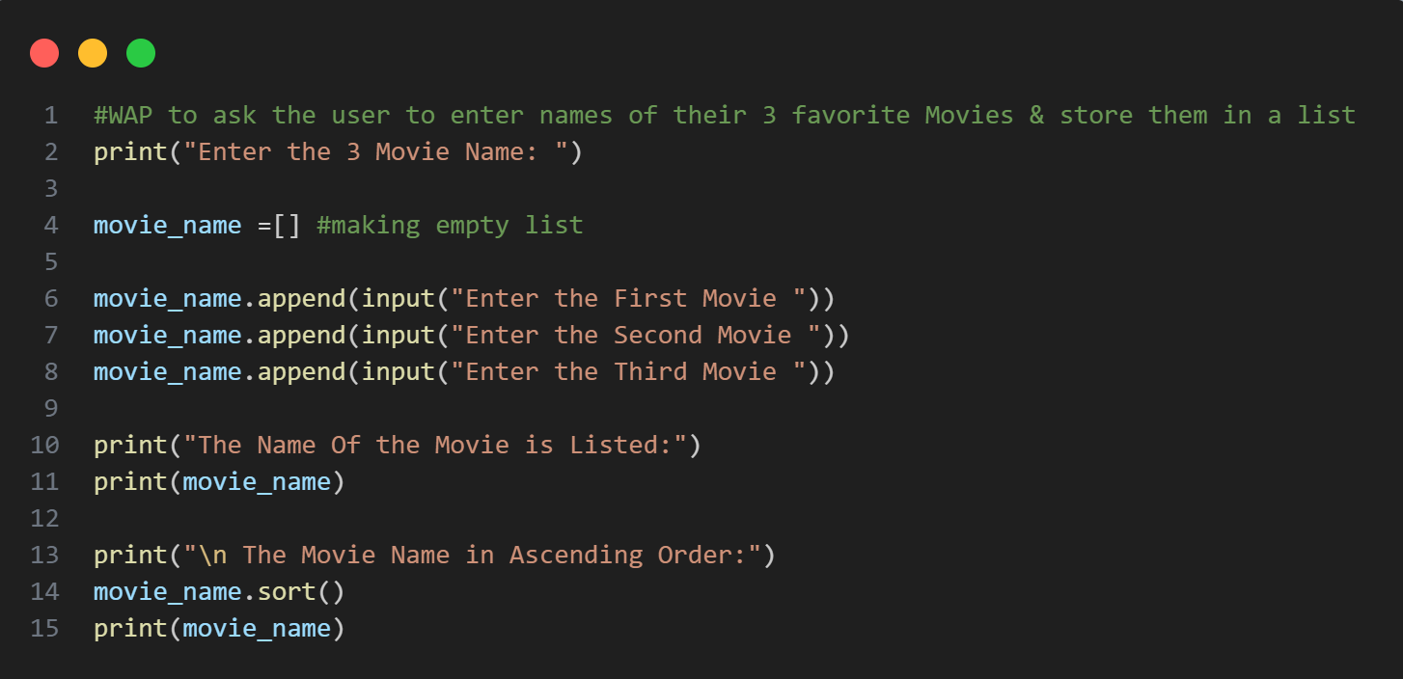
Let‘s Practice
WAP to ask the user to enter names of their 3 favorite movies & store them in a list.

Slide 14
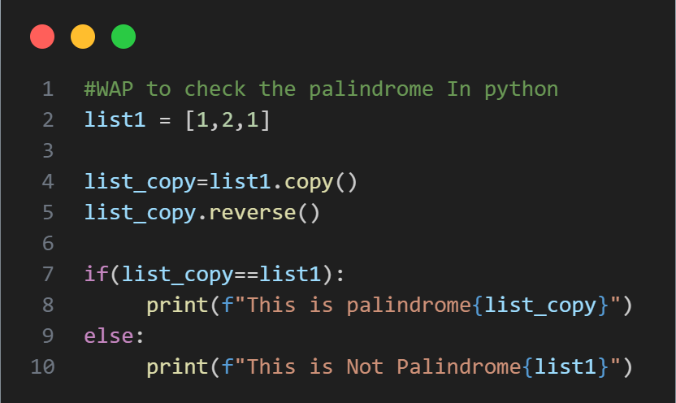
Let‘s Practice
WAP to check if a list contains a palindrome of elements. (Hint: use copy( ) method)
[1, 2, 3, 2, 1] [1, “abc”, “abc”, 1]

Slide 15
Let‘s Practice
WAP to count the number of students with the “A” grade in the following List.
[”C”, “D”, “A”, “A”, “B”, “B”, “A”]
Store the above values in a list & sort them from “A” to “D”.

Slide 16
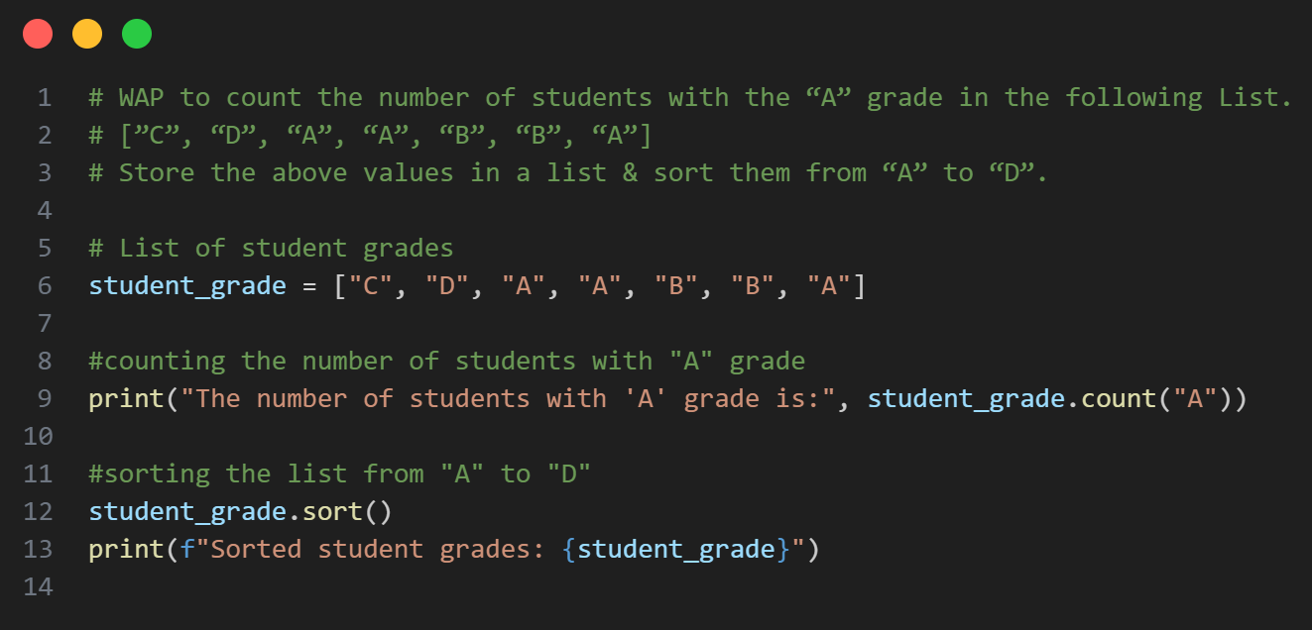

Slide 17
Thank You So Much

