Slide 1
Lecture: 5 Data Structures or Data Types In Python [list],(tuple),{dict: dictionary},{set}

Slide 2
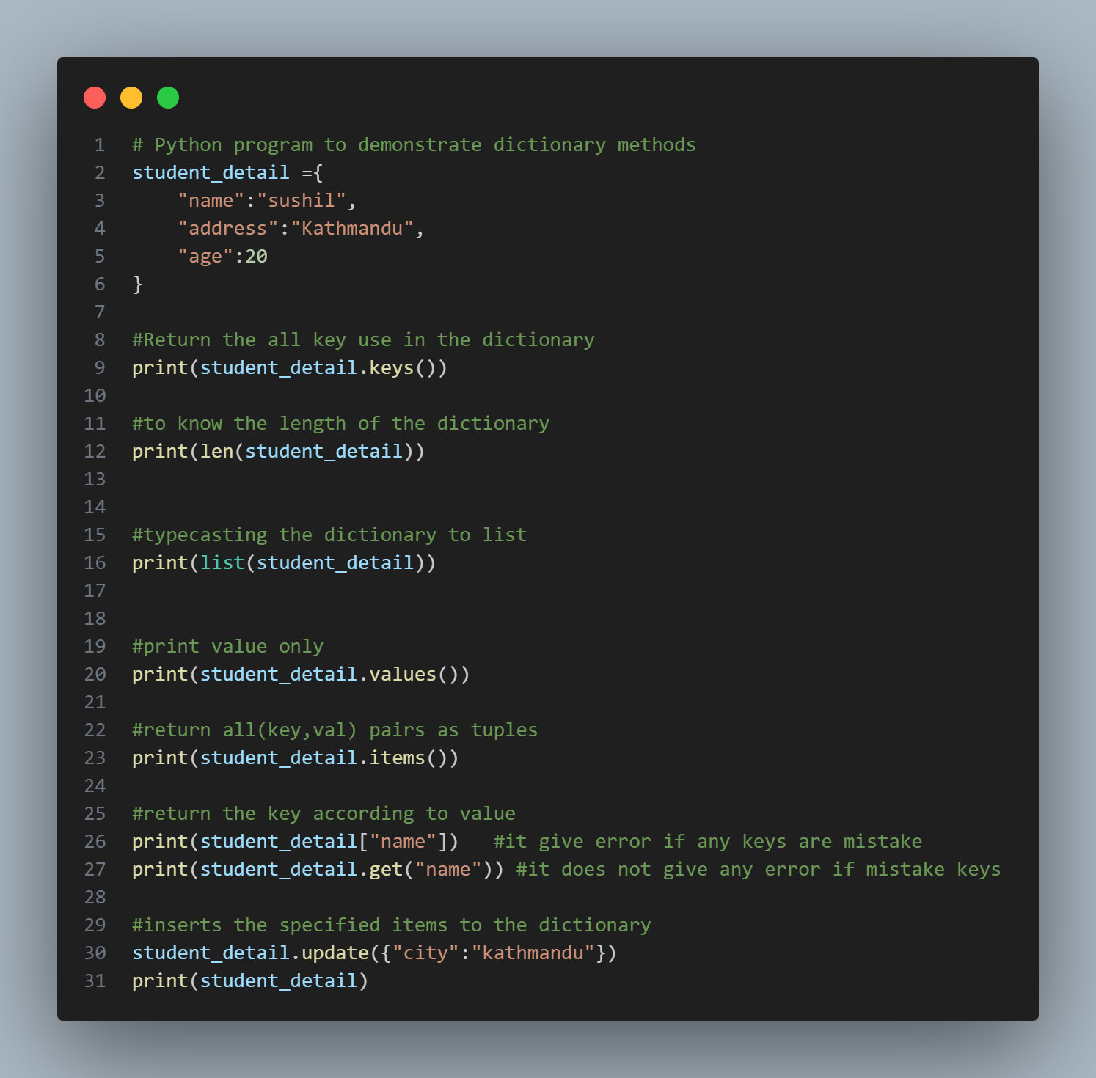
Dictionary in Python
Dictionaries are used to store data values in key:value pairs
They are unordered, mutable(changeable) & don’t allow duplicate keys
“key” : value

Slide 3
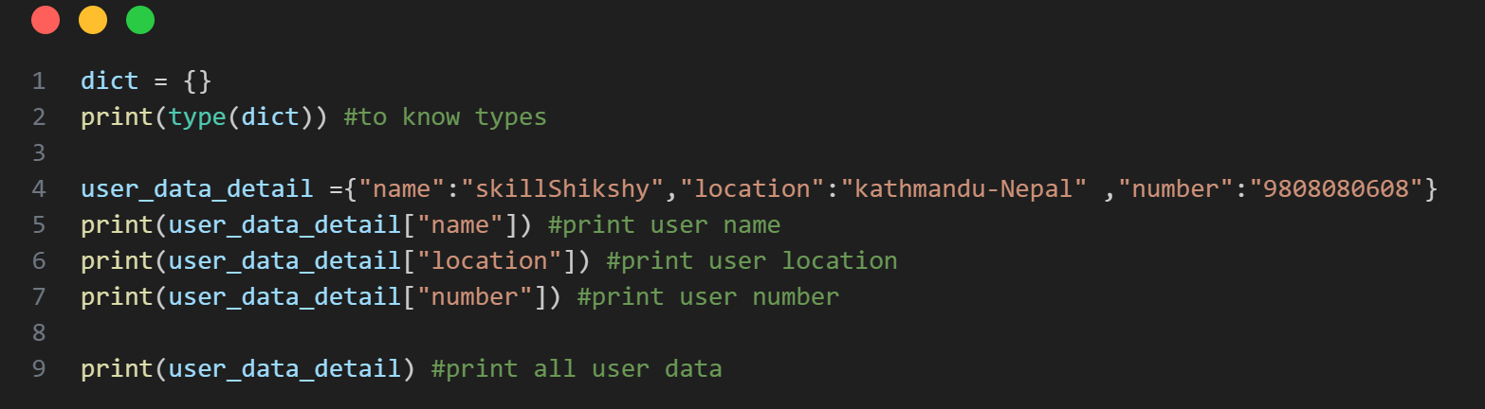

Slide 4
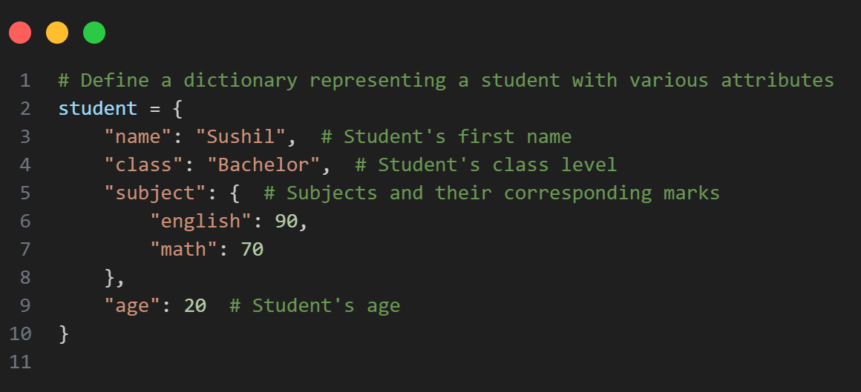
Dictionary in Python
Nested Dictionaries

Slide 5
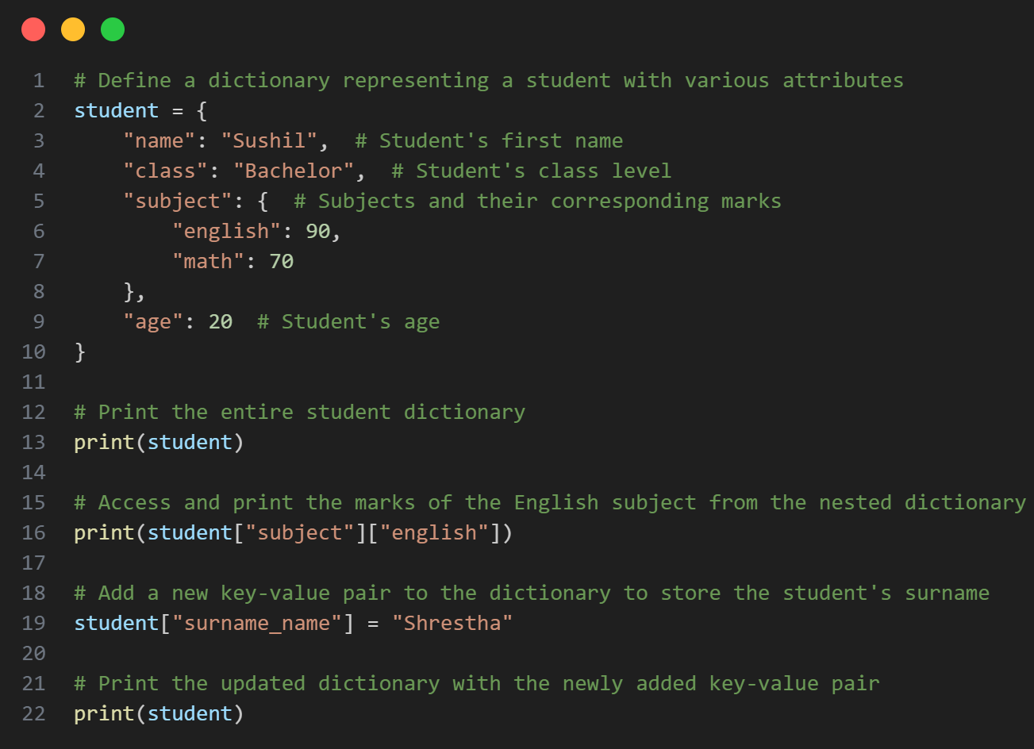

Slide 6
Dictionary Methods
myDict.keys( ) #returns all keys
myDict.values( ) #returns all values
myDict.items( ) #returns all (key, val) pairs as tuples myDict.get( “key““ ) #returns the key according to value
myDict.update( newDict ) #inserts the specified items to the dictionary

Slide 7
Dictionary Methods

Slide 8
Set in Python
Set is the collection of the unordered items.
Each element in the set must be unique & immutable.
nums = { 1, 2, 3, 4 }
set2 = { 1, 2, 2, 2 }
#repeated elements stored only once, so it resolved to {1, 2}
null_set = set( )
#empty set syntax

Slide 9
Set Methods
set.add( el ) #adds an element
set.remove( el ) #removes the elem an set.clear( ) #empties the set
set.pop( ) #removes a random value

Slide 10
Set Methods
set.union( set2 ) #combines both set values & returns new
set.intersection( set2 ) #combines common values & returns new

Slide 11
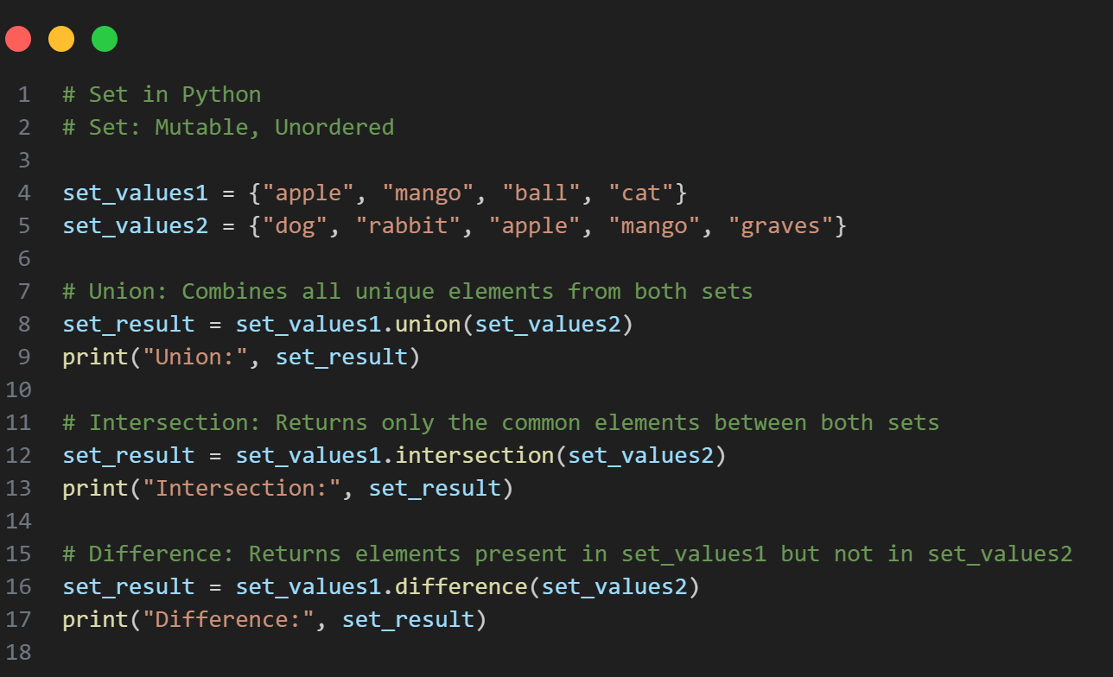
Set Methods

Slide 12
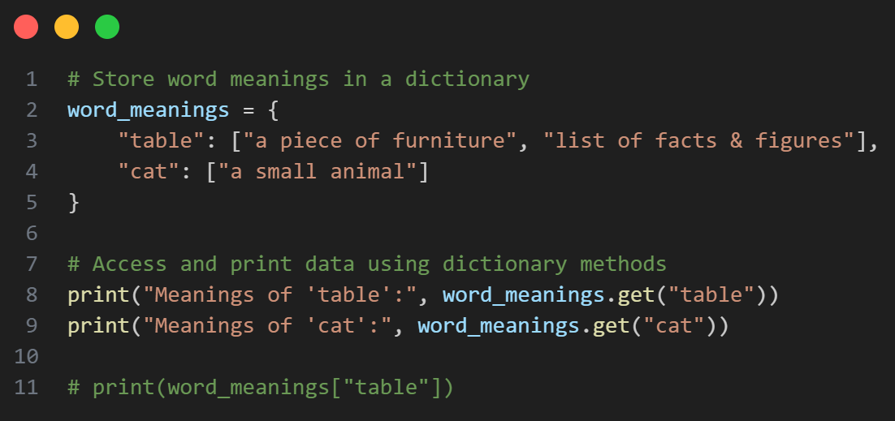
Let‘s Practice
Store following word meanings in a python dictionary :
table : “a piece of furniture”, “list of facts & figures” cat : “a small animal”

Slide 13
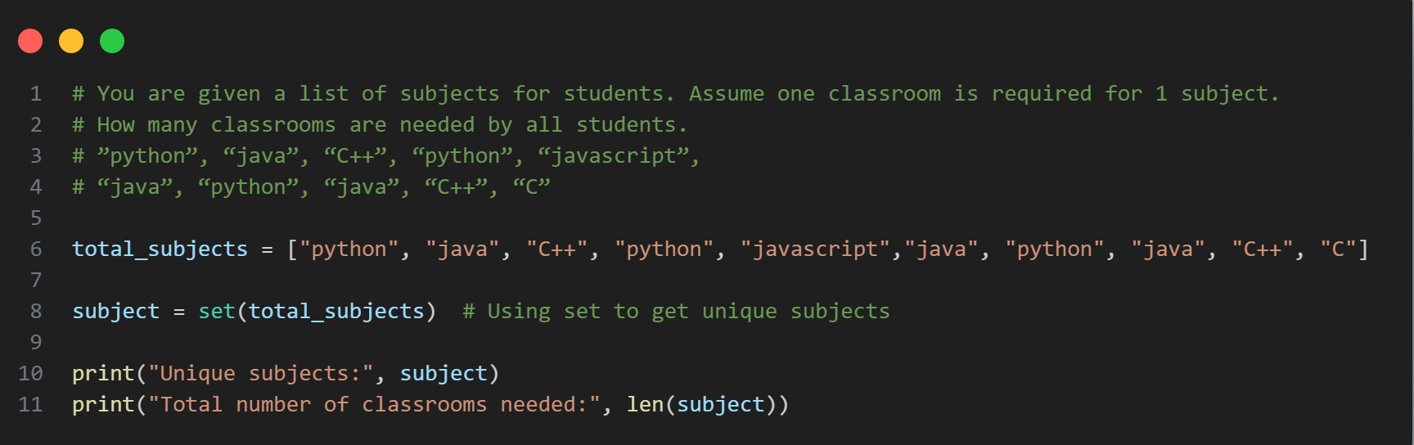
Let‘s Practice
You are given a list of subjects for students. Assume one classroom is required for 1 subject. How many classrooms are needed by all students.
”python”, “java”, “C++”, “python”, “javascript”,
“java”, “python”, “java”, “C++”, “C”

Slide 14
Let‘s Practice
WAP to enter marks of 3 subjects from the user and store them in a dictionary. Start with an empty dictionary & add one by one. Use subject name as key & marks as value.

Slide 15
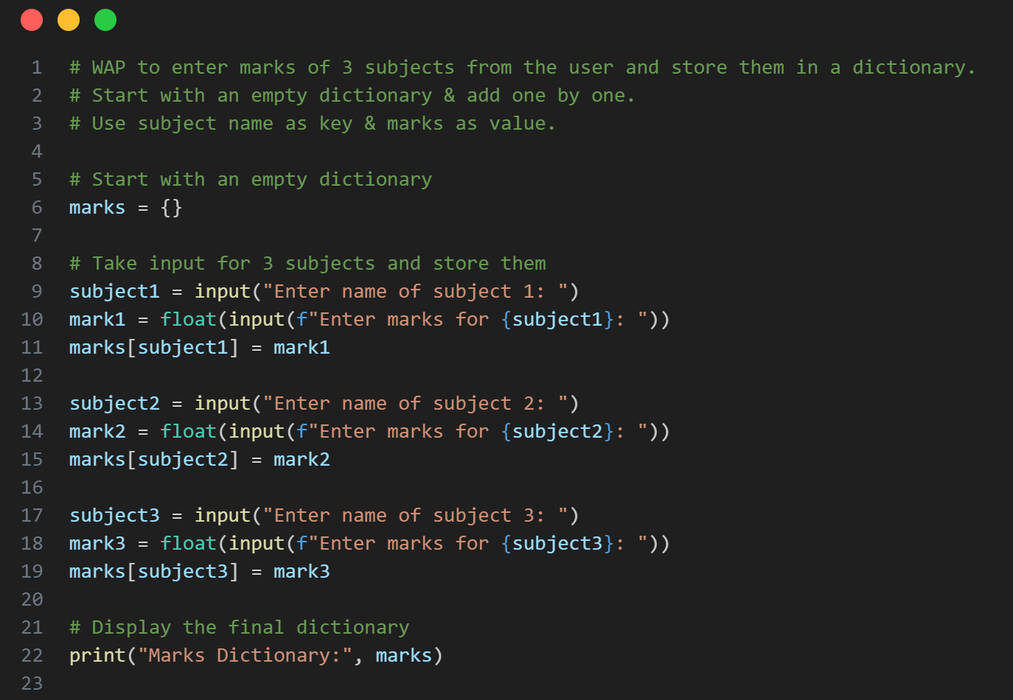

Slide 16
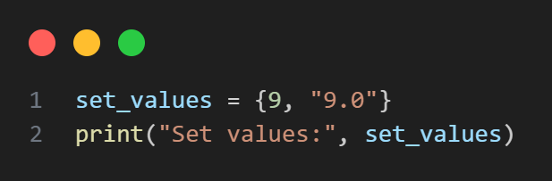
Let‘s Practice
Figure out a way to store 9 & 9.0 as separate values in the set. (You can take help of built-in data types)

Slide 17
Thank You So Much

