Slide 1
BANANAS: Bayesian Optimization
with Neural Architectures
for Neural Architecture Search
Colin White¹, Willie Neiswanger²³, Yash Savani¹
¹ Abacus.AI
² Stanford University
³ Petuum, Inc.
2021
Notes:
Ok, today I’ll present the paper BANANAS: Bayesian Optimization with Neural Architectures for Neural Architecture Search, published in 2021.

Slide 2

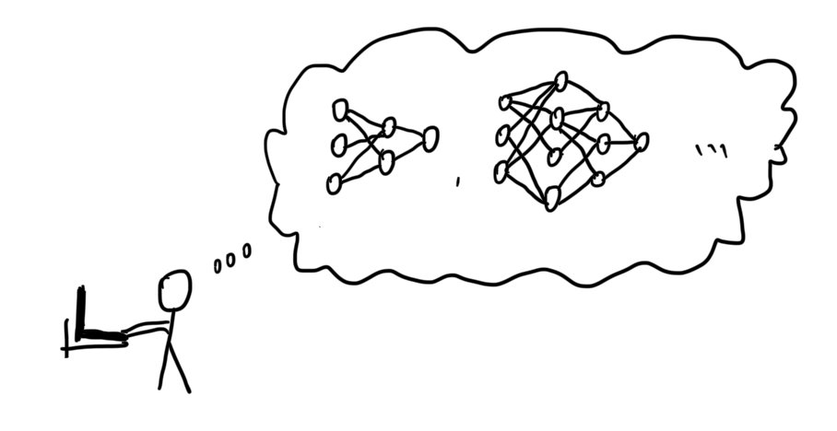
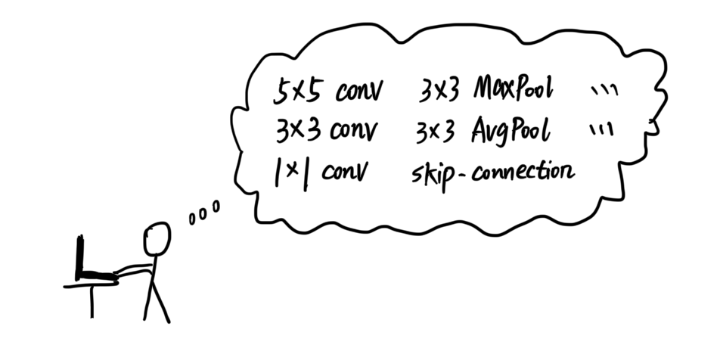
Neural Architecture Design
2 / 30
Notes:
Let’s think about a simple task.
We are handling an image classification task, cat or dog.
To solve this, we need to design a neural network, which includes many decisions, like how many layers, which operations.
But honestly, this process is not happy and kind of painful. Because it’s based on intuition and experience.

Slide 3
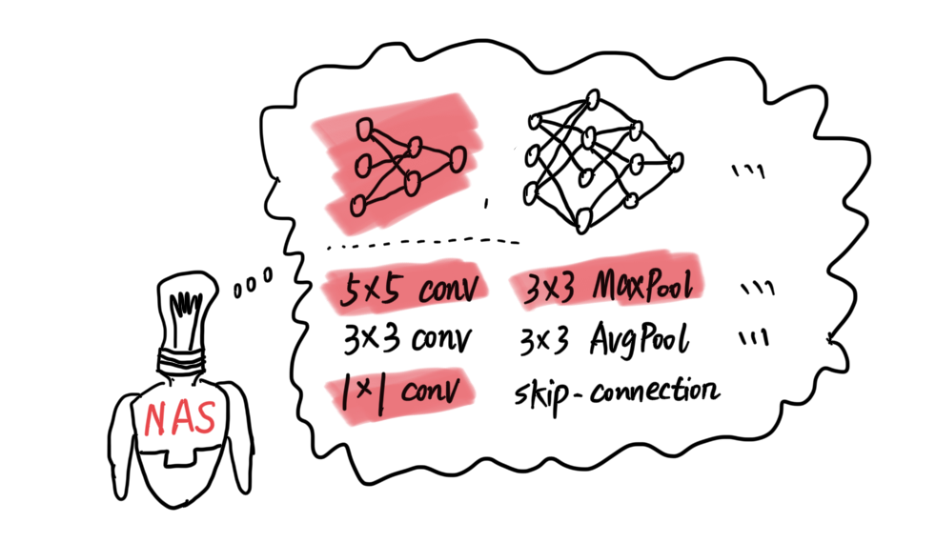
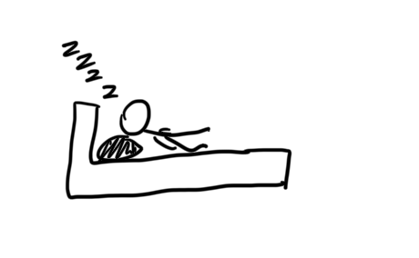
Neural Architecture Search (NAS)
3 / 30
Notes:
So this leads to Neural Architecture Search, or NAS.
It’s like hiring a robot to explores a huge search space that contains many possible neural architectures.
It evaluates them, compares them, and tries to find a near-optimal architecture.
Ideally, we can just go to sleep, and after we wake up, we get a good neural network that works well for our task.

Slide 4
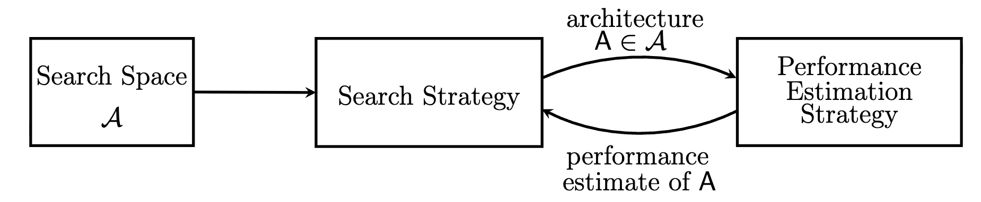


Introducing Neural Architecture Search (NAS)
How can we find a near-optimal architecture with only a small evaluation budget?
4 / 30
Notes:
So, what exactly do we mean by NAS?
Imagine we want to cook the best meal.
First, we have a menu of ingredients and cooking steps we’re allowed to use. That’s the search space. In NAS, these are neural architectures.
Second, we need to decide what recipe to try next. That’s the search strategy.
Third, we need a taste test. This is the performance estimation strategy. In ML, this means: we train the architecture and measure its validation error.
After each taste test, we use the feedback to decide what to try next.
So the whole loop is very simple: pick an architecture → train and evaluate → use the result to pick a better one next time.
---
But there are some bottlenecks for NAS.
The search space is enormous. In practice, we can only afford a very small number of trials, maybe around 100 evaluations.
So the question becomes:
how do we choose a NAS algorithm? to make sure we can finally find a near-optimal architecture under a limited budget?

Slide 5
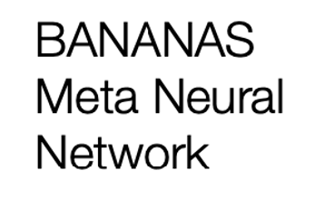
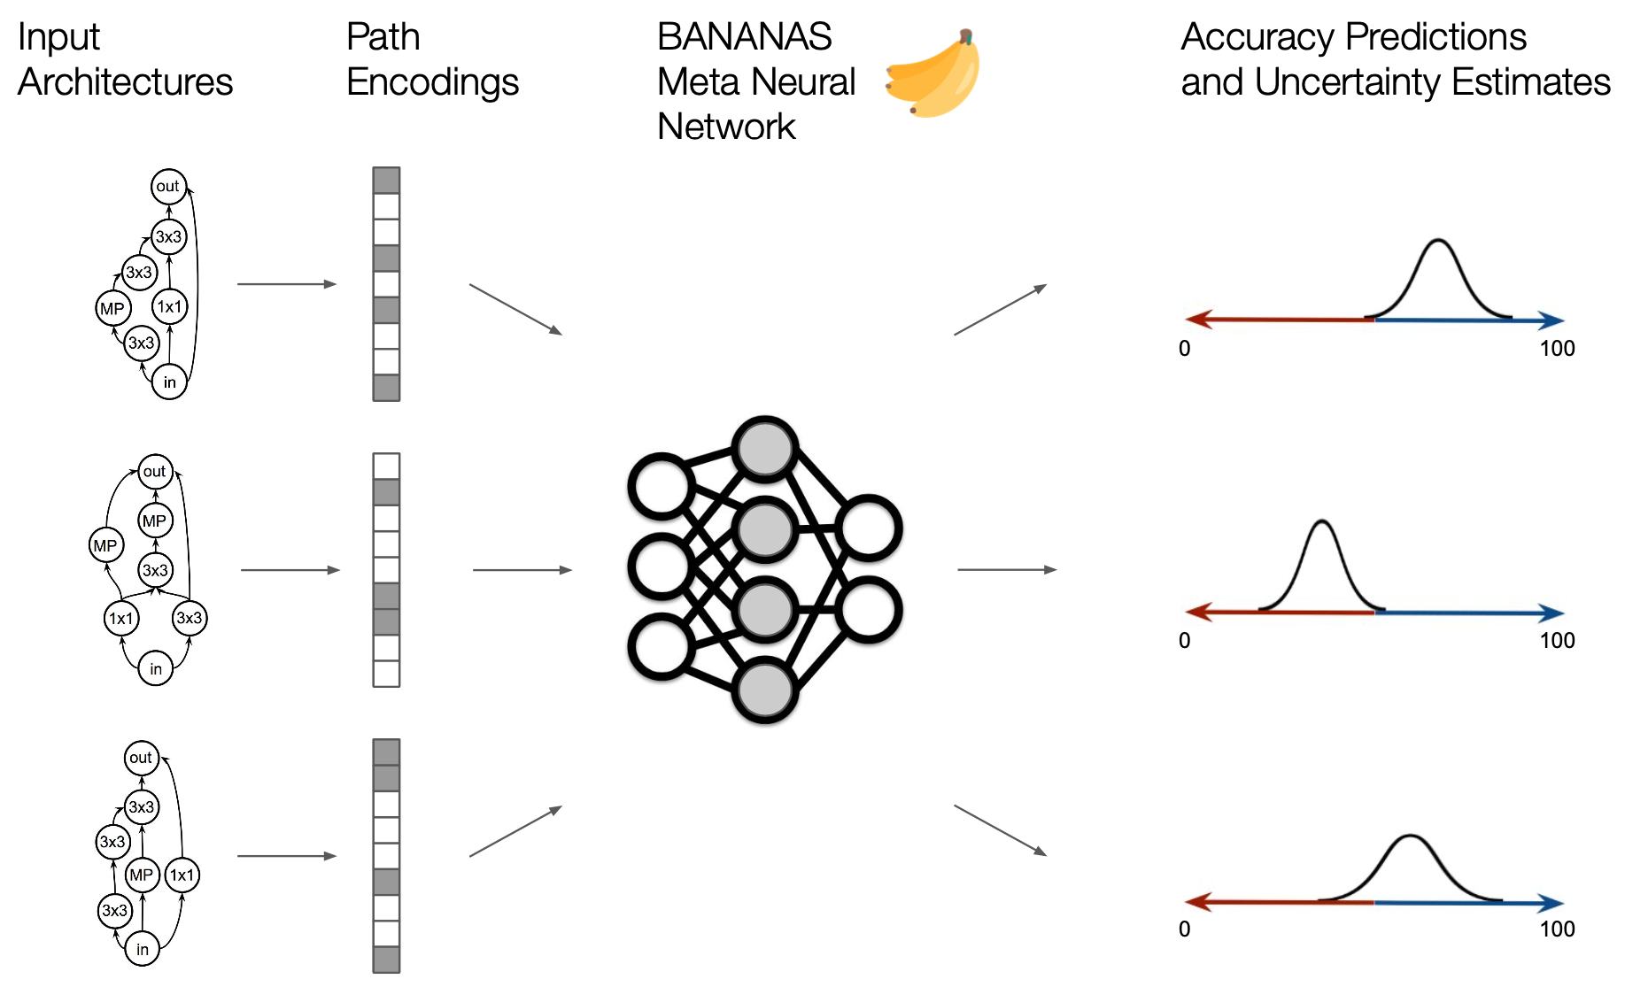
Bayesian Optimization + Neural Predictor
5 / 30
Notes:
And this is exactly where Bayesian optimization naturally fits.
In this paper, the NAS algorithm is Bayesian optimization plus a neural predictor.
We can check this framework step by step.
We start with some initial random architectures.
First, we encode each architecture into a vector representation.
Then we train a neural network predictor that takes this encoding as input, and predicts the architecture’s validation accuracy.
At the same time, the model also gives us an uncertainty estimate about this prediction.
We can then use the predicted mean and uncertainty to construct an acquisition function, which scores how promising each architecture is.
We then select the most promising architecture, train and evaluate it, and add this result back to our data.
This process is repeated iteratively.

Slide 6
A Framework Contains 5 Components
Architecture encoding
Neural predictor
Uncertainty calibration method
Acquisition function
Acquisition function optimization
6 / 30
Notes:
So far, we said the NAS algorithm is Bayesian optimization plus a neural predictor.
The key point of this paper is:
This framework is not one fixed algorithm. It has five components, and each component has design choices.
For example,
First, architecture encoding. We need to find a good encoding algorithm to turn an architecture graph into a vector.

Slide 7

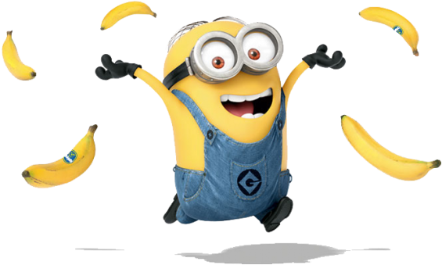
Which combination of design choices works best for sample-efficient search?
BANANAS = the best-performing combination found by testing different design choices for each component.
Architecture encoding
Neural predictor
Uncertainty calibration method
Acquisition function
Acquisition function optimization
7 / 30
Notes:
And the main question of the paper — and of this talk — is very practical: which combination of design choices, across these five components, works best under a small budget?
So basically, we are Minions here, and we want to find the best banana from each component.
And if we put these best choices together, we get BANANAS —the best-performing combination found by the component studies.
Next, we’ll go through these five components one by one, and explore the best option each time.

Slide 8
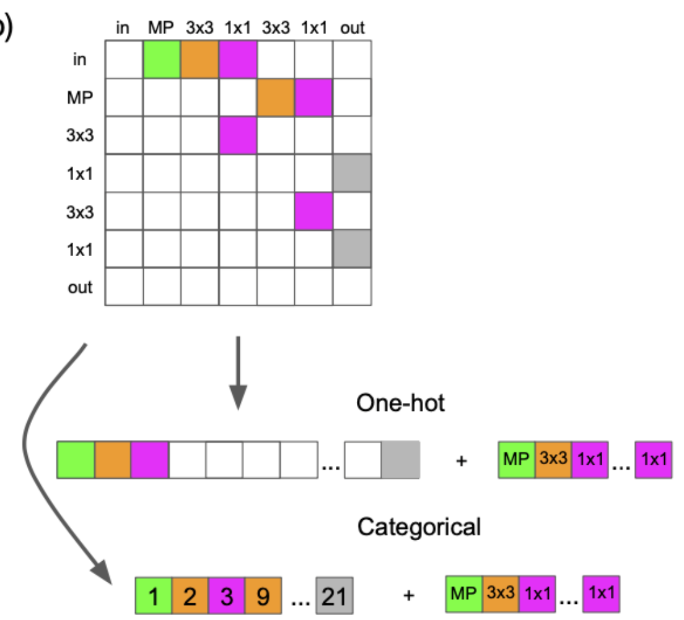
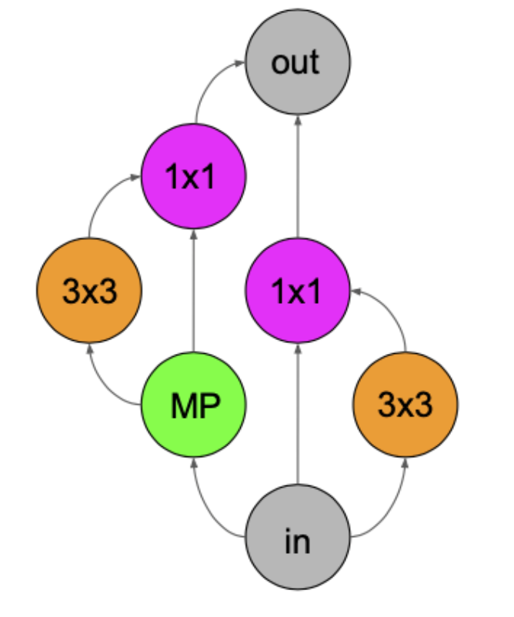
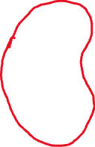



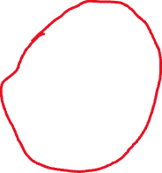

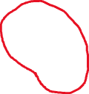
Encoding
Predictor
Uncertainty
Acquisition
Optimization
Architecture Encoding
Adjacency matrix encoding
8 / 30
Notes:
Now the first component: architecture encoding.
Most existing work uses an adjacency matrix to encode neural architectures.
First, we view an architecture as a directed acyclic graph. Each node is an operation, like 3×3 conv, 1×1 conv, or max-pool. And each edge means “the output of one node flows into the next node.”
Then we create an adjacency matrix to represent the connections. Rows and columns correspond to nodes, and an entry indicates whether there is a connection.
For example,
from the input node, we connect to MP, 1×1, and 3×3. From MP, we connect to the next nodes, and so on, until we reach out.
In this search space, connections only go forward one-way,
So we only care about the top-right part of the matrix.
After that, we flatten the matrix into a long vector, and use either a one-hot or a categorical representation.
And in both cases, we also append the operation labels for the nodes, so the encoding also captures the used operations.

Slide 9
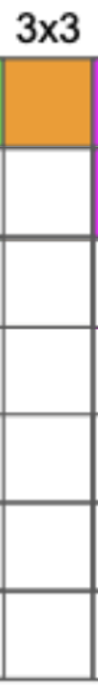




Encoding
Predictor
Uncertainty
Acquisition
Optimization
Limitations about Adjacency Matrix Encoding
Arbitrary node ordering
Edges can be meaningless without a full path
9 / 30
Notes:
There are some limitations of adjacency matrix encoding.
The encoding depends on how we index the nodes.
For example,
if we swap the positions of MP and 3×3 in the ordering, the architecture graph is the same, but the adjacency matrix and the flattened vector — looks different.
Second: edges can be ambiguous without full paths. An adjacency matrix only tells us “this node connects to that node.” But it does not explicitly represent complete input-to-output paths.
For example, if we have an edge that connects to a 1×1 node, but if that branch never reaches the output, that edge contributes nothing to the final computation, yet it still appears in the encoding and adds noise to the representation.
And this is exactly why we proposes the alternative: path encoding.

Slide 10
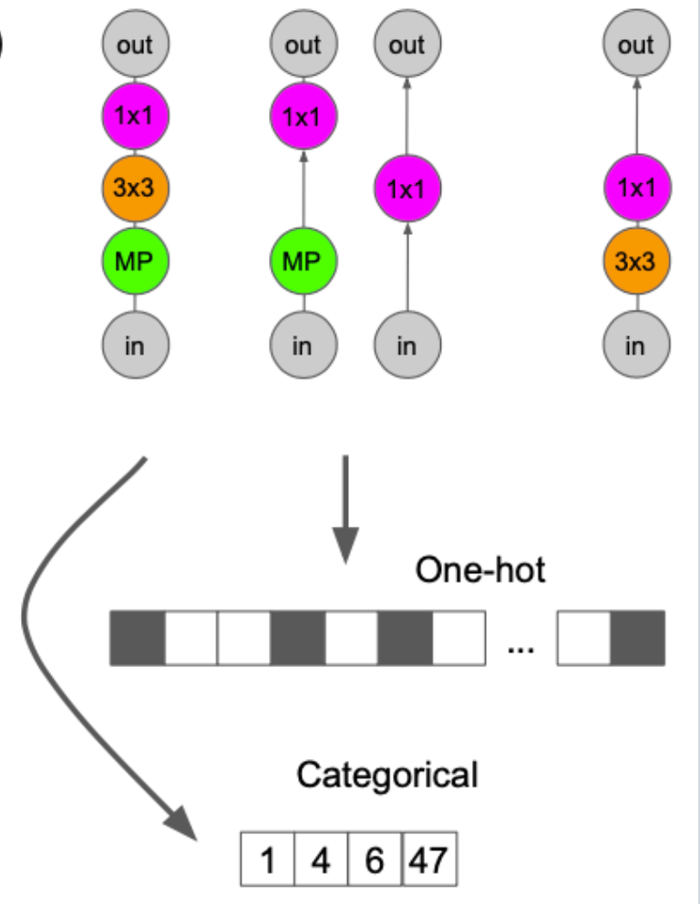

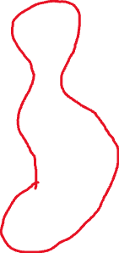


Encoding
Predictor
Uncertainty
Acquisition
Optimization
Architecture Encoding
Adjacency matrix encoding
Path encoding
10 / 30
Notes:
The idea is simple. Instead of representing individual edges, we represent the architecture by enumerating all valid input-to-output paths.
For example, from this architecture graph we can extract paths like: in → MP → 3×3 → 1×1 → out, in → MP → 1×1 → out, in → 1×1 → out, and in → 3×3 → 1×1 → out.
We define a global list of all possible paths in this search space. The encoding length is the number of paths in that list.
Each path has a fixed index in this list.
So if a path exists in the architecture, we mark that position in the encoding vector.
In this example,
the first path correspond to index 1, and the last path correspond to something like index 47.
So the final encoding is basically a compact “fingerprint” of which complete paths appear in the architecture.

Slide 11
Encoding
Predictor
Uncertainty
Acquisition
Optimization
Path Encoding
No arbitrary node ordering
Each feature = an complete input→output path
11 / 30
Notes:
So for path encoding, there is no arbitrary ordering. Each possible path has a fixed index, so one architecture maps to one unique encoding.
Second, each feature represents a complete input-to-output path. So the encoding focuses on the structure that actually matters, and contains less irrelevant information compared to adjacency matrices.
So for the first component — architecture encoding — the Minion finds the first banana: path encoding.
Next, we move to the second component: the neural predictor.

Slide 12
Encoding
Predictor
Uncertainty
Acquisition
Optimization
Neural Predictor
Encoded architecture
A sequential fully-connected network with 10 layers of width 20
Feedforward neural network
Predicted accuray
12 / 30
Notes:
It takes an encoded architecture as input, and predicts its validation accuracy.
In this paper, the predictor is a feedforward neural network, basically an MLP.
Concretely, it’s a sequential fully-connected network with 10 layers, each with width 20.
As we evaluate more architectures, we keep updating this predictor using the data we have so far. So it gradually becomes better at ranking new candidates.

Slide 13
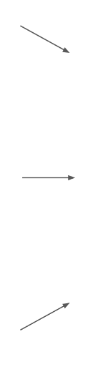

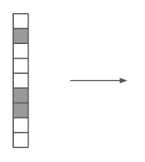

Encoding
Predictor
Uncertainty
Acquisition
Optimization
Uncertainty via Ensembles
Disagreement across predictors ≈ uncertainty
Ensemble
Train M predictors
(same architecture,
different initial weights)
Mean
Standard deviation
For a candidate x
Predictions: f₁(x) … f_{M}(x)
Mean and Standard deviation
candidate x
M predictors
13 / 30
Notes:
Now we move to the third component: uncertainty estimation.
To use Bayesian optimization, the surrogate model must give us two things: a prediction and an uncertainty about that prediction.
A simple baseline is one neural network with two outputs: one for the mean, and one for the standard deviation.
In this paper, we mainly use a very practical method: ensembles.
The idea is: we train M predictors with the same architecture, but with different random initial weights, and different data order.
Then for one candidate architecture $x$, each predictor gives a predicted validation error: $f_{1}\left(x\right),f_{2}\left(x\right),…,f_{M}\left(x\right)$.
We take the mean of these predictions as our best estimate. And we take the standard deviation as the uncertainty.

Slide 14
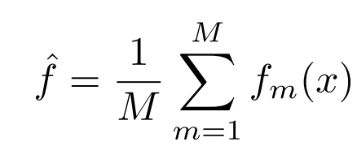
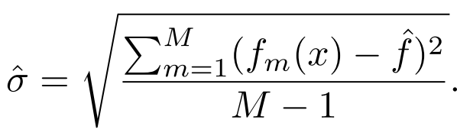

Encoding
Predictor
Uncertainty
Acquisition
Optimization
Ensemble Predictor: Mean + Uncertainty
14 / 30
Notes:
Here are the formulas for the ensemble’s mean and uncertainty.
For one candidate architecture $x$, we have $M$predictions from the $M$ predictors: $f_{1}\left(x\right),f_{2}\left(x\right),…,f_{M}\left(x\right)$.
We take their average as the predicted performance, that’s the mean.
And we take their standard deviation as the uncertainty.
We can loosely think of the output as a distribution around the mean.
And that’s exactly what we need to build an acquisition function.

Slide 15
Encoding
Predictor
Uncertainty
Acquisition
Optimization
Best choice: an ensemble of feed-forward networks with the path encoding.
M predictors
15 / 30
Notes:
Okay, so far we can summarize the choice we found for NAS algorithm: an ensemble of feed-forward networks with the path encoding.
First, path encoding, we encode an architecture with path encoding. So the same architecture always maps to the same vector.
Second, the feed-forward network: this is just an MLP that takes that encoded vector as input, and outputs a predicted performance—like validation accuracy, or equivalently validation error.
Third, the ensemble: we train M copies of the same MLP. So for each architecture $x$, we get a mean prediction and a standard deviation as uncertainty.
so now we’re ready to define the acquisition function, which turns them into a single score for what to try next.

Slide 16
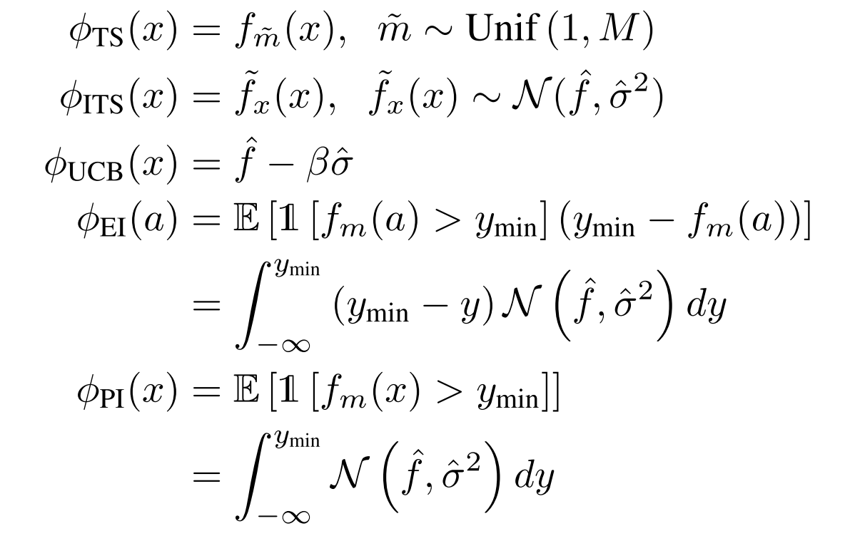
Encoding
Predictor
Uncertainty
Acquisition
Optimization
Acquisition Function
Turn (mean, uncertainty) into a “what to try next” score
16 / 30
Notes:
Now we move to the fourth component: the acquisition function.
The acquisition function turns the output — mean and uncertainty — into a single “what to try next” score.
The paper mentions five acquisition functions.
Intuitively, they balance two goals: exploitation, choosing architectures with low predicted error, and exploration, trying uncertain architectures that might surprise us.
Here, we’ll focus on the first three on this slide: Thompson Sampling (TS), Independent Thompson Sampling (ITS), and UCB.
Next, I’ll briefly explain what each one means and how it uses the ensemble predictions.

Slide 17

Encoding
Predictor
Uncertainty
Acquisition
Optimization
Thompson Sampling (TS)
Randomly pick one model,
Use that model’s prediction as the acquisition score.
3
3
17 / 30
Notes:
The first acquisition function is Thompson Sampling, or TS.
The idea is: we randomly pick one predictor from the ensemble, and we use that predictor’s predicted error as the acquisition score for all candidates.
For example, here we have three predictors $f_{1},f_{2},f_{3}$. If we randomly pick the third one, then the acquisition score becomes f3 for every candidate $x$.
Then we just rank candidates using these scores and pick the best ones to evaluate next.
So instead of combining mean and uncertainty explicitly, TS injects exploration through randomness:
The biggest feature of TS is exactly this:
it’s simple and cheap, but still encourages exploration.

Slide 18
Encoding
Predictor
Uncertainty
Acquisition
Optimization
Independent Thompson Sampling (ITS)
For each candidate x, sample a plausible value
Use the value as the acquisition score.
18 / 30
Notes:
The second one is Independent Thompson Sampling, or ITS.
Compared to TS, the key difference is this: TS picks one ensemble model once, but ITS samples a value for every candidate architecture.
Concretely, for each candidate $x$, we already have a mean and a standard deviation from the ensemble. We treat that as a simple Gaussian, then we draw one sample, and we use that sampled value as the acquisition score.
Intuitively, if a candidate has higher uncertainty, the distribution is wider, so sampling can sometimes give it a very good score, which encourages exploration.

Slide 19
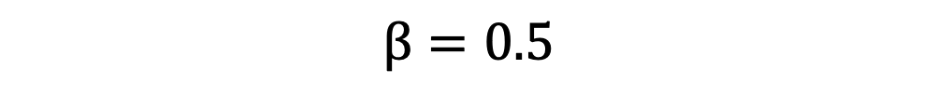
Encoding
Predictor
Uncertainty
Acquisition
Optimization
Upper Confidence Bound (UCB)
Balance exploitation and exploration.
Mean Uncertainty
$$β=0.5$$
19 / 30
Notes:
The third acquisition method is UCB, which stands for Upper Confidence Bound.
It’s a classic way to balance exploitation and exploration using a simple formula.
Here we are minimizing validation error, so we choose the candidate with the smallest acquisition score.
The intuition is straightforward: $\hat{f}\left(x\right)$is the predicted error — so lower is better. And $\hat{σ}\left(x\right)$is uncertainty — if uncertainty is high, we subtract more, which makes that candidate look more attractive and encourages exploration.
The parameter $β$ controls the trade-off: larger $β$ means we explore more; smaller $β$ means we exploit more. In the paper they set $β=0.5$.

Slide 20
Encoding
Predictor
Uncertainty
Acquisition
Optimization
Acquisition Function Optimization
Scoring every architecture is expensive
Candidate pool
Select next
Sample 100–1000 architectures
Compute acquisition score for each
Pick the best candidate
Train and evaluate it
Add it to the evaluated data
Quality depends on candidate pool generation.
Random, mutation...
20 / 30
Notes:
Now we come to the last component: optimizing acquisition function.
In standard BO, you can often maximize the acquisition over the whole space. But in NAS, the space is discrete and enormous, so we cannot score every architecture.
So the practical solution is: we first build a candidate pool, usually 100 to 1000 architectures, and compute the acquisition score for each one.
Then we try to pick the best candidate to actually evaluate next.
The key question becomes: how do we generate a good candidate pool? We can use methods like random and mutation.
1. Random:
just sample 100–1000 architectures uniformly at random. Simple, but not very sample-efficient.

Slide 21
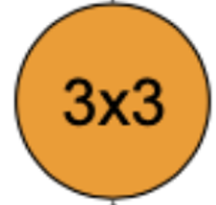
Encoding
Predictor
Uncertainty
Acquisition
Optimization
Mutation
21 / 30
Notes:
2. Mutation:
take a strong architecture we already have and create candidates by randomly changing one edge or one operation,
Including change an operation randomly, add or remove one edge.
This let us focus the search locally around promising regions.

Slide 22
Encoding
Predictor
Uncertainty
Acquisition
Optimization
Experiment
Dataset
NASBench-101
NASBench-201
DARTS
Multiple neural architectures,
Precomputed validation and test accuracies
22 / 30
Notes:
Now let’s move to the experiments.
The paper evaluates each component and BANANAS on three search spaces: NASBench-101, NASBench-201, and DARTS.
NASBench-101 and NASBench-201 are tabular benchmarks:
they contain many architectures with precomputed validation/test accuracies, so we can run NAS experiments fast and reproducibly.
DARTS is different: it’s a much larger search space, so here the method has to behave well in a more realistic setting. general

Slide 23
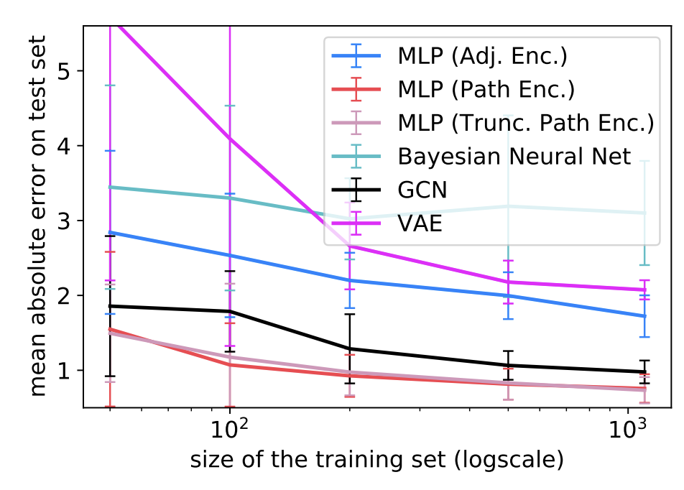
Encoding
Predictor
Uncertainty
Acquisition
Optimization
Performance Analysis: Neural Predictors on NASBench-101
Feedforward neural network
23 / 30
Notes:
We conduct an experiment to evaluate a standard feedforward network, an MLP, using different encodings, adjacency and path encoding
and we compare it with more complex predictors like GCN and VAE.
A GCN is a graph neural network that directly processes the architecture graph, no encoding needed. A VAE is a generative model that learns a latent representation of architectures. But they are not the focus here, if we don’t understand them, that’s totally okay.
The benchmark here is NASBench-101. It contains a very large set of CNN architectures, and for each architecture it already have precomputed accuracies on CIFAR-10. So we can use them to quickly train and test neural predictors.
For this plot. The x-axis is the training set size. The y-axis is mean absolute error between the predicted and ground truth on test set — and lower is better.
The main takeaway is very clear: the MLP with path encoding performs the best overall. And truncated path encoding is also strong.
“Truncated” just means we only keep effective length paths, to make encoding vector smaller, but still keeps most of the important information.
So for the predictor component, the Minion gets a new banana: a simple feedforward network with path encoding works really well.

Slide 24
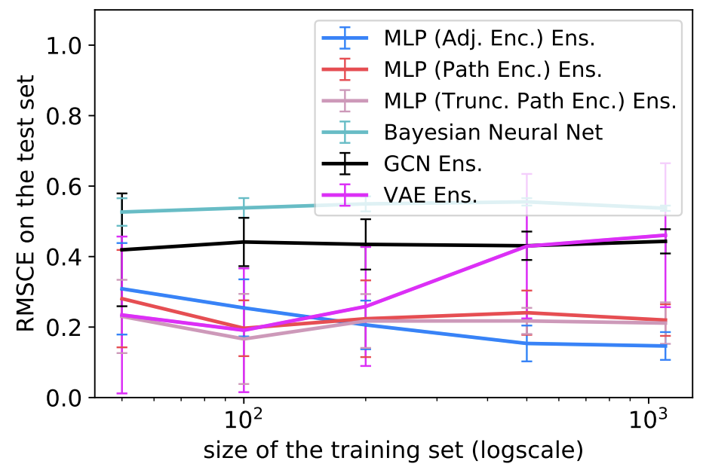
Encoding
Predictor
Uncertainty
Acquisition
Optimization
Performance Analysis: Uncertainty Estimate on NASBench-101
RMSCE: root mean squared calibration error
Ensemble
24 / 30
Notes:
The experimental setup here is similar to the previous slide, but now we evaluate uncertainty calibration instead of prediction error.
The metric is RMSCE — root mean squared calibration error. We don’t need the details; just remember: lower is better.
Intuitively, calibration means: if the model says “I’m 80% confident,” then it should be correct about 80% of the time.
Now look at the results. The main takeaway is that ensemble-based predictors give better uncertainty estimation than the Bayesian neural network baseline, across training set sizes.
So for the uncertainty component, the Minion gets the banana: use ensembles to estimate uncertainty.

Slide 25
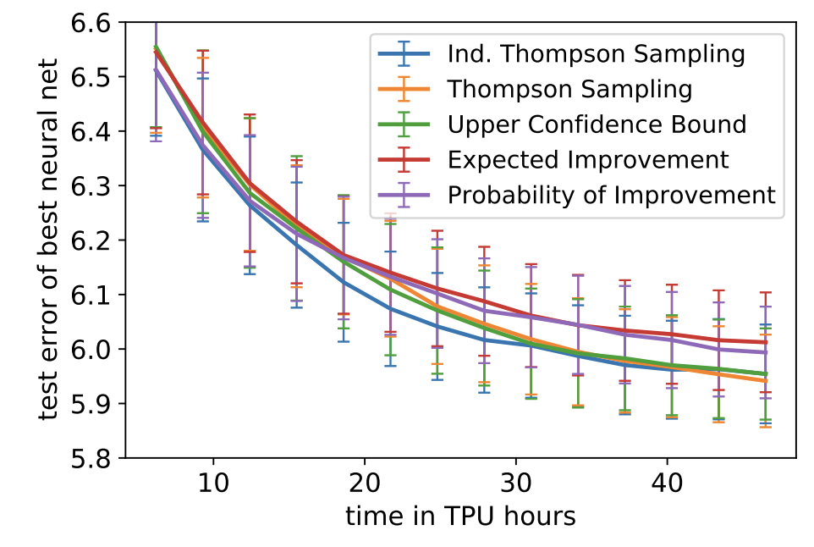
Encoding
Predictor
Uncertainty
Acquisition
Optimization
Performance of different acquisition functions
Use the best settings from the previous section: path encoding, ensemble networks
ITS
25 / 30
Notes:
Now we compare acquisition functions, while keeping the best settings fixed: path encoding + ensemble predictor.
In this plot, the y-axis is test error of the best model found so far—so lower is better. The x-axis is search time.
The main message is: the curves are very close. So the acquisition function matters, but not as much as the earlier components like encoding and the predictor.
That said, there is still a winner: ITS—Integrated Thompson Sampling—performs best overall, especially in the start stage,
so the paper uses ITS as the default choice going forward.

Slide 26
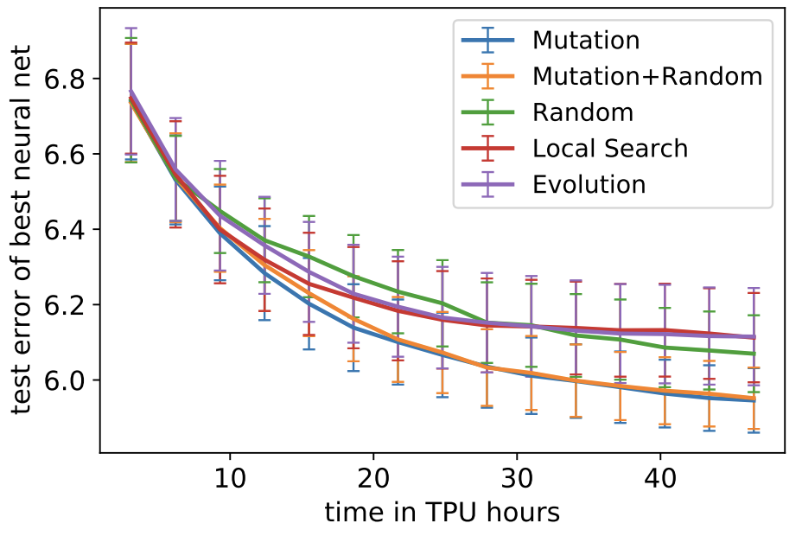
Encoding
Predictor
Uncertainty
Acquisition
Optimization
Performance of different acquisition function optimization strategies
Pick the next architecture to test based on acquisition function
Mutation
26 / 30
Notes:
Now we move to the last component: acquisition function optimization opponents.
This plot compares different ways to generate that candidate pool: Random, Mutation, Local Search, and Evolution.
Again, the y-axis is test error of the best model found so far, so lower is better.
The takeaway is very clear: Mutation performs best overall. It gives a good balance: we mostly explore near the current best architectures, but still introduce small changes to discover improvements efficiently.
So for the optimization component, the Minion gets the final banana: use mutation to search for the next candidates.

Slide 27
BANANAS
The strongest combination from the previous component study
Architecture encoding: path encoding
Neural predictor: feedforward neural network
Uncertainty: an ensemble of predictors
Acquisition function: Independent Thompson Sampling
Acquisition optimization: candidate pool (mutation)
27 / 30
Notes:
Now let’s summarize BANANAS.
After studying the five components one by one, we combine the best choice for each component into one final recipe.
So in the end, the Minions have collected the five best bananas: path encoding, a feedforward neural network as the predictor, an ensemble for uncertainty, ITS as the acquisition function, and mutation for candidate-pool generation.
And this full combination is what they call BANANAS, the strongest setup we found under a small evaluation budget.

Slide 28
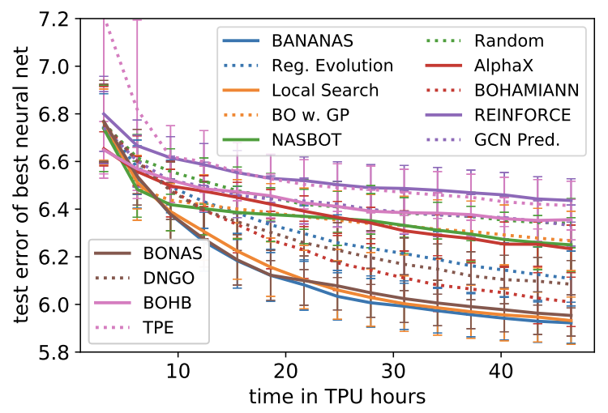
Performance of BANANAS compared to other NAS algorithms
BANANAS
path encoding
feedforward neural network
an ensemble of predictors
ITS
candidate pool (mutation)
28 / 30
Notes:
Now we compare BANANAS with other NAS algorithms.
The x-axis is the search time (TPU hours), and the y-axis is the test error of the best architecture found so far — so lower is better.
You can see that BANANAS drops the error faster, and it stays among the best across the whole budget.
This means: with the same limited time, BANANAS finds strong architectures more sample-efficiently. So overall, the component choices we identified — path encoding, feedforward ensemble, ITS, and mutation-based candidate pool — translate into better end-to-end NAS performance.

Slide 29
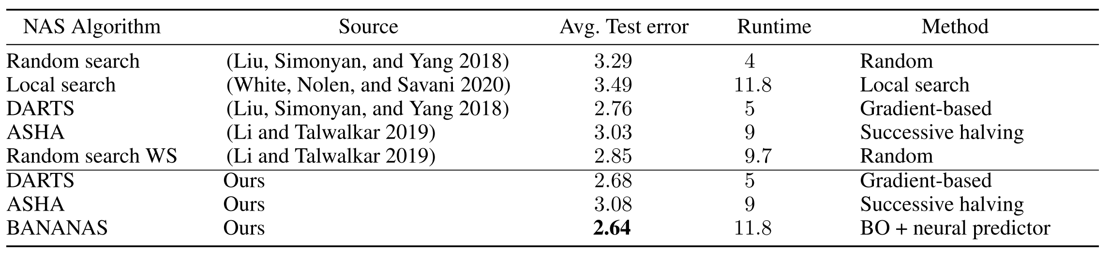
Comparison of NAS algorithms on the DARTS search space
DARTS provides 1018 architectures and precomputed validation and test accuracy
29 / 30
Notes:
This table shows results on the DARTS search space, much larger and realistic search space
The key column is Avg. test error — again, lower is better. We can see BANANAS achieves the lowest test error (2.64) among the methods listed.
One thing to notice is runtime: BANANAS is not the fastest here, but it gives the best final accuracy under a comparable budget. So the message is: even on the DARTS space, the BO + neural predictor approach remains competitive and often best in final quality.

Slide 30
Takeaways
Bayesian Optimization + a neural predictor is a high-performance framework for Neural Architecture Search (NAS).
BANANAS achieves strong performance by selecting the best design choices across five components: Encoding, Predictor, Uncertainty, Acquisition, and Optimization.
The winning setup is: path encoding + MLP predictor + ensemble uncertainty + ITS acquisition + mutation optimization.
30 / 30
Notes:
To wrap up, the big message is: Bayesian Optimization + a neural predictor is a very strong and practical framework for Neural Architecture Search, especially when we only have a small evaluation budget.
The key idea of this paper is that this framework is not one fixed algorithm. It’s made of five components — encoding, predictor, uncertainty, acquisition, and optimization — and each one has design choices that matter.
And BANANAS is basically the best combination they found from these component studies: path encoding, a simple MLP predictor, ensemble-based uncertainty, ITS as the acquisition rule, and mutation to generate the candidate pool.
So overall: with the right “recipe”, we can do sample-efficient NAS and reach strong performance with only around ~100 evaluations.

