Slide 1

EXPLOITS UNIVERSITY
BSc INFORMATION COMMUNICATION AND TECHNOLOGY
BICT 3202 · OBJECT-ORIENTED ANALYSIS AND DESIGN
WEEK 1
Business Needs, Software Needs and Object Technology for Business
Francis Fweta · ICT Lecturer · Week 1 of 16

Slide 2
Learning Outcomes
By the end of this week, you should be able to…
▪ Define a business need and explain why organisations build or acquire software.
▪ Distinguish business problem · business need · requirement · software solution.
▪ Identify stakeholders and explain functional vs non-functional software needs.
▪ Relate business objectives to software requirements through the business-to-software chain.
▪ Describe object technology and explain what an object is.
▪ Explain identity, state and behaviour — and why real-world entities help in analysis.
▪ Discuss strengths & limitations of object-oriented approaches.
▪ Apply the concepts to a real-world business case (e.g. registration, ATM, library).
Requirements come first — not the class diagram.
BICT 3202 · Object-Oriented Analysis and Design
Week 1 · Slide 1

Slide 3
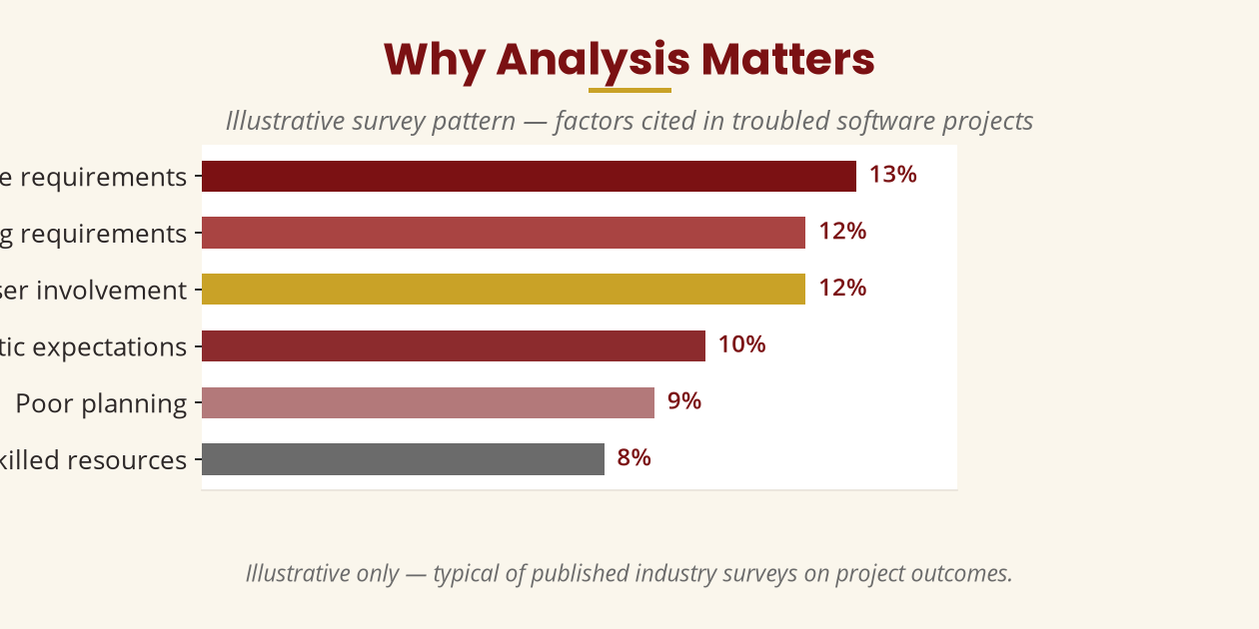
Why Do We Need OOAD?
The story of a developer who started coding too early
▪ University: “We need a new student management system.”
▪ Developer builds login, tables, payments, exams, dashboard.
▪ Six months later: “This isn't what we asked for.”
▪ The real problem? insufficient analysis of business needs before design.
▪ OOAD exists to prevent exactly this failure.
Analysis first — programming second.
BICT 3202 · Object-Oriented Analysis and Design
Week 1 · Slide 2

Slide 4
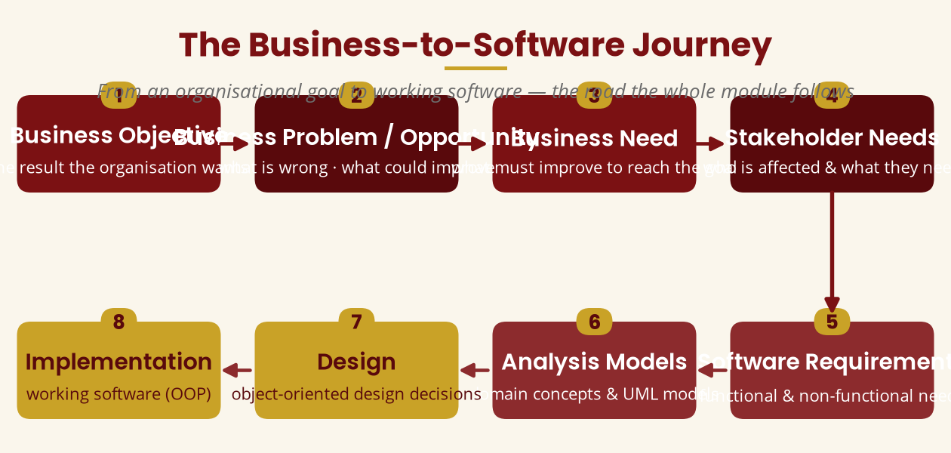
The Business-to-Software Journey
Eight steps from a goal to working software
This chain is the backbone of the entire 16-week module.
BICT 3202 · Object-Oriented Analysis and Design
Week 1 · Slide 3

Slide 5
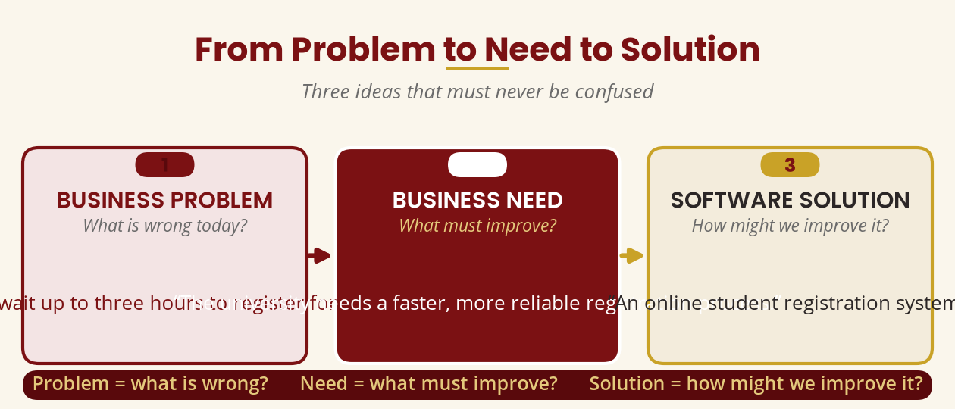
Problem → Need → Solution
Three ideas that must never be confused
Problem = what is wrong · Need = what must improve · Solution = how we improve it
BICT 3202 · Object-Oriented Analysis and Design
Week 1 · Slide 4

Slide 6
Business Objectives & the Chain
Objectives drive needs, which drive requirements
▪ Business objective: a specific result the organisation wants (e.g. cut account-opening from 45 to 10 minutes).
▪ Business need: what must improve to reach the objective.
▪ Not every problem is a software problem — investigate first.
▪ Constraints & business rules shape the eventual solution.
▪ Business Objective
▪ Business Problem
▪ Business Need
▪ Stakeholder Needs
▪ Software Requirements
▪ Analysis Models
▪ Design
▪ Implementation
Objective → Problem → Need → Requirements → Models → Design → Implementation
BICT 3202 · Object-Oriented Analysis and Design
Week 1 · Slide 5

Slide 7
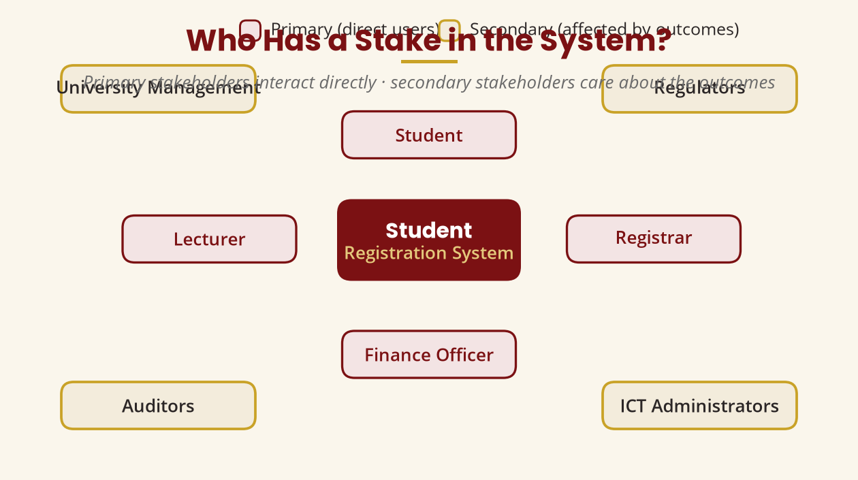
Stakeholders
Who has an interest in, or is affected by, the system?
Ignore a stakeholder and you miss their requirements.
BICT 3202 · Object-Oriented Analysis and Design
Week 1 · Slide 6

Slide 8
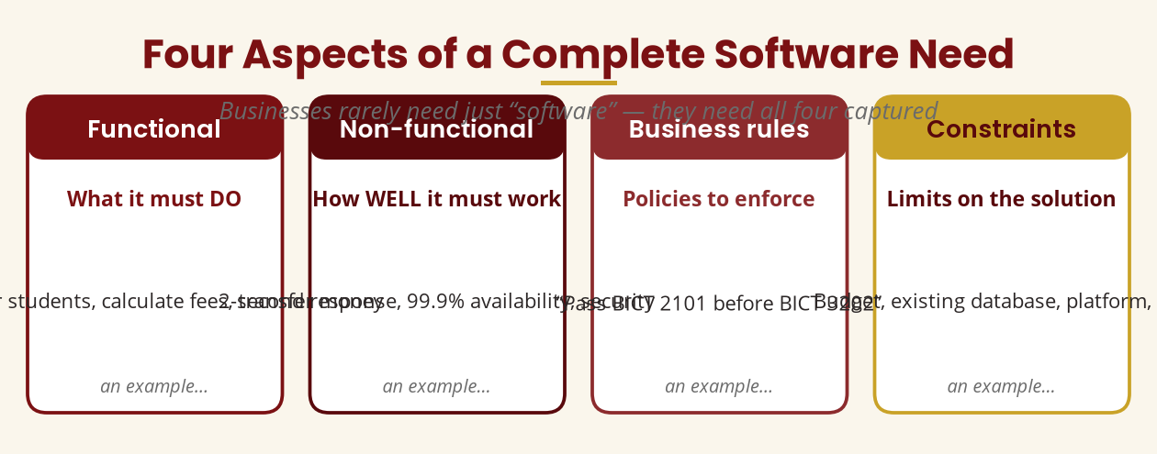
Aspects of Business Software Needs
A complete need has four parts
Functional · Non-functional · Business rules · Constraints
BICT 3202 · Object-Oriented Analysis and Design
Week 1 · Slide 7

Slide 9
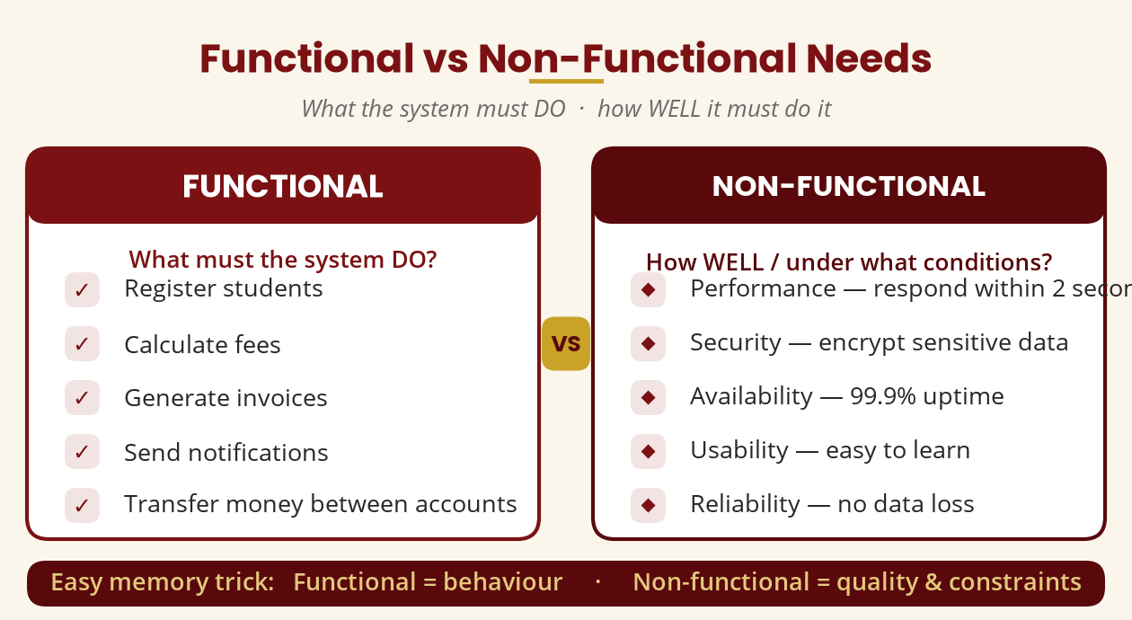
Functional vs Non-Functional
What it does vs how well it does it
Functional = behaviour · Non-functional = quality & constraints
BICT 3202 · Object-Oriented Analysis and Design
Week 1 · Slide 8

Slide 10
Business Rules & Constraints
Policies the software must enforce, and limits on the solution
▪ Business rule — a policy or condition governing the organisation.
▪ “Pass BICT 2101 before registering for BICT 3202.”
▪ “Withdraw at most MWK 500,000 per day.”
▪ “An employee cannot approve their own claim.”
▪ The functional requirement tells the software how to enforce the rule.
▪ Constraints restrict the solution:
▪ Available budget
▪ Existing hardware & database
▪ Legal & organisational policy
▪ Required platform & deployment
▪ Internet availability
Rules come from the organisation — the software enforces them.
BICT 3202 · Object-Oriented Analysis and Design
Week 1 · Slide 9

Slide 11
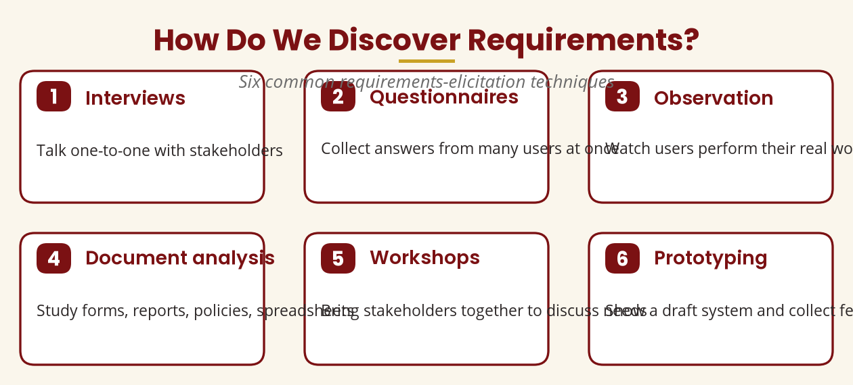
Requirements Elicitation
How the analyst discovers stakeholder needs (ISO/IEC/IEEE 29148)
Interviews · Questionnaires · Observation · Documents · Workshops · Prototyping
BICT 3202 · Object-Oriented Analysis and Design
Week 1 · Slide 10

Slide 12
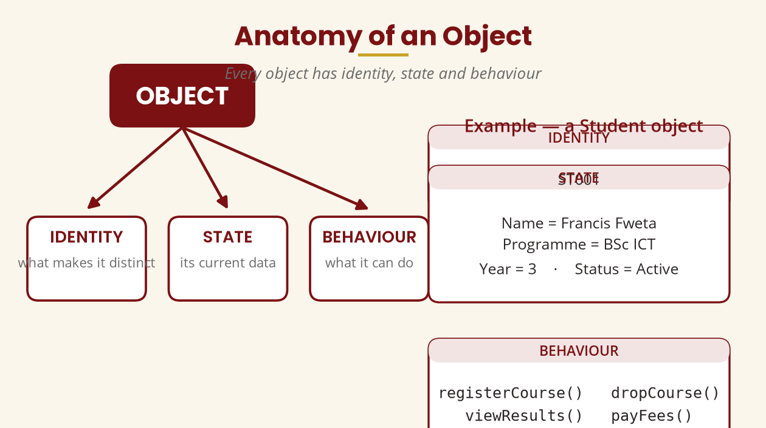
What Is an Object?
Identity · State · Behaviour
State = data · Behaviour = methods · Identity = uniqueness
BICT 3202 · Object-Oriented Analysis and Design
Week 1 · Slide 11

Slide 13
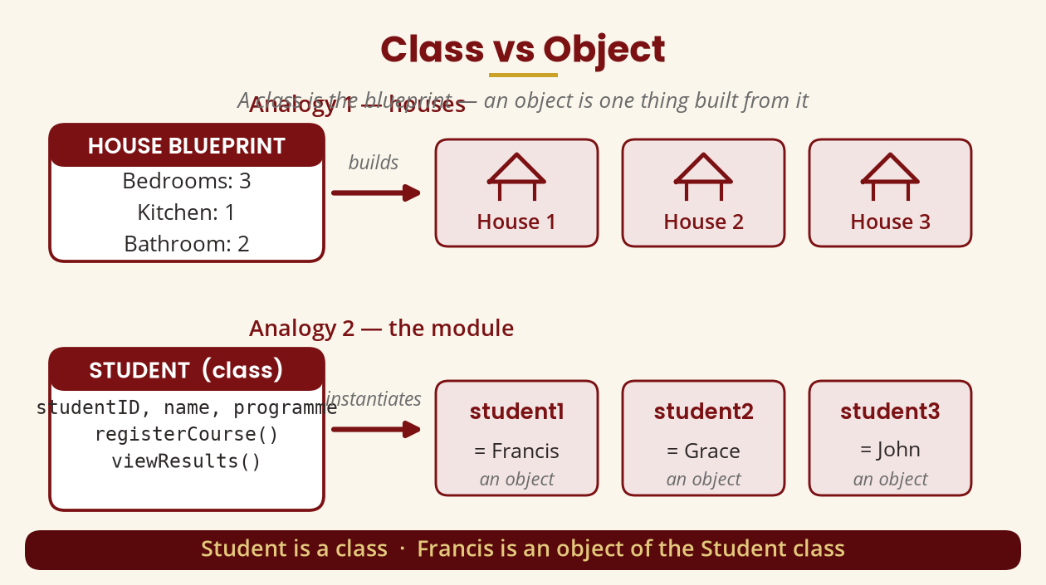
Class vs Object
The blueprint and the things built from it
Student is a class · Francis is an object of the Student class
BICT 3202 · Object-Oriented Analysis and Design
Week 1 · Slide 12

Slide 14
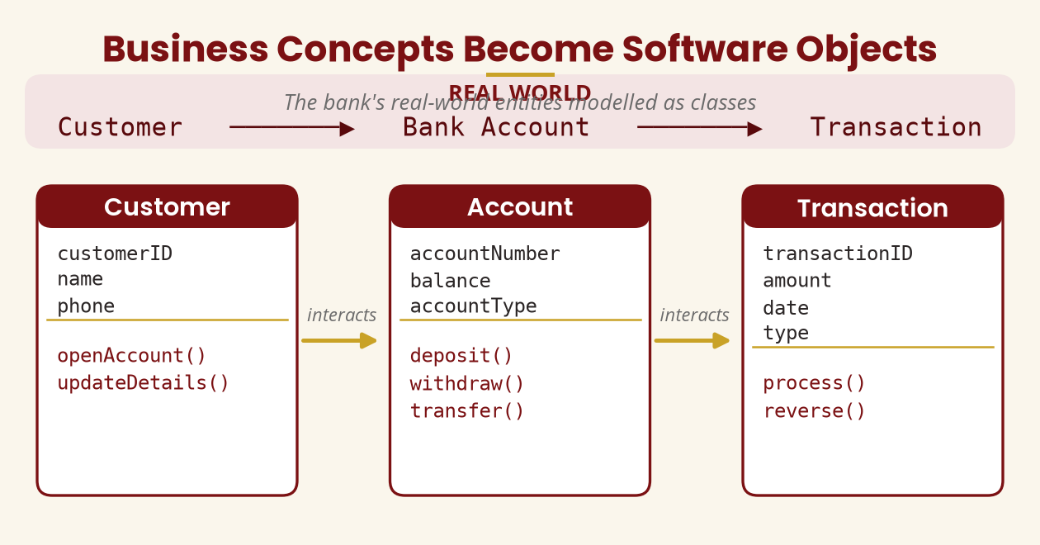
Business Concepts Become Objects
The bank's real-world entities modelled as classes
Objects need not be physical — Registration, Payment and Order are objects too.
BICT 3202 · Object-Oriented Analysis and Design
Week 1 · Slide 13

Slide 15
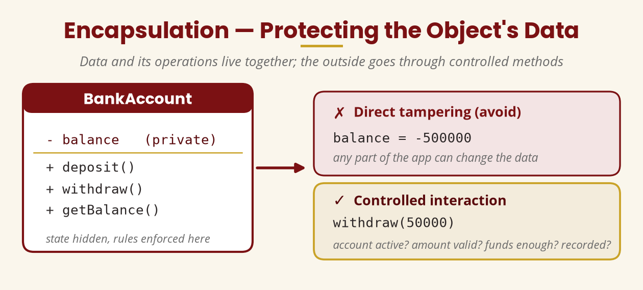
Encapsulation
Protect data behind controlled methods
Never let the whole app write balance = -500000 directly.
BICT 3202 · Object-Oriented Analysis and Design
Week 1 · Slide 14

Slide 16
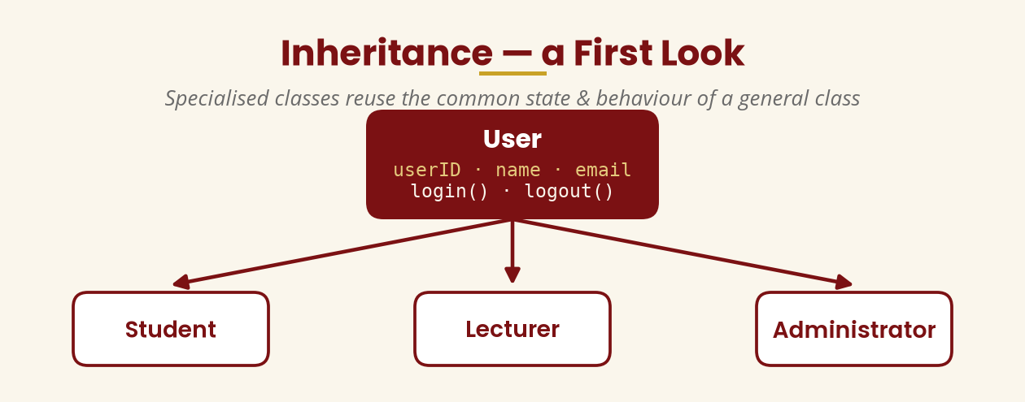
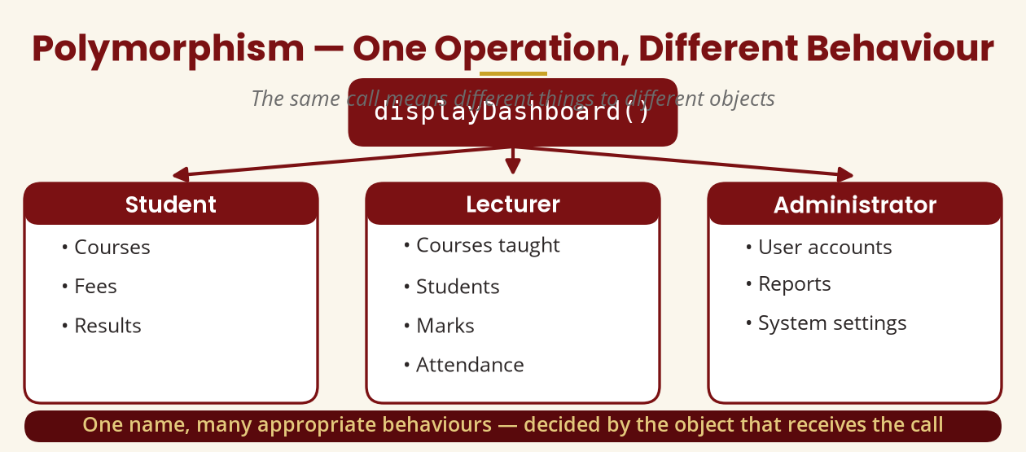
Inheritance & Polymorphism
Reuse common behaviour · respond differently to the same call
User → Student / Lecturer · displayDashboard() behaves differently per object
BICT 3202 · Object-Oriented Analysis and Design
Week 1 · Slide 15

Slide 17
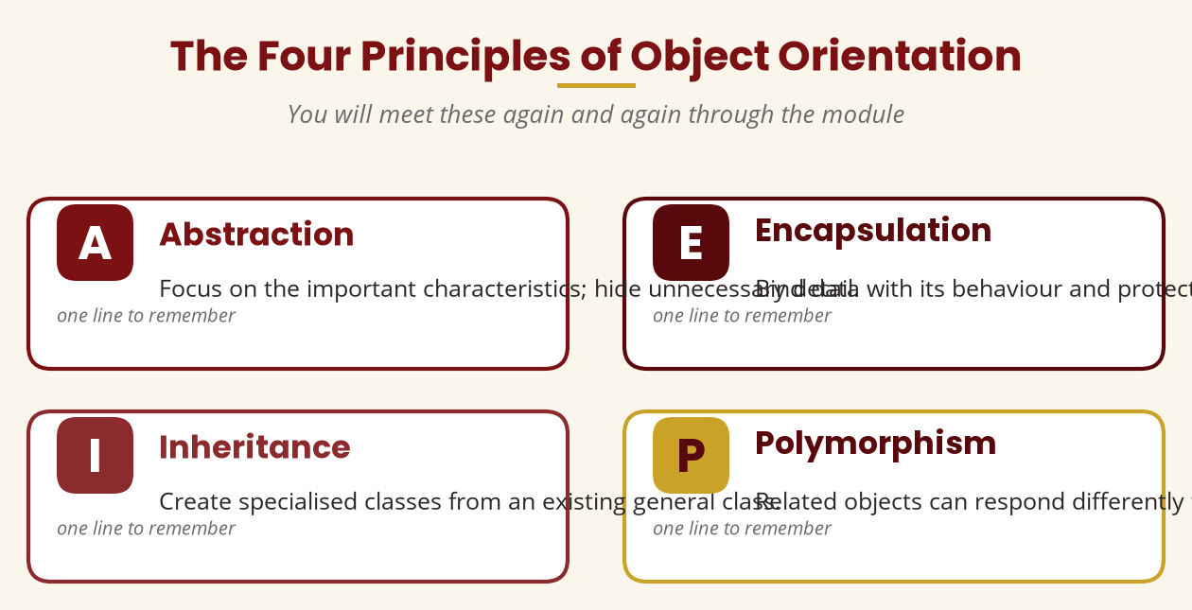
The Four OO Principles
The ideas you will meet again and again
Abstraction · Encapsulation · Inheritance · Polymorphism
BICT 3202 · Object-Oriented Analysis and Design
Week 1 · Slide 16

Slide 18
Strengths & Limitations
Object orientation is powerful — but it is not magic
▪ Strengths:
▪ Modularity — systems divided into components
▪ Reusability — components and classes reused
▪ Maintainability — changes isolated
▪ Encapsulation — details hidden
▪ Extensibility — easy to grow
▪ Natural mapping of business concepts
▪ Limitations:
▪ Complexity — thousands of classes
▪ Learning curve — many concepts
▪ Poor modelling adds complexity
▪ Inheritance can be misused
▪ Up-front modelling effort
OOA → OOD → OOP are three different stages — analysis is not coding.
BICT 3202 · Object-Oriented Analysis and Design
Week 1 · Slide 17

Slide 19
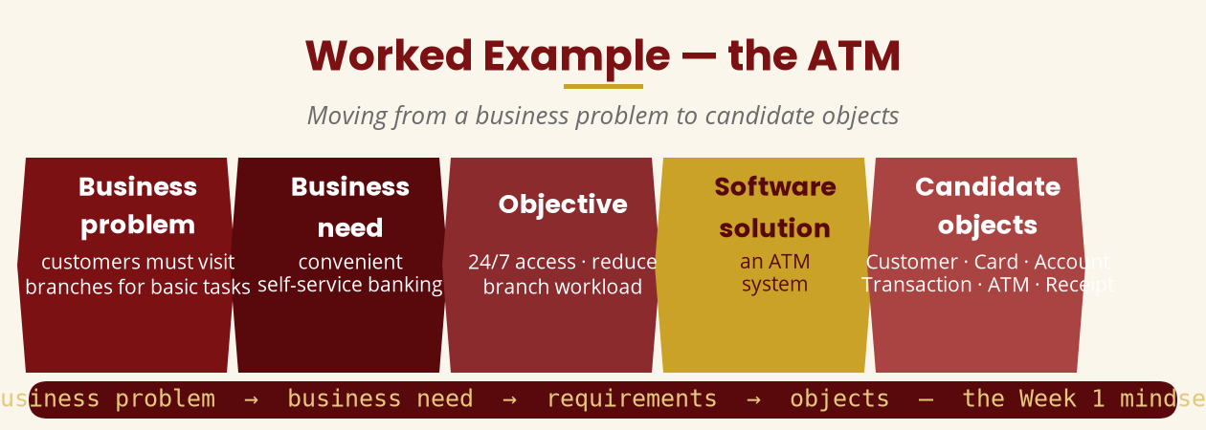
Worked Example — the ATM
From a business problem to candidate objects
business problem → business need → requirements → objects
BICT 3202 · Object-Oriented Analysis and Design
Week 1 · Slide 18

Slide 20
Practical & Tutorial
Apply Week 1 to a manual library system
▪ Practical (individual): the college's manual library system.
▪ List ≥ 5 business problems
▪ List ≥ 3 business needs
▪ List ≥ 6 stakeholders
▪ List ≥ 8 functional requirements
▪ List ≥ 5 non-functional requirements
▪ List ≥ 8 candidate objects — justify each
▪ Tutorial (groups): pick one system —
▪ Mobile money
▪ Hospital management
▪ Online shopping
▪ Hotel booking
▪ University registration
▪ Produce: problem, need, objective, stakeholders, functional & non-functional needs, rules, objects.
Present your group's findings to the class.
BICT 3202 · Object-Oriented Analysis and Design
Week 1 · Slide 19

Slide 21
Week 1 Summary
The definitions to remember
▪ Business need — a problem/opportunity/improvement the organisation must address.
▪ Stakeholder — anyone interested in or affected by the system.
▪ Functional requirement — what the system must do.
▪ Non-functional requirement — quality and constraints.
▪ Object — identity + state + behaviour.
▪ Class — the blueprint; object — the instance.
Business objective → problem → need → requirements → models → design → implementation.
BICT 3202 · Object-Oriented Analysis and Design
Week 1 · Slide 20

Slide 22
REVISION & NEXT STEPS
Attempt the revision questions in the Week 1 module and the assignment.
Observe a system you use daily — write its problem, needs, stakeholders, requirements and objects.
Identify 10 real-world objects around you; list their state and behaviour.
Next week: we begin turning these ideas into formal analysis models.
Thank you — Francis Fweta · ICT Lecturer · Exploits University

