Slide 1

EXPLOITS UNIVERSITY
BSc INFORMATION COMMUNICATION AND TECHNOLOGY
BICT 3202 · OBJECT-ORIENTED ANALYSIS AND DESIGN
WEEK 10
Object-Oriented Design
Francis Fweta · ICT Lecturer · Week 10 of 16

Slide 2
Learning Outcomes
By the end of this week, you should be able to…
▪ Define software design and object-oriented design.
▪ Distinguish OO analysis from OO design, with examples.
▪ Explain why design is necessary and list the goals of good design.
▪ Explain responsibility, cohesion, coupling, abstraction, encapsulation.
▪ Explain high cohesion + low coupling, and why good design seeks both.
▪ Explain architecture, refinement, interfaces and traceability.
▪ Combine the Object, Dynamic and Behavioural models into a design.
Analysis = what the system needs · Design = how the software is organised.
BICT 3202 · Object-Oriented Analysis and Design
Week 10 · Slide 1

Slide 3
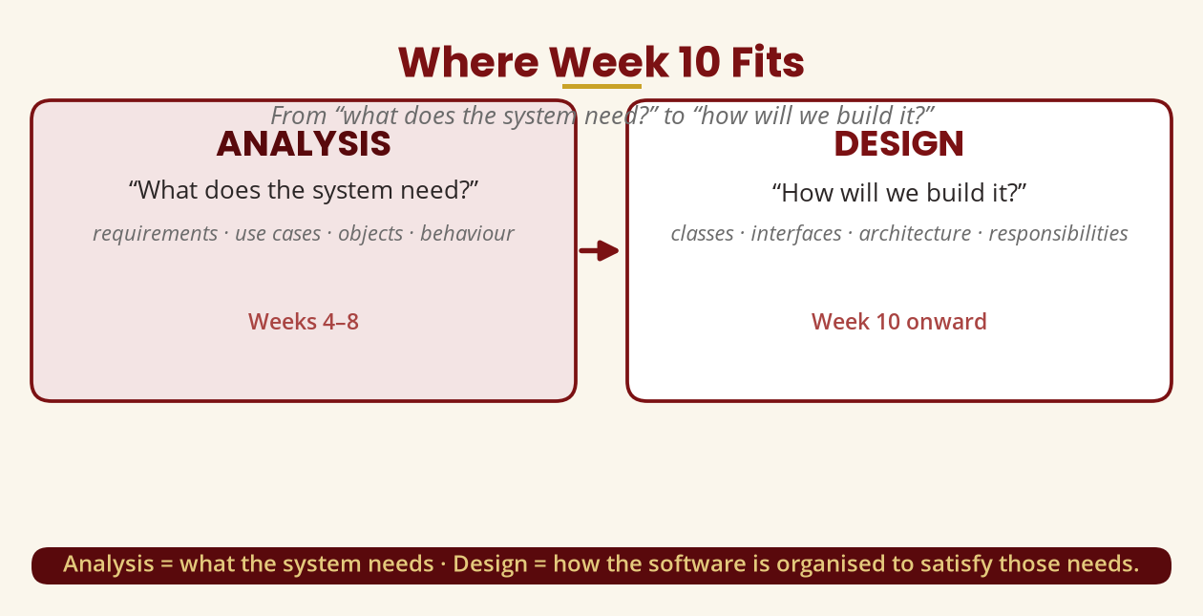
Where Week 10 Fits
The most important transition in OOAD
Weeks 4–8 built the models; Week 10 turns them into a design.
BICT 3202 · Object-Oriented Analysis and Design
Week 10 · Slide 2

Slide 4
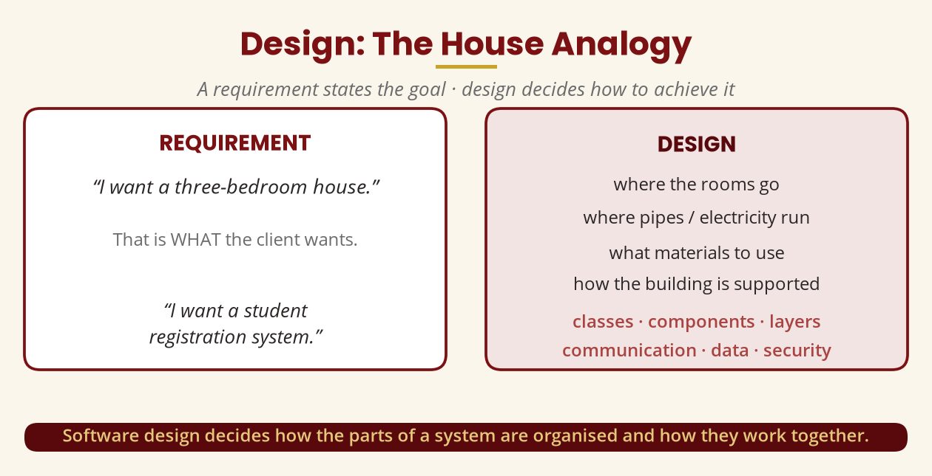
Design: The House Analogy
A requirement states the goal · design decides how
Software design decides how the parts are organised and work together.
BICT 3202 · Object-Oriented Analysis and Design
Week 10 · Slide 3

Slide 5
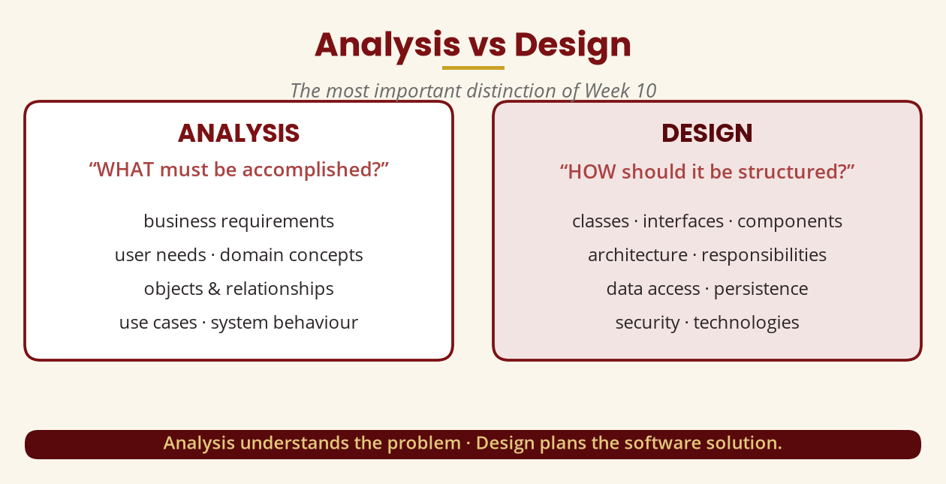
Analysis vs Design
The key distinction of Week 10
Analysis understands the problem · Design plans the software solution.
BICT 3202 · Object-Oriented Analysis and Design
Week 10 · Slide 4

Slide 6
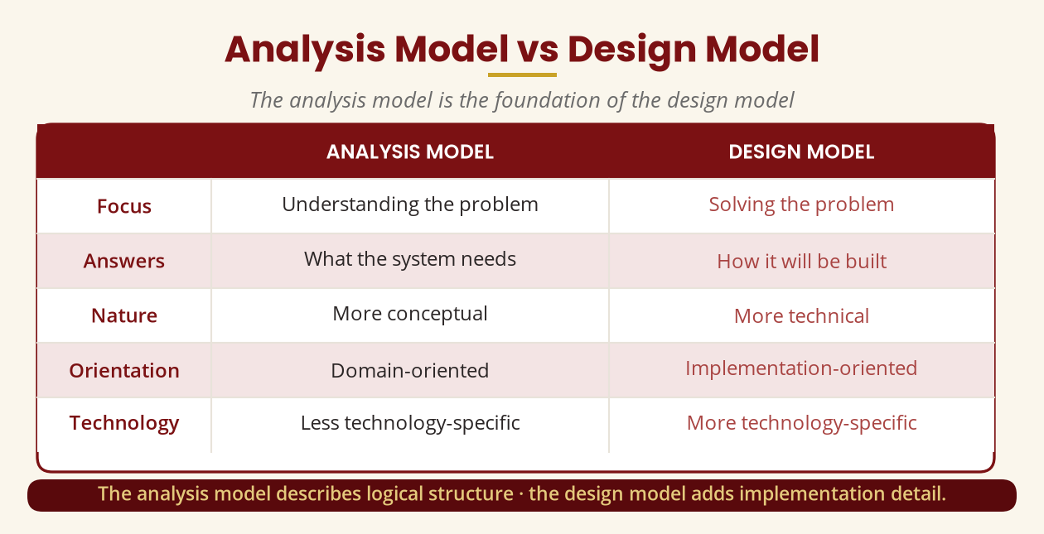
Analysis Model vs Design Model
The analysis model is the foundation
The design model adds implementation detail: classes, interfaces, packages.
BICT 3202 · Object-Oriented Analysis and Design
Week 10 · Slide 5

Slide 7
Why Not Just Start Coding?
student.java, three months later…
▪ One 15,000-line file holds login, payments, registration, reports, database, email, SMS…
▪ Change one feature and five others break.
▪ Good design makes systems easier to understand, implement, test, maintain, modify, extend, reuse, debug, scale.
Design first — it is far cheaper than redesigning after coding.
BICT 3202 · Object-Oriented Analysis and Design
Week 10 · Slide 6

Slide 8
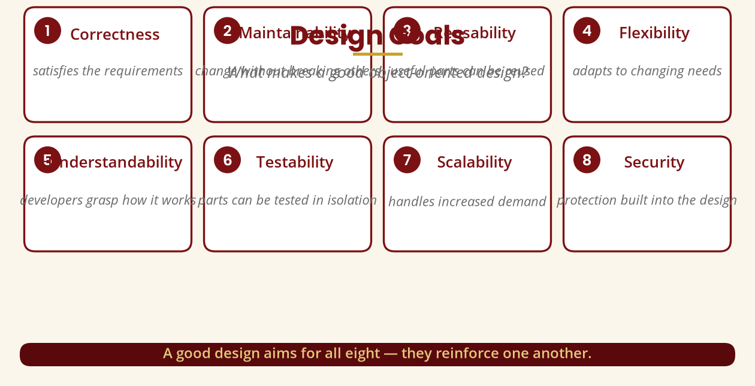
Design Goals
What makes a good object-oriented design?
Correctness · maintainability · reusability · flexibility · understandability · testability · scalability · security.
BICT 3202 · Object-Oriented Analysis and Design
Week 10 · Slide 7

Slide 9
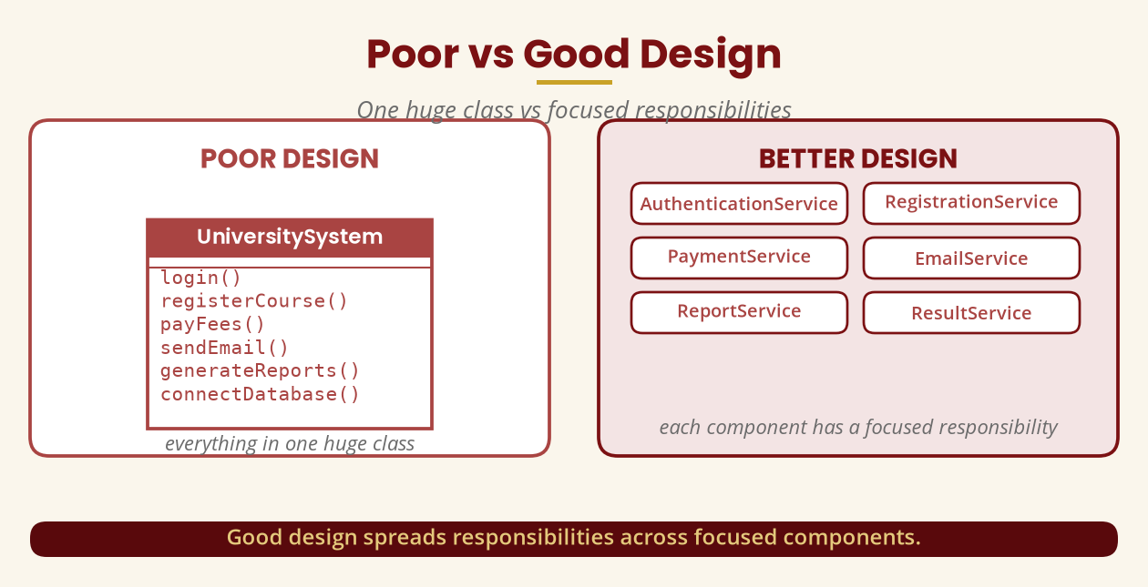
Poor vs Good Design
One huge class vs focused responsibilities
Good design spreads responsibilities across focused components.
BICT 3202 · Object-Oriented Analysis and Design
Week 10 · Slide 8

Slide 10
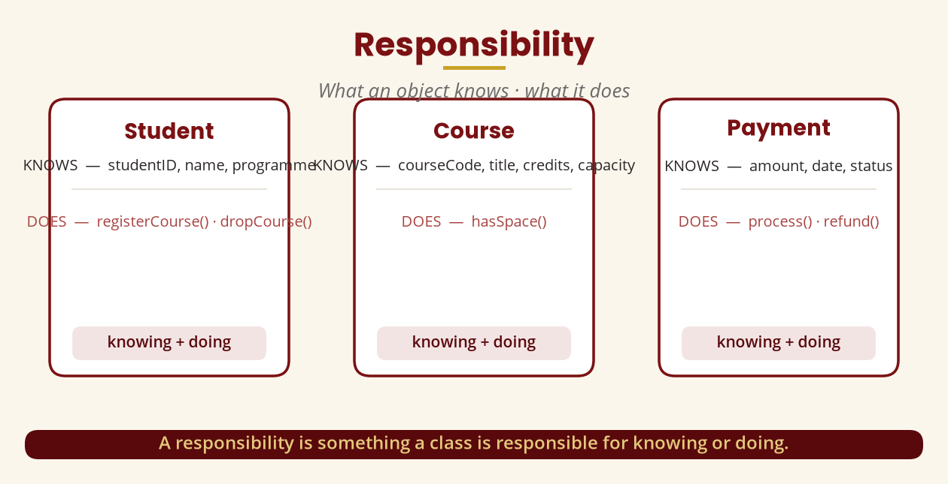
Responsibility
What an object knows · what it does
A responsibility is something a class is responsible for knowing or doing.
BICT 3202 · Object-Oriented Analysis and Design
Week 10 · Slide 9

Slide 11
Responsibility Assignment
Which object should do this?
▪ To calculate total fees, who should do it?
▪ Option 1: Student.calculateFees()
▪ Option 2: FeeAccount.calculateTotal()
▪ Option 3: PaymentService.calculateFees()
▪ The designer chooses based on the responsibilities and relationships of the objects.
Central design question: “Which object should be responsible for this operation?”
BICT 3202 · Object-Oriented Analysis and Design
Week 10 · Slide 10

Slide 12
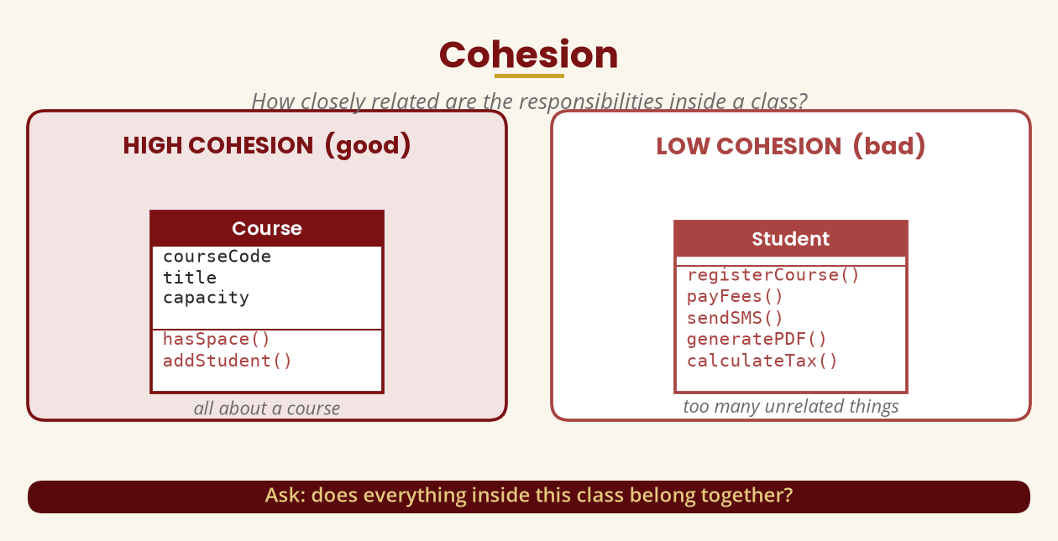
Cohesion
How closely related are the responsibilities inside a class?
Ask: does everything inside this class belong together?
BICT 3202 · Object-Oriented Analysis and Design
Week 10 · Slide 11

Slide 13
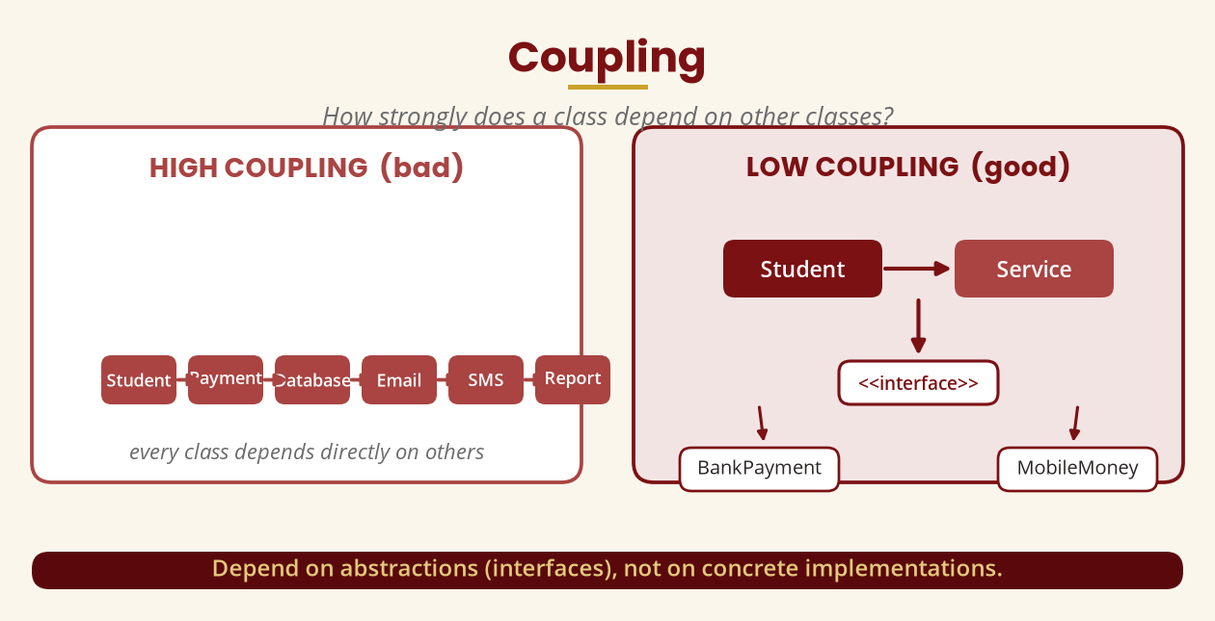
Coupling
How strongly does a class depend on other classes?
Depend on abstractions (interfaces), not on concrete implementations.
BICT 3202 · Object-Oriented Analysis and Design
Week 10 · Slide 12

Slide 14
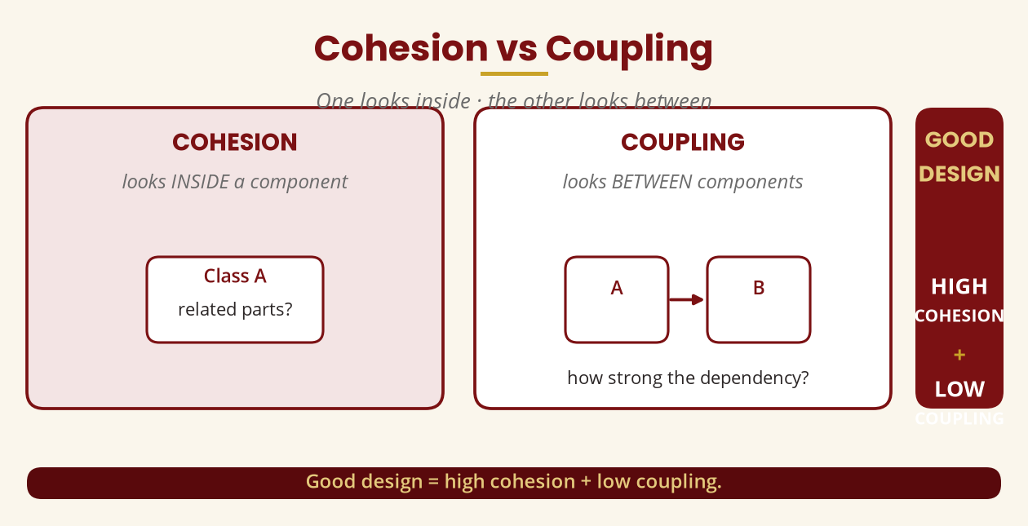
Cohesion vs Coupling
One looks inside · the other looks between
Good design = high cohesion + low coupling.
BICT 3202 · Object-Oriented Analysis and Design
Week 10 · Slide 13

Slide 15
Abstraction
Focus on the important, hide the unnecessary
▪ Using an ATM: insert card, enter PIN, select withdrawal, enter amount, receive money.
▪ You don't need to know the database, encryption, communication or cash dispenser internals.
▪ In design: call PaymentProcessor.processPayment() — the details are hidden.
Abstraction shows the interface and hides the complexity.
BICT 3202 · Object-Oriented Analysis and Design
Week 10 · Slide 14

Slide 16
Encapsulation
Keep data and operations together; protect the state
▪ BankAccount has private balance with deposit(), withdraw(), getBalance().
▪ Change state via account.deposit(500) — never account.balance = 500.
▪ Result: the object's state is protected from outside interference.
Encapsulation protects the internal state and implementation.
BICT 3202 · Object-Oriented Analysis and Design
Week 10 · Slide 15

Slide 17
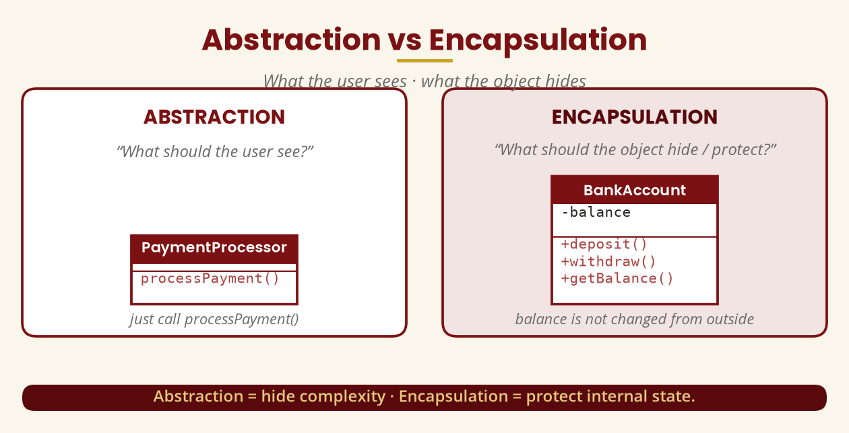
Abstraction vs Encapsulation
What the user sees · what the object hides
Abstraction = hide complexity · Encapsulation = protect internal state.
BICT 3202 · Object-Oriented Analysis and Design
Week 10 · Slide 16

Slide 18
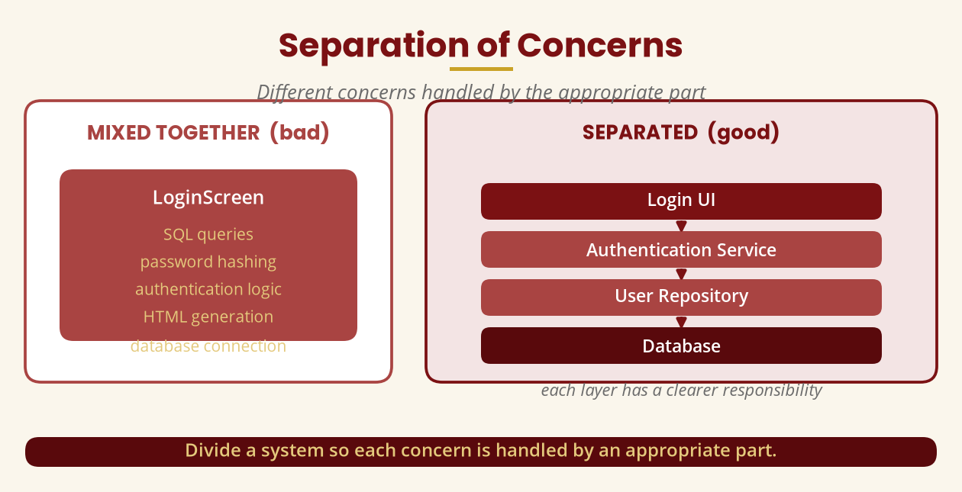
Separation of Concerns
Different concerns handled by the appropriate part
Presentation -> Business Logic -> Data Access -> Database.
BICT 3202 · Object-Oriented Analysis and Design
Week 10 · Slide 17

Slide 19
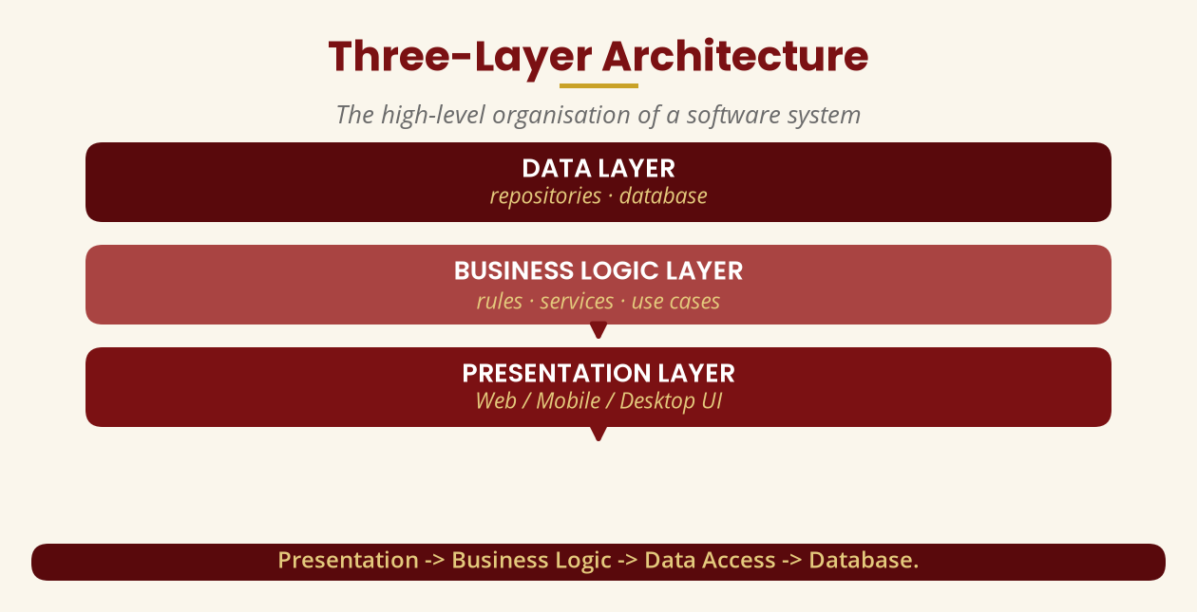
Design Architecture
The high-level organisation of a software system
Major components, layers, interfaces, dependencies and deployment decisions.
BICT 3202 · Object-Oriented Analysis and Design
Week 10 · Slide 18

Slide 20
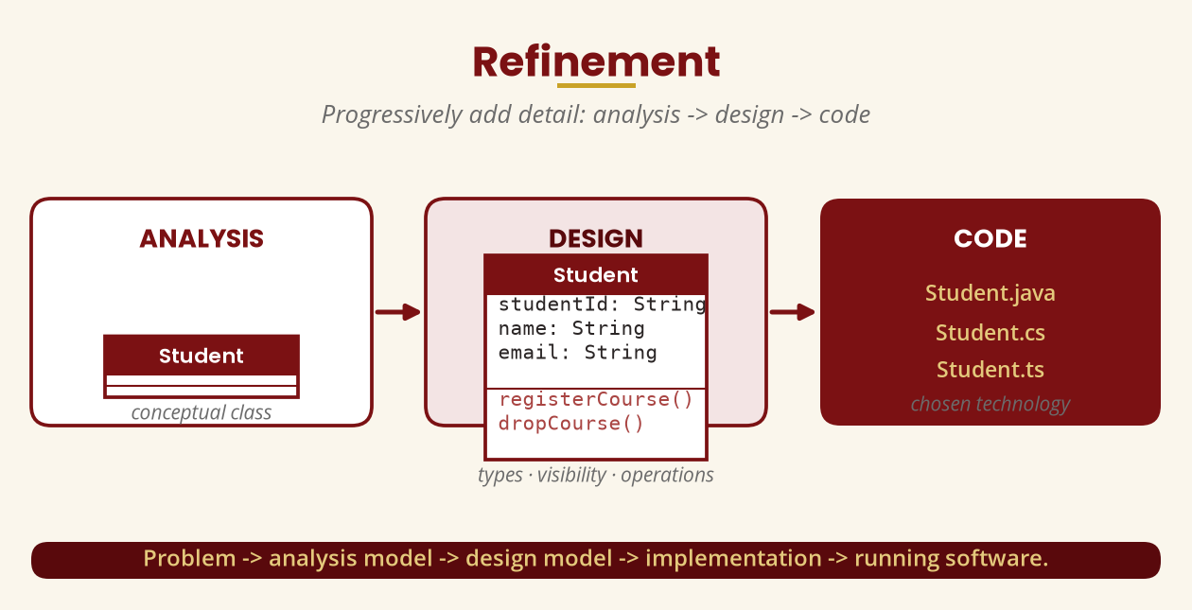
Refinement
Progressively add detail: analysis -> design -> code
Problem -> analysis model -> design model -> implementation -> running software.
BICT 3202 · Object-Oriented Analysis and Design
Week 10 · Slide 19

Slide 21
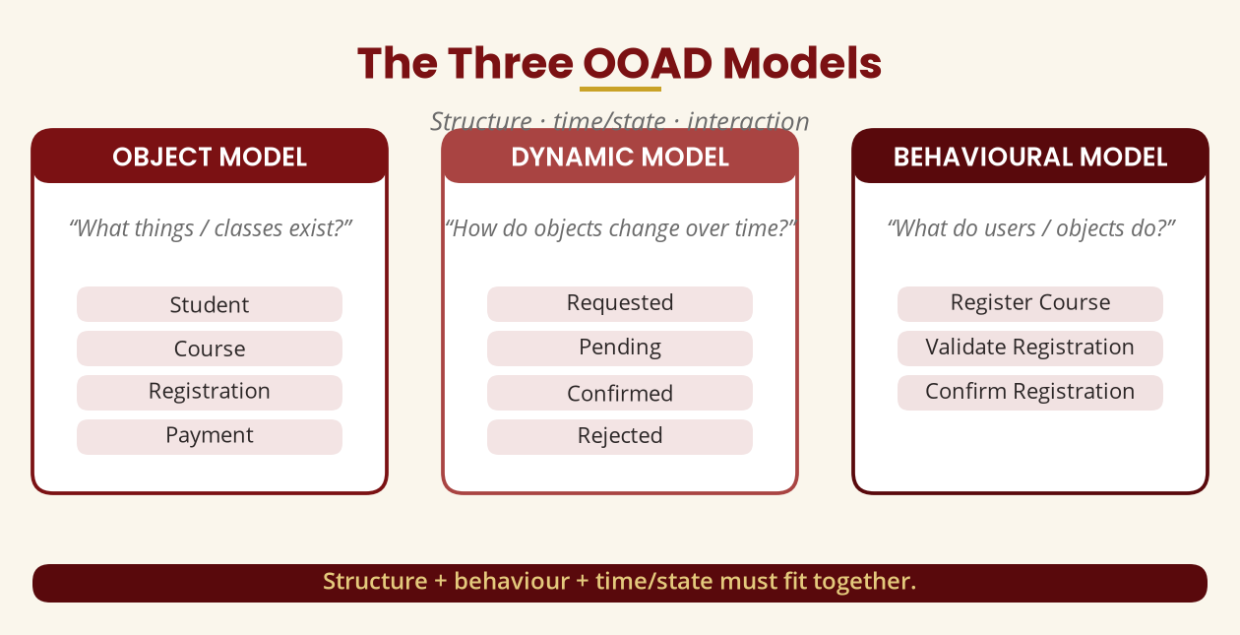
The Three OOAD Models
Structure · time/state · interaction
Object model = what exists · Dynamic model = what changes · Behavioural model = what happens.
BICT 3202 · Object-Oriented Analysis and Design
Week 10 · Slide 20

Slide 22
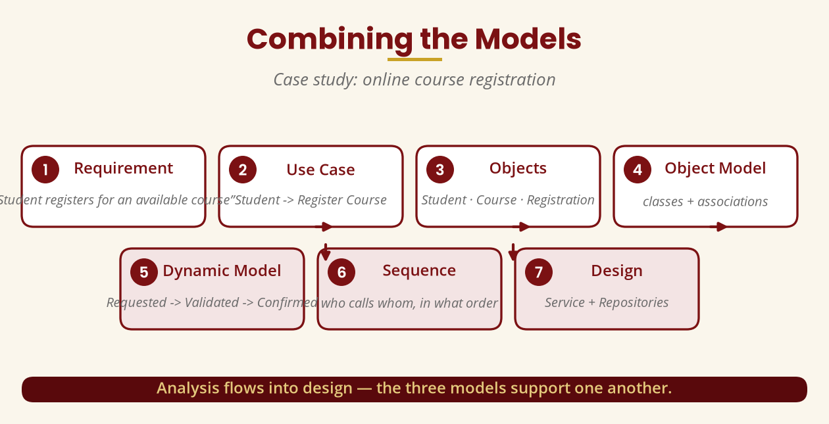
Combining the Models
Case study: online course registration
Requirement -> use case -> objects -> models -> sequence -> design.
BICT 3202 · Object-Oriented Analysis and Design
Week 10 · Slide 21

Slide 23
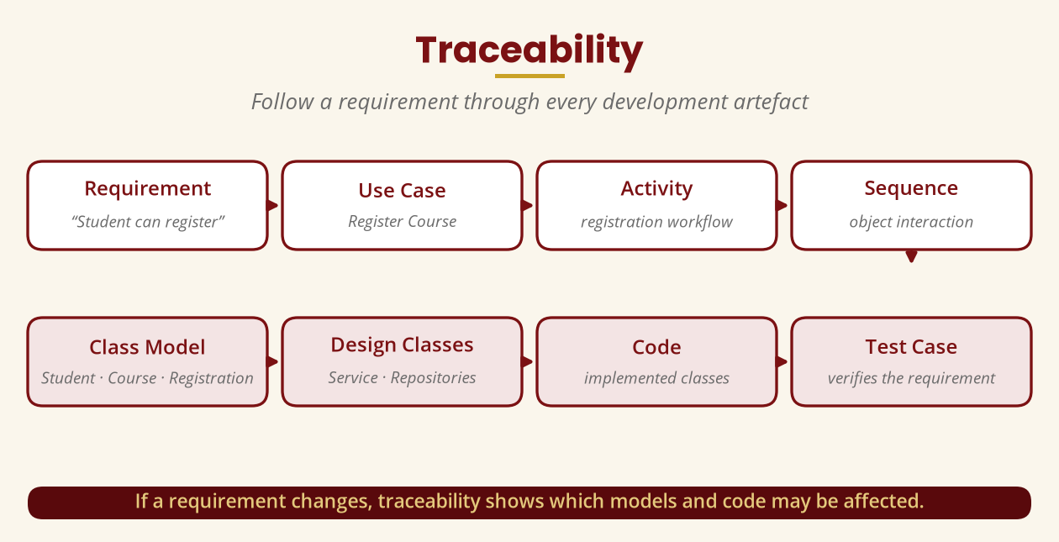
Model Consistency & Traceability
The models must agree — and be followable
▪ Consistency: if the sequence diagram calls Course.checkPrerequisite(), the class model must define it.
▪ Consistency: if the use case actor is Student, the sequence must not show Lecturer -> registerCourse().
▪ Traceability: requirement -> use case -> activity -> sequence -> class -> code -> test.
Traceability shows which models and code a change might affect.
BICT 3202 · Object-Oriented Analysis and Design
Week 10 · Slide 22

Slide 24
Sequence, Design Classes & Interfaces
Design-level UML
▪ Sequence diagrams show the order of interactions between objects.
▪ Design classes add visibility, attribute types, parameter and return types, operations.
▪ Interfaces define a contract — <<interface>> PaymentProcessor.processPayment().
▪ BankPayment and MobileMoneyPayment can both implement the same interface -> lower coupling.
Interfaces let the application depend on the abstraction, not a concrete class.
BICT 3202 · Object-Oriented Analysis and Design
Week 10 · Slide 23

Slide 25
Design Patterns & SOLID (outline)
Reusable structures · design guidelines
▪ Design patterns: Factory · Observer · Strategy · Adapter · Singleton.
▪ Strategy example: PaymentStrategy — Bank, Mobile, Card (no chain of if/else).
▪ SOLID: Single Responsibility · Open/Closed · Liskov Substitution · Interface Segregation · Dependency Inversion.
▪ Treat SOLID as guidelines, not magical rules.
Patterns and principles support cohesion, low coupling and flexibility.
BICT 3202 · Object-Oriented Analysis and Design
Week 10 · Slide 24

Slide 26
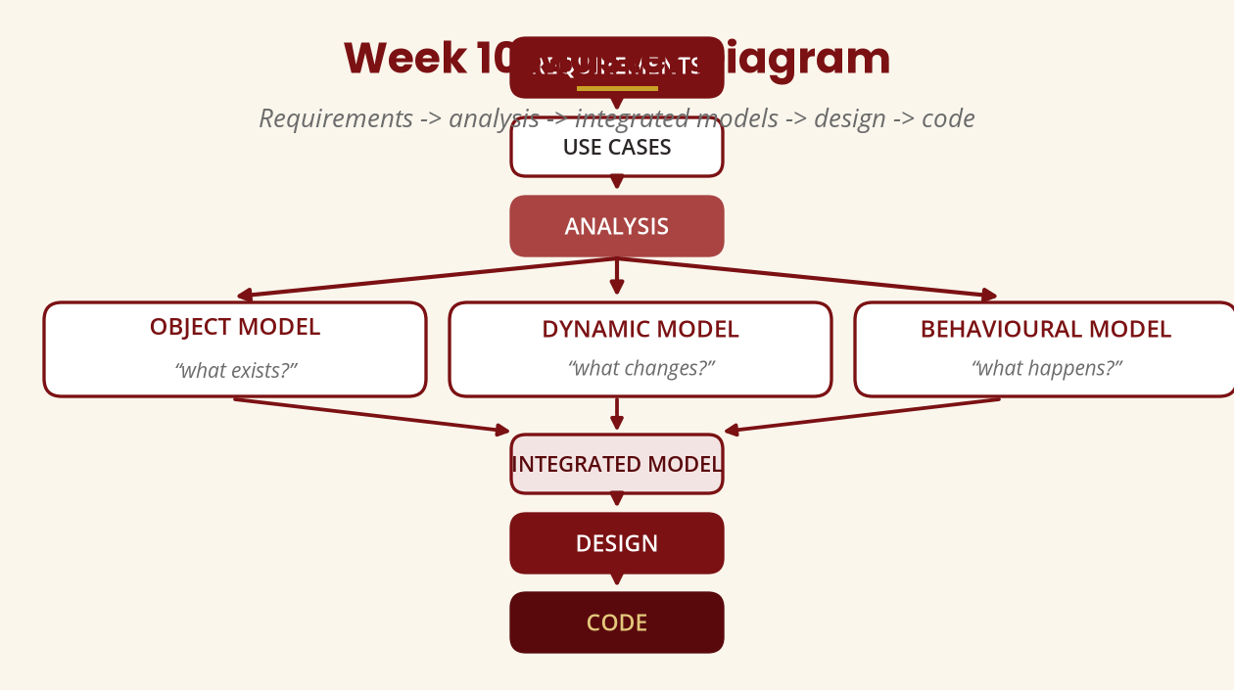
Week 10 Master Diagram
Requirements -> models -> design -> code
That is the central lesson of Week 10.
BICT 3202 · Object-Oriented Analysis and Design
Week 10 · Slide 25

Slide 27
Common Misunderstandings
Avoid these
▪ “Analysis is just drawing diagrams” — it is understanding requirements, domain and behaviour.
▪ “Design means coding” — coding is implementation; design precedes it.
▪ “A class diagram is enough” — you may also need sequence, state, activity, component and deployment views.
▪ “More classes = better design” — aim for an appropriate structure, not a maximum count.
▪ “Always use inheritance” — only when a genuine IS-A relationship exists.
Classic exam traps — know them.
BICT 3202 · Object-Oriented Analysis and Design
Week 10 · Slide 26

Slide 28
Week 10 Summary
The big idea
▪ 1. Analysis tells us WHAT the system needs; design determines HOW to organise the software.
▪ 2. Good design aims for high cohesion and low coupling.
▪ 3. Abstraction hides complexity; encapsulation protects state.
▪ 4. The three models complement one another — structure + behaviour + time/state.
▪ 5. Traceability links every requirement to its models, code and tests.
Week 10 = turning the Weeks 4–8 models into an implementable design.
BICT 3202 · Object-Oriented Analysis and Design
Week 10 · Slide 27

Slide 29
REVISION & NEXT STEPS
▪ Define OO design, then explain analysis vs design with the registration example.
▪ For the UniversitySystem class, diagnose cohesion and coupling and propose a redesign.
▪ Combine the three models for “Customer withdraws money” and draw the sequence.
▪ Next week: Object-Oriented Design continues — refinements, integration and further design detail.
Thank you — Francis Fweta · ICT Lecturer · Exploits University

