Slide 1

EXPLOITS UNIVERSITY
BSc INFORMATION COMMUNICATION AND TECHNOLOGY
BICT 3202 · OBJECT-ORIENTED ANALYSIS AND DESIGN
WEEK 11
Refining the Object-Oriented Design
Francis Fweta · ICT Lecturer · Week 11 of 16

Slide 2
Learning Outcomes
By the end of this week, you should be able to…
▪ Explain design refinement and the analysis-to-design transformation.
▪ Distinguish an analysis class from a design class.
▪ Identify design classes — entity, boundary and control.
▪ Refine attributes and operations with types and signatures.
▪ Assign responsibilities; choose association vs inheritance.
▪ Compare interfaces and abstract classes.
▪ Explain cohesion, coupling, encapsulation, dependencies, layers, reuse and traceability.
Drawing a UML class diagram is not the same as completing an OO design.
BICT 3202 · Object-Oriented Analysis and Design
Week 11 · Slide 1

Slide 3
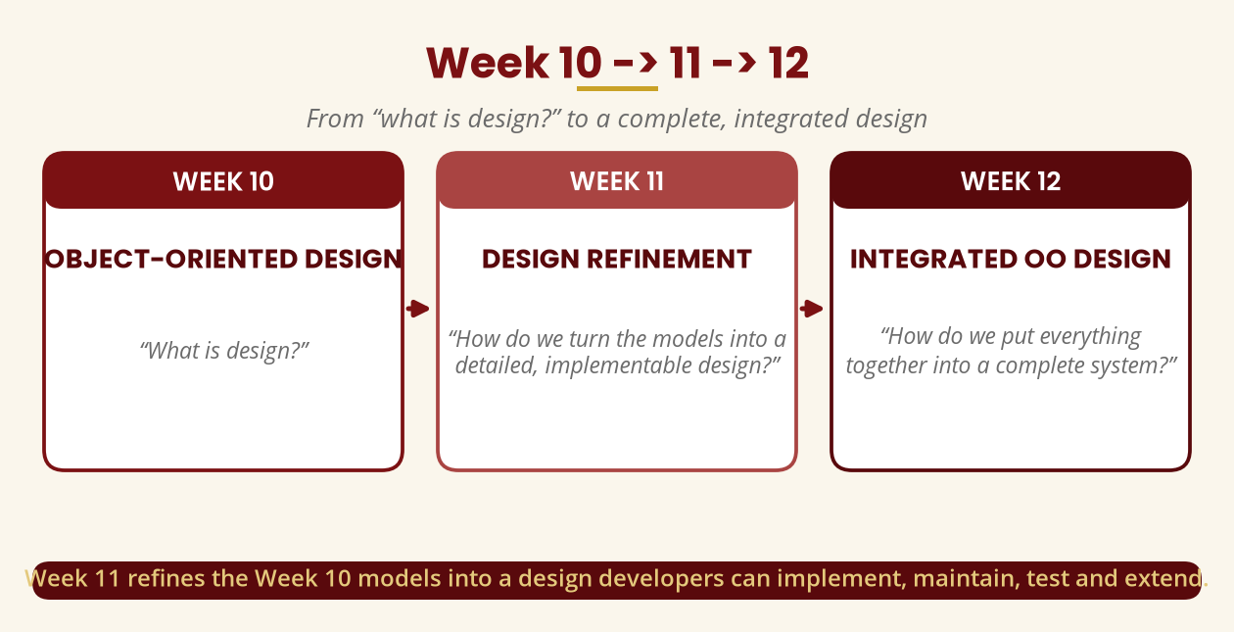
Week 10 -> 11 -> 12
What is design? -> refine it -> integrate it
Week 11 turns the Week 10 models into an implementable design.
BICT 3202 · Object-Oriented Analysis and Design
Week 11 · Slide 2

Slide 4
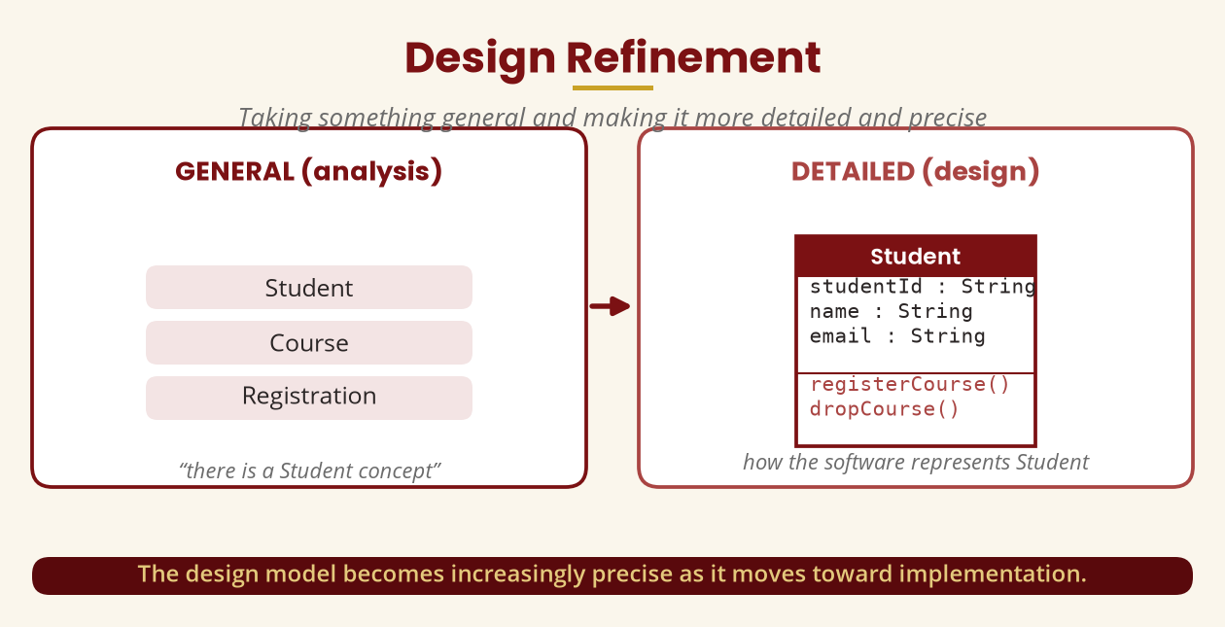
Design Refinement
General -> detailed and precise
The design model becomes increasingly precise toward implementation.
BICT 3202 · Object-Oriented Analysis and Design
Week 11 · Slide 3

Slide 5
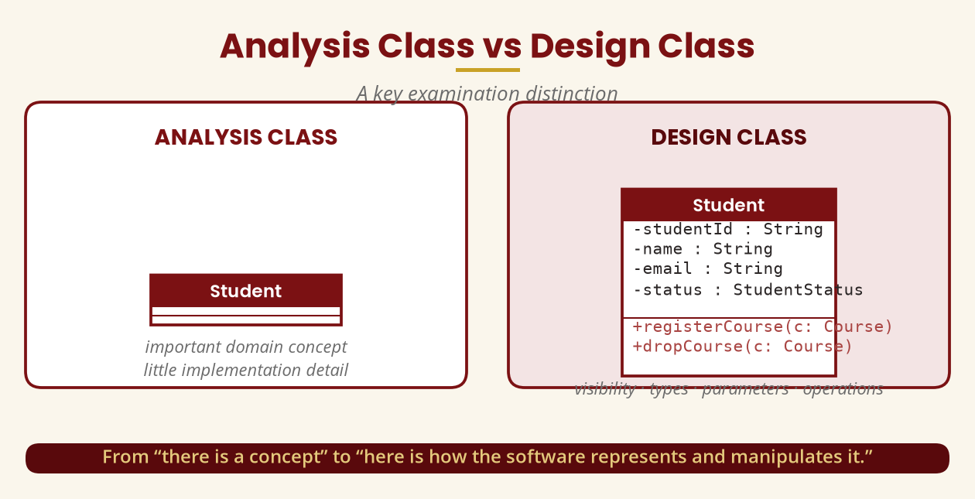
Analysis Class vs Design Class
A key examination distinction
Analysis = domain concept · Design = how the software represents and manipulates it.
BICT 3202 · Object-Oriented Analysis and Design
Week 11 · Slide 4

Slide 6
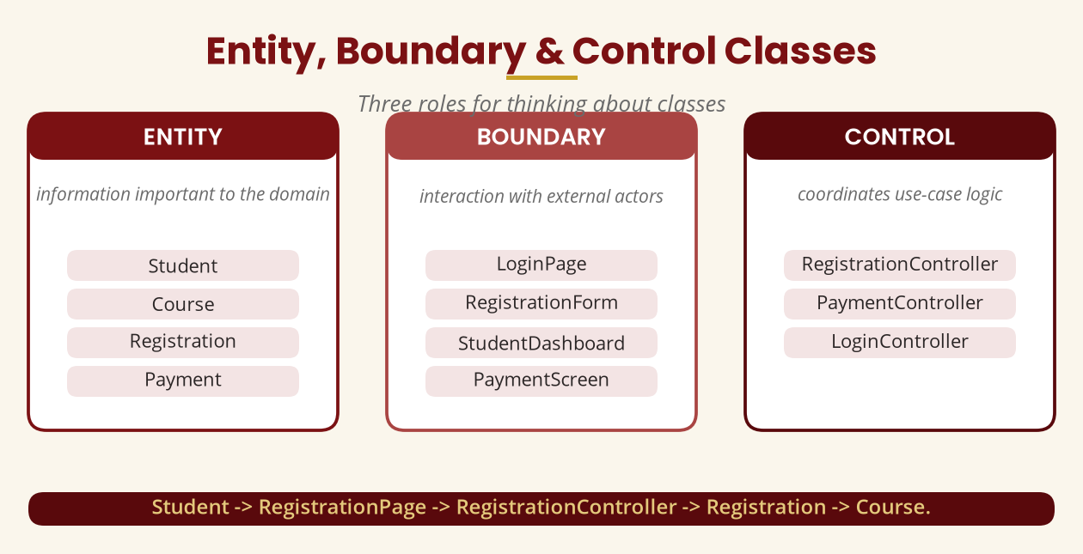
Entity, Boundary & Control Classes
Three roles for thinking about classes
Student -> RegistrationPage -> RegistrationController -> Registration -> Course.
BICT 3202 · Object-Oriented Analysis and Design
Week 11 · Slide 5

Slide 7
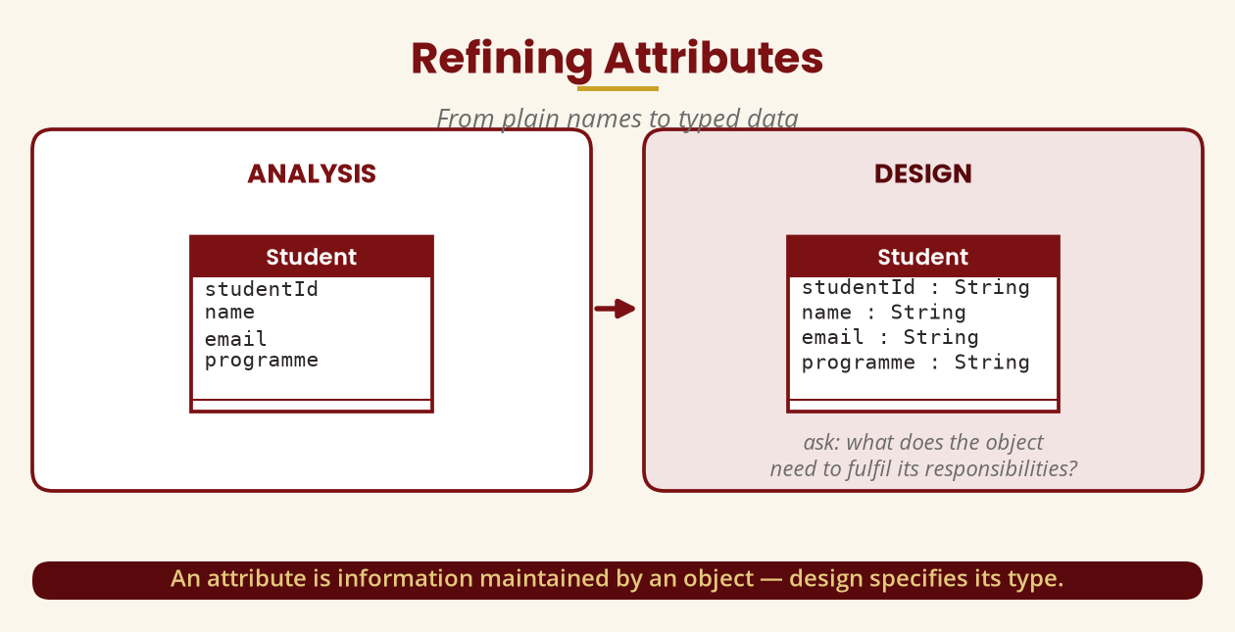
Refining Attributes
From plain names to typed data
Ask: what does the object need to fulfil its responsibilities?
BICT 3202 · Object-Oriented Analysis and Design
Week 11 · Slide 6

Slide 8
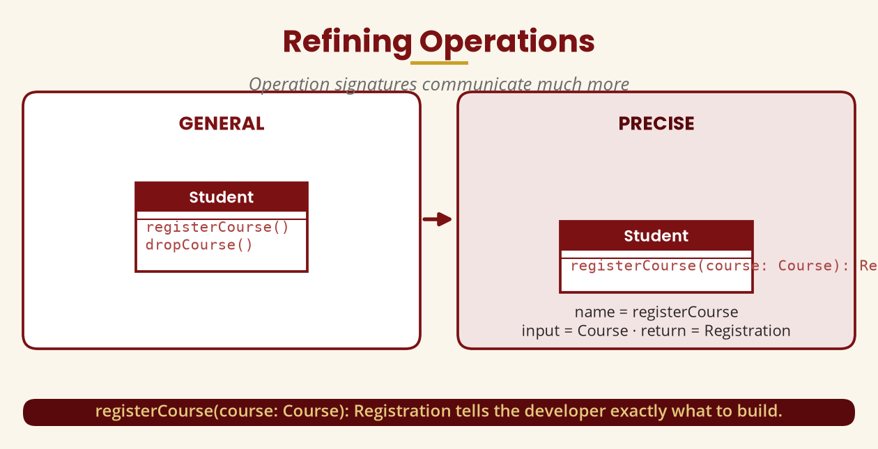
Refining Operations
Operation signatures communicate much more
registerCourse(course: Course): Registration — name, input, return value.
BICT 3202 · Object-Oriented Analysis and Design
Week 11 · Slide 7

Slide 9
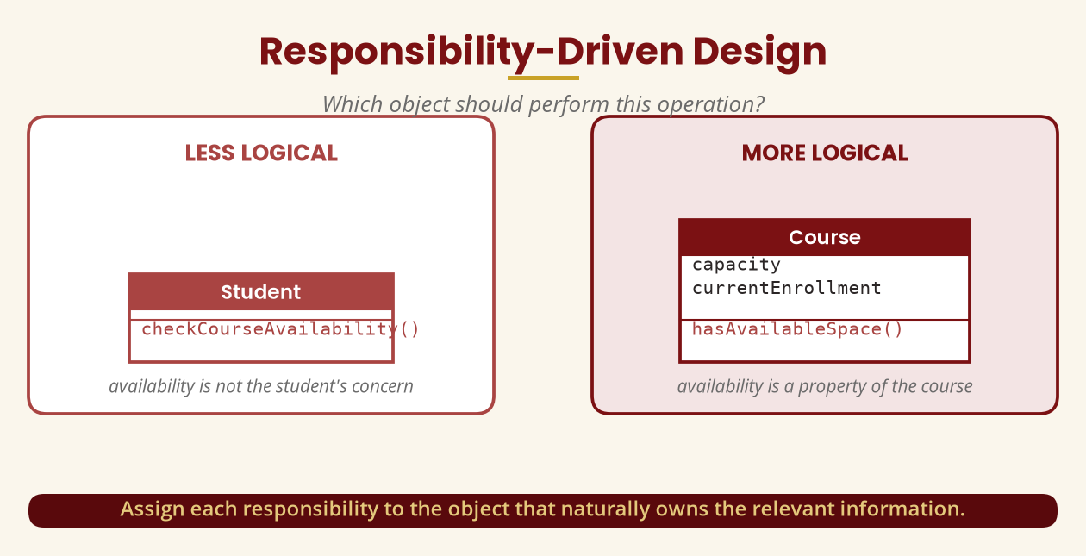
Responsibility-Driven Design
Which object should do this?
Assign each responsibility to the object that owns the relevant information.
BICT 3202 · Object-Oriented Analysis and Design
Week 11 · Slide 8

Slide 10
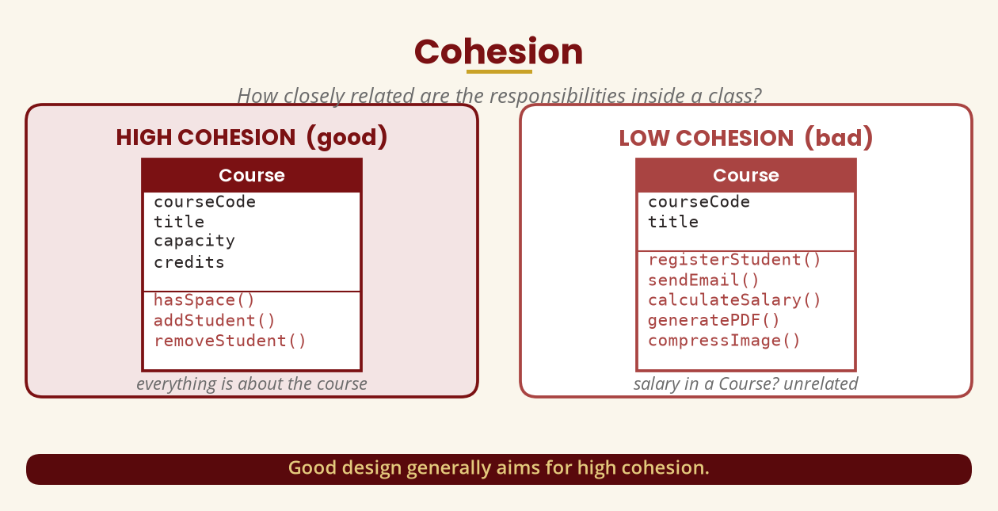
Cohesion
How closely related are the responsibilities inside a class?
Good design generally aims for high cohesion.
BICT 3202 · Object-Oriented Analysis and Design
Week 11 · Slide 9

Slide 11
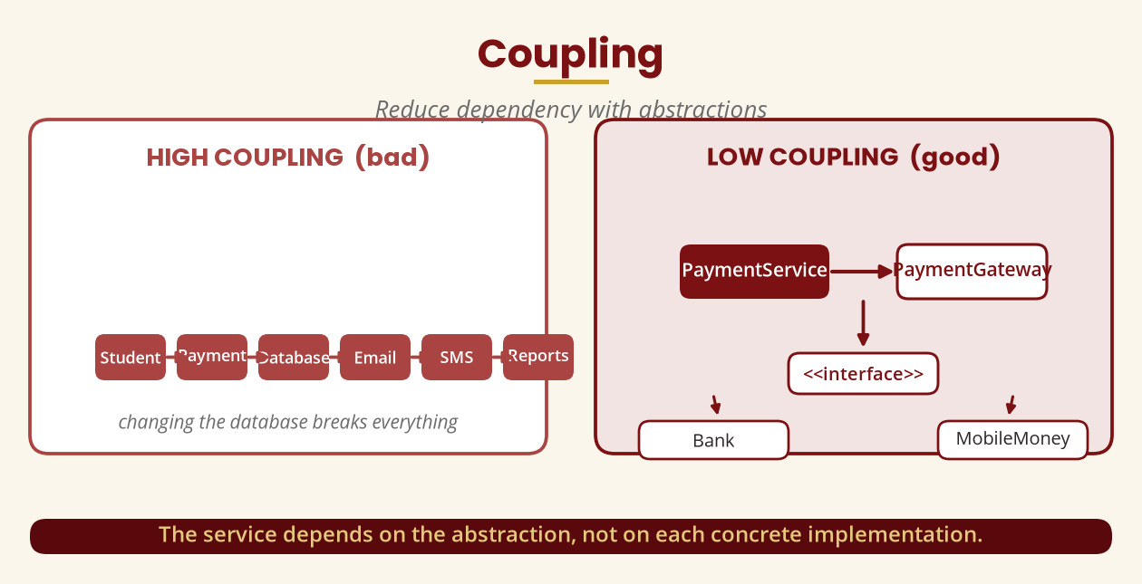
Coupling
Reduce dependency with abstractions
The service depends on the abstraction, not each concrete implementation.
BICT 3202 · Object-Oriented Analysis and Design
Week 11 · Slide 10

Slide 12
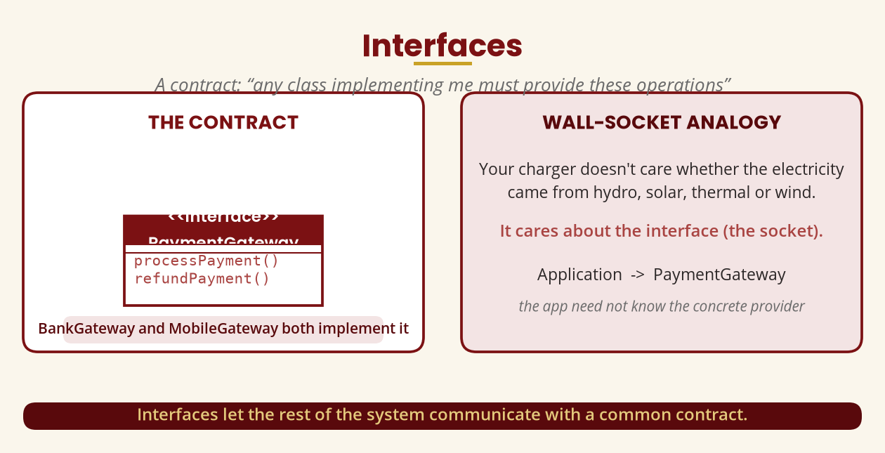
Interfaces
A contract — and the wall-socket analogy
Any class implementing an interface must provide those operations.
BICT 3202 · Object-Oriented Analysis and Design
Week 11 · Slide 11

Slide 13
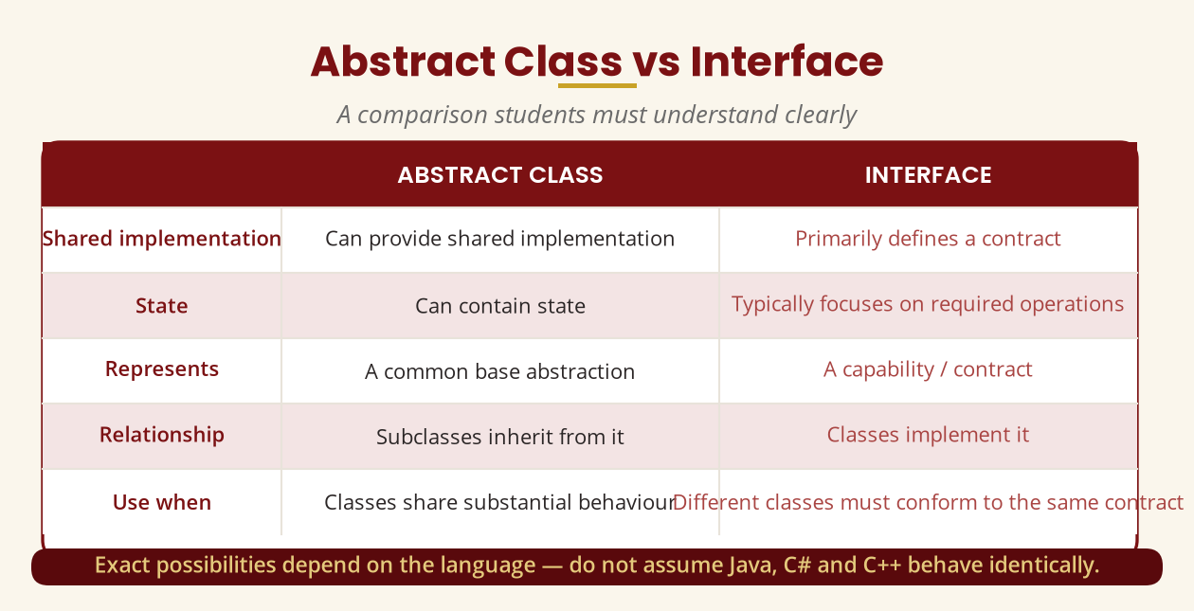
Abstract Class vs Interface
A comparison you must know
Abstract class = common base · interface = contract (language details vary).
BICT 3202 · Object-Oriented Analysis and Design
Week 11 · Slide 12

Slide 14
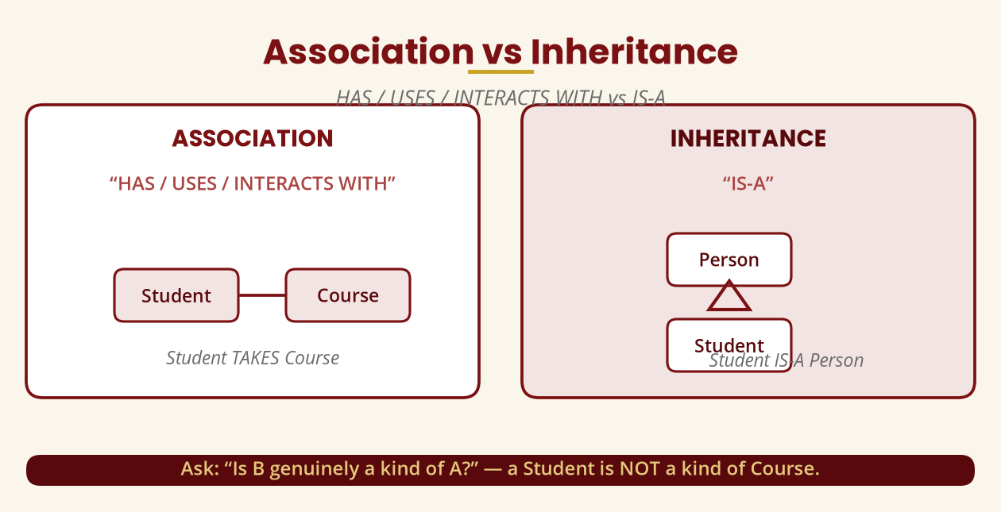
Association vs Inheritance
HAS / USES vs IS-A
A Student TAKES a Course (association) · a Student IS-A Person (inheritance).
BICT 3202 · Object-Oriented Analysis and Design
Week 11 · Slide 13

Slide 15
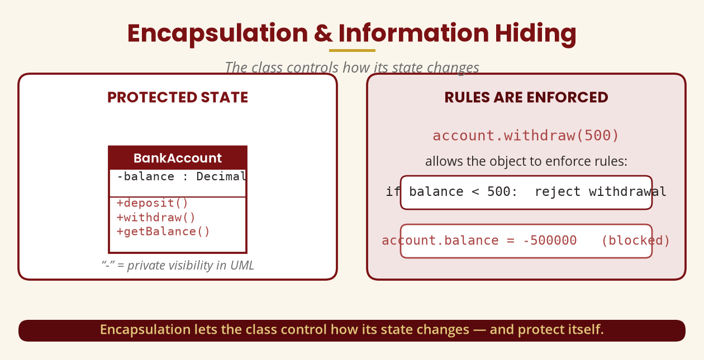
Encapsulation & Information Hiding
The class controls its own state
account.withdraw(500) enforces rules; account.balance = -500000 is blocked.
BICT 3202 · Object-Oriented Analysis and Design
Week 11 · Slide 14

Slide 16
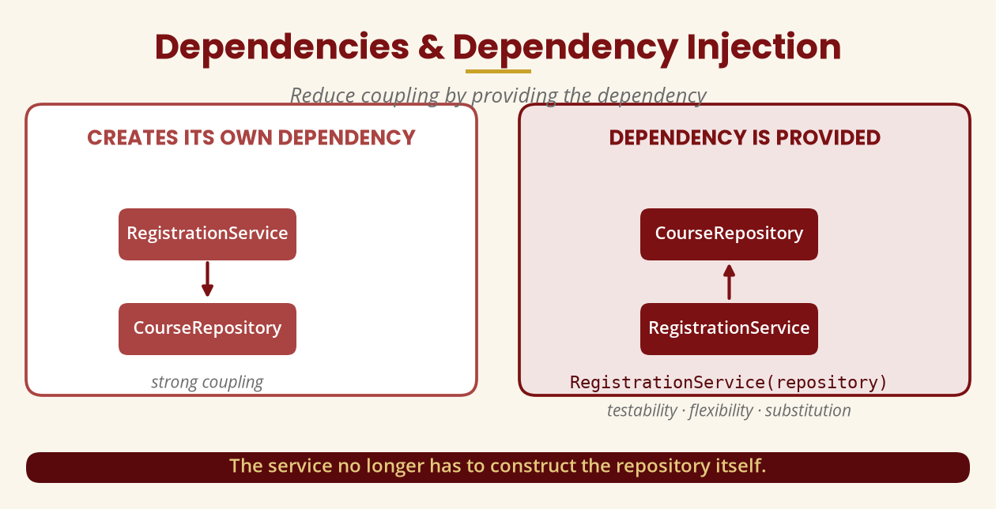
Dependencies & Dependency Injection
Provide the dependency, don't construct it
RegistrationService(repository) improves testability, flexibility, substitution.
BICT 3202 · Object-Oriented Analysis and Design
Week 11 · Slide 15

Slide 17
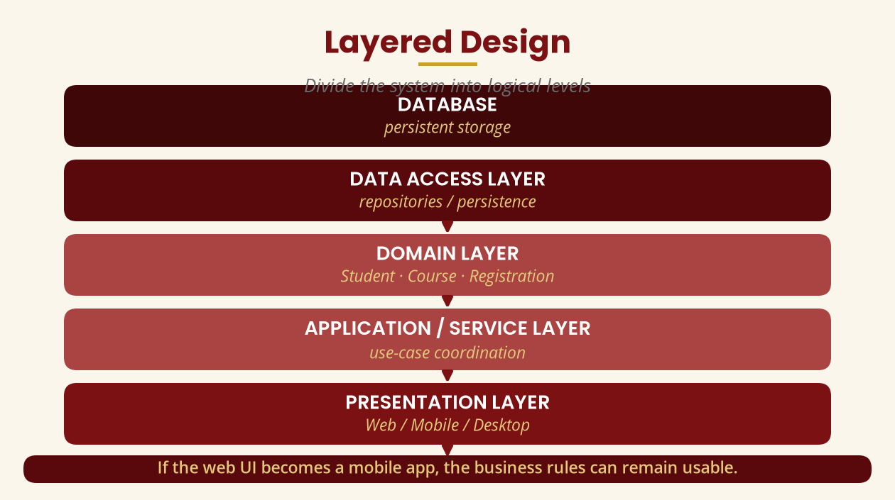
Layered Design
Divide the system into logical levels
If the web UI becomes a mobile app, the business rules can remain usable.
BICT 3202 · Object-Oriented Analysis and Design
Week 11 · Slide 16

Slide 18
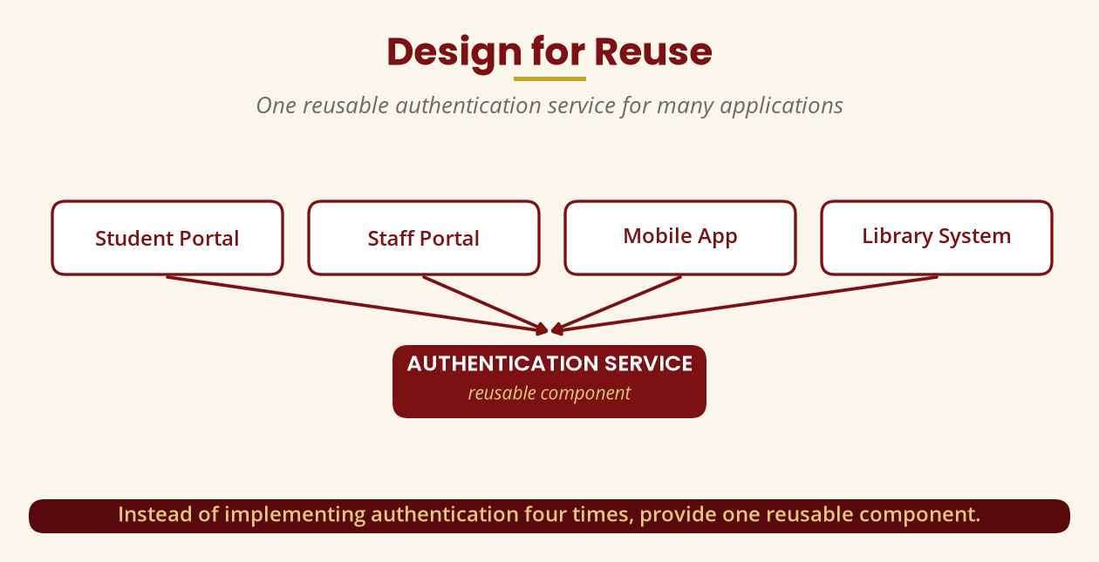
Design for Reuse
One reusable component, many applications
One AuthenticationService for Student Portal, Staff Portal, Mobile App, Library.
BICT 3202 · Object-Oriented Analysis and Design
Week 11 · Slide 17

Slide 19
Design for Change
Requirements will change
▪ Start: “Students only use email.”
▪ Then: “Add SMS.” — later, “Add WhatsApp.”
▪ Poor design: every new method changes the Student class.
▪ Better: NotificationService behind a Notification interface -> Email, SMS, WhatsApp.
▪ Result: the architecture stays adaptable.
Design for reasonable future change without trying to predict everything.
BICT 3202 · Object-Oriented Analysis and Design
Week 11 · Slide 18

Slide 20
How Do We Judge a Design?
Seven questions
▪ Correct? meets the requirements.
▪ Understandable? another developer can understand it.
▪ Maintainable? it can be changed.
▪ Testable? components can be tested in isolation.
▪ Reusable? useful parts can be used elsewhere.
▪ Appropriately coupled? no unnecessary dependencies.
▪ Cohesive? each component has a focused purpose.
These mirror the OO design-quality literature (coupling, cohesion, maintainability).
BICT 3202 · Object-Oriented Analysis and Design
Week 11 · Slide 19

Slide 21
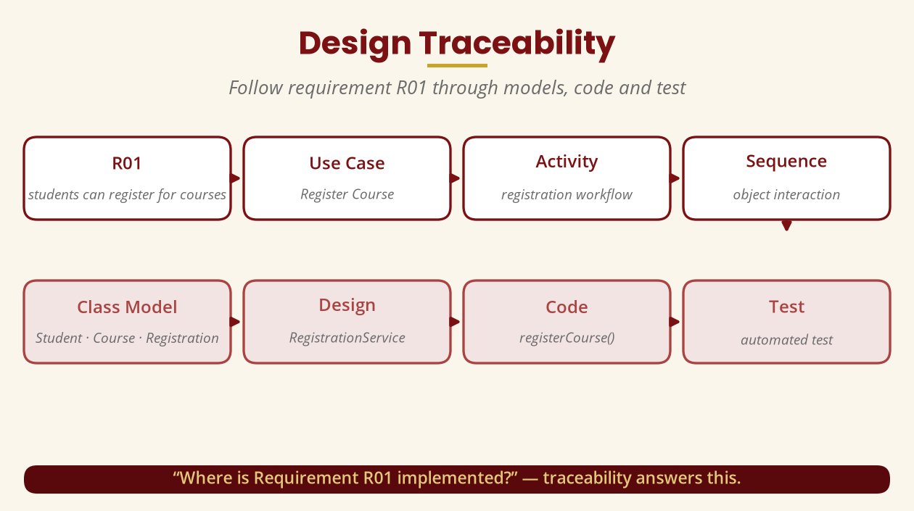
Design Traceability
Follow requirement R01 to code and test
“Where is R01 implemented?” — traceability answers this.
BICT 3202 · Object-Oriented Analysis and Design
Week 11 · Slide 20

Slide 22
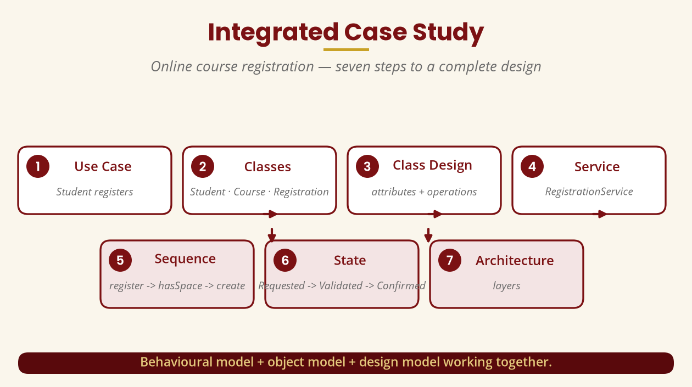
Integrated Case Study
Seven steps to a complete design
Use case -> classes -> class design -> service -> sequence -> state -> architecture.
BICT 3202 · Object-Oriented Analysis and Design
Week 11 · Slide 21

Slide 23
Common Design Mistakes
Avoid these
▪ One giant class — low cohesion and high coupling.
▪ Everything inherits from everything — only when IS-A genuinely holds.
▪ Direct database access everywhere — route through repositories.
▪ Exposing everything — public balance / password undermines encapsulation.
▪ Designing only for today — consider reasonable future change.
Five classic traps in examination answers.
BICT 3202 · Object-Oriented Analysis and Design
Week 11 · Slide 22

Slide 24
Week 11 Summary
The most important idea
▪ 1. Refinement turns analysis classes into detailed design classes.
▪ 2. Assign responsibilities to the objects that own the information.
▪ 3. Aim for high cohesion and low coupling (use interfaces).
▪ 4. Encapsulate state; hide implementation; inject dependencies.
▪ 5. Layer the architecture; design for reuse and change; keep traceability.
Goal: correct, understandable, maintainable, testable, reusable, adaptable design.
BICT 3202 · Object-Oriented Analysis and Design
Week 11 · Slide 23

Slide 25
REVISION & NEXT STEPS
▪ Refine the Student/Course/Registration analysis classes into full design classes.
▪ Draw a PaymentGateway interface with Bank and Mobile implementations.
▪ Redesign the HospitalSystem class into a layered, cohesive structure.
▪ Next week: Integrated OO Design — putting all models and decisions together into a complete system.
Thank you — Francis Fweta · ICT Lecturer · Exploits University

