Slide 1

EXPLOITS UNIVERSITY
BSc INFORMATION COMMUNICATION AND TECHNOLOGY
BICT 3202 · OBJECT-ORIENTED ANALYSIS AND DESIGN
WEEK 12
Integrated Object-Oriented Modelling and Design
Francis Fweta · ICT Lecturer · Week 12 of 16

Slide 2
Learning Outcomes
By the end of this week, you should be able to…
▪ Explain integrated modelling and why models must be consistent.
▪ Relate the use-case, class, interaction, state and activity models.
▪ Trace a requirement through classes, interactions and operations.
▪ Apply multiplicity and packages to organise a model.
▪ Think at component and architecture level.
▪ Detect contradictions between models and validate a design.
▪ Distinguish a model from a diagram.
Every model should contribute to the same understanding of the system.
BICT 3202 · Object-Oriented Analysis and Design
Week 12 · Slide 1

Slide 3
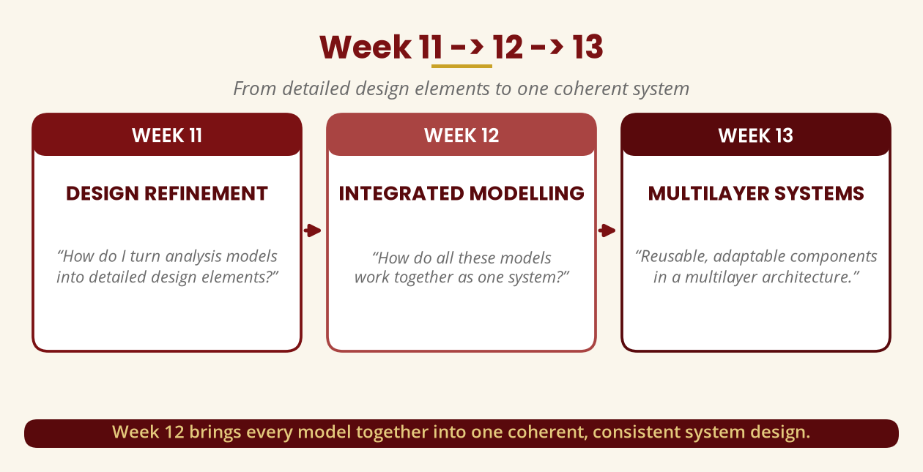
Week 11 -> 12 -> 13
From detailed design elements to one coherent system
Week 12 brings every model together into one consistent system design.
BICT 3202 · Object-Oriented Analysis and Design
Week 12 · Slide 2

Slide 4
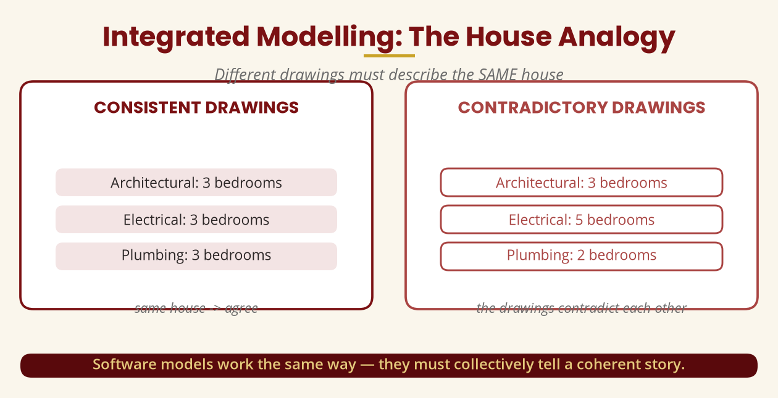
Integrated Modelling: The House Analogy
Different drawings must describe the SAME house
Software models must collectively tell a coherent story.
BICT 3202 · Object-Oriented Analysis and Design
Week 12 · Slide 3

Slide 5
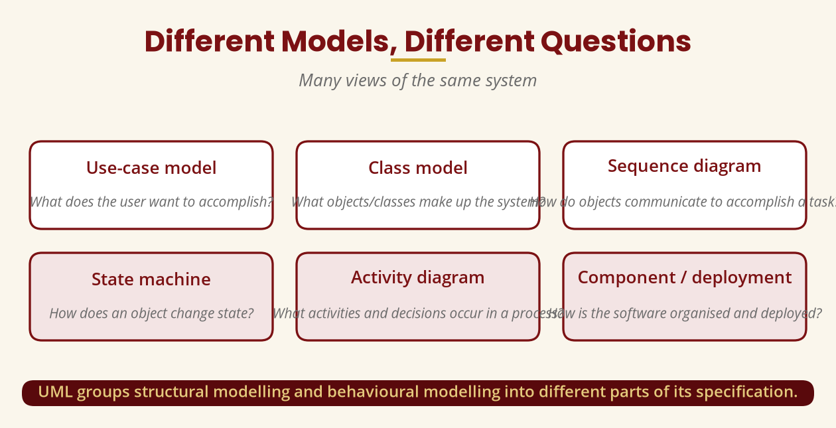
Different Models, Different Questions
Many views of the same system
UML groups structural and behavioural modelling into different parts of its specification.
BICT 3202 · Object-Oriented Analysis and Design
Week 12 · Slide 4

Slide 6
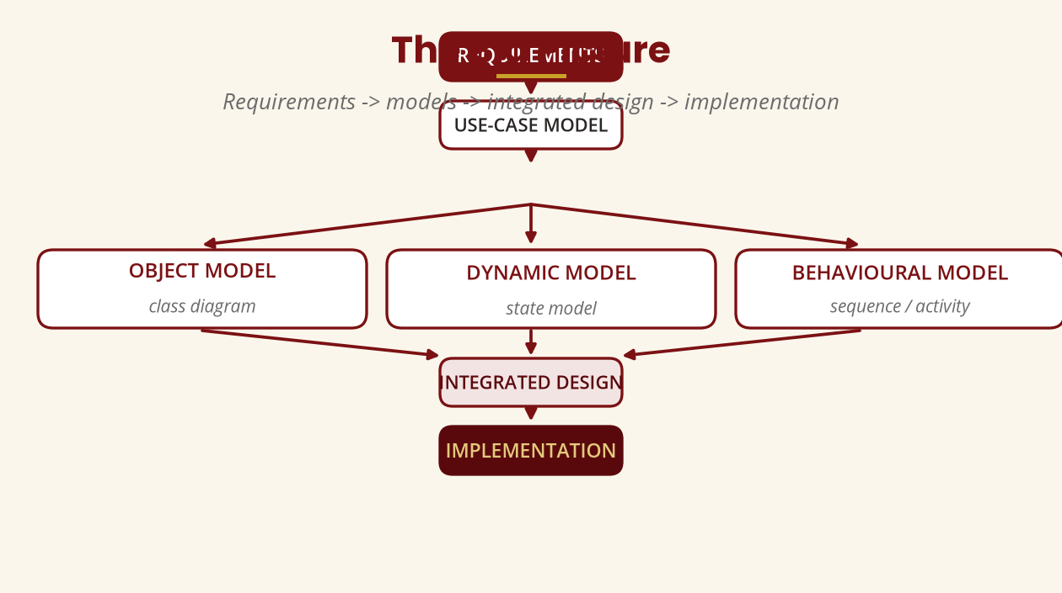
The Big Picture
Requirements -> models -> integrated design -> implementation
That is the central idea of Week 12.
BICT 3202 · Object-Oriented Analysis and Design
Week 12 · Slide 5

Slide 7
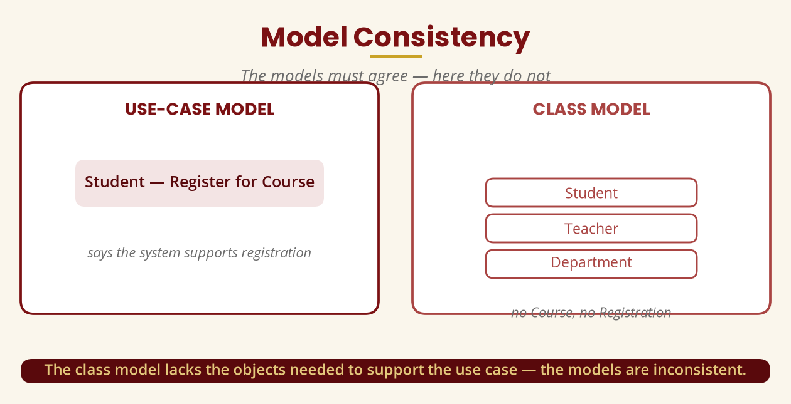
Model Consistency
The models must agree — here they do not
The class model lacks Course and Registration — inconsistent with the use case.
BICT 3202 · Object-Oriented Analysis and Design
Week 12 · Slide 6

Slide 8
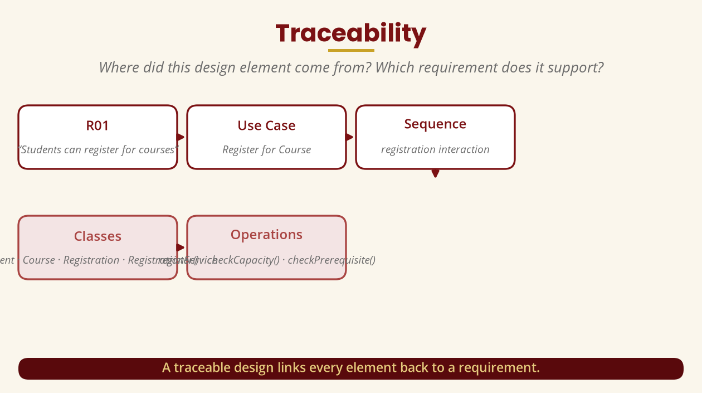
Traceability
Where did this design element come from?
A traceable design links every element back to a requirement.
BICT 3202 · Object-Oriented Analysis and Design
Week 12 · Slide 7

Slide 9
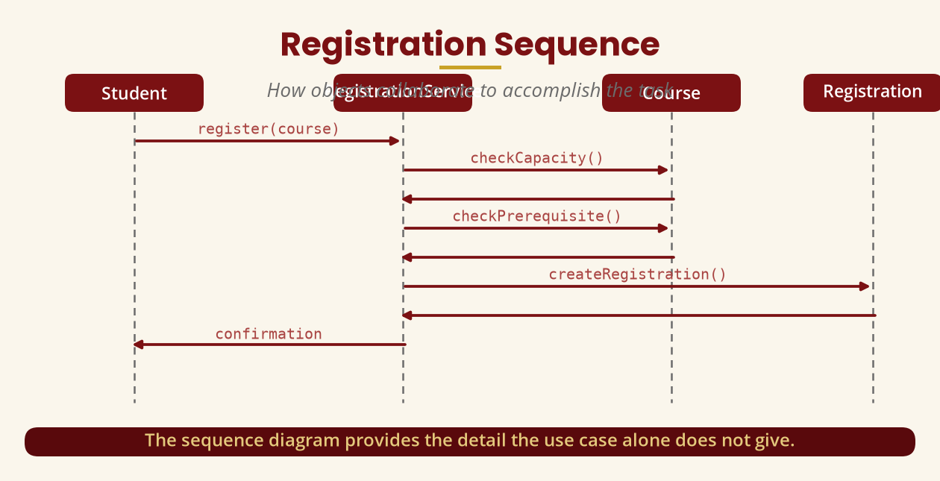
Registration Sequence
How objects collaborate to accomplish the task
If the sequence uses a class, that class must exist in the class model.
BICT 3202 · Object-Oriented Analysis and Design
Week 12 · Slide 8

Slide 10
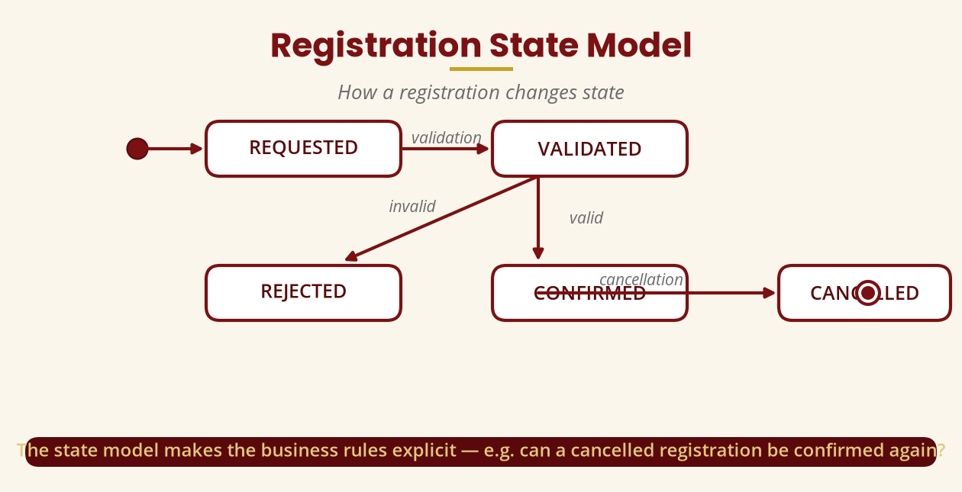
Registration State Model
How a registration changes state
The state model makes business rules explicit (e.g. can CANCELLED become CONFIRMED?).
BICT 3202 · Object-Oriented Analysis and Design
Week 12 · Slide 9

Slide 11
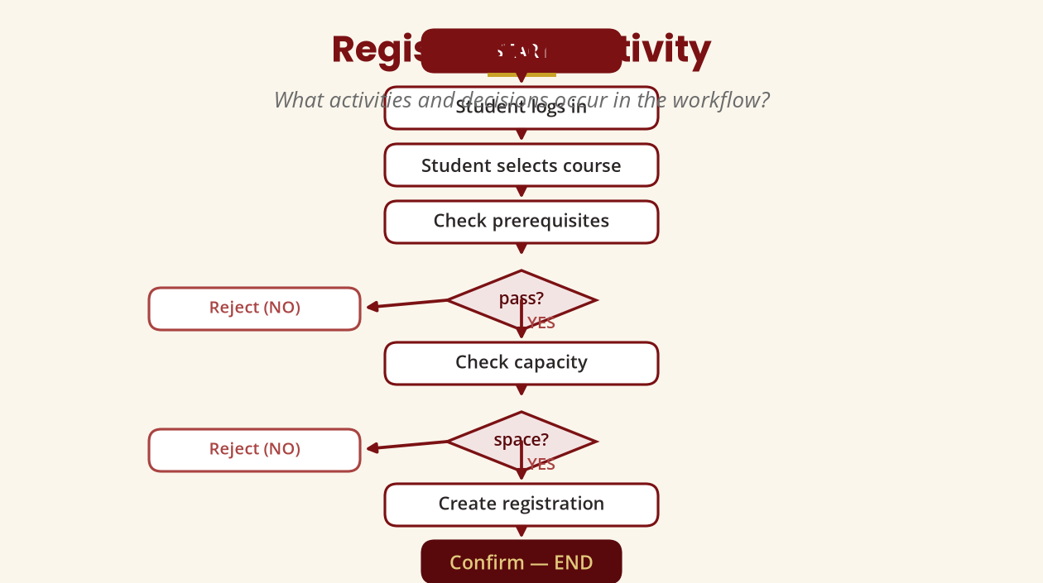
Registration Activity
What activities and decisions occur in the workflow?
Activity = the workflow; sequence = who talks to whom.
BICT 3202 · Object-Oriented Analysis and Design
Week 12 · Slide 10

Slide 12
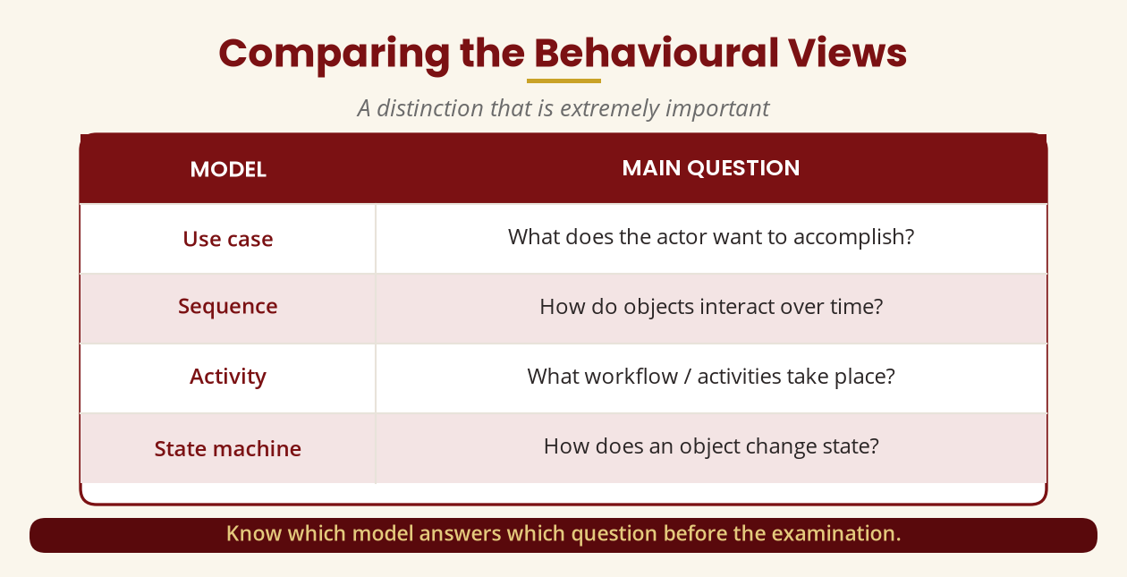
Comparing the Behavioural Views
Know which model answers which question
Use case = what · sequence = how over time · activity = workflow · state = object lifecycle.
BICT 3202 · Object-Oriented Analysis and Design
Week 12 · Slide 11

Slide 13
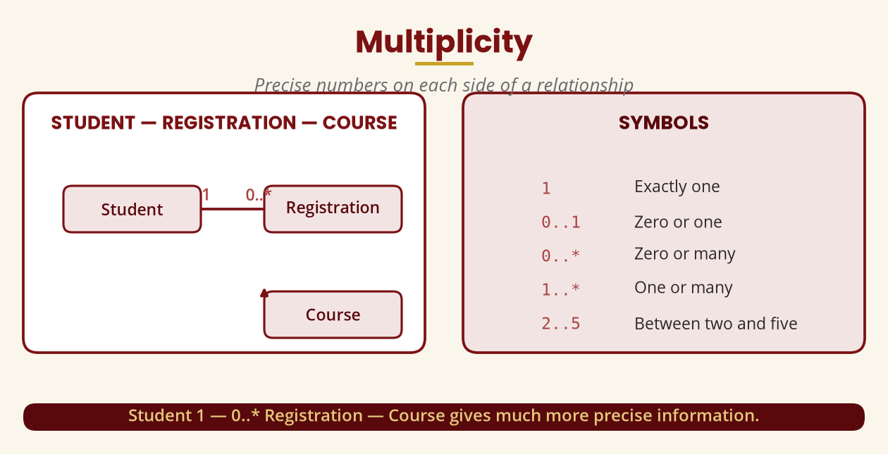
Multiplicity
Precise numbers on each side of a relationship
Student 1 — 0..* Registration — Course gives precise information.
BICT 3202 · Object-Oriented Analysis and Design
Week 12 · Slide 12

Slide 14
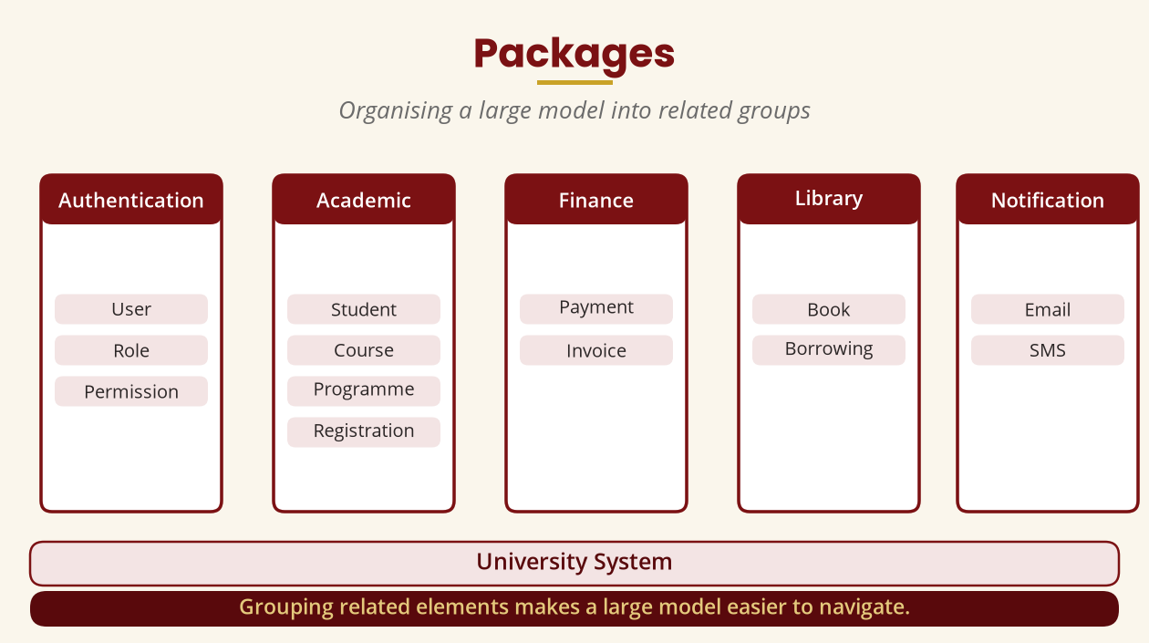
Packages
Organising a large model into related groups
Authentication · Academic · Finance · Library · Notification.
BICT 3202 · Object-Oriented Analysis and Design
Week 12 · Slide 13

Slide 15
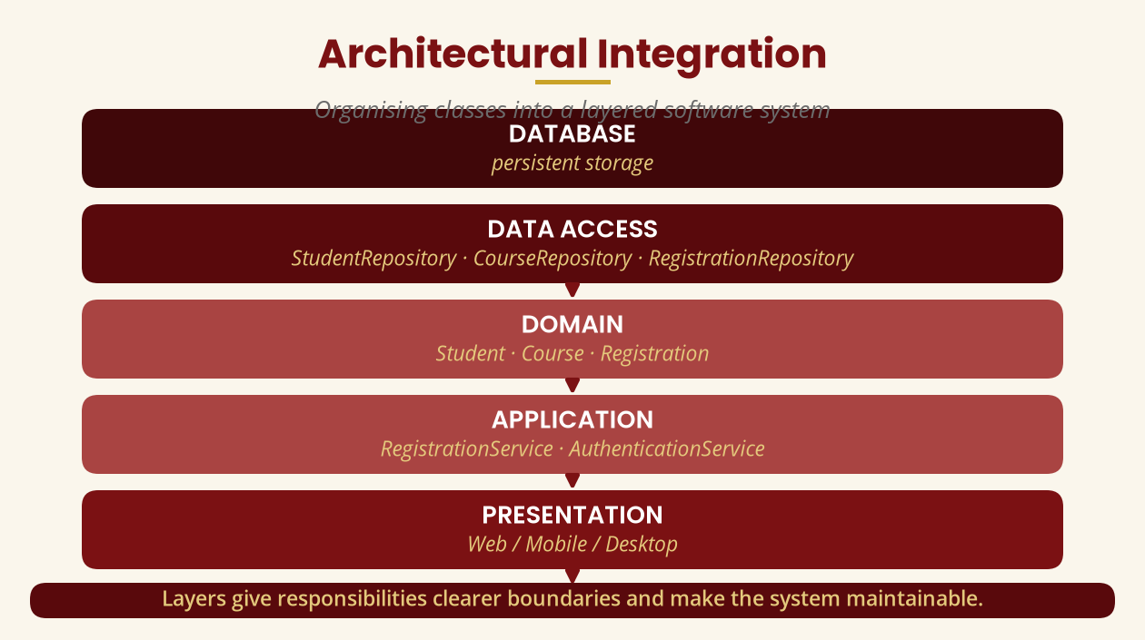
Architectural Integration
Organising classes into a layered system
Layers give responsibilities clearer boundaries.
BICT 3202 · Object-Oriented Analysis and Design
Week 12 · Slide 14

Slide 16
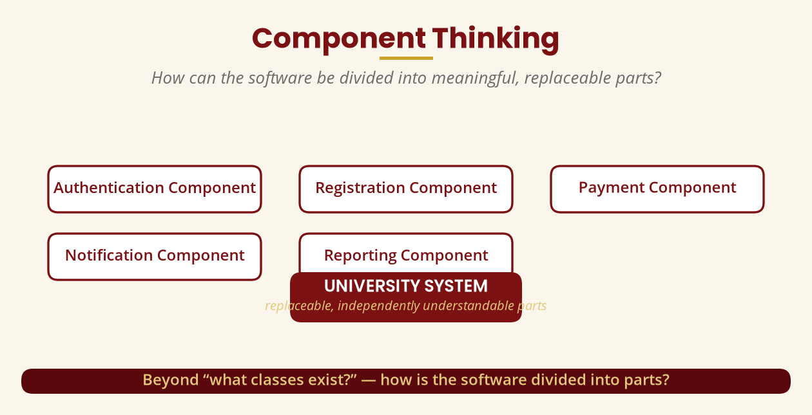
Component Thinking
Meaningful, replaceable, understandable parts
Beyond classes: how is the software divided into components?
BICT 3202 · Object-Oriented Analysis and Design
Week 12 · Slide 15

Slide 17
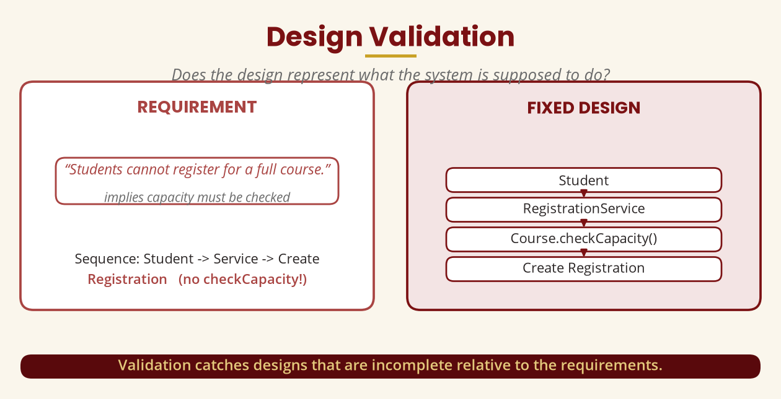
Design Validation
Does the design represent what the system must do?
A sequence with no checkCapacity() fails the “full course” requirement.
BICT 3202 · Object-Oriented Analysis and Design
Week 12 · Slide 16

Slide 18
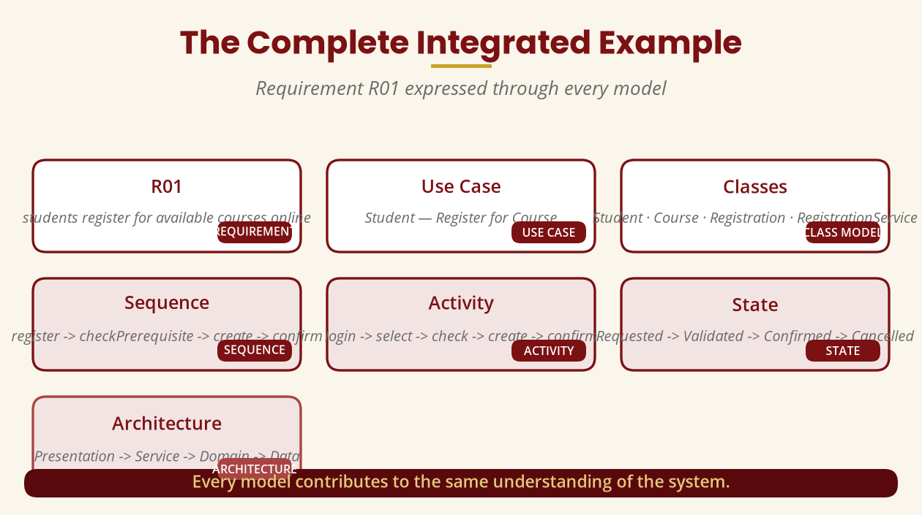
The Complete Integrated Example
Requirement R01 through every model
Use case · classes · sequence · activity · state · architecture.
BICT 3202 · Object-Oriented Analysis and Design
Week 12 · Slide 17

Slide 19
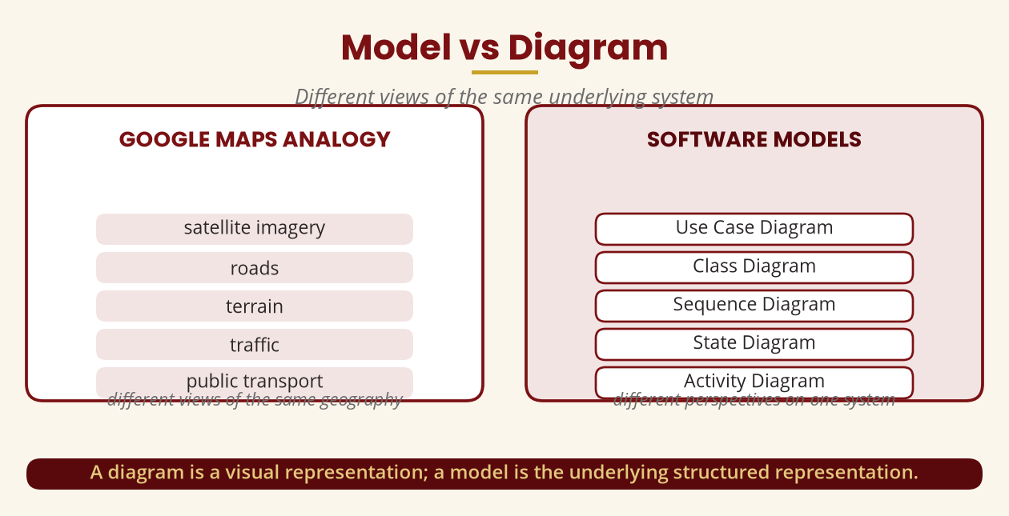
Model vs Diagram
The Google Maps analogy
A diagram is a visual representation; a model is the underlying structure.
BICT 3202 · Object-Oriented Analysis and Design
Week 12 · Slide 18

Slide 20
Design Review
Questions a design team should ask
▪ Requirement coverage? every important requirement represented.
▪ Use-case coverage? every major use case has supporting design elements.
▪ Class / interaction / state coverage? the required data and behaviour exist.
▪ Architecture? responsibilities divided appropriately.
▪ Coupling / cohesion? no unnecessary dependencies; each part has a focus.
▪ Reuse / maintainability? components reusable; change is manageable.
Run this review before implementation.
BICT 3202 · Object-Oriented Analysis and Design
Week 12 · Slide 19

Slide 21
Common Confusions
Don't mix these up
▪ Use case vs sequence: what the user wants vs how objects communicate.
▪ Activity vs state: activities in a process vs states of one object.
▪ Class vs object diagram: blueprint (Student) vs instance (student:Student).
Class = blueprint · object = actual thing created from the blueprint.
BICT 3202 · Object-Oriented Analysis and Design
Week 12 · Slide 20

Slide 22
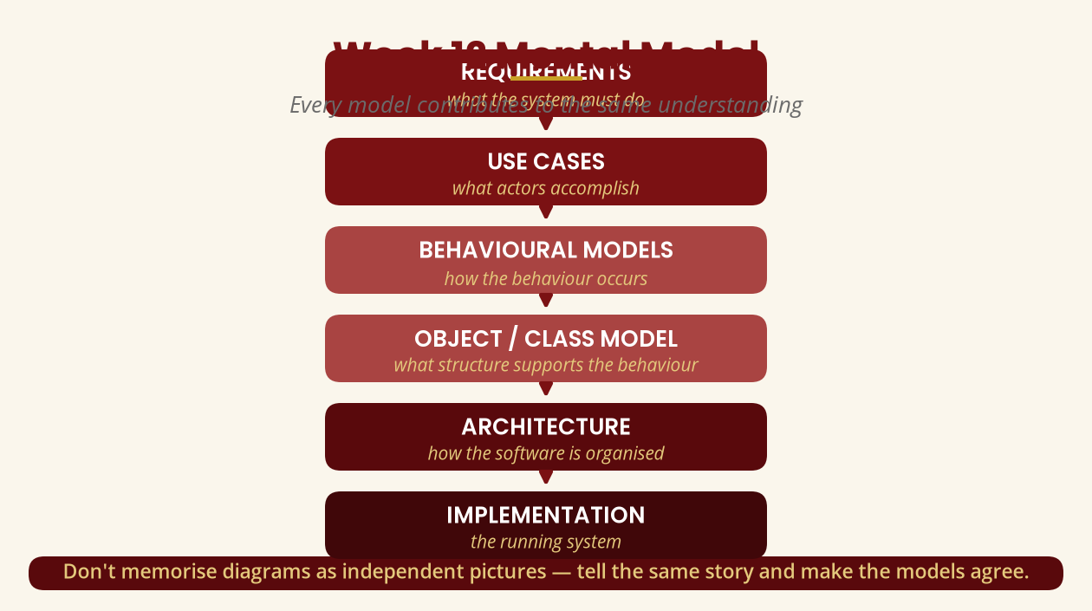
Week 12 Summary
The central principle
Tell the same system's story through different models — and make them agree.
BICT 3202 · Object-Oriented Analysis and Design
Week 12 · Slide 21

Slide 23
REVISION & NEXT STEPS
▪ Build a full integrated model for “patient books an appointment” (use case -> class -> sequence -> activity -> state).
▪ Audit one use case for missing links (requirement -> class -> operation -> test).
▪ Explain model vs diagram using the Google Maps analogy.
▪ Next week: multilayer architecture, reusable/adaptable components, and architectural design.
Thank you — Francis Fweta · ICT Lecturer · Exploits University

