Slide 1

EXPLOITS UNIVERSITY
BSc INFORMATION COMMUNICATION AND TECHNOLOGY
BICT 3202 · OBJECT-ORIENTED ANALYSIS AND DESIGN
WEEK 13
Multilayer Systems, Reusable Components and Architectural Design
Francis Fweta · ICT Lecturer · Week 13 of 16

Slide 2
Learning Outcomes
By the end of this week, you should be able to…
▪ Explain software architecture and distinguish it from class design.
▪ Explain multilayer architecture and identify common layers.
▪ Explain separation of concerns, cohesion and coupling.
▪ Define a software component and explain component interfaces.
▪ Explain reusable and adaptable components.
▪ Draw a basic UML component diagram and explain packages.
▪ Evaluate the benefits and limitations of multilayer architecture.
Organise the software so it is easier to maintain, reuse, replace and adapt.
BICT 3202 · Object-Oriented Analysis and Design
Week 13 · Slide 1

Slide 3
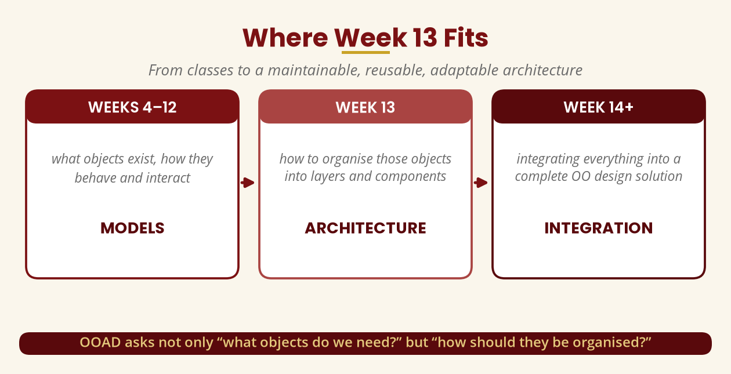
Where Week 13 Fits
From classes to architecture
Not just “what objects do we need?” but “how should they be organised?”
BICT 3202 · Object-Oriented Analysis and Design
Week 13 · Slide 2

Slide 4
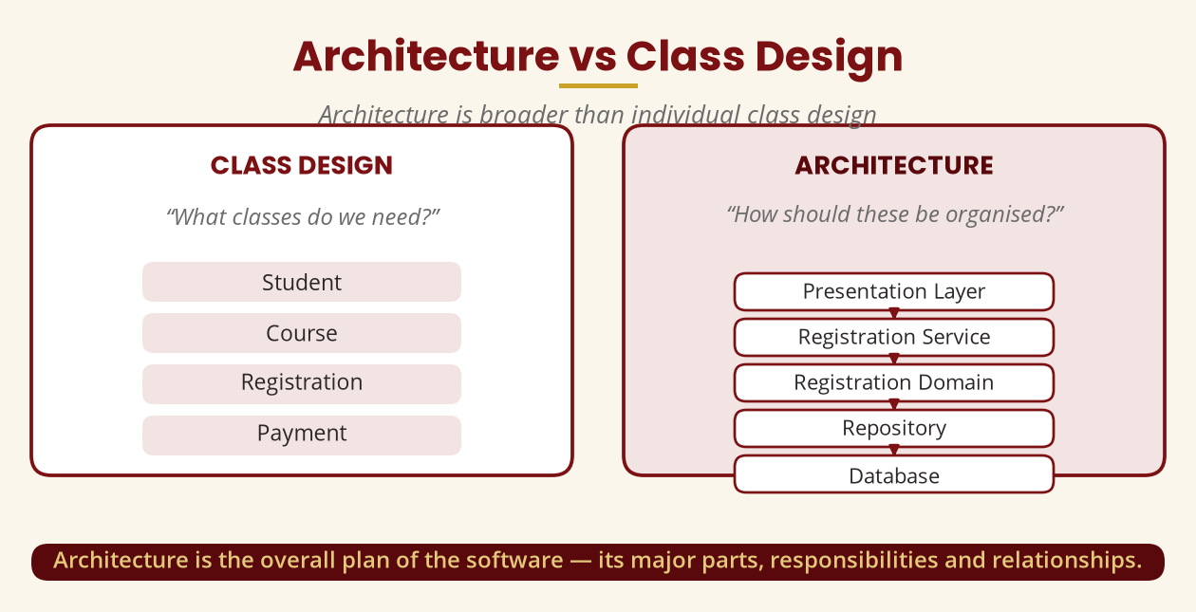
Architecture vs Class Design
Architecture is broader
Class design = what classes; architecture = how they are organised.
BICT 3202 · Object-Oriented Analysis and Design
Week 13 · Slide 3

Slide 5
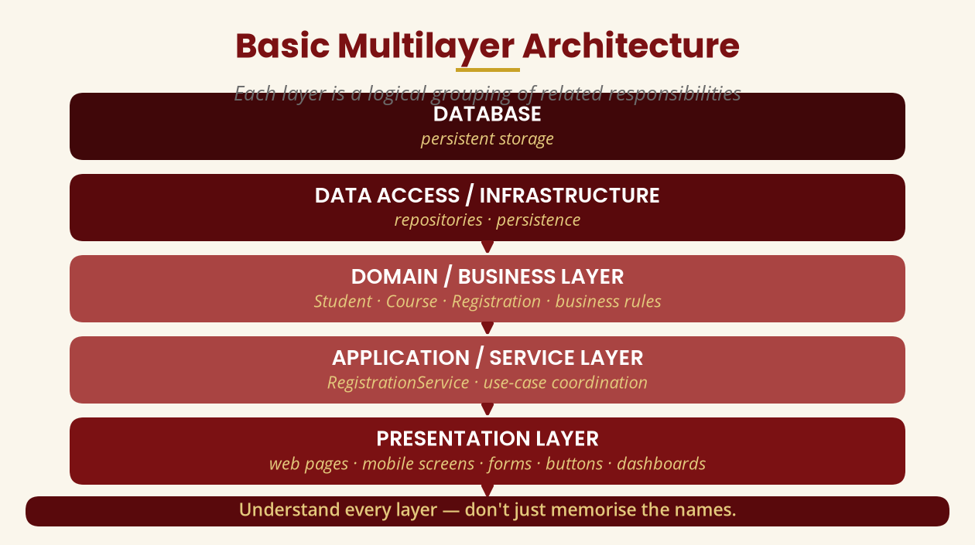
Basic Multilayer Architecture
Five logical levels
Presentation -> Application -> Domain -> Data Access -> Database.
BICT 3202 · Object-Oriented Analysis and Design
Week 13 · Slide 4

Slide 6
The Presentation Layer
User interaction only
▪ Handles: displaying information, collecting input, basic formatting, sending requests, showing responses.
▪ Does not normally hold all the business rules.
▪ Why: web, Android, iOS and desktop would each duplicate the same logic.
One rule change should not mean changing several applications.
BICT 3202 · Object-Oriented Analysis and Design
Week 13 · Slide 5

Slide 7
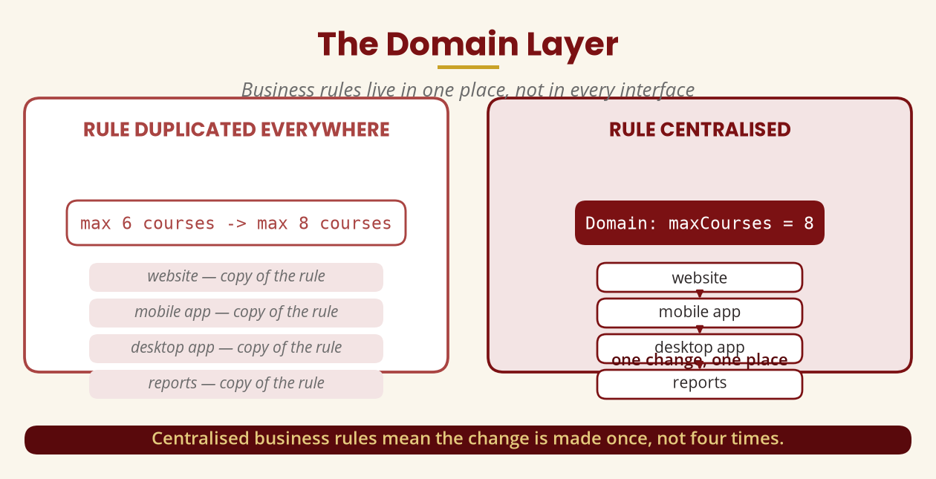
The Domain Layer
Business rules in one place
max 6 -> max 8 courses: centralised = one change; duplicated = four changes.
BICT 3202 · Object-Oriented Analysis and Design
Week 13 · Slide 6

Slide 8
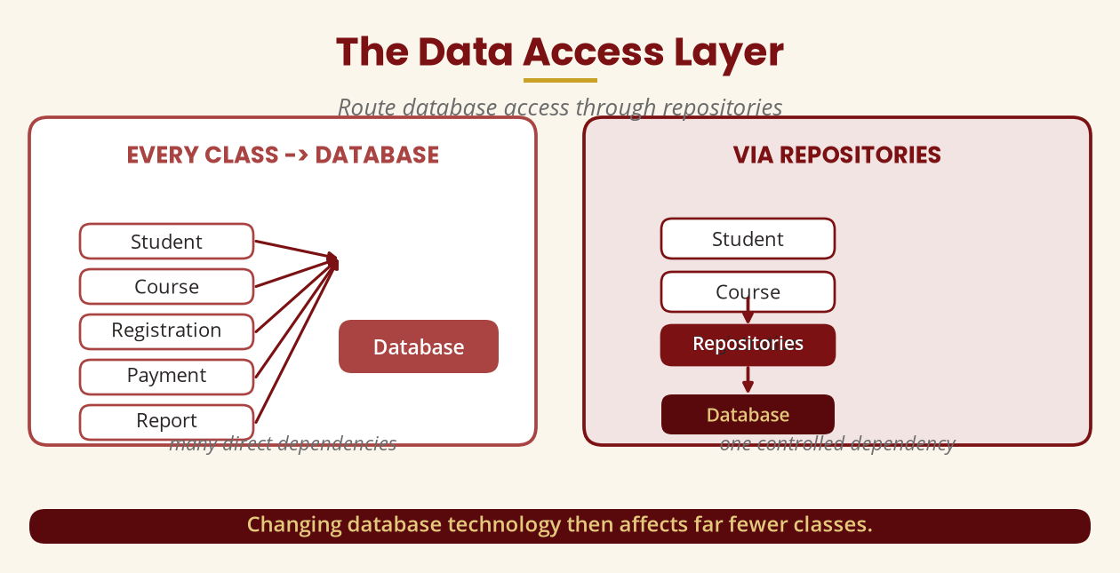
The Data Access Layer
Route database access through repositories
Changing database technology then affects far fewer classes.
BICT 3202 · Object-Oriented Analysis and Design
Week 13 · Slide 7

Slide 9
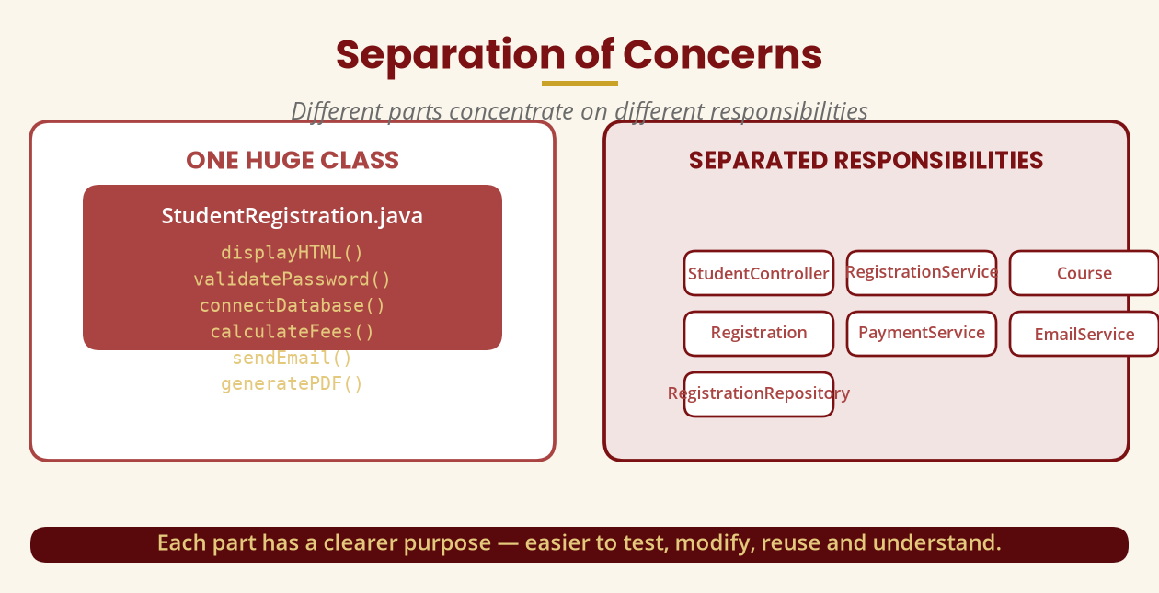
Separation of Concerns
Different parts, different responsibilities
One huge class is hard to test, modify, reuse and understand.
BICT 3202 · Object-Oriented Analysis and Design
Week 13 · Slide 8

Slide 10
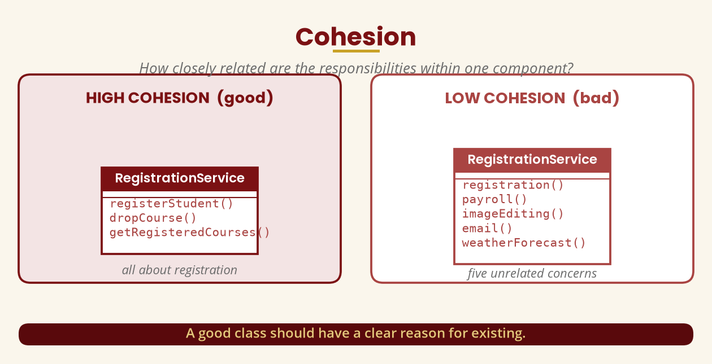
Cohesion
Keep related responsibilities together
A good class has a clear reason for existing.
BICT 3202 · Object-Oriented Analysis and Design
Week 13 · Slide 9

Slide 11
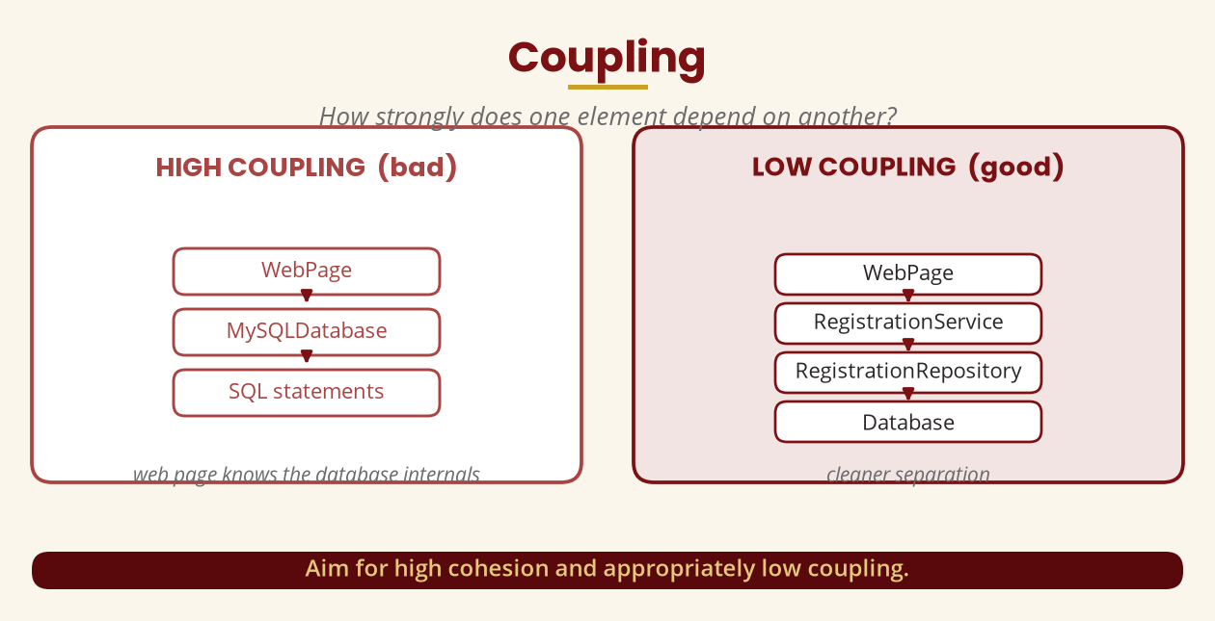
Coupling
Avoid unnecessary dependencies
High cohesion + appropriately low coupling.
BICT 3202 · Object-Oriented Analysis and Design
Week 13 · Slide 10

Slide 12
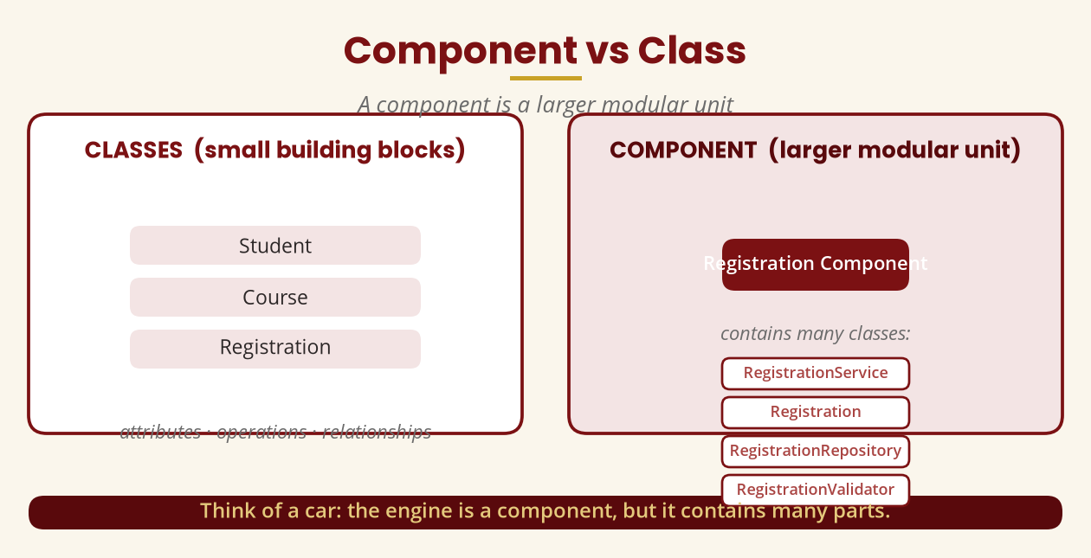
Component vs Class
A component is a larger modular unit
The engine is a component, but it contains many parts.
BICT 3202 · Object-Oriented Analysis and Design
Week 13 · Slide 11

Slide 13
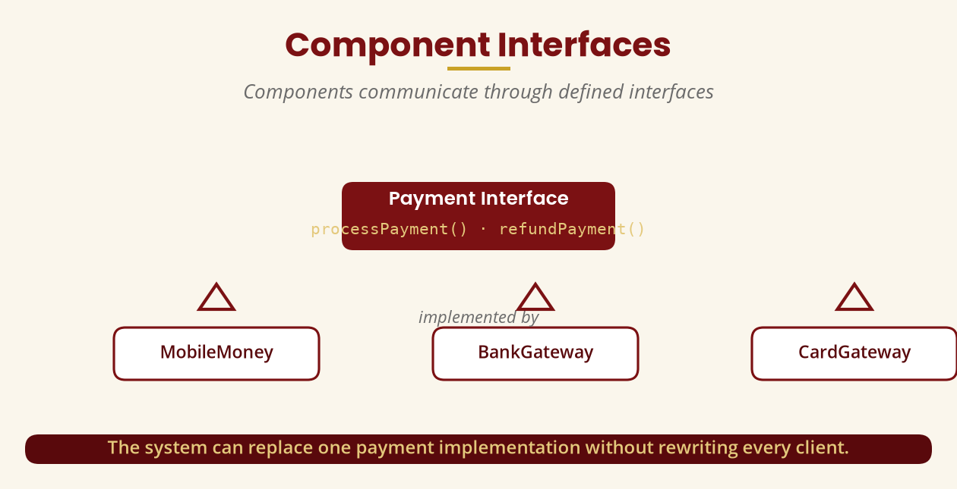
Component Interfaces
Communicate through defined contracts
Replace one payment implementation without rewriting every client.
BICT 3202 · Object-Oriented Analysis and Design
Week 13 · Slide 12

Slide 14
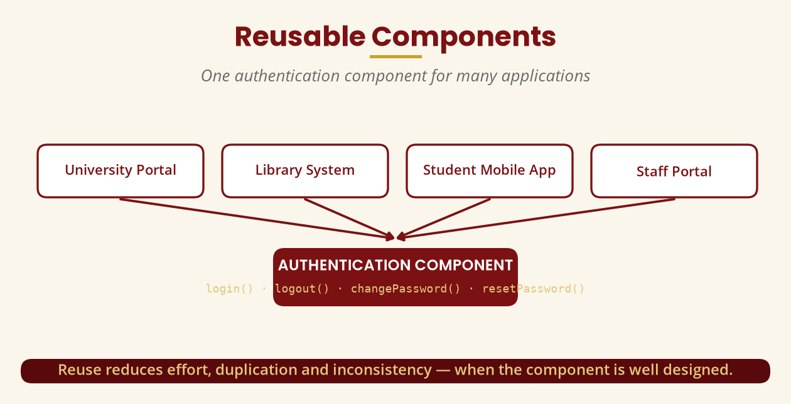
Reusable Components
One authentication component, many apps
Reuse reduces effort and duplication — when the component is well designed.
BICT 3202 · Object-Oriented Analysis and Design
Week 13 · Slide 13

Slide 15
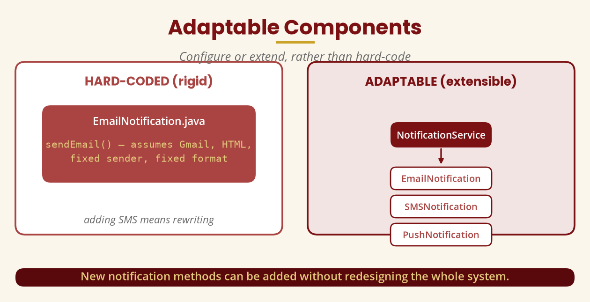
Adaptable Components
Configure or extend, don't hard-code
NotificationService with Email, SMS and Push adapts without a redesign.
BICT 3202 · Object-Oriented Analysis and Design
Week 13 · Slide 14

Slide 16
Reuse vs Inheritance
Inheritance is not always the best reuse
▪ Inheritance = an IS-A relationship (Administrator IS-A User).
▪ Not: RegistrationService IS-A Database.
▪ Composition = RegistrationService USES NotificationService.
▪ Other reuse: composition, interfaces, services, libraries, frameworks, configurable components.
Reuse does not automatically require inheritance.
BICT 3202 · Object-Oriented Analysis and Design
Week 13 · Slide 15

Slide 17
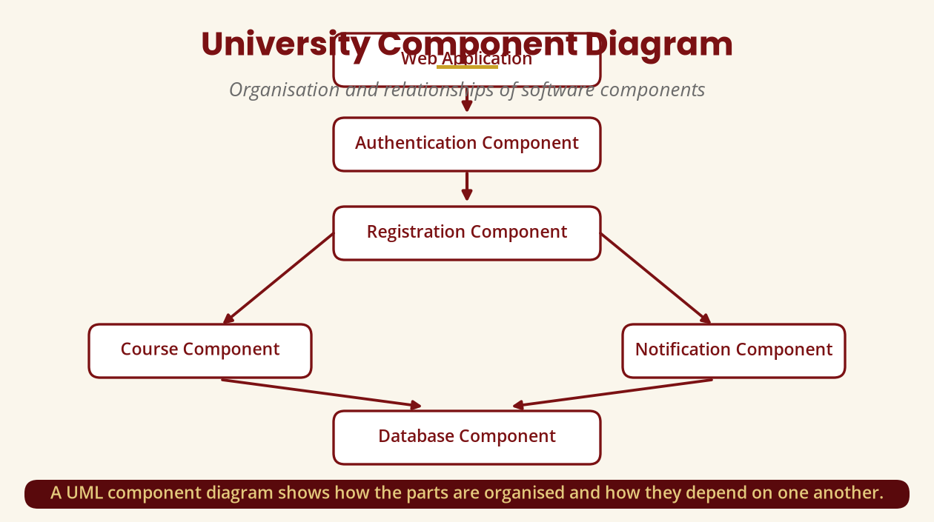
UML Component Diagram
Organisation and relationships of components
One of UML's structural diagram types.
BICT 3202 · Object-Oriented Analysis and Design
Week 13 · Slide 16

Slide 18
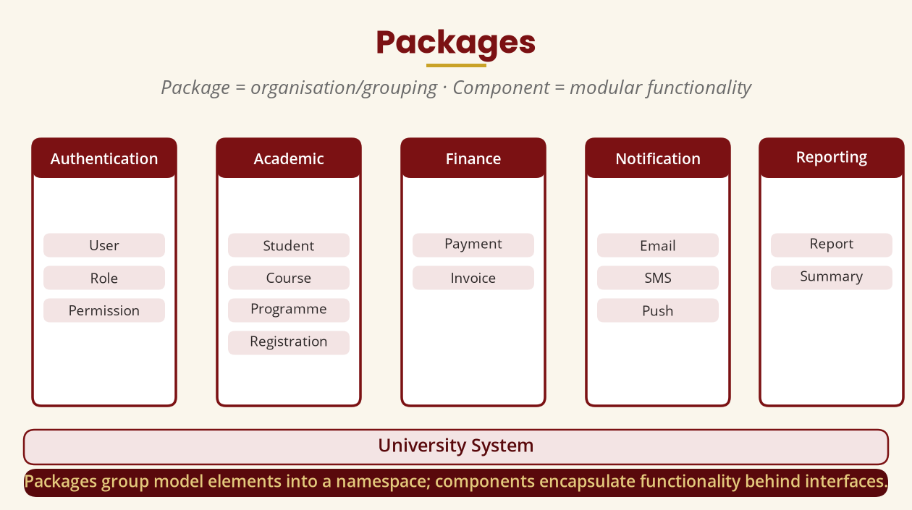
Packages
Package = organisation · Component = functionality
A package is a namespace; a component encapsulates functionality behind interfaces.
BICT 3202 · Object-Oriented Analysis and Design
Week 13 · Slide 17

Slide 19
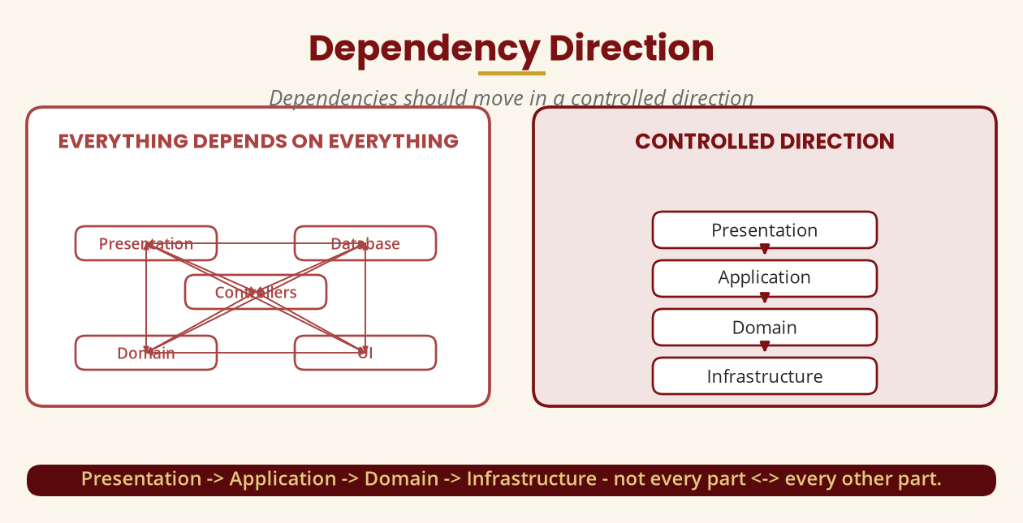
Dependency Direction
Control the direction of dependencies
Presentation -> Application -> Domain -> Infrastructure — not everything <- everything.
BICT 3202 · Object-Oriented Analysis and Design
Week 13 · Slide 18

Slide 20
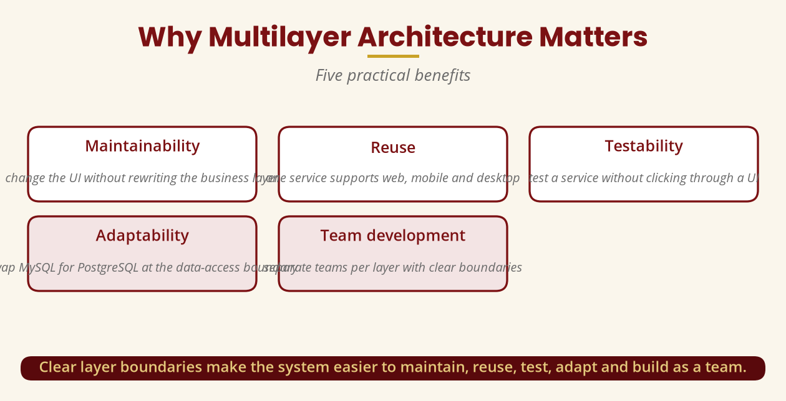
Why Multilayer Architecture Matters
Five practical benefits
Maintainability · reuse · testability · adaptability · team development.
BICT 3202 · Object-Oriented Analysis and Design
Week 13 · Slide 19

Slide 21
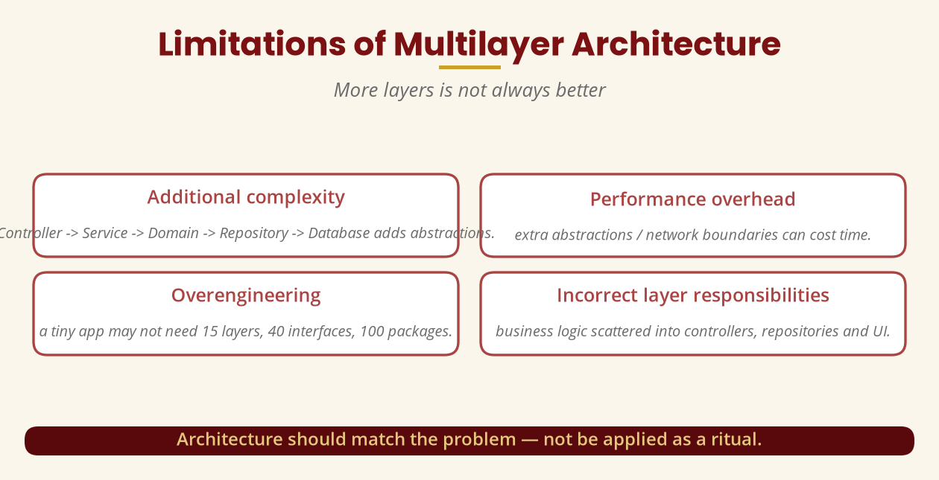
Limitations of Multilayer Architecture
More layers is not always better
Architecture should match the problem — not be a ritual.
BICT 3202 · Object-Oriented Analysis and Design
Week 13 · Slide 20

Slide 22
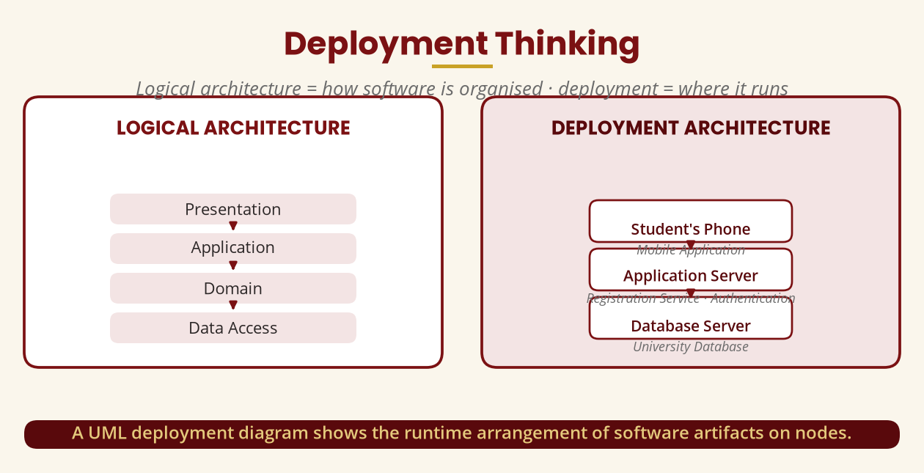
Deployment Thinking
Logical = how it is organised · deployment = where it runs
A deployment diagram shows software artifacts on nodes at runtime.
BICT 3202 · Object-Oriented Analysis and Design
Week 13 · Slide 21

Slide 23
Reusability Design Principles
Four principles + a warning
▪ Clear interfaces — interact through a well-defined contract.
▪ Minimise dependencies — don't couple to one application.
▪ Encapsulation — expose processPayment(), hide the internals.
▪ Configuration — channel = SMS instead of hard-coding SMS.
▪ Warning: design for appropriate reuse, not reuse at any cost.
Don't spend three weeks turning a SmallCalculator into a framework.
BICT 3202 · Object-Oriented Analysis and Design
Week 13 · Slide 22

Slide 24
Common Confusions
Don't mix these up
▪ Layer vs component: a level vs a modular unit.
▪ Component vs class: larger unit vs finer building block.
▪ Package vs layer: namespace vs responsibility-based separation.
▪ Reuse vs inheritance: reuse does not require inheritance.
▪ Cohesion vs coupling: keep related things together; keep dependencies apart.
Five classic traps in examination answers.
BICT 3202 · Object-Oriented Analysis and Design
Week 13 · Slide 23

Slide 25
Week 13 Summary
The core message
▪ 1. Divide responsibilities into logical layers.
▪ 2. Keep related responsibilities together (high cohesion).
▪ 3. Avoid unnecessary dependencies (low coupling).
▪ 4. Build components with clear interfaces.
▪ 5. Design for appropriate reuse and adaptability — and let architecture match the problem.
OO design = responsibilities, objects, components and layers working together.
BICT 3202 · Object-Oriented Analysis and Design
Week 13 · Slide 24

Slide 26
REVISION & NEXT STEPS
▪ Classify the registration activities into layers (Presentation/Application/Domain/Data Access/Database).
▪ Draw a component diagram for the online banking system.
▪ Identify three reusable and two adaptable components for the university system.
▪ Next week: integrating the Object, Dynamic and Behavioural models into the OO design.
Thank you — Francis Fweta · ICT Lecturer · Exploits University

