Slide 1

EXPLOITS UNIVERSITY
BSc INFORMATION COMMUNICATION AND TECHNOLOGY
BICT 3202 · OBJECT-ORIENTED ANALYSIS AND DESIGN
WEEK 14
Integrating Object, Dynamic and Behavioural Models into Object-Oriented Design
Francis Fweta · ICT Lecturer · Week 14 of 16

Slide 2
Learning Outcomes
By the end of this week, you should be able to…
▪ Define OOD and explain analysis vs design.
▪ Explain why analysis models must become design models.
▪ Explain design classes, responsibilities, attributes and operations.
▪ Integrate the object model with the dynamic and behavioural models.
▪ Trace a requirement from a use case to classes and operations.
▪ Use sequence, state and activity diagrams to refine class responsibilities.
▪ Identify design inconsistencies and refine an analysis model.
Each diagram is a different view of the SAME system.
BICT 3202 · Object-Oriented Analysis and Design
Week 14 · Slide 1

Slide 3
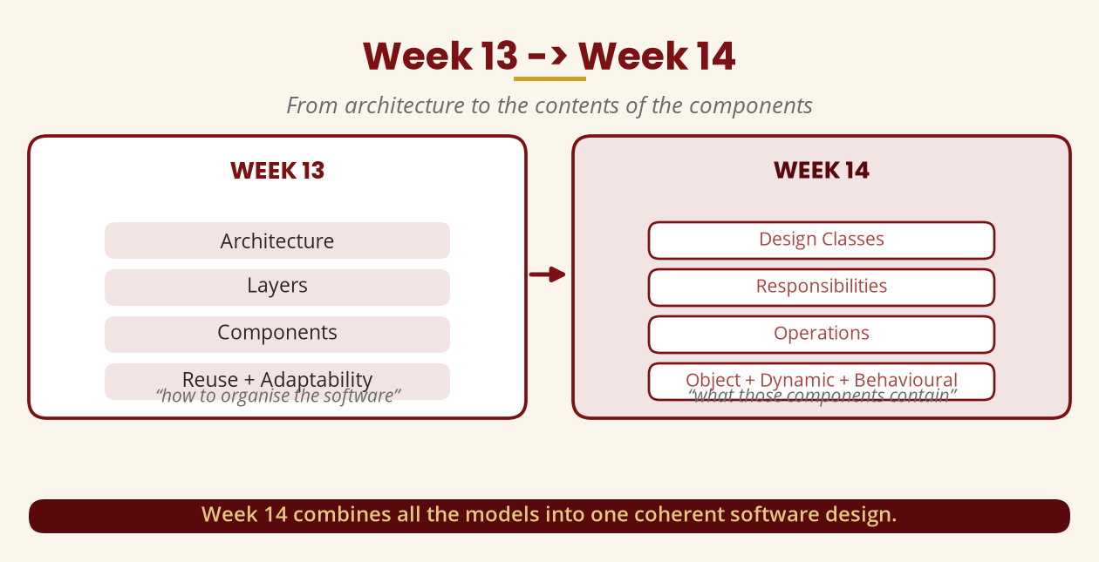
Week 13 -> Week 14
From architecture to the contents of the components
Week 14 combines all the models into one coherent software design.
BICT 3202 · Object-Oriented Analysis and Design
Week 14 · Slide 2

Slide 4
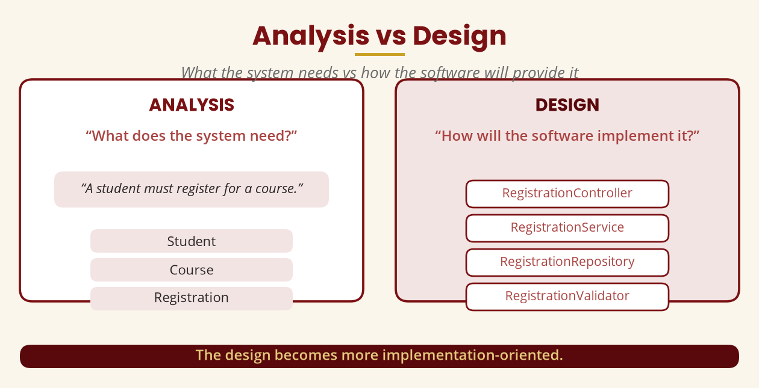
Analysis vs Design
What the system needs vs how the software provides it
Analysis = Student/Course/Registration · Design = Controller/Service/Repository/Validator.
BICT 3202 · Object-Oriented Analysis and Design
Week 14 · Slide 3

Slide 5
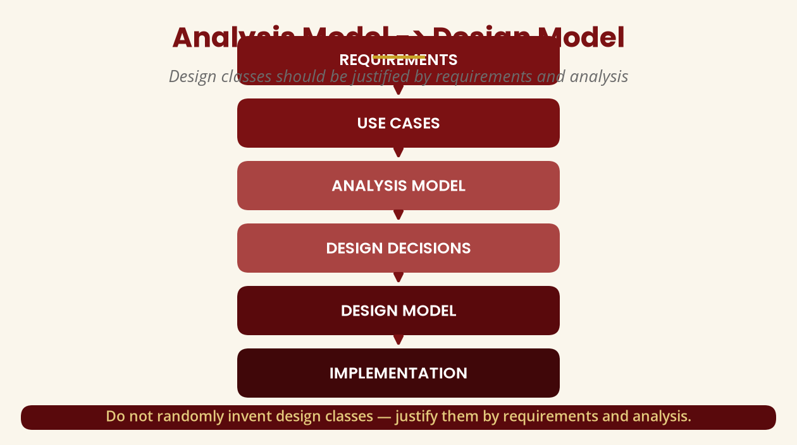
Analysis Model -> Design Model
Design classes must be justified
Requirements -> use cases -> analysis -> design decisions -> design -> implementation.
BICT 3202 · Object-Oriented Analysis and Design
Week 14 · Slide 4

Slide 6
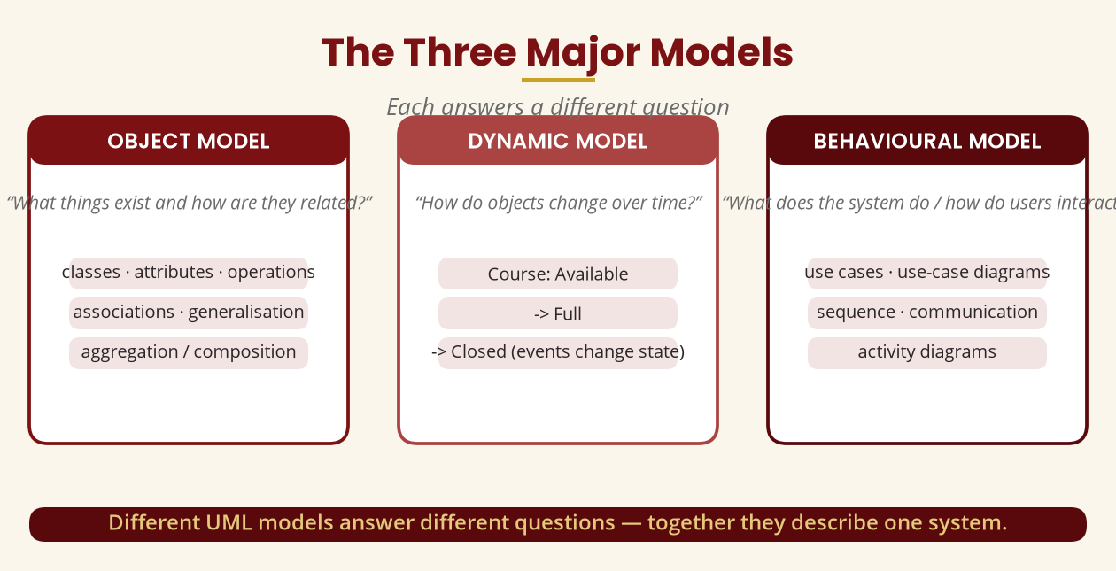
The Three Major Models
Each answers a different question
Object = what exists · Dynamic = what changes · Behavioural = what happens.
BICT 3202 · Object-Oriented Analysis and Design
Week 14 · Slide 5

Slide 7
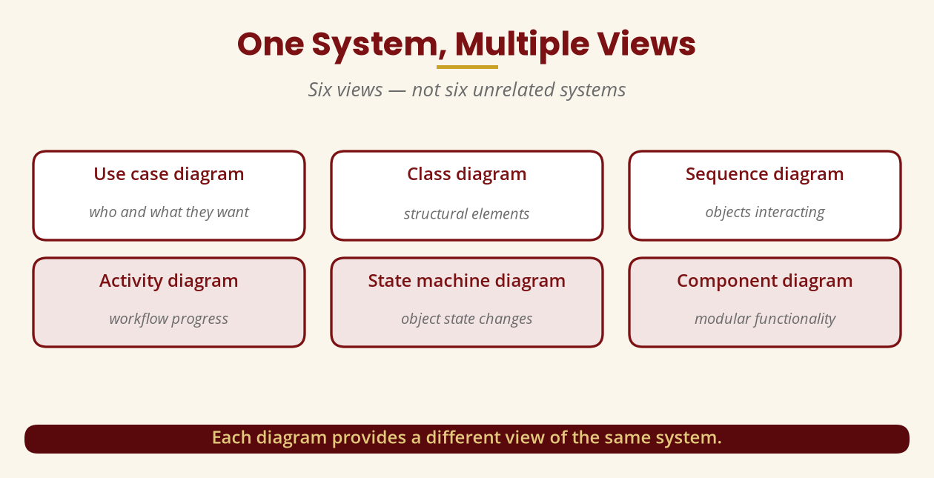
One System, Multiple Views
Six views — not six systems
Use case · class · sequence · activity · state · component.
BICT 3202 · Object-Oriented Analysis and Design
Week 14 · Slide 6

Slide 8
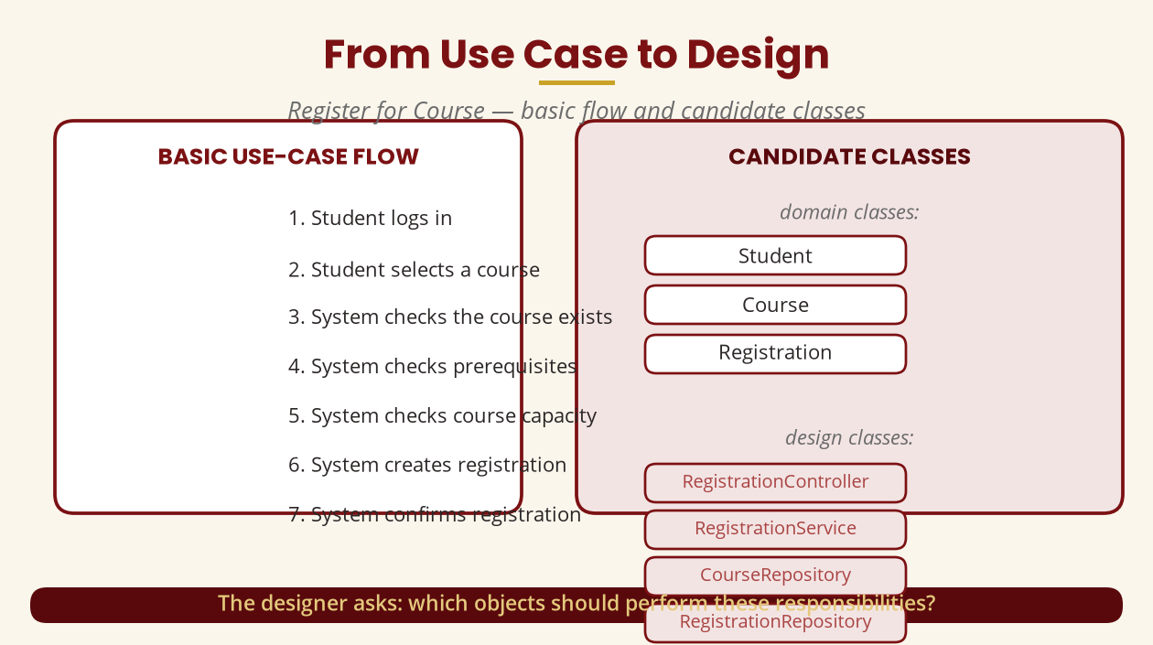
From Use Case to Design
Basic flow and candidate classes
Which objects should perform these responsibilities?
BICT 3202 · Object-Oriented Analysis and Design
Week 14 · Slide 7

Slide 9
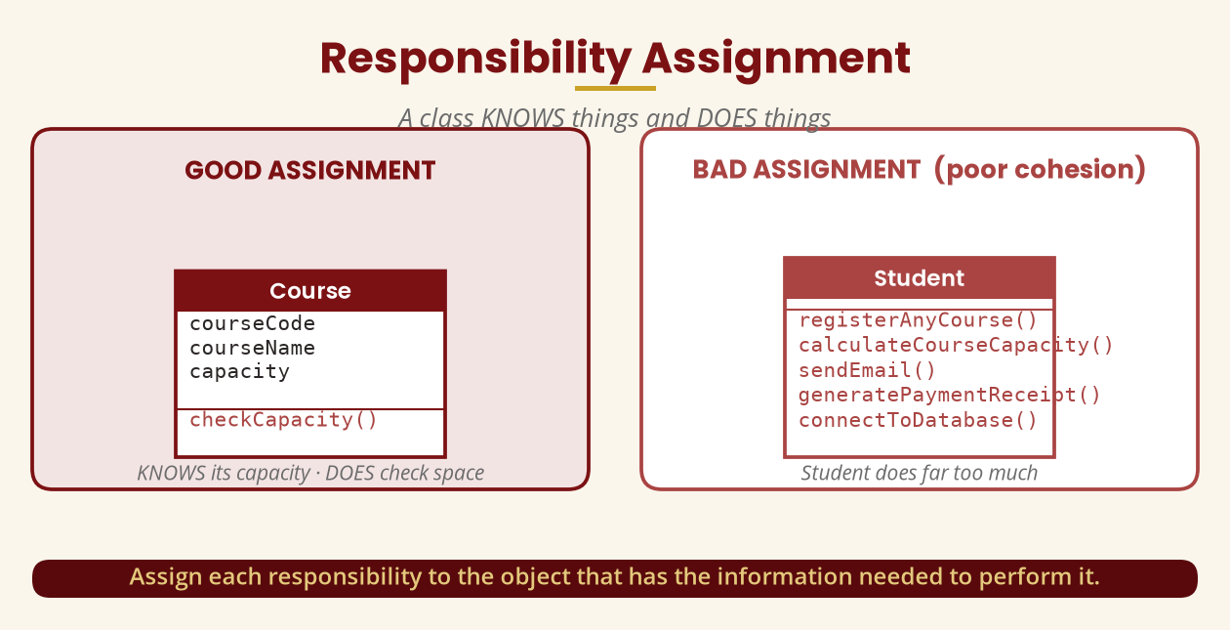
Responsibility Assignment
A class KNOWS things and DOES things
Assign each responsibility to the object with the information to perform it.
BICT 3202 · Object-Oriented Analysis and Design
Week 14 · Slide 8

Slide 10
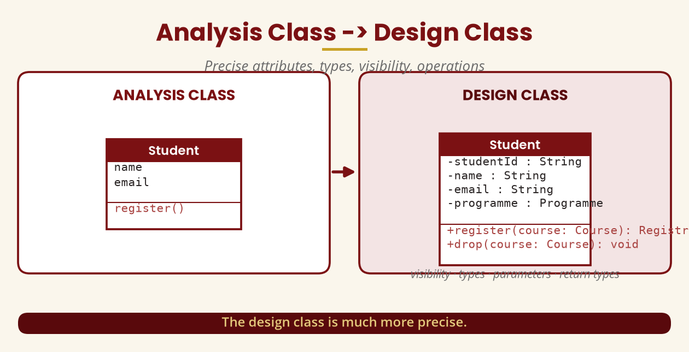
Analysis Class -> Design Class
Precise attributes, types, visibility, operations
The design class is much more precise.
BICT 3202 · Object-Oriented Analysis and Design
Week 14 · Slide 9

Slide 11
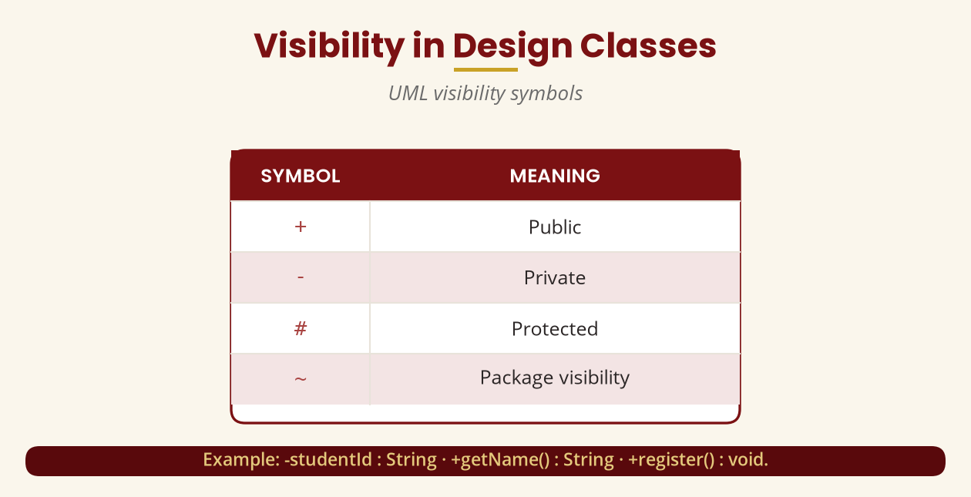
Visibility
UML visibility symbols
+ public · - private · # protected · ~ package.
BICT 3202 · Object-Oriented Analysis and Design
Week 14 · Slide 10

Slide 12
Attributes & Operations
Know vs do
▪ Attributes = what an object knows (studentId, name, email, balance).
▪ Operations = what an object can do (register(), withdraw(), getBalance()).
▪ Example: BankAccount -accountNumber, -balance; +deposit(), +withdraw(), +getBalance().
Attributes store information; operations perform actions.
BICT 3202 · Object-Oriented Analysis and Design
Week 14 · Slide 11

Slide 13
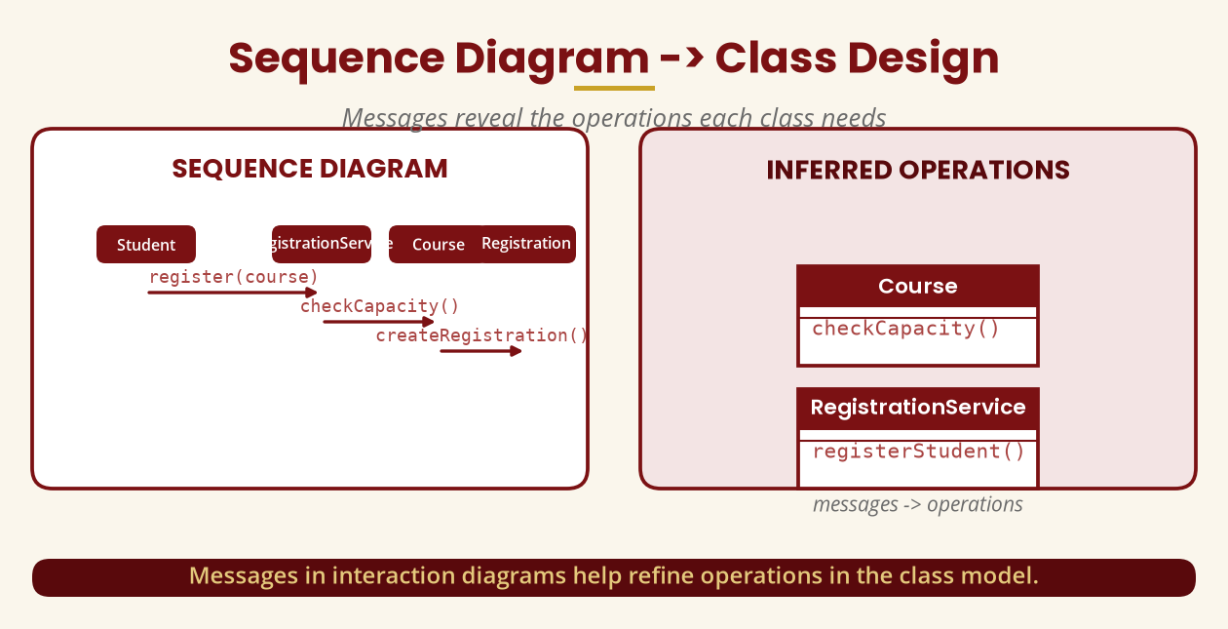
Sequence Diagram -> Class Design
Messages reveal operations
Course -> checkCapacity() means Course needs checkCapacity().
BICT 3202 · Object-Oriented Analysis and Design
Week 14 · Slide 12

Slide 14
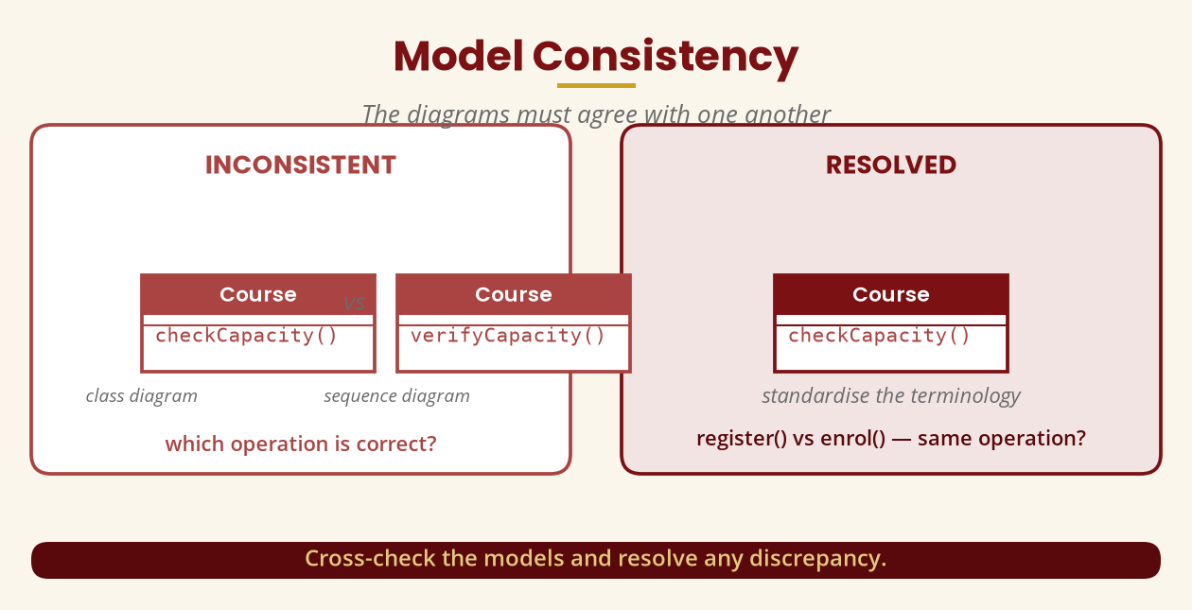
Model Consistency
The diagrams must agree
checkCapacity() vs verifyCapacity() — resolve the discrepancy.
BICT 3202 · Object-Oriented Analysis and Design
Week 14 · Slide 13

Slide 15
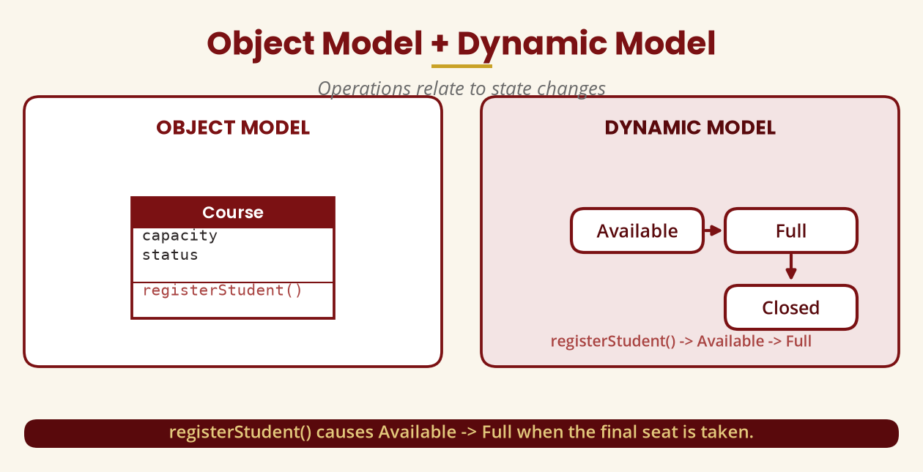
Object Model + Dynamic Model
Operations relate to state changes
registerStudent() causes Available -> Full at the final seat.
BICT 3202 · Object-Oriented Analysis and Design
Week 14 · Slide 14

Slide 16
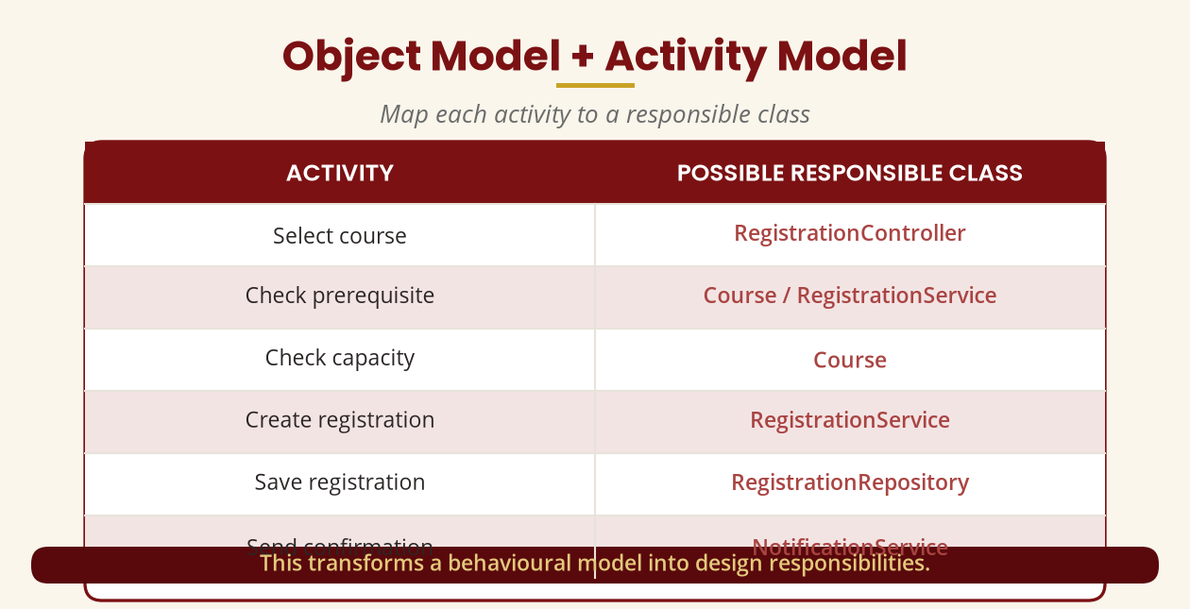
Object Model + Activity Model
Map activities to responsible classes
This turns a behavioural model into design responsibilities.
BICT 3202 · Object-Oriented Analysis and Design
Week 14 · Slide 15

Slide 17
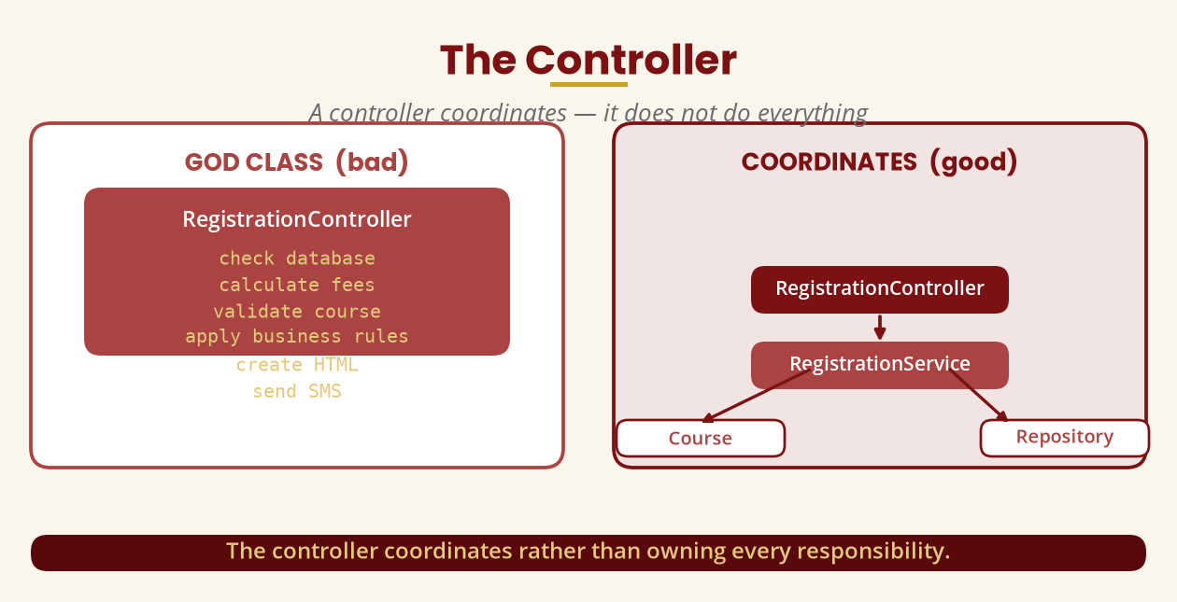
The Controller
Coordinates — does not do everything
Avoid the God class: the controller delegates to the service.
BICT 3202 · Object-Oriented Analysis and Design
Week 14 · Slide 16

Slide 18
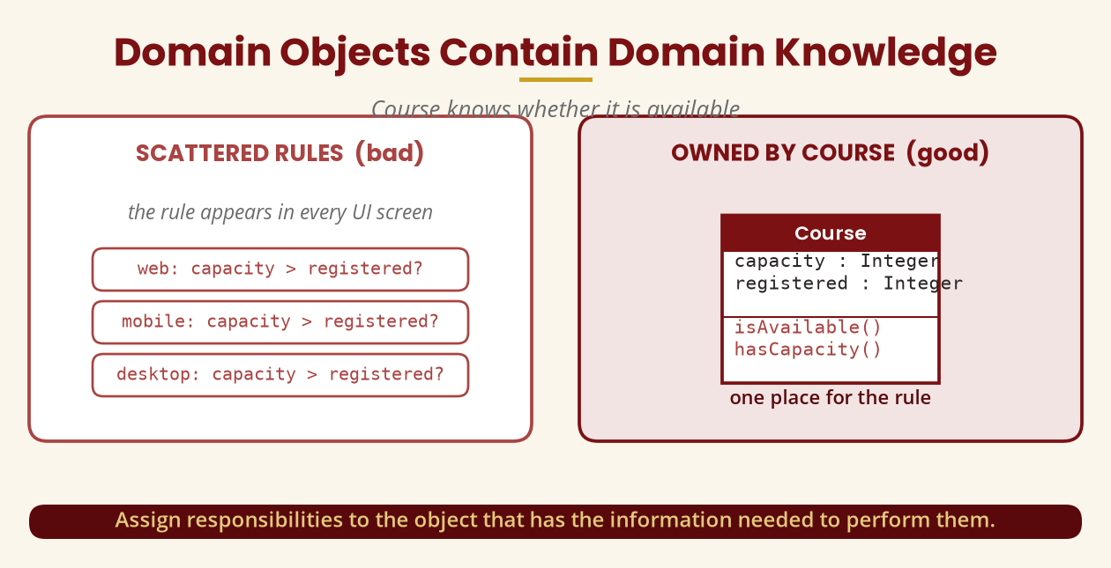
Domain Objects Own Domain Knowledge
Course knows if it is available
Course.isAvailable() / hasCapacity() instead of rules in every UI.
BICT 3202 · Object-Oriented Analysis and Design
Week 14 · Slide 17

Slide 19
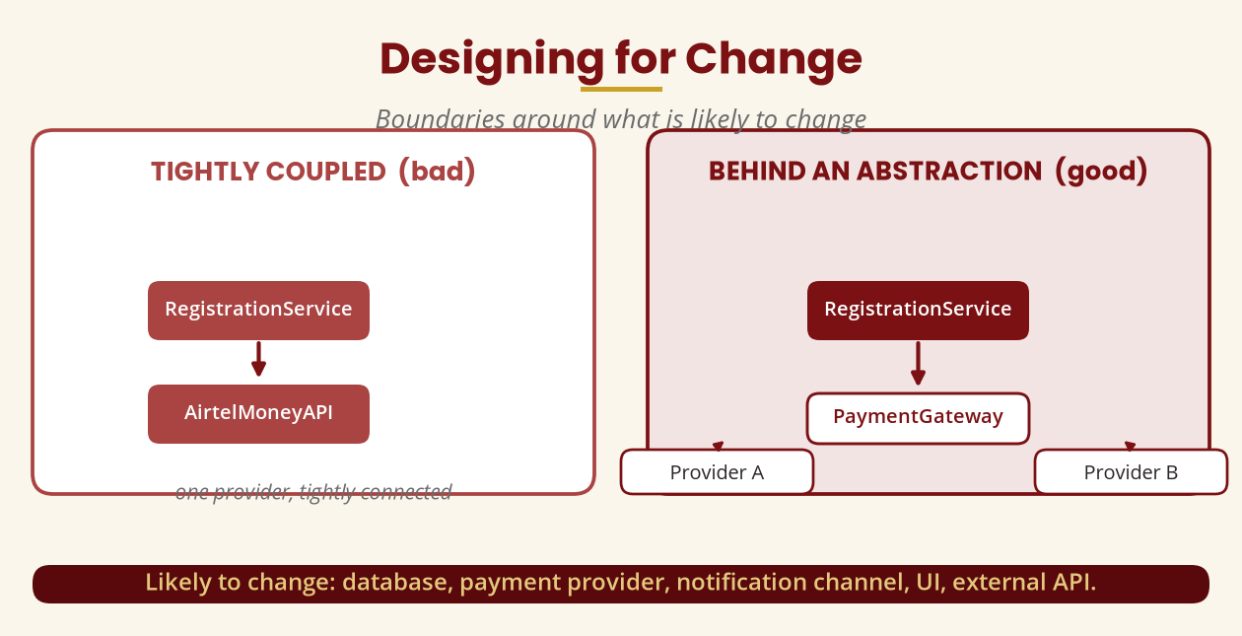
Designing for Change
Boundaries around what is likely to change
RegistrationService -> PaymentGateway, not -> AirtelMoneyAPI.
BICT 3202 · Object-Oriented Analysis and Design
Week 14 · Slide 18

Slide 20
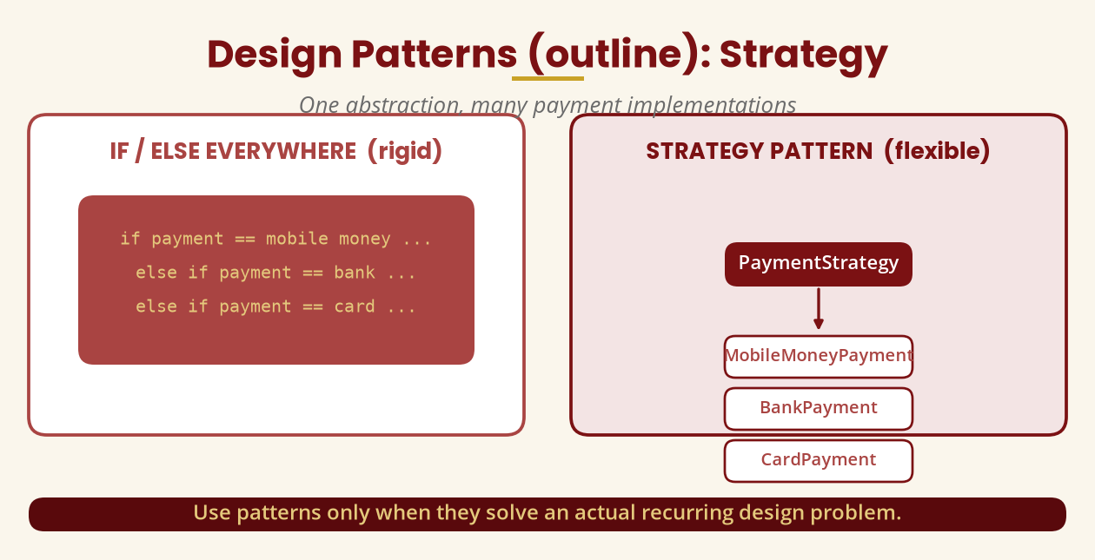
Design Patterns (outline): Strategy
One abstraction, many implementations
Use patterns only when they solve an actual recurring problem.
BICT 3202 · Object-Oriented Analysis and Design
Week 14 · Slide 19

Slide 21
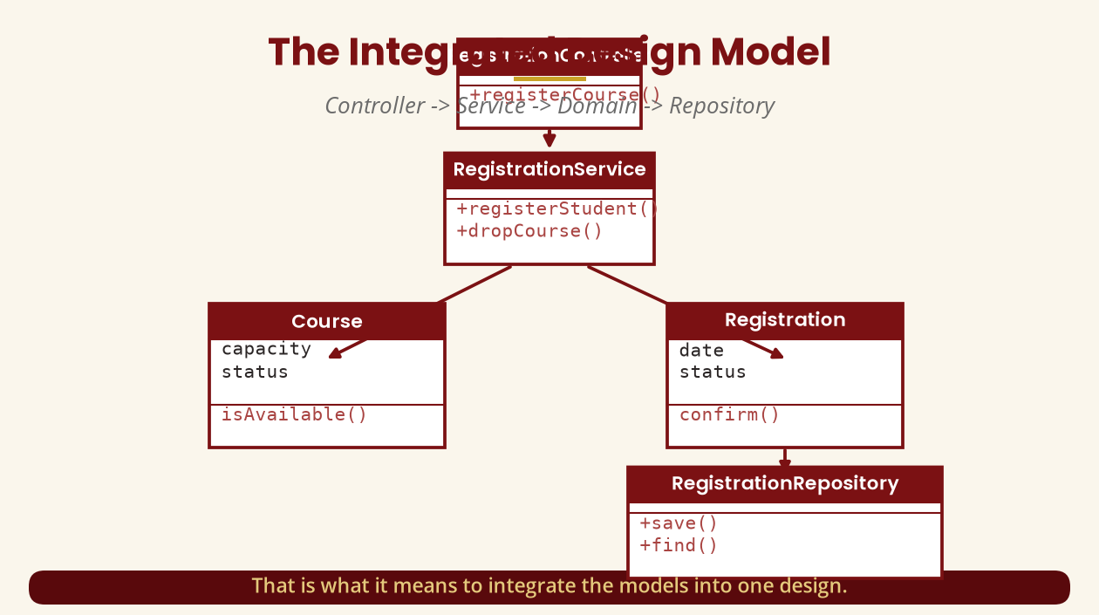
The Integrated Design Model
Controller -> Service -> Domain -> Repository
That is what it means to integrate the models.
BICT 3202 · Object-Oriented Analysis and Design
Week 14 · Slide 20

Slide 22
Model Validation
Eight questions to check your models
▪ Does every use case have supporting classes?
▪ Does every sequence message correspond to an operation?
▪ Do operations belong to sensible classes?
▪ Do state changes correspond to actual events/operations?
▪ Do activity flows agree with the use case? Any duplicated responsibilities or God classes?
If “drop courses” has no drop operation, introduce RegistrationService.dropCourse().
BICT 3202 · Object-Oriented Analysis and Design
Week 14 · Slide 21

Slide 23
Common Mistakes
Avoid these
▪ Treating diagrams as independent — the sequence explains how classes cooperate.
▪ One class does everything — poor responsibility assignment.
▪ Confusing analysis and design — what is needed vs how it is implemented.
▪ Classes without justification — every design class needs a reason.
▪ Ignoring consistency — register() vs enrolStudent() must be reconciled.
Five classic traps in examination answers.
BICT 3202 · Object-Oriented Analysis and Design
Week 14 · Slide 22

Slide 24
Week 14 Summary
The most important concept
▪ 1. Requirement -> use case -> scenario -> sequence -> classes -> responsibilities -> design -> implementation.
▪ 2. Class model <- dynamic model <- behavioural model.
▪ 3. The models must support one another, not contradict one another.
That is the central lesson of Week 14.
BICT 3202 · Object-Oriented Analysis and Design
Week 14 · Slide 23

Slide 25
REVISION & NEXT STEPS
▪ Refine Student/Course/Registration into full design classes with visibility and signatures.
▪ Draw the sequence and state models for “Register for Course” and cross-check them.
▪ Map each registration activity to a responsible class.
▪ Next week: complete OOAD case study, model integration and CASE-tool implementation.
Thank you — Francis Fweta · ICT Lecturer · Exploits University

