Slide 1

EXPLOITS UNIVERSITY
BSc INFORMATION COMMUNICATION AND TECHNOLOGY
BICT 3202 · OBJECT-ORIENTED ANALYSIS AND DESIGN
WEEK 15
Complete OOAD Case Study, Model Integration and CASE Tool Implementation
Francis Fweta · ICT Lecturer · Week 15 of 16

Slide 2
Learning Outcomes
By the end of this week, you should be able to…
▪ Analyse a complete software problem using OO techniques.
▪ Extract actors, functional and non-functional requirements.
▪ Build use-case, class, interaction, activity, state and component models.
▪ Refine the analysis model into a design model with responsibilities.
▪ Check consistency between the UML models.
▪ Document a complete OOAD solution and use a CASE/UML tool.
▪ Explain how the final design could be implemented.
The diagrams must tell one consistent story and guide implementation.
BICT 3202 · Object-Oriented Analysis and Design
Week 15 · Slide 1

Slide 3
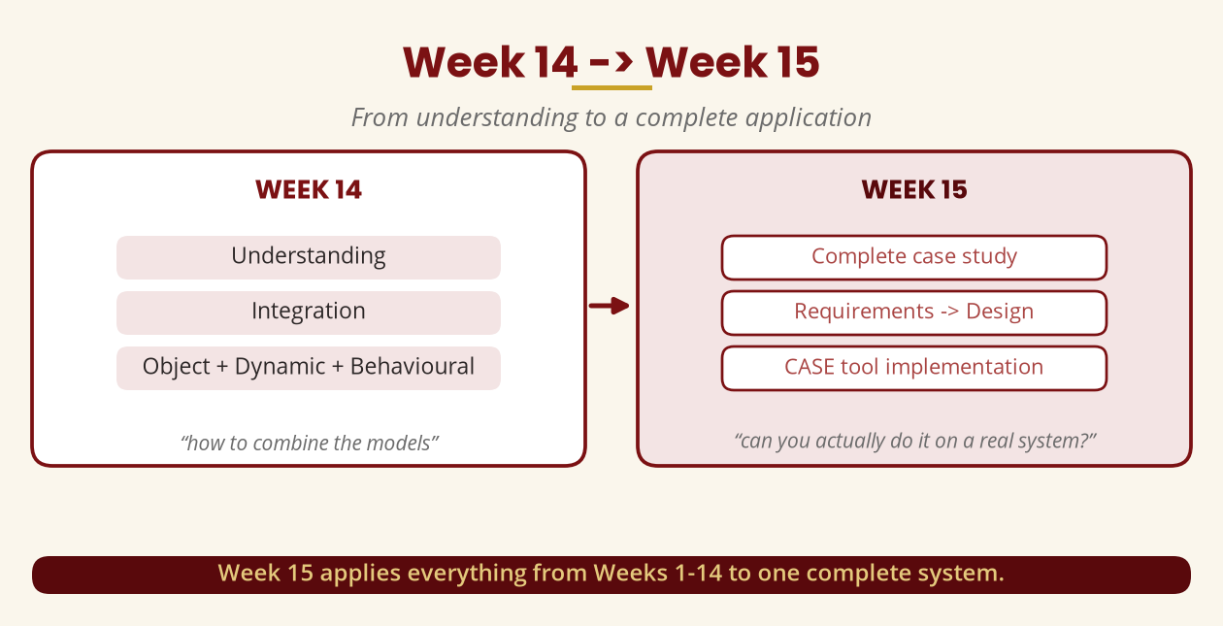
Week 14 -> Week 15
From understanding to a complete application
Week 15 applies Weeks 1–14 to one complete system.
BICT 3202 · Object-Oriented Analysis and Design
Week 15 · Slide 2

Slide 4
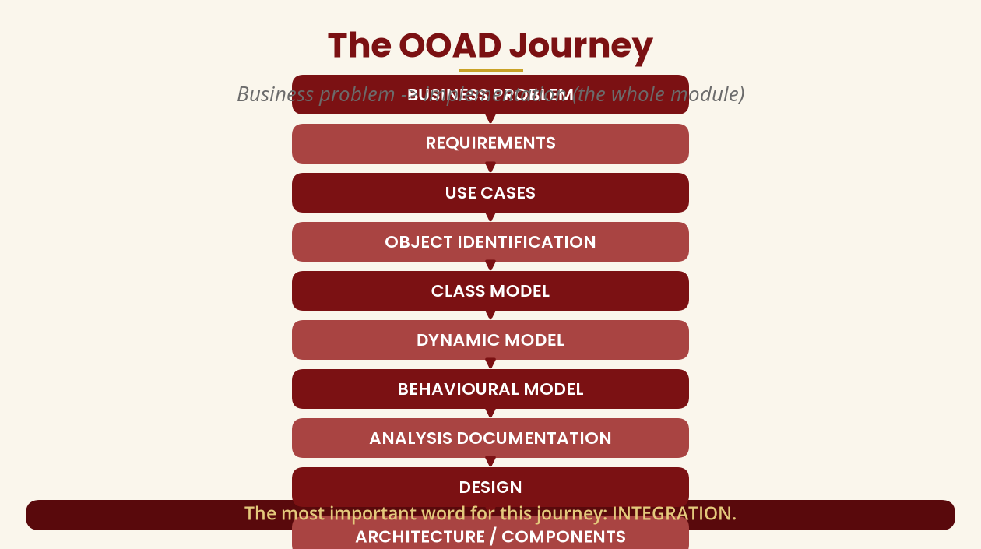
The OOAD Journey
The whole module in one flow
The most important word: INTEGRATION.
BICT 3202 · Object-Oriented Analysis and Design
Week 15 · Slide 3

Slide 5
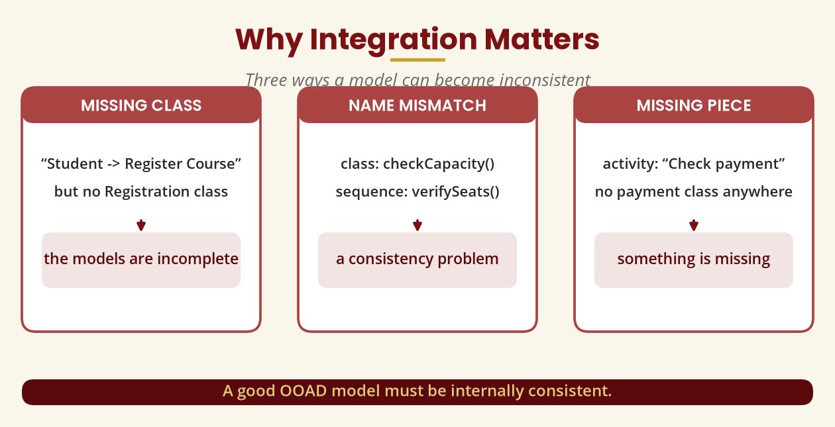
Why Integration Matters
Three ways a model can go wrong
A good OOAD model must be internally consistent.
BICT 3202 · Object-Oriented Analysis and Design
Week 15 · Slide 4

Slide 6
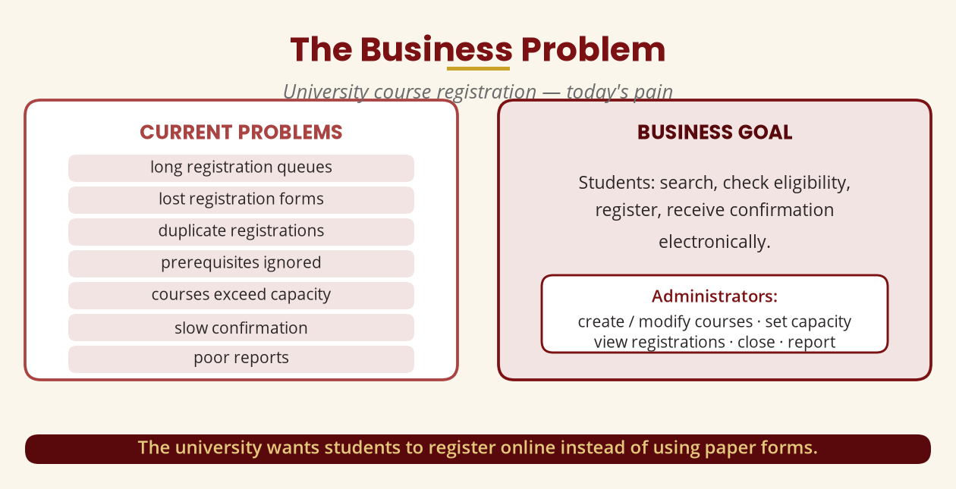
The Business Problem
University course registration — the pain
Students register online; administrators manage courses and reports.
BICT 3202 · Object-Oriented Analysis and Design
Week 15 · Slide 5

Slide 7
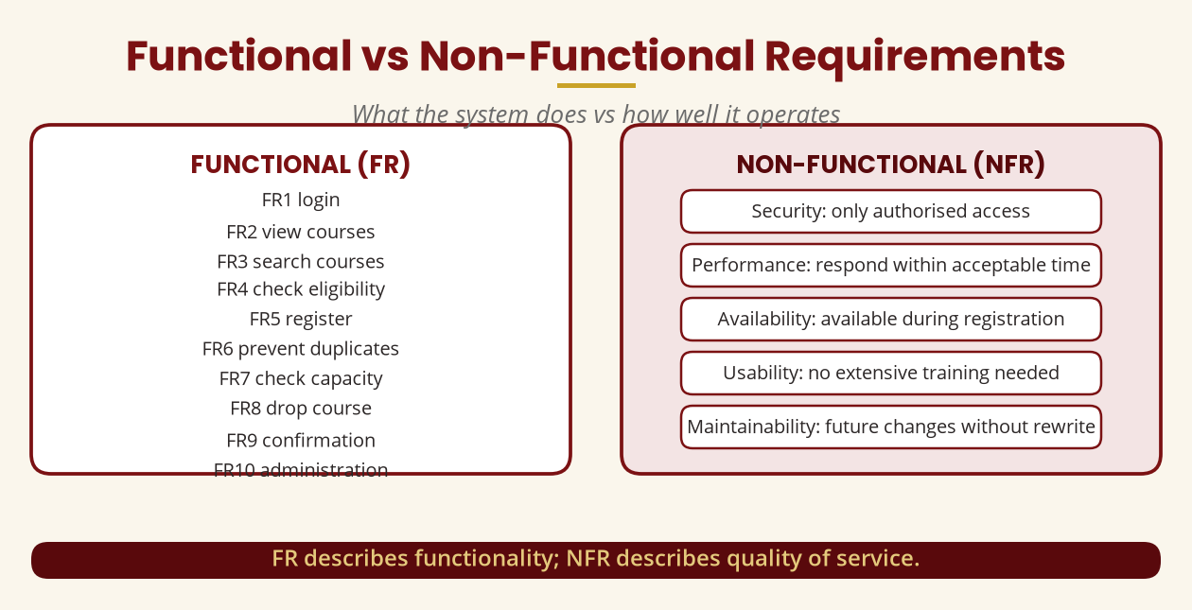
Requirements
Functional vs non-functional
FR = what it does · NFR = how well it operates.
BICT 3202 · Object-Oriented Analysis and Design
Week 15 · Slide 6

Slide 8
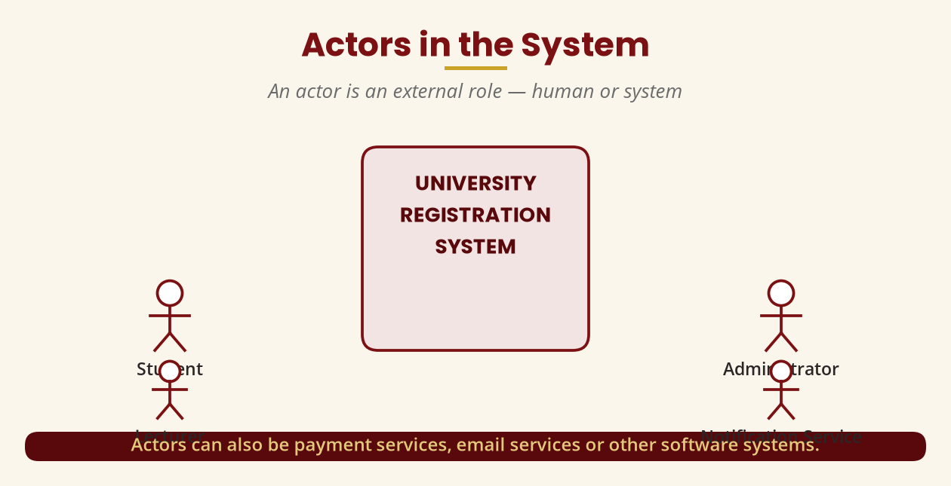
Actors
External roles — human or system
Student · Administrator · Lecturer · Notification Service · Payment Gateway.
BICT 3202 · Object-Oriented Analysis and Design
Week 15 · Slide 7

Slide 9
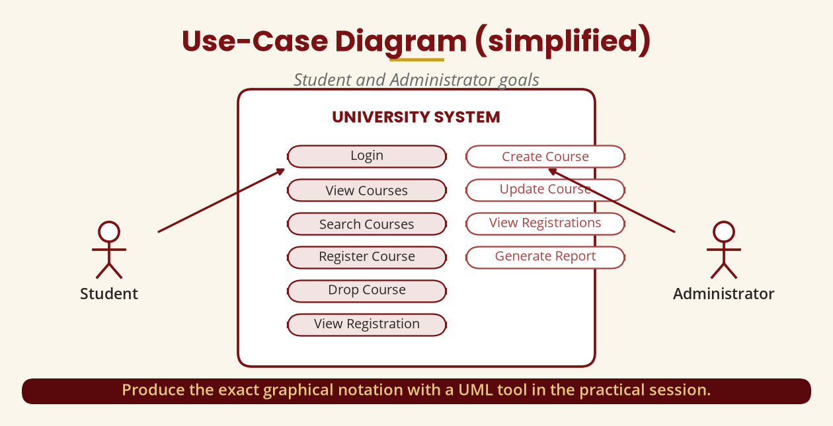
Use-Case Diagram
Student and Administrator goals
Produce the exact notation with a UML tool in the practical.
BICT 3202 · Object-Oriented Analysis and Design
Week 15 · Slide 8

Slide 10
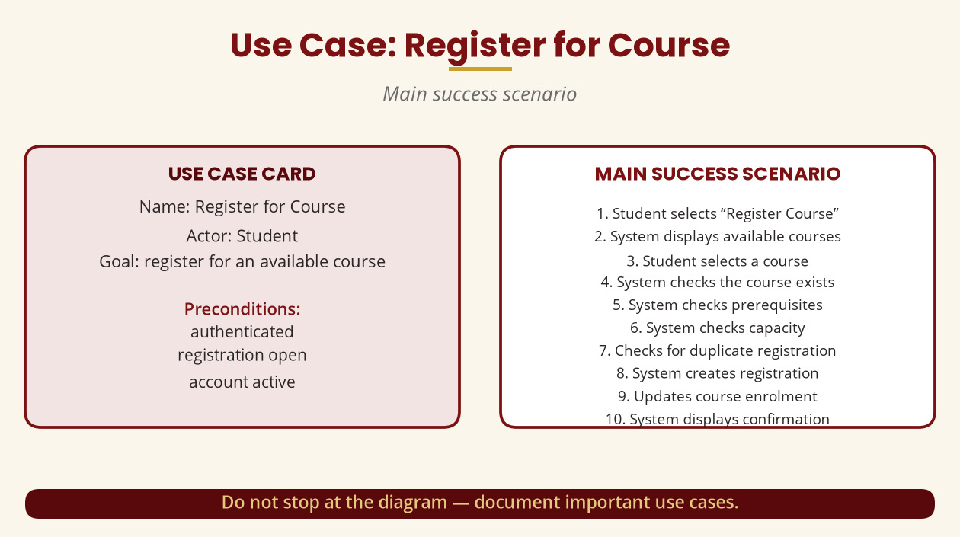
Use Case: Register for Course
Do not stop at the diagram
Document the main scenario AND the alternative flows.
BICT 3202 · Object-Oriented Analysis and Design
Week 15 · Slide 9

Slide 11
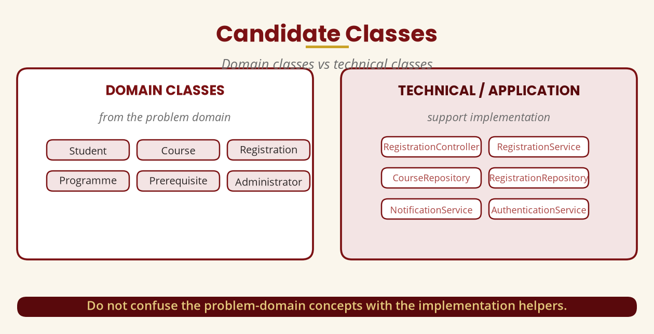
Candidate Classes
Domain vs technical
Domain = the problem · Technical = the implementation support.
BICT 3202 · Object-Oriented Analysis and Design
Week 15 · Slide 10

Slide 12
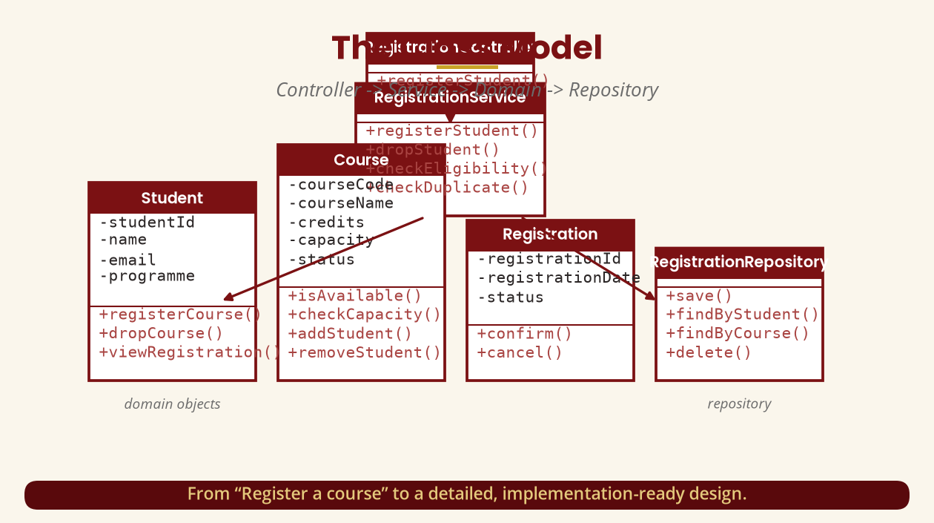
The Class Model
Controller -> Service -> Domain -> Repository
From “register a course” to an implementation-ready design.
BICT 3202 · Object-Oriented Analysis and Design
Week 15 · Slide 11

Slide 13
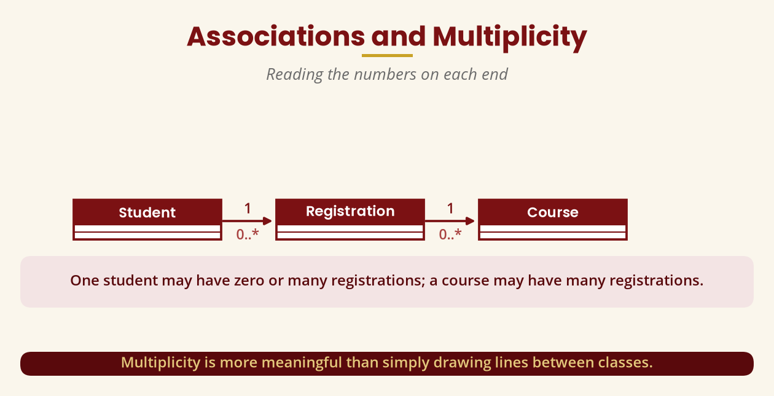
Associations & Multiplicity
Reading the numbers
Student 1 — 0..* Registration — 0..* 1 Course.
BICT 3202 · Object-Oriented Analysis and Design
Week 15 · Slide 12

Slide 14
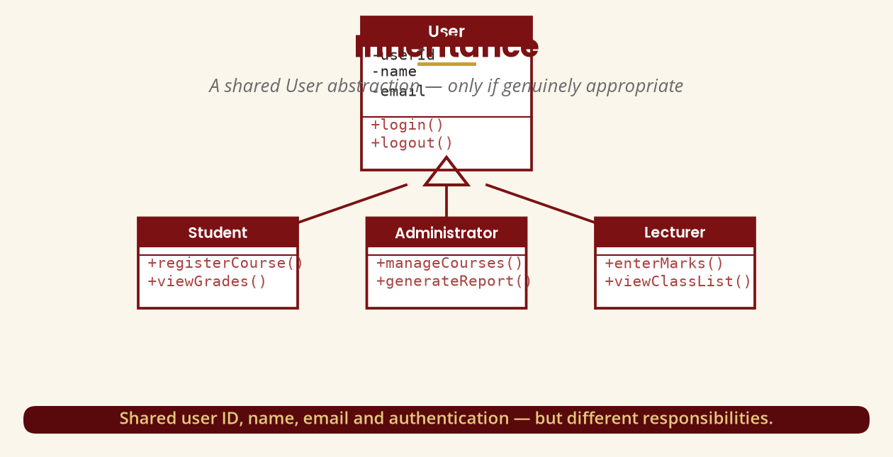
Inheritance
A shared User abstraction
Use inheritance only when it is genuinely appropriate.
BICT 3202 · Object-Oriented Analysis and Design
Week 15 · Slide 13

Slide 15
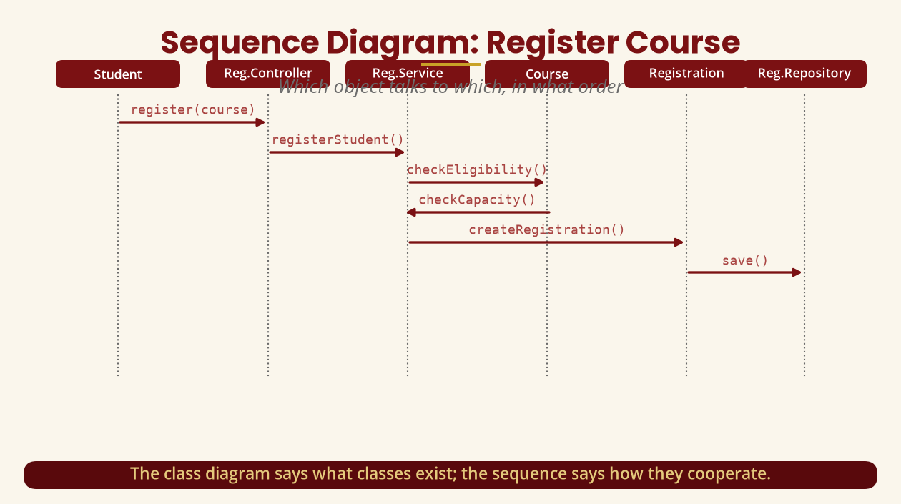
Sequence Diagram
Which object talks to which, in what order
Class diagram = what exists · Sequence = how they cooperate.
BICT 3202 · Object-Oriented Analysis and Design
Week 15 · Slide 14

Slide 16
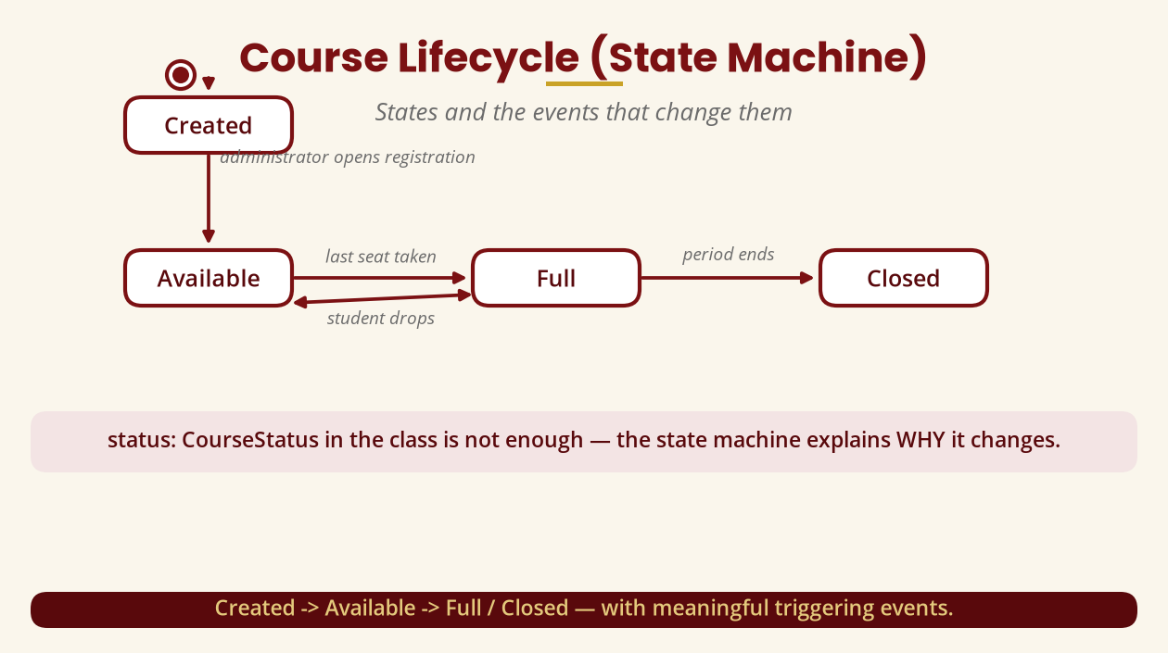
State Machine: Course Lifecycle
States and their triggering events
The state machine explains WHY the status changes.
BICT 3202 · Object-Oriented Analysis and Design
Week 15 · Slide 15

Slide 17
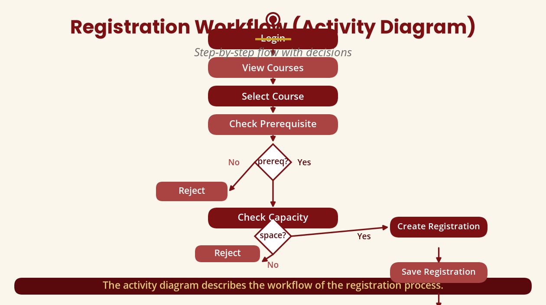
Activity Diagram
The registration workflow
Decisions: prerequisite satisfied? space available?
BICT 3202 · Object-Oriented Analysis and Design
Week 15 · Slide 16

Slide 18
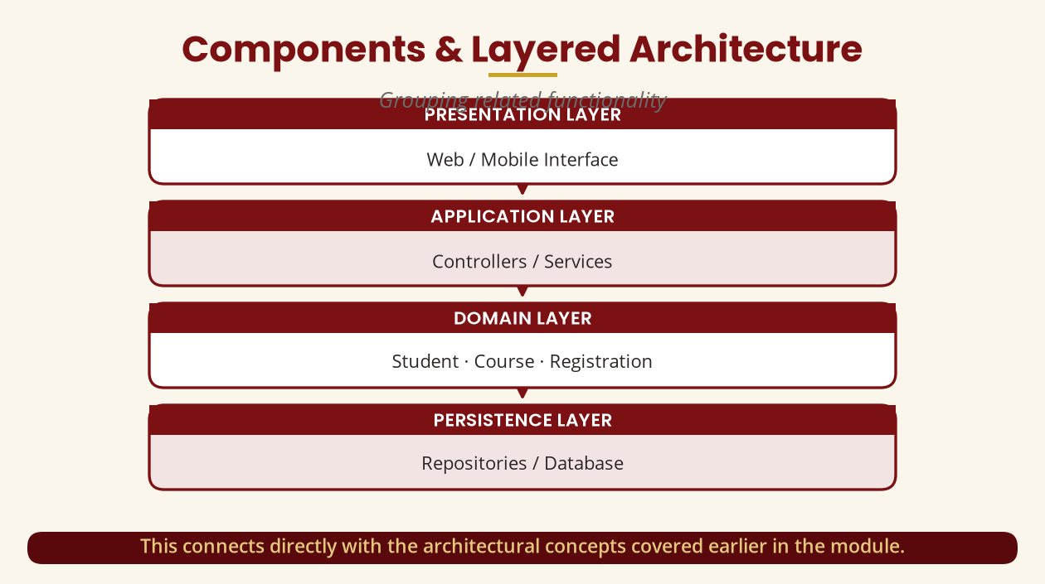
Components & Layers
Presentation -> Application -> Domain -> Persistence
Connects directly with the architecture covered earlier.
BICT 3202 · Object-Oriented Analysis and Design
Week 15 · Slide 17

Slide 19
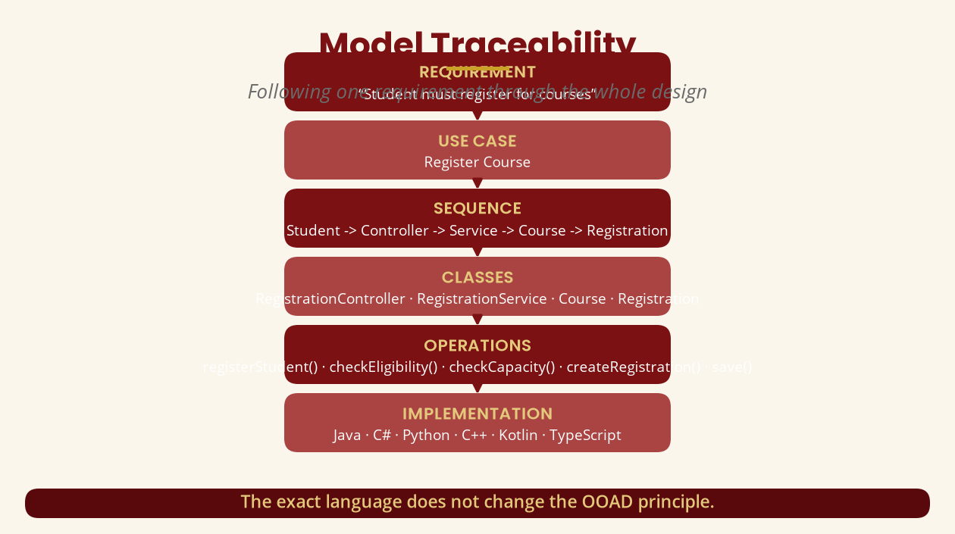
Model Traceability
Following one requirement through the design
The exact language does not change the OOAD principle.
BICT 3202 · Object-Oriented Analysis and Design
Week 15 · Slide 18

Slide 20
The Model Audit
Six consistency checks
▪ Use Case <- Class: does every use case have supporting classes?
▪ Class <- Sequence: does every message match an operation?
▪ Sequence <- State: do messages cause the right transitions?
▪ Activity <- Sequence: does the workflow match the interaction?
▪ Class <- Component: are classes sensibly allocated?
▪ Requirements <- Design: can each requirement be traced in?
“Check payment” with no payment class = something is missing.
BICT 3202 · Object-Oriented Analysis and Design
Week 15 · Slide 19

Slide 21
Complete OOAD Documentation
What the document contains
▪ 1. Introduction · 2. Requirements · 3. Actors · 4. Use cases · 5. Use-case diagram.
▪ 6. Domain/class model · 7. Interaction models · 8. Dynamic model · 9. Activity model.
▪ 10. Design · 11. Architecture · 12. Model validation · 13. Conclusion.
A professional analysis/design document is complete and consistent.
BICT 3202 · Object-Oriented Analysis and Design
Week 15 · Slide 20

Slide 22
CASE Tools
Computer-Aided Software Engineering
▪ Why: diagram editing, model repositories, documentation, consistency, code engineering.
▪ Examples: Enterprise Architect · Visual Paradigm · StarUML · Modelio · diagrams.net.
▪ Course outline: CASE Tool — Select Enterprise Demonstration.
The tool matters less than understanding the modelling principles.
BICT 3202 · Object-Oriented Analysis and Design
Week 15 · Slide 21

Slide 23
The Tool Does Not Do the Thinking
Four classic mistakes
▪ Diagrams without requirements — follow the correct order.
▪ Too many classes — Manager/Processor/Handler/Helper without justification.
▪ Copying diagrams — the model must represent YOUR system.
▪ Inconsistent naming — Registration vs Enrollment vs CourseSignup.
Understand Problem -> Model -> Design, then use the tool.
BICT 3202 · Object-Oriented Analysis and Design
Week 15 · Slide 22

Slide 24
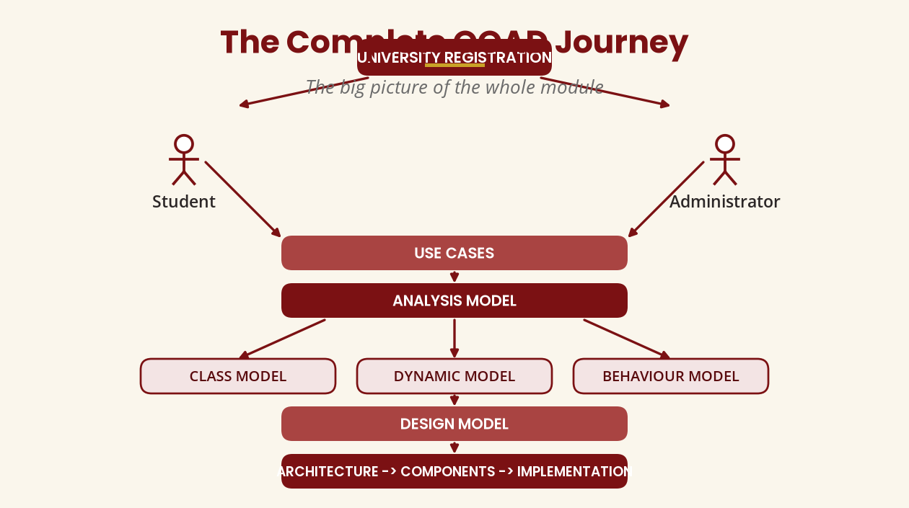
The Complete OOAD Journey
The big picture
Actors -> Use cases -> Analysis -> Class/Dynamic/Behaviour -> Design -> Implementation.
BICT 3202 · Object-Oriented Analysis and Design
Week 15 · Slide 23

Slide 25
Week 15 Summary
The most important lesson
▪ 1. OOAD is not about drawing many diagrams — it is about a coherent model.
▪ 2. Requirements, use cases, classes, interactions, behaviour and design support one another.
▪ 3. Requirement -> Use Case -> Class -> Interaction -> Behaviour -> Design -> Components -> Documentation.
That is exactly what Week 15 is designed to test.
BICT 3202 · Object-Oriented Analysis and Design
Week 15 · Slide 24

Slide 26
REVISION & NEXT STEPS
▪ Complete the ten-deliverable major assignment on a real information system.
▪ Cross-check your models: messages match operations, transitions have events.
▪ Use a CASE/UML tool to organise the University Registration case study.
▪ Next week: comprehensive revision and the integrated examination.
Thank you — Francis Fweta · ICT Lecturer · Exploits University

