Slide 1

EXPLOITS UNIVERSITY
BSc INFORMATION COMMUNICATION AND TECHNOLOGY
BICT 3202 · OBJECT-ORIENTED ANALYSIS AND DESIGN
WEEK 16
Comprehensive Revision, Integrated Case Study and Examination Preparation
Francis Fweta · ICT Lecturer · Week 16 of 16

Slide 2
Learning Outcomes
By the end of this week, you should be able to…
▪ Explain the principles of OOAD and the strengths/limitations of OO development.
▪ Distinguish analysis from design; explain UML and its diagram families.
▪ Construct use-case, class, state, activity, sequence and communication diagrams.
▪ Explain relationships, inheritance, polymorphism and the Unified Process.
▪ Combine object, dynamic and behavioural models and check consistency.
▪ Apply OOAD to an unfamiliar problem and answer exam questions effectively.
The student becomes the analyst / designer.
BICT 3202 · Object-Oriented Analysis and Design
Week 16 · Slide 1

Slide 3
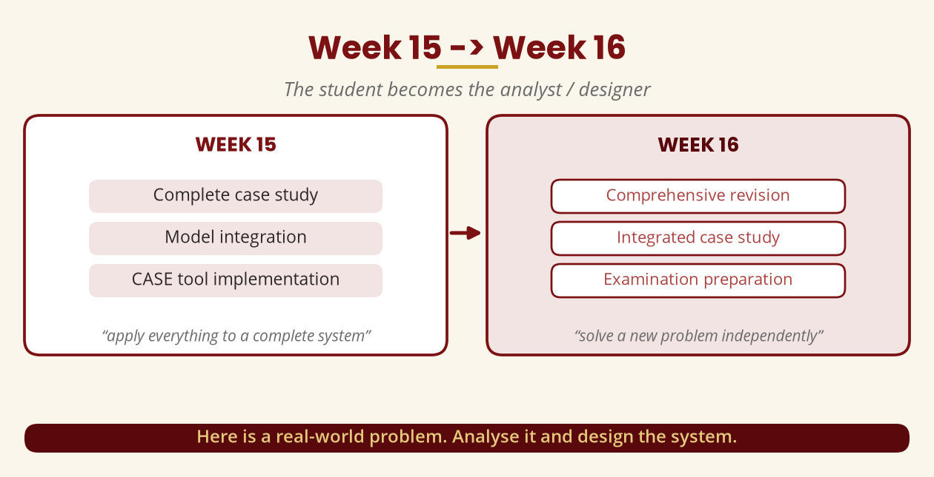
Week 15 -> Week 16
From application to independence
Here is a real-world problem. Analyse it and design the system.
BICT 3202 · Object-Oriented Analysis and Design
Week 16 · Slide 2

Slide 4
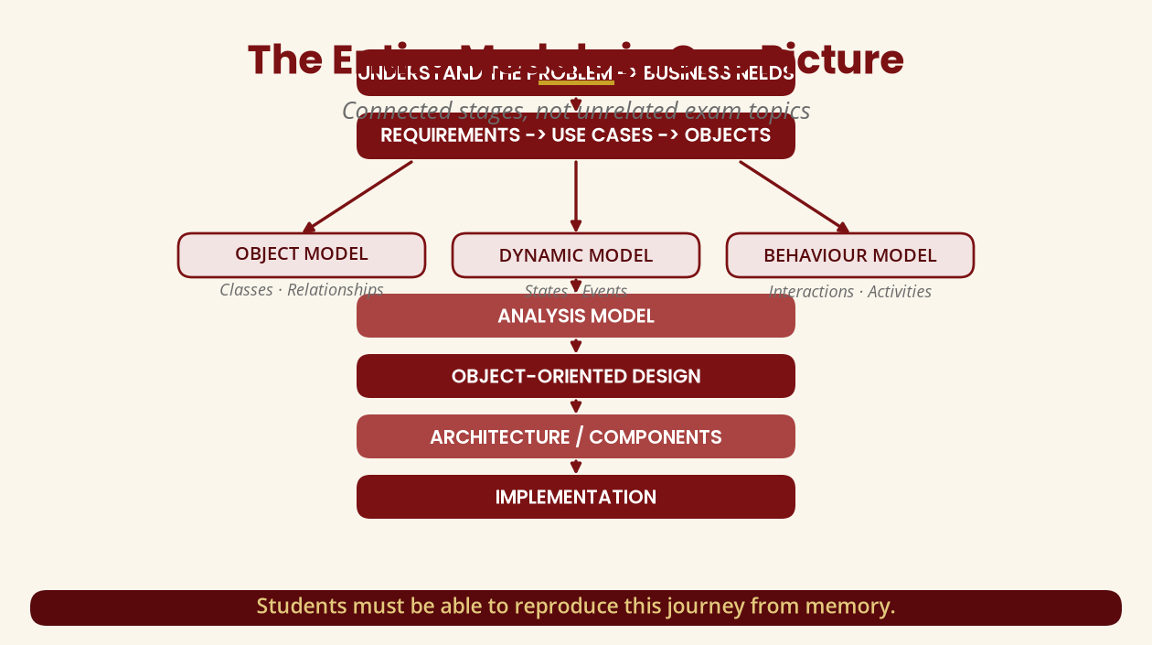
The Entire Module in One Picture
Connected stages, not exam topics
You should reproduce this journey from memory.
BICT 3202 · Object-Oriented Analysis and Design
Week 16 · Slide 3

Slide 5
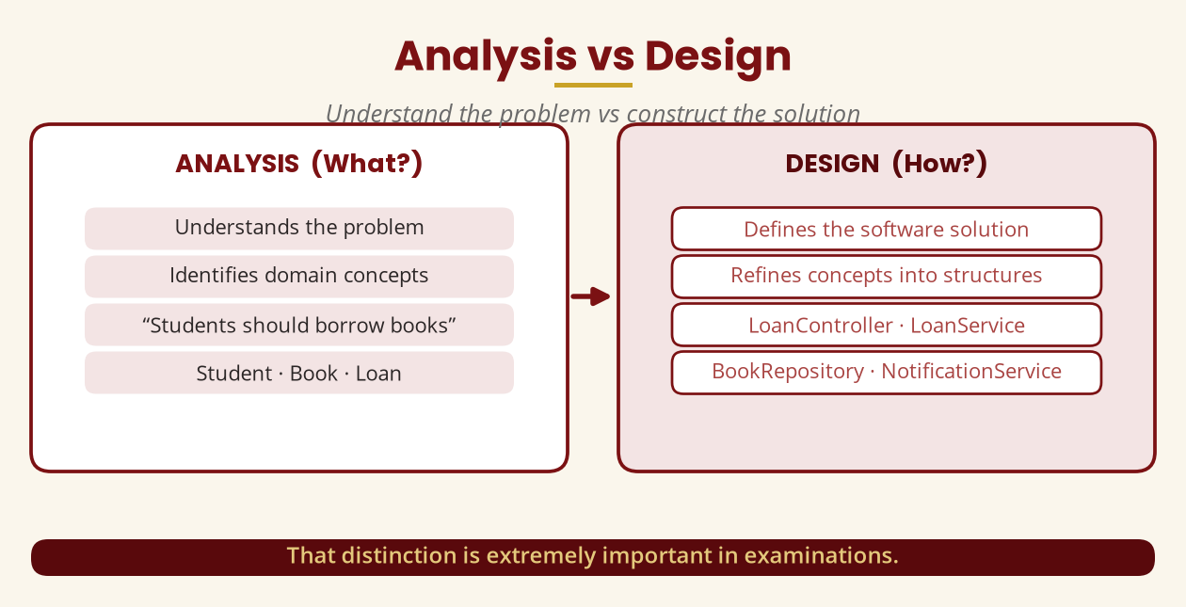
Analysis vs Design
Understand the problem vs construct the solution
Analysis = Student/Book/Loan · Design = LoanController/Service/Repository.
BICT 3202 · Object-Oriented Analysis and Design
Week 16 · Slide 4

Slide 6
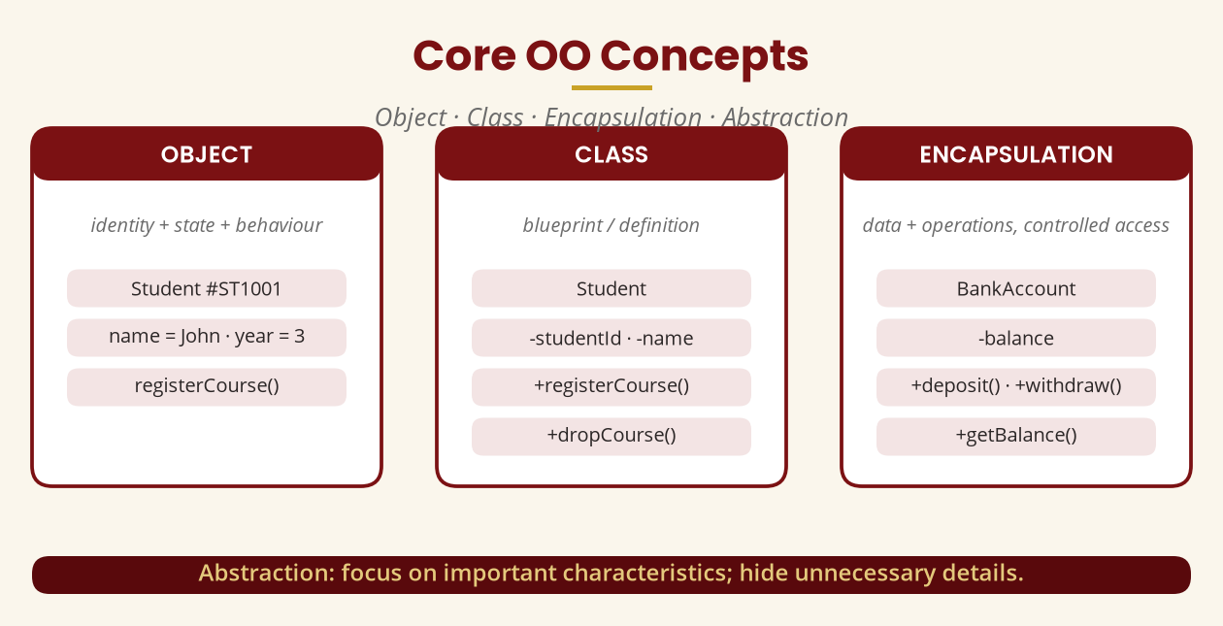
Core OO Concepts
Object · Class · Encapsulation · Abstraction
Class = blueprint · Object = instance · Encapsulation controls access.
BICT 3202 · Object-Oriented Analysis and Design
Week 16 · Slide 5

Slide 7
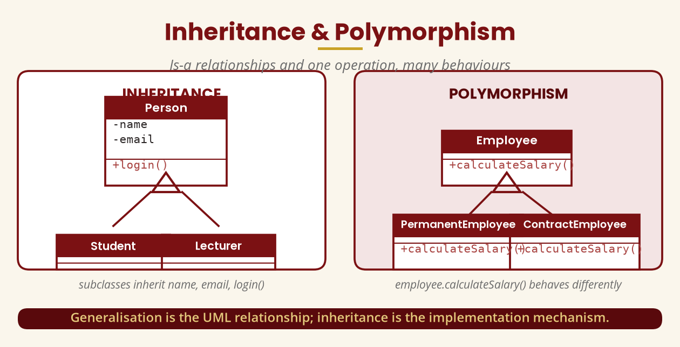
Inheritance & Polymorphism
Is-a relationships and one operation, many behaviours
Generalisation = UML relationship · Inheritance = implementation mechanism.
BICT 3202 · Object-Oriented Analysis and Design
Week 16 · Slide 6

Slide 8
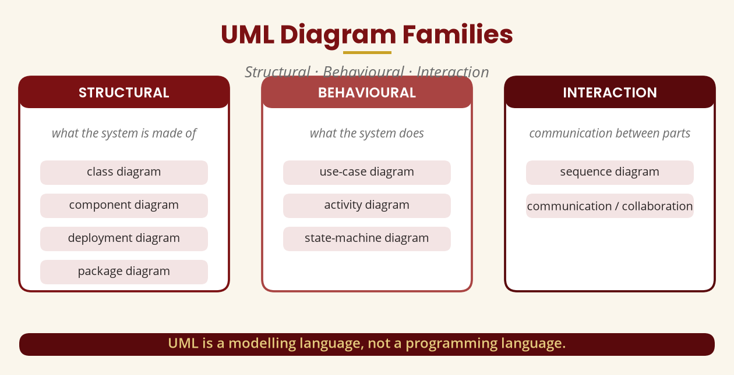
UML Diagram Families
Structural · Behavioural · Interaction
UML is a modelling language, not a programming language.
BICT 3202 · Object-Oriented Analysis and Design
Week 16 · Slide 7

Slide 9
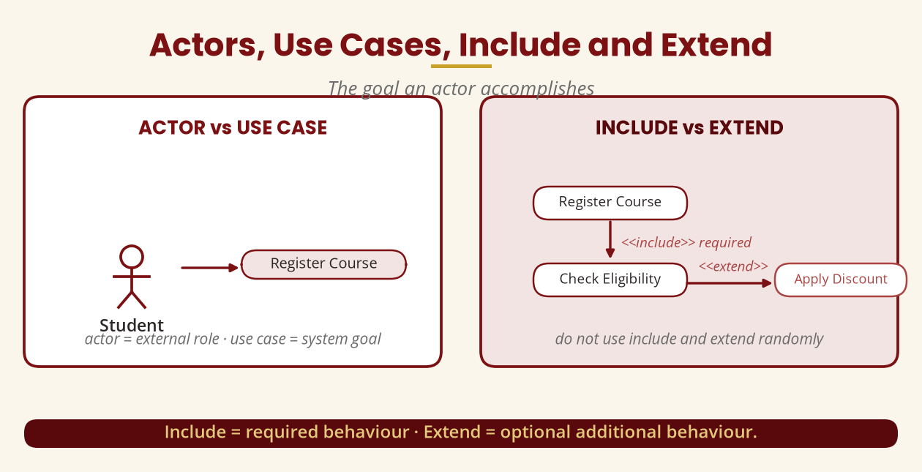
Actors, Use Cases, Include & Extend
The goal an actor accomplishes
Include = required · Extend = optional — do not use them randomly.
BICT 3202 · Object-Oriented Analysis and Design
Week 16 · Slide 8

Slide 10
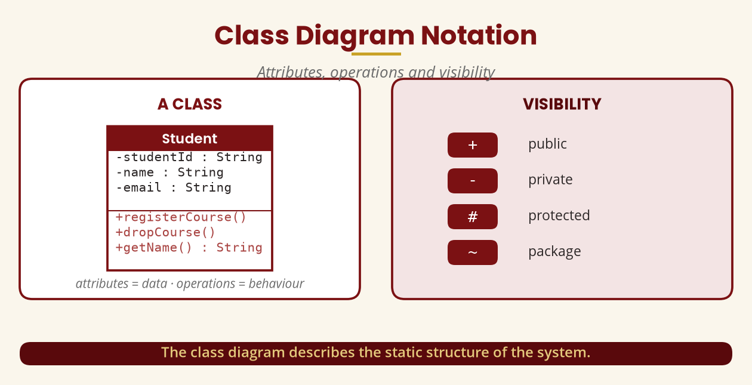
Class Diagram Notation
Attributes, operations and visibility
+ public · - private · # protected · ~ package.
BICT 3202 · Object-Oriented Analysis and Design
Week 16 · Slide 9

Slide 11
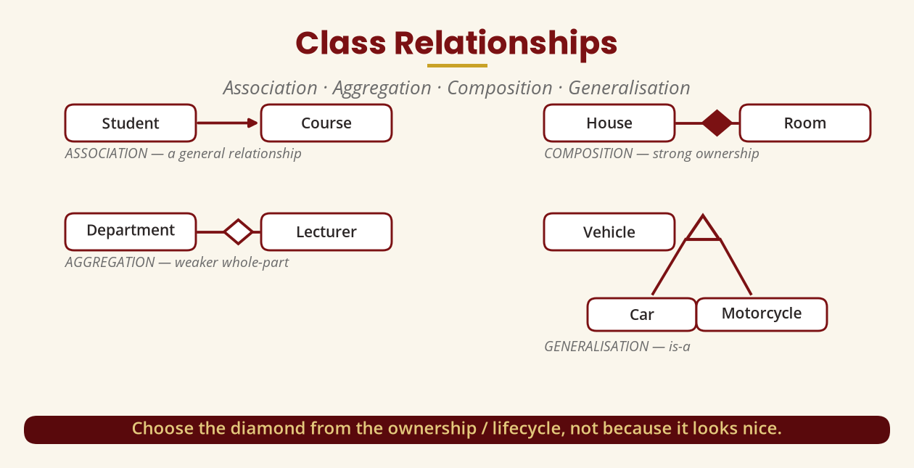
Class Relationships
Association · Aggregation · Composition · Generalisation
Choose the diamond from ownership/lifecycle, not aesthetics.
BICT 3202 · Object-Oriented Analysis and Design
Week 16 · Slide 10

Slide 12
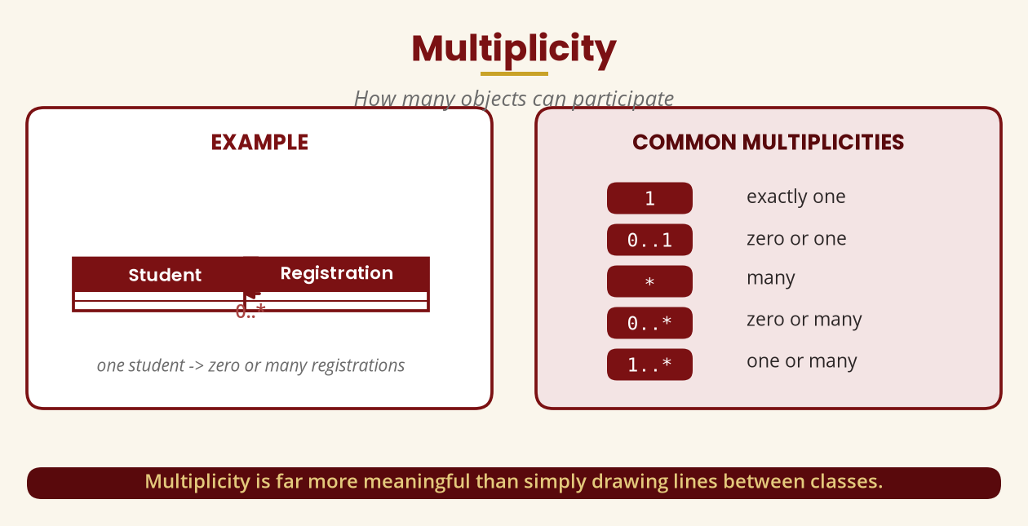
Multiplicity
How many objects can participate
1 · 0..1 · * · 0..* · 1..* — Student 1 — 0..* Registration.
BICT 3202 · Object-Oriented Analysis and Design
Week 16 · Slide 11

Slide 13
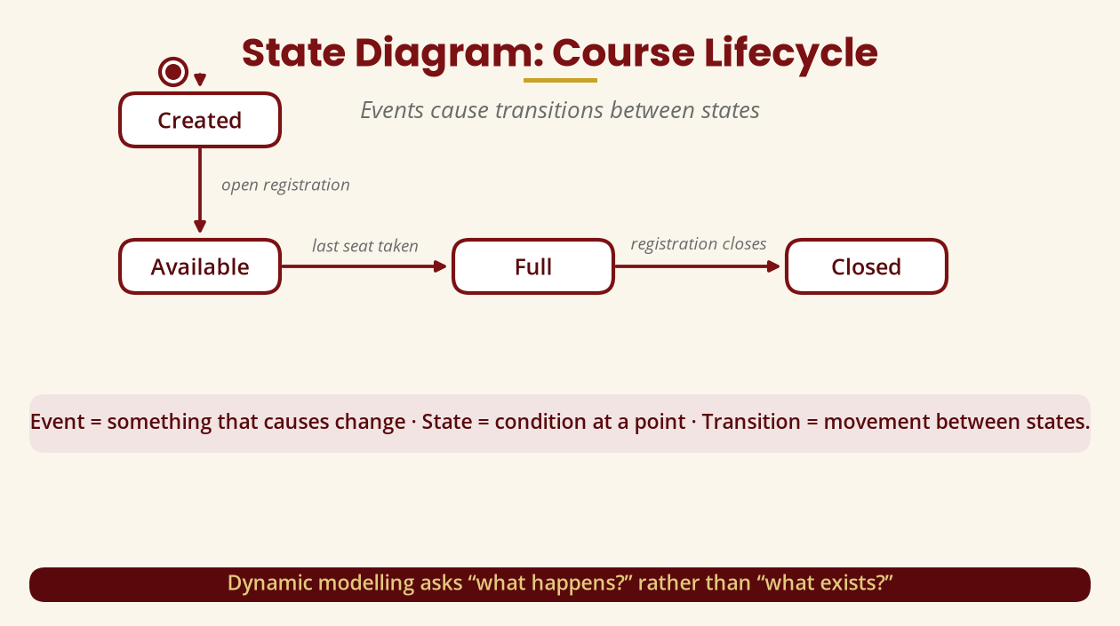
State Diagram: Course Lifecycle
Events cause transitions
Dynamic modelling asks “what happens?”, not “what exists?”.
BICT 3202 · Object-Oriented Analysis and Design
Week 16 · Slide 12

Slide 14
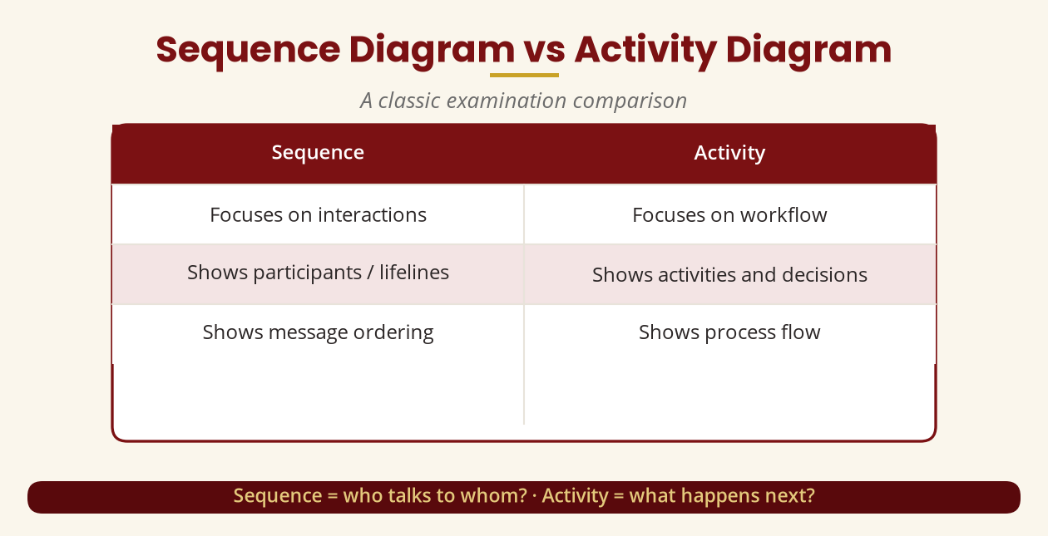
Sequence vs Activity
A classic exam comparison
Sequence = who talks to whom? · Activity = what happens next?
BICT 3202 · Object-Oriented Analysis and Design
Week 16 · Slide 13

Slide 15
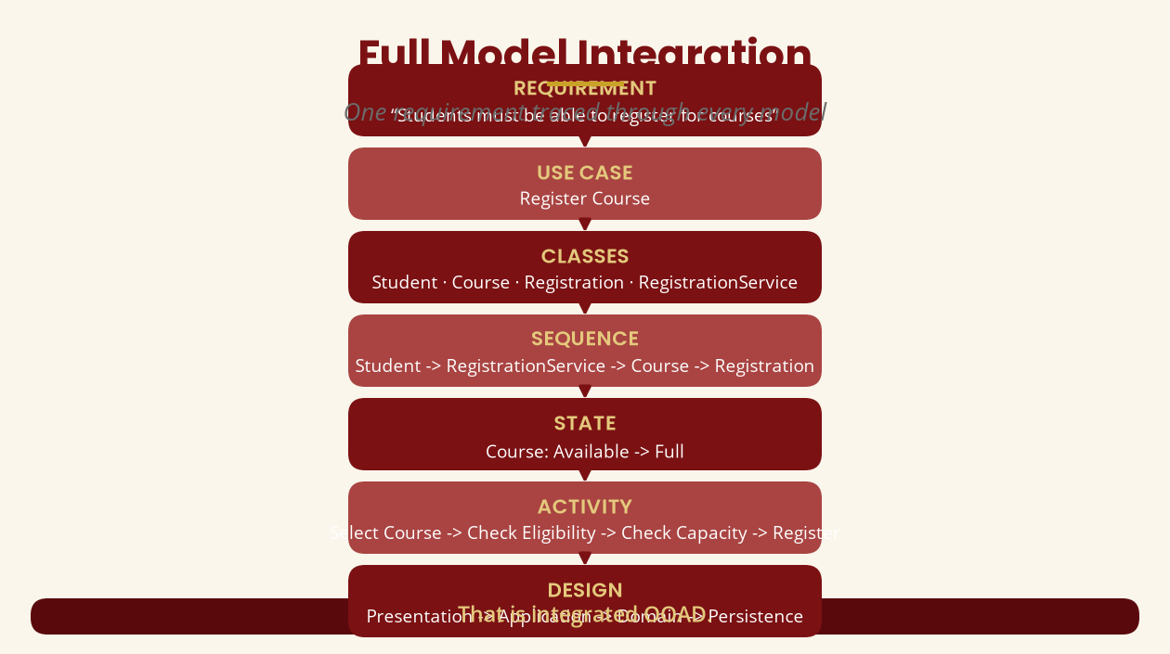
Full Model Integration
One requirement traced through every model
Requirement -> Use Case -> Classes -> Sequence -> State -> Activity -> Design.
BICT 3202 · Object-Oriented Analysis and Design
Week 16 · Slide 14

Slide 16
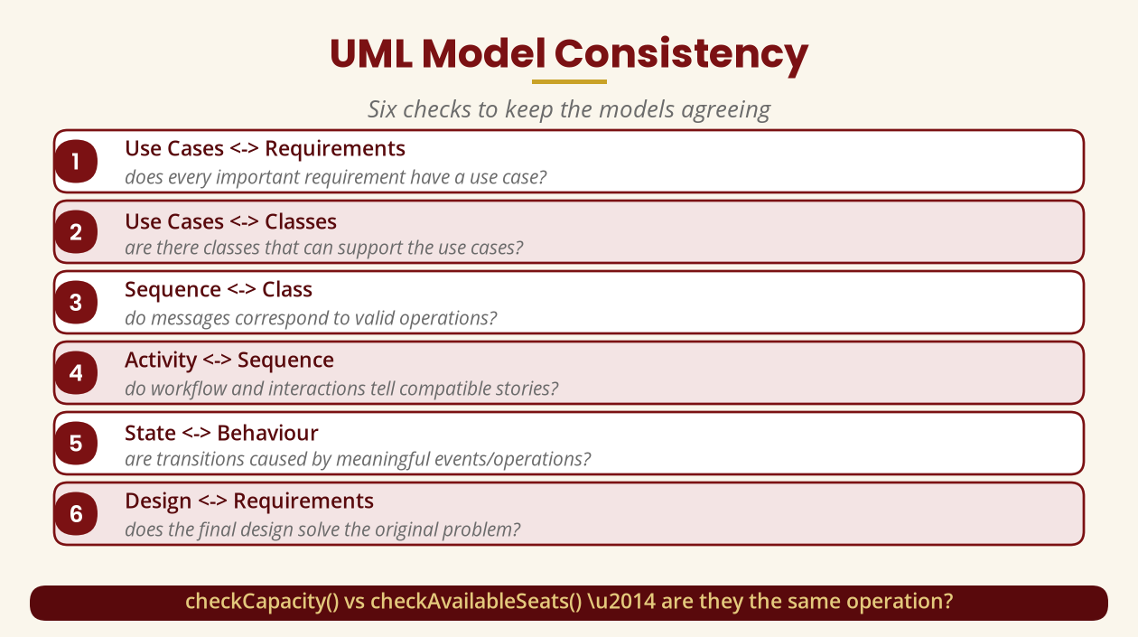
UML Model Consistency
Six checks
checkCapacity() vs checkAvailableSeats() — are they the same operation?
BICT 3202 · Object-Oriented Analysis and Design
Week 16 · Slide 15

Slide 17
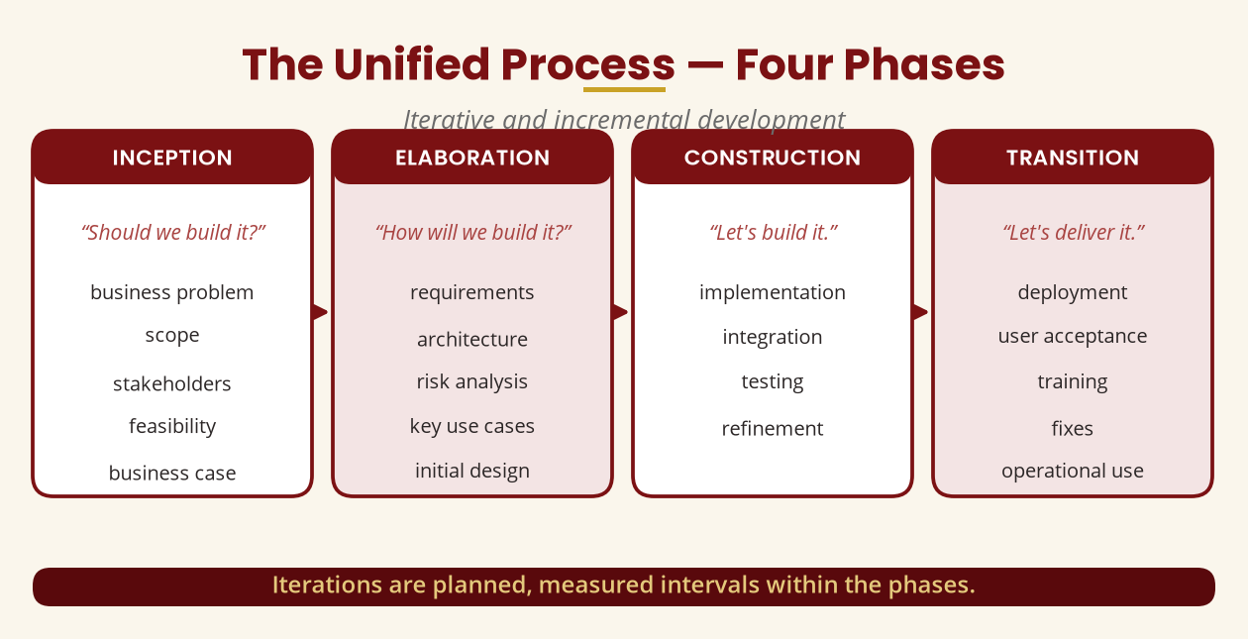
The Unified Process — Four Phases
Iterative and incremental
Inception -> Elaboration -> Construction -> Transition.
BICT 3202 · Object-Oriented Analysis and Design
Week 16 · Slide 16

Slide 18
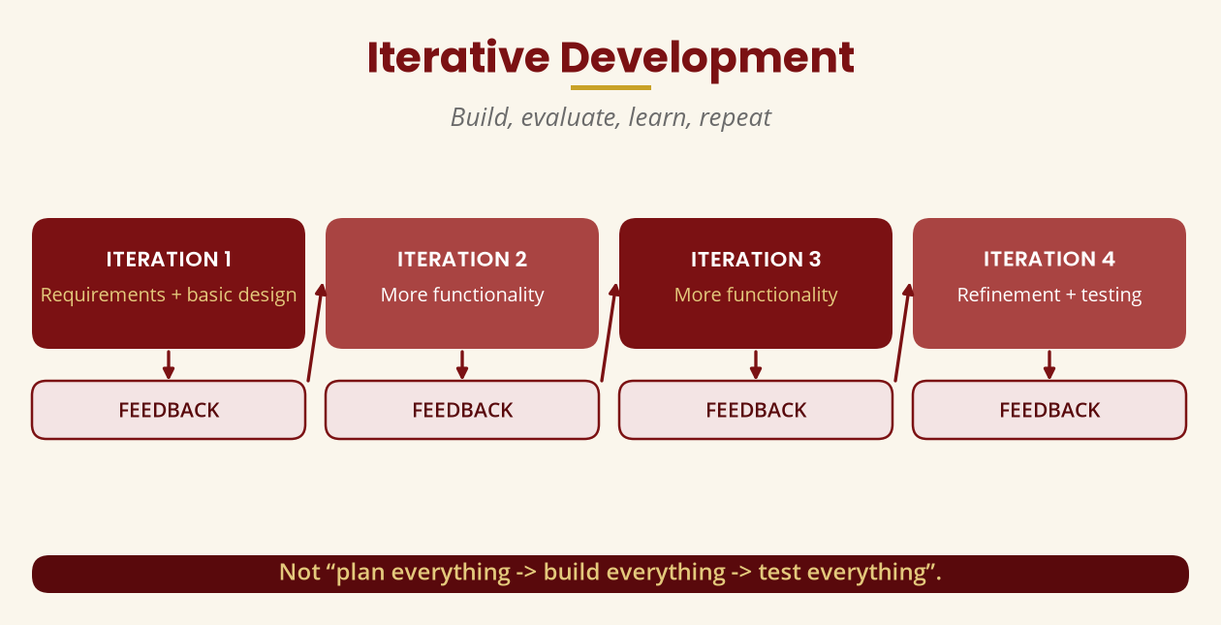
Iterative Development
Build, evaluate, learn, repeat
Iterations are planned, measured intervals within phases.
BICT 3202 · Object-Oriented Analysis and Design
Week 16 · Slide 17

Slide 19
Software Reuse
Use what exists — wisely
▪ Reuse: component, class, library, framework, service, design, architecture.
▪ Benefits: less duplication, less effort, better consistency, easier maintenance.
▪ But: base reuse on suitability, security, maintainability, compatibility, licensing.
Reuse should not be “because something already exists.”
BICT 3202 · Object-Oriented Analysis and Design
Week 16 · Slide 18

Slide 20
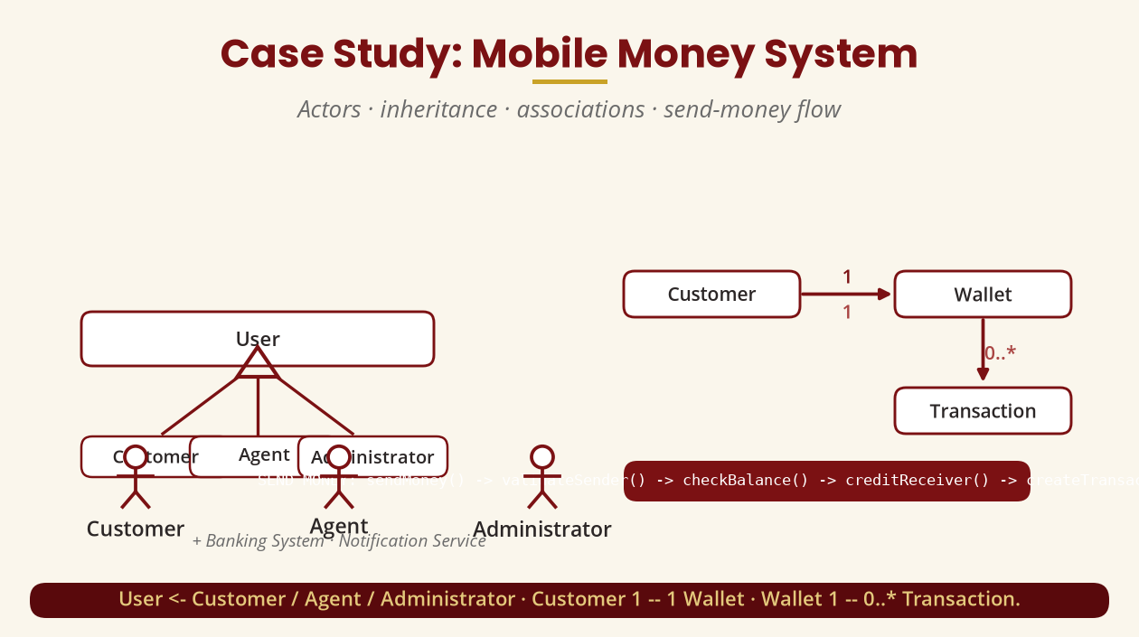
Case Study: Mobile Money System
Actors · inheritance · associations · send money
User <- Customer/Agent/Admin · Customer 1—1 Wallet · Wallet 1—0..* Transaction.
BICT 3202 · Object-Oriented Analysis and Design
Week 16 · Slide 19

Slide 21
Practical Challenge
Six diagrams + one deliberate error
▪ Diagrams: use-case, class, sequence (Send Money), activity, state (Transaction), component.
▪ Introduce: sequence calls validateTransaction() but the class has checkTransaction().
▪ Then: identify the inconsistency and correct it.
Modelling is complete when the model is logically consistent.
BICT 3202 · Object-Oriented Analysis and Design
Week 16 · Slide 20

Slide 22
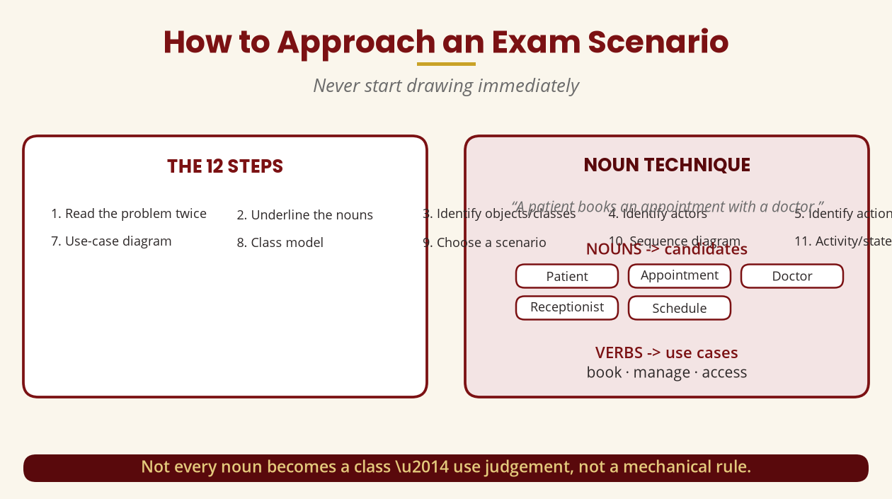
How to Approach an Exam Scenario
Never start drawing immediately
Read twice -> nouns -> objects -> actors -> use cases -> models -> consistency.
BICT 3202 · Object-Oriented Analysis and Design
Week 16 · Slide 21

Slide 23
Exam Answering Strategy
Definition · Explain · Compare · UML
▪ Define: full definition, then an example.
▪ Explain: Definition -> Explanation -> Example -> Importance.
▪ Compare: use a table (class vs object: meaning, memory, example, quantity).
▪ UML: requirement -> actors -> use cases -> classes -> relationships -> behaviour -> consistency.
Examiners mark correct modelling, not artistic decoration.
BICT 3202 · Object-Oriented Analysis and Design
Week 16 · Slide 22

Slide 24
Mock Examination
Four sections
▪ Section A: 20 short answers (OOAD, encapsulation, UML, actor, use case, multiplicity…).
▪ Section B: differentiate (class/object, aggregation/composition, include/extend…).
▪ Section C: long answers (four principles, role of UML, Unified Process).
▪ Section D: full case study with actors, diagrams and relationships.
Practise under timed conditions.
BICT 3202 · Object-Oriented Analysis and Design
Week 16 · Slide 23

Slide 25
Final Takeaway
The whole module in one question
▪ 1. OOAD is not simply about drawing UML diagrams.
▪ 2. Think systematically: identify what matters, how things interact and behave.
▪ 3. Transform understanding into a coherent design developers can implement.
Business Problem -> Requirements -> … -> Model Integration -> Implementation.
BICT 3202 · Object-Oriented Analysis and Design
Week 16 · Slide 24

Slide 26
GOOD LUCK IN THE EXAMINATION
▪ Work through the final revision checklist before sitting the exam.
▪ Practise the noun technique and the 12-step scenario process.
▪ Use the OMG UML 2.5.1 specification to verify notation.
▪ You are now ready to analyse and design real systems independently.
Thank you — Francis Fweta · ICT Lecturer · Exploits University

