Slide 1

EXPLOITS UNIVERSITY
BSc INFORMATION COMMUNICATION AND TECHNOLOGY
BICT 3202 · OBJECT-ORIENTED ANALYSIS AND DESIGN
WEEK 2
Principles of Object Modelling
Francis Fweta · ICT Lecturer · Week 2 of 16

Slide 2
Learning Outcomes
By the end of this week, you should be able to…
▪ Define object modelling and an object model.
▪ Explain why object models are useful in analysis.
▪ Relate object → class → object model.
▪ Identify objects in a problem domain — and reject irrelevant nouns.
▪ Identify attributes, behaviours and relationships of objects.
▪ Explain identity, abstraction and encapsulation in modelling.
▪ Show how models manage system complexity.
▪ Build a conceptual object model from a text description.
Modelling is simplification — keep what matters, hide the rest.
BICT 3202 · Object-Oriented Analysis and Design
Week 2 · Slide 1

Slide 3
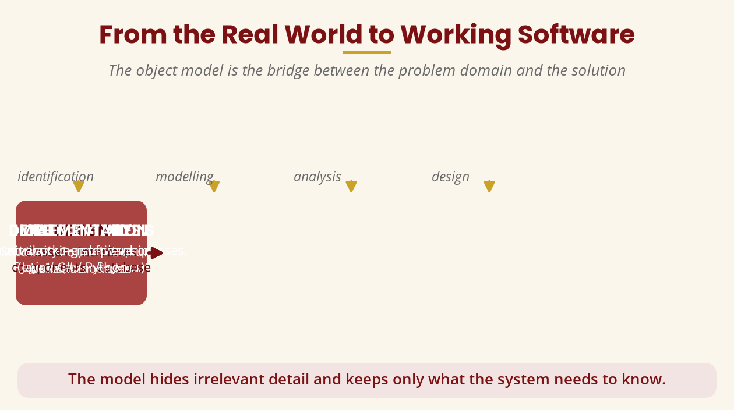
From the Real World to Software
The object model is the bridge
Real world → object model → analysis → design → implementation
BICT 3202 · Object-Oriented Analysis and Design
Week 2 · Slide 2

Slide 4
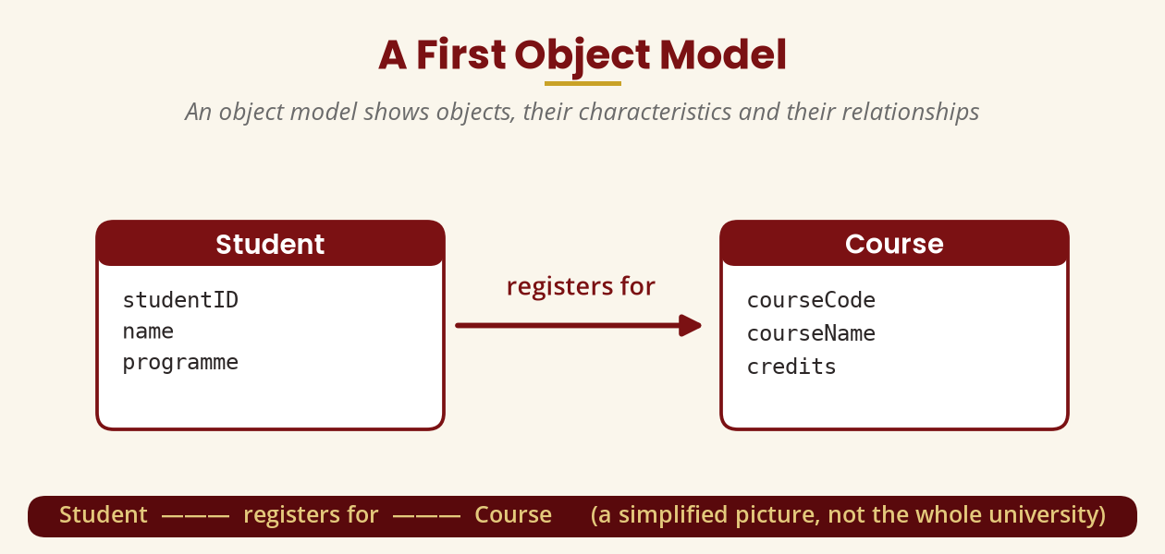
What Is an Object Model?
Objects, characteristics, behaviour and relationships
Student — registers for — Course: a simplified, purposeful picture
BICT 3202 · Object-Oriented Analysis and Design
Week 2 · Slide 3

Slide 5
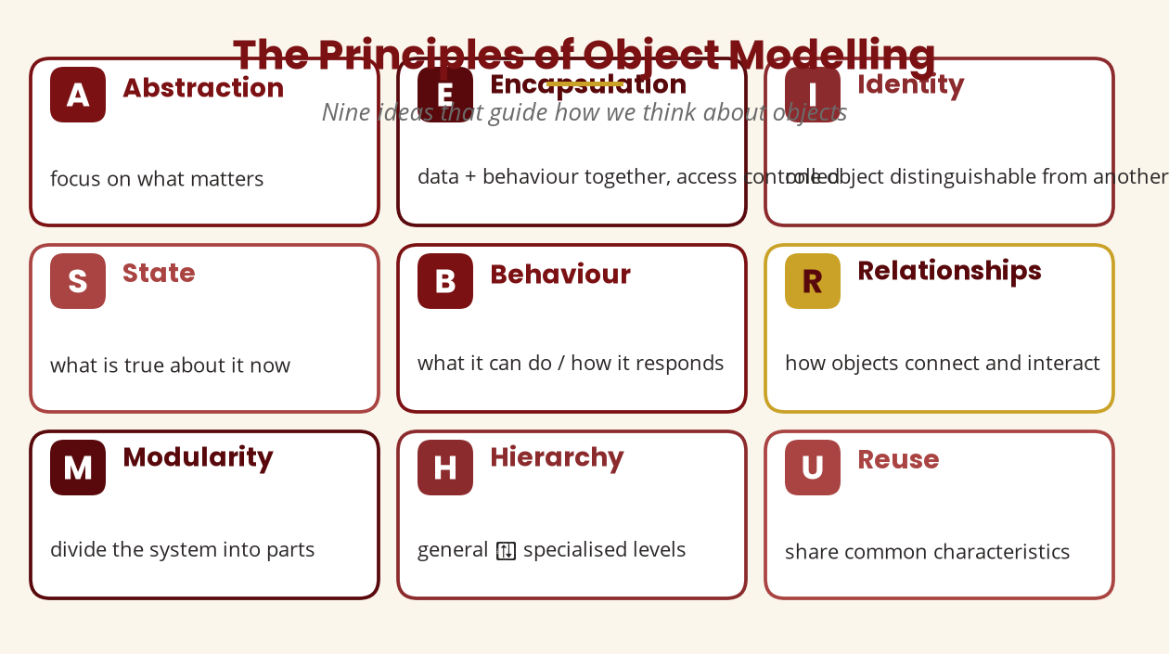
The Nine Principles
The ideas that guide object thinking
Abstraction · Encapsulation · Identity · State · Behaviour · Relationships · Modularity · Hierarchy · Reuse
BICT 3202 · Object-Oriented Analysis and Design
Week 2 · Slide 4

Slide 6
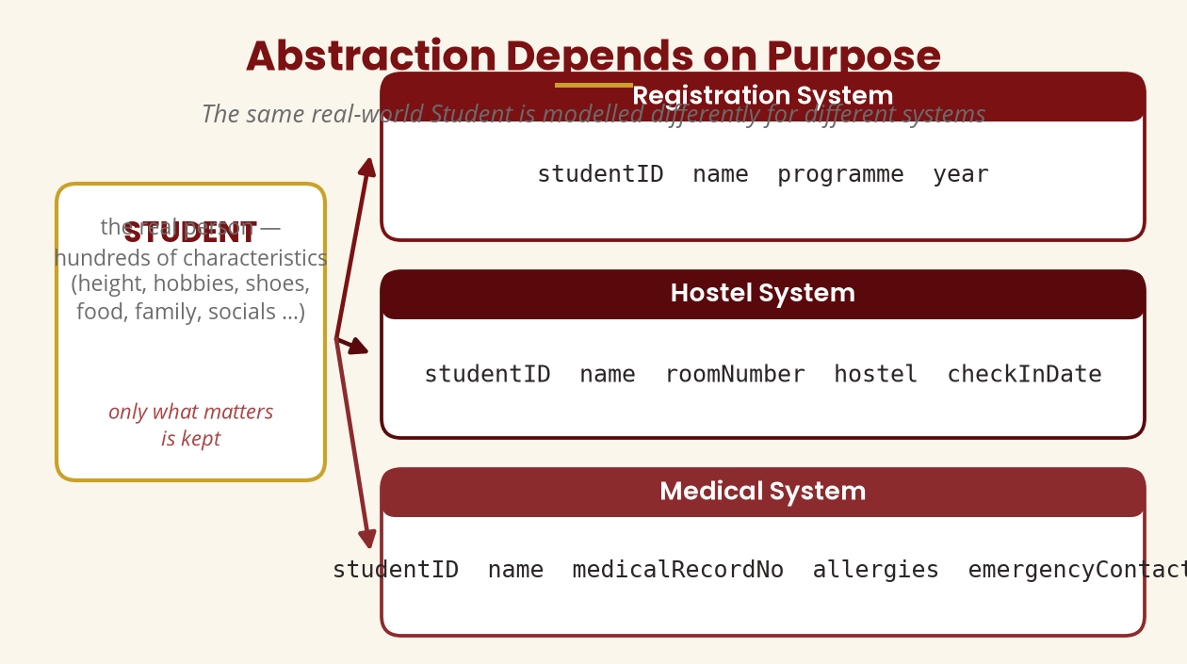
Abstraction Depends on Purpose
The same Student, modelled three ways
Keep only the characteristics the system actually needs.
BICT 3202 · Object-Oriented Analysis and Design
Week 2 · Slide 5

Slide 7
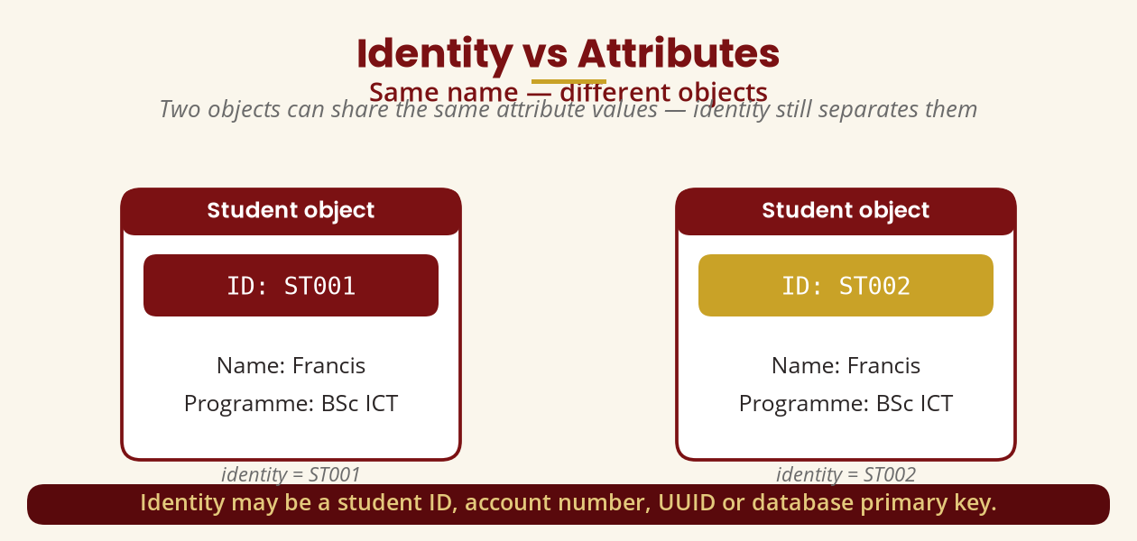
Identity vs Attributes
Two “Francis” students — different objects
Identity = student ID, account number, UUID or primary key.
BICT 3202 · Object-Oriented Analysis and Design
Week 2 · Slide 6

Slide 8
State · Behaviour · Relationships
What it is, what it does, how it connects
▪ State — values describing current condition (Status: Active → Graduated).
▪ Behaviour — what it can do (registerCourse(), payFees()).
▪ Identity — distinguishes it from every other object.
▪ Relationships — Student—registers for—Course; Customer—owns—Account.
▪ Student
▪ studentID · name · programme
▪ registerCourse() · dropCourse()
▪
▪ Course
▪ courseCode · courseName · credits
▪ checkAvailability()
An object = identity + state + behaviour, linked to others by relationships.
BICT 3202 · Object-Oriented Analysis and Design
Week 2 · Slide 7

Slide 9
Object Identification
The noun technique — and why nouns are not enough
▪ Candidate ≠ final object. Underline nouns, then analyse.
▪ “A student uses a mobile phone to register for a course.” → Student, Course… but Phone?
▪ Judge, don't just parse grammar: scope, information, behaviour, identity, relationships.
▪ Events can be objects — Payment, Registration, Appointment, Transaction.
Object identification is analytical reasoning, not noun extraction.
BICT 3202 · Object-Oriented Analysis and Design
Week 2 · Slide 8

Slide 10
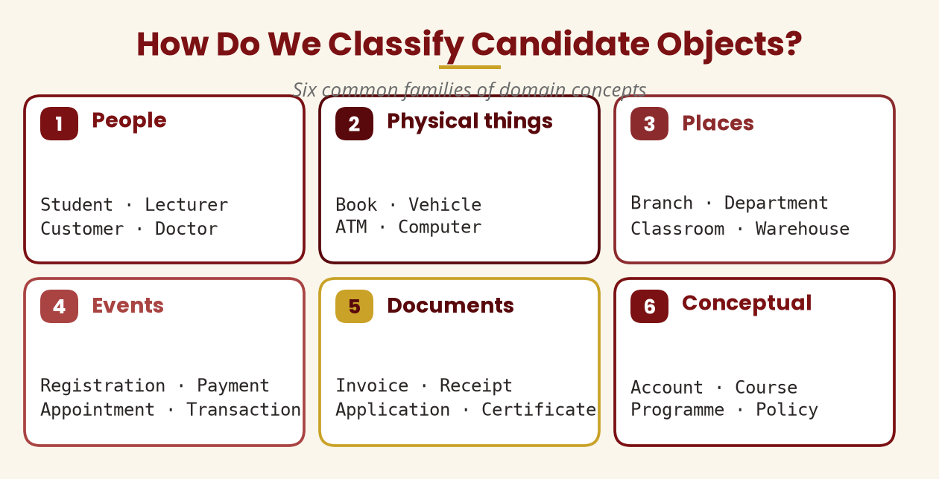
Classifying Candidates
Six families of domain concepts
People · Physical · Places · Events · Documents · Conceptual
BICT 3202 · Object-Oriented Analysis and Design
Week 2 · Slide 9

Slide 11
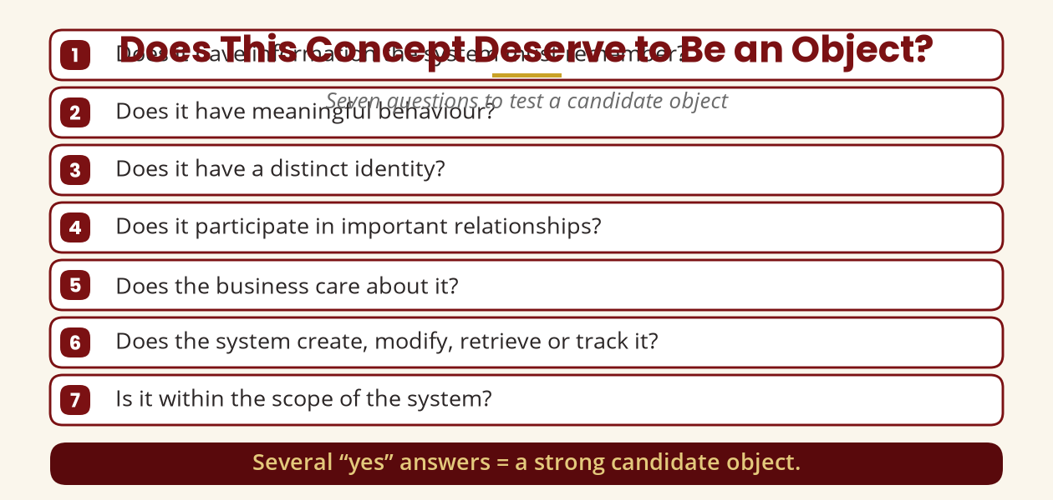
Does It Deserve to Be an Object?
Seven questions for each candidate
Several “yes” answers = a strong candidate.
BICT 3202 · Object-Oriented Analysis and Design
Week 2 · Slide 10

Slide 12
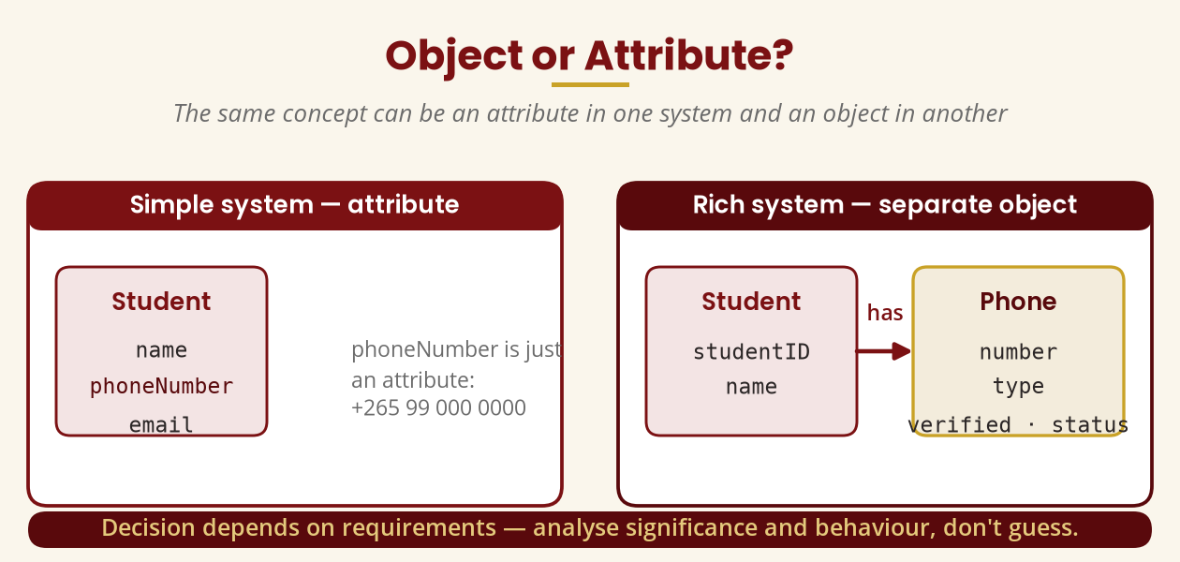
Object or Attribute?
It depends on the requirements
phoneNumber is an attribute — until you must track type, verification and status.
BICT 3202 · Object-Oriented Analysis and Design
Week 2 · Slide 11

Slide 13
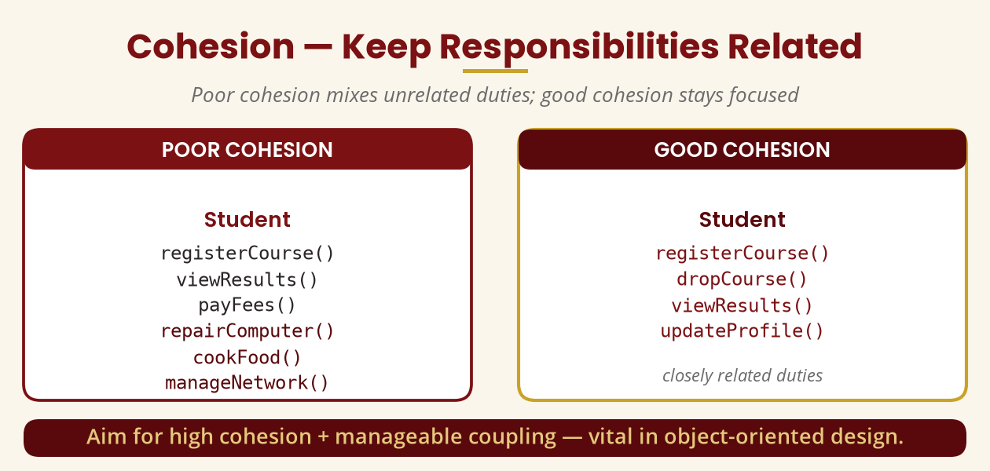
Cohesion & Coupling
Keep duties related, dependencies controlled
Aim for high cohesion + manageable coupling.
BICT 3202 · Object-Oriented Analysis and Design
Week 2 · Slide 12

Slide 14
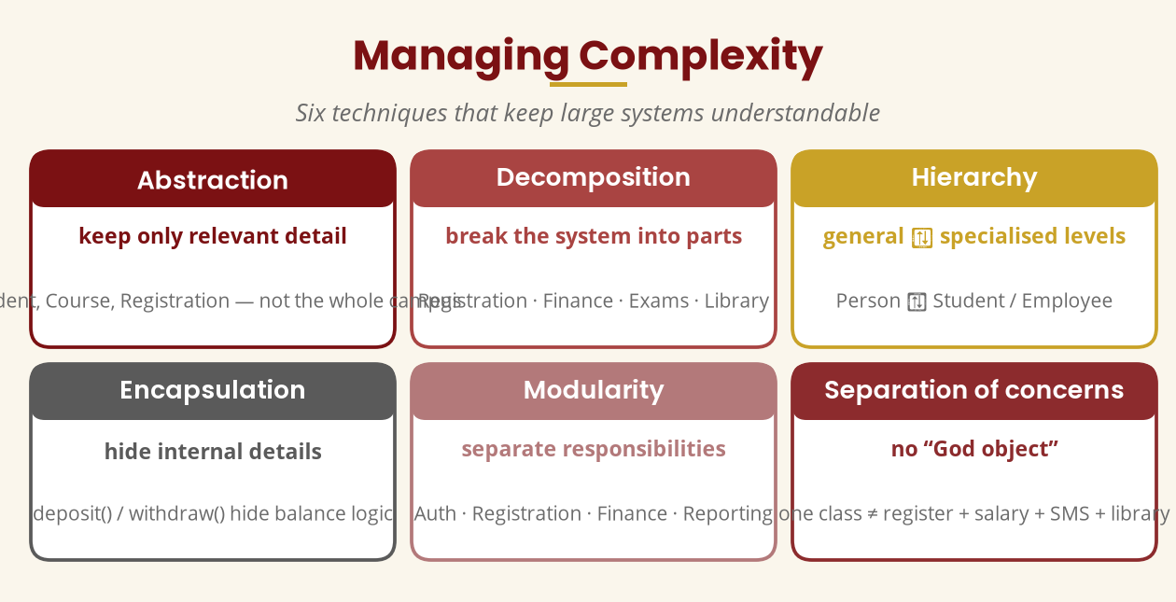
Managing Complexity
Six techniques for large systems
Abstraction · Decomposition · Hierarchy · Encapsulation · Modularity · Separation of concerns
BICT 3202 · Object-Oriented Analysis and Design
Week 2 · Slide 13

Slide 15
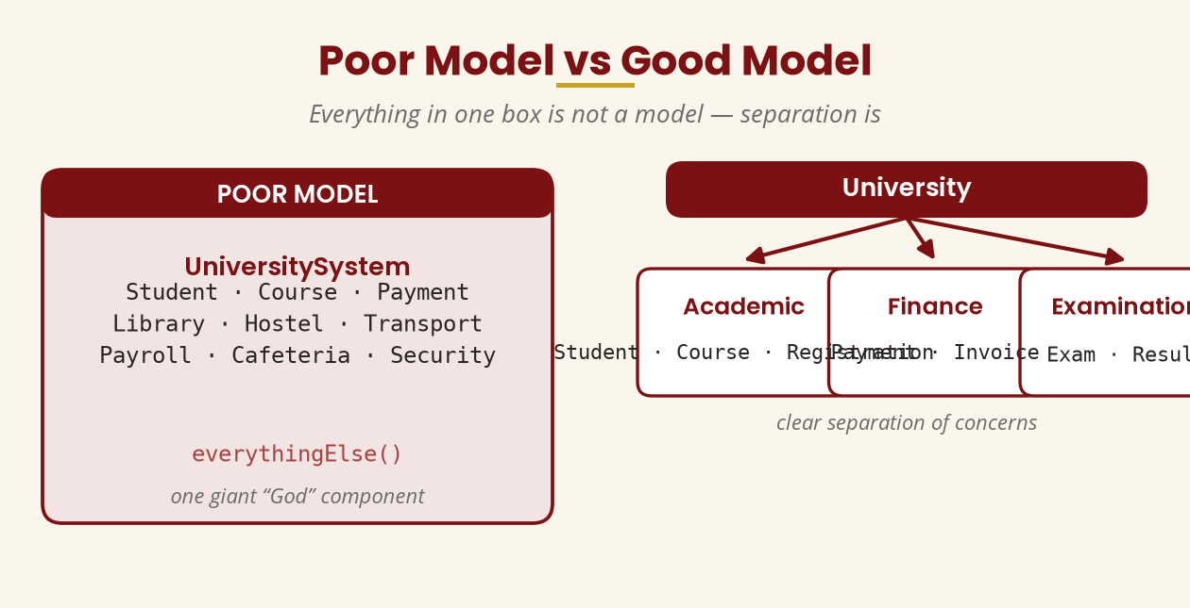
Poor Model vs Good Model
Don't build a “God object”
Separate Academic, Finance and Examination — one box is not a model.
BICT 3202 · Object-Oriented Analysis and Design
Week 2 · Slide 14

Slide 16
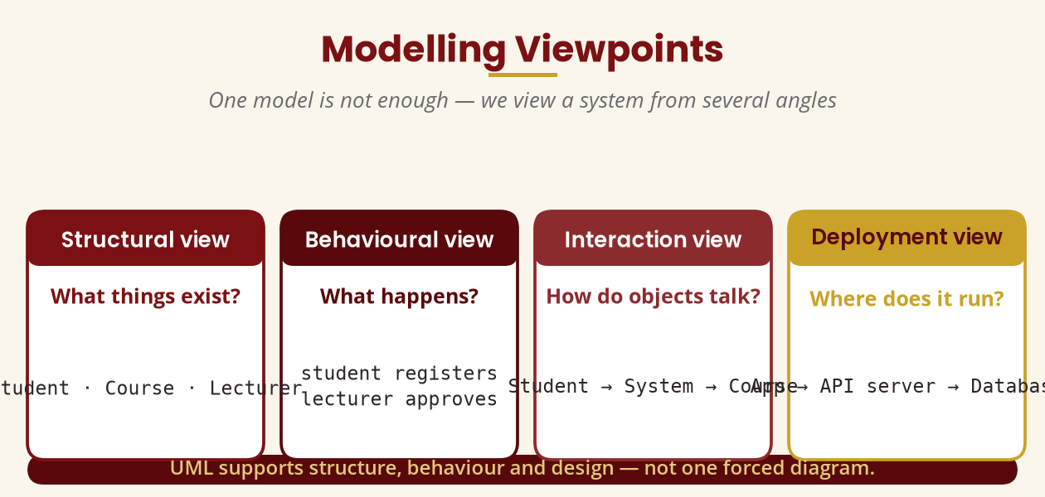
Modelling Viewpoints
One angle is never enough
Structural · Behavioural · Interaction · Deployment
BICT 3202 · Object-Oriented Analysis and Design
Week 2 · Slide 15

Slide 17
Standards for Modelling
Why UML — and why standards don't replace thinking
▪ UML (Unified Modeling Language) — the OMG standard; current formal spec is UML 2.5.1.
▪ Standard notation gives agreed meaning — no personal drawing styles.
▪ But correct notation ≠ correct analysis. “Student owns Toilet” is valid UML, meaningless modelling.
▪ Good modelling = understand business + requirements + right concepts + right notation.
UML is the language; object modelling is the thinking.
BICT 3202 · Object-Oriented Analysis and Design
Week 2 · Slide 16

Slide 18
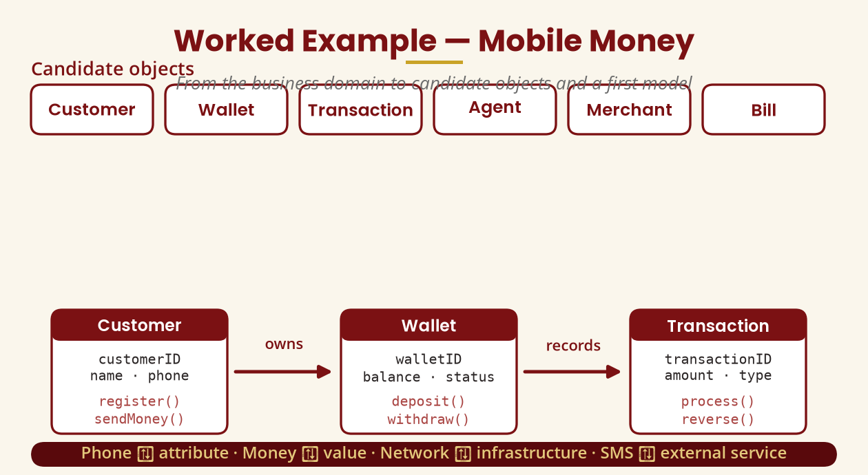
Worked Example — Mobile Money
From candidates to a first model
Phone → attribute · Money → value · Network → infrastructure · SMS → external
BICT 3202 · Object-Oriented Analysis and Design
Week 2 · Slide 17

Slide 19
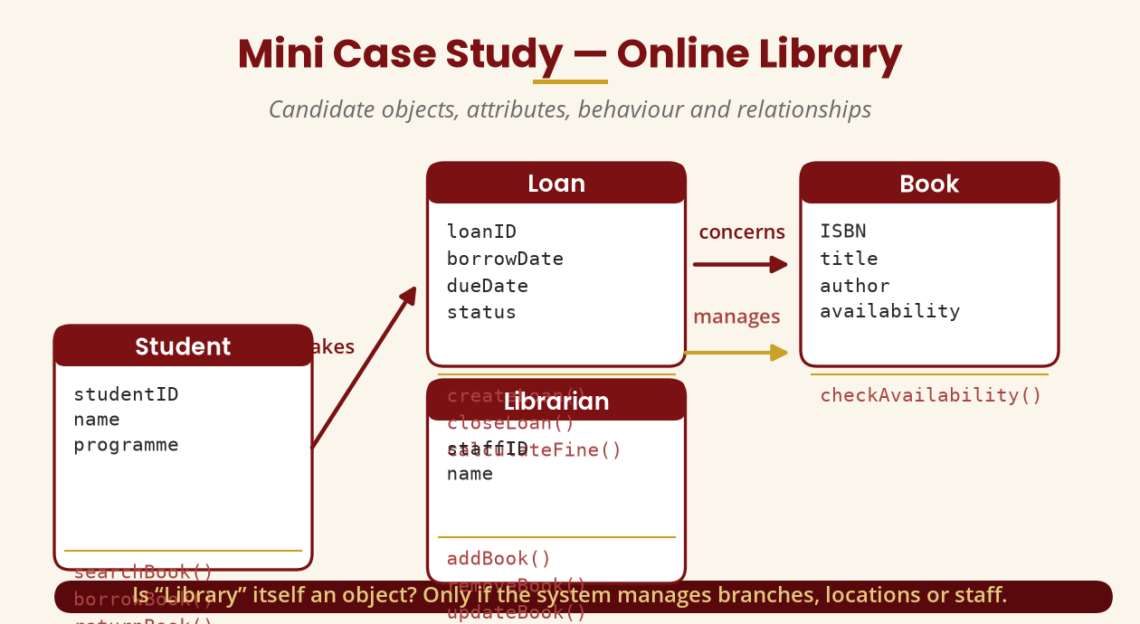
Mini Case Study — Online Library
Candidate objects and their relationships
Is “Library” an object? Only if the system manages branches/locations/staff.
BICT 3202 · Object-Oriented Analysis and Design
Week 2 · Slide 18

Slide 20
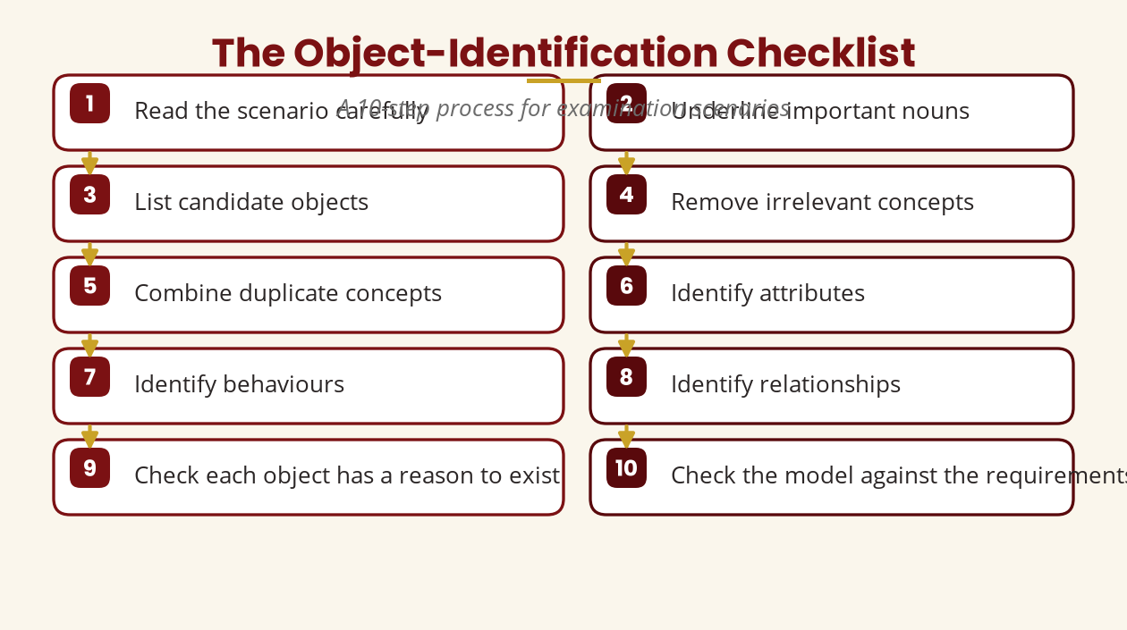
The Identification Checklist
A 10-step process for exam scenarios
Read → underline nouns → candidates → filter → attributes → behaviour → relationships → verify.
BICT 3202 · Object-Oriented Analysis and Design
Week 2 · Slide 19

Slide 21
Practical & Tutorial
Apply Week 2 to real scenarios
▪ Practical — hospital appointments:
▪ Identify candidates (Patient, Doctor, Appointment, Receptionist, Specialty)
▪ List attributes (patientID, doctorID, appointmentID…)
▪ List behaviours (request, schedule, cancel…)
▪ List relationships (Patient—requests—Appointment…)
▪ Justify every decision
▪ Tutorial — “Is it an object?”:
▪ Student · Name · Course · Mobile Phone · Payment
▪ Money · University · Registration · Keyboard
▪ Invoice · Lecturer · Internet
▪ Classify each and justify: object / attribute / external / scope-dependent / irrelevant.
Reasoning matters more than the final label.
BICT 3202 · Object-Oriented Analysis and Design
Week 2 · Slide 20

Slide 22
Week 2 Summary
The definitions to remember
▪ Object modelling — representing a domain with objects, characteristics, behaviour and relationships.
▪ Abstraction / Encapsulation — keep what matters; protect state behind operations.
▪ Identity / State / Behaviour — the three parts of every object.
▪ Object identification — judgement, not noun extraction.
▪ Complexity — tamed by decomposition, modularity, hierarchy and separation of concerns.
▪ UML — the standard language (2.5.1) we start in Week 3.
Problem domain → candidate concepts → relevant objects → attributes → behaviour → relationships → model.
BICT 3202 · Object-Oriented Analysis and Design
Week 2 · Slide 21

Slide 23
REVISION & NEXT STEPS
▪ Attempt the revision and examination-style questions in the Week 2 module and the assignment.
▪ Identify 15 candidate objects for a system you use daily — then filter them.
▪ Practise the 10-step identification checklist on a past-paper scenario.
▪ Next week: UML — the standard language for expressing the models we build.
Thank you — Francis Fweta · ICT Lecturer · Exploits University

