Slide 1

EXPLOITS UNIVERSITY
BSc INFORMATION COMMUNICATION AND TECHNOLOGY
BICT 3202 · OBJECT-ORIENTED ANALYSIS AND DESIGN
WEEK 3
Modelling Language — UML
Francis Fweta · ICT Lecturer · Week 3 of 16

Slide 2
Learning Outcomes
By the end of this week, you should be able to…
▪ Define UML and explain why it is used in OOAD.
▪ Separate modelling language vs development methodology.
▪ Identify the building blocks — things, relationships, diagrams.
▪ Classify structural, behavioural, grouping and annotational elements.
▪ Explain the diagram families and their purposes.
▪ Apply rules, common mechanisms and extensibility (stereotypes, tagged values, constraints).
▪ Explain the four-layer architecture M0–M3.
UML is a standard language for communicating models — not a programming language.
BICT 3202 · Object-Oriented Analysis and Design
Week 3 · Slide 1

Slide 3
What Is UML?
Unified · Modeling · Language
▪ Unified — brought together ideas from earlier OO modelling approaches.
▪ Modeling — used to create representations of systems.
▪ Language — defined concepts and notation for communicating those representations.
▪ The problem it solves: five people, five different mental pictures — UML makes the structure visible.
▪ Current specification: UML 2.5.1 (OMG, December 2017).
UML = visualise, specify and document systems — structure, behaviour and processes.
BICT 3202 · Object-Oriented Analysis and Design
Week 3 · Slide 2

Slide 4
What UML Is NOT
Three distinctions that examiners love
▪ Not a programming language — Java/Python/C# execute; UML communicates models.
▪ Not a methodology — UML says how to represent; UP/USDP says what activities to do, in what order.
▪ Not only for software — business processes, workflows and non-software systems too.
▪ One diagram ≠ everything — use multiple views for different perspectives.
UML = modelling language · UP = development process (Weeks 12–13).
BICT 3202 · Object-Oriented Analysis and Design
Week 3 · Slide 3

Slide 5
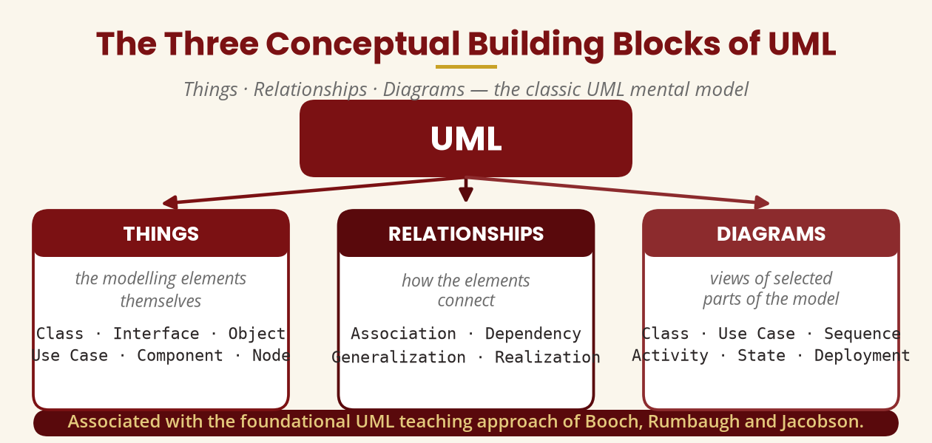
The Three Building Blocks
Things · Relationships · Diagrams
The classic framework of Booch, Rumbaugh and Jacobson.
BICT 3202 · Object-Oriented Analysis and Design
Week 3 · Slide 4

Slide 6
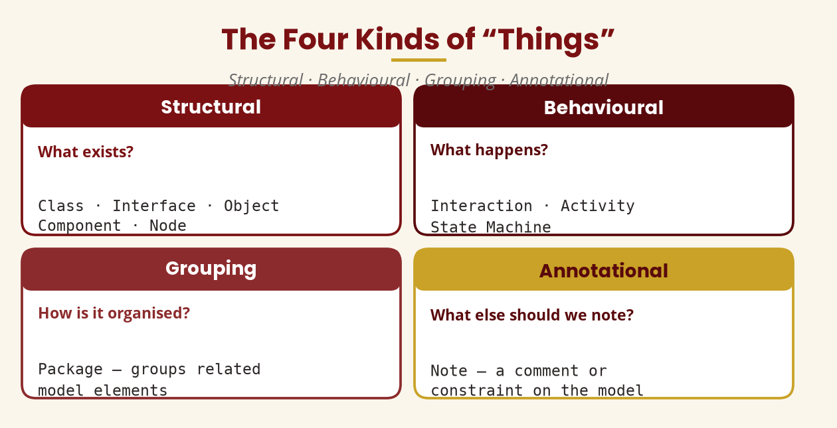
Building Block 1 — Things
Structural · Behavioural · Grouping · Annotational
What exists? · What happens? · How is it organised? · What else to note?
BICT 3202 · Object-Oriented Analysis and Design
Week 3 · Slide 5

Slide 7
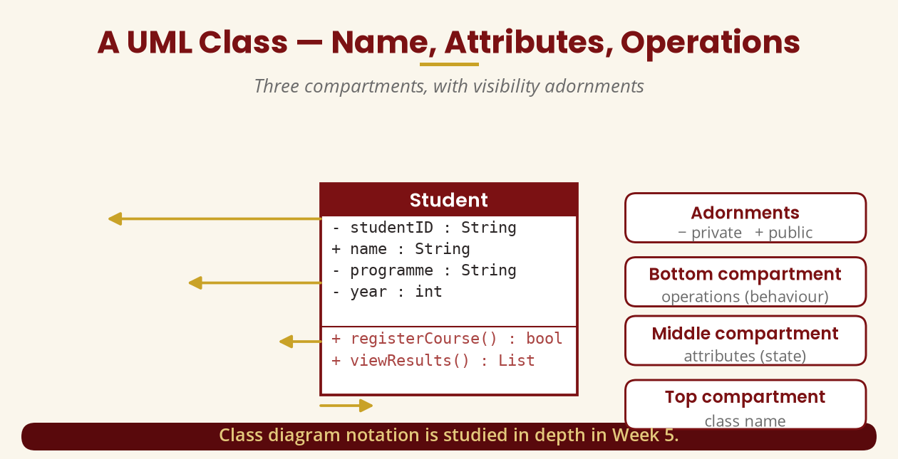
A UML Class
Three compartments with adornments
Name · Attributes · Operations — with − private / + public adornments
BICT 3202 · Object-Oriented Analysis and Design
Week 3 · Slide 6

Slide 8
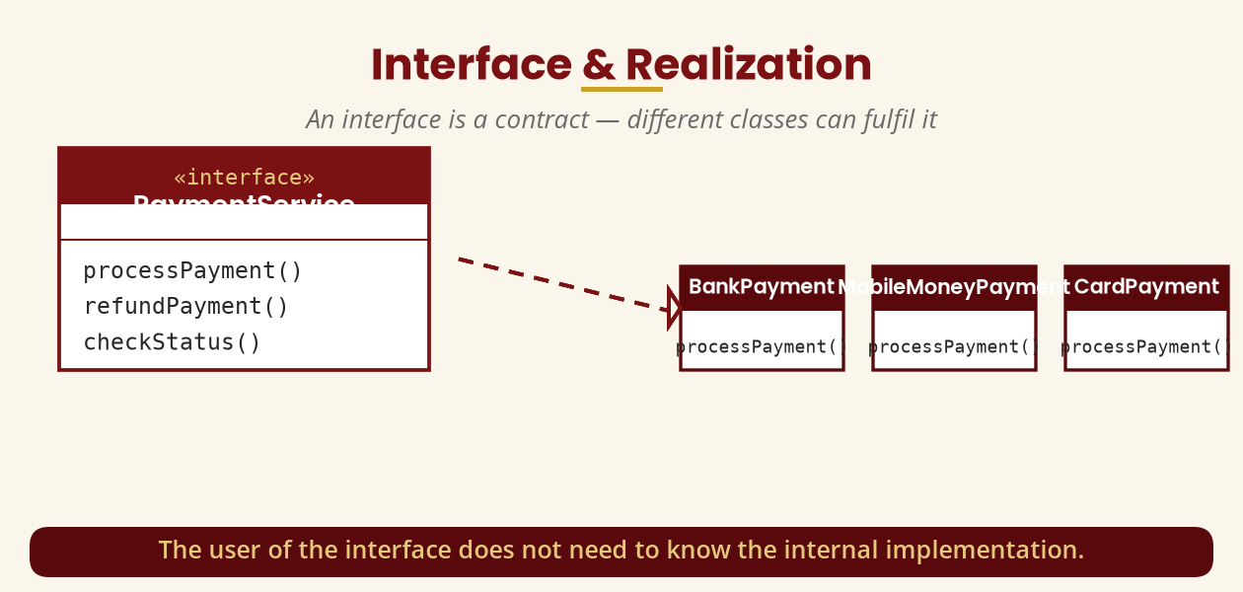
Interface & Realization
A contract, fulfilled by different implementations
The user of an interface need not know the internal implementation.
BICT 3202 · Object-Oriented Analysis and Design
Week 3 · Slide 7

Slide 9
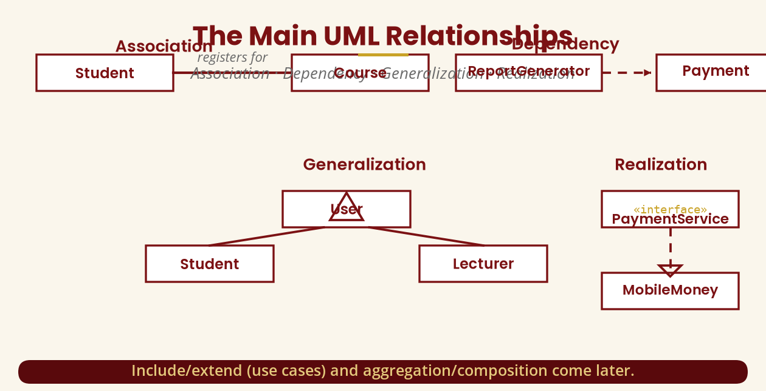
Building Block 2 — Relationships
Association · Dependency · Generalization · Realization
Generalization → hollow triangle · Realization → dashed hollow triangle · Dependency → dashed arrow
BICT 3202 · Object-Oriented Analysis and Design
Week 3 · Slide 8

Slide 10
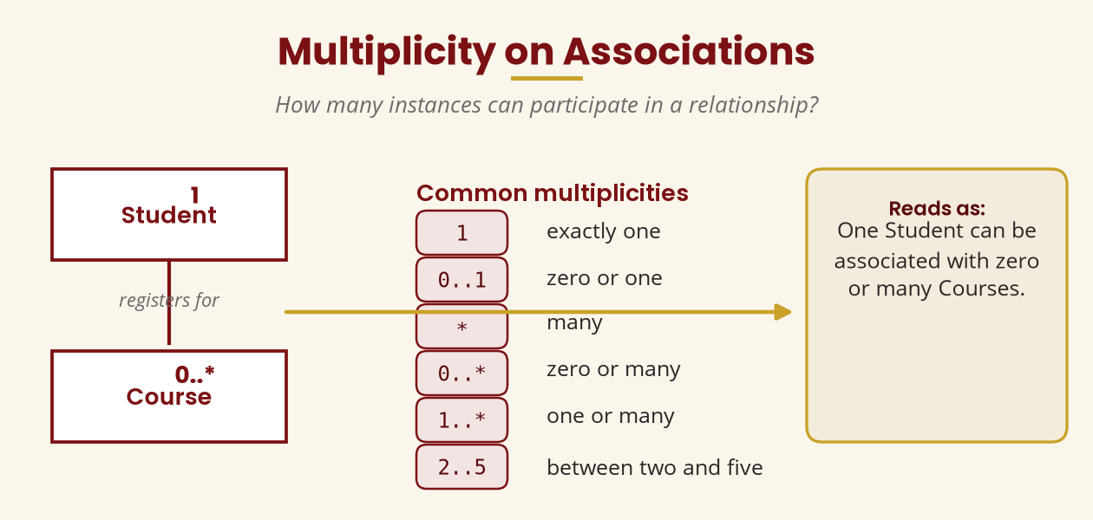
Multiplicity
How many instances participate?
Student 1 ——— 0..* Course · one student, zero or many courses
BICT 3202 · Object-Oriented Analysis and Design
Week 3 · Slide 9

Slide 11
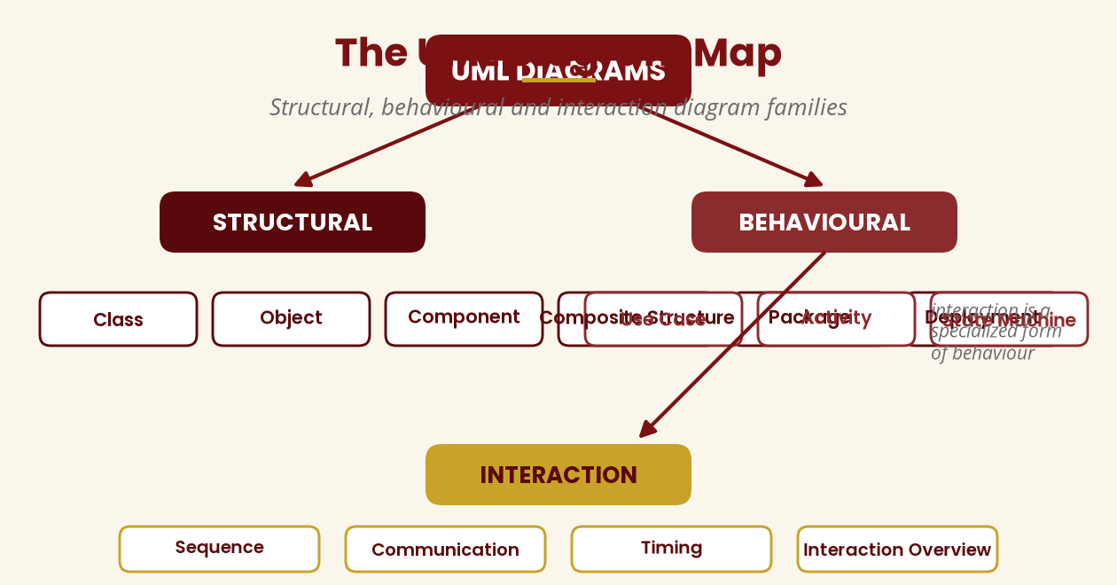
Building Block 3 — Diagrams
The UML diagram families
Structural (6) · Behavioural (3) · Interaction (4) — per OMG UML 2.5.1
BICT 3202 · Object-Oriented Analysis and Design
Week 3 · Slide 10

Slide 12
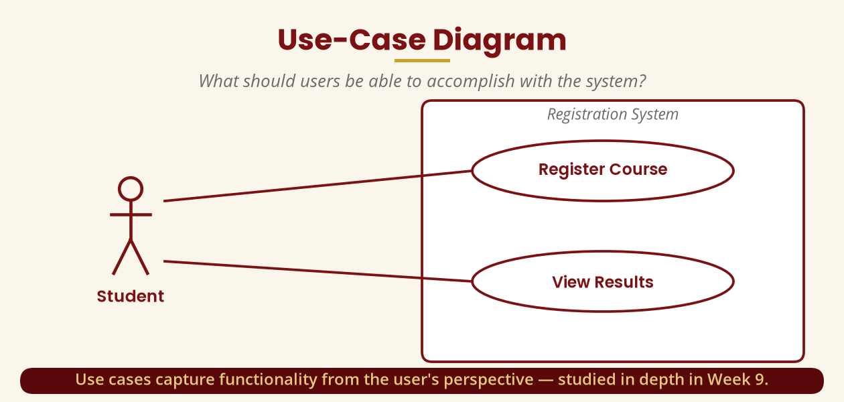
Use-Case Diagram
What should users be able to accomplish?
Captures functionality from the user's perspective — Week 9 in depth.
BICT 3202 · Object-Oriented Analysis and Design
Week 3 · Slide 11

Slide 13
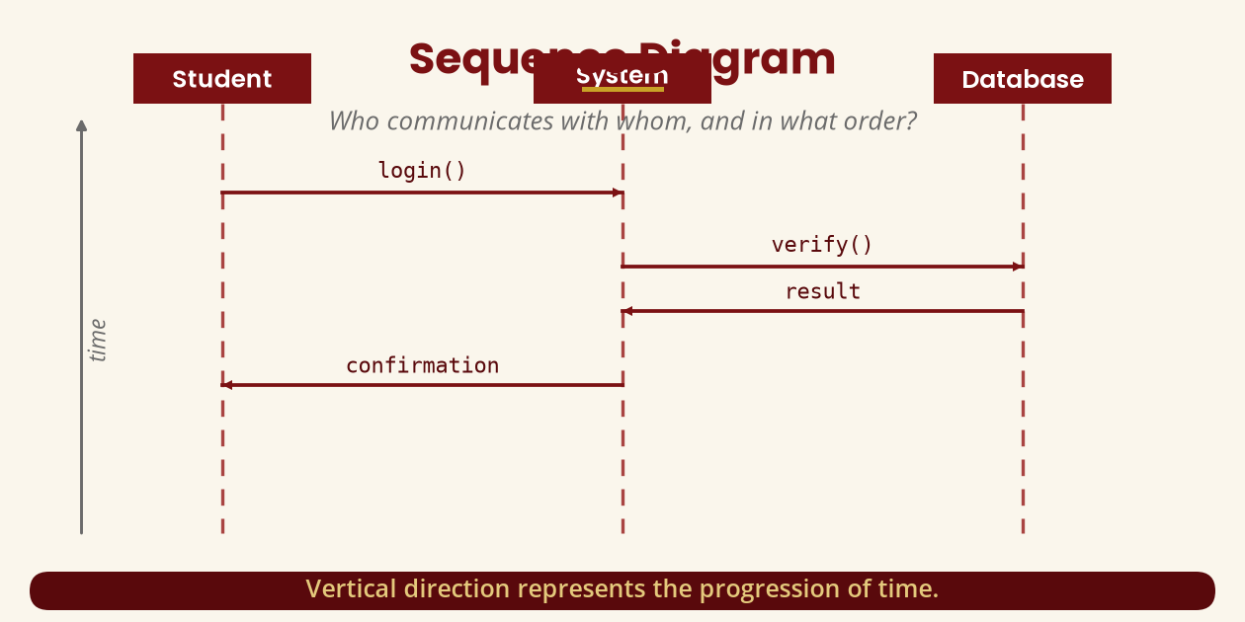
Sequence Diagram
Who communicates with whom, in what order?
Lifelines + messages; vertical axis = time.
BICT 3202 · Object-Oriented Analysis and Design
Week 3 · Slide 12

Slide 14
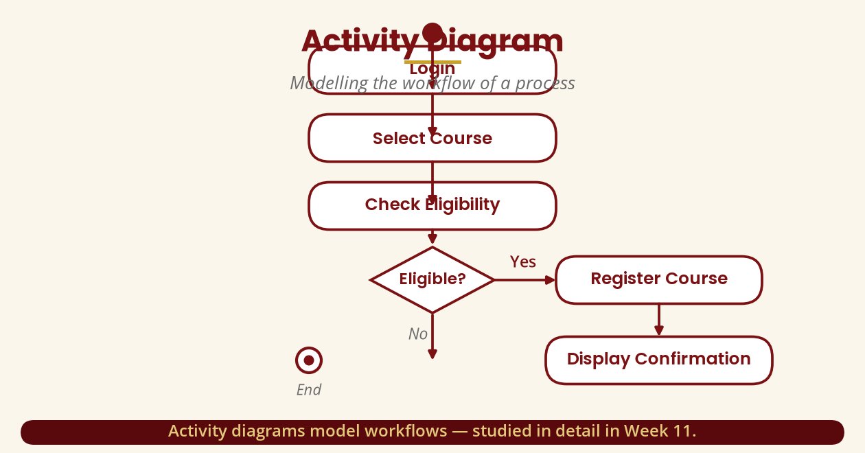
Activity Diagram
Modelling the workflow
Actions, decisions and start/end nodes — Week 11 in depth.
BICT 3202 · Object-Oriented Analysis and Design
Week 3 · Slide 13

Slide 15
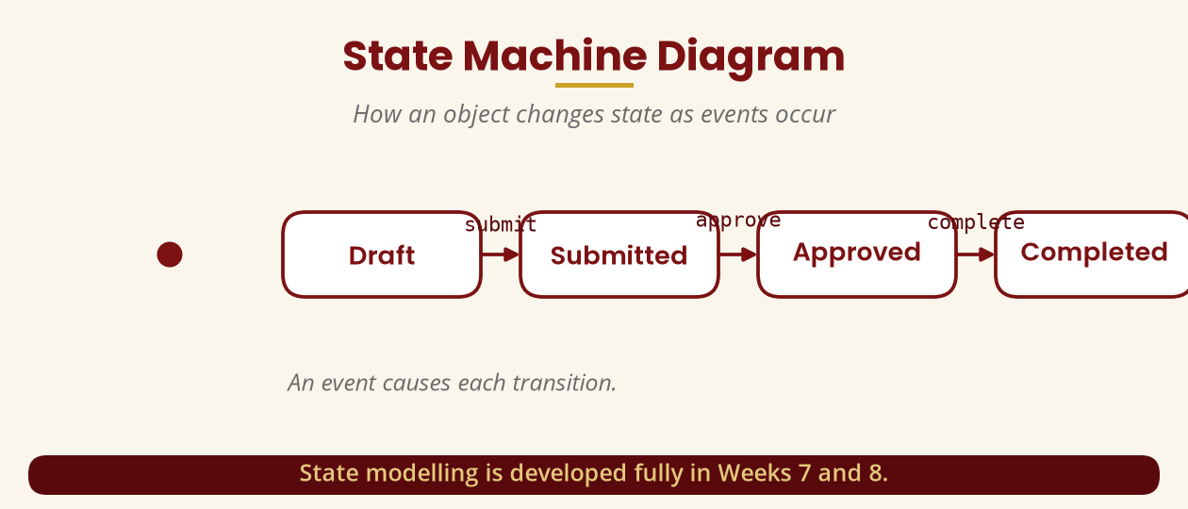
State Machine Diagram
How an object changes state
Events drive transitions: submit → approve → complete. Weeks 7–8 in depth.
BICT 3202 · Object-Oriented Analysis and Design
Week 3 · Slide 14

Slide 16
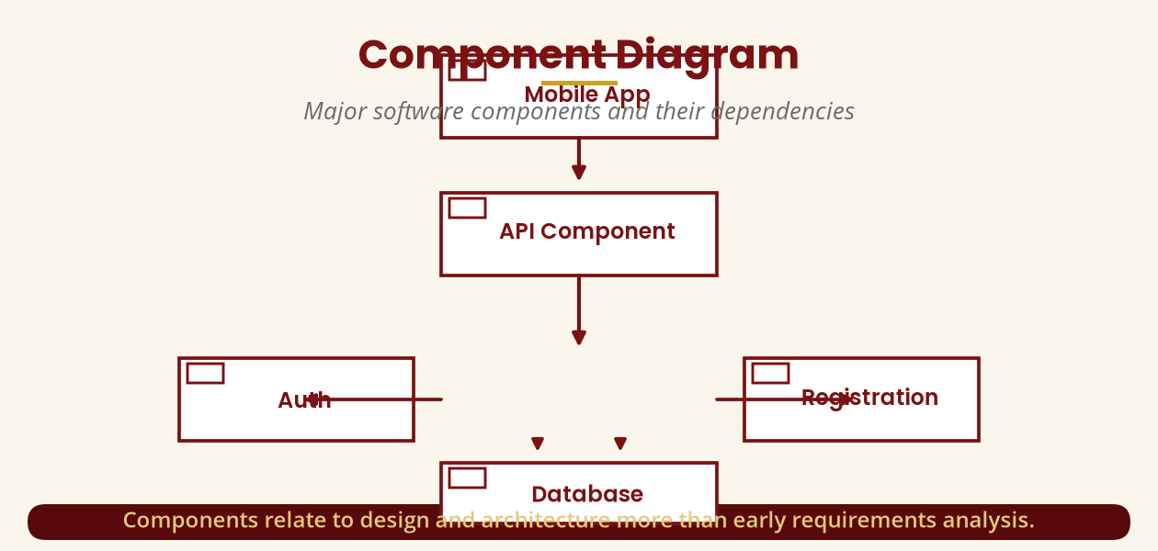
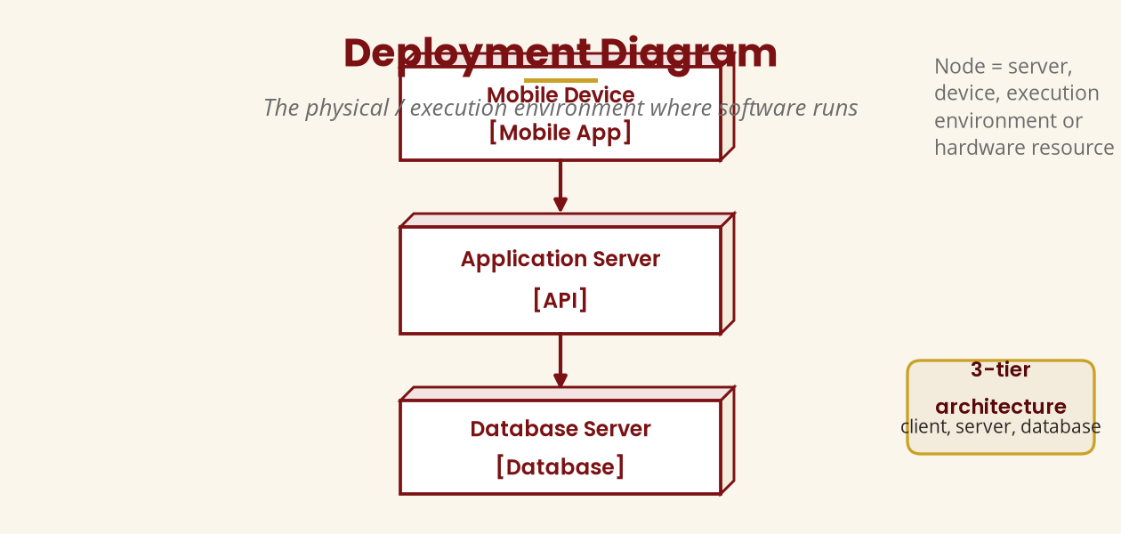
Component & Deployment Diagrams
Software parts and where they run
Components = design/architecture · Nodes = servers, devices, execution environments
BICT 3202 · Object-Oriented Analysis and Design
Week 3 · Slide 15

Slide 17
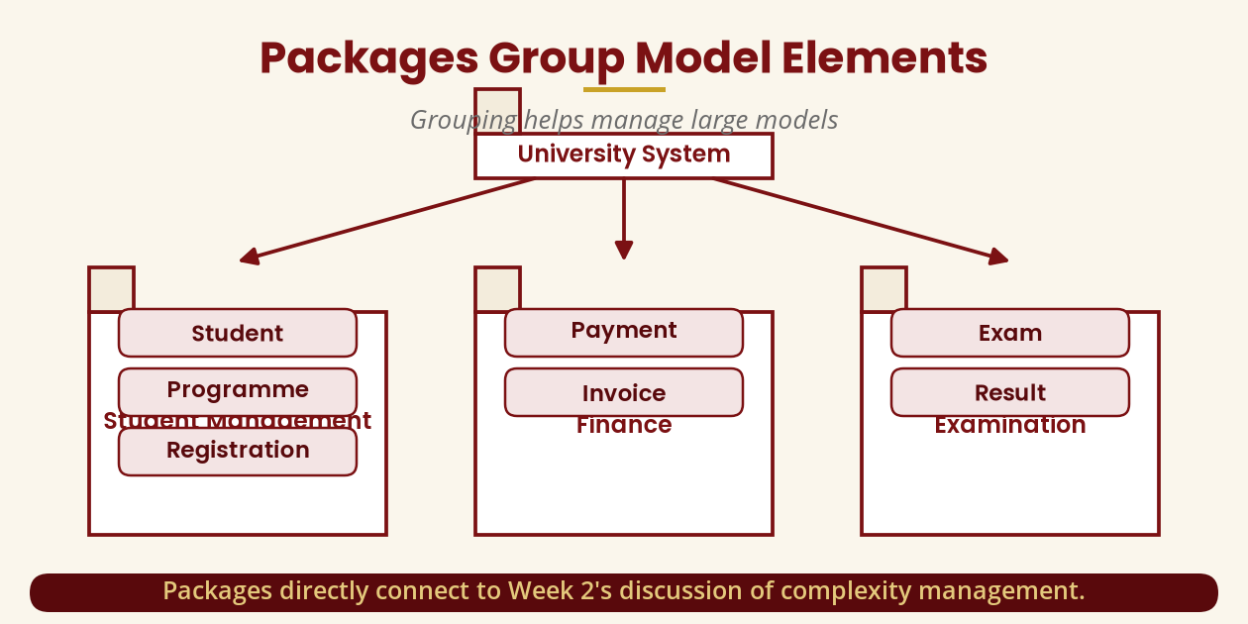
Packages
Grouping elements to manage large models
Packages connect directly to Week 2's complexity management.
BICT 3202 · Object-Oriented Analysis and Design
Week 3 · Slide 16

Slide 18
Rules of UML
Syntax, semantics and well-formedness
▪ Syntax — how something is drawn.
▪ Semantics — what it means.
▪ Well-formedness — satisfies the rules of the language.
▪ Four checks: notation correct? relationship sensible? requirements met? understandable?
▪ A diagram can look right and still mean the wrong thing.
Correct notation ≠ correct analysis.
BICT 3202 · Object-Oriented Analysis and Design
Week 3 · Slide 17

Slide 19
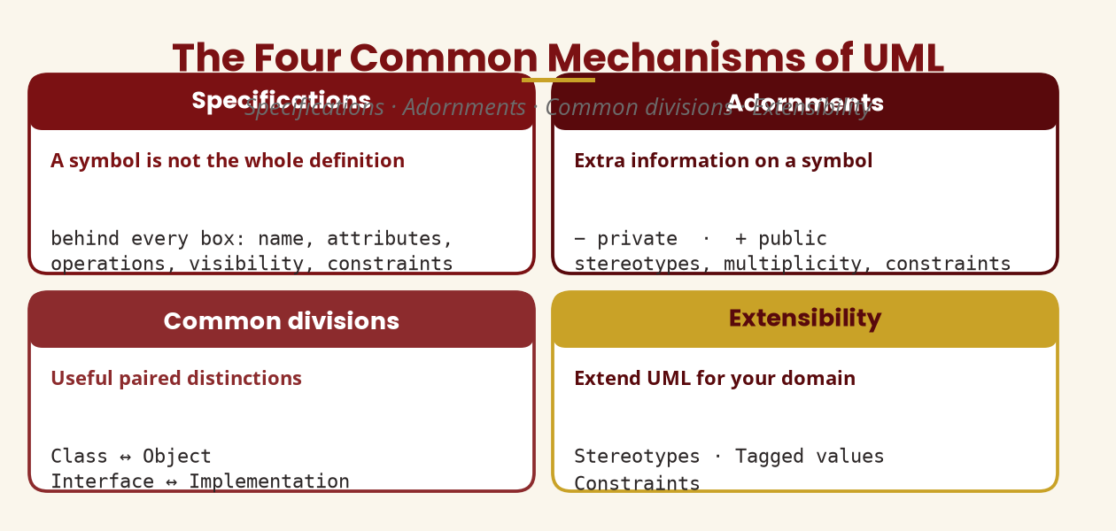
The Four Common Mechanisms
Specifications · Adornments · Divisions · Extensibility
Stereotypes «entity» · Tagged values {location=…} · Constraints {balance ≥ 0}
BICT 3202 · Object-Oriented Analysis and Design
Week 3 · Slide 18

Slide 20
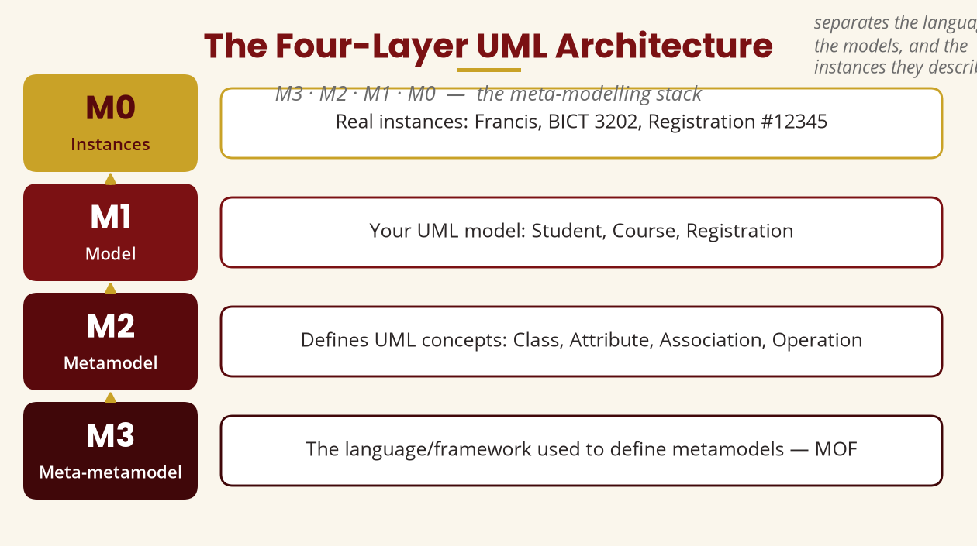
The Four-Layer Architecture
M3 → M2 → M1 → M0
Meta-metamodel (MOF) → Metamodel → Your model → Instances
BICT 3202 · Object-Oriented Analysis and Design
Week 3 · Slide 19

Slide 21
Don't Confuse the Two Architectures
A classic examination trap
▪ UML architecture — M3 / M2 / M1 / M0 abstraction levels of the modelling language itself.
▪
▪
▪ A dictionary analogy:
▪ M3 rules for languages, M2 definitions (Class…), M1 your model, M0 actual instances.
▪ Software architecture — Presentation → Business Logic → Data Access → Database.
▪
▪
▪ Completely different concept:
▪ how the system is organised, not how the language is defined.
UML architecture ≠ software architecture — know which one the question asks about.
BICT 3202 · Object-Oriented Analysis and Design
Week 3 · Slide 20

Slide 22
One System, Five Views
The university registration requirement
▪ Use case — Student · Register Course (what users can do)
▪ Class — Student, Course + attributes (structure)
▪ Sequence — Student → System → Course (interaction)
▪ Activity — login → select → check → register (workflow)
▪ State — Draft → Submitted → Approved → Completed (lifecycle)
Different diagrams answer different questions — that's why UML is powerful.
BICT 3202 · Object-Oriented Analysis and Design
Week 3 · Slide 21

Slide 23
Practical & Tutorial
Try UML yourself
▪ Practical — build a class diagram:
▪ Student · Course · Lecturer · Registration
▪ Add attributes (studentID, courseCode, lecturerID, registrationID…)
▪ Add relationships (Student—Registration, Lecturer—Course…)
▪ Add multiplicities (Student 1 — 0..* Registration)
▪ Tutorial — which diagram?
▪ Functions a student can do → Use Case
▪ Classes & relationships → Class
▪ Communication order → Sequence
▪ Steps of a process → Activity
▪ States of an application → State Machine
▪ Where components run → Deployment
Choose the diagram by the question you are trying to answer.
BICT 3202 · Object-Oriented Analysis and Design
Week 3 · Slide 22

Slide 24
Week 3 Summary
The essentials
▪ UML — a standardised language for visualising, specifying and documenting systems.
▪ Building blocks — Things · Relationships · Diagrams.
▪ Relationships — association, dependency, generalization, realization.
▪ Rules — syntax, semantics, well-formedness.
▪ Mechanisms — specifications, adornments, divisions, extensibility.
▪ Architecture — M3 meta-metamodel → M2 metamodel → M1 model → M0 instances.
UML is not pretty pictures — it's a language for communicating models.
BICT 3202 · Object-Oriented Analysis and Design
Week 3 · Slide 23

Slide 25
REVISION & NEXT STEPS
▪ Study the OMG UML 2.5.1 specification — the authoritative reference.
▪ Build a table of 10+ diagram types: what each represents, the question it answers, when it is useful.
▪ Map the Week 1–2 registration system onto the right diagrams (requirements, structure, workflow, interaction, lifecycle, deployment).
▪ Next week: deeper into UML building blocks, rules, mechanisms and architecture.
Thank you — Francis Fweta · ICT Lecturer · Exploits University

