Slide 1

EXPLOITS UNIVERSITY
BSc INFORMATION COMMUNICATION AND TECHNOLOGY
BICT 3202 · OBJECT-ORIENTED ANALYSIS AND DESIGN
WEEK 4
UML Building Blocks, Rules, Mechanisms and Architecture
Francis Fweta · ICT Lecturer · Week 4 of 16

Slide 2
Learning Outcomes
By the end of this week, you should be able to…
▪ Identify the building blocks of UML and their types.
▪ Explain structural, behavioural, grouping and annotational things.
▪ Distinguish association, dependency, generalization and realization.
▪ Explain UML notation, semantics and well-formedness.
▪ Apply adornments — visibility, multiplicity, constraints and modifiers.
▪ Use extensibility mechanisms — stereotypes, tagged values, constraints, profiles.
▪ Explain the layered architecture M0–M3.
▪ Apply all of it to a university information system.
Week 4 is the bridge between understanding UML and using it for analysis.
BICT 3202 · Object-Oriented Analysis and Design
Week 4 · Slide 1

Slide 3
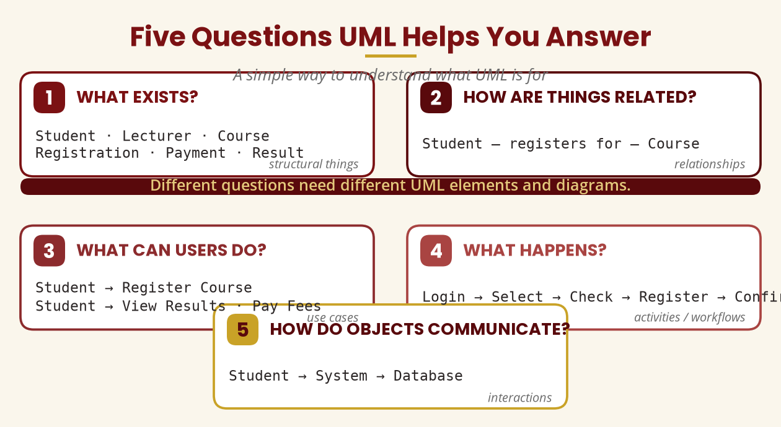
A Simple Way In
Five questions UML helps you answer
What exists? · How are things related? · What can users do? · What happens? · How do objects communicate?
BICT 3202 · Object-Oriented Analysis and Design
Week 4 · Slide 2

Slide 4
The Building Blocks
Things · Relationships · Diagrams
▪ Things — structural, behavioural, grouping, annotational.
▪ Relationships — association, dependency, generalization, realization.
▪ Diagrams — structural and behavioural views of the model.
▪
▪ Why the classification matters: UML is not a collection of random shapes — every symbol has a defined meaning.
Building blocks = the vocabulary of UML.
BICT 3202 · Object-Oriented Analysis and Design
Week 4 · Slide 3

Slide 5
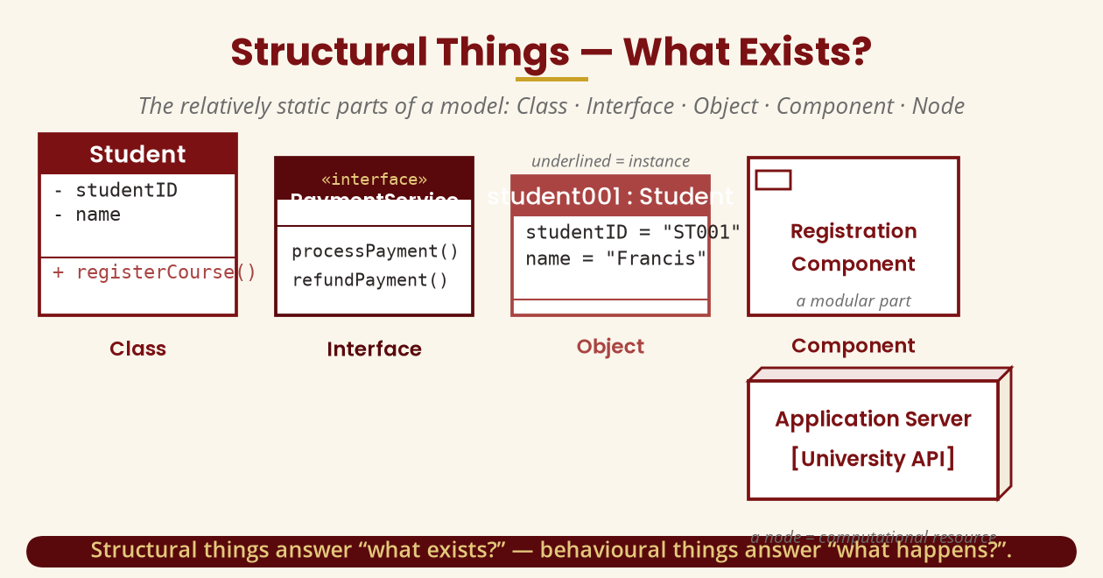
Structural Things
What exists in the system?
Class · Interface · Object · Component · Node — the relatively static parts.
BICT 3202 · Object-Oriented Analysis and Design
Week 4 · Slide 4

Slide 6
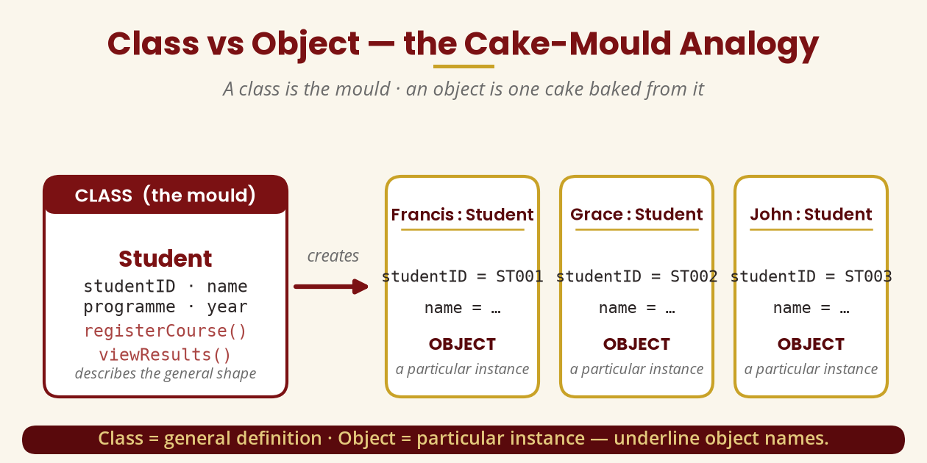
Class vs Object
The cake-mould analogy
A class is a description; an object is a particular instance — student001 : Student.
BICT 3202 · Object-Oriented Analysis and Design
Week 4 · Slide 5

Slide 7
Behavioural, Grouping & Annotational Things
What happens · How it's organised · What to note
▪ Behavioural — interactions (who communicates), activities (workflows), state machines (Draft → Submitted → Approved).
▪ Grouping — packages organise a large model (Student Management, Finance, Examination).
▪ Annotational — notes explain the model without adding a new business object.
Not everything in a model is a class — some things happen, group, or explain.
BICT 3202 · Object-Oriented Analysis and Design
Week 4 · Slide 6

Slide 8
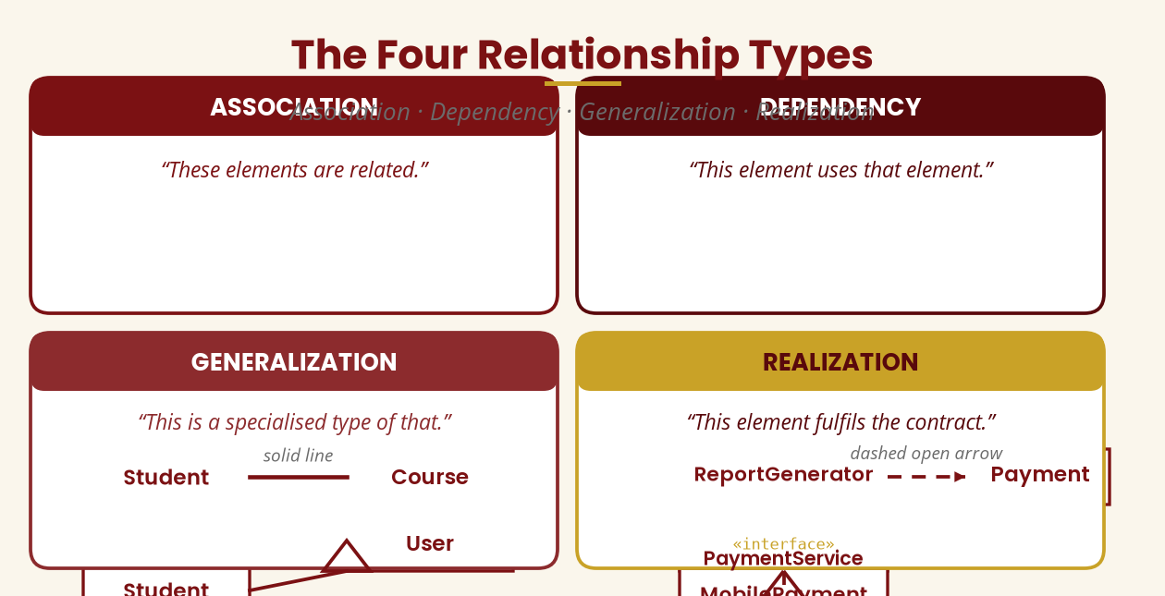
The Four Relationships
Association · Dependency · Generalization · Realization
Related-to · Uses · Is-a · Implements — four different arrows, four different meanings.
BICT 3202 · Object-Oriented Analysis and Design
Week 4 · Slide 7

Slide 9
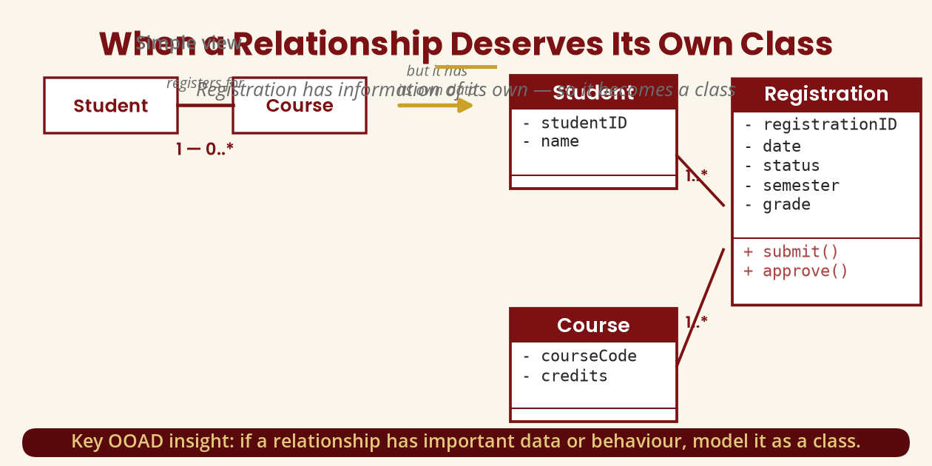
When a Relationship Needs Its Own Class
Student — Course → Registration
If a relationship has data or behaviour (date, status, grade), promote it to a class.
BICT 3202 · Object-Oriented Analysis and Design
Week 4 · Slide 8

Slide 10
UML Diagrams
A diagram is a view of the model — not necessarily the whole system
▪ Structural diagrams — class, object, component, composite structure, package, deployment → “What exists?”
▪ Behavioural diagrams — use case, activity, state machine → “What happens?”
▪ Interaction diagrams — sequence, communication, interaction overview, timing → “Who communicates, in what order?”
One model supports many views — choose the diagram by the question you ask.
BICT 3202 · Object-Oriented Analysis and Design
Week 4 · Slide 9

Slide 11
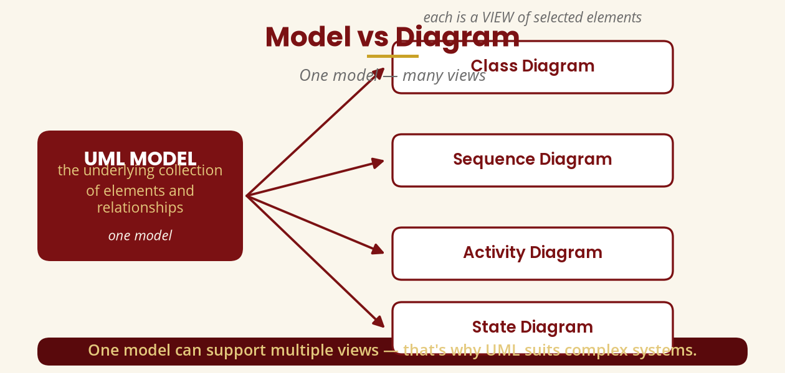
Model vs Diagram
One model, many diagrams
The diagram shows selected elements; the model holds everything behind them.
BICT 3202 · Object-Oriented Analysis and Design
Week 4 · Slide 10

Slide 12
Rules of UML
Syntax, semantics and well-formedness
▪ Syntax — how something is drawn.
▪ Semantics — what it means; a symbol is not decoration.
▪ Well-formedness — a model that follows the relevant rules.
▪
▪ Never choose a symbol because “it looks nice” — a diamond has a specific meaning.
Correct notation ≠ correct analysis.
BICT 3202 · Object-Oriented Analysis and Design
Week 4 · Slide 11

Slide 13
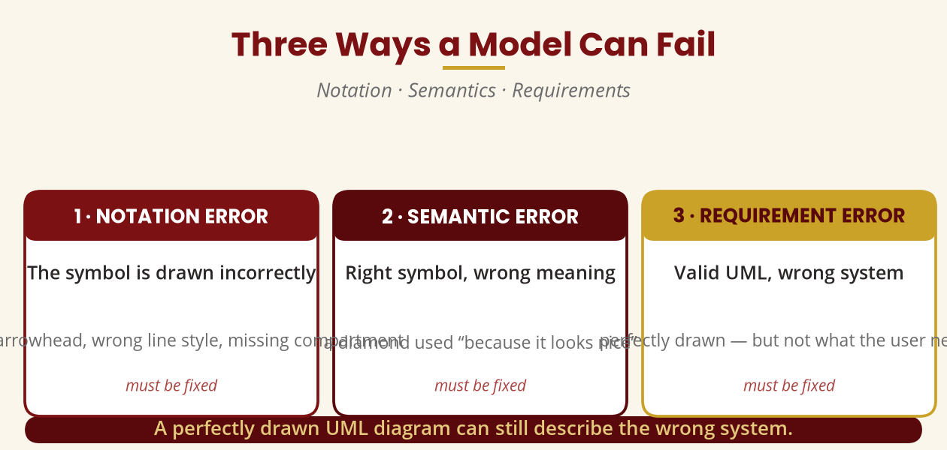
Three Ways a Model Can Fail
Notation · Semantics · Requirements
A perfectly drawn diagram can still describe the wrong system.
BICT 3202 · Object-Oriented Analysis and Design
Week 4 · Slide 12

Slide 14
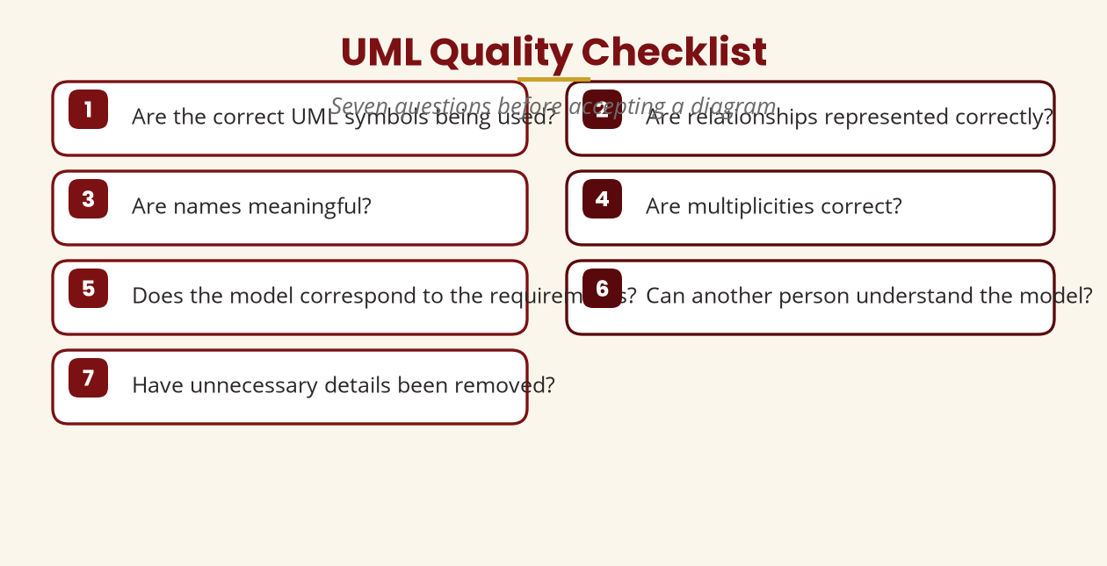
The Seven-Question Checklist
Quality-check every UML diagram
Name · Kind · Meaning · Relationships · Multiplicity · Constraint · Stereotype.
BICT 3202 · Object-Oriented Analysis and Design
Week 4 · Slide 13

Slide 15
The Four Common Mechanisms
Specifications · Adornments · Divisions · Extensibility
▪ Specifications — the diagram is a view; behind every box lies a richer specification.
▪ Adornments — visibility, multiplicity, constraints, modifiers added to a basic element.
▪ Common divisions — class ↔ object (type vs instance); interface ↔ implementation (contract vs behaviour).
▪ Extensibility — stereotypes, tagged values, constraints and profiles.
The classic four mechanisms of Booch, Rumbaugh and Jacobson.
BICT 3202 · Object-Oriented Analysis and Design
Week 4 · Slide 14

Slide 16
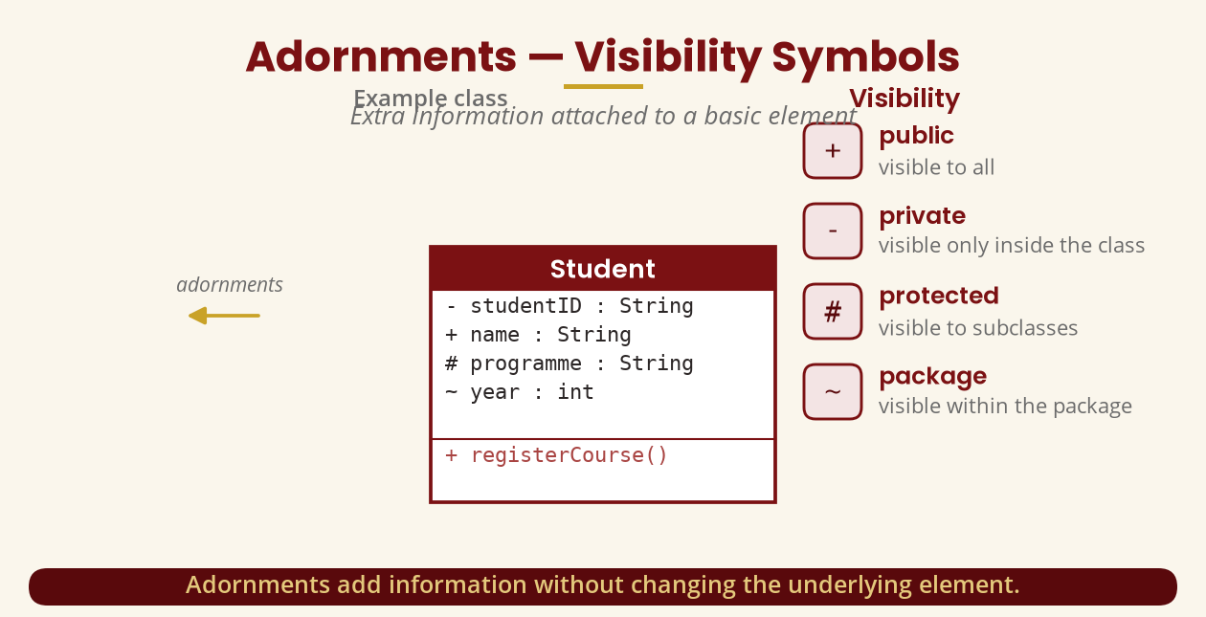
Adornments — Visibility
Reading the symbols in a class box
+ public · − private · # protected · ~ package.
BICT 3202 · Object-Oriented Analysis and Design
Week 4 · Slide 15

Slide 17
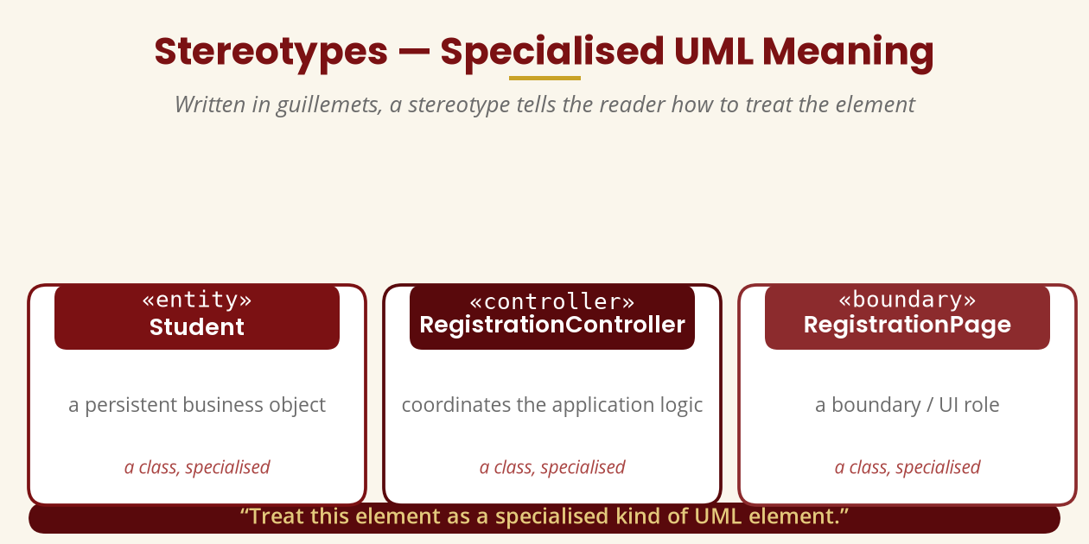
Extensibility — Stereotypes
«entity» · «controller» · «boundary»
A stereotype gives an element a specialised meaning.
BICT 3202 · Object-Oriented Analysis and Design
Week 4 · Slide 16

Slide 18
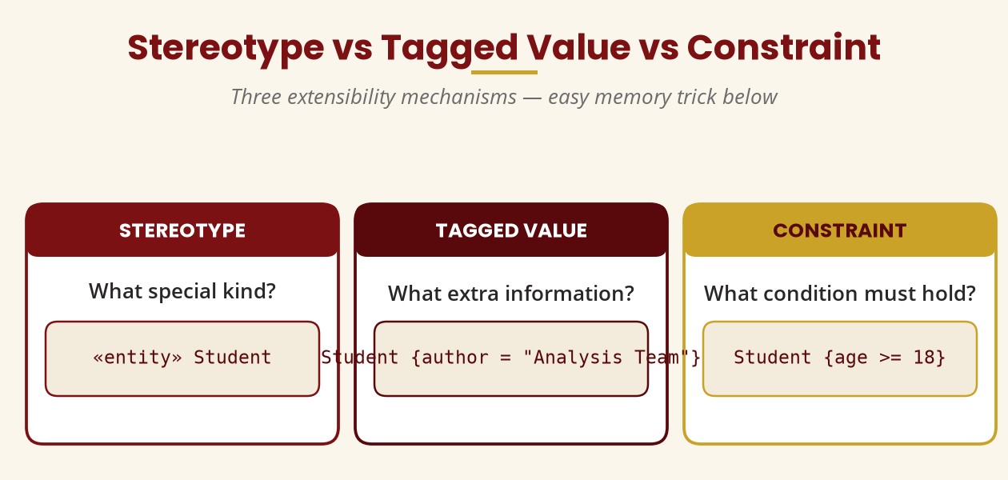
Stereotype · Tagged Value · Constraint
Three extensibility mechanisms compared
Specialised meaning · extra metadata · a condition that must hold.
BICT 3202 · Object-Oriented Analysis and Design
Week 4 · Slide 17

Slide 19
UML Profiles
Customising UML for a domain
▪ UML — a general-purpose modelling language.
▪ Profile — a tailored UML vocabulary and rules for a domain (security, business process, real-time).
▪ Defines stereotypes and their associated extensions.
▪
▪ UML 2.5.1 ships with a standard profile as a machine-readable artefact.
UML = the language · Profile = a customised dialect for a domain.
BICT 3202 · Object-Oriented Analysis and Design
Week 4 · Slide 18

Slide 20
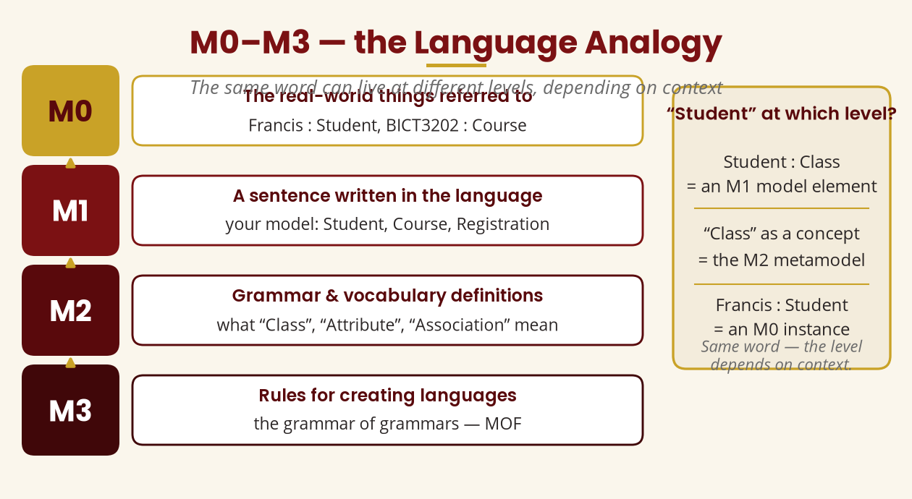
UML Architecture — M0 to M3
The meta-modelling hierarchy
M3 meta-metamodel (MOF) → M2 metamodel → M1 your model → M0 instances.
BICT 3202 · Object-Oriented Analysis and Design
Week 4 · Slide 19

Slide 21
Don't Confuse the Two Architectures
A classic examination trap
▪ UML architecture — M3 / M2 / M1 / M0 abstraction levels of the modelling language itself.
▪
▪
▪ Is “Student” M0, M1 or M2? Depends on context:
▪ Student : Class → M1 element
▪ “Class” as a concept → M2 metamodel
▪ Francis : Student → M0 instance
▪ Software architecture — Presentation → Business Logic → Data Access → Database.
▪
▪
▪ Completely different concept:
▪ how the system is organised,
▪ not how the language is defined.
UML architecture ≠ software architecture — know which one the question asks about.
BICT 3202 · Object-Oriented Analysis and Design
Week 4 · Slide 20

Slide 22
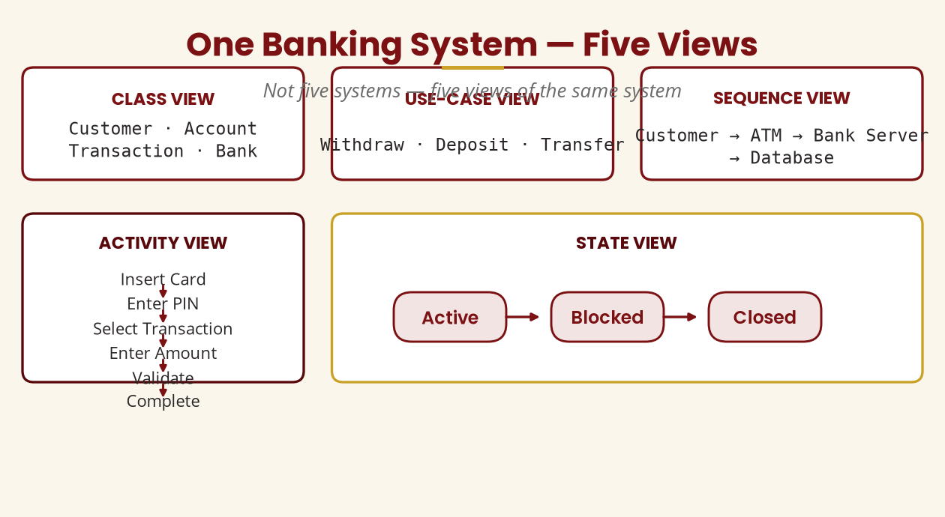
One System, Five Views
The same banking model, different diagrams
Different diagrams answer different questions — that's why UML suits complex systems.
BICT 3202 · Object-Oriented Analysis and Design
Week 4 · Slide 21

Slide 23
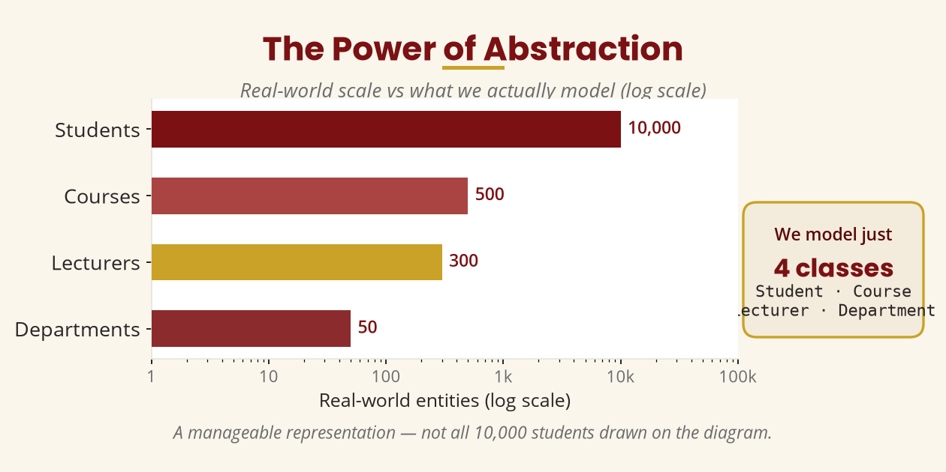
UML and Abstraction
10,000 students → one Student class
We model the essential, ignoring the irrelevant — abstraction makes complexity manageable.
BICT 3202 · Object-Oriented Analysis and Design
Week 4 · Slide 22

Slide 24
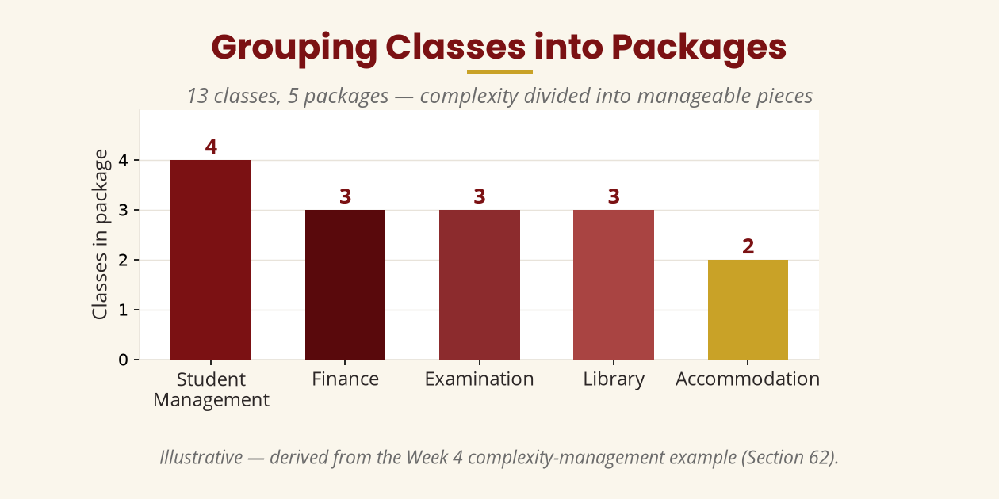
UML and Complexity Management
Grouping classes into packages
Don't overload one diagram — split related areas into packages.
BICT 3202 · Object-Oriented Analysis and Design
Week 4 · Slide 23

Slide 25
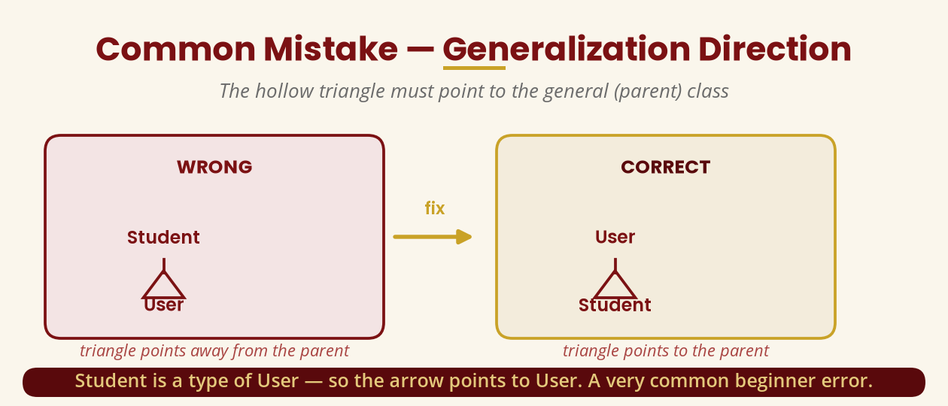
Common Mistake — Generalization Direction
The hollow triangle points to the general class
Student ▷ User — triangle at the User end. The most common beginner error.
BICT 3202 · Object-Oriented Analysis and Design
Week 4 · Slide 24

Slide 26
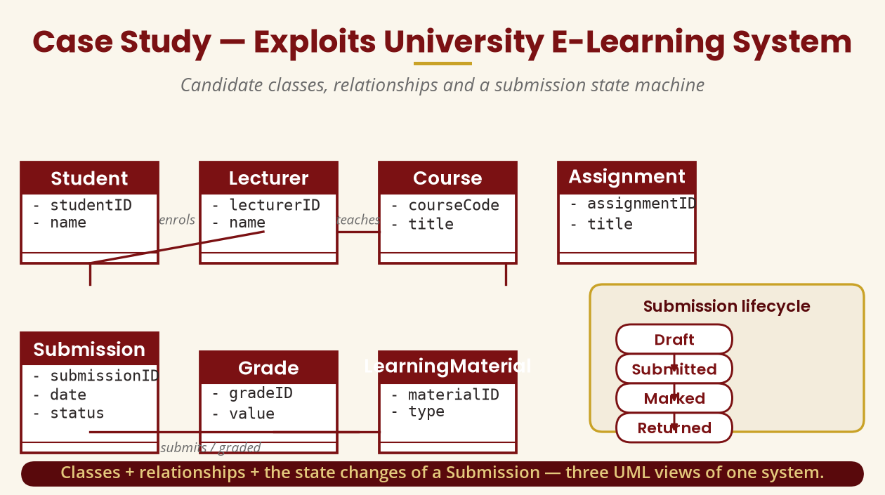
Case Study — University E-Learning System
Classes, relationships and the Submission lifecycle
Student · Lecturer · Course · Assignment · Submission · Grade · LearningMaterial.
BICT 3202 · Object-Oriented Analysis and Design
Week 4 · Slide 25

Slide 27
Week 4 Summary
The essentials
▪ Building blocks — things, relationships, diagrams.
▪ Things — structural, behavioural, grouping, annotational.
▪ Relationships — association, dependency, generalization, realization.
▪ Rules — syntax, semantics, well-formedness.
▪ Mechanisms — specifications, adornments, divisions, extensibility.
▪ Architecture — M3 → M2 → M1 → M0.
UML is a language: learn its vocabulary, rules and organisation — then use it.
BICT 3202 · Object-Oriented Analysis and Design
Week 4 · Slide 26

Slide 28
REVISION & NEXT STEPS
▪ Study the building blocks and relationship notations — draw each one from memory.
▪ Practice the seven-question checklist on every diagram you create.
▪ Model the university e-learning system: classes, relationships, multiplicity, constraints.
▪ Next week: the object-oriented analysis process — applying everything from Weeks 1–4.
Thank you — Francis Fweta · ICT Lecturer · Exploits University

