Slide 1

EXPLOITS UNIVERSITY
BSc INFORMATION COMMUNICATION AND TECHNOLOGY
BICT 3202 · OBJECT-ORIENTED ANALYSIS AND DESIGN
WEEK 5
Object-Oriented Analysis — Object Modelling I
Francis Fweta · ICT Lecturer · Week 5 of 16

Slide 2
Learning Outcomes
By the end of this week, you should be able to…
▪ Explain object-oriented analysis.
▪ Distinguish object vs class, and link vs association.
▪ Identify candidate objects/classes and filter irrelevant nouns.
▪ Identify attributes and operations/responsibilities.
▪ Draw a UML class and object diagram with correct notation.
▪ Apply association names, roles and multiplicity.
▪ Explain generalization and specialization, and draw them.
▪ Use a CASE tool to build a basic class diagram — and evaluate it.
Week 5 is where we start doing real Object-Oriented Analysis.
BICT 3202 · Object-Oriented Analysis and Design
Week 5 · Slide 1

Slide 3
The Transition
From knowing UML to doing analysis
▪ Weeks 1–4 built the foundation: needs, OO principles, UML, UML mechanics.
▪ Now: “Given a real-world problem, I can identify objects/classes and their relationships.”
▪ Week 5 — Object Modelling I: object/class · notation · links & association · generalization/specialization · CASE tool.
▪ Week 6 — Object Modelling II: aggregation · inheritance · polymorphism · grouping.
Analysis first — identify and represent the objects before anything else.
BICT 3202 · Object-Oriented Analysis and Design
Week 5 · Slide 2

Slide 4
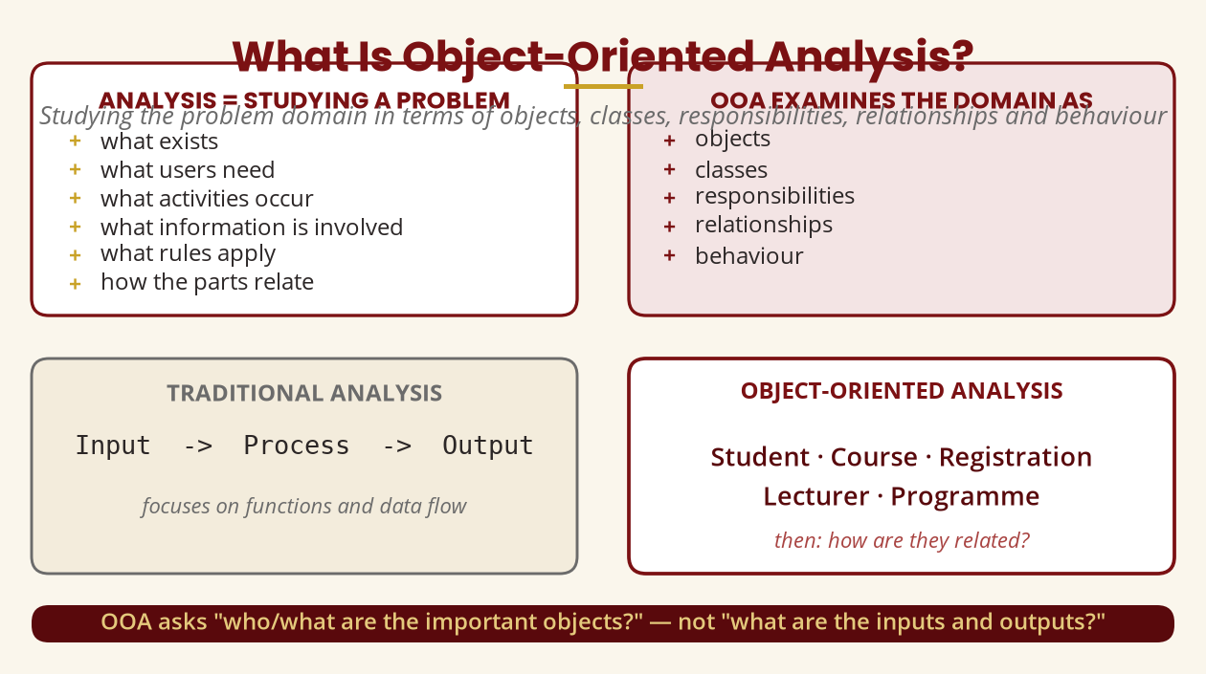
What Is Object-Oriented Analysis?
Studying the problem domain
OOA examines the domain as objects, classes, responsibilities, relationships and behaviour.
BICT 3202 · Object-Oriented Analysis and Design
Week 5 · Slide 3

Slide 5
The Key Question
“What important things exist in this problem domain?”
▪ Banking: Customer · Account · Transaction · Bank · Loan · Card
▪ Hospital: Patient · Doctor · Nurse · Appointment · Prescription · MedicalRecord
▪ Online university: Student · Lecturer · Course · Assignment · Submission · Grade
▪
▪ These become candidate classes — but not every noun is a class.
Identify the important objects first, then ask how they are related.
BICT 3202 · Object-Oriented Analysis and Design
Week 5 · Slide 4

Slide 6
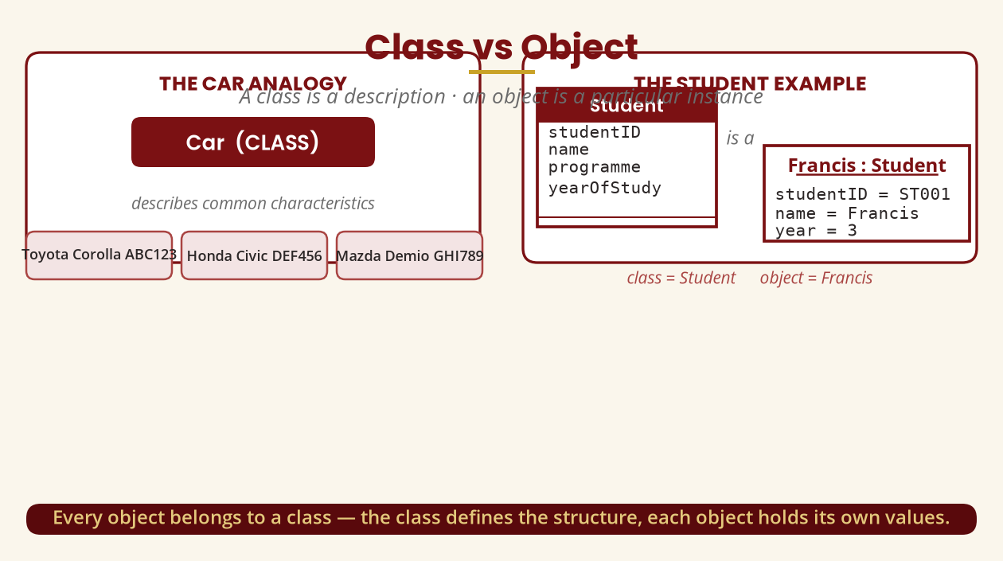
Class vs Object
Description vs particular instance
Car = class · Toyota Corolla ABC123 = object · Student = class · Francis : Student = object
BICT 3202 · Object-Oriented Analysis and Design
Week 5 · Slide 5

Slide 7
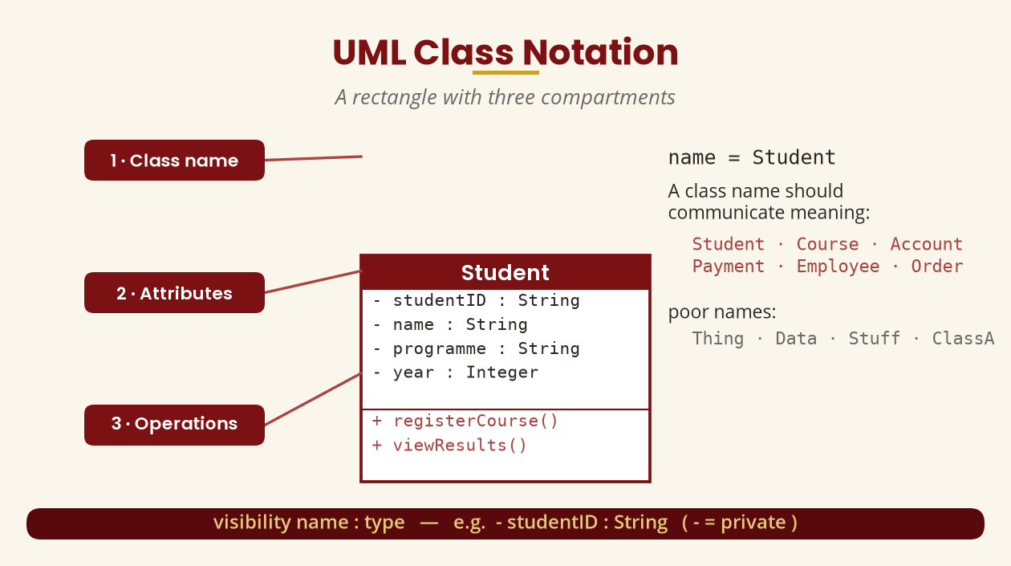
UML Class Notation
Three compartments: name · attributes · operations
visibility name : type — e.g. - studentID : String
BICT 3202 · Object-Oriented Analysis and Design
Week 5 · Slide 6

Slide 8
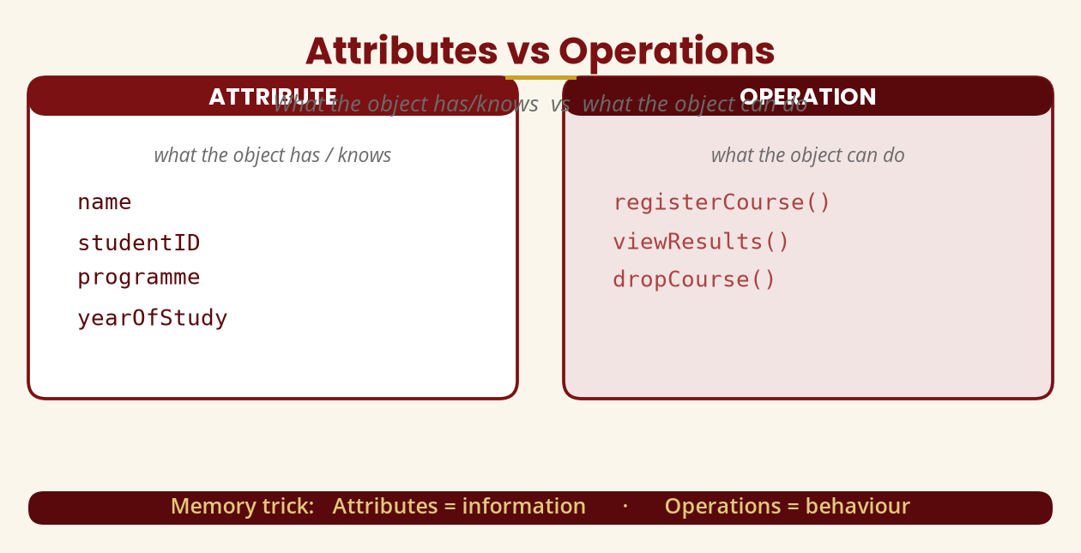
Attributes vs Operations
Information vs behaviour
Memory trick: attributes = information · operations = behaviour
BICT 3202 · Object-Oriented Analysis and Design
Week 5 · Slide 7

Slide 9
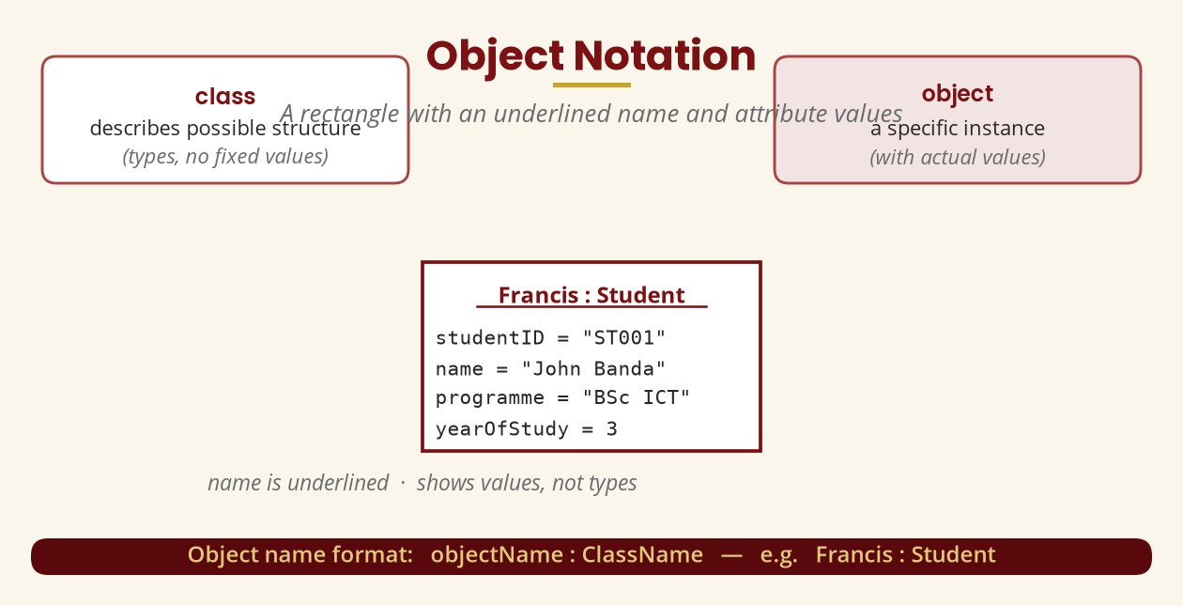
Object Notation
Underlined name + attribute values
A class describes structure; an object shows a specific instance and its values.
BICT 3202 · Object-Oriented Analysis and Design
Week 5 · Slide 8

Slide 10
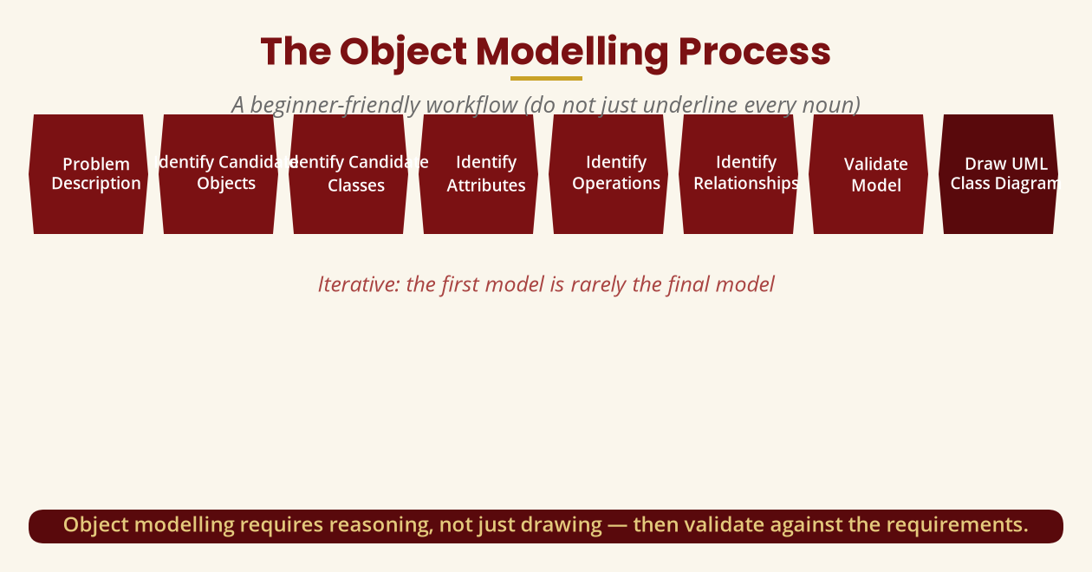
The Object Modelling Process
A beginner-friendly workflow
Do not just underline every noun — validate each step against the requirements.
BICT 3202 · Object-Oriented Analysis and Design
Week 5 · Slide 9

Slide 11
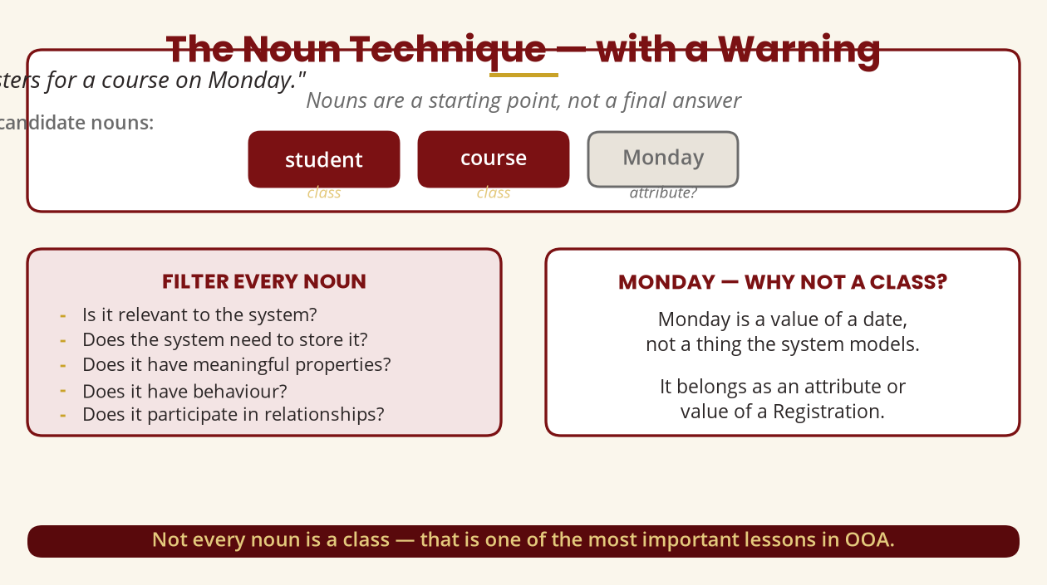
Identifying Candidate Classes
The noun technique — with a warning
“Monday” is a value of a date, not a class the system models.
BICT 3202 · Object-Oriented Analysis and Design
Week 5 · Slide 10

Slide 12
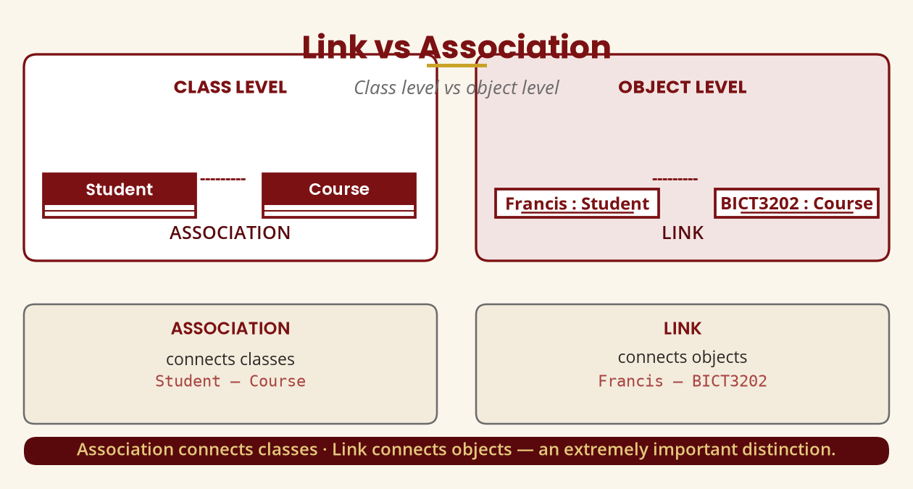
Links and Associations
Class level vs object level
Association connects classes · Link connects objects — a key distinction.
BICT 3202 · Object-Oriented Analysis and Design
Week 5 · Slide 11

Slide 13
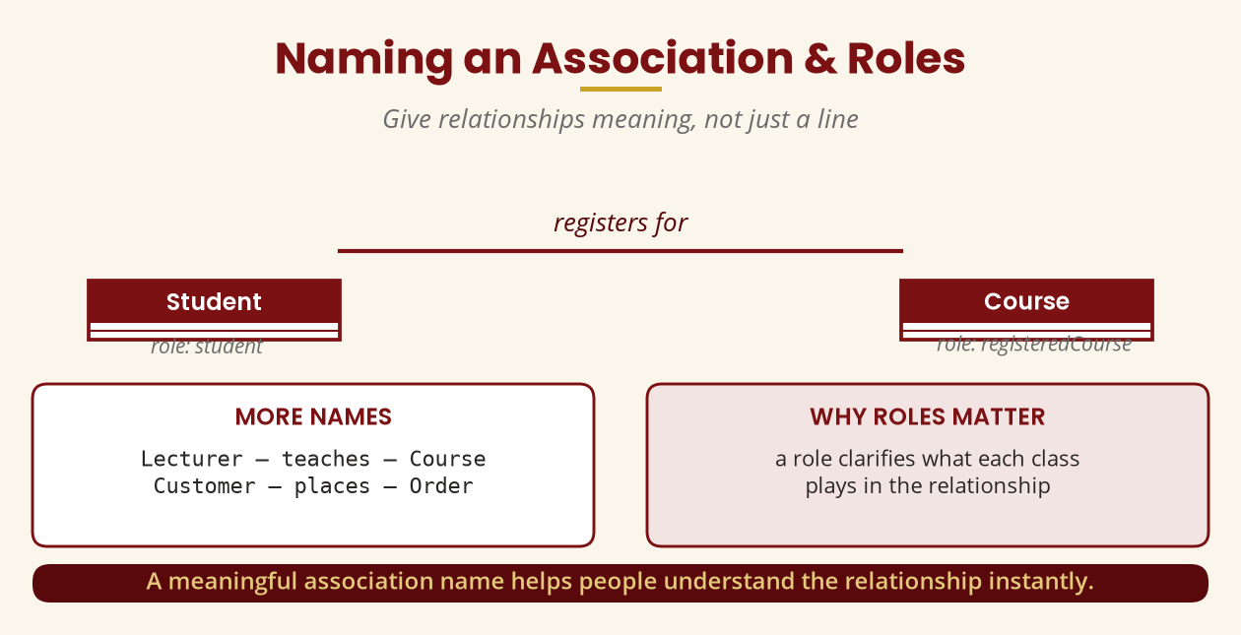
Naming an Association & Roles
Give relationships meaning
Student — registers for — Course · roles: student / registeredCourse
BICT 3202 · Object-Oriented Analysis and Design
Week 5 · Slide 12

Slide 14
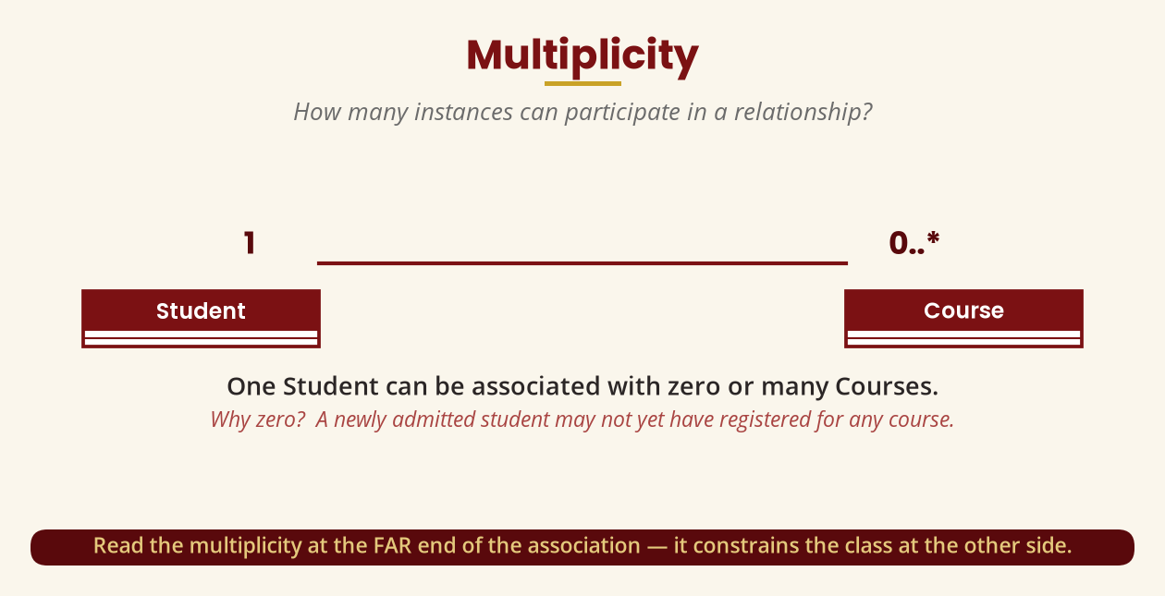
Multiplicity
How many instances can participate?
Student 1 — 0..* Course: one student, zero or many courses.
BICT 3202 · Object-Oriented Analysis and Design
Week 5 · Slide 13

Slide 15
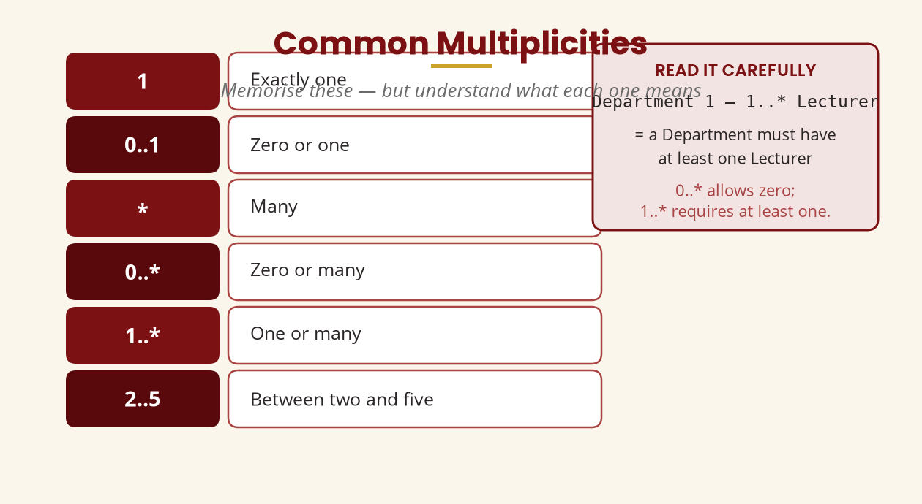
Common Multiplicities
1 · 0..1 · * · 0..* · 1..* · 2..5
0..* allows zero · 1..* requires at least one.
BICT 3202 · Object-Oriented Analysis and Design
Week 5 · Slide 14

Slide 16
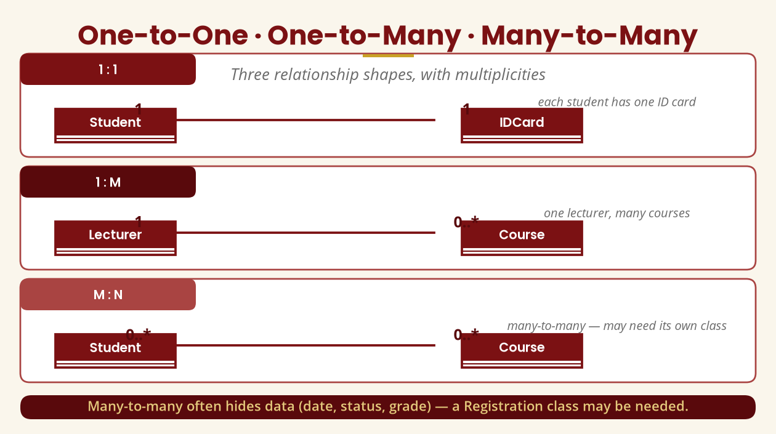
One-to-One · One-to-Many · Many-to-Many
Three relationship shapes
Many-to-many often hides data (date, status, grade) — a Registration class may be needed.
BICT 3202 · Object-Oriented Analysis and Design
Week 5 · Slide 15

Slide 17
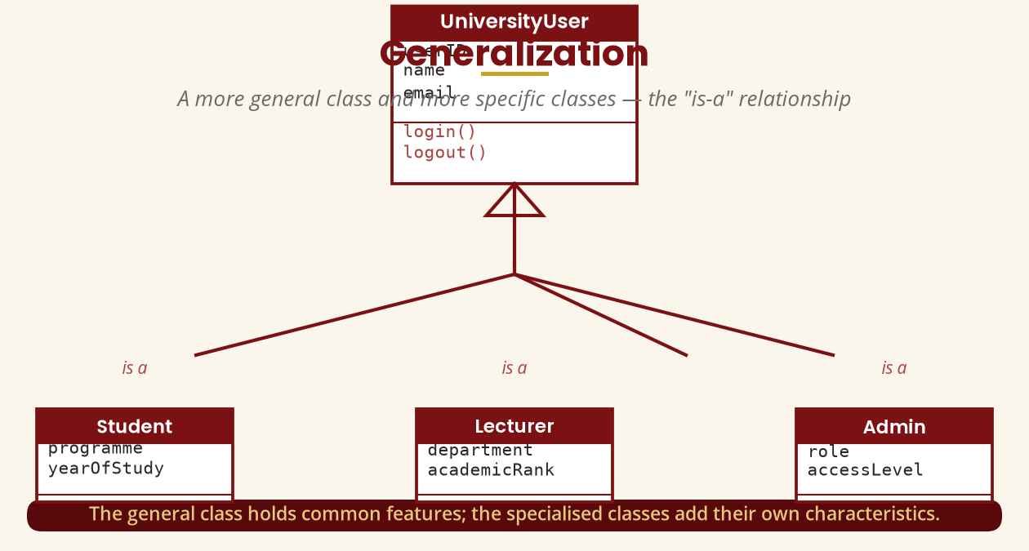
Generalization
The “is-a” relationship
A Student is a User — the general class holds the shared features.
BICT 3202 · Object-Oriented Analysis and Design
Week 5 · Slide 16

Slide 18
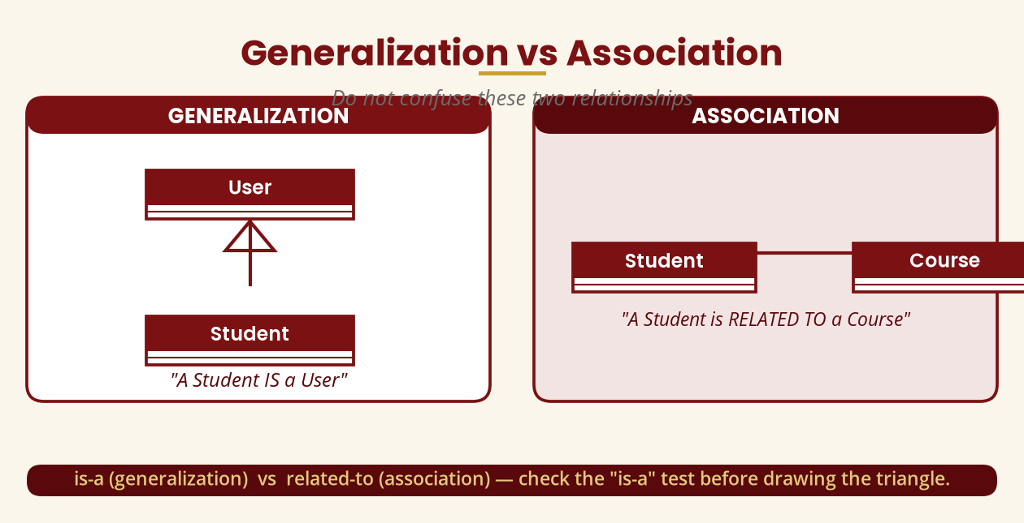
Generalization vs Association
Do not confuse them
is-a (generalization) vs related-to (association) — check the is-a test first.
BICT 3202 · Object-Oriented Analysis and Design
Week 5 · Slide 17

Slide 19
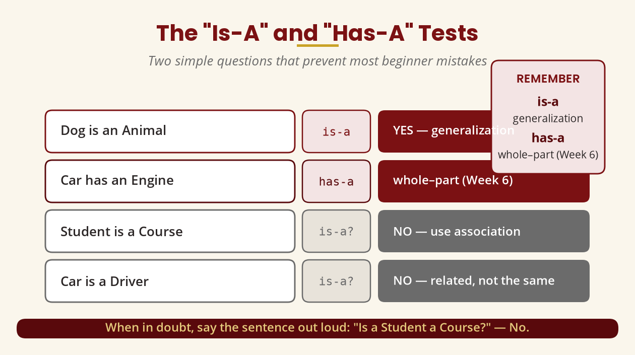
The “Is-A” and “Has-A” Tests
Two questions that prevent most mistakes
“Is a Student a Course?” No — use an association, not generalization.
BICT 3202 · Object-Oriented Analysis and Design
Week 5 · Slide 18

Slide 20
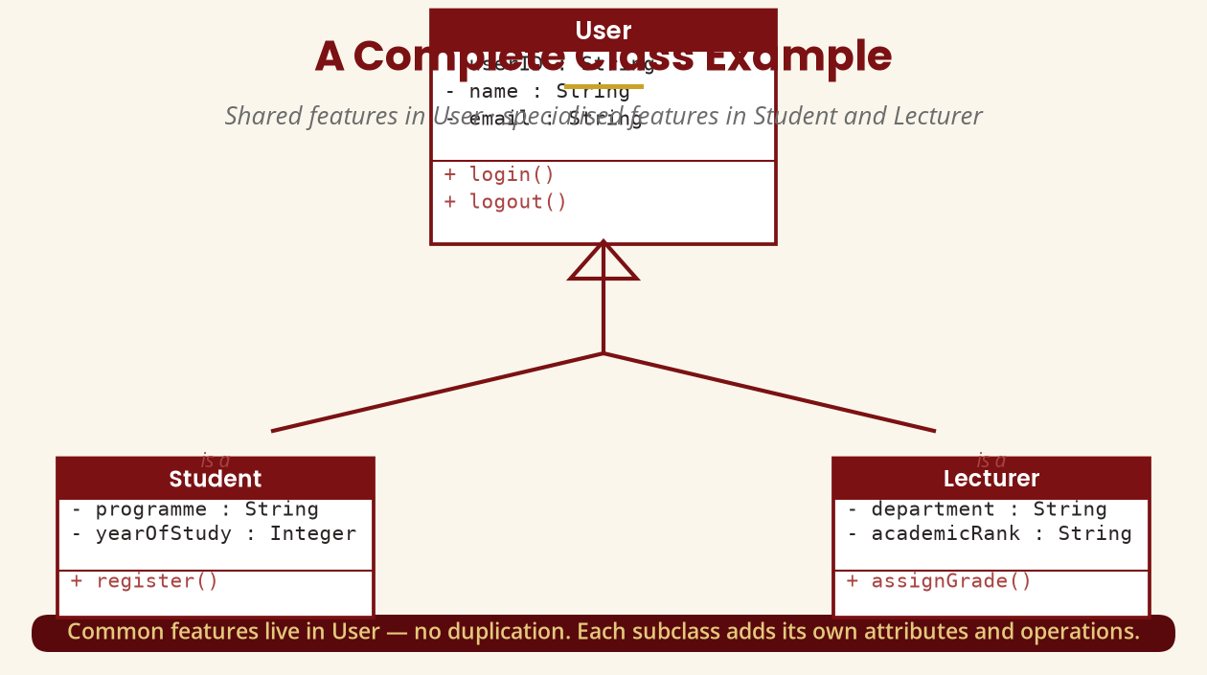
A Complete Class Example
User · Student · Lecturer
Common features live in User; each subclass adds its own attributes and operations.
BICT 3202 · Object-Oriented Analysis and Design
Week 5 · Slide 19

Slide 21
Specialization & Vocabulary
Opposite perspectives, same structure
▪ Generalization — bottom-up: “Car is generalized into Vehicle.”
▪ Specialization — top-down: “Vehicle is specialized into Car.”
▪ Superclass / parent / generalized class = the general class (User).
▪ Subclass / child / derived class = the specialized class (Student).
Same diagram, two viewpoints — know the vocabulary for the exam.
BICT 3202 · Object-Oriented Analysis and Design
Week 5 · Slide 20

Slide 22
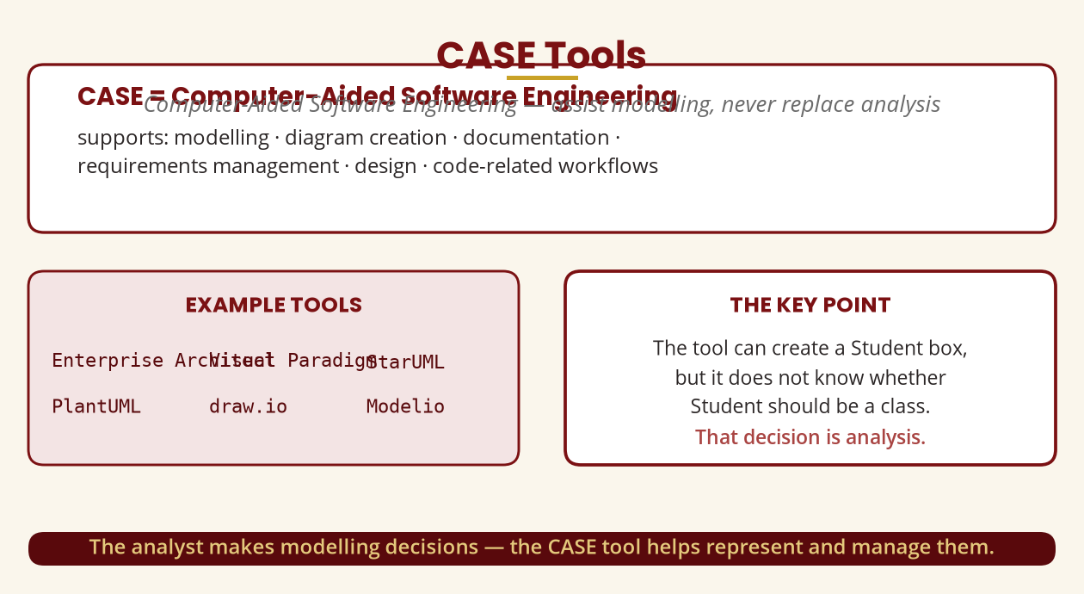
CASE Tools
Computer-Aided Software Engineering
The analyst decides; the tool represents and manages — it does not think for you.
BICT 3202 · Object-Oriented Analysis and Design
Week 5 · Slide 21

Slide 23
Practical Lab — Your First Class Diagram
Student · Course · Lecturer · Registration
▪ Create the four classes with attributes and operations.
▪ Add associations: Student — makes — Registration · Registration — is for — Course · Lecturer — teaches — Course.
▪ Add multiplicities: Student 1 — 0..* Registration · Course 1 — 0..* Registration · Lecturer 1 — 0..* Course.
▪ Add generalization: User ▷ Student · User ▷ Lecturer, then move shared attributes up.
Document your assumptions — multiplicity depends on the real requirements.
BICT 3202 · Object-Oriented Analysis and Design
Week 5 · Slide 22

Slide 24
Validating a Class Diagram
Review before you submit
▪ Purpose — does every class earn its place?
▪ Placement — does every attribute belong to the right class?
▪ Meaningful operations — no random methods to fill the box.
▪ Correct relationships — and multiplicities supported by requirements.
▪ Genuine is-a — is each generalization a real is-a relationship?
▪ Readable — can someone else understand it?
A diagram is a communication tool — review it the way an examiner would.
BICT 3202 · Object-Oriented Analysis and Design
Week 5 · Slide 23

Slide 25
Common Student Mistakes
Avoid these five
▪ Confusing class and object — “John is the Student class” is wrong.
▪ Generalization everywhere — Student ▷ Course is wrong; a student is not a course.
▪ Forgetting multiplicities — requirements need to know “how many?”
▪ Every noun a class — filter, don't just underline.
▪ Random operations — eat(), sleep(), walk() are not system responsibilities.
Analysis level: model registerCourse() — leave public void syntax for design.
BICT 3202 · Object-Oriented Analysis and Design
Week 5 · Slide 24

Slide 26
Week 5 Summary
The essentials
▪ OOA — study the domain as objects, classes, responsibilities, relationships, behaviour.
▪ Class / Object — description vs particular instance.
▪ Attributes / Operations — information vs behaviour.
▪ Link / Association — object-level vs class-level connection.
▪ Multiplicity — how many instances participate.
▪ Generalization / Specialization — is-a, general-to-specific.
▪ CASE tool — assists modelling, never replaces analysis.
OOA is understanding the domain, not just drawing boxes.
BICT 3202 · Object-Oriented Analysis and Design
Week 5 · Slide 25

Slide 27
REVISION & NEXT STEPS
▪ Practise the noun technique, then apply the is-a / has-a tests to every candidate class.
▪ Draw the hospital and library models with attributes, operations, associations and multiplicities.
▪ Use your CASE tool to build the registration model from the practical lab.
▪ Next week: Object Modelling II — aggregation, inheritance, polymorphism and grouping.
Thank you — Francis Fweta · ICT Lecturer · Exploits University

