Slide 1

EXPLOITS UNIVERSITY
BSc INFORMATION COMMUNICATION AND TECHNOLOGY
BICT 3202 · OBJECT-ORIENTED ANALYSIS AND DESIGN
WEEK 6
Object-Oriented Analysis — Object Modelling II
Francis Fweta · ICT Lecturer · Week 6 of 16

Slide 2
Learning Outcomes
By the end of this week, you should be able to…
▪ Define aggregation and explain whole-part relationships.
▪ Distinguish ordinary association, aggregation and composition.
▪ Explain inheritance and its link to UML generalization.
▪ Distinguish is-a (inheritance) from has-a (aggregation).
▪ Explain polymorphism and method overriding with examples.
▪ Explain why polymorphism supports extensibility.
▪ Group related classes into packages.
▪ Evaluate whether aggregation, inheritance or polymorphism fits a problem.
Week 6 makes the object model reusable, extensible and organised.
BICT 3202 · Object-Oriented Analysis and Design
Week 6 · Slide 1

Slide 3
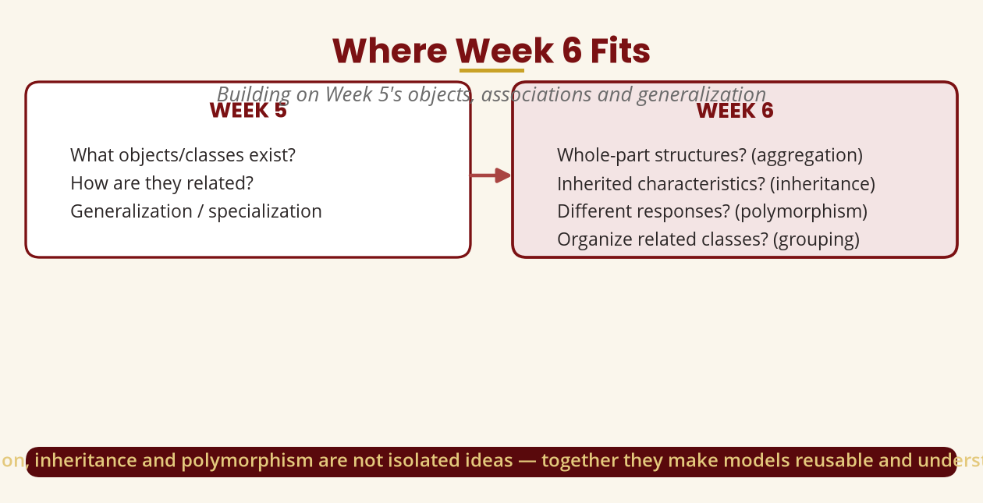
Where Week 6 Fits
Building on Week 5
Week 5 = what exists & how related · Week 6 = whole-part, inheritance, polymorphism, grouping.
BICT 3202 · Object-Oriented Analysis and Design
Week 6 · Slide 2

Slide 4
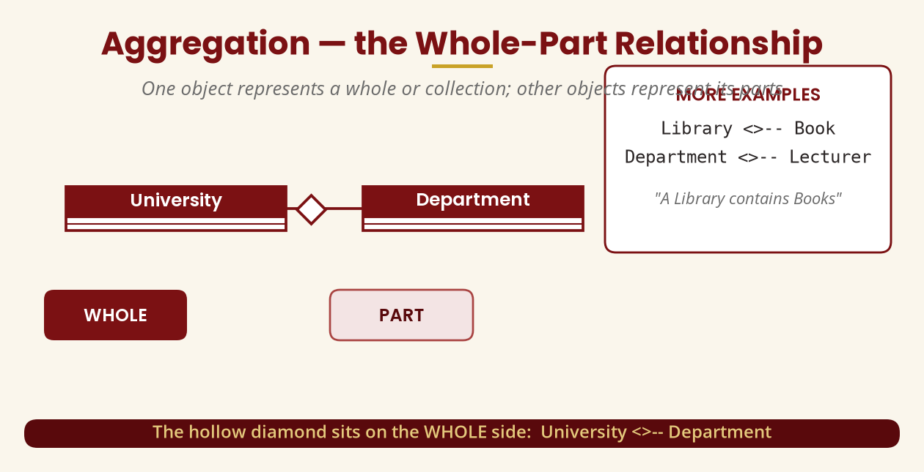
Aggregation — Whole-Part
One object represents a whole; others are its parts
University <>-- Department · Library <>-- Book · the hollow diamond sits on the whole.
BICT 3202 · Object-Oriented Analysis and Design
Week 6 · Slide 3

Slide 5
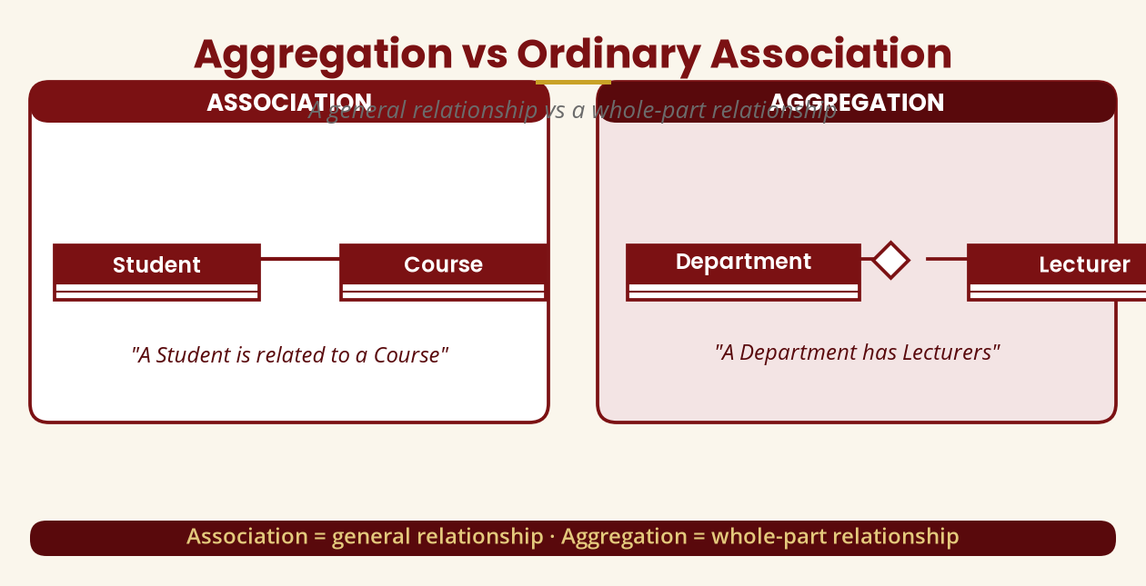
Aggregation vs Association
A general relationship vs whole-part
Association = related-to · Aggregation = has/contains (whole-part).
BICT 3202 · Object-Oriented Analysis and Design
Week 6 · Slide 4

Slide 6
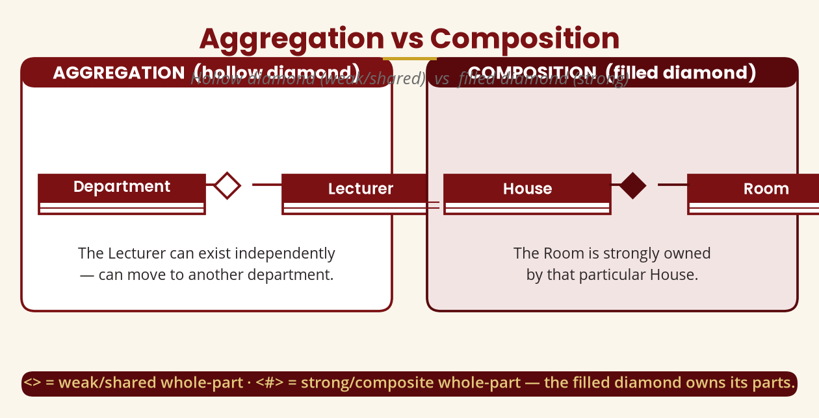
Aggregation vs Composition
Hollow diamond vs filled diamond
Hollow = parts can exist independently · Filled = the composite owns its parts.
BICT 3202 · Object-Oriented Analysis and Design
Week 6 · Slide 5

Slide 7
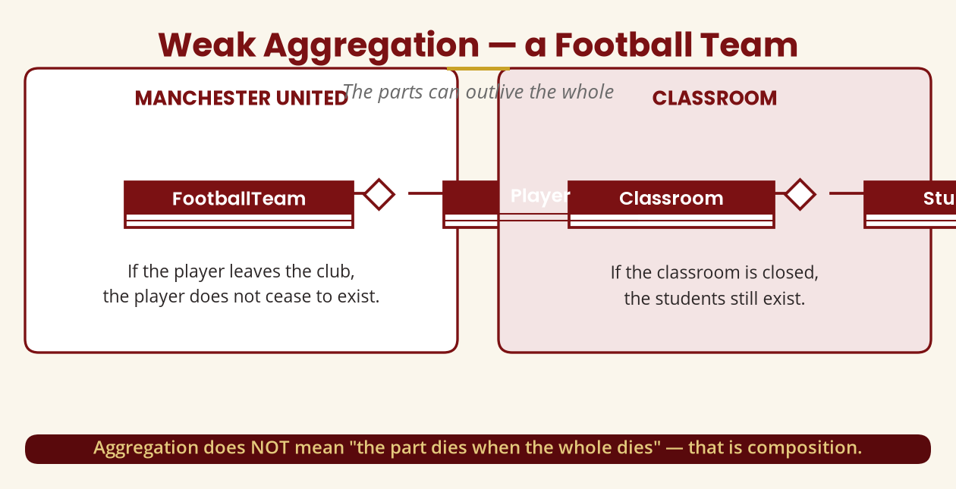
Weak Aggregation
The parts can outlive the whole
Aggregation does NOT mean “the part dies when the whole dies” — that's composition.
BICT 3202 · Object-Oriented Analysis and Design
Week 6 · Slide 6

Slide 8
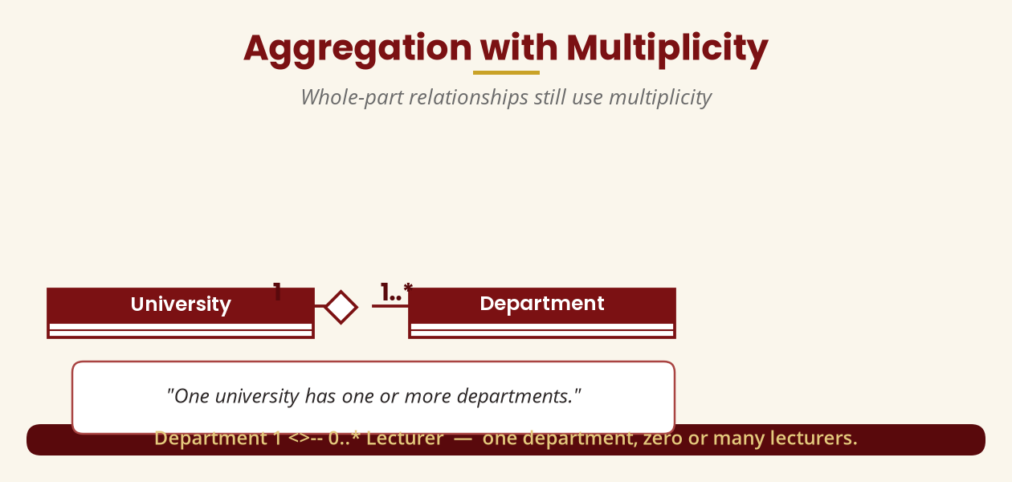
Aggregation with Multiplicity
Whole-part relationships still use multiplicity
University 1 <>-- 1..* Department · Department 1 <>-- 0..* Lecturer.
BICT 3202 · Object-Oriented Analysis and Design
Week 6 · Slide 7

Slide 9
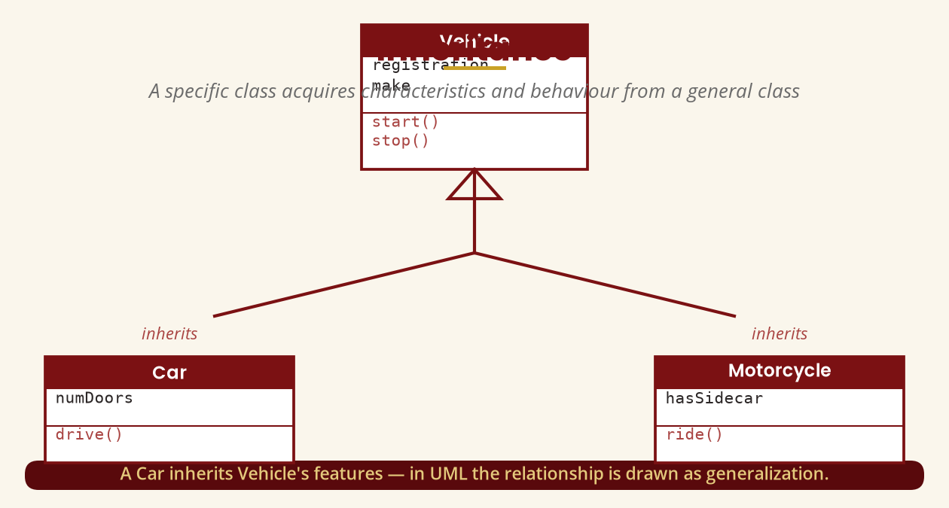
Inheritance
A specific class acquires features from a general class
A Car inherits Vehicle's features — drawn as UML generalization.
BICT 3202 · Object-Oriented Analysis and Design
Week 6 · Slide 8

Slide 10
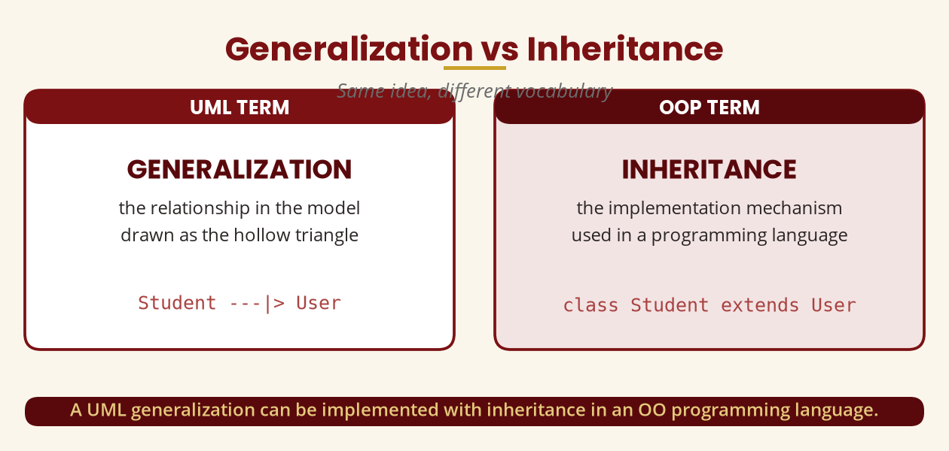
Generalization vs Inheritance
Same idea, different vocabulary
UML says generalization · OOP says inheritance — one implements the other.
BICT 3202 · Object-Oriented Analysis and Design
Week 6 · Slide 9

Slide 11
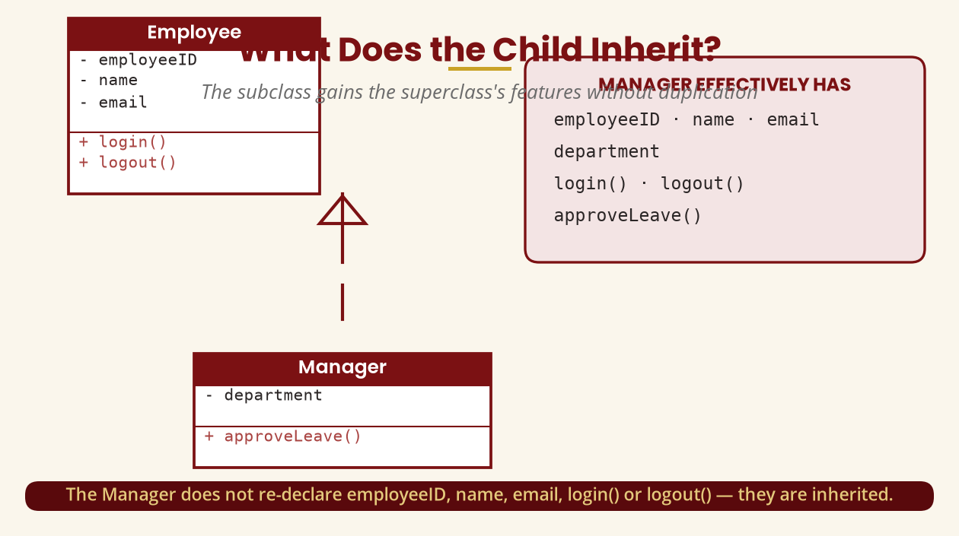
What Does the Child Inherit?
No duplication of common features
Manager gains employeeID, name, email, login(), logout() from Employee — automatically.
BICT 3202 · Object-Oriented Analysis and Design
Week 6 · Slide 10

Slide 12
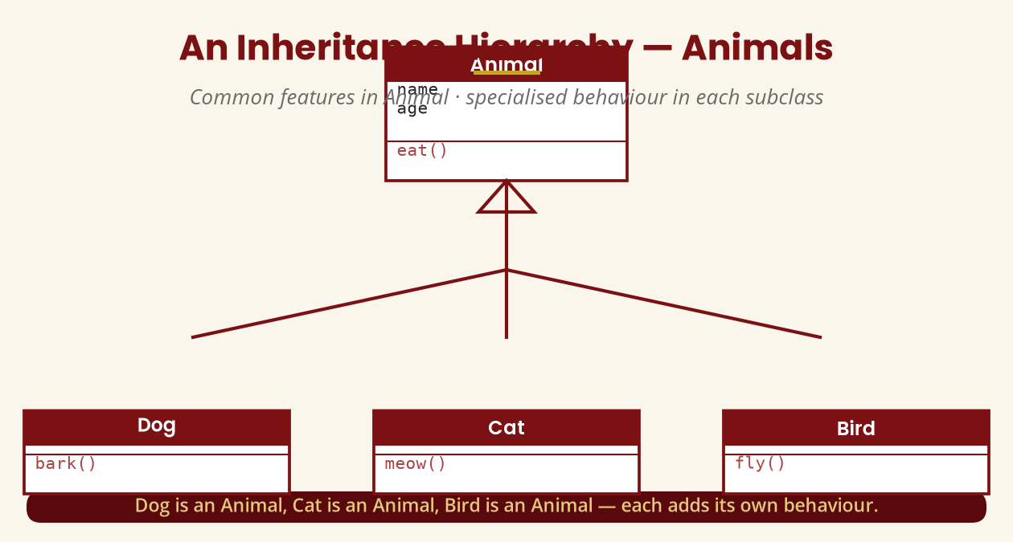
An Inheritance Hierarchy
Animal -> Dog, Cat, Bird
Each subclass adds its own behaviour — bark(), meow(), fly().
BICT 3202 · Object-Oriented Analysis and Design
Week 6 · Slide 11

Slide 13
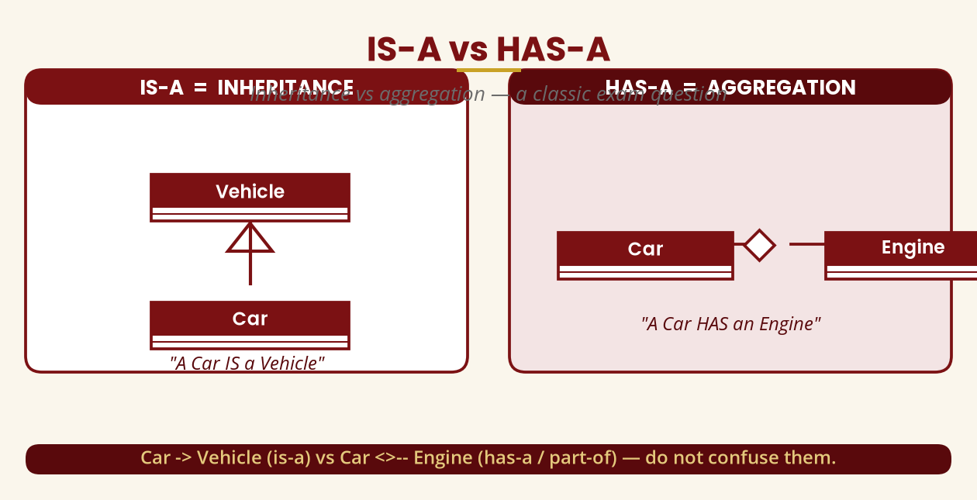
IS-A vs HAS-A
A classic exam question
Car -> Vehicle (is-a) = inheritance · Car <>-- Engine (has-a) = aggregation.
BICT 3202 · Object-Oriented Analysis and Design
Week 6 · Slide 12

Slide 14
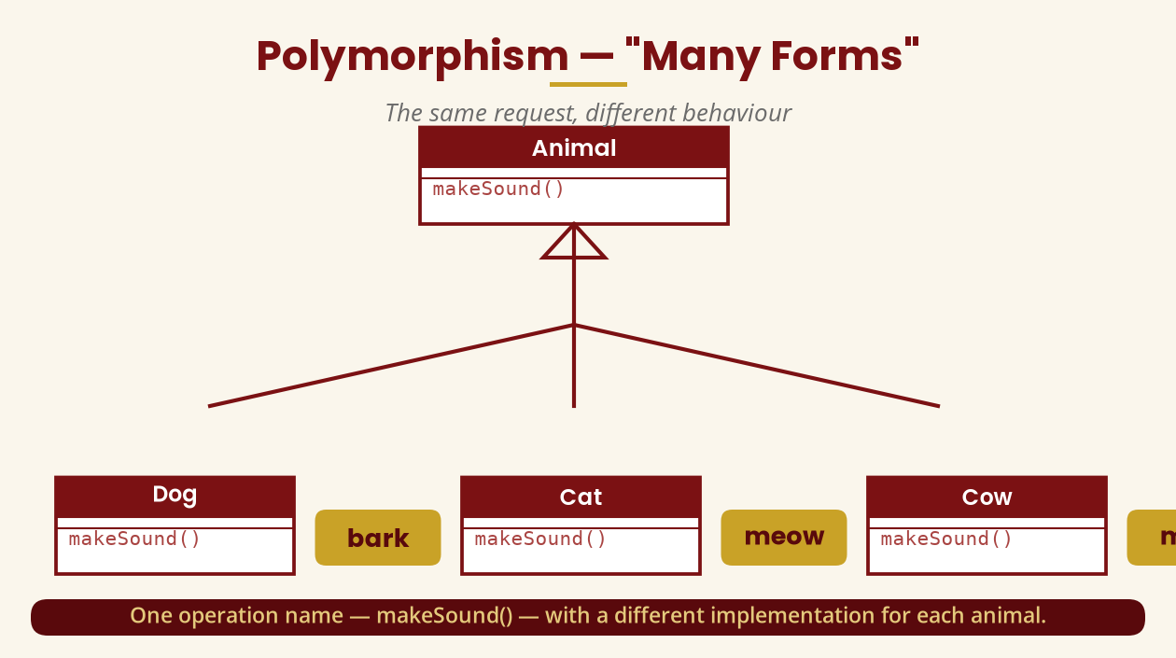
Polymorphism — “Many Forms”
The same request, different behaviour
makeSound() -> bark / meow / moo — the object decides how to respond.
BICT 3202 · Object-Oriented Analysis and Design
Week 6 · Slide 13

Slide 15
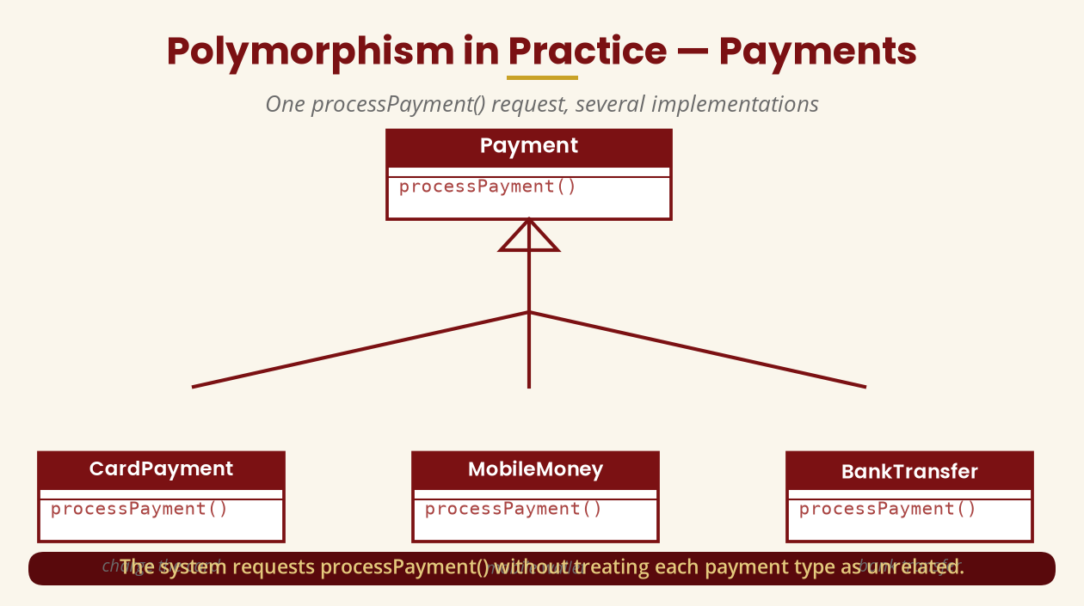
Polymorphism in Practice — Payments
One processPayment(), several implementations
The system requests processPayment() without treating each payment type as unrelated.
BICT 3202 · Object-Oriented Analysis and Design
Week 6 · Slide 14

Slide 16
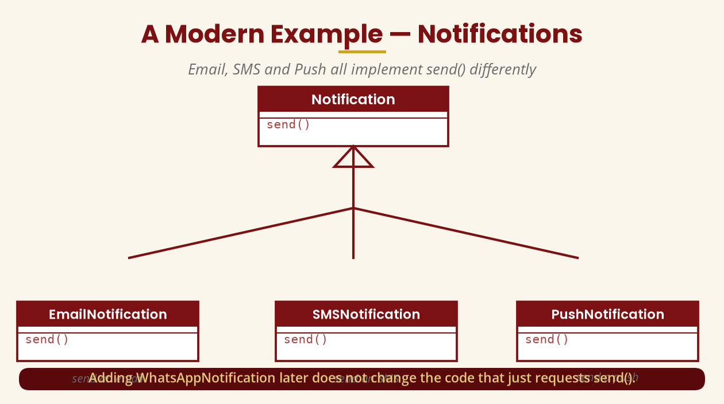
A Modern Example — Notifications
Email, SMS and Push all implement send()
Add WhatsAppNotification later — the code that requests send() stays unchanged.
BICT 3202 · Object-Oriented Analysis and Design
Week 6 · Slide 15

Slide 17
Method Overriding
The programming mechanism behind polymorphism
▪ The general class defines makeSound().
▪ Each subclass provides a specialised version that overrides the inherited operation.
▪ Java: Animal a = new Dog(); a.makeSound(); -> Bark
▪ a = new Cat(); a.makeSound(); -> Meow
▪
▪ In OOAD, model the idea first — leave programming syntax for design.
The variable is typed Animal, but the actual object decides the behaviour.
BICT 3202 · Object-Oriented Analysis and Design
Week 6 · Slide 16

Slide 18
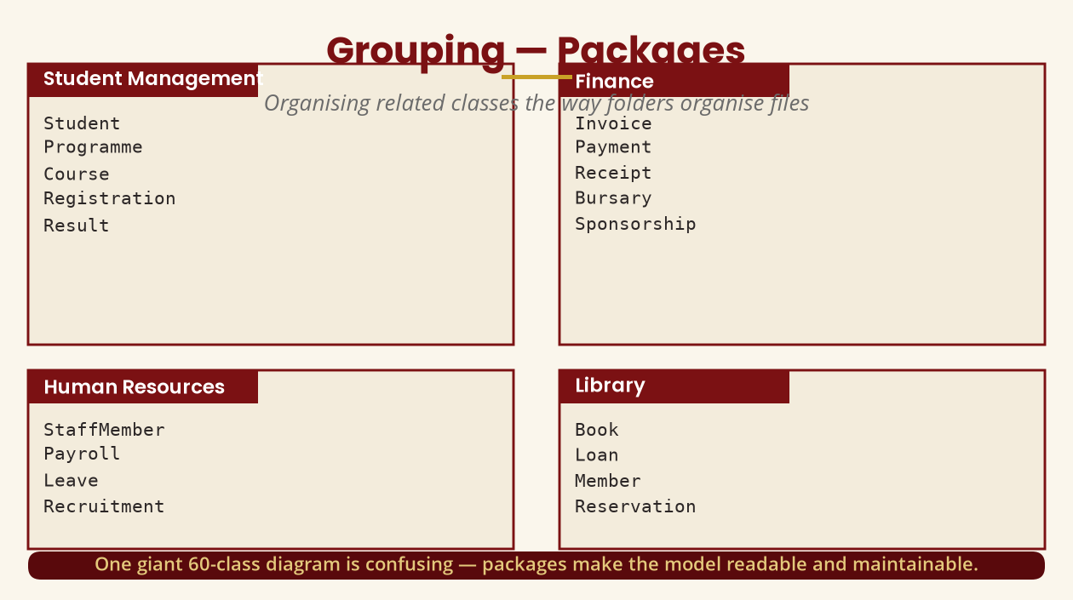
Grouping — Packages
Organise classes the way folders organise files
60 classes in one diagram is confusing — packages restore readability and modularity.
BICT 3202 · Object-Oriented Analysis and Design
Week 6 · Slide 17

Slide 19
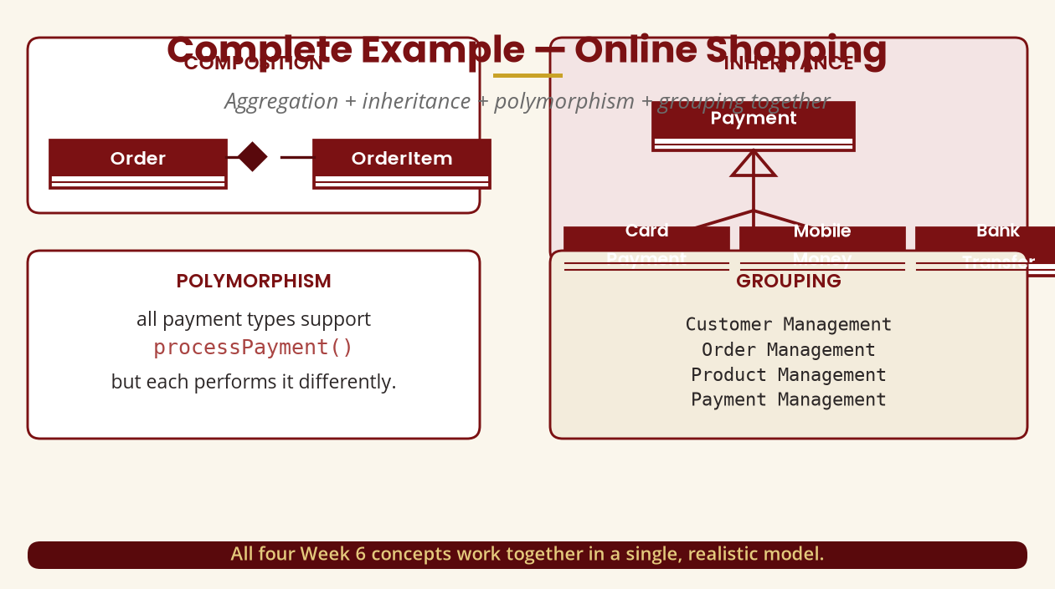
Complete Example — Online Shopping
All four concepts together
Composition (Order *-- OrderItem) + inheritance (Payment) + polymorphism + grouping.
BICT 3202 · Object-Oriented Analysis and Design
Week 6 · Slide 18

Slide 20
Complete Example — University System
Building a larger model
▪ Inheritance: User --|> Student · User --|> Lecturer.
▪ Aggregation: Department <>-- Lecturer.
▪ Association: Student — Registration — Course.
▪ Composition: Course *-- CourseMaterial (strongly owned parts).
▪ Polymorphism: Assessment.calculateMark() -> Assignment, Exam, Quiz, Project.
Choose the relationship that best represents the requirements — not every possible symbol.
BICT 3202 · Object-Oriented Analysis and Design
Week 6 · Slide 19

Slide 21
Evaluating a Model
Ask before you submit
▪ Whole-part? is the aggregation really whole-part, or just an association?
▪ Independent or owned? do the parts outlive the whole (aggregation) or not (composition)?
▪ Genuine is-a? is every generalization a real is-a relationship?
▪ Common meaning? does the polymorphic operation mean the same across subclasses?
▪ Readable? is the model organised into sensible packages?
The goal is a model that best represents the requirements — not one that uses every symbol.
BICT 3202 · Object-Oriented Analysis and Design
Week 6 · Slide 20

Slide 22
Week 6 Summary
The essentials
▪ Aggregation — whole-part, hollow diamond, parts independent.
▪ Composition — strong whole-part, filled diamond, composite owns parts.
▪ Inheritance — is-a; UML generalization implemented in code.
▪ Polymorphism — one operation name, different behaviour; supports extensibility.
▪ Grouping — packages organise related classes.
These four ideas make the object model reusable, extensible and understandable.
BICT 3202 · Object-Oriented Analysis and Design
Week 6 · Slide 21

Slide 23
REVISION & NEXT STEPS
▪ Draw Department <>-- Lecturer and Order *-- OrderLine — justify each choice.
▪ Model the Payment hierarchy with processPayment(), then add a new payment type without breaking the design.
▪ Organise the university system into packages using your CASE tool.
▪ Next week: Dynamic Modelling — events, states, operations and concurrency.
Thank you — Francis Fweta · ICT Lecturer · Exploits University

