Slide 1

EXPLOITS UNIVERSITY
BSc INFORMATION COMMUNICATION AND TECHNOLOGY
BICT 3202 · OBJECT-ORIENTED ANALYSIS AND DESIGN
WEEK 7
Object-Oriented Analysis — Dynamic Modelling
Francis Fweta · ICT Lecturer · Week 7 of 16

Slide 2
Learning Outcomes
By the end of this week, you should be able to…
▪ Define dynamic modelling and explain why behaviour must be modelled.
▪ Define events and states, and tell them apart.
▪ Explain transitions, initial/final states and guards.
▪ Explain entry, exit and do behaviour.
▪ Distinguish operations from events, and explain state change.
▪ Explain concurrency and model concurrent states.
▪ Relate structural and dynamic models.
▪ Use a CASE tool to build and inspect a state machine.
Week 7 moves from “what exists” to “what happens over time.”
BICT 3202 · Object-Oriented Analysis and Design
Week 7 · Slide 1

Slide 3
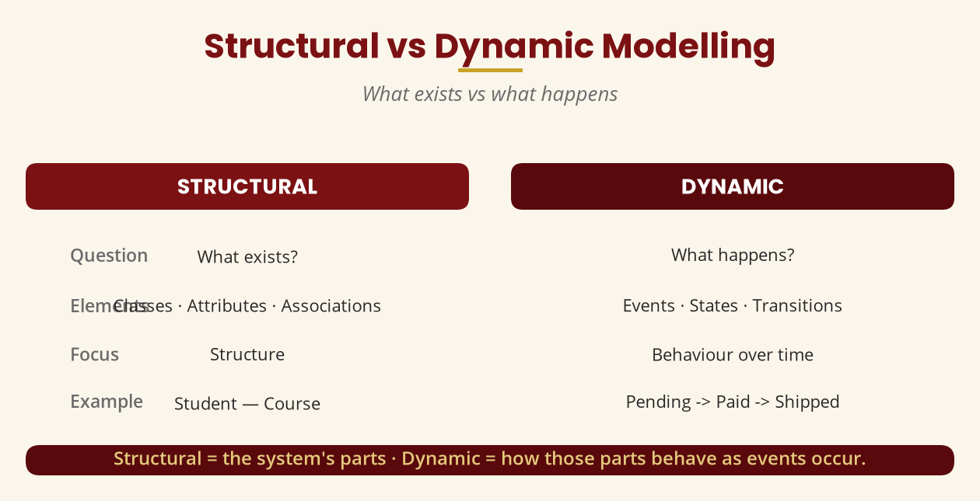
Structural vs Dynamic Modelling
What exists vs what happens
Structural = classes, attributes, associations · Dynamic = events, states, transitions.
BICT 3202 · Object-Oriented Analysis and Design
Week 7 · Slide 2

Slide 4
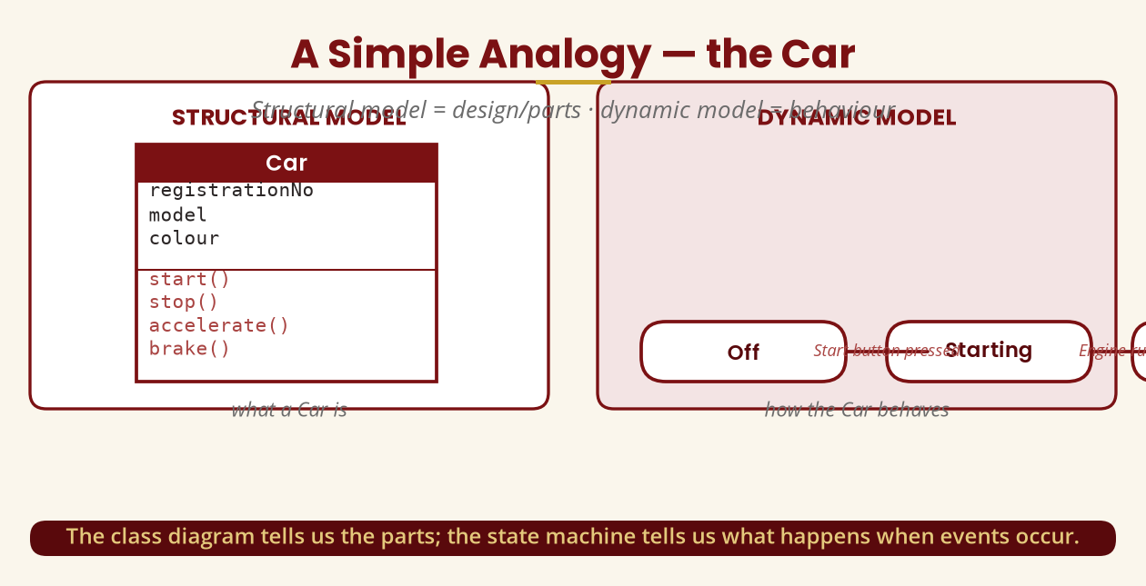
The Car Analogy
Design/parts vs behaviour
The class diagram tells us the parts; the state machine tells us what happens.
BICT 3202 · Object-Oriented Analysis and Design
Week 7 · Slide 3

Slide 5
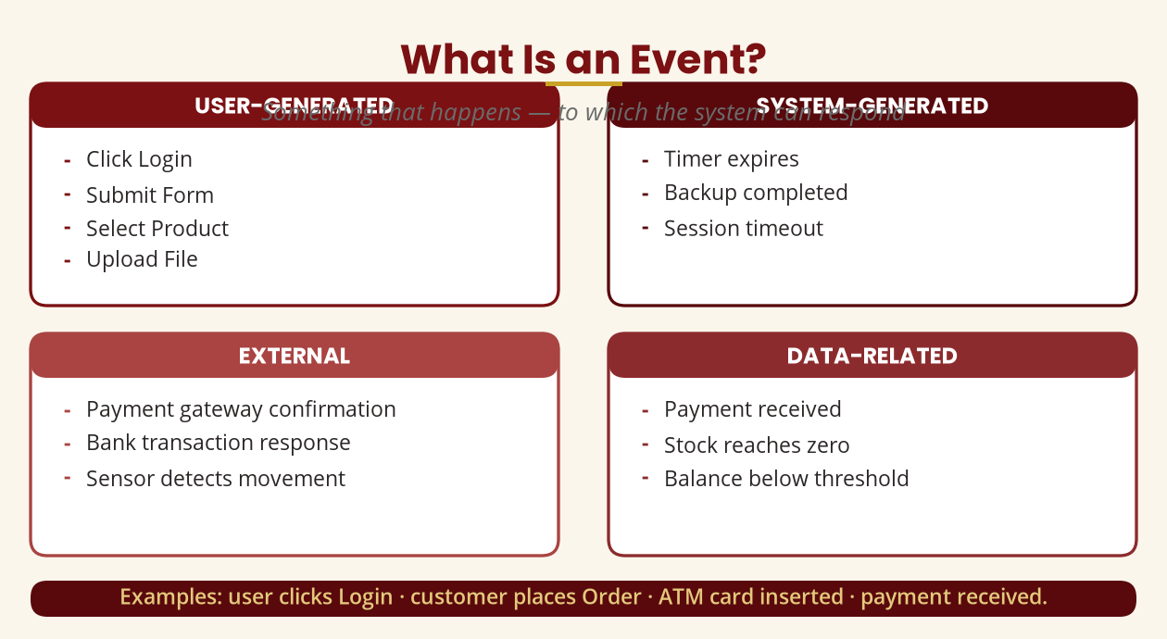
What Is an Event?
Something that happens — to which the system responds
User · system · external · data events — e.g. click Login, timer expires, payment received.
BICT 3202 · Object-Oriented Analysis and Design
Week 7 · Slide 4

Slide 6
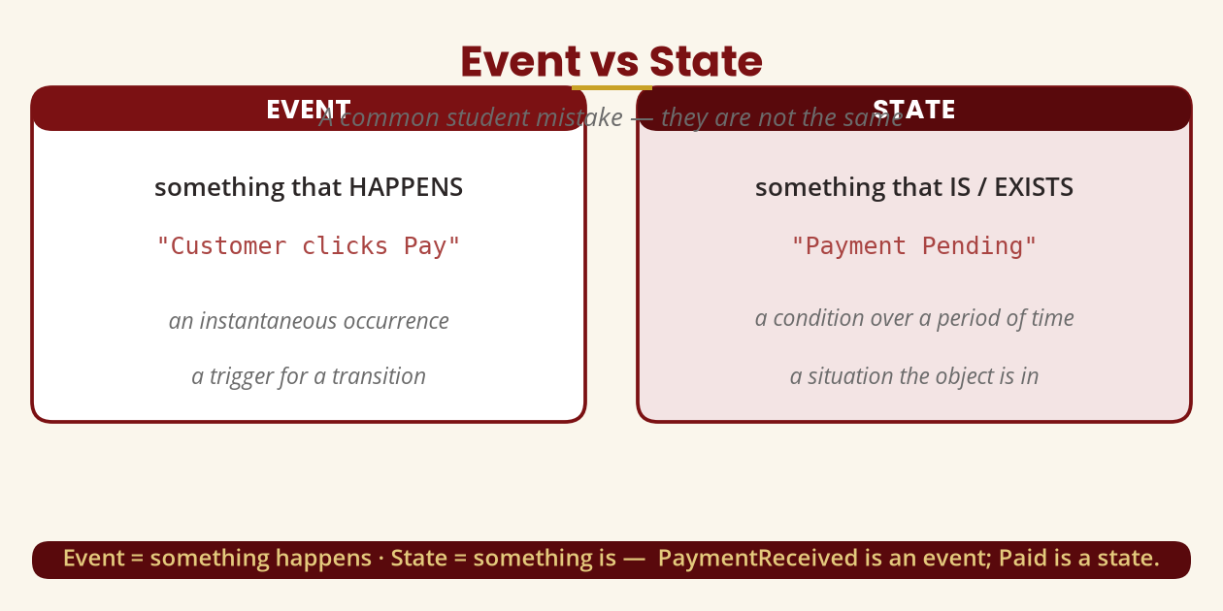
Event vs State
A common mistake
Event = something happens · State = something is. PaymentReceived ≠ Paid.
BICT 3202 · Object-Oriented Analysis and Design
Week 7 · Slide 5

Slide 7
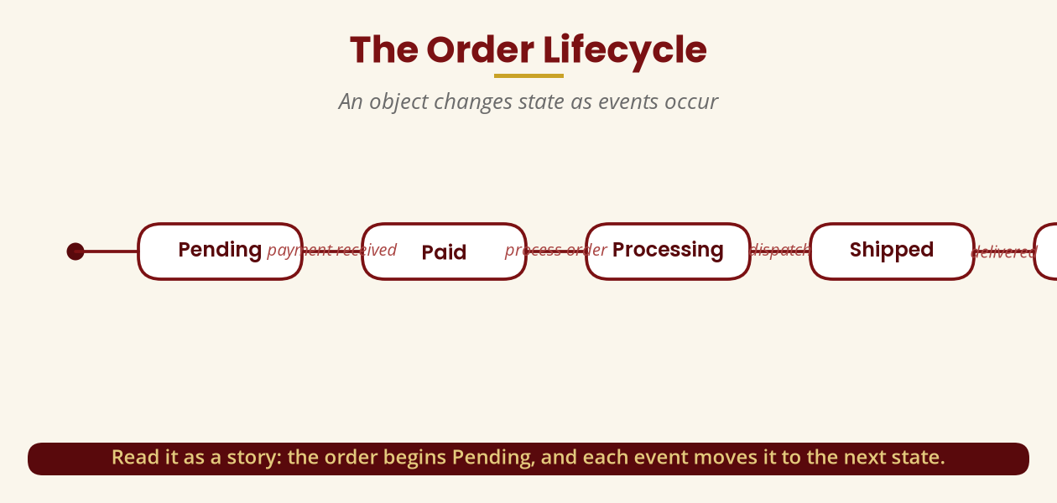
The Order Lifecycle
An object changes state as events occur
Pending -> Paid -> Processing -> Shipped -> Delivered — read it as a story.
BICT 3202 · Object-Oriented Analysis and Design
Week 7 · Slide 6

Slide 8
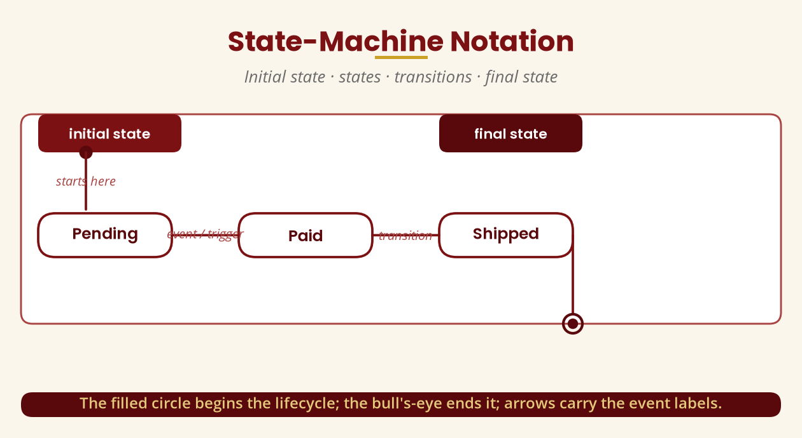
State-Machine Notation
Initial · states · transitions · final
Filled circle begins the lifecycle; the bull's-eye ends it; arrows carry events.
BICT 3202 · Object-Oriented Analysis and Design
Week 7 · Slide 7

Slide 9
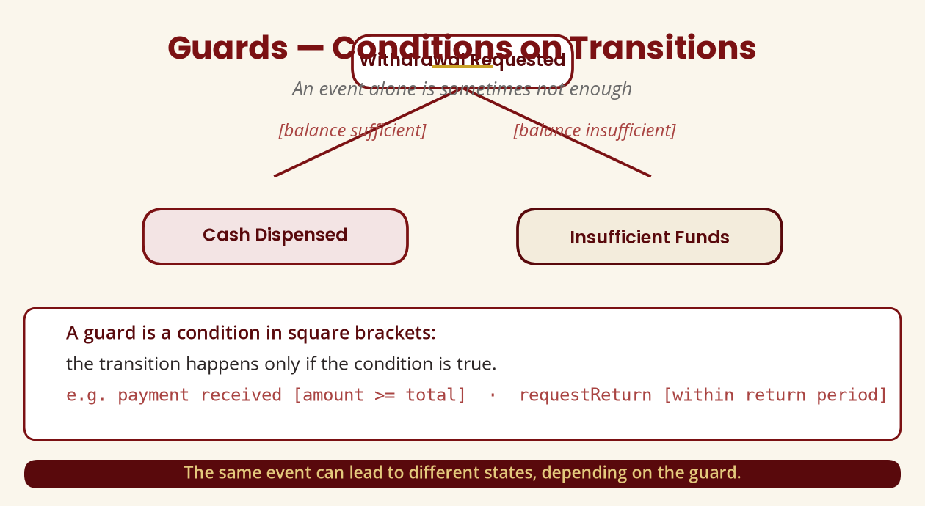
Guards
Conditions on transitions
[balance sufficient] -> Cash Dispensed · [balance insufficient] -> Insufficient Funds.
BICT 3202 · Object-Oriented Analysis and Design
Week 7 · Slide 8

Slide 10
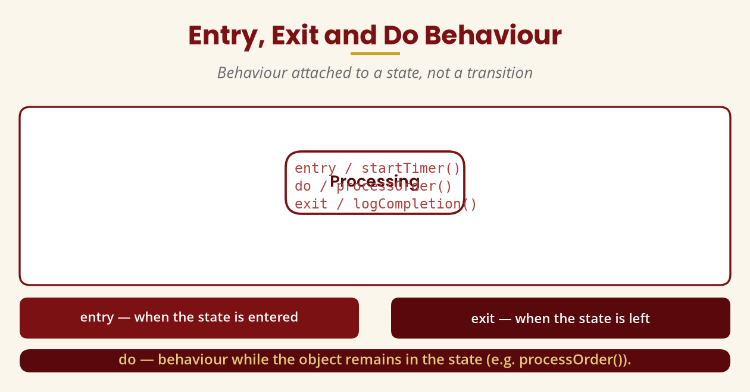
Entry, Exit and Do Behaviour
Behaviour attached to a state
entry / on arrival · exit / on leaving · do / while inside the state.
BICT 3202 · Object-Oriented Analysis and Design
Week 7 · Slide 9

Slide 11
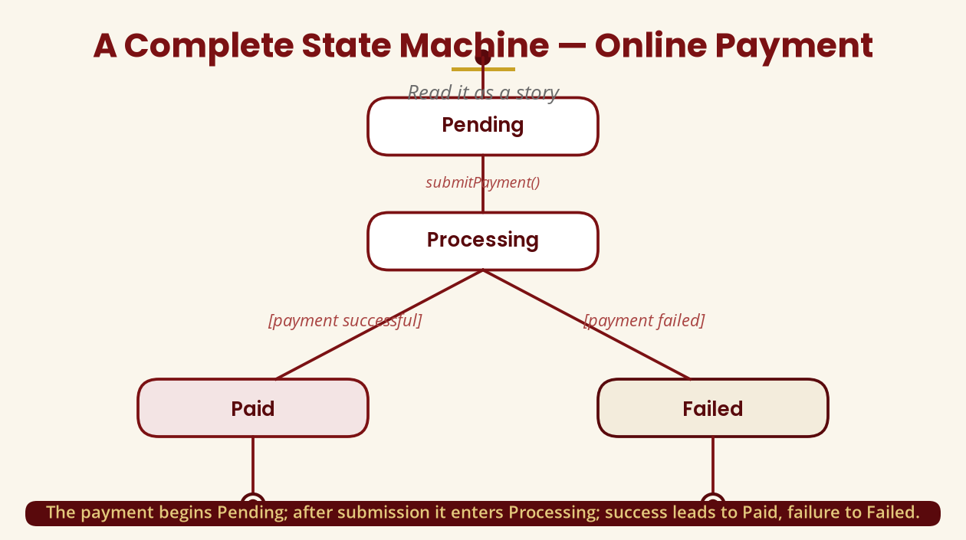
A Complete State Machine — Payment
Read it as a story
Pending -> Processing -> (success: Paid | failure: Failed).
BICT 3202 · Object-Oriented Analysis and Design
Week 7 · Slide 10

Slide 12
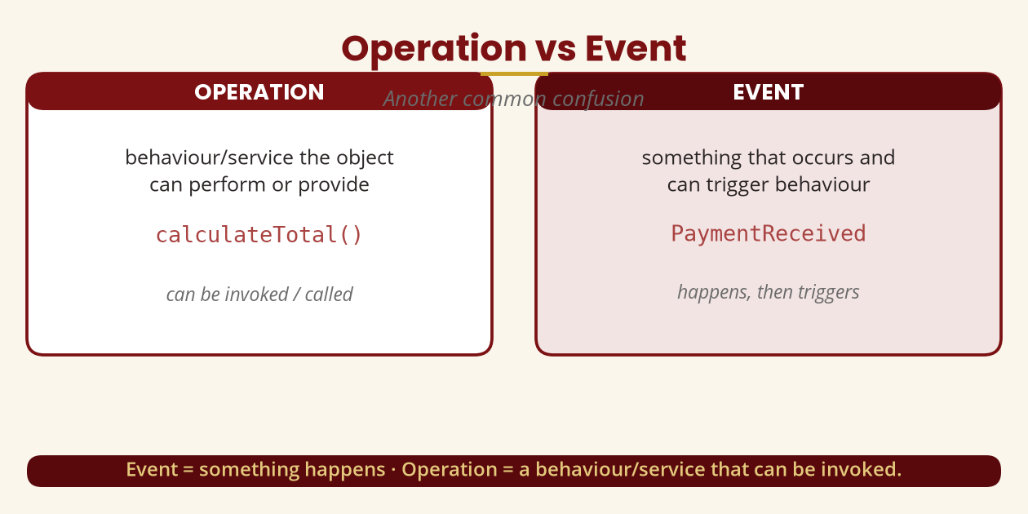
Operation vs Event
Another common confusion
Operation = can be invoked (calculateTotal()) · Event = occurs (PaymentReceived).
BICT 3202 · Object-Oriented Analysis and Design
Week 7 · Slide 11

Slide 13
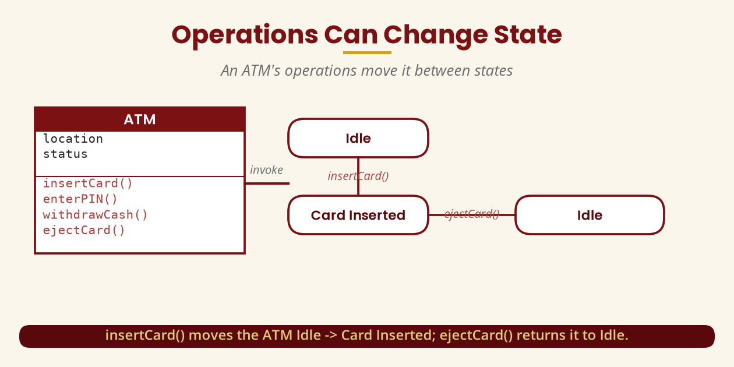
Operations Can Change State
An ATM's operations move it between states
insertCard(): Idle -> Card Inserted · ejectCard(): Card Inserted -> Idle.
BICT 3202 · Object-Oriented Analysis and Design
Week 7 · Slide 12

Slide 14
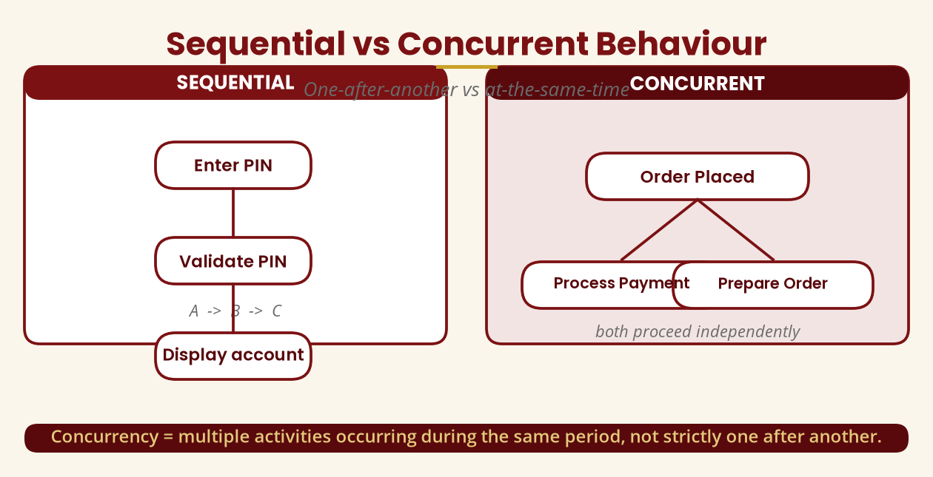
Sequential vs Concurrent
One-after-another vs at-the-same-time
After placing an order: payment, preparation and driver assignment can overlap.
BICT 3202 · Object-Oriented Analysis and Design
Week 7 · Slide 13

Slide 15
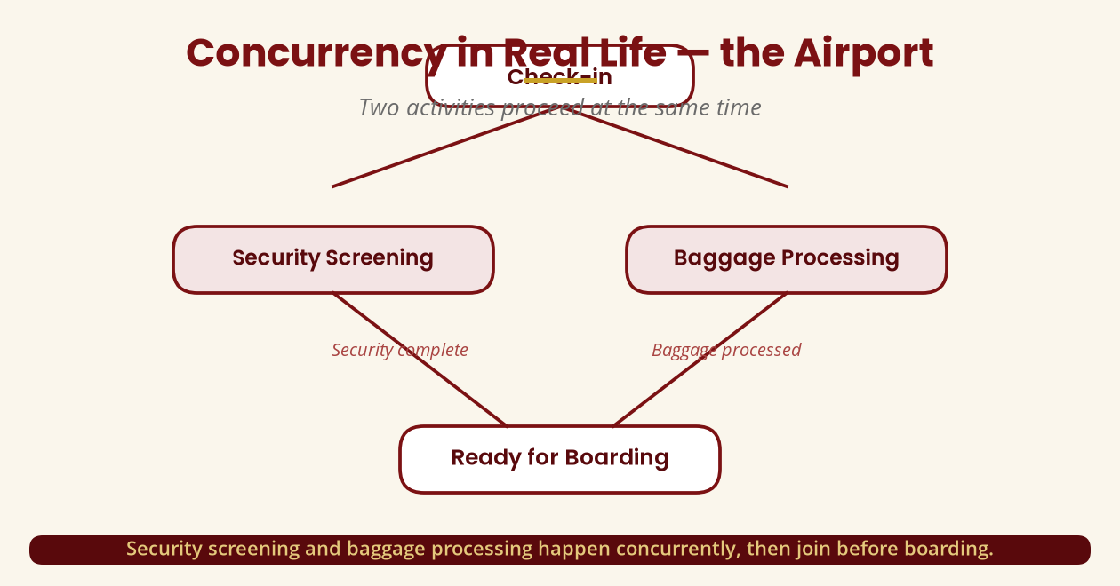
Concurrency in Real Life — Airport
Two activities at once
Security screening and baggage processing run concurrently, then join before boarding.
BICT 3202 · Object-Oriented Analysis and Design
Week 7 · Slide 14

Slide 16
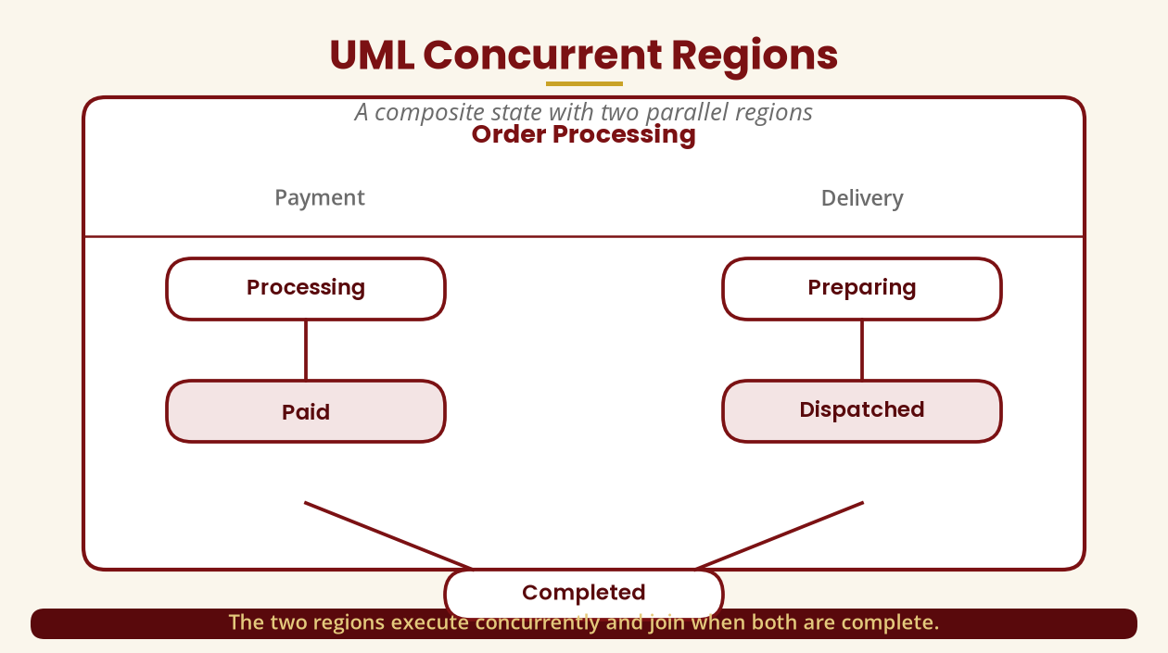
UML Concurrent Regions
A composite state with parallel regions
Order Processing = Payment region + Delivery region, joining at Completed.
BICT 3202 · Object-Oriented Analysis and Design
Week 7 · Slide 15

Slide 17
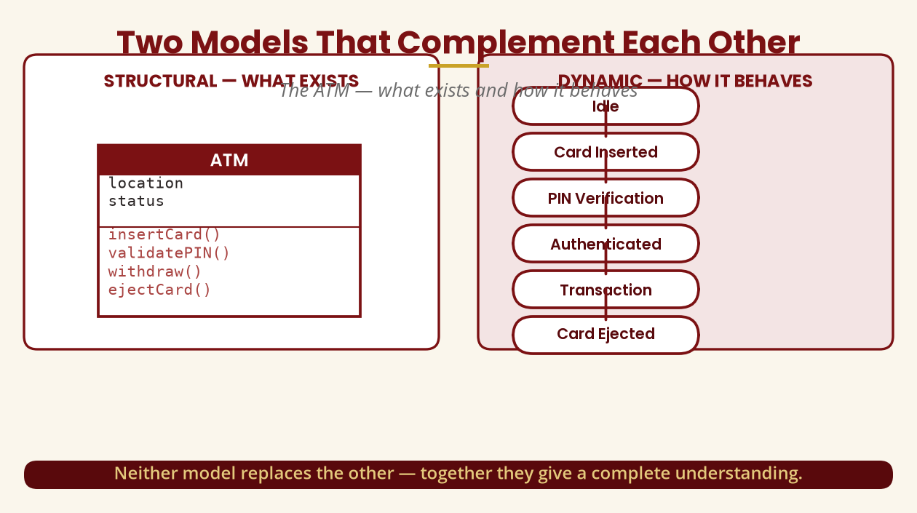
Two Models That Complement Each Other
The ATM
Neither replaces the other — structure + behaviour = complete understanding.
BICT 3202 · Object-Oriented Analysis and Design
Week 7 · Slide 16

Slide 18
Dynamic Models Reveal Problems
Impossible transitions surface requirements gaps
▪ A class diagram shows Order with cancelOrder() — but when is it allowed?
▪ The state machine shows Delivered -> Cancelled, which may not make business sense.
▪ Correct rule: Pending/Paid/Processing -> Cancelled; Shipped/Delivered -> Return process.
▪
▪ Modelling behaviour exposes requirements problems before implementation.
That is a key reason analysts model behaviour, not just structure.
BICT 3202 · Object-Oriented Analysis and Design
Week 7 · Slide 17

Slide 19
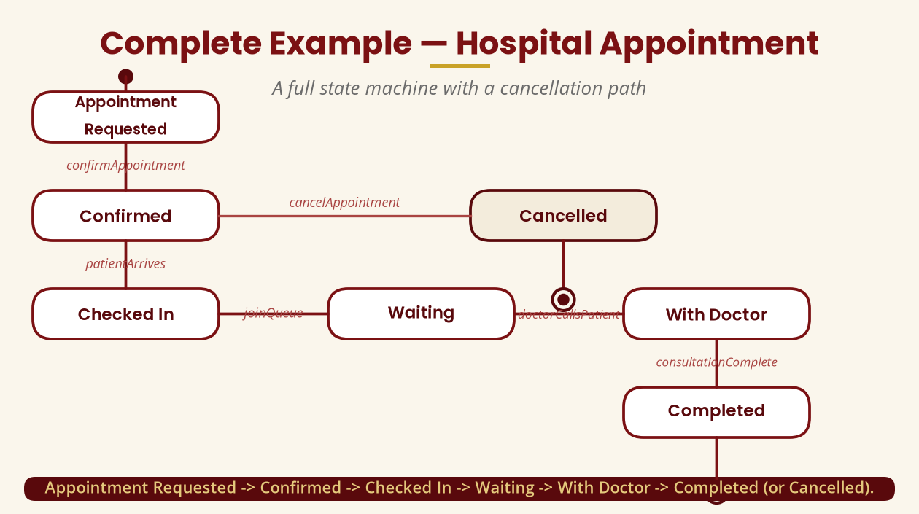
Complete Example — Hospital Appointment
A full state machine
Requested -> Confirmed -> Checked In -> Waiting -> With Doctor -> Completed (or Cancelled).
BICT 3202 · Object-Oriented Analysis and Design
Week 7 · Slide 18

Slide 20
State vs Class vs Object
Three distinct ideas
▪ Class — a blueprint/type: Order.
▪ Object — a specific instance: order1024.
▪ State — the condition of that object: Paid.
▪ Event — something that happens: PaymentReceived.
▪
▪ Order #1001 -> Paid · #1002 -> Pending · #1003 -> Shipped— same class, different states.
A state describes the current condition of an object during its lifecycle.
BICT 3202 · Object-Oriented Analysis and Design
Week 7 · Slide 19

Slide 21
State Machine vs Flowchart
They are not the same
▪ Flowchart thinking — procedural flow:
▪ Calculate total
▪ Check payment
▪ Print receipt
▪
▪
▪ State-machine thinking — lifecycle of an object:
▪ Pending -> (PaymentReceived) -> Paid
▪ Paid -> (Dispatched) -> Shipped
▪ focuses on states + events
▪
A state machine is about an entity's states and event-driven transitions — not procedural steps.
BICT 3202 · Object-Oriented Analysis and Design
Week 7 · Slide 20

Slide 22
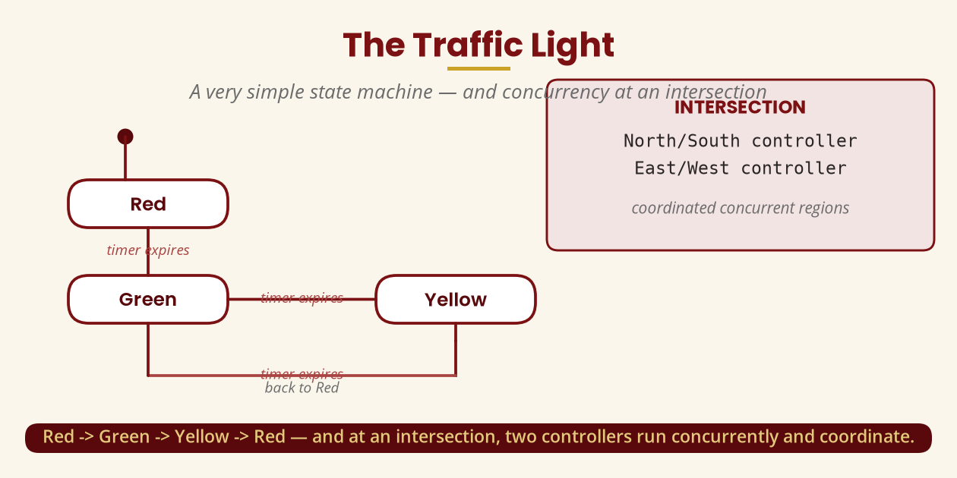
The Traffic Light
A simple state machine — and intersection concurrency
Red -> Green -> Yellow -> Red; at an intersection, two controllers coordinate concurrently.
BICT 3202 · Object-Oriented Analysis and Design
Week 7 · Slide 21

Slide 23
Practical Lab — Online Order
Build a full state machine
▪ States: New · Pending Payment · Paid · Processing · Shipped · Delivered · Cancelled · Returned.
▪ Events: placeOrder · paymentConfirmed · dispatchOrder · deliverOrder · cancelOrder · requestReturn.
▪ Guards: requestReturn [within return period].
▪ Entry behaviour: entry / sendNotification() on Paid · entry / notifyCustomer() on Shipped.
Add guards and entry behaviour — then explain what happens on entering each state.
BICT 3202 · Object-Oriented Analysis and Design
Week 7 · Slide 22

Slide 24
Common Student Mistakes
Avoid these five
▪ Event as a state — PaymentReceived is an event, not [PaymentReceived].
▪ Operation as a state — processPayment() is an operation, not [ProcessPayment].
▪ Forgetting the object — whose state are we describing?
▪ Impossible transitions — Delivered -> Paid may make no sense.
▪ A state for every action — “Click Button” is an event, not a state.
If you cannot explain the diagram in words, you probably don't understand the model.
BICT 3202 · Object-Oriented Analysis and Design
Week 7 · Slide 23

Slide 25
Week 7 Summary
The essentials
▪ Dynamic modelling — behaviour and change over time.
▪ Event — something that happens; can trigger a transition.
▪ State — a condition of an object over time.
▪ Transition + guard — movement between states, gated by a condition.
▪ Operation — behaviour/service that can change state.
▪ Concurrency — activities in parallel or overlapping.
▪ Structure + dynamic — together, a complete object-oriented model.
Object -> state -> event -> transition -> new state — the heart of dynamic modelling.
BICT 3202 · Object-Oriented Analysis and Design
Week 7 · Slide 24

Slide 26
REVISION & NEXT STEPS
▪ Draw the ATM-withdrawal and bank-account state machines with guards, entry and exit behaviour.
▪ Read every state machine you draw aloud as a story — then check the transitions make sense.
▪ Build the online-order state machine in your CASE tool and add concurrent regions.
▪ Next week: Behavioural Modelling — use cases, sequence, collaboration and activity diagrams.
Thank you — Francis Fweta · ICT Lecturer · Exploits University

