Slide 1

EXPLOITS UNIVERSITY
BSc INFORMATION COMMUNICATION AND TECHNOLOGY
BICT 3202 · OBJECT-ORIENTED ANALYSIS AND DESIGN
WEEK 8
Object-Oriented Analysis — Behavioural Modelling
Francis Fweta · ICT Lecturer · Week 8 of 16

Slide 2
Learning Outcomes
By the end of this week, you should be able to…
▪ Define behavioural modelling and why it matters.
▪ Identify use cases and actors; build a use case diagram.
▪ Explain the system boundary and include/extend/generalisation.
▪ Write a detailed use-case specification.
▪ Construct sequence diagrams (lifelines, activation bars, messages).
▪ Construct communication diagrams and activity diagrams (decisions, swimlanes).
▪ Connect use cases, activities and interactions into analysis documentation.
Week 8: how users and objects interact to accomplish tasks.
BICT 3202 · Object-Oriented Analysis and Design
Week 8 · Slide 1

Slide 3
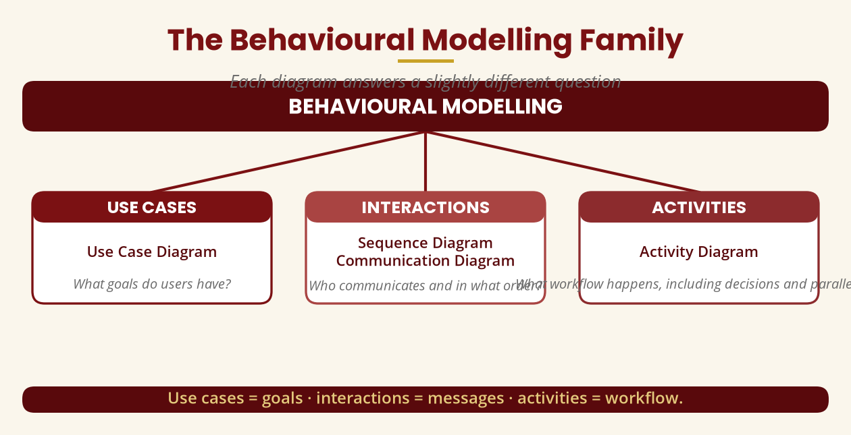
The Behavioural Modelling Family
Each diagram answers a different question
Use cases = goals · interactions = messages · activities = workflow.
BICT 3202 · Object-Oriented Analysis and Design
Week 8 · Slide 2

Slide 4
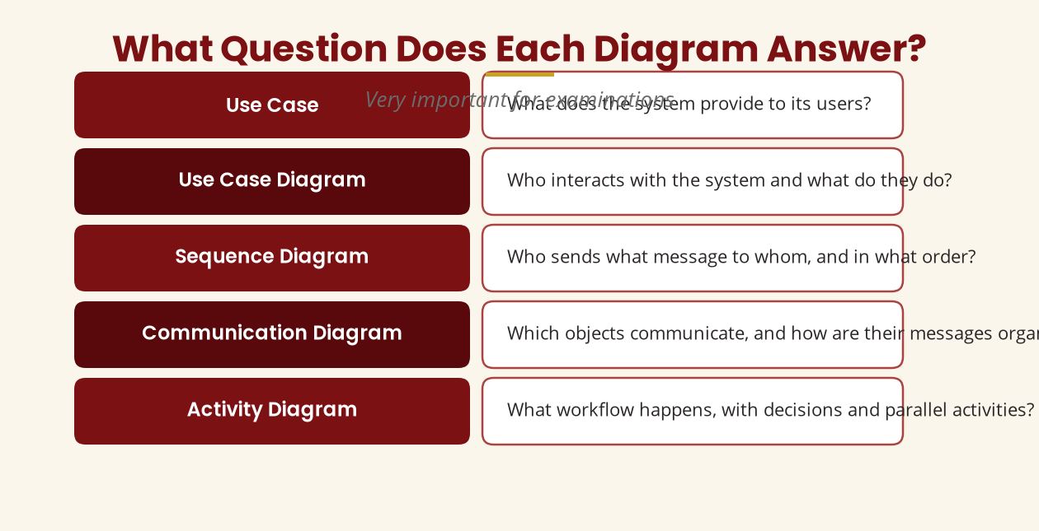
What Question Does Each Diagram Answer?
Very important for examinations
Choose the diagram by the question you are trying to answer.
BICT 3202 · Object-Oriented Analysis and Design
Week 8 · Slide 3

Slide 5
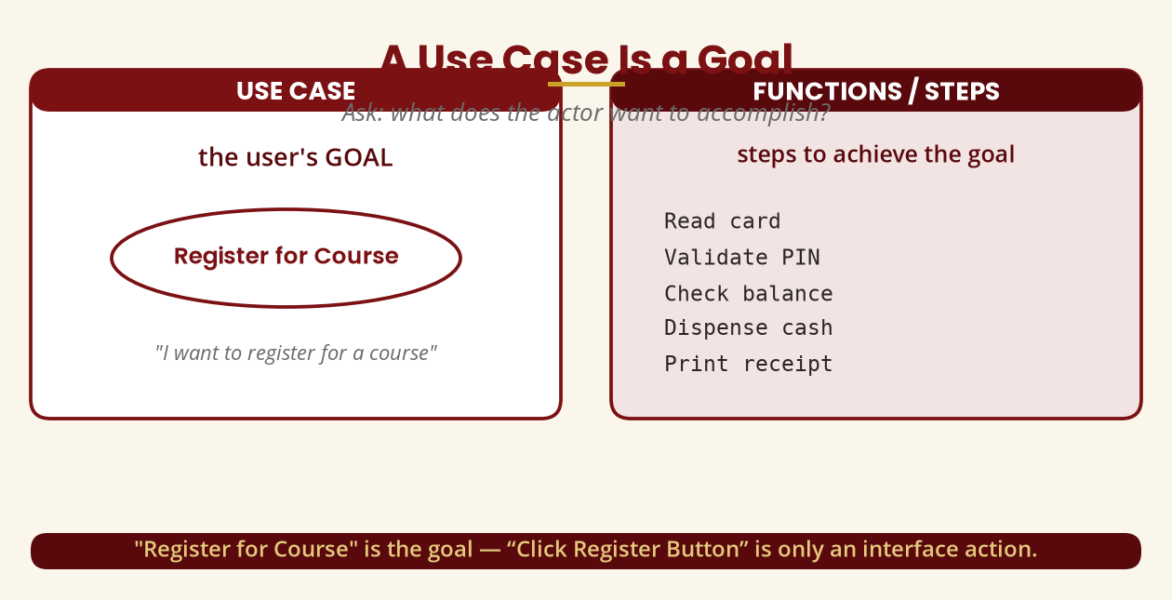
What Is a Use Case?
A goal, not a function
“Register for Course” is the goal — “Click Register Button” is only an interface action.
BICT 3202 · Object-Oriented Analysis and Design
Week 8 · Slide 4

Slide 6
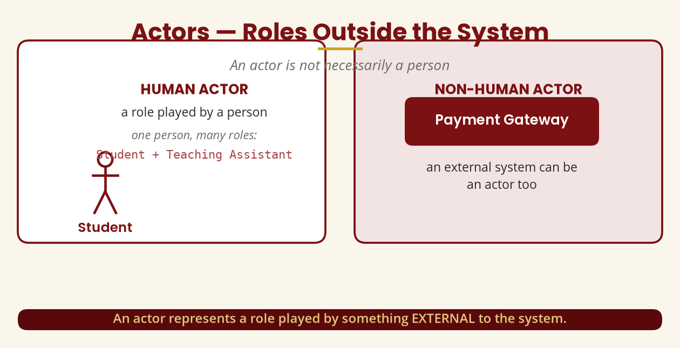
Actors
Roles outside the system — not always people
A Payment Gateway external to the system is an actor too.
BICT 3202 · Object-Oriented Analysis and Design
Week 8 · Slide 5

Slide 7
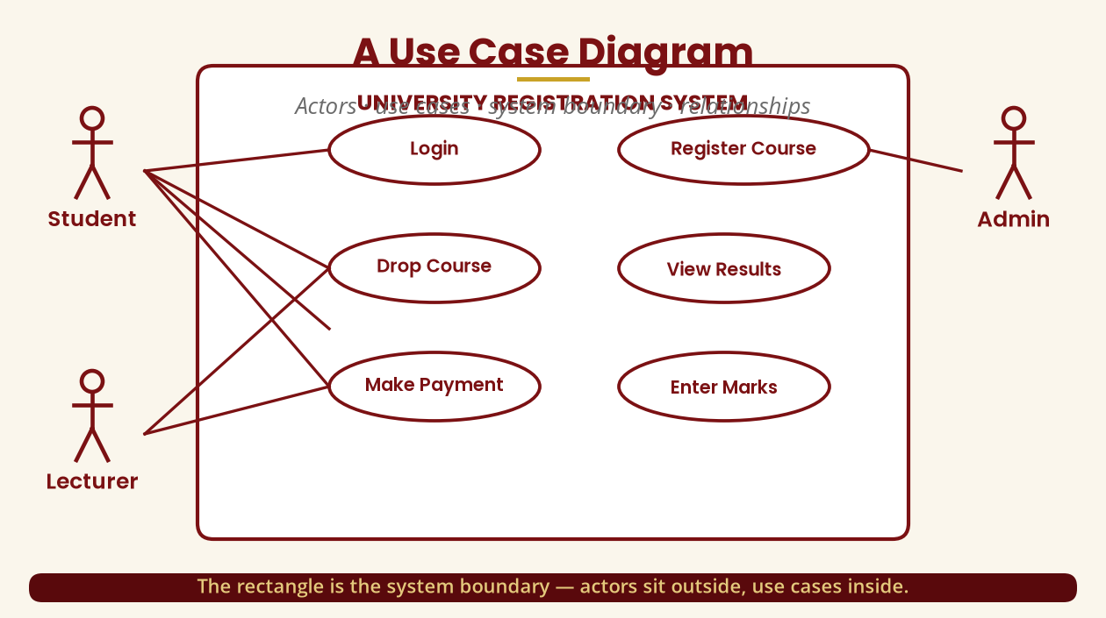
A Use Case Diagram
Actors · use cases · system boundary
The rectangle is the system boundary — actors outside, use cases inside.
BICT 3202 · Object-Oriented Analysis and Design
Week 8 · Slide 6

Slide 8
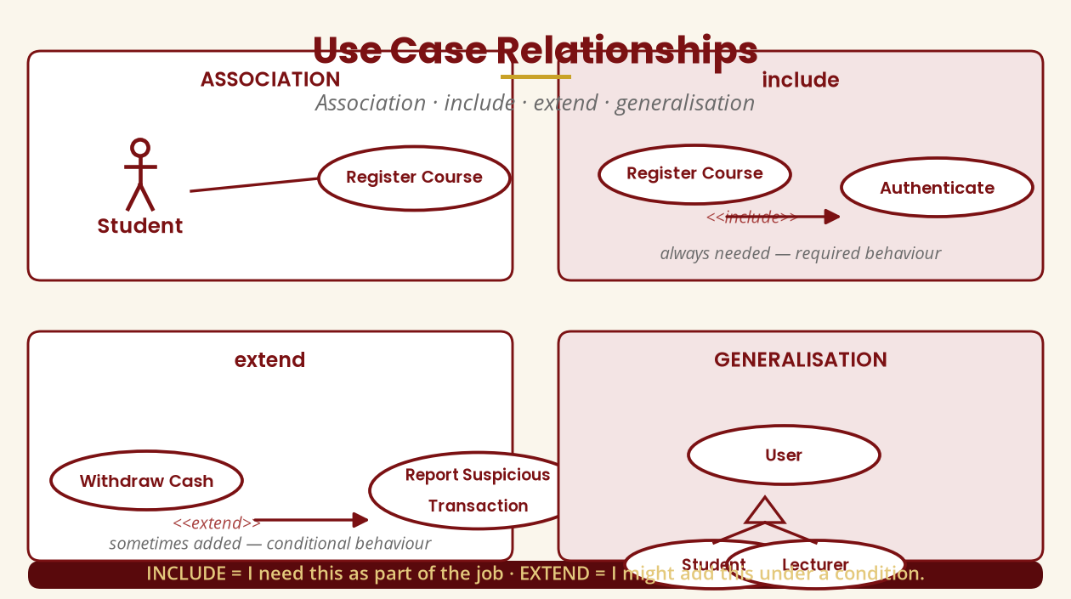
Use Case Relationships
Association · include · extend · generalisation
include = required · extend = conditional · generalisation = is-a.
BICT 3202 · Object-Oriented Analysis and Design
Week 8 · Slide 7

Slide 9
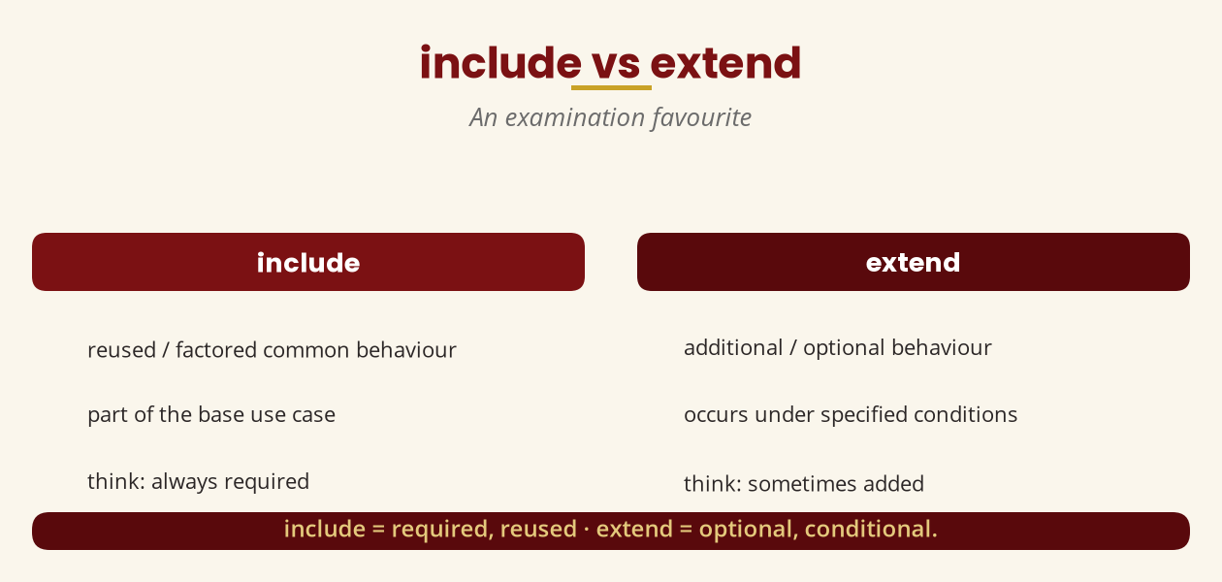
include vs extend
An examination favourite
INCLUDE = “I need this as part of the job” · EXTEND = “I might add this.”
BICT 3202 · Object-Oriented Analysis and Design
Week 8 · Slide 8

Slide 10
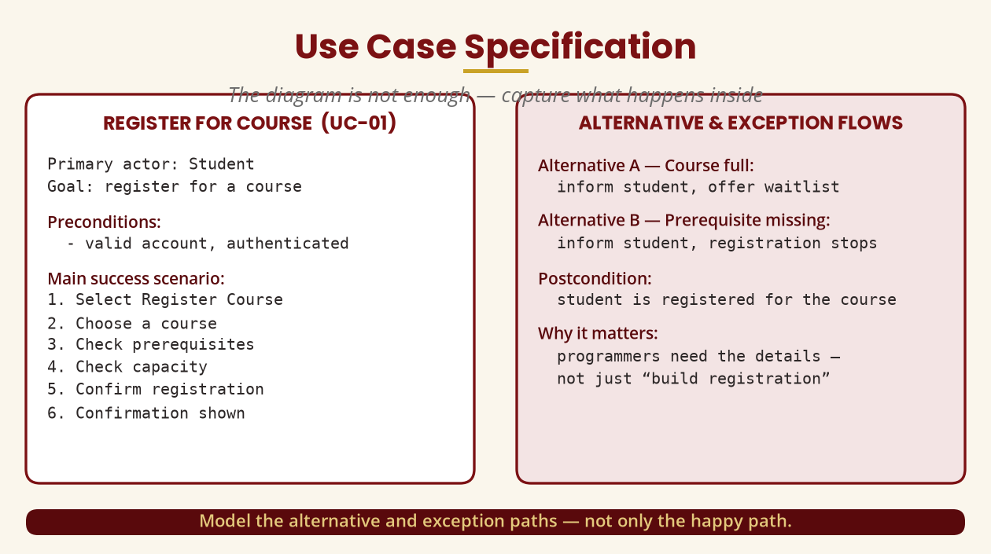
Use Case Specifications
The diagram is not enough
Capture the main scenario AND the alternative/exception paths.
BICT 3202 · Object-Oriented Analysis and Design
Week 8 · Slide 9

Slide 11
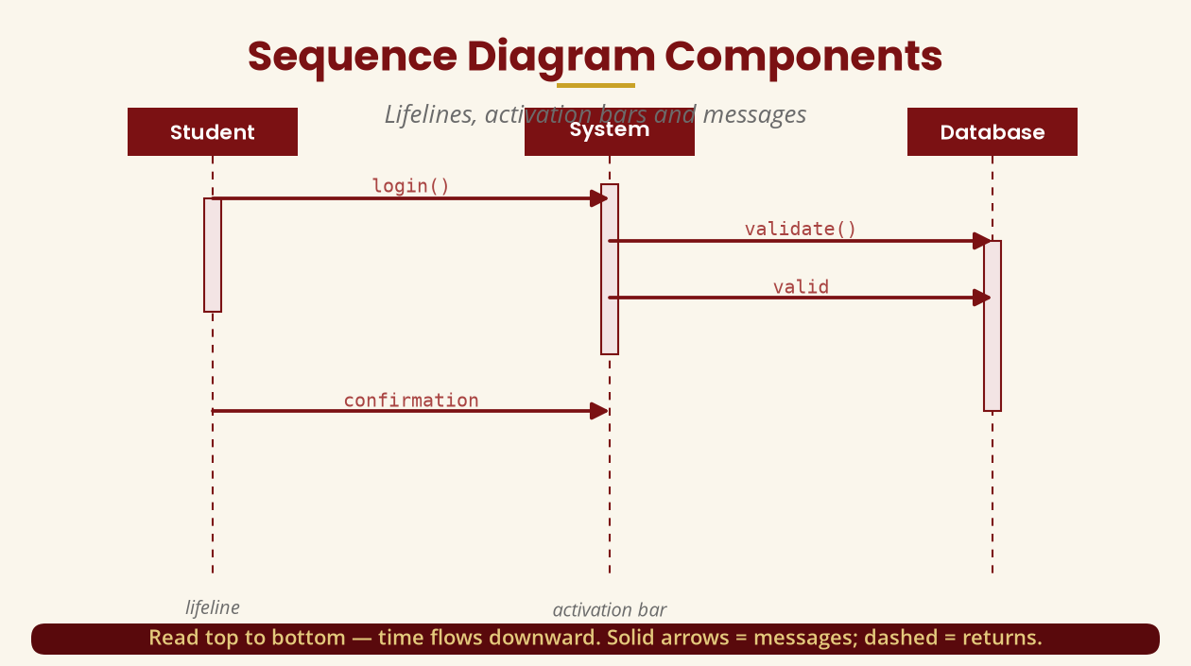
Sequence Diagram Components
Lifelines · activation bars · messages
Read top to bottom — time flows downward.
BICT 3202 · Object-Oriented Analysis and Design
Week 8 · Slide 10

Slide 12
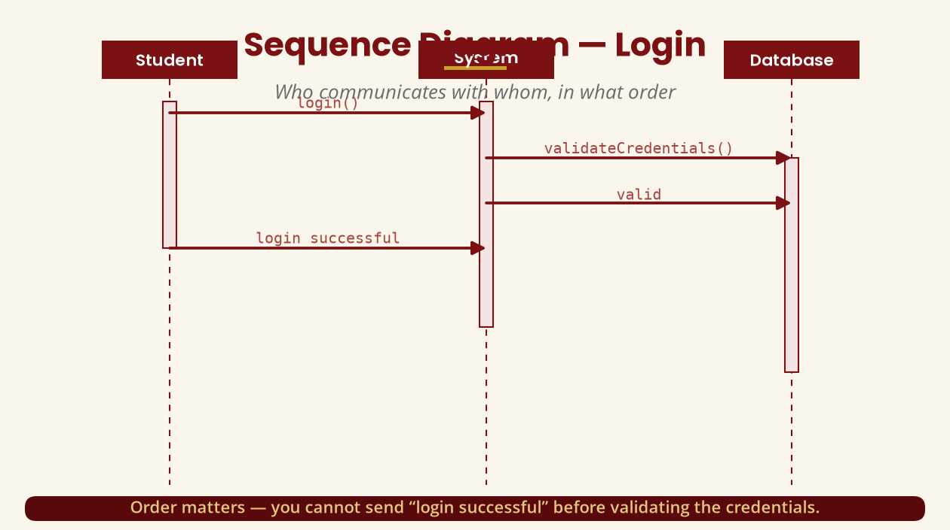
Sequence Diagram — Login
Who communicates with whom, in what order
Order matters — you cannot confirm login before validating credentials.
BICT 3202 · Object-Oriented Analysis and Design
Week 8 · Slide 11

Slide 13
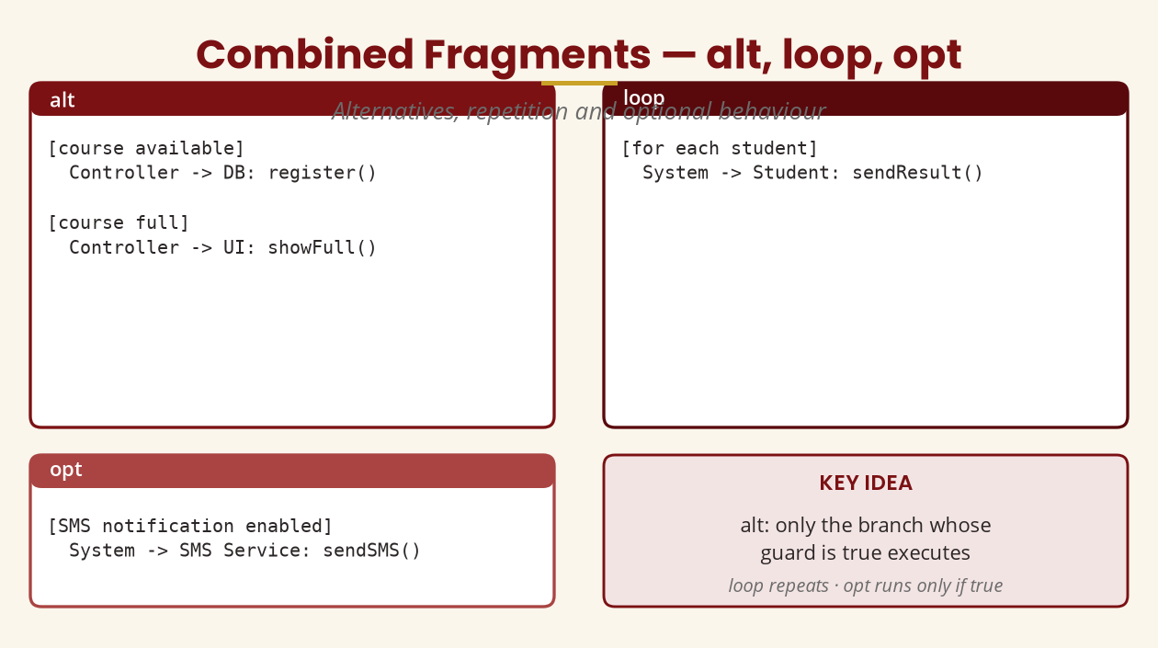
Combined Fragments — alt, loop, opt
Alternatives, repetition, optional
alt = branch by guard · loop = repeat · opt = run only if true.
BICT 3202 · Object-Oriented Analysis and Design
Week 8 · Slide 12

Slide 14
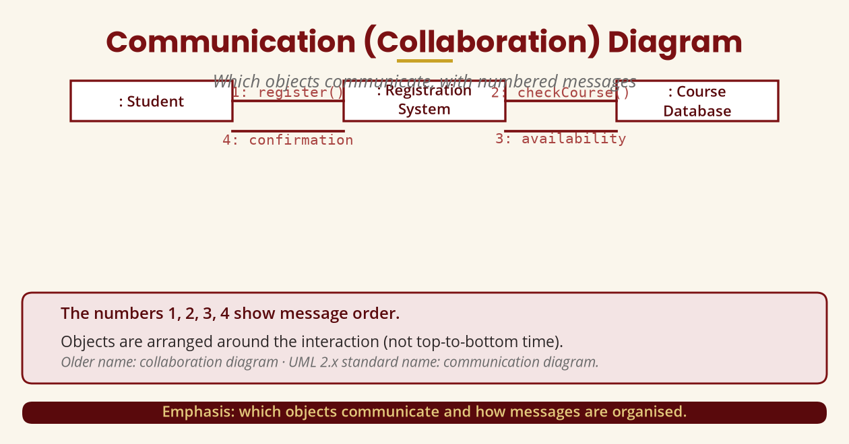
Communication (Collaboration) Diagram
Objects + numbered messages
Numbers 1, 2, 3, 4 show order; older name = collaboration diagram.
BICT 3202 · Object-Oriented Analysis and Design
Week 8 · Slide 13

Slide 15
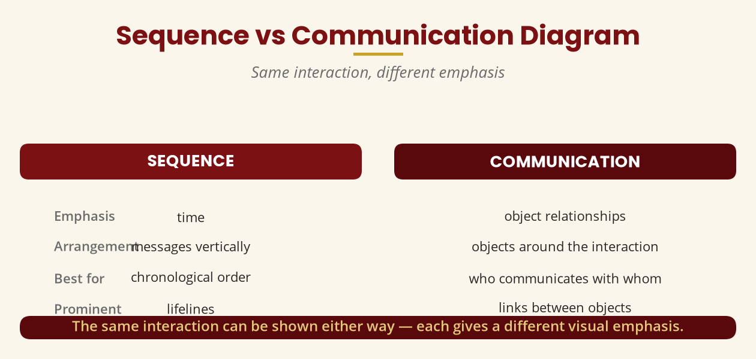
Sequence vs Communication
Same interaction, different emphasis
Sequence = time/order · Communication = objects and their links.
BICT 3202 · Object-Oriented Analysis and Design
Week 8 · Slide 14

Slide 16
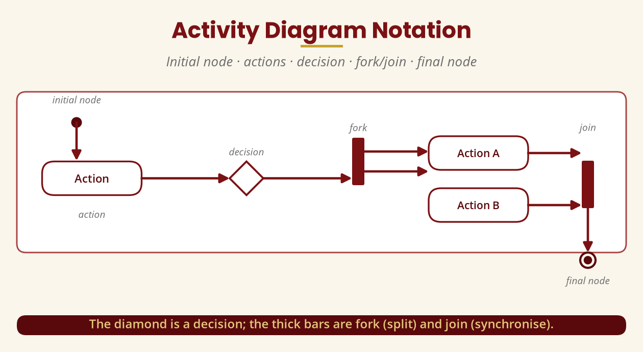
Activity Diagram Notation
Initial · actions · decision · fork/join · final
The diamond is a decision; thick bars are fork (split) and join (synchronise).
BICT 3202 · Object-Oriented Analysis and Design
Week 8 · Slide 15

Slide 17
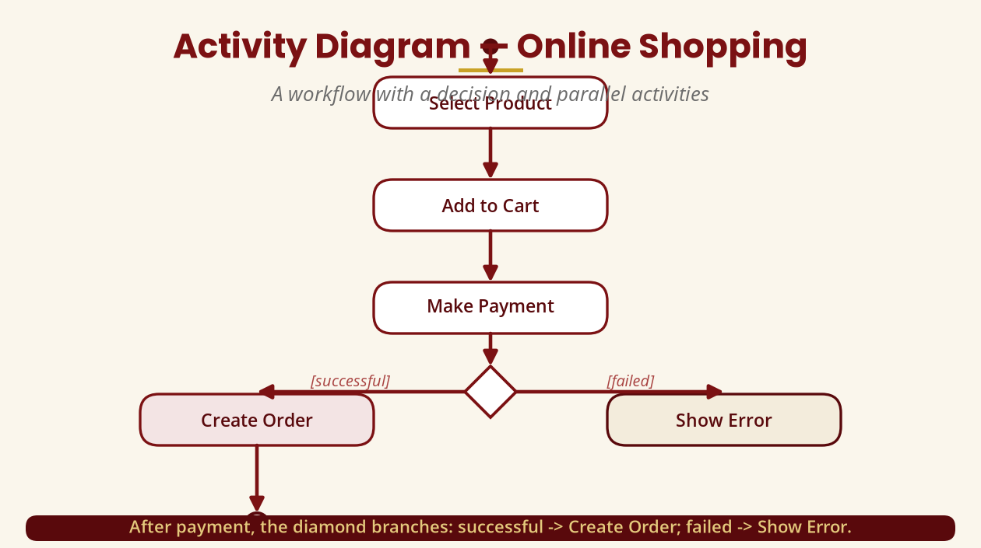
Activity Diagram — Online Shopping
A workflow with a decision
After payment: [successful] -> Create Order · [failed] -> Show Error.
BICT 3202 · Object-Oriented Analysis and Design
Week 8 · Slide 16

Slide 18
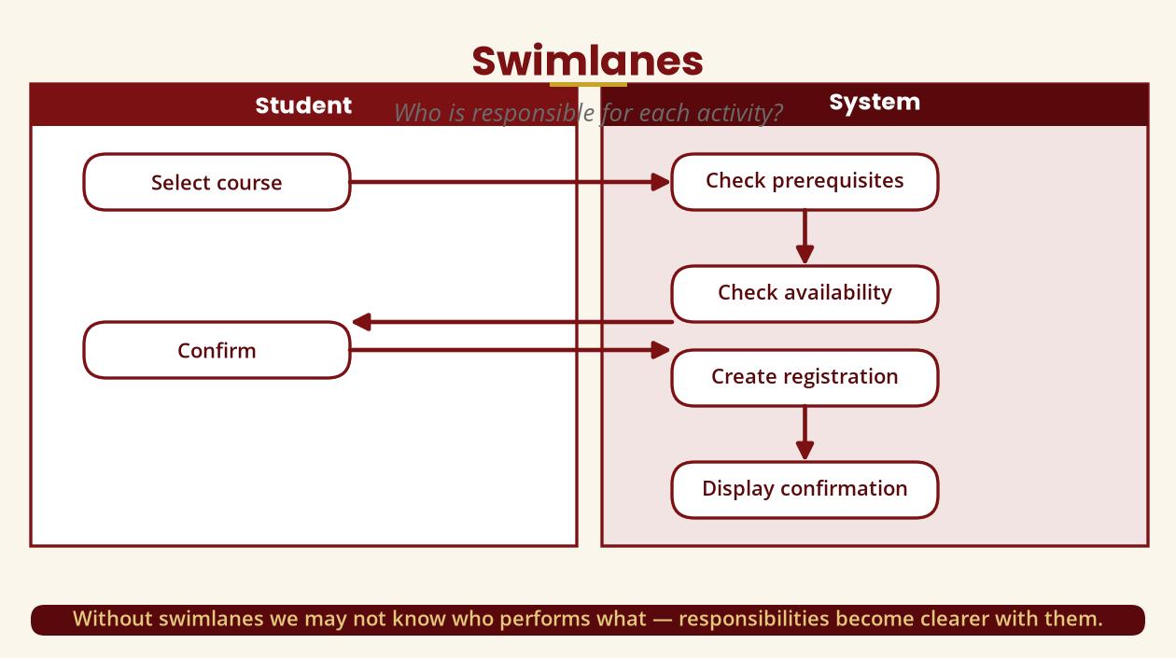
Swimlanes
Who is responsible for each activity?
Student selects/confirms; System checks prerequisites and creates the registration.
BICT 3202 · Object-Oriented Analysis and Design
Week 8 · Slide 17

Slide 19
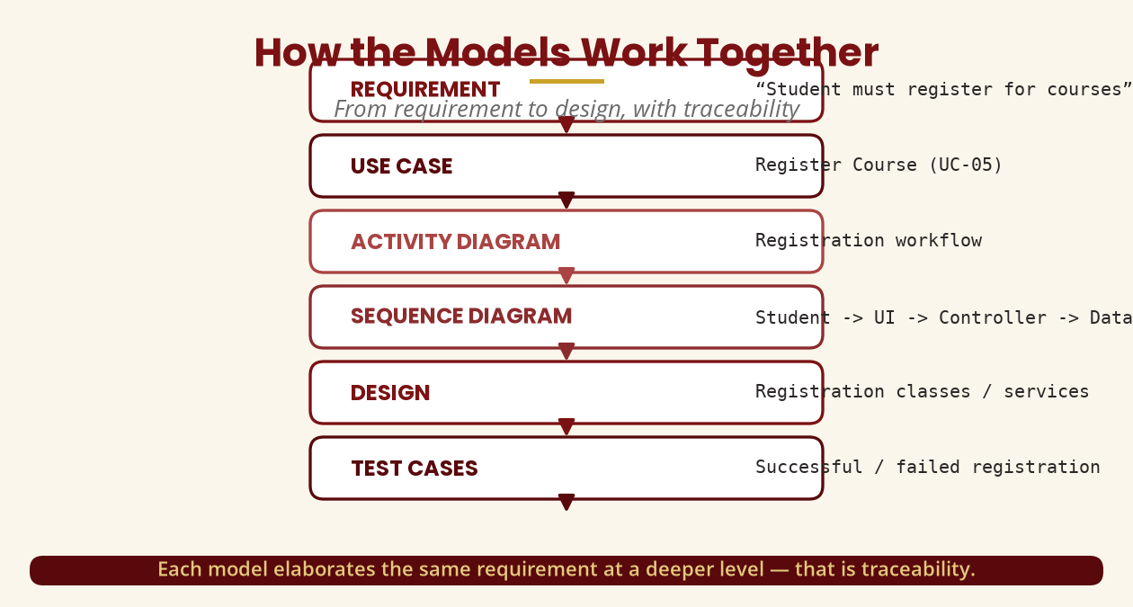
How the Models Work Together
Requirement -> design, with traceability
Use case -> activity -> sequence -> communication -> analysis model -> design.
BICT 3202 · Object-Oriented Analysis and Design
Week 8 · Slide 18

Slide 20
A Full Example — Assignment Submission
Four models, one requirement
▪ Use case: Submit Assignment (actor: Student).
▪ Specification: log in -> open course -> select assignment -> upload -> validate -> submit -> confirm.
▪ Activity: Login -> Open Course -> Upload File -> (valid? Submit : Show Error) -> Confirm.
▪ Sequence: Student -> Web UI -> Assignment Controller -> Database.
▪ Communication: 1: upload, 2: submit, 3: validate, 4: save, 5: confirmation.
The same requirement described from different perspectives — that is behavioural analysis.
BICT 3202 · Object-Oriented Analysis and Design
Week 8 · Slide 19

Slide 21
Full Analysis Documentation
Everything that explains what the system must do
▪ Contents: problem statement, requirements, actors, use cases + specifications, activity, sequence, communication, class and state diagrams, assumptions, constraints, business rules, glossary.
▪ Why it matters: client, analyst, designer, programmer, tester and manager all need a common language.
▪ Traceability: REQ-05 -> UC-05 -> activity model -> sequence model -> design -> test cases.
Documentation creates traceability from requirement to test.
BICT 3202 · Object-Oriented Analysis and Design
Week 8 · Slide 20

Slide 22
Common Confusions
Five distinctions to master
▪ Use case vs diagram — a goal vs the visual representation.
▪ Use case vs activity — what goal vs what workflow.
▪ Activity vs sequence — workflow vs messages over time.
▪ Sequence vs communication — time/order vs objects/links.
▪ Actor vs class — external role vs a type inside the system.
These distinctions are examination favourites.
BICT 3202 · Object-Oriented Analysis and Design
Week 8 · Slide 21

Slide 23
Practical Lab — Course Registration
Five tasks, one system
▪ 1. Use case diagram — boundary, 4+ actors, 8+ use cases, include/extend/generalisation.
▪ 2. Specification — full document for Register Course.
▪ 3. Activity diagram — decisions, alternatives, swimlanes.
▪ 4. Sequence diagram — 8+ messages: Student -> UI -> Controller -> Database.
▪ 5. Communication diagram — the same scenario, numbered messages.
Then compare the sequence and communication diagrams — what changed in emphasis?
BICT 3202 · Object-Oriented Analysis and Design
Week 8 · Slide 22

Slide 24
Week 8 Summary
The essentials
▪ Use case — the actor's goal; the diagram shows actors, use cases and the boundary.
▪ include / extend — required/reused vs conditional/additional behaviour.
▪ Sequence diagram — messages in time order.
▪ Communication diagram — objects and numbered messages.
▪ Activity diagram — workflow with decisions, forks/joins and swimlanes.
▪ Documentation — all models together, with traceability.
A system is behaviours performed by users and objects working together to reach goals.
BICT 3202 · Object-Oriented Analysis and Design
Week 8 · Slide 23

Slide 25
REVISION & NEXT STEPS
▪ Model the ATM system: actors, use cases, include/extend, one specification, activity and sequence diagrams.
▪ Practise include vs extend until the memory trick is automatic.
▪ Draw sequence and communication diagrams for the same scenario and compare them.
▪ Next week: The Unified Software Development Process (USDP/UP) — phases, workflows and artefacts.
Thank you — Francis Fweta · ICT Lecturer · Exploits University

