Slide 1

EXPLOITS UNIVERSITY
BSc INFORMATION COMMUNICATION AND TECHNOLOGY
BICT 3202 · OBJECT-ORIENTED ANALYSIS AND DESIGN
WEEK 9
The Unified Software Development Process (USDP / Unified Process)
Francis Fweta · ICT Lecturer · Week 9 of 16

Slide 2
Learning Outcomes
By the end of this week, you should be able to…
▪ Define the Unified Process and explain why it suits OO development.
▪ Explain iterative vs incremental development.
▪ Explain the four characteristics (use-case driven, architecture-centred, iterative & incremental, risk-driven).
▪ Distinguish phase vs iteration; explain the four phases and milestones.
▪ Explain process workflows, artefacts and reuse guidelines.
▪ Explain concurrency, generalisation and inheritance.
▪ Connect UP to the UML models already studied.
UML = how to model · UP = how to organise the work.
BICT 3202 · Object-Oriented Analysis and Design
Week 9 · Slide 1

Slide 3
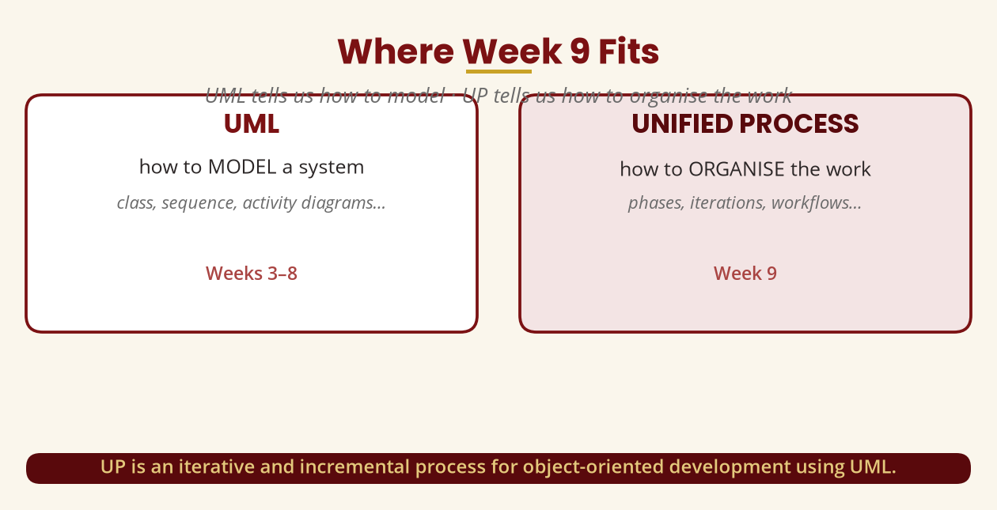
Where Week 9 Fits
From modelling the system to organising the work
UP is an iterative and incremental process for OO development using UML.
BICT 3202 · Object-Oriented Analysis and Design
Week 9 · Slide 2

Slide 4
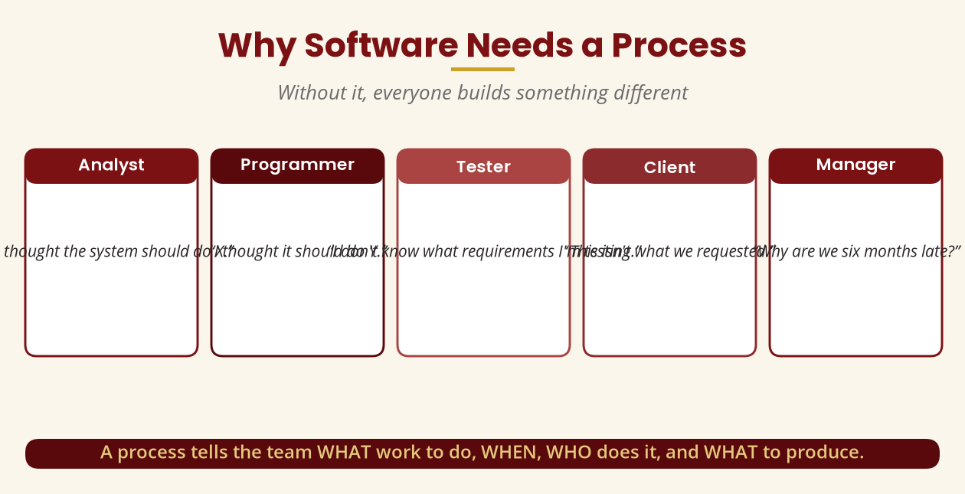
Why Software Needs a Process
Without it, everyone builds something different
A process tells the team WHAT work, WHEN, WHO does it, and WHAT to produce.
BICT 3202 · Object-Oriented Analysis and Design
Week 9 · Slide 3

Slide 5
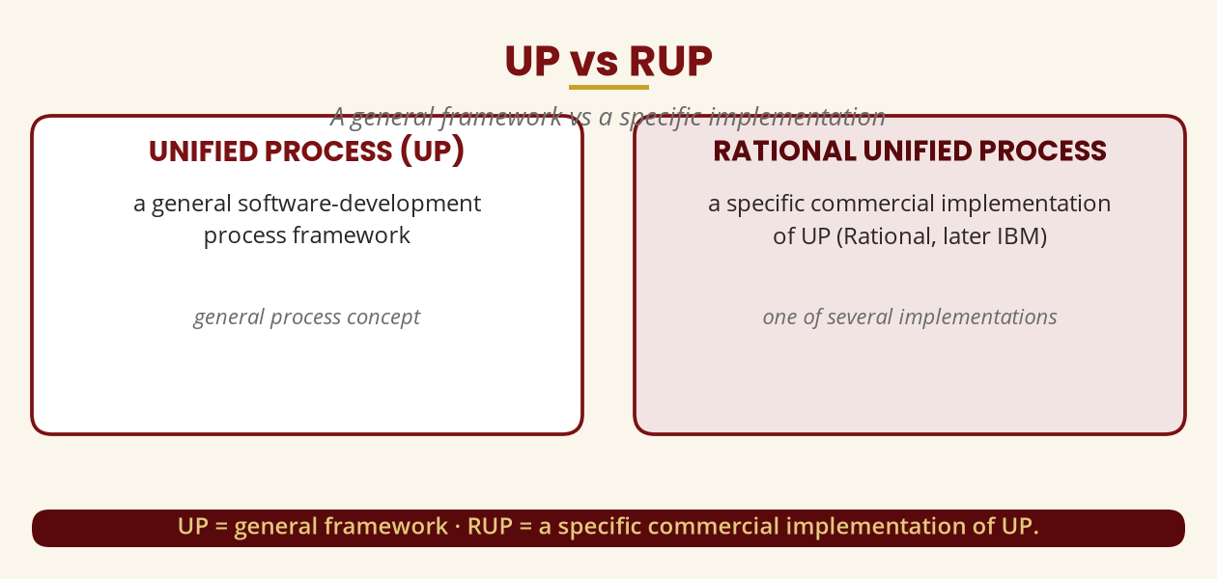
UP vs RUP
A general framework vs a specific implementation
UP = general framework · RUP = Rational's commercial implementation of UP.
BICT 3202 · Object-Oriented Analysis and Design
Week 9 · Slide 4

Slide 6
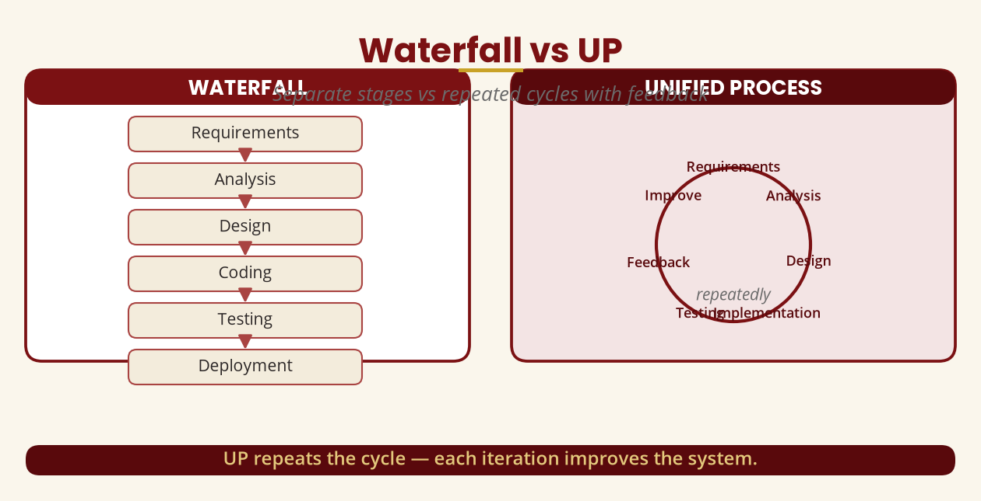
Waterfall vs UP
Separate stages vs repeated cycles
UP repeats the cycle — each iteration improves the system.
BICT 3202 · Object-Oriented Analysis and Design
Week 9 · Slide 5

Slide 7
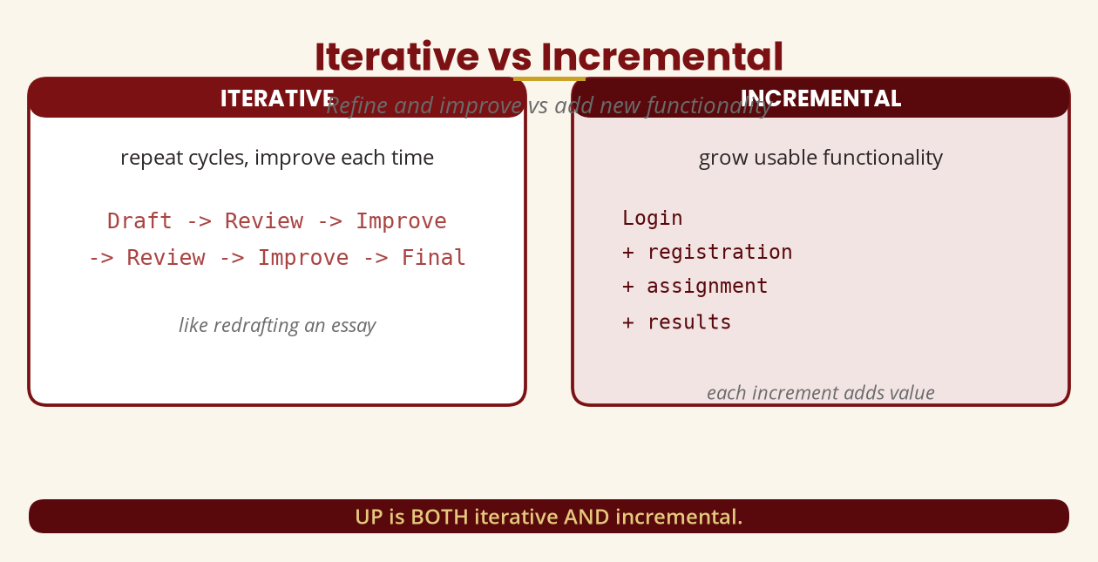
Iterative vs Incremental
Refine and improve vs add functionality
UP is BOTH iterative AND incremental — short, timeboxed iterations.
BICT 3202 · Object-Oriented Analysis and Design
Week 9 · Slide 6

Slide 8
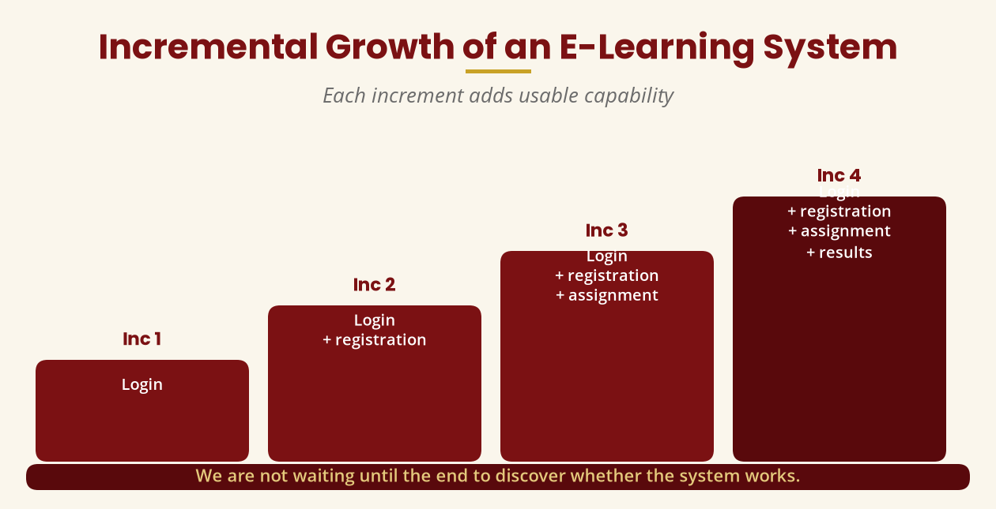
Incremental Growth
Each increment adds usable capability
Login -> + registration -> + assignment -> + results.
BICT 3202 · Object-Oriented Analysis and Design
Week 9 · Slide 7

Slide 9
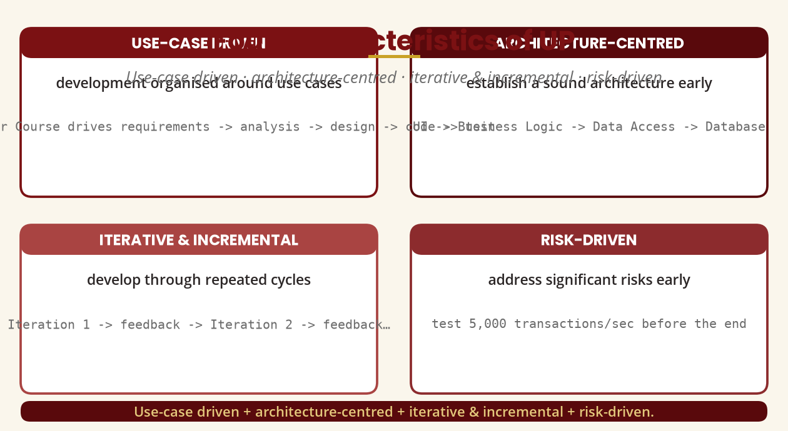
Four Characteristics of UP
Use-case driven · architecture-centred · iterative & incremental · risk-driven
Remember these four — they are a favourite examination question.
BICT 3202 · Object-Oriented Analysis and Design
Week 9 · Slide 8

Slide 10
Use-Case Driven
A use case threads through the whole lifecycle
▪ UC-01 Register Course drives the work:
▪ Requirements: what should registration do?
▪ Analysis: Student · Course · Registration
▪ Design: RegistrationController · CourseService
▪ Implementation: program the functionality
▪ Testing: available · full · prerequisite missing · already registered
The use case becomes a thread running through every activity.
BICT 3202 · Object-Oriented Analysis and Design
Week 9 · Slide 9

Slide 11
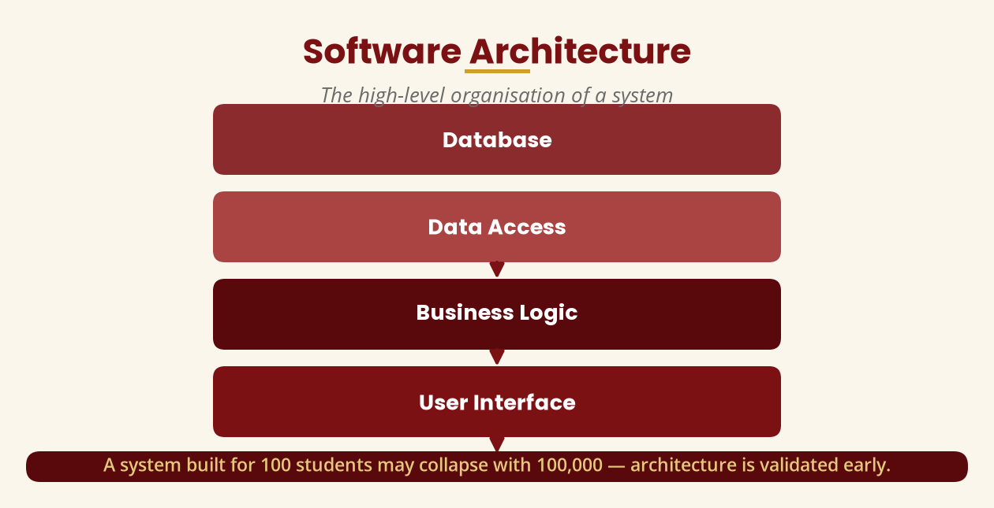
Architecture-Centred
Validate the high-level design early
A system for 100 students may collapse with 100,000 — test the architecture early.
BICT 3202 · Object-Oriented Analysis and Design
Week 9 · Slide 10

Slide 12
Risk-Driven
Address significant risks early
▪ Common mistake: “Let's build the easiest things first.”
▪ UP instead identifies and addresses significant risks early.
▪ Risk types: technical · security · performance · financial · schedule · requirements · integration.
▪ Example: “5,000 transactions per second” — test the architecture in an early iteration.
Attack the riskiest parts while there is still time to mitigate them.
BICT 3202 · Object-Oriented Analysis and Design
Week 9 · Slide 11

Slide 13
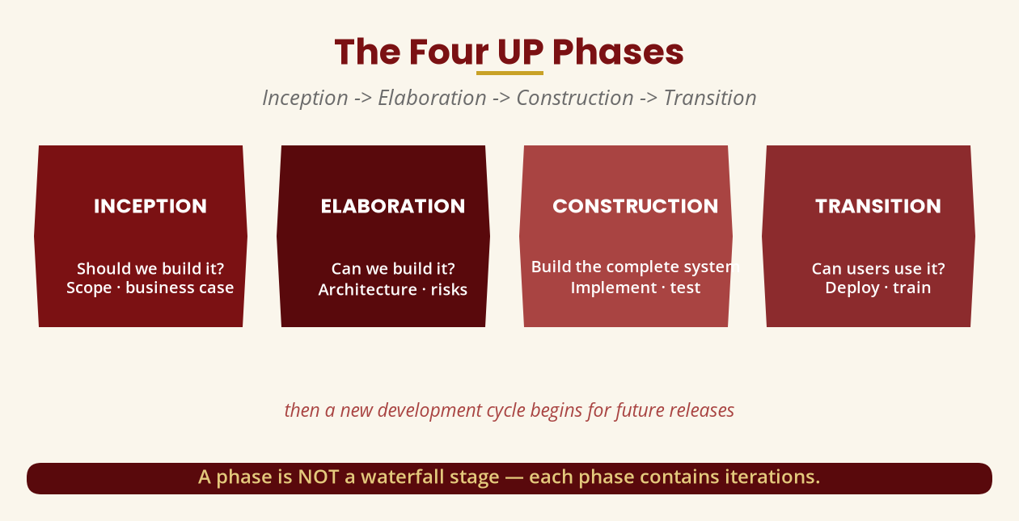
The Four UP Phases
Inception -> Elaboration -> Construction -> Transition
A phase is NOT a waterfall stage — each phase contains iterations.
BICT 3202 · Object-Oriented Analysis and Design
Week 9 · Slide 12

Slide 14
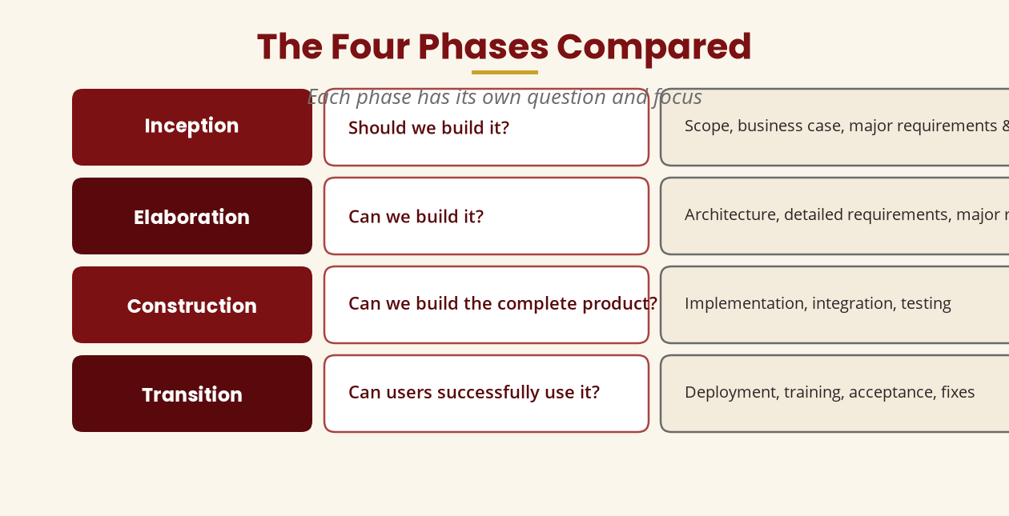
The Four Phases Compared
Each has its own question and focus
Inception = scope · Elaboration = architecture · Construction = build · Transition = deploy.
BICT 3202 · Object-Oriented Analysis and Design
Week 9 · Slide 13

Slide 15
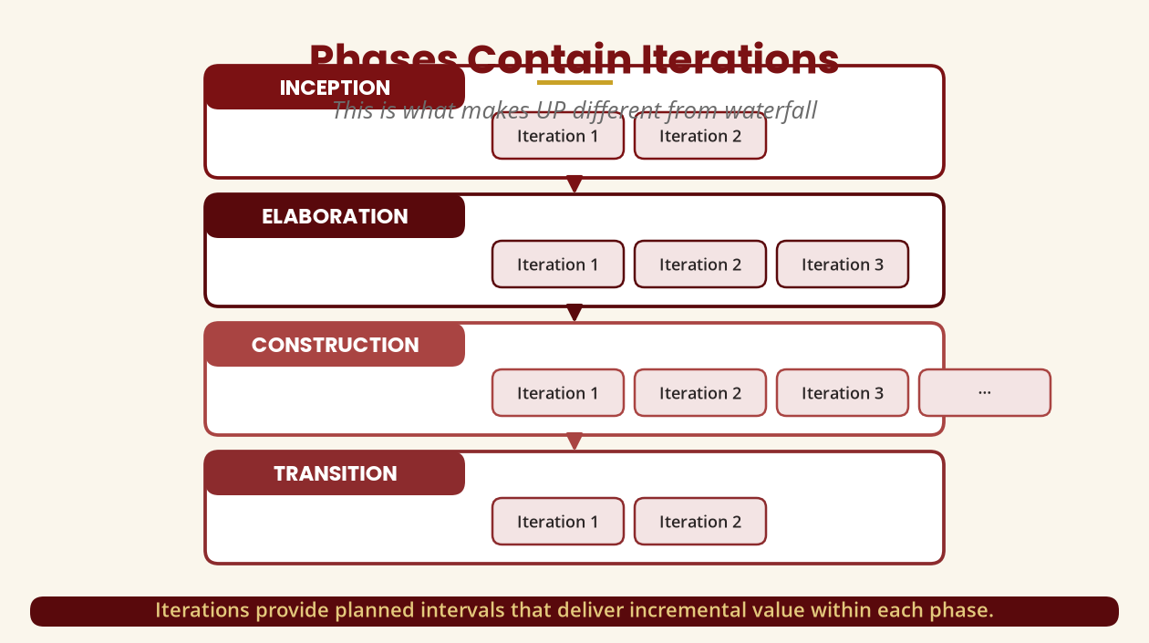
Phases Contain Iterations
What makes UP different from waterfall
Iterations deliver incremental value within each phase.
BICT 3202 · Object-Oriented Analysis and Design
Week 9 · Slide 14

Slide 16
Milestones
Go / no-go decision points
▪ End of Inception: Lifecycle Objectives Milestone — “do we understand enough to continue?”
▪ End of Elaboration: Lifecycle Architecture Milestone — “can the architecture support the requirements?”
▪ End of Construction: Initial Operational Capability — the system is ready for users.
▪ End of Transition: Product Release — the system is in production.
If major risks remain unresolved, the project should not blindly continue.
BICT 3202 · Object-Oriented Analysis and Design
Week 9 · Slide 15

Slide 17
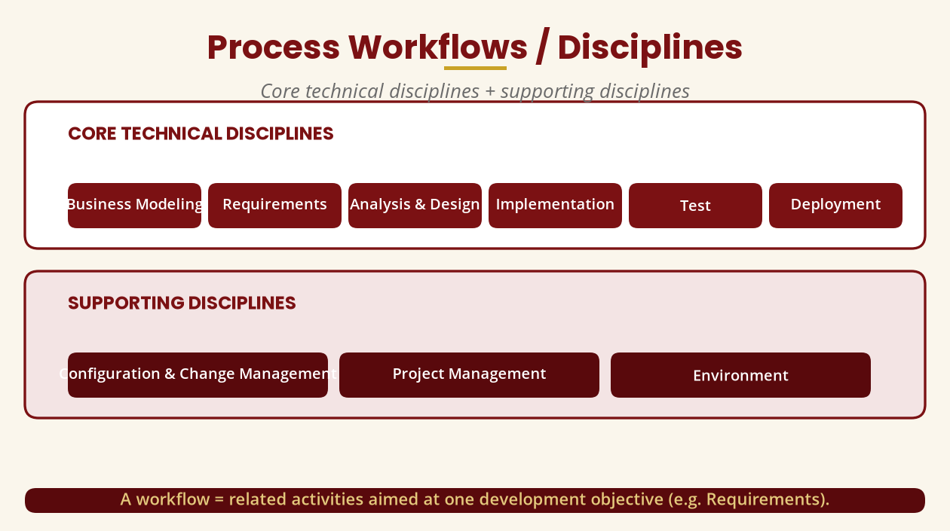
Process Workflows / Disciplines
Core technical + supporting disciplines
Business Modeling · Requirements · Analysis & Design · Implementation · Test · Deployment + 3 supporting.
BICT 3202 · Object-Oriented Analysis and Design
Week 9 · Slide 16

Slide 18
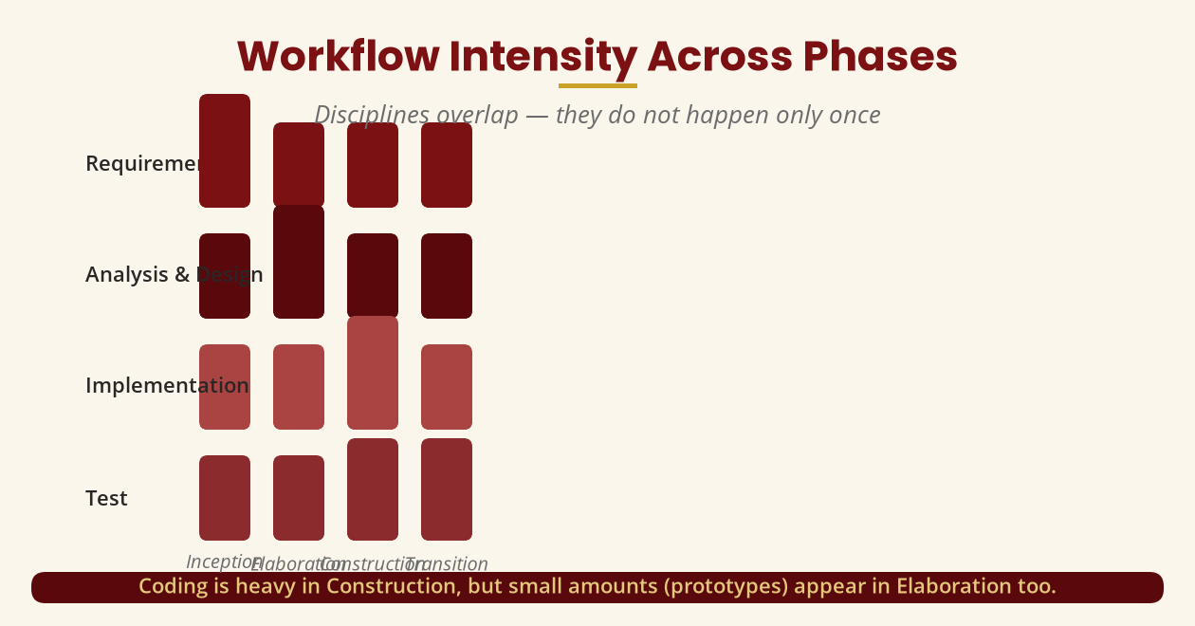
Workflow Intensity Across Phases
Disciplines overlap — they do not happen once
Coding is heavy in Construction, but prototypes appear in Elaboration too.
BICT 3202 · Object-Oriented Analysis and Design
Week 9 · Slide 17

Slide 19
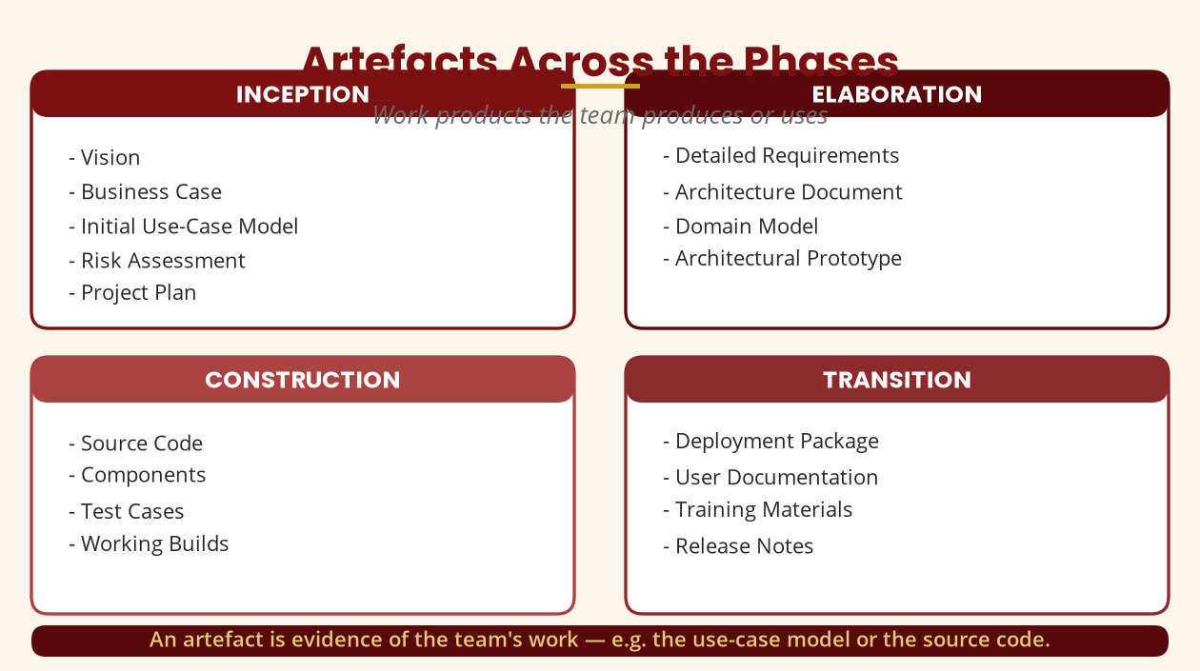
Artefacts
Work products across the phases
An artefact is evidence of the team's work — the use-case model, code, tests…
BICT 3202 · Object-Oriented Analysis and Design
Week 9 · Slide 18

Slide 20
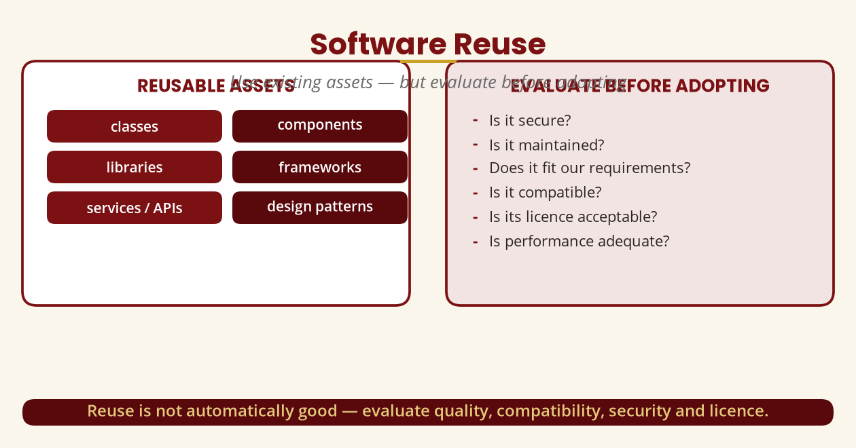
Reuse in OO Development
Use existing assets — but evaluate
Reuse is not automatically good — check security, compatibility, licence, quality.
BICT 3202 · Object-Oriented Analysis and Design
Week 9 · Slide 19

Slide 21
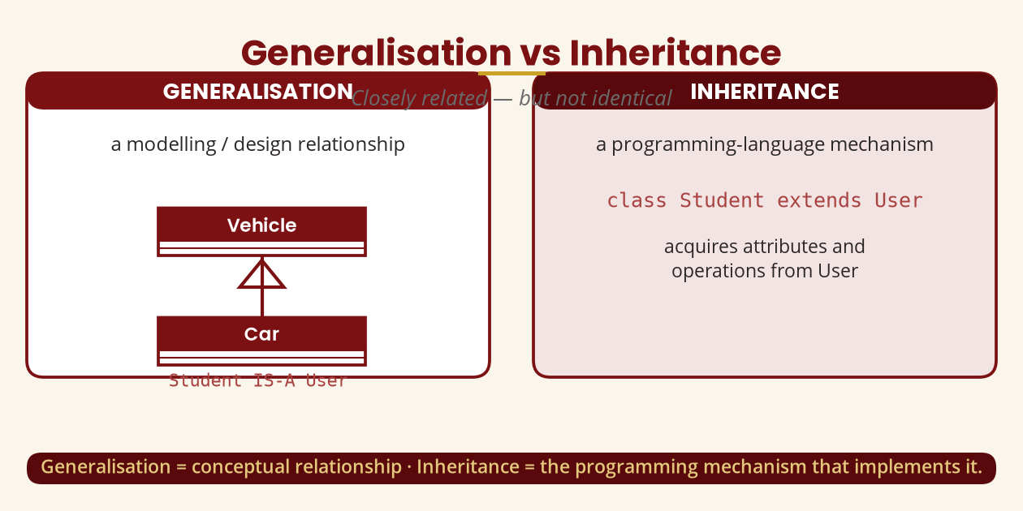
Generalisation vs Inheritance
Closely related, not identical
Generalisation = modelling relationship · Inheritance = programming mechanism.
BICT 3202 · Object-Oriented Analysis and Design
Week 9 · Slide 20

Slide 22
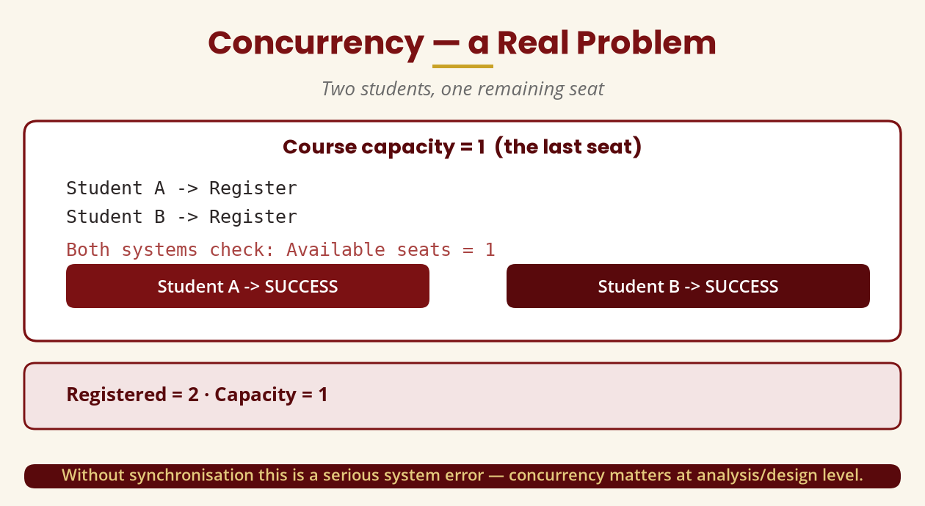
Concurrency — a Real Problem
Two students, one remaining seat
Without synchronisation, two registrations succeed for one seat — concurrency matters.
BICT 3202 · Object-Oriented Analysis and Design
Week 9 · Slide 21

Slide 23
Connecting UP to the UML Models
The models become artefacts in the process
▪ Requirement -> use case -> use-case diagram -> activity -> sequence -> class model -> design -> implementation.
▪
▪ UP provides the development process; UML provides the modelling languages used within it.
▪ Case study: Mzuni Online Registration — Inception, Elaboration, Construction, Transition.
The models of Weeks 4–8 do not exist in isolation — they are UP artefacts.
BICT 3202 · Object-Oriented Analysis and Design
Week 9 · Slide 22

Slide 24
Common Misunderstandings
Avoid these
▪ “UP is the same as Waterfall” — no: phases contain iterations.
▪ “Inception collects every requirement” — no: scope + major requirements only.
▪ “Coding only happens in Construction” — prototypes are coded in Elaboration.
▪ “Testing starts after coding” — testing happens every iteration.
▪ “Generalisation = inheritance” — closely related, but one is a relationship, the other a mechanism.
These five are classic traps in examination answers.
BICT 3202 · Object-Oriented Analysis and Design
Week 9 · Slide 23

Slide 25
Week 9 Summary
Five things to remember
▪ 1. UP is iterative and incremental.
▪ 2. UP is use-case driven.
▪ 3. UP is architecture-centred.
▪ 4. UP has four phases — Inception, Elaboration, Construction, Transition.
▪ 5. Phases contain iterations — that is what makes UP different from waterfall.
Week 8 = what the system does · Week 9 = how to organise the work · Week 10+ = design.
BICT 3202 · Object-Oriented Analysis and Design
Week 9 · Slide 24

Slide 26
REVISION & NEXT STEPS
▪ Explain iterative vs incremental with a concrete example, then draw the four phases with iterations.
▪ Compare UP against waterfall — list what changes for requirements, risk, delivery and documentation.
▪ Map the Week 8 models onto UP phases and artefacts for the registration system.
▪ Next week: Object-Oriented Design — turning the analysis into a software design.
Thank you — Francis Fweta · ICT Lecturer · Exploits University

