Slide 1
Story Point Estimation

Slide 2
Dataset
Dataset are 23,313 issues with story points from 16 large open source projects in 9 repositories namely
- Apache
- Appcelerator
- DuraSpace
- Atlassian
- Moodle
- Lsstcorp
- Mulesoft
- Spring
- Tatendforge
The authors claim this is the largest dataset in term of number of data points for story point estimation

Slide 3
Among projects, 7 / 16 follow Fibonnaci scale, other 9 did not use any scale.
This makes their approach applicable for wider range of projects.
Features:
- Story points
- title
- description

Slide 4
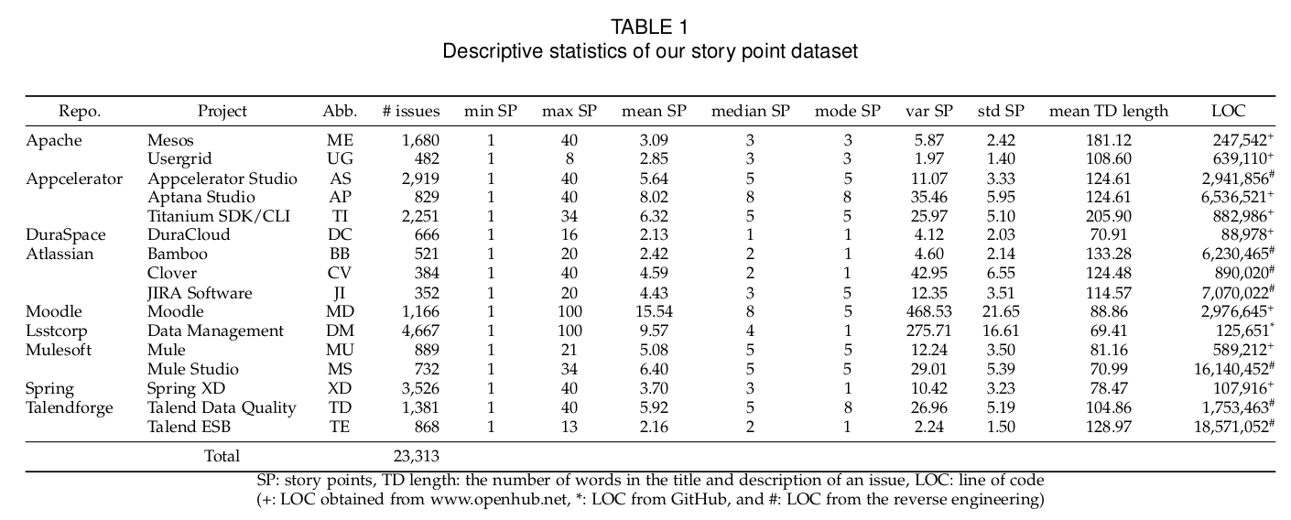

Slide 5
Traing / Test split
To mimic a real deployment scenario that prediction on a current issue is made by using knowledge from estimations of the past issues.
the issues in each project were split into
- training set (60% of the issues),
- development/validation set (i.e. 20%)
- and test set (i.e. 20%) based on their creation time.
Timeline (Creation Time)
Training Set → Validation Set → Test Set

Slide 6
Approach
Input: Title + description of an issues
Output: story-point estimation
Key ideas:
1. Mapping input to a high dimensional space (input now become a N-dimension vector)
2. Use those vectors as features in machine learning model.

Slide 7
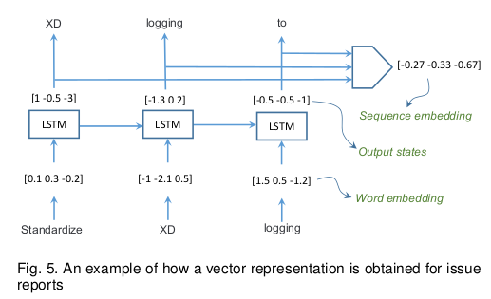
Approach
1. Mapping input to a high dimension space (input now become a N-dimension vector)
- Doc2Vec model
- Bag-of-Word
- LSTM ?
Can we do
two steps with
a single LSTM?

Slide 8
Approach
2. Use those vectors as features in machine learning model.
- Recurrent Highway Net (extension of LSTM) + linear regression
- Random Forest
- Logistic Regression
- Another Neural Net?
- Automatically Transformed Linear Model (baseline)

Slide 9
Approach
Deep-SE (LSTM + RHWN)
LSTM + RF
LSTM + SVM
LSTM + ATLM,
LSTM + LR
BoW + RF
Doc2Vec + RF
…..

Slide 10
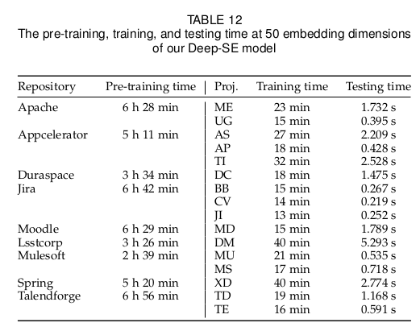
Training Time
1. Pre-train: LSTM to find the mapping to a high-dimensional space ( 7 hours at maximum)
2. Training time:
Avg 22 mins
All the experiments were run on
a MacOS laptop with
2.4 GHz Intel Core i5 and
8 GB of RAM
and the embedding
dimensions of 50.

Slide 11
Result
In general, their proposed solution “Deep-SE” (LSTM + Recurrent High Way Net + linear regressor) outperform other methods in most of cases and metrics (Mean Absolute Error, Median Absolute error, Standardized accuray).
Compared against the BoW and Doc2Vec techniques, our approach has improved 23.68% and 17.90% in MAE. These are significant results in the literature of effort estimation. A major part of those improvement were brought by our use of the deep learning.
Note: The usage of LSTM to learn document representation is very effective while RHWN is not as that significant.

Slide 12
