Slide 1
PROJECT REPORT
<Egreetings>

Slide 2
Contributions
Nguyễn Tiến Thịnh.
Phạm Thành Đạt.
Nguyễn Mạnh Tiến.
Nguyễn Đoàn Phi Hùng
LBC/Session 8

Slide 3
Problem Definition
TechBlog can be known as a famous technology online newspaper
The website must have some following functions:
Catchy, informative homepage
Hot news will be shown on the top of homepage
Each posts are shown with clearly title, eye-catching poster,...
Easy for reading, visually attractive and psychologically

Slide 4





Implementation Environment
.NET Framework
ASP.NET
HTML5, CSS3
JQuery, Bootstrap

Slide 5
User Case
The site dynamic data is updated by only ADMIN.
The role of Admin will be adding new templates for various occasions which can be further used by the user.
User has to register their account first for using the site facility.
Any Guest user can also subscribe for monthy services offered but it will be chargeable on the monthly basis.
LBC/Session 8

Slide 6
User Case
The constraint validation must be provided to the field to accept the appropriate data type.
Navigation of the project must be smooth.
User can also send the feedback.
All the data must be viewed by the admin.
Admin can deactivate the status of the user who has subscribed the services of sending the mail.
Report section must be added for the Admin to view the daily transaction happening from the site.
LBC/Session 8

Slide 7
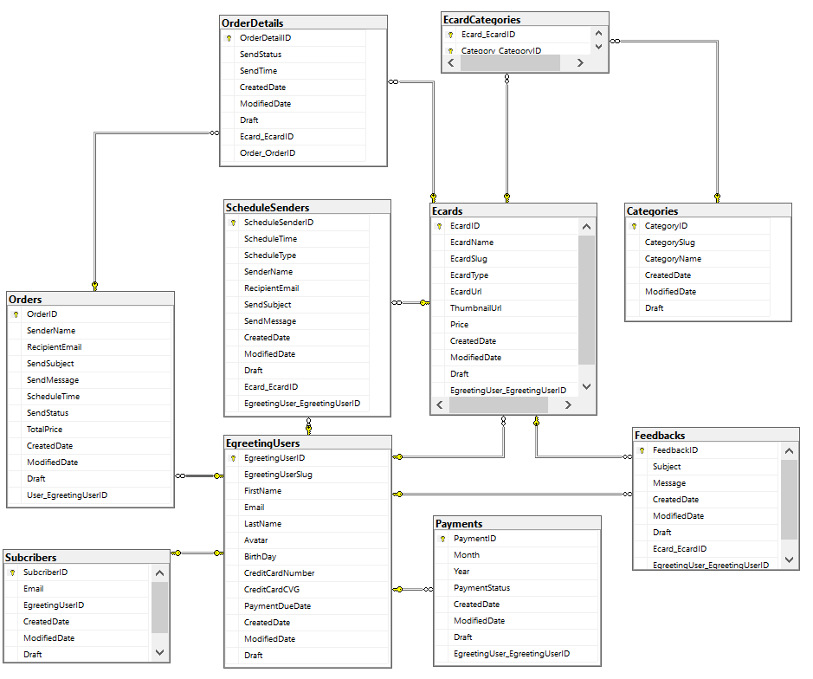
Database Relationship Diagram
LBC/Session 8

