Slide 1
PROJECT REPORT
<TechBlog>

Slide 2
Contributions
Nguyễn Tiến Thịnh.
Phạm Thành Đạt.
Lê Quang Thành.
LBC/Session 8

Slide 3
Problem Definition
TechBlog can be known as a famous technology online newspaper
The website must have some following functions:
Catchy, informative homepage
Hot news will be shown on the top of homepage
Each posts are shown with clearly title, eye-catching poster,...
Easy for reading, visually attractive and psychologically

Slide 4





Implementation Environment
PHP
HTML5, CSS3, JavaScript
Laravel Library
JQuery, Bootstrap

Slide 5
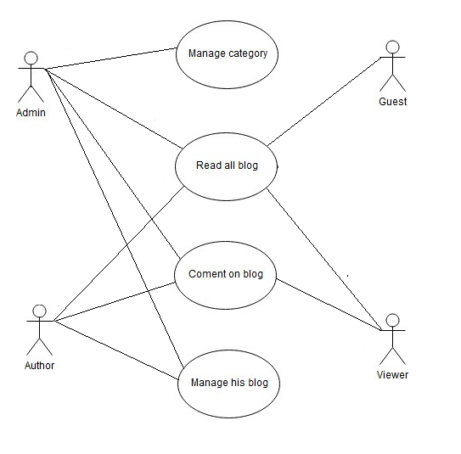
User Case
LBC/Session 8

Slide 6
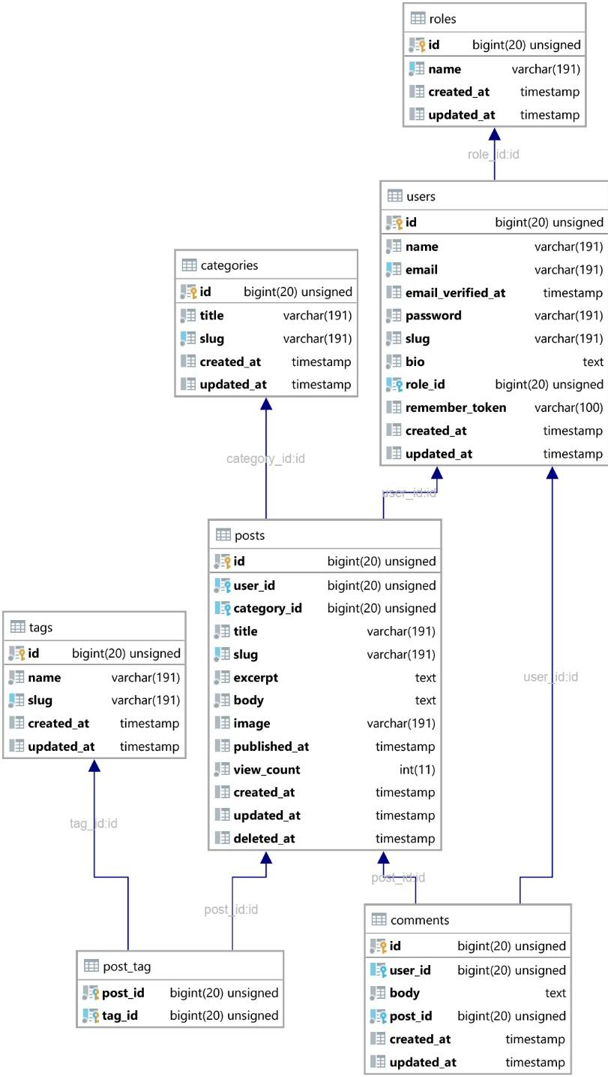
Database Relationship Diagram
LBC/Session 8

