Slide 1
10 - Social networking for idiots

Slide 2
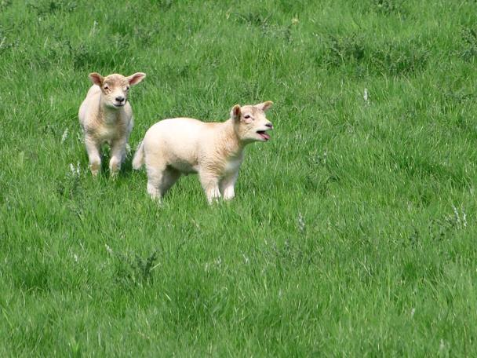
Join a Facebook group with me!

Slide 3
How to stand out
Facebook
Airbrush your profile photo.
Join a group so you don’t look like a creepy loner.
Fabricate an interesting life story.
Show some skin.

Slide 4
You’re not fooling anyone
No matter how many pictures you post showing how fabulous your life is now, your high school classmates will still think of you as they did in high school.

Slide 5

When you join a social networking site, immediately pick a fight with a friend or co-worker. Otherwise, people will think you’re soft.

Slide 6
Your Parents
They’re on the Facebooks,
they love you,
and they want to be your friends!

Slide 7

Do not create profiles for your pets and become their Facebook friends. Even they will feel be ashamed of you.

