Slide 1


Hande Hazan Keskin 21070006014 Mert Kahraman 20070006020 Pelin Sude Kırlı 20070006023
CONTENT
What did we test
Techniques that we used
Results of out tests
Spring, 2022-2023 SE2226 - Software Quality Assurance and Testing Term Project

Slide 2

CONTENT
What did we test
Techniques that we used
Results of our tests
In our project we have tested the Amazon website (https://www.amazon.com.tr) which is used for online shopping world-wide. It is found in 1994 and it is one of the biggest sites of the world. On the website, there are nearly 300 million members and more than 353 million products in multiple categories such as fashion, consumer electronics, home & furniture, grocery and lifestyle products.
This Photo by Unknown Author is licensed under CC BY-SA

Slide 3


For testing of the Amazon Website we have used Black Box testing and White Box Testing together
Black-Box testing
1.1 Testing Report
1.2 Decision Table
1.3 Equivalence Table
1.4 Boundary Analysis
1.5 Use Case Testing
White-Box Technique
2.1 Test for Java Selenium, ChromeDriver
Usability Testing
Load Testing
In our project we have tested the Amazon website (https://www.amazon.com.tr) which is used for online shopping world-wide. It is found in 1994 and it is one of the biggest sites of the world. On the website, there are nearly 300 million members and more than 353 million products in multiple categories such as fashion, consumer electronics, home & furniture, grocery and lifestyle products.
This Photo by Unknown Author is licensed under CC BY-SA

Slide 4
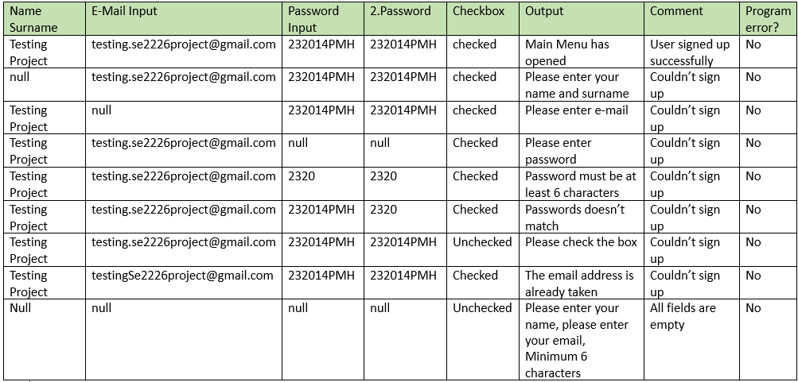
Result Of Our Tests
For testing of the Amazon Website we have used Black Box testing and White Box Testing together
Black-Box testing
1.1 Testing Report
1.2 Decision Table
1.3 Equivalence Table
1.4 Boundary Analysis
1.5 Use Case Testing
White-Box Technique
2.1 Test for Java Selenium, ChromeDriver
Usability Testing
1.1 Testing Report for Sign up Action:

Slide 5
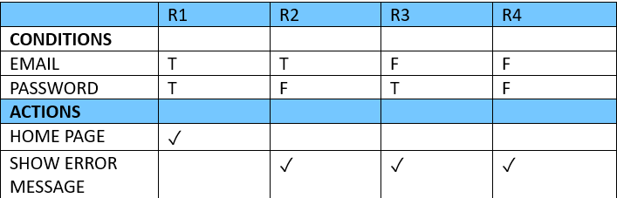
Result Of Our Tests
1.2 Decision Table for Log in Action
1.1 Testing Report for Sign up Action:

Slide 6
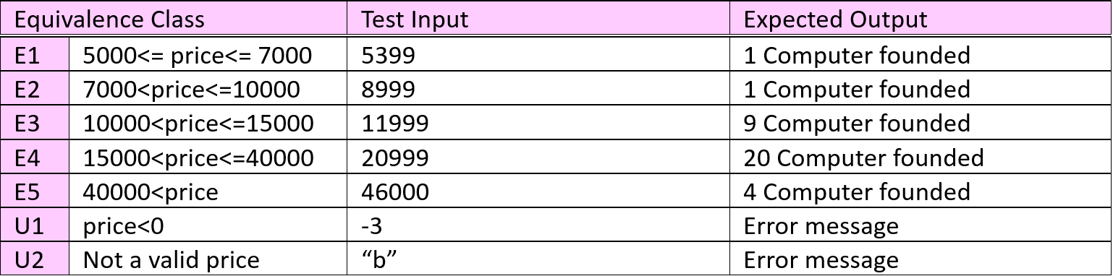
1. 3 Equivalence Table
1.2 Decision Table for Log in Action

Slide 7
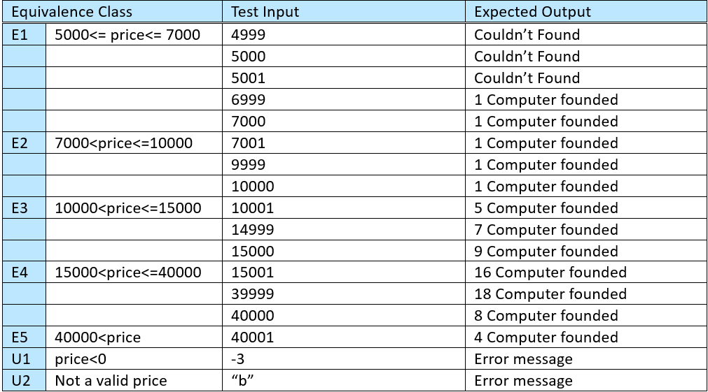
1. 3 Equivalence Table
1. 4 Boundary Analysis

Slide 8
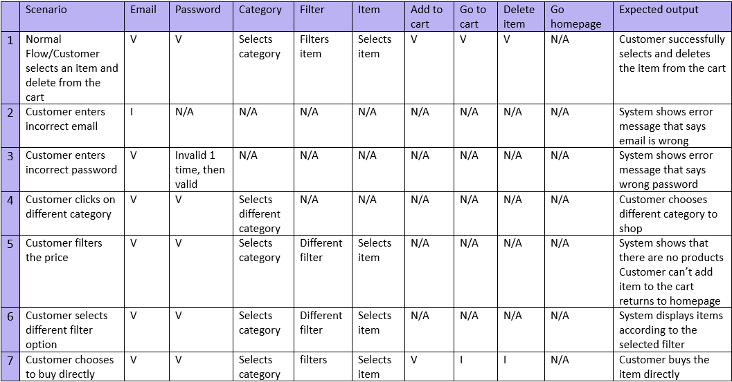
1.5 Use Case Testing
1. 4 Boundary Analysis

Slide 9
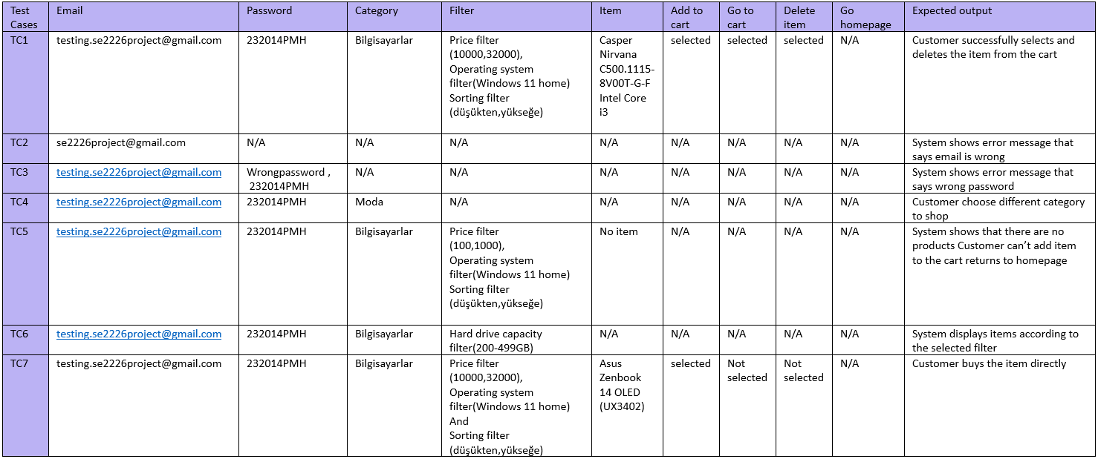
1.5 Use Case Testing

Slide 10

2. White-Box Technique Test for Java Selenium, ChromeDriver We have used the Selenium library and ChromeDriver while automating out test cases. The scenario that we have automated is choosing a computer, adding it to the card and deleting it.
This Photo by Unknown Author is licensed under CC BY-SA

Slide 11

2. White-Box Technique Test for Java Selenium, ChromeDriver We have used the Selenium library and ChromeDriver while automating our test cases. The scenario that we have automated is choosing a computer, adding it to the card and deleting it.
3. Usability Testing Website is tested for these browsers and seen that the website works correctly in these browsers: - Google Chrome - Mozilla Firefox - Internet Explorer/Microsoft Edge
This Photo by Unknown Author is licensed under CC BY-SA

Slide 12
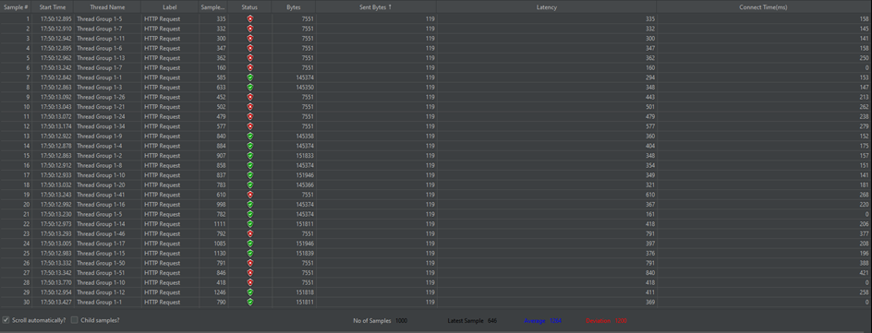

3. Usability Testing Website is tested for these browsers and seen that the website works correctly in these browsers: - Google Chrome - Mozilla Firefox - Internet Explorer/Microsoft Edge
4. Load Testing
Server Hostname: www.amazon.com.tr
Time taken for tests: 27.4 seconds
Completed request: 1000
Failed request: 345
Average bytes: 99221.7 bytes
Longest request: 15850
Shortest request: 113
This Photo by Unknown Author is licensed under CC BY

Slide 13
Thank You for Listening

