Slide 1

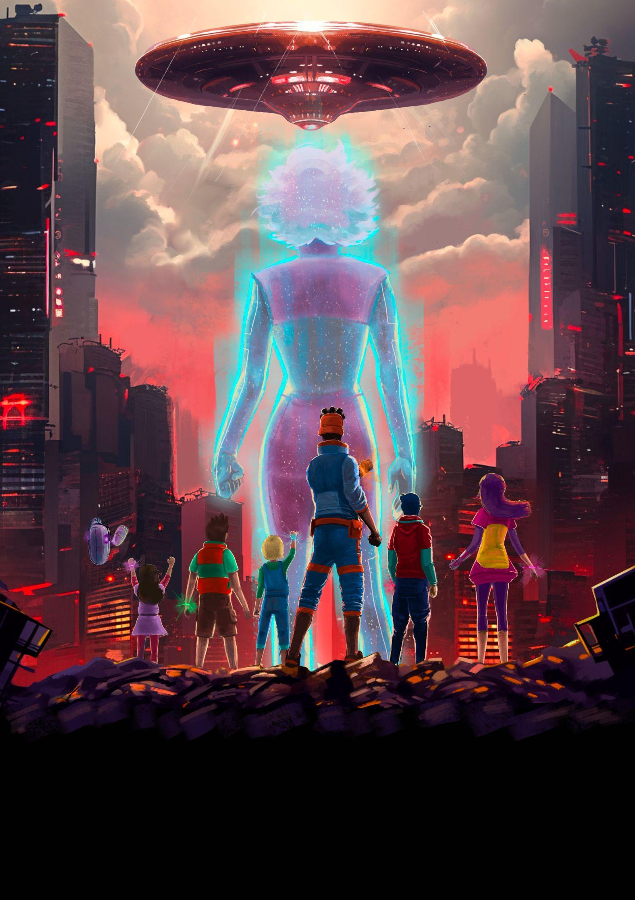
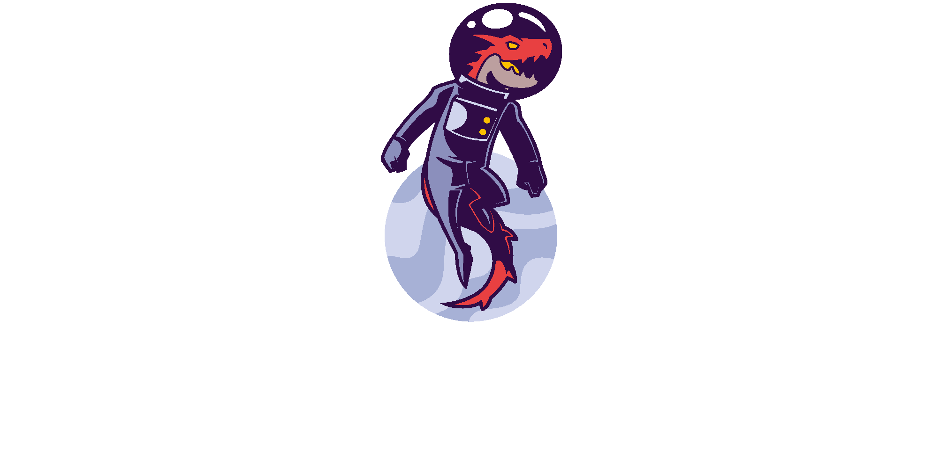





Mitchell Simmons: A brave youth with mechanical expertise who’s still searching to prove as a leader.
—------
Ren Zhao: A genius in robotics and mathematics, who struggles in socializing due to her reserved character.
—------
Marty Mendoza: A natural in programming, with a rebellious spirit, but shy at heart keeping him from coming out of his shell.
—------
Dasha Pavlov: Rough and tough, yet kind and caring, with a knack for medicine and operating medical equipment.
—------
Tony Mendoza: A child daredevil, with exceptional intuition and recklessness with any device, scaring even their creators.
—------
Chandra Yadav: The youngest of the group with unlimited scientific potential, able to grasp new concepts making her a powerful ally, but an unpredictable one.
—------
HELEN: An advanced Artificial intelligence with the intention of improving life on Earth.
—------
R081 “ROBI”: A friendly robot, designed to adapt to any situation, transforming his body using different devices
TV series
2D frame by frame
Elementary to junior high
Action / Adventure
12 episodes x 22 min
The earth is on the brink of destruction, and the only ones who can stop it have been captured. Their only hope? their kids. These brilliant young minds must use all the technology at their disposal to fight back the mysterious menace and defeat the dreaded Master and his shadowy army of grey men.
The adventures of each episode will address some topic of trending technology and exemplify it in a simple way for understanding. Seeking an educational purpose, achieving a greater understanding of the use of current technology.
DRAGONAUT ANIMATION CONFIDENTIAL DOCUMENT. PARTIAL OR TOTAL DIFFUSION IS PROHIBITED.

