Slide 1
Design and Implementation of Real-time Communication for Sensory Network with Website Based Control Application
Martin Zlámal
UNIVERSITY OF WEST BOHEMIA
2016
Faculty of Electrical Engineering
Department of Electric power engineering and Ecology

Slide 2
Intelligent Home Wiring
Martin Zlámal
UNIVERSITY OF WEST BOHEMIA
2016
Faculty of Electrical Engineering
Department of Electric power engineering and Ecology

Slide 3
What was the first idea?
What I actually did.
Implementation of the communication.
Result discussion, what about feature?
Overview
1/7

Slide 4
Basic home wiring is good enough.
So what is the point?
Automation can be (very) complicated.
What about PLC (Programmable Logic Controller)?
Can it be done better? Of course!
First idea
2/7

Slide 5
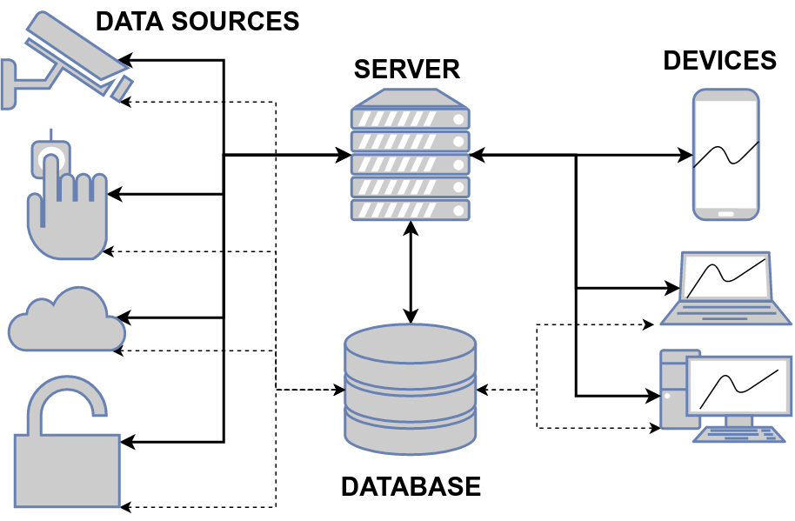
Final implementation
3/7

Slide 6
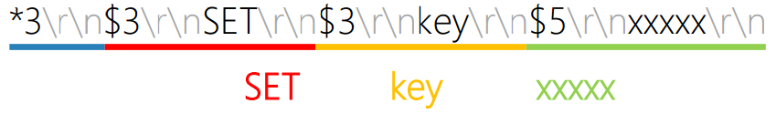
Goal number one? Ludicrous speed.
I mean really absurd (millions of requests per second).
TCP, UDP, Websockets – nothing special.
Direct database access – RESP data format.
REdis Serialization Protocol:
Communication
4/7

Slide 7
YES
It's flexible?
It's fast and reliable.
It's easily extendable.
It's network independent.
YES, maybe
YES
YES
Why is it awesome?
5/7

Slide 8
Home wiring can be done better (differently).
But, home is not the right use case.
Speed is not an issue, reliability may be.
You just saw the distant future.
(but maybe not so distant)
Summary
6/7

Slide 9
ABB University Award 2015 winner
I would choose different approach now.
I learned a lot, but I don't want to continue.
Remember: it's all about data handling.
Conclusion
7/7

Slide 10
Thank you for listening.
I will now answer any questions you may have.

