Slide 1
Event Processing Project SS22
Ahmet Turkmen

Slide 2

Overview
Environment
Architecture
Producer
Streams
Queries
Demo

Slide 3



Environment
Go Programming Language
Apache Kafka
ksqlDB

Slide 4



Host System Information
20.04.1-Ubuntu
x86_64 GNU/Linux
Intel(R) Core(TM) i5-6300U
CPU @ 2.40GHz
4 Cores
12GB 2133 Mhz

Slide 5

Apache Kafka
Apache Kafka is an open-source distributed event streaming platform used by thousands of companies for high-performance data pipelines, streaming analytics, data integration, and mission-critical applications.
More than 80% of all Fortune 100 companies trust, and use Kafka
*All information and figures on this page taken from: https://kafka.apache.org/

Slide 6
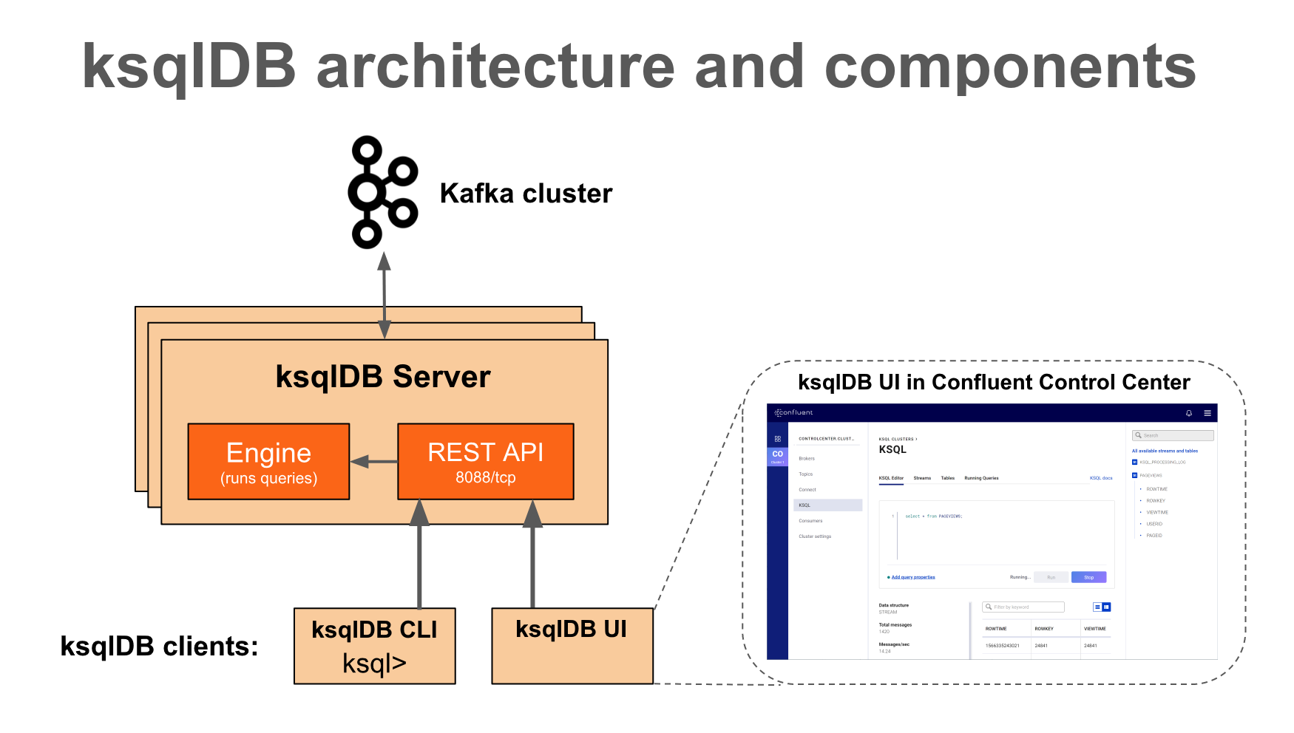
Architecture
*Figure taken from: https://docs.ksqldb.io/en/latest/operate-and-deploy/how-it-works/

Slide 7
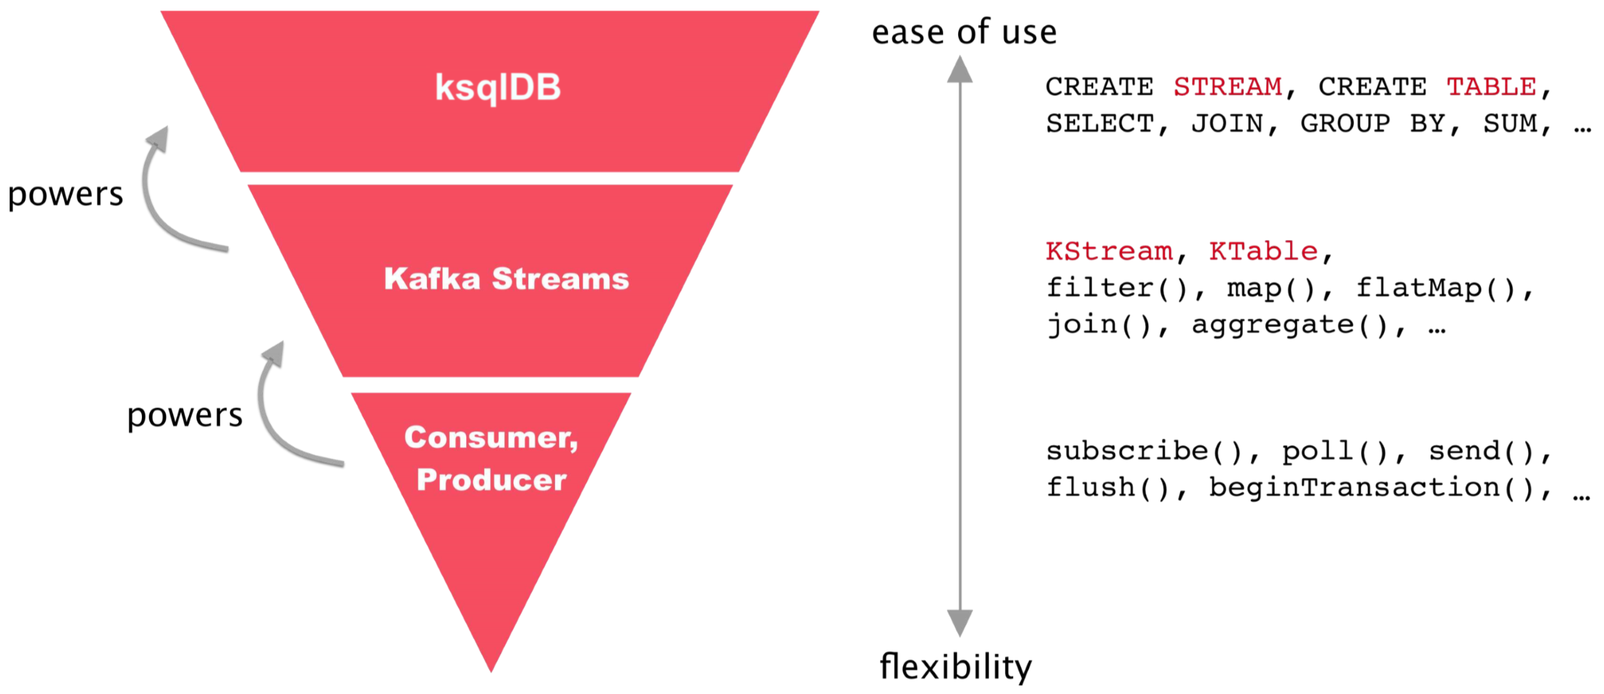
ksqlDB and Kafka Streams

Slide 8
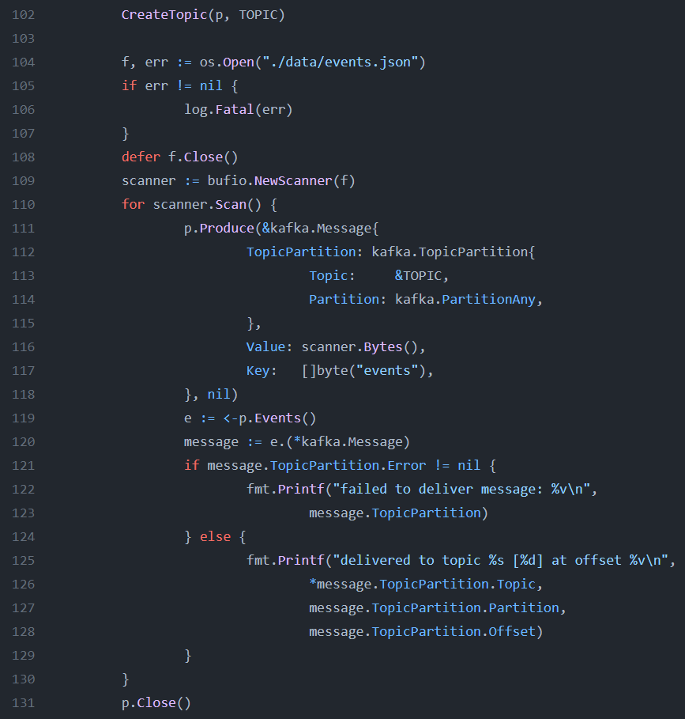
Producer

Slide 9
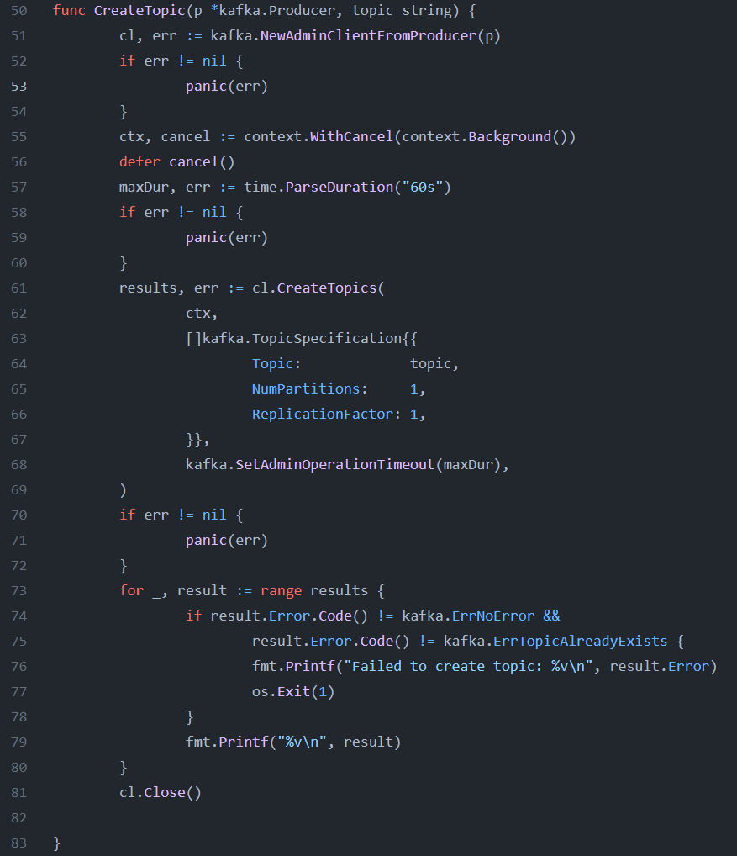
CreateTopic

Slide 10
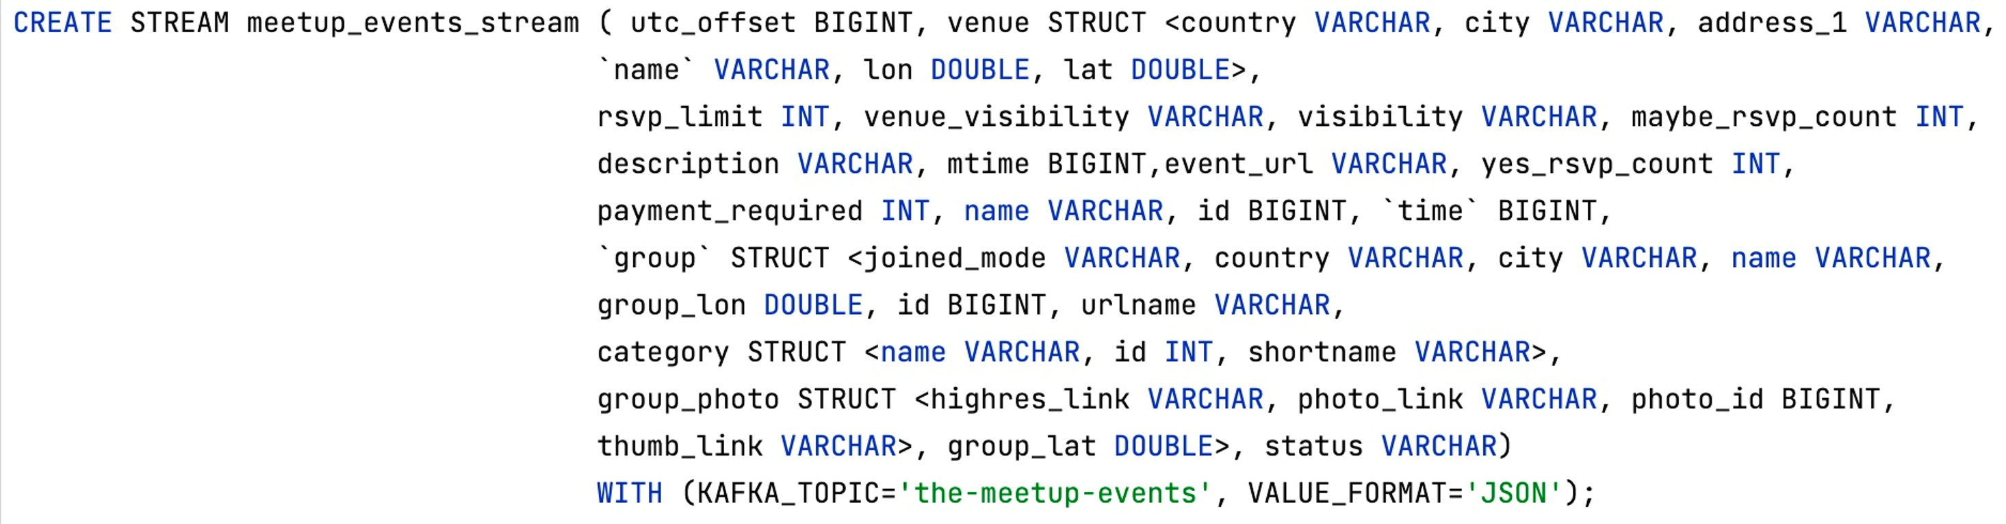
Queries
meetup_events_stream

Slide 11
Queries
The filters- country_filtered, city_filtered_*

Slide 12

Stream Flow

Slide 13

Demo
CAN BE WATCHED OVER HERE
PROJECT REPOSITORY
https://github.com/mrtrkmn/kafka-event-processing
https://youtu.be/_

Slide 14
Any questions ?
Reach out me at:
https://mrturkmen.com
ahmet.tuerkmen@tum.de
github.com/mrtrkmn

