Slide 1
Predictive Maintenance
Literature Review

Slide 2
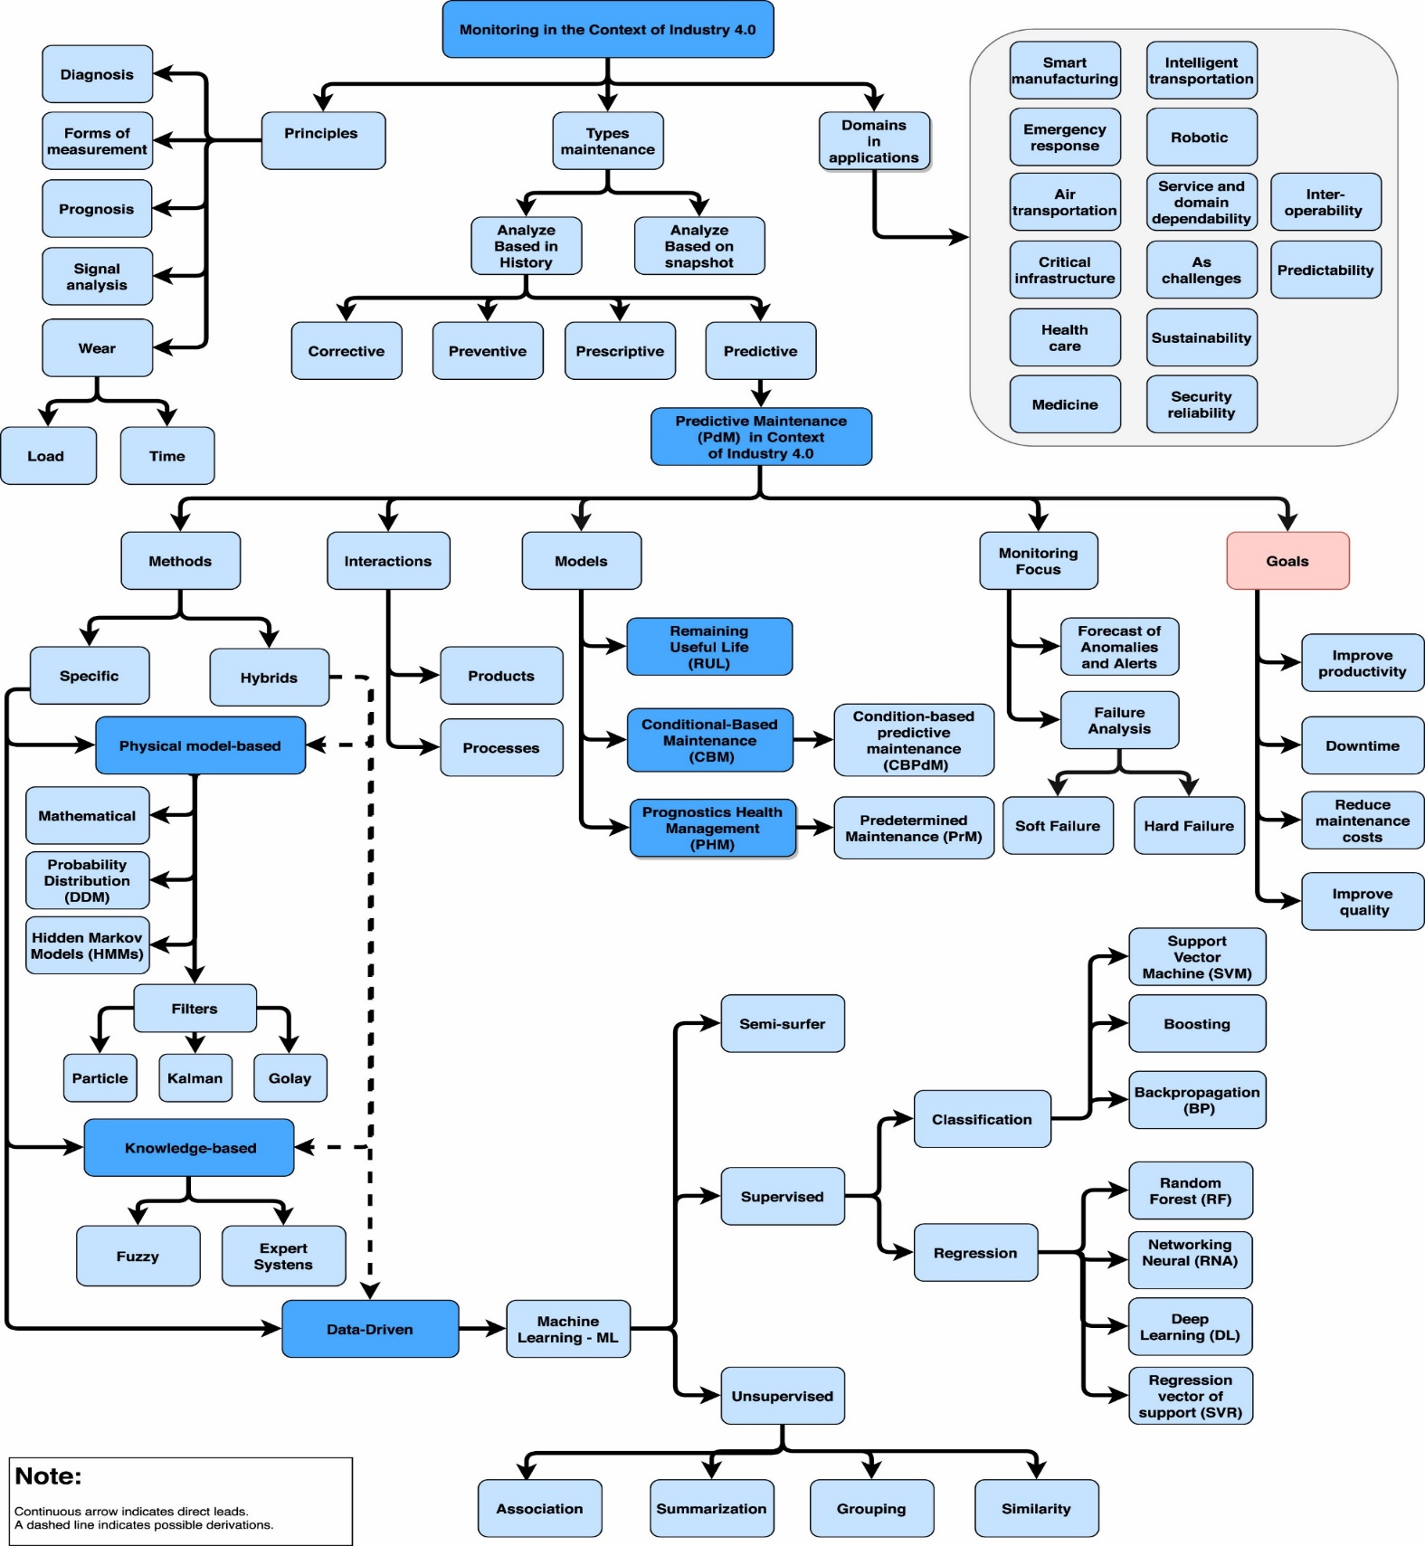
Predictive maintenance in the Industry 4.0: A systematic literature review
Physical model-based (hybrid approaches – DL/ML model + physical model | IoT + Cloud computing)
Knowledge-based (monitoring alerts/ hybrid approaches – statistical-based approach)
Data-driven (data acquisition)
Search strategy
Google scholar (starting database)
Association for Computing Machinery (ACM)
IEEE
ScienceDirect (Elsevier)
Scopus
Web of Science
Challenge
Real time-based PdM application:
Single case predicted a 7-day interval: An Industrial Case Study Using Vibration Data and Machine Learning to Predict Asset Health (IEEE 20th Conference on Business Informatics CBI - 2018)
Schedule maintenance, Scheduled preventive operations
Heterogeneous data, bench tests:
The complexity of stopping a machine for evaluation/ allowing failure
Image-based PdM: images and thermography
Industrial Big Data in an Industry 4.0 Environment: Challenges, Schemes, and Applications for Predictive Maintenance (IEEE Access 2017)
Computer & Industrial Engineering (Journal) – Elsevier (Publisher) – December 2020
Review/ Methods

Slide 3
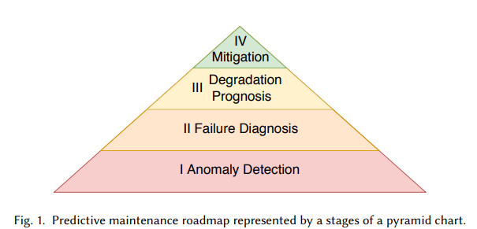
Deep learning models for predictive maintenance: a survey, comparison, challenges and prospect
Contributions:
Review and explain the SOTA DL in PdM
Compare pros and corns between DL and ML
Trends on PdM, research gaps, opportunities and challenges
Steps:
1. Anomaly Detection: detect abnormal events
2. Diagnosis: anomaly detected => faulty working condition | no risk of failure (Models | Health Index (HI))
3. Prognosis: monitor (Remaining useful life models)
Similarity-based | Statistical | Time series analysis (ARIMA) | Learning (Classification | Regression (directly estimate HI))
4. Mitigation: perform maintenance actions
Methodology:
Feed-forward/MLP - GAN
CNN - SOM
RNN/ LSTM/ GRU
AE/ Sparse AE
Dataset:
Milling dataset
Bearing dataset
Turbofan engine degradation simulation dataset
Femto bearing dataset
- explainable artificial intelligence (XAI) (domain experts + data scientists)
Applied Intelligence (APIN) – Springer Link (Publisher) – January 2022
Review/ Methods

Slide 4
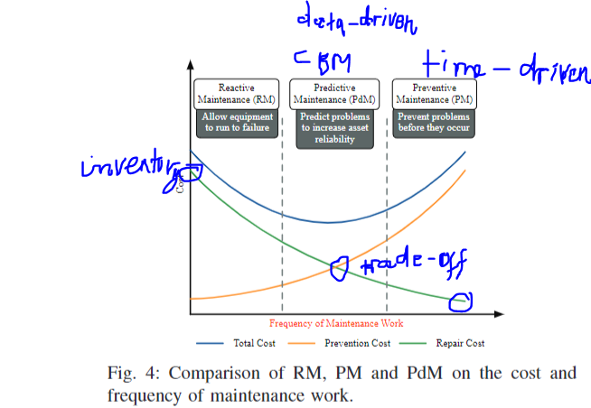
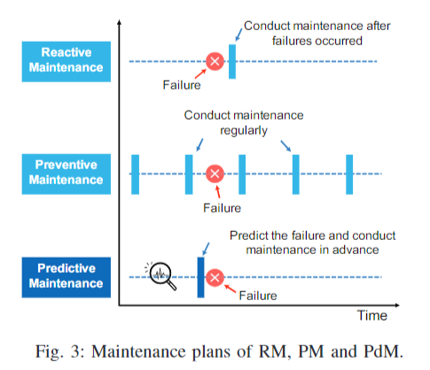
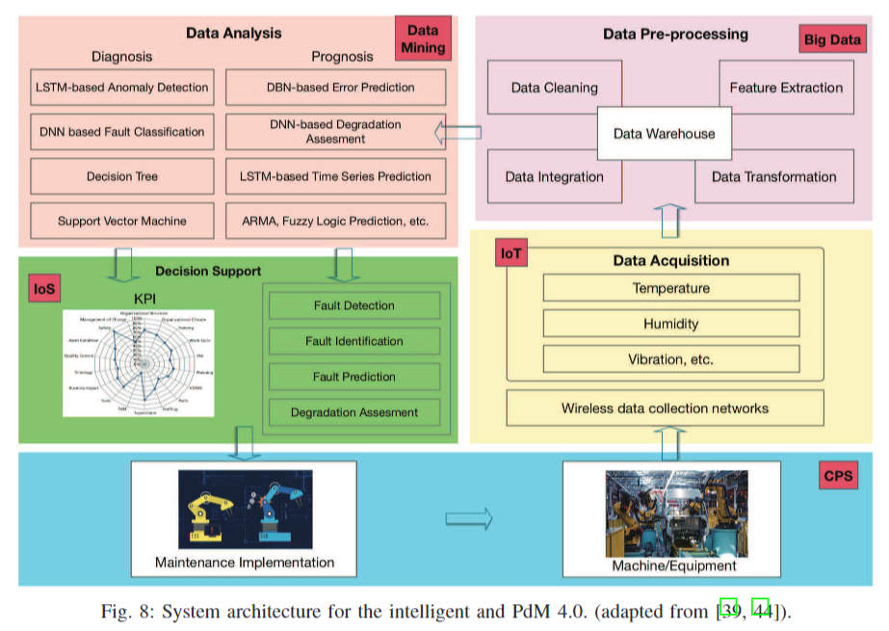
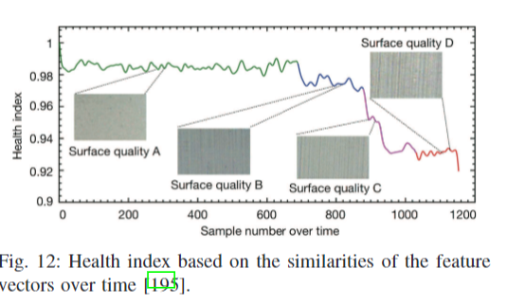
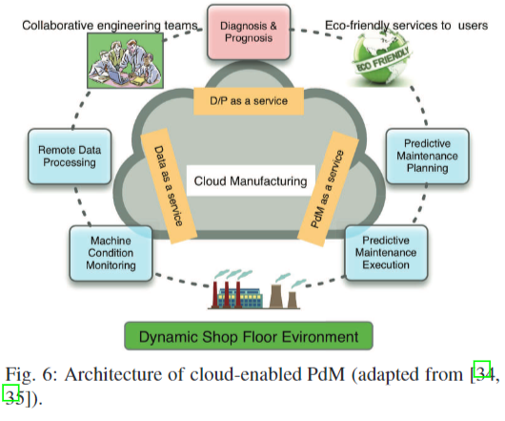
A Survey of Predictive Maintenance: Systems, Purposes and Approaches
- A transition of maintenance strategies from Reactive Maintenance (restore the equipment after failure occurs) → Preventive Maintenance (a planned schedule, unnecessary, prevention costs) → PdM
- The limitations of existing surveys:
Focus on equipment specific -> provide a holistic PdM system.
Lacking mathematical models for PdM
New DL approaches
GAN is firstly utilized as a data augmentation technique to
address the class imbalance issue in the field of PdM
Electrical Engineering and Systems Science – arXivLabs – December 2019
Review/ Methods

Slide 5
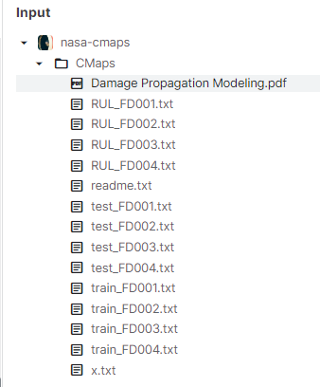
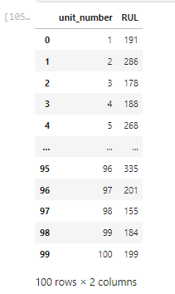
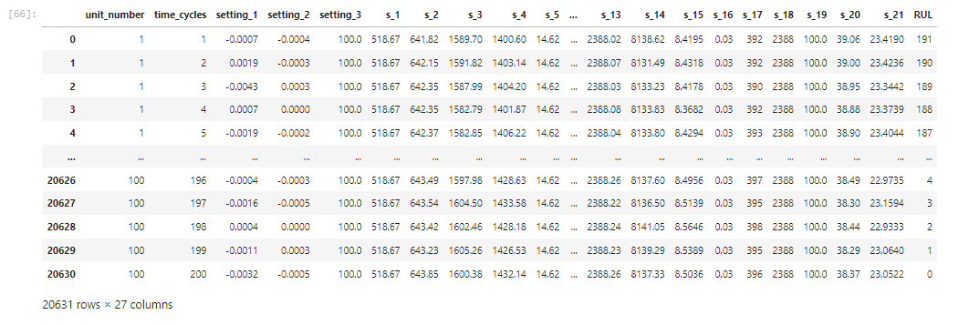
Aircraft Turbofan Engines dataset (C-MAPSS)

Slide 6
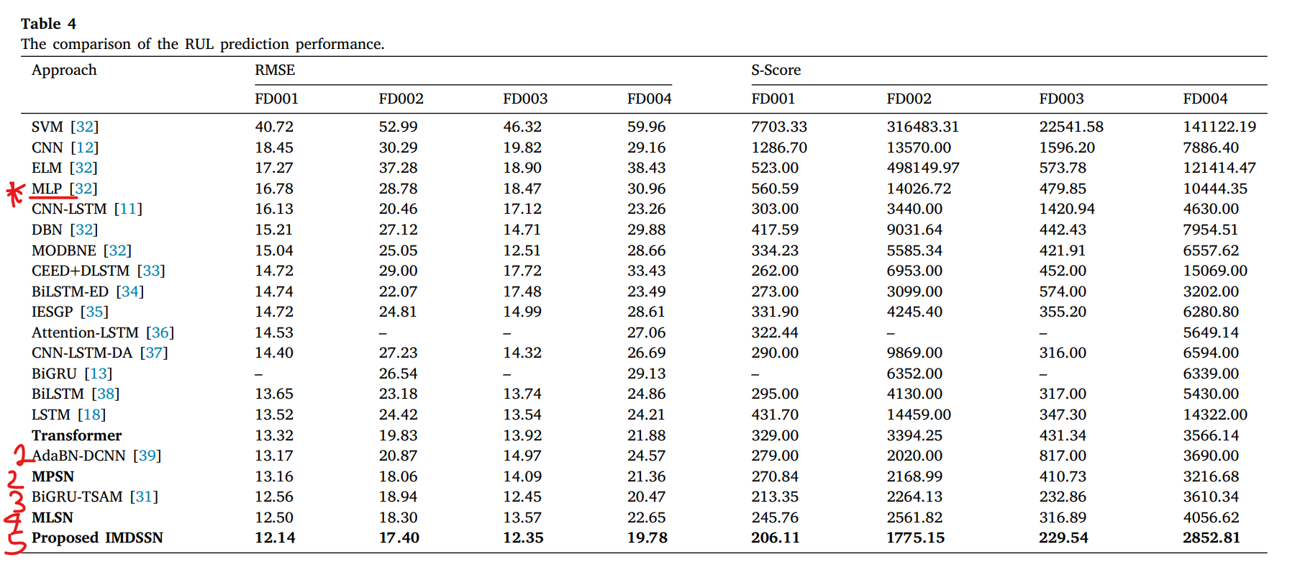
Experimental Results

Slide 7
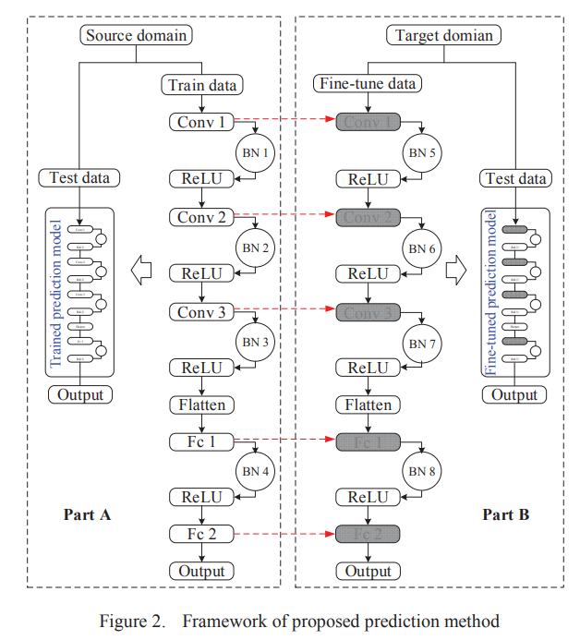
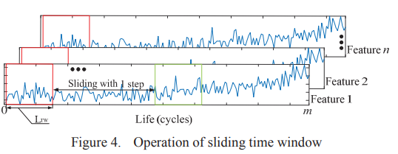
Domain Adaptation Remaining Useful Life Prediction Method Based on AdaBN-DCNN
Aircraft turbofan engine/ milling dataset
Adaptive Batch Normalization (AdaBN)
Fine-tune data
Improve the predictive results under different data domains
Quickly
Review/ Methods
Prognostics and System Health Management (Conference) – IEEE (Publisher) – December 2019

Slide 8
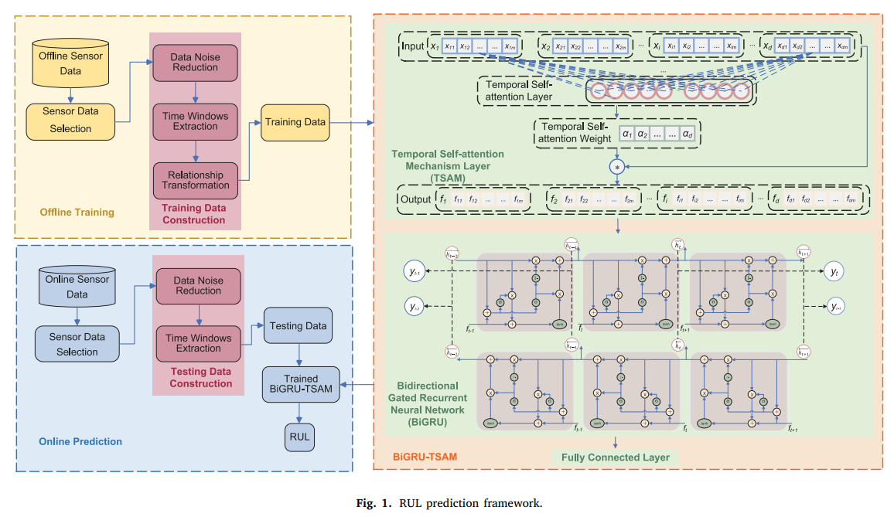
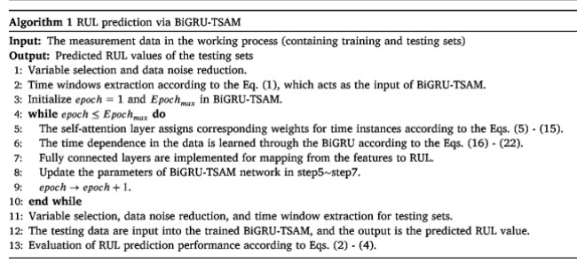
Prediction of remaining useful life based on bidirectional gated recurrent unit with temporal self-attention mechanism (BiGRU-TSAM)
Aircraft turbofan engine/ milling dataset
Temporal self-attention mechanism (TSAM)
Bidirectional gated recurrent neural network (BiGRU)
Analysis of the interpretability of TSAM layer/ residul matrices (visualization)
Review/ Methods
Reliability Engineering & System Safety (Journal) – Elsevier (Publisher) – December 2021

Slide 9
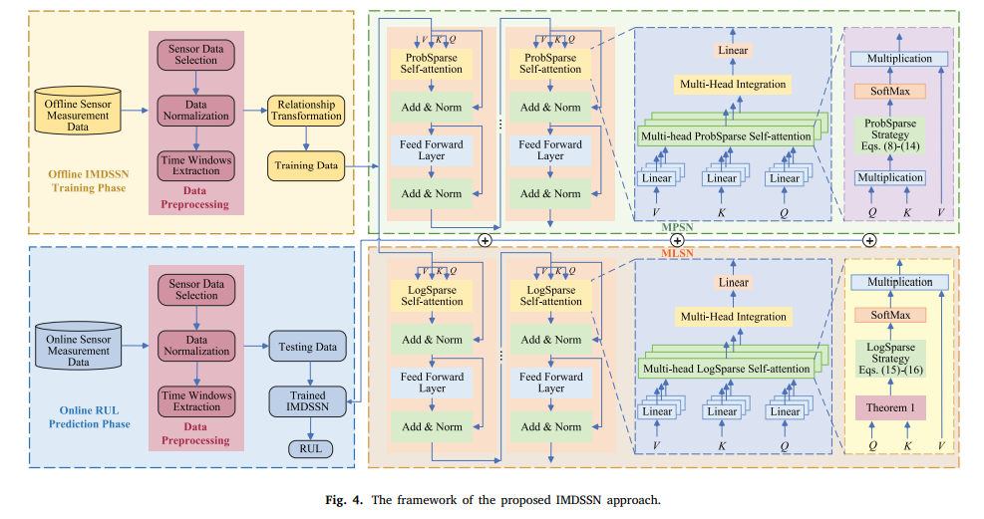
An integrated multi-head dual sparse self-attention network for remaining useful life prediction
A multi-head ProbSparse self-attention network (MPSN) - (𝑂(𝐿𝑙𝑛𝐿) < 𝑂 (𝐿2))
A multi-head LogSparse self-attention network (MLSN) - 𝑂((𝑙𝑜𝑔2𝐿) 2 )
A novel integrated multi-head dual sparse self-attention network (IMDSSN)
Local regions and computational complexity
CNN limitations: the size of convolution → challenging to capture long-distance features
RNN limitations: cannot construct the associations between non-adjacent data
Conventional Transformers limitation:
decrease the sensitivity to the significant local regions
computational complexity increases quadratically with the time window length
Embedded features + positional information
Kullback Leibler (KL) divergence
Review/ Methods
Reliability Engineering and System Safety (Journals) – Elsevier (Publisher) – January 2023

Slide 10
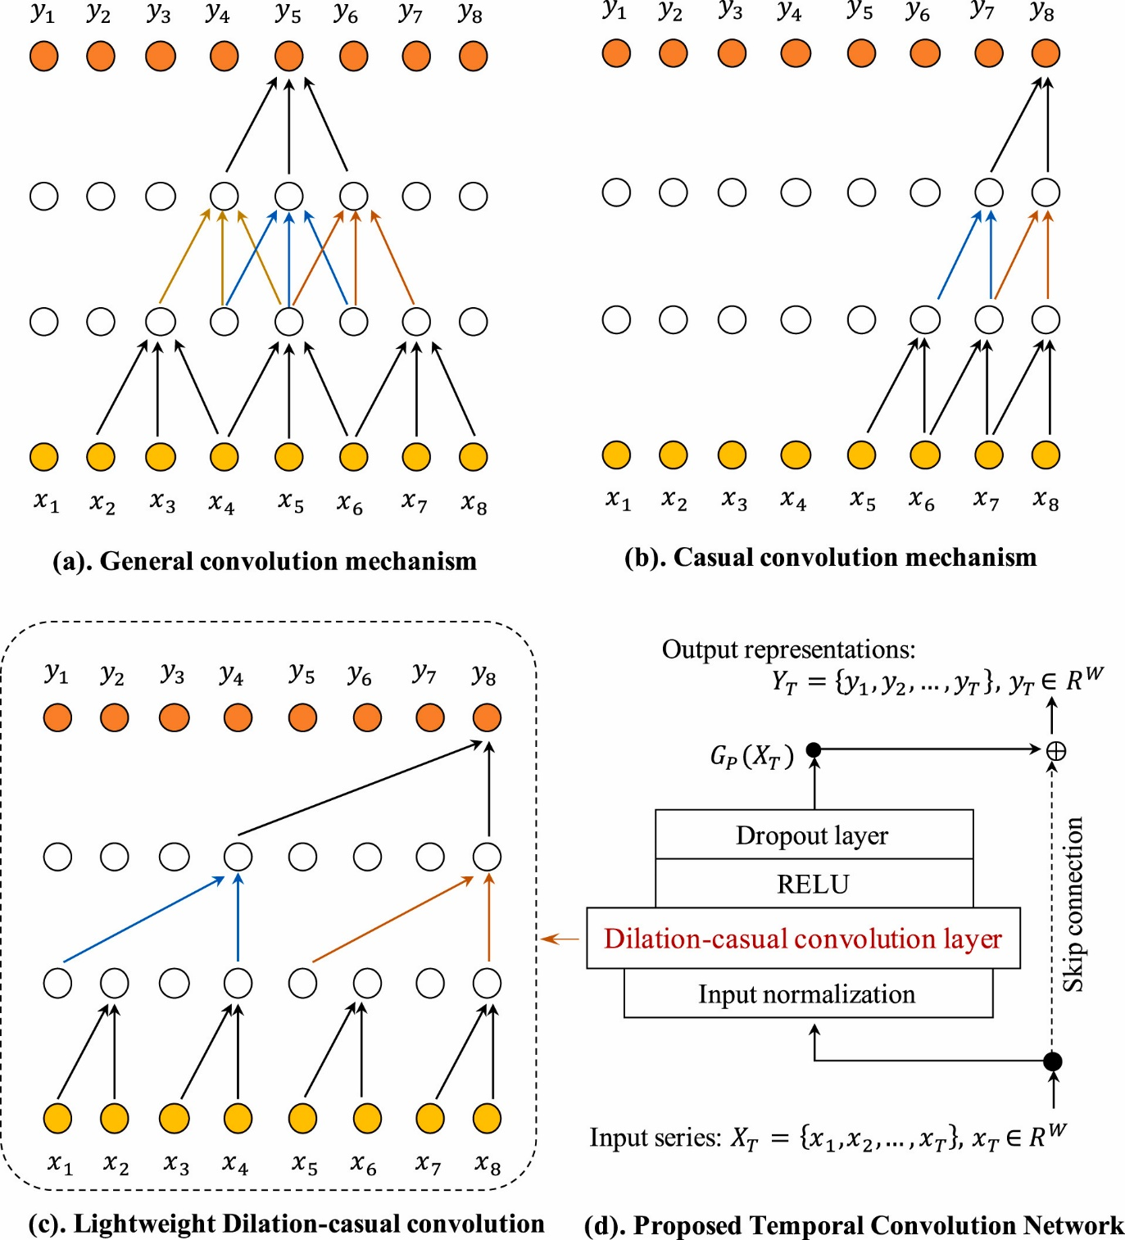
Modelling long- and short-term multi-dimensional patterns in predictive maintenance with accumulative attention
Temporal Convolution Network (TCN) - good long-term dependencies >< local patterns
Accumulative self-attention layer (ASA)
Autoregressive component
Lightweight RUL (TCN-ASA)
Transformer →Sparse Transformer (Reduce the computational complexity/ some cells are abandoned for attention, which leads information loss) → How to design a lightweight but effective self-attention mechanism?
Research Gap:
sequential models face input length restrictions
Disadvantages in local feature extraction (temporal and spatial)
Prediction model is still in shortage for predictive maintenance
Review/ Methods
Reliability Engineering & System Safety (Journal) – Elsevier (Publisher) – September 2023

Slide 11
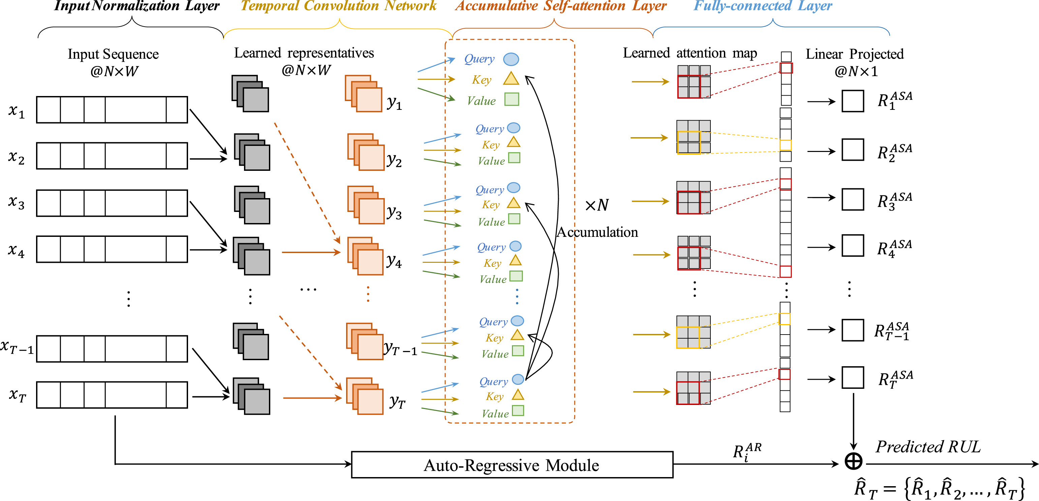
Modelling long- and short-term multi-dimensional patterns in predictive maintenance with accumulative attention
Review/ Methods
Computer & Industrial Engineering (Journal) – Elsevier (Publisher) – December 2020

Slide 12
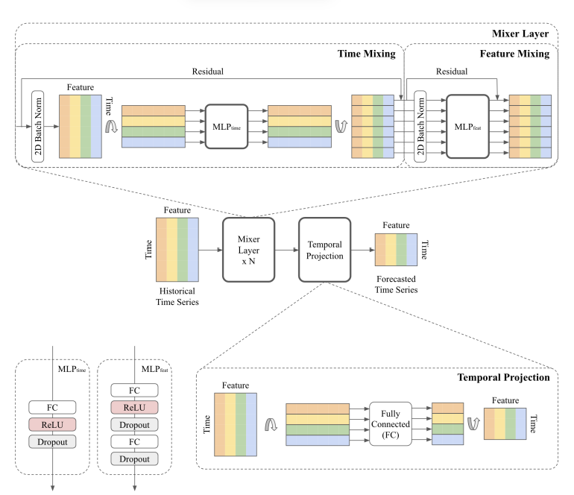
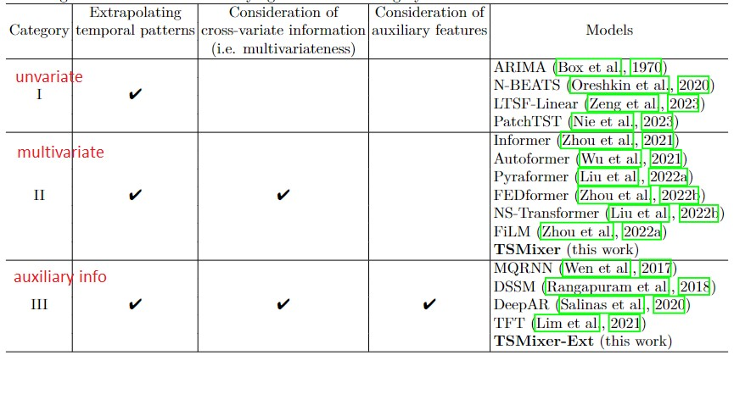
TSMixer: An All-MLP Architecture for Time Series Fore casting
Google Cloud AI Research
https://github.com/google-research/google-research/tree/master/tsmixer
Previous DL tend to overfit the data
“time-step-dependent” >< “data-dependent”
Review/ Methods
arXiv – CS| ML – September 2023

Slide 13
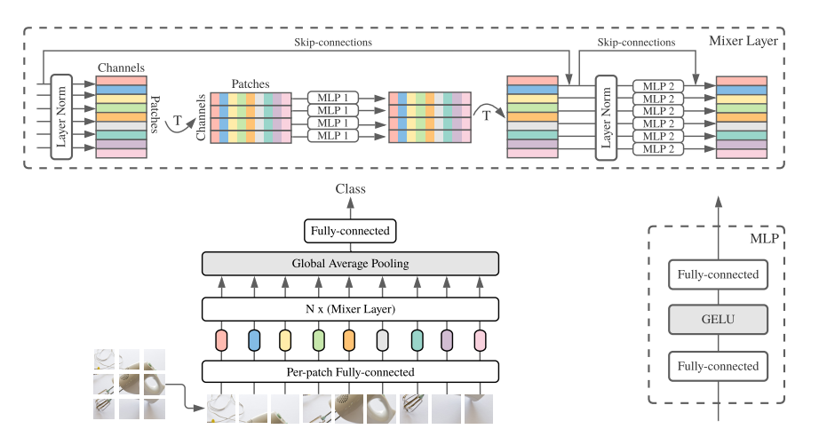
MLP-Mixer: An all-MLP Architecture for Vision
Review/ Methods
Advances in Neural Information Processing Systems 34 (NeurIPS 2021)

Slide 14
Research Methodology
- lay data ve
- code kien truc
- thu nghiem data nao
- phuong phap metric
review - data - phuong phap - ket qua

