Slide 1
Magnetic Characterization
February 28th 2024
Notes:
1

Slide 2
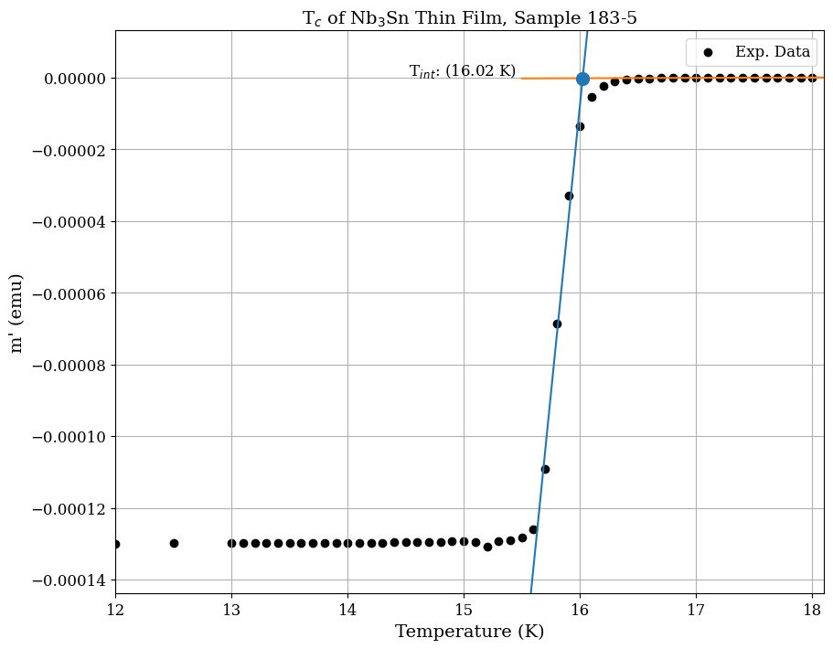
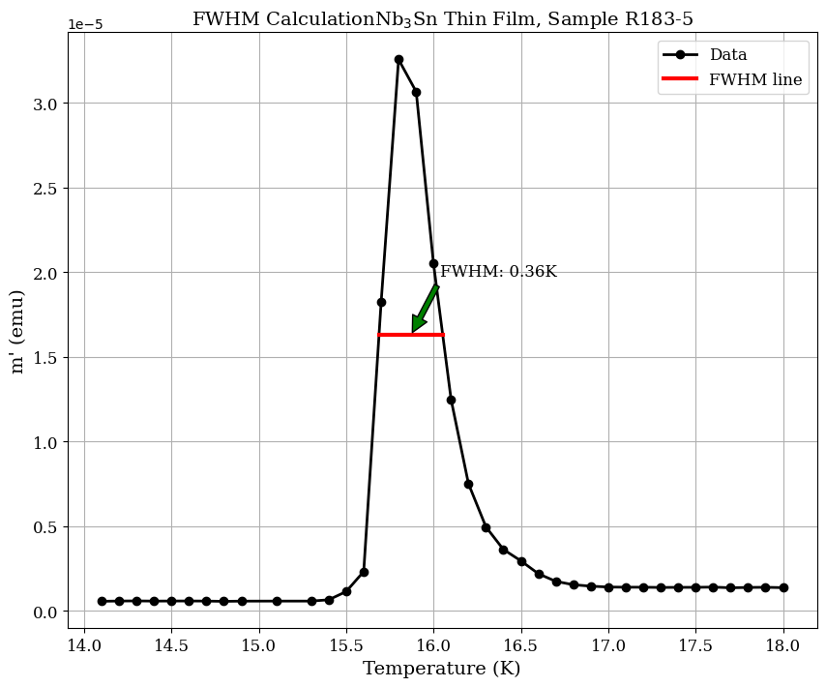
T_{c}
Sample | T_{c} (K) | ∆T_{c} (K)
R183-5 | 16.02 | 0.36
R168-5 | 15.83 | 0.3
R173-5 | 15.76 | 0.43
R192-5 | 15.93 | 0.4
R94-4 | 15.23 | 0.3

Slide 3
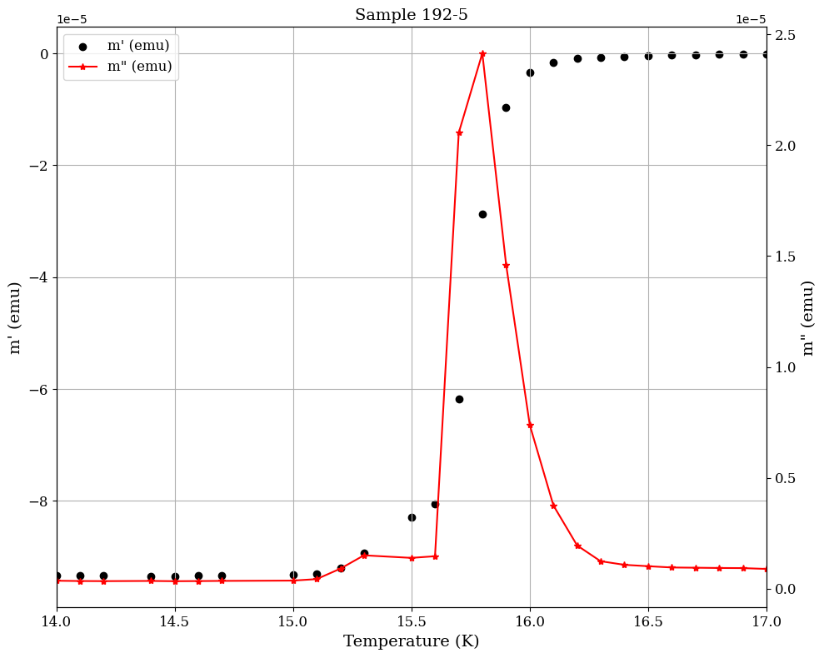
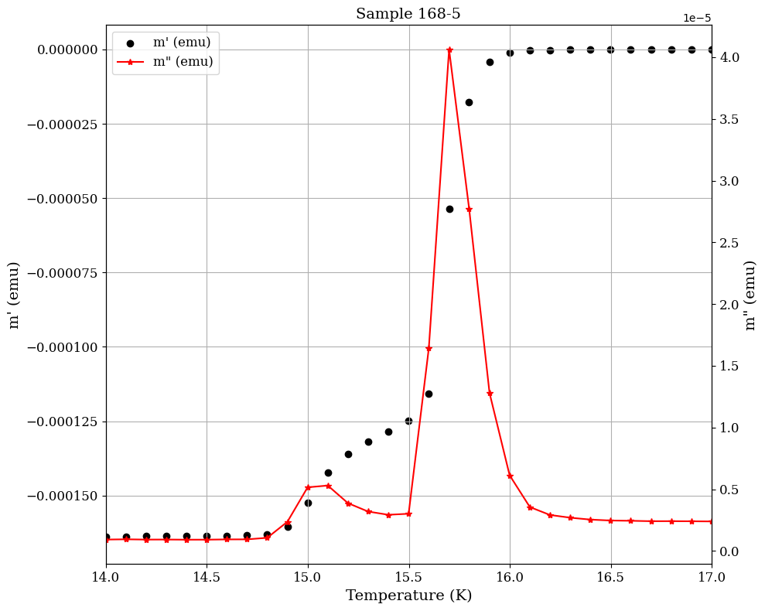
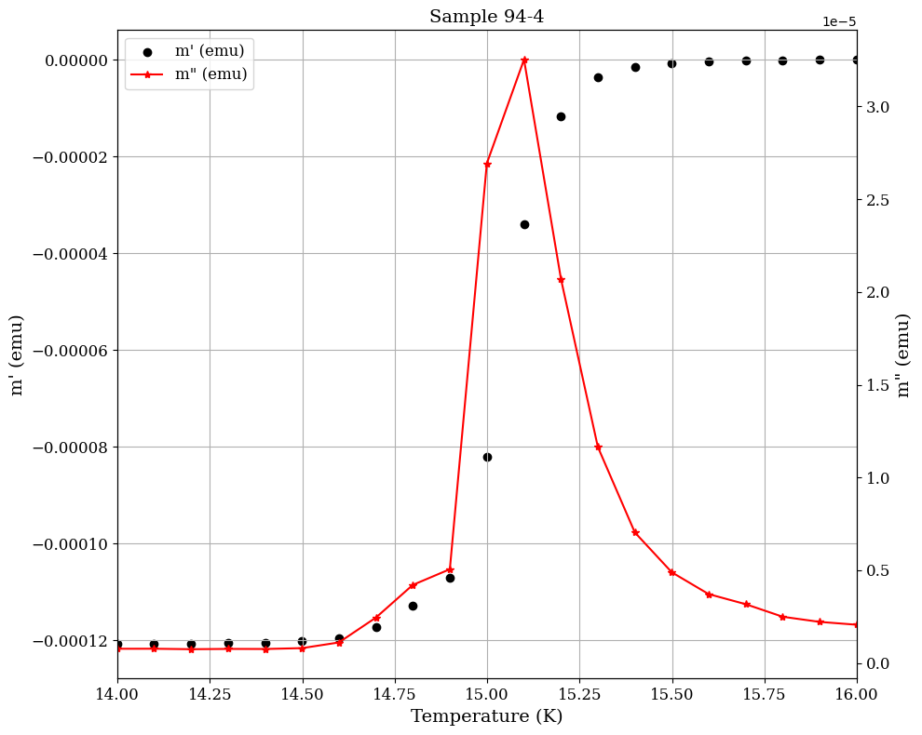
Samples with Ta interlayer

Slide 4
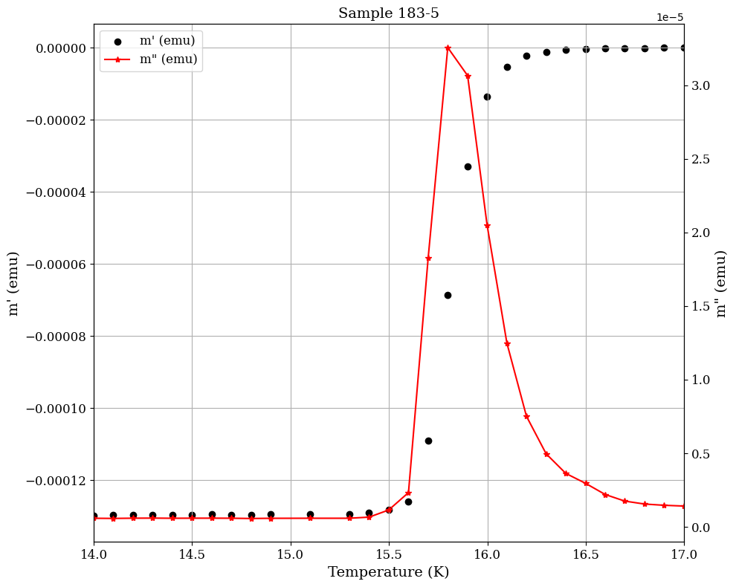
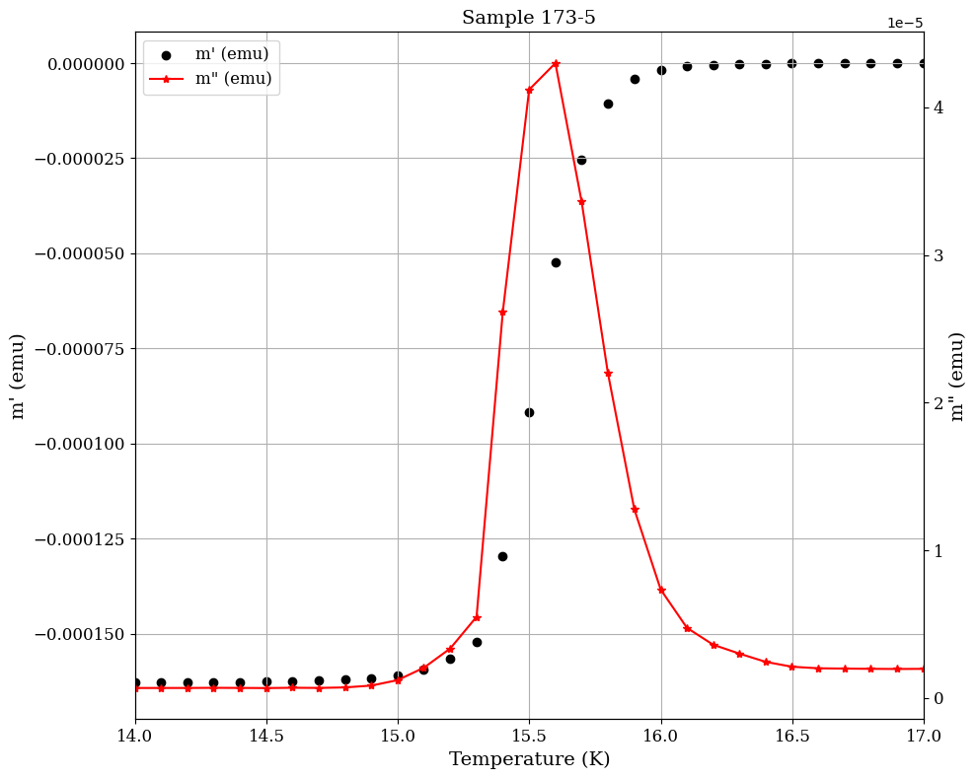
Samples without Ta interlayer

Slide 5
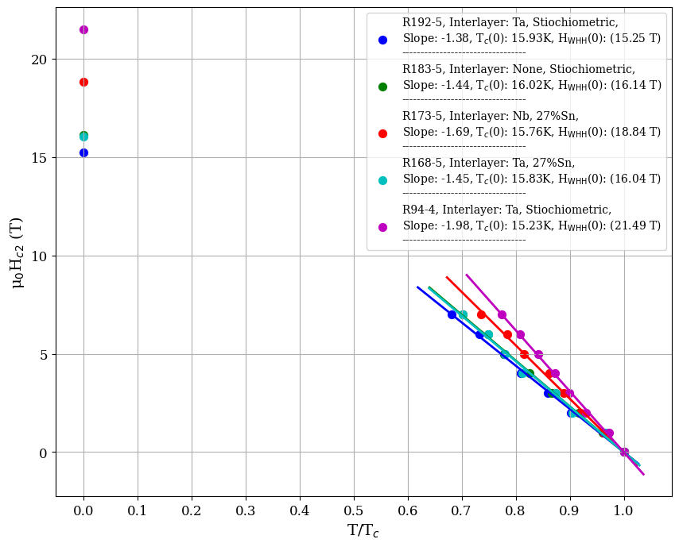
Upper critical field

Slide 6
Comparison
R183-5
No interlayer, of course no Interlayer Annealing, and no Post-Annealing of S.C. Layer
Type: Stoichiometric
S.C. layer thickness = 2.717 μm
T_{c}(0) = 16.02 K, μ₀H_{WHH}(0) = 16.14 T
Interlayer: Ta
S.C. layer thickness = 2.672 μm
R192-5
Type: Stoichiometric
T_{c}(0) = 15.93 K , μ₀H_{WHH}(0) = 15.25 T
Post-Annealing of S.C. Layer
Interlayer: Ta
S.C. layer thickness = ----
R94-4
Type: Stoichiometric
T_{c}(0) = 15.23 K , μ₀H_{WHH}(0) = 21.94 T
Interlayer Annealing

Slide 7
Comparison
R183-5
No interlayer, of course no Interlayer Annealing, and no Post-Annealing of S.C. Layer
Type: Stoichiometric
S.C. layer thickness = 2.717 μm
T_{c}(0) = 16.02 K, μ₀H_{WHH}(0) = 16.14 T
Interlayer: Ta
S.C. layer thickness = 3 μm
R168-5
Type: 27%Sn
T_{c}(0) = 15.83 K , μ₀H_{WHH}(0) = 16.04 T
No Annealing
Interlayer: Nb
S.C. layer thickness = 2.672 μm
R173-4
Type: 27%Sn
T_{c}(0) = 15.76 K , μ₀H_{WHH}(0) = 18.84 T
No Annealing

Slide 8
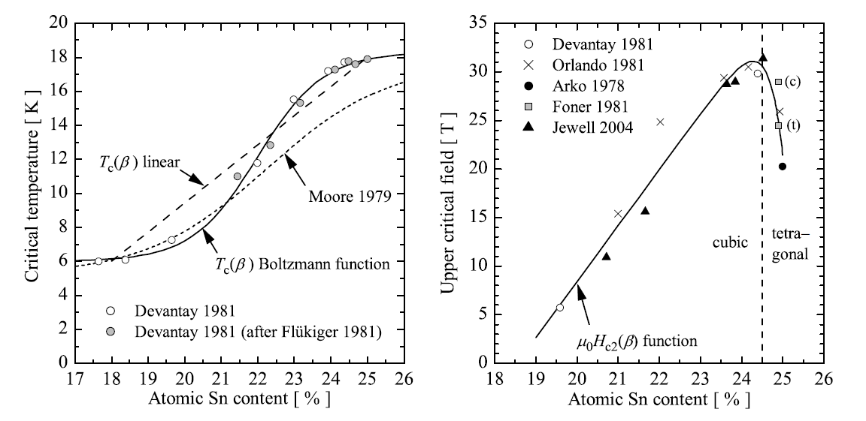
Godeke, A. (2006). A review of the properties of Nb3Sn and their variation with A15 composition, morphology and strain state. Superconductor Science and Technology, 19(8), R68.

Slide 9
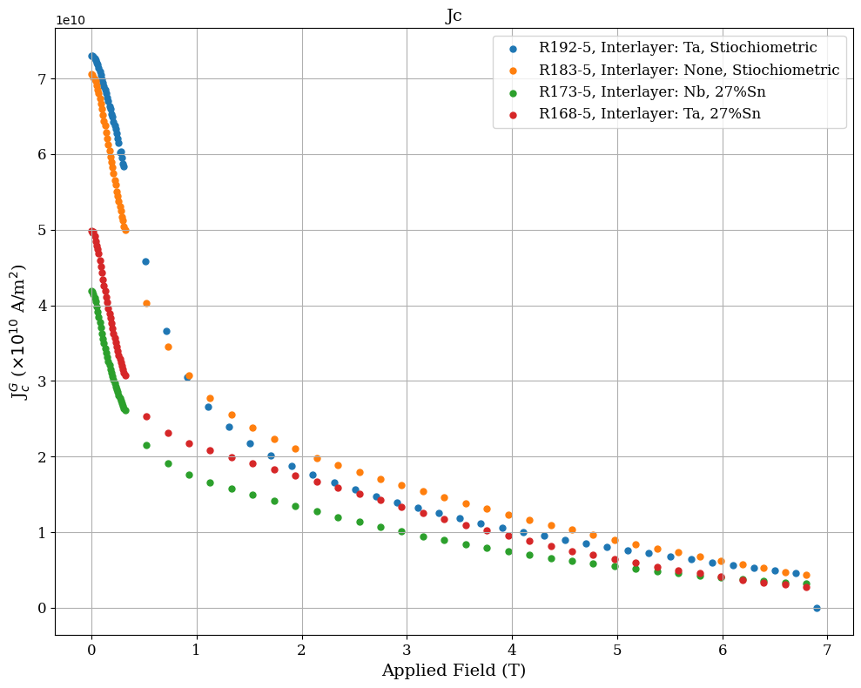
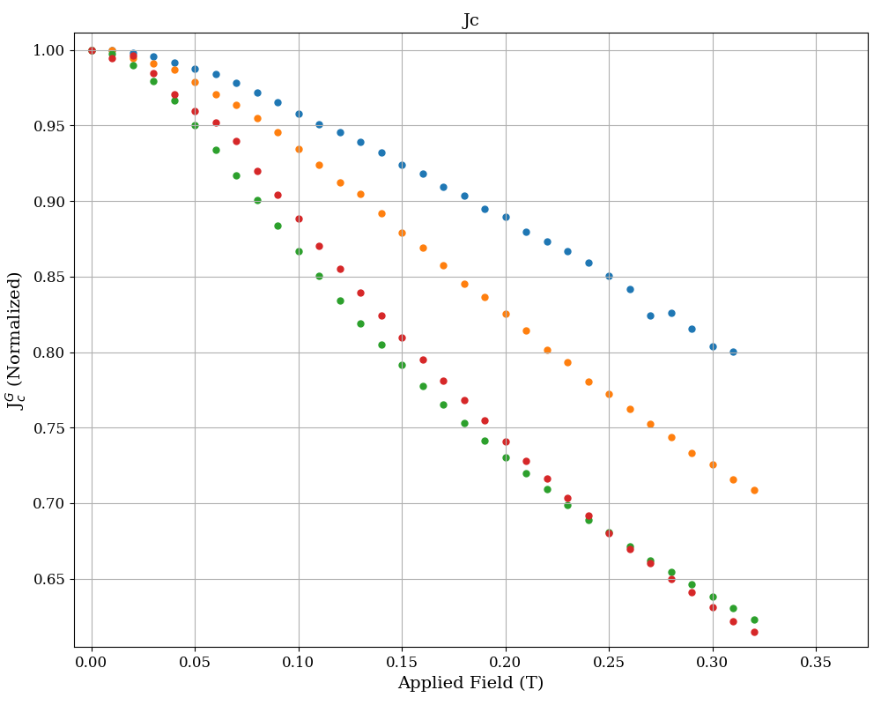
Critical current density

Slide 10
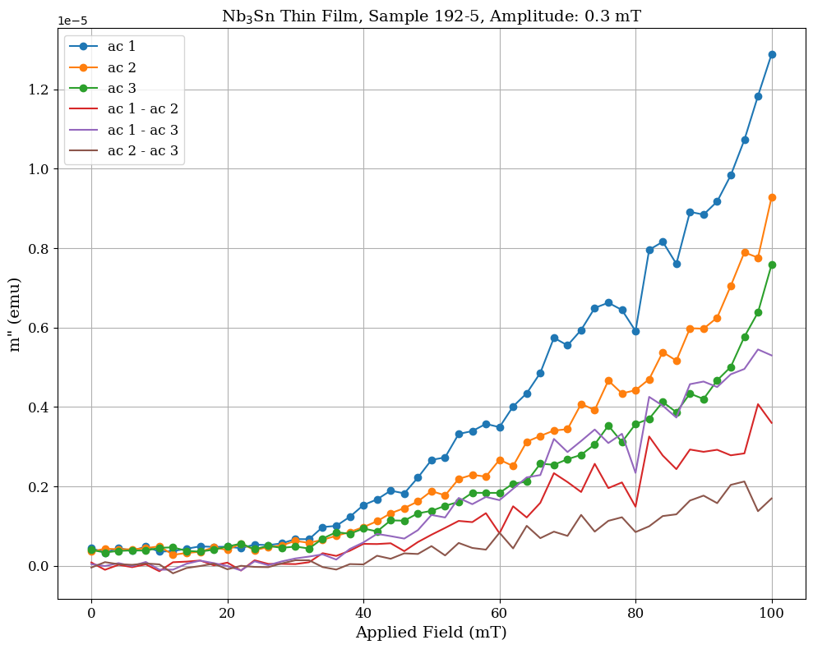
AC measurement

Slide 11
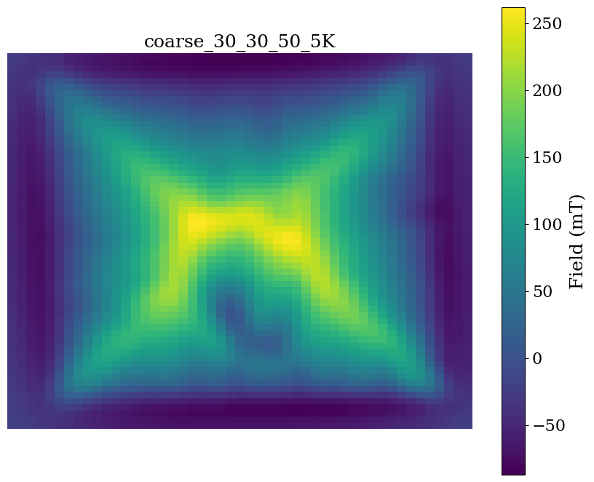
SHMP

Slide 12
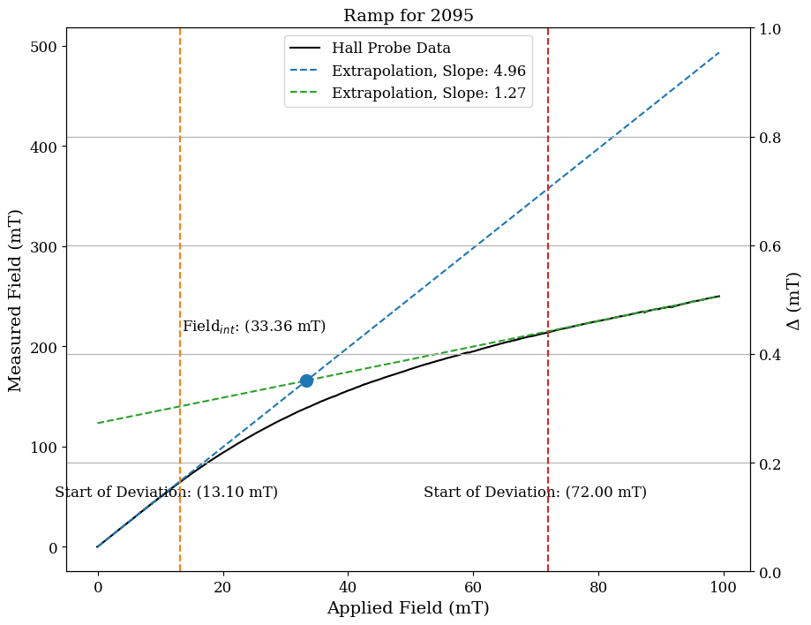
Measuring Edge

