Slide 1

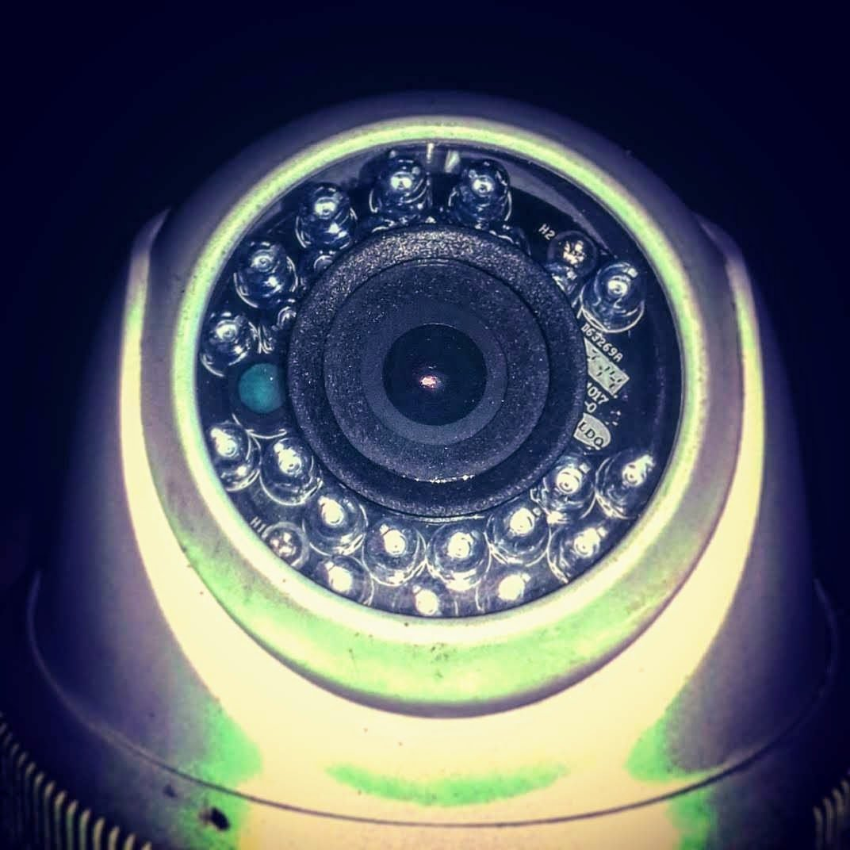
PROBLEM & INDIAN CONTEXT
01 / 10
Why Crowd Safety Needs Prediction, Not Just Surveillance
JUL 2024 · TEMPLE / SATSANG
JAN 2025 · TEMPLE FESTIVAL
JAN 2025 · TEMPLE FESTIVAL
FEB 2025 · PUBLIC / TRANSIT
JUN 2025 · STADIUM
121 dead
6 dead
30+ dead
18 dead
11 dead
Hathras, UP — ~250k attended vs. ~80k permitted
Tirupati — crush while queuing for darshan tokens
Prayagraj Maha Kumbh Mela — Mauni Amavasya crush
New Delhi Railway Station — footbridge surge
Bengaluru, Chinnaswamy Stadium — 35k cap. vs ~3 lakh crowd
Wikipedia — 2024 Hathras crowd crush
Oneindia News, Jan 2025
Al Jazeera, 29 Jan 2025
PBS NewsHour, 16 Feb 2025
Wikipedia — 2025 Bengaluru crowd crush
SEP 2025 · POLITICAL RALLY / PROCESSION
41 dead
Karur, Tamil Nadu — crowd trailing a delayed roadshow, ~100 injured
Wikipedia — 2025 Karur crowd crush
551,500
The problem is not the lack of cameras.
The problem is the lack of intelligence on top of those cameras.
CCTV cameras in Delhi alone — among the most surveilled cities on earth
ThePrint / Comparitech surveillance index
Hyderabad tops global camera density at 79/1000 people
Temple chariot festival, Tamil Nadu (illustrative)

Slide 2
PROBLEM DRIVERS & CROWD CONTEXT
02 / 10
Understanding Why Crowds Become Dangerous
A — PROBLEM DRIVERS
B — CROWD SPATIAL CONTEXT
Crowd aggregation
Constrained spaces
Open / dispersive
Unidirectional
Multidirectional
Bottlenecks
Inflow > Outflow
Converging
Dispersing
Constrained
Sudden disturbances
Competing crowd flows
Age / vulnerability mix
Infrastructure limits
stream A
stream B
stream C
RISK
accumulation →
compression →
Same head-count, different spatial context and flow → different risk.

Slide 3
TARGET USERS & PERSPECTIVES
03 / 10
One Crowd, Multiple Stakeholder Perspectives
01
02
03
04
05
Police / Security
Rescue / Fire Team
Event / Religious Organizer
Administration / Leadership
Public
— Crowd control
— Escalation points
— Bottlenecks
— Volatile zones
— Incident location
— Blocked routes
— Fallen-person alerts
— Evacuation path
— Entry / exit flow
— Queue build-up
— Capacity limits
— Accumulation
— Overall risk
— Incident overview
— Resource allocation
— Emergency coordination
— Safe zones
— Unsafe zones
— Evacuation direction
— Emergency info
The same crowd intelligence must be presented differently depending on who is responsible for the next action.

Slide 4
HACKATHON REQUIREMENT → SOLUTION MATRIX
04 / 10
Requirement-to-Solution Mapping
Requirements as documented in CROWDLENS's own problem framing (README / project docs) — mapped before anything was built.
✓ Implemented — running today
◑ Partial — verified prototype, not wired in
○ Designed / Planned
Requirement
Ppl. Detect
Anon. Track
Density/Occ
Inflow/Out
Crowd Dyn
Risk Pred
Structural
Evac
Alerts
Privacy
Detect & count people from CCTV / video
✓
Anonymous tracking — never identify individuals
◑
✓
Crowd density & per-zone occupancy
✓
Inflow / outflow & flow-imbalance detection
◑
Crowd dynamics — compression, bottleneck, reverse-flow
◑
✓
Real-time 0–100 risk scoring, 5-band severity
✓
Predictive early warning — forecast, time-to-critical
◑
Structural / physical-load risk indicator
◑
Evacuation & rescue-route guidance
○
Human-in-the-loop alerting, action & audit
✓
✓
Multi-camera / multi-zone coverage
◑
We mapped every requirement to a concrete capability before prioritizing what to build first.

Slide 5
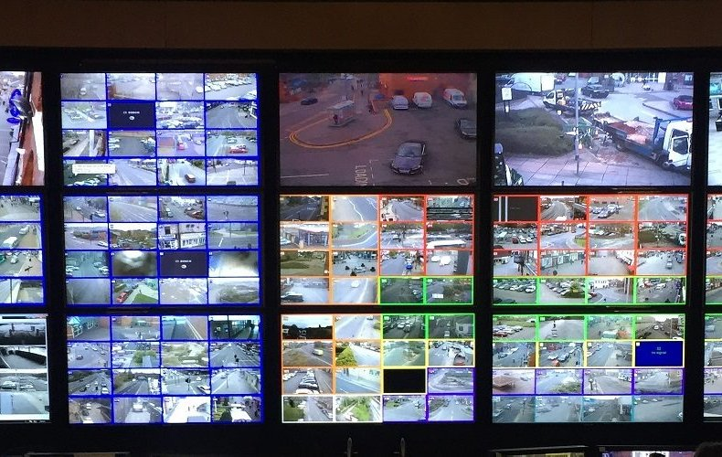
CROWDLENS SOLUTION MODULES
05 / 10
CROWDLENS Solution Modules
Crowd Analytics
Crowd Dynamics
Early Warning & Risk
Predictive Analytics
✓ Density & occupancy
✓ Zone-level people counts
○ Multi-camera aggregation
✓ Movement & turbulence (optical flow)
✓ Compression / spacing
◑ Bottleneck & reverse-flow
✓ 0–100 SRI, 5-band severity
✓ Auto-alert on RED / BLACK
✓ Contributing-factor ranking
◑ +N sec trend forecast
◑ Time-to-critical estimate
◑ Confidence scoring
What-If / Preemptive
Command Center
Rescue & Evacuation
Public Safety
◑ Controlled evaluation replay
○ Entry-control simulation
◑ Scenario timeline authoring
✓ Live control-room dashboard
✓ Crowd video library & search
✓ System / detector health panel
◑ Fallen-person heuristic
○ Incident location flagging
○ Dynamic evacuation routing
○ Safe / unsafe zone display
○ Emergency information feed
Privacy & Audit
✓ No facial recognition, ephemeral IDs
✓ Alert acknowledge history
◑ Full incident audit timeline
CCTV control room (illustrative)

Slide 6
SYSTEM ARCHITECTURE
06 / 10
From Multi-Source Video to Actionable Safety Intelligence
L1 · INPUT
✓ Recorded / uploaded video
○ Live CCTV / RTSP
○ Drone feed
○ Multi-camera array
L2 · FOUNDATION
○ Time frame of reference — sync feeds by timestamp
○ Spatial frame of reference — camera pose & zone coverage
L3 · PERCEPTION
✓ Person detection
◑ Anonymous tracking
○ Pose estimation
✓ Optical flow
L4 · CROWD INTEL
✓ Density
✓ Occupancy
○ Demographics
◑ Inflow
◑ Outflow
✓ Accumulation
✓ Compression
◑ Direction
◑ Bottleneck
◑ Edge pressure
L5 · ANALYTICS
✓ Descriptive
◑ Predictive
◑ Preemptive / what-if
◑ Prescriptive
L6 · ACTION
✓ Alerts
✓ Command center
○ Rescue
○ Evacuation
○ Public safety
Time framing and spatial/camera-angle framing are the foundation for trustworthy multi-camera analytics — not needed yet for a single feed, mandatory the moment a second camera joins.

Slide 7
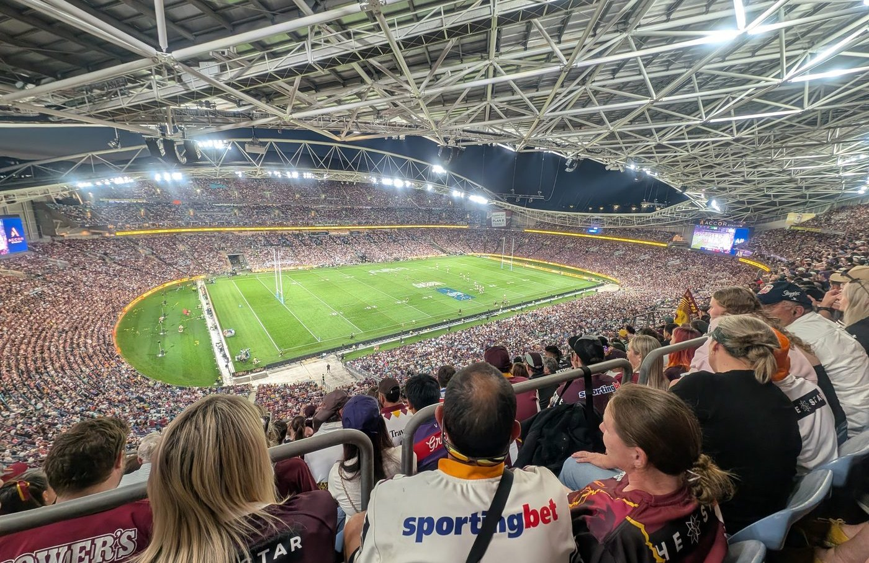
CROWD DYNAMICS & BEHAVIOURAL PROFILING
07 / 10
Understanding How the Crowd Behaves
MEASURABLE SIGNALS
DYNAMIC BEHAVIOUR
✓ Density
✓ Occupancy
✓ Accumulation rate
✓ Velocity
✓ Interpersonal distance
✓ Compression
◑ Inflow / outflow rate
◑ Direction entropy
◑ Reverse-flow ratio
◑ Bottleneck / edge-pressure
○ Flow imbalance
A rule-based classifier scores compression + turbulence + reverse-flow into four coarse states today (◑ prototype).
Stationary
Flow
Disturbed
≈ PASSIVE
≈ ACTIVE
◑ signal
Volatile
Reverse Flow
Stop-Wave
≈ VOLATILE
◑ ratio
○ planned
Illustrative example
Inflow 60/min > Outflow 30/min
→ accumulation → density ↑
→ compression ↑ → risk escalating
DEMOGRAPHIC PROFILE — aggregate, zone-level only
Age groups · children / adults / elderly · group composition ○ Planned — never linked to identity
Dense stadium crowd (illustrative)

Slide 8
ANALYTICS SPECTRUM & EARLY WARNING
08 / 10
From Seeing the Crowd to Deciding What to Do
✓ Implemented
◑ Prototype
◑ Prototype
○ Planned UI
Descriptive
Predictive
Preemptive
Prescriptive
“What is happening now?”
“What is likely to happen?”
“What can we do before it happens?”
“What should we do?”
Density, occupancy, flow, headcount
Risk forecast, time-to-critical
What-if scenarios, entry control
Evacuation route, resource recommendation
EARLY WARNING SIGNAL TYPES
Multiple signals → Risk Engine → SRI → Alert
○ 1. High Inflow–Low Outflow
✓ 2. Rapid Accumulation
(density, movement, build-up, compression)
✓ 3. Critical Density
◑ 4. Bottleneck Congestion
○ 5. Flow Imbalance
◑ 6. Reverse Flow
density
✓ 7. Compression Increase
◑ 8. Edge Pressure
movement
✓ 9. Sudden Flow Disturbance
◑ 10. Fallen Person / Obstruction
build-up
compression
SRI
Alert
No single signal predicts a crush on its own — the engine weighs several together.

Slide 9
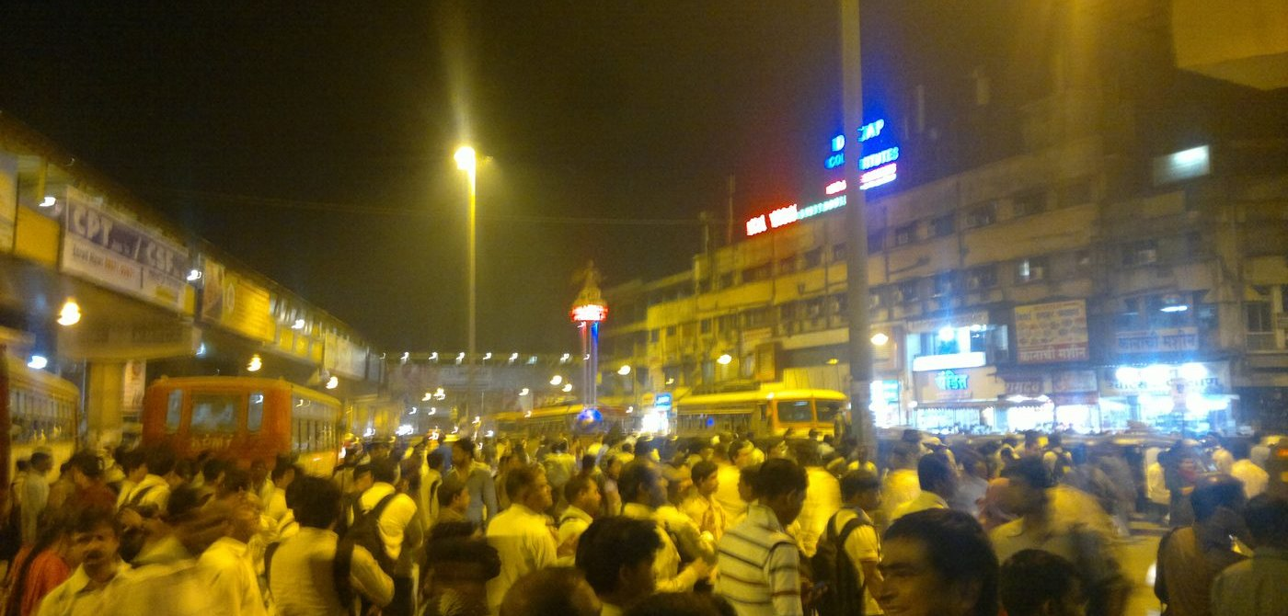
IMPLEMENTATION, DEMO & VALIDATION
09 / 10
What We Actually Built and How We Validate It
A · IMPLEMENTED
B · PARTIALLY IMPLEMENTED
C · DESIGNED / FUTURE
— Multi-format upload + video library
— Real YOLOv8n detection (HOG fallback)
— Density, optical-flow dynamics, compression
— 0–100 weighted risk score, 5-band severity
— 4 zone bands, per-zone risk
— Auto-alerts on RED/BLACK + history
— Live WebSocket dashboard
— 14/14 automated tests passing
— BYTE-style anonymous tracker (standalone)
— Bottleneck / reverse-flow / dynamics state
— Predictive forecast + time-to-critical
— Structural-load indicator endpoint
— Incident escalate/resolve lifecycle
— Multi-camera time & spatial fusion
— Live RTSP / CCTV ingestion
— Demographic / vulnerability profiling
— Dynamic evacuation routing
— Public-facing safe-zone display
— Interactive what-if scenario editor
Uploaded Video
→
Detection
→
Density+Dynamics
→
Risk Score
→
Alert
→
Operator Ack.
→
Evacuation ○
Actual single-feed demo path. Multi-camera fusion is designed / prototype / future enhancement, not built.
Validation today = 14/14 automated correctness tests on the deterministic engines — not accuracy against ground-truth footage.
The evaluation schema stores an explicit is_measured=False flag so target metrics can never display as measured results.
Uploaded-video source (illustrative)

Slide 10
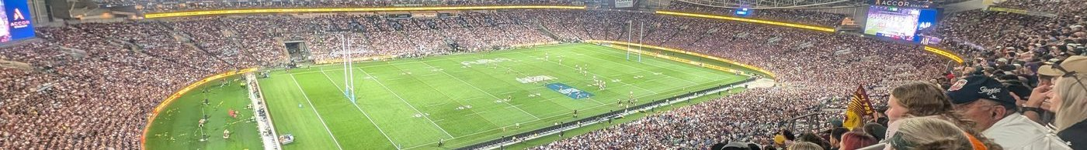
INNOVATION, PRIVACY & IMPACT
10 / 10
From Reactive CCTV to Predictive Crowd Safety
Crowd density at scale — the exact condition CROWDLENS is built to read (illustrative)
Key Innovation
Privacy by Design
Limitations
○ Multi-camera temporal framing
○ Spatial camera framing
✓ Crowd dynamics intelligence
○ Vulnerability profiling
◑ Predictive risk
◑ What-if analysis
○ Crowd-aware evacuation
◑ Context-aware response
✓ No facial recognition
✓ Anonymous / ephemeral tracking
✓ Aggregate zone analytics only
✓ No persistent identity profiling
✓ Alert audit trail
— CCTV can't measure oxygen — asphyxia is a risk proxy
— Structural load is an estimate, not certification
— Prototype signals need real-world validation
— Demographic inference may carry bias — not built today
— Decision support only — never replaces trained staff
“We don't identify people. We identify crowd risk.” CROWDLENS transforms multiple passive video sources into time-aware, spatially-aware, predictive crowd-safety intelligence — helping responders understand what is happening, what may happen next, and what action can be taken before it becomes critical.
VISION STATEMENT
Built today: detection, density, dynamics, risk scoring. Designed next: multi-camera fusion, prediction, evacuation.

