Slide 1
MDP

Slide 3
Result

Slide 4
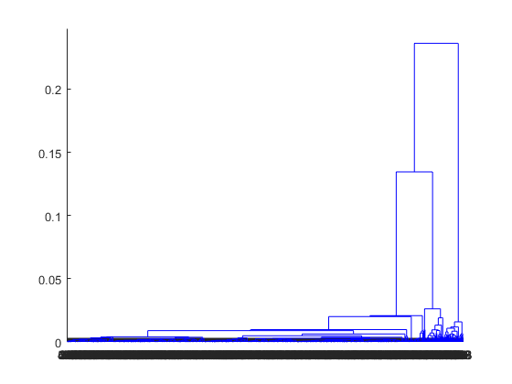

Slide 5
Verification and Validation

Slide 9
Example of ABM Analysis

