Slide 1
Method Diagram

Slide 6
MDP

Slide 10
Result

Slide 11
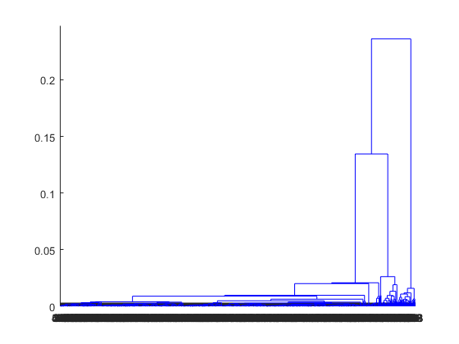

Slide 12
Verification and Validation

Slide 16


Slide 17
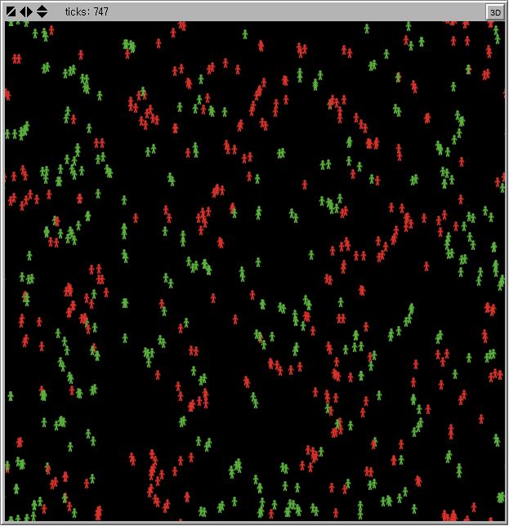

Slide 18
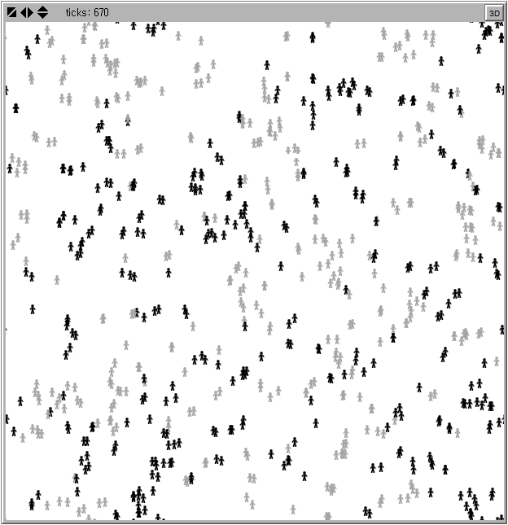

Slide 19
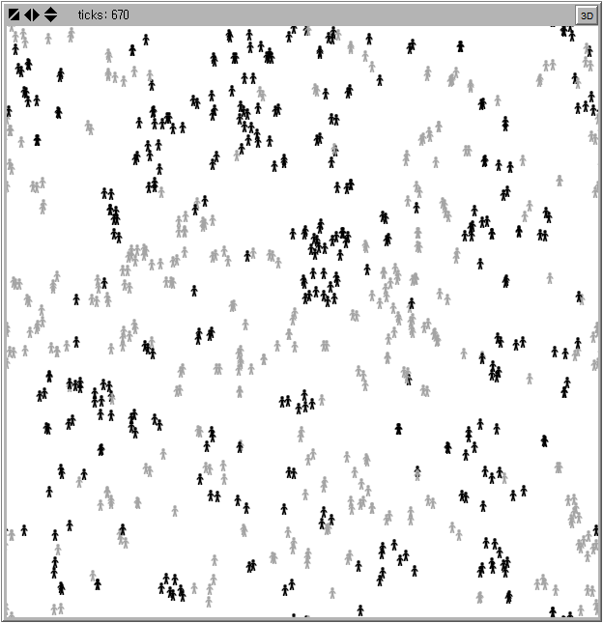

Slide 20
Example of ABM Analysis

Slide 21
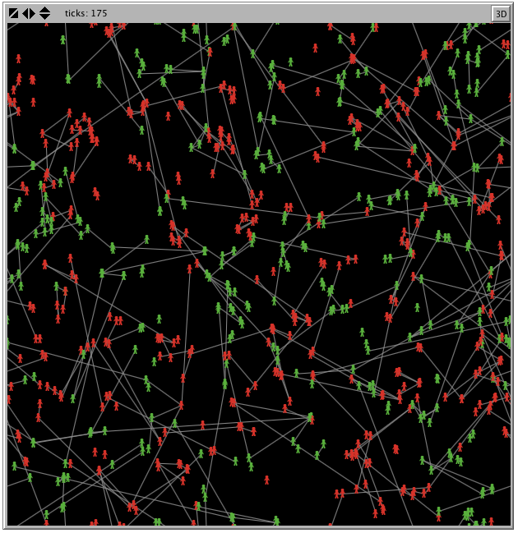

Slide 22
