Slide 1
MDP

Slide 4
Result

Slide 5
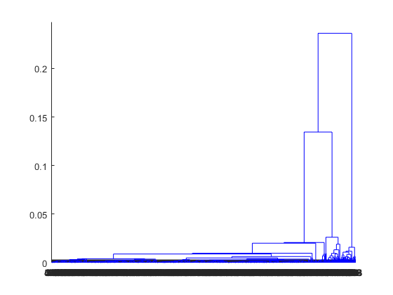

Slide 6
Verification and Validation

Slide 10
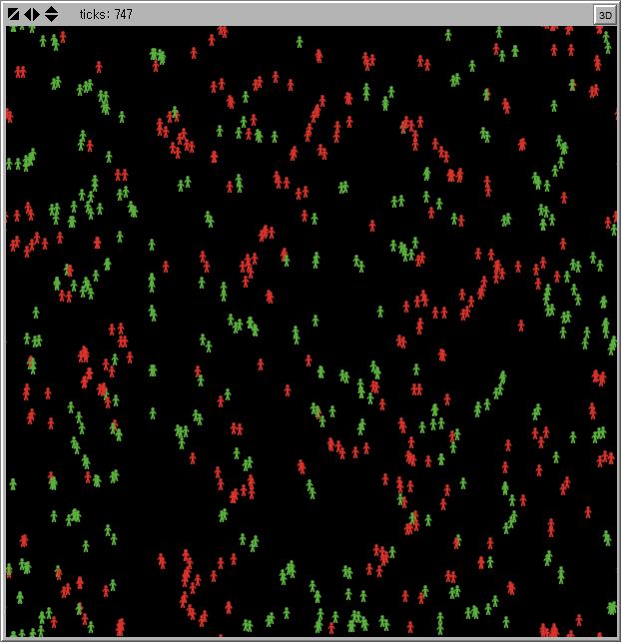

Slide 11
Example of ABM Analysis

Slide 12
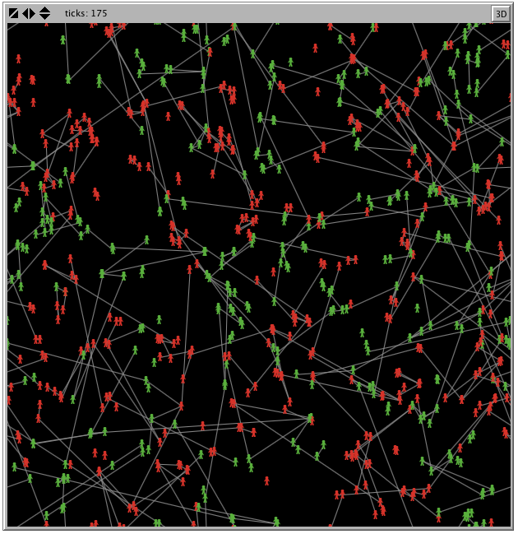

Slide 13
